Slide 1
Consortium Office Hours
April 7th, 2020

Slide 2
Please type your name, agency and email in the chat

Slide 3
Zoom: Help Video, Hosting
https://support.zoom.us/hc/en-us/articles/201362603-Host-and-Co-Host-Controls-in-a-Meeting

Slide 4
Best Practices, Teaching Online: Maria Delgado

Slide 9
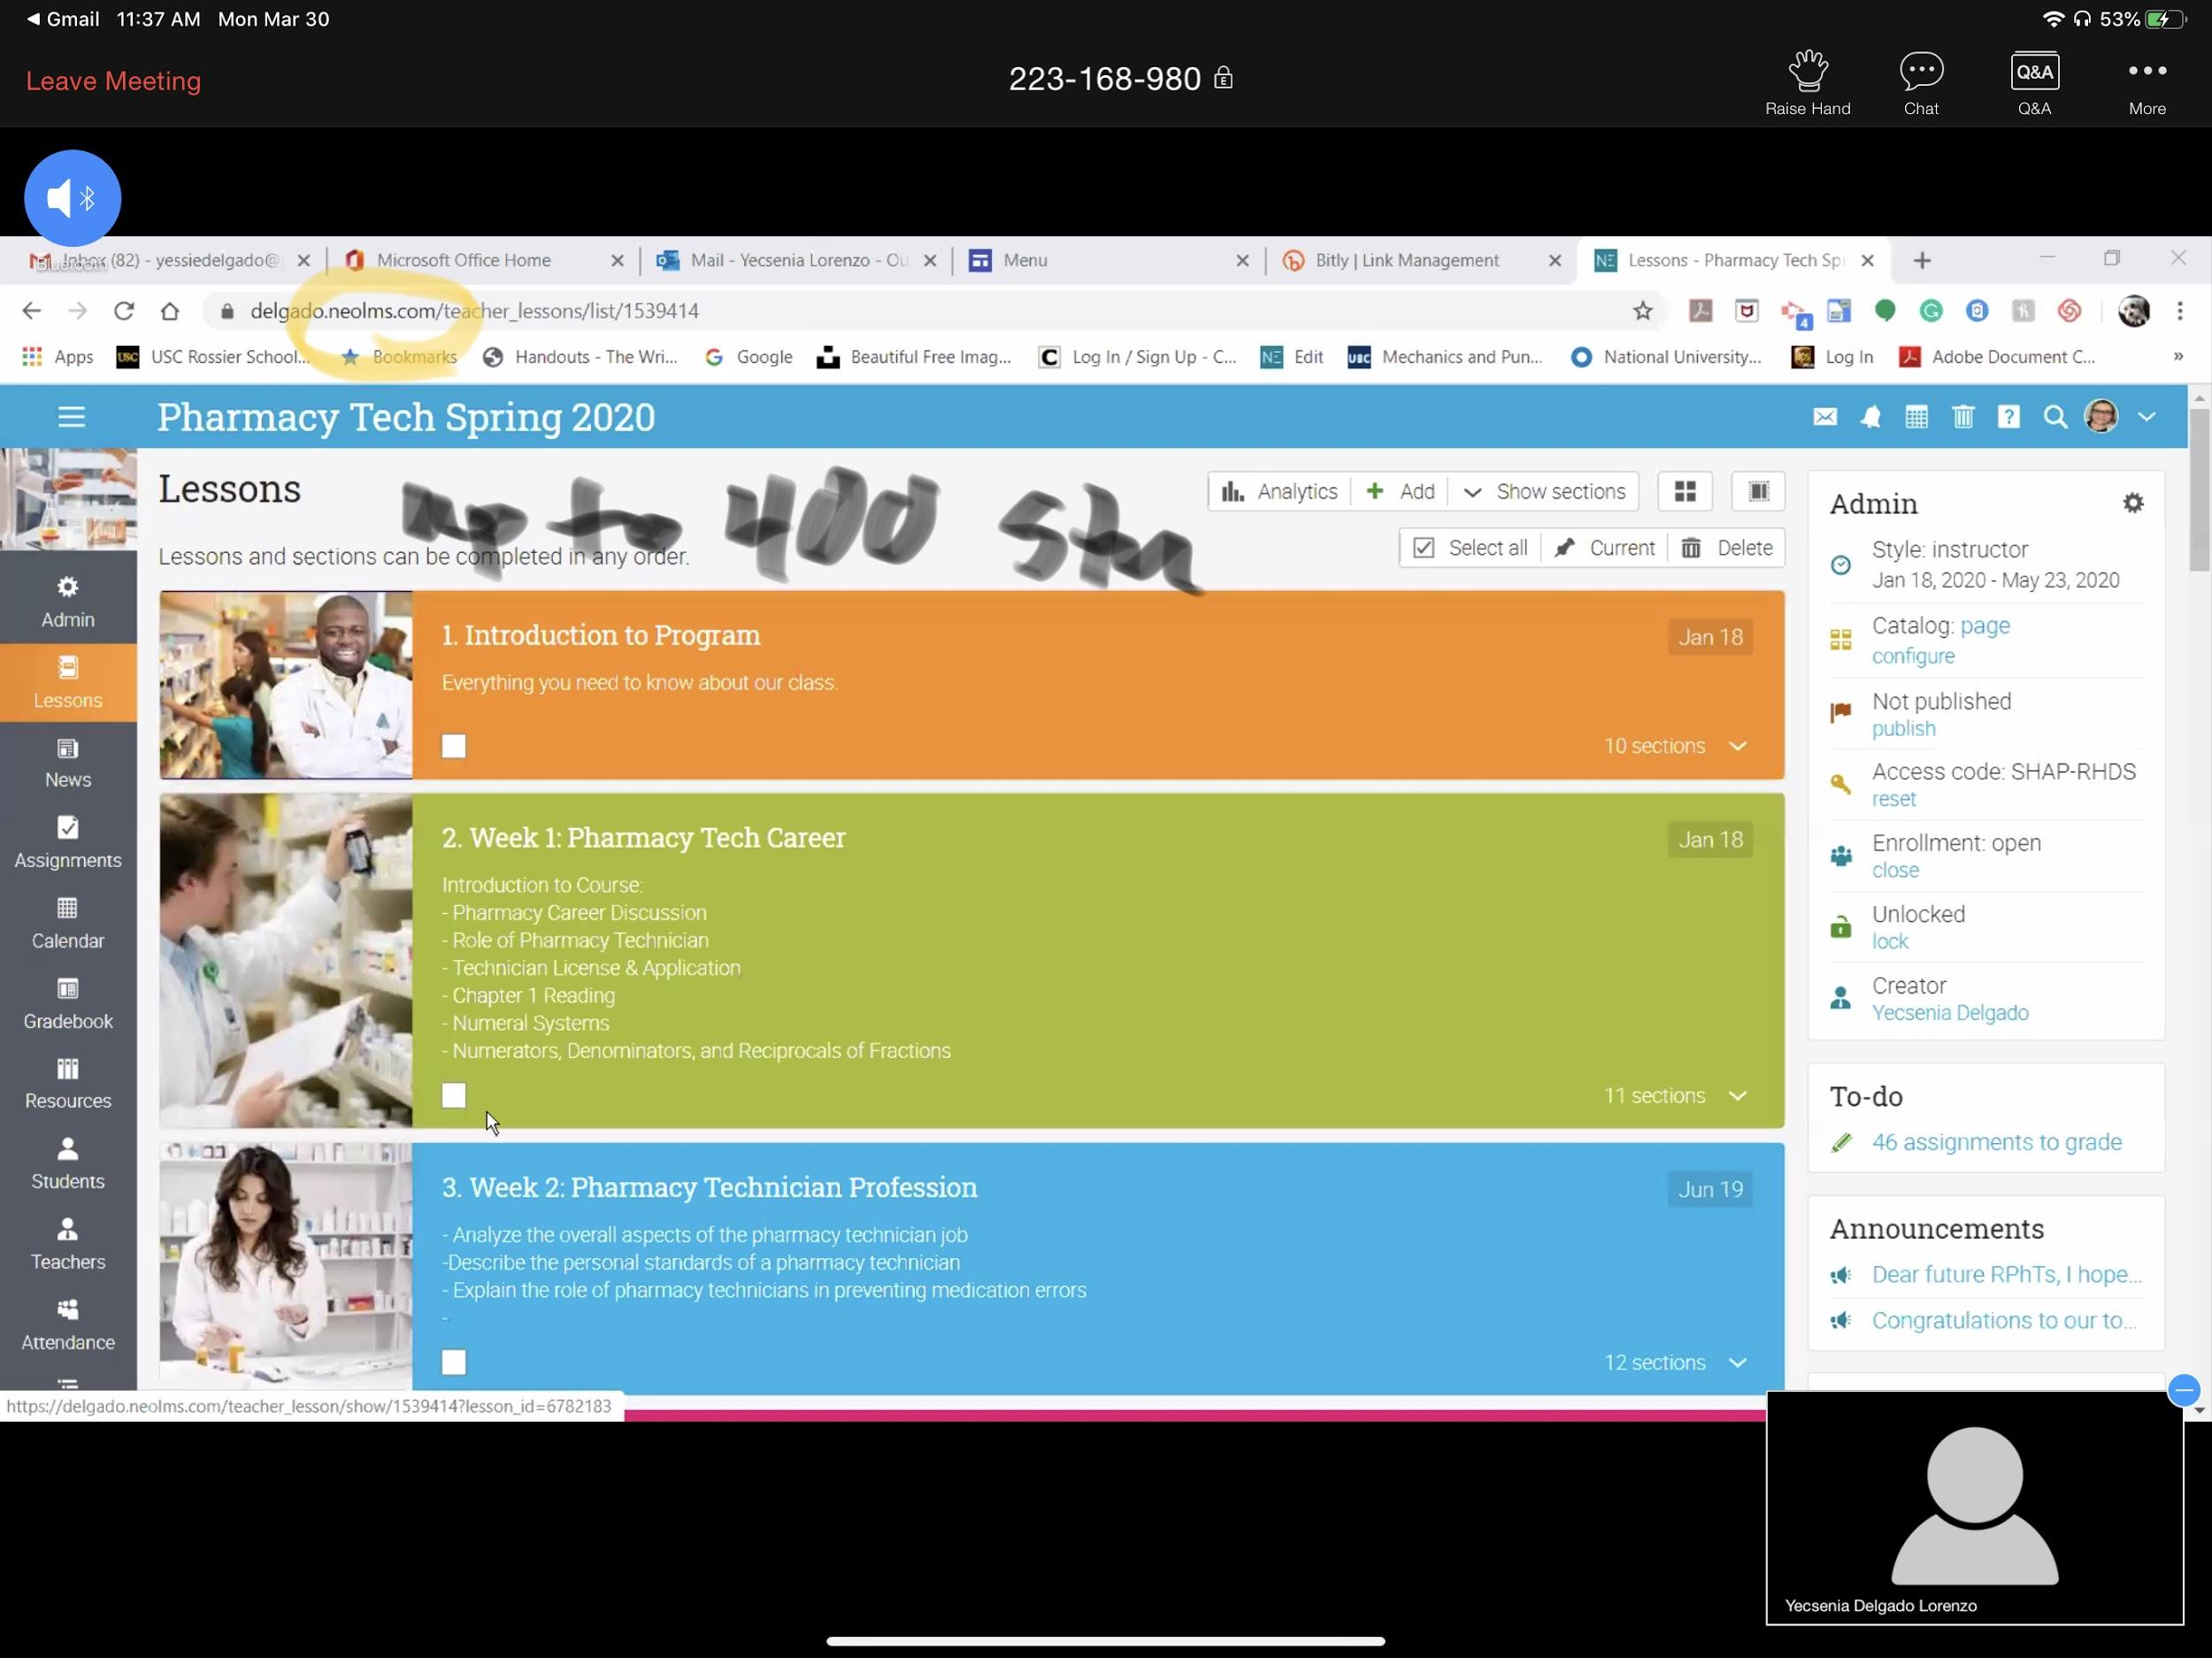
Https://Neolms.com

Slide 10
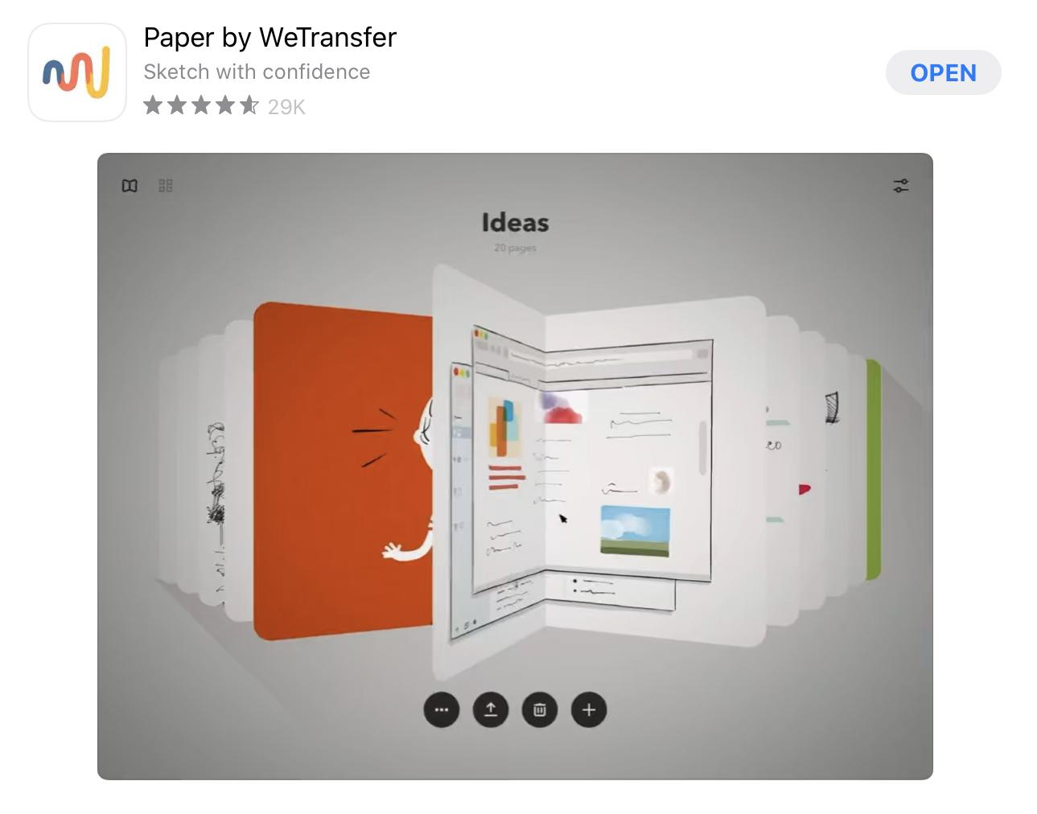
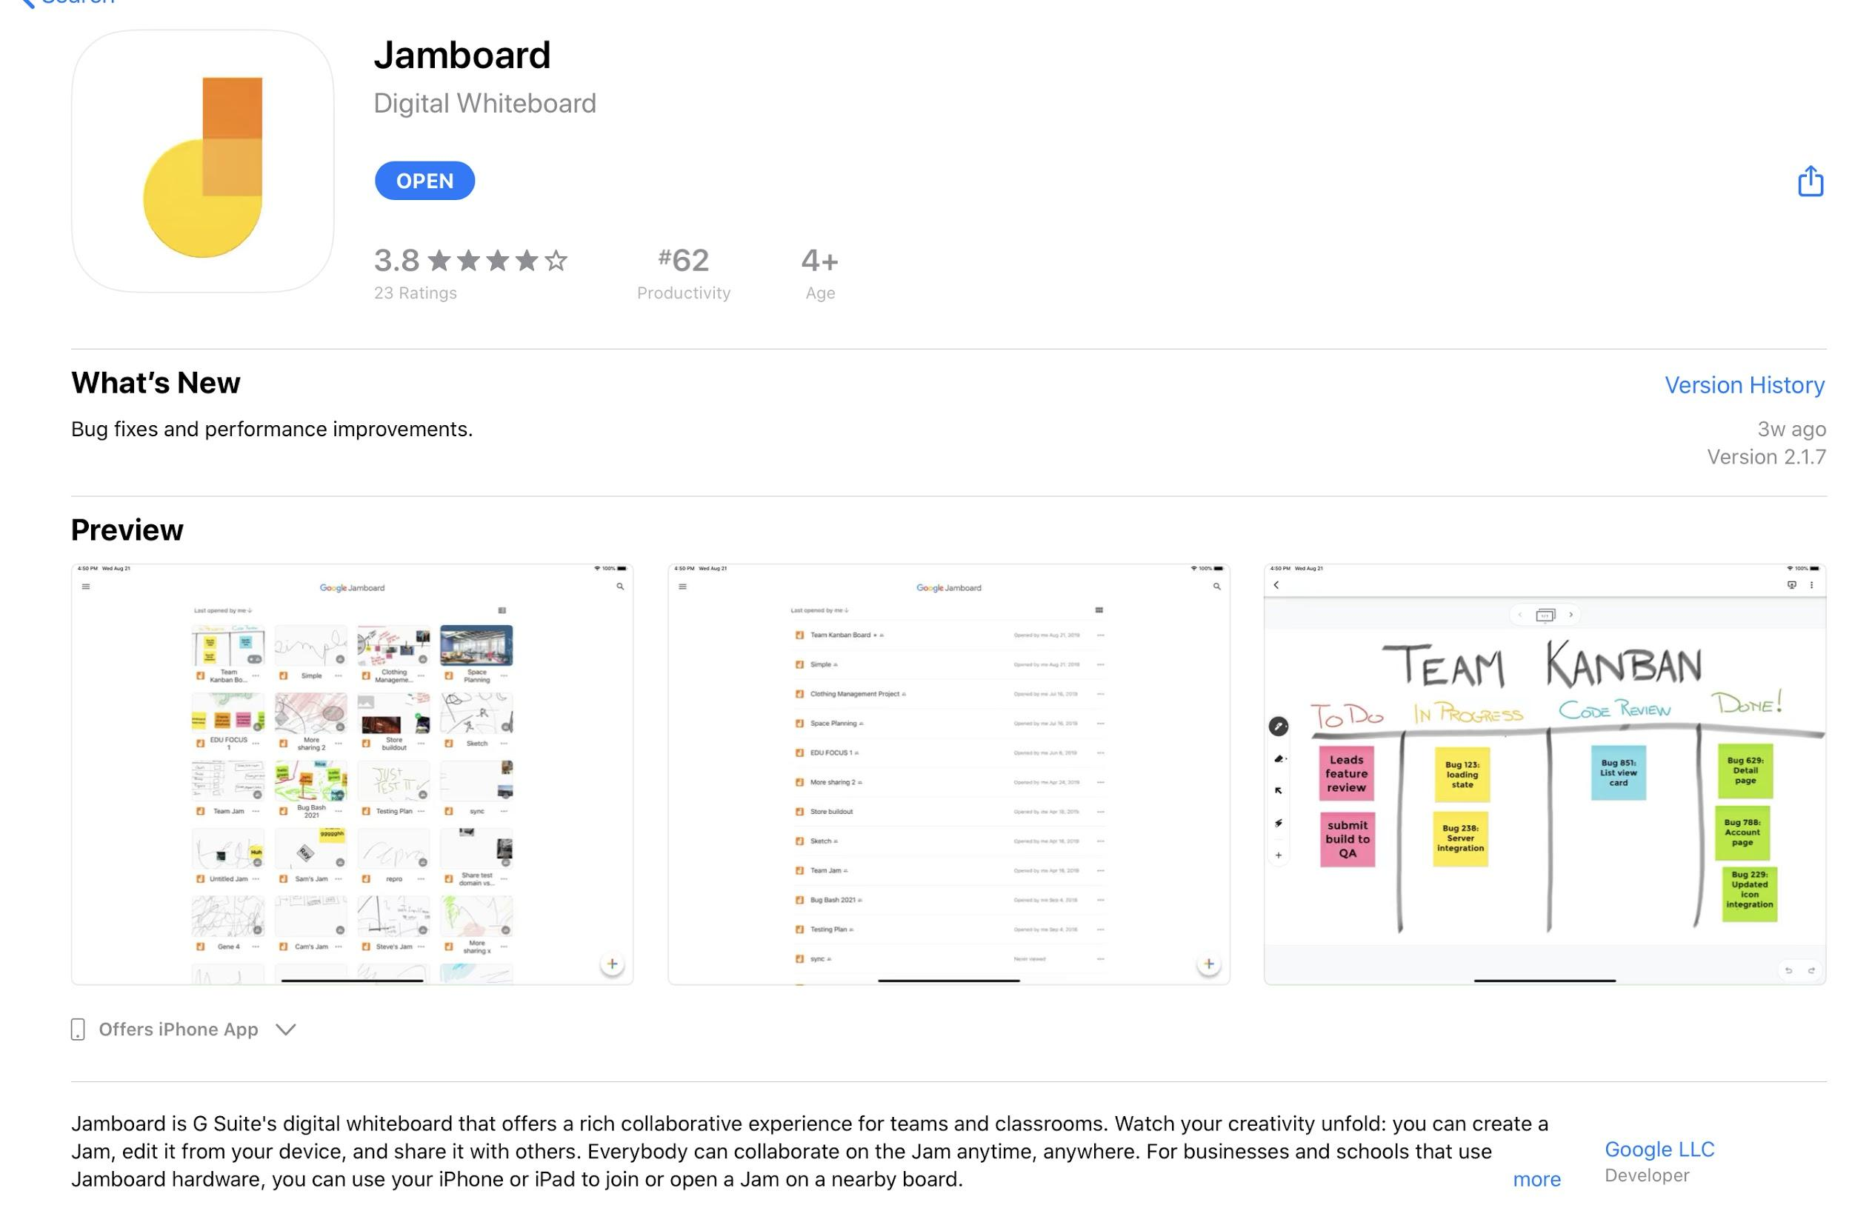
White Board App to use with zoom, etc.

Slide 11
From the Bay Area Community College Consortium
Toolkit for teaching online with beginners in mind:
https://acue.org/online-teaching-toolkit/

Slide 12
Potential Sites to Help from Various Sources
https://www.englishcentral.com/browse/videos
http://a4esl.org
http://www.manythings.org
https://eslbrains.com
https://www.eslamerica.us
https://www.learningchocolate.com
Virtual field trips: https://docs.google.com/document/d/1sEu7TPNqQxgE3FTEK8iLTyplhSXY_ULHjelJbu8Nan0
Https://Typingclub.com

Slide 13
Creating Videos: Screencastify
https://youtu.be/Gz0ZeHwulVY

Slide 14
Otan Tech Talks:
https://www.youtube.com/playlist?list=PLanOvdxbZVxswxH0qJlySvUWqw_ncfuKi
https://www.screencastify.com

Slide 15
Other Ideas, Questions, Needs?

