Slide 1
INTRADAY VOLATILITY
Gamma Capture
Barrier Crossing Method for Intraday Volatility
Presented by Caleb Johnson
Project sponsor Louis Pellathy

Slide 2
What is Gamma Capture?
Gamma Capture vol = 0.000185 * SQRT(3.20) * SQRT(Y) = 19.94%
LOOKBACK WINDOW
BARRIER SIZE
CROSSINGS, AVERAGE
60 minutes
±0.0185%
192, 3.20 / min
1 trading hour
resets on each cross
barrier touch events
GAMMA CAPTURE REALIZED VOLATILITY ESTIMATOR
σ̂GC = b × √(N / T) × √Yannual
b = barrier half-width (log units) N = observed crossings in window
T = lookback length (minutes) Yannual = annualization factor

Slide 3
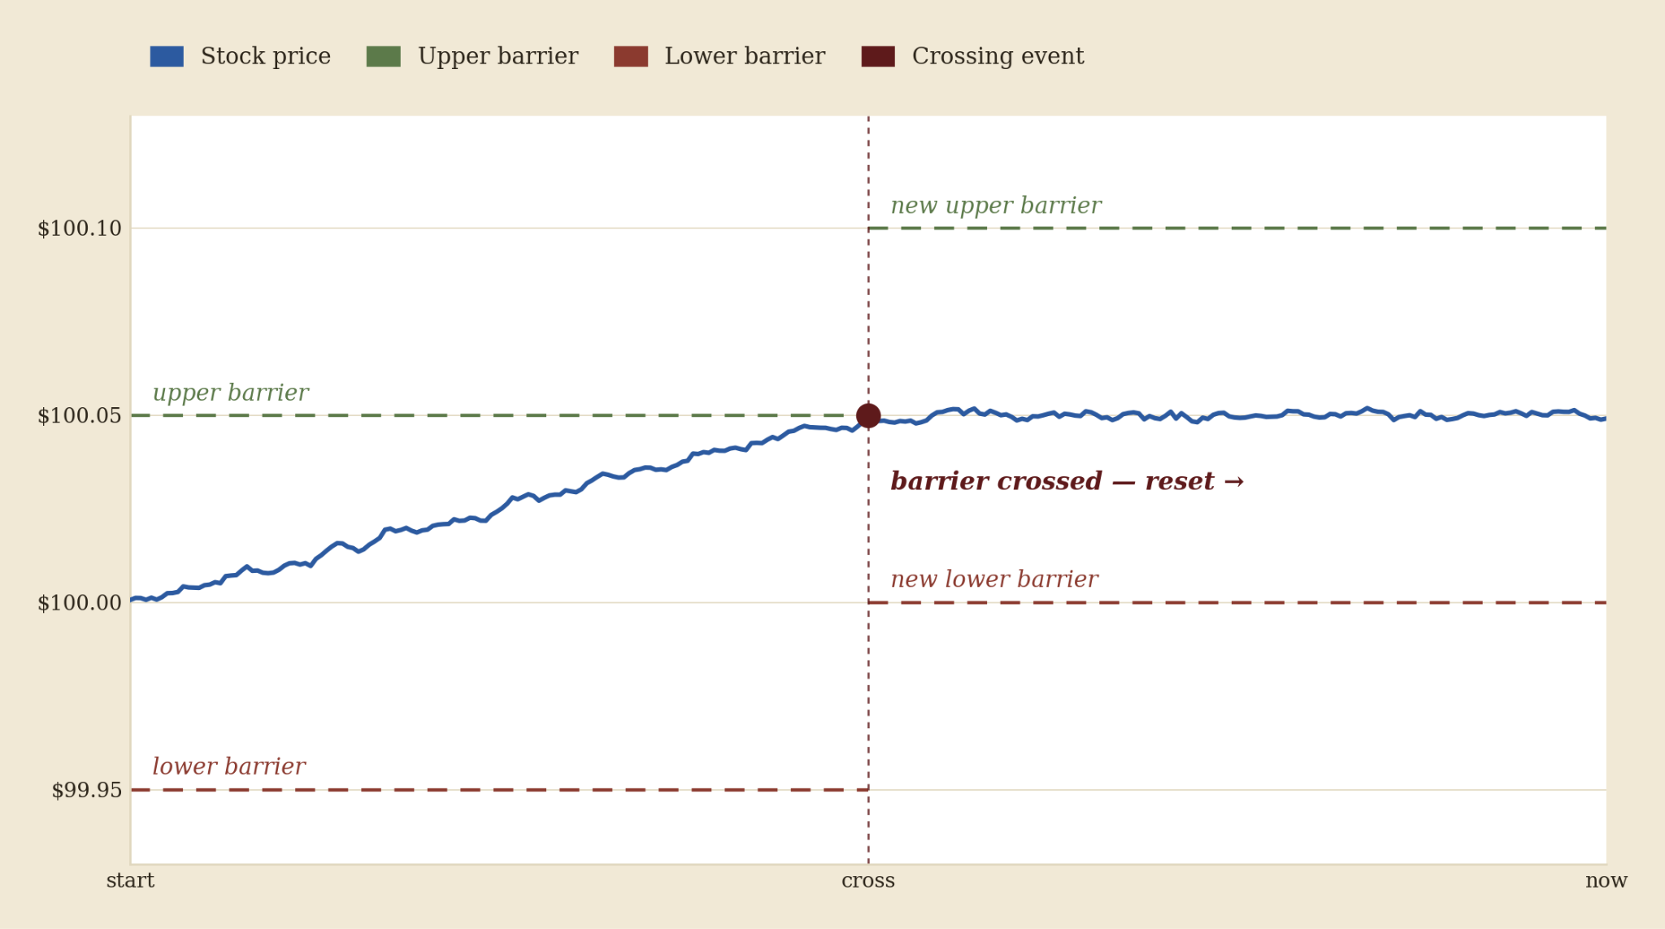
What is Gamma Capture?

Slide 4
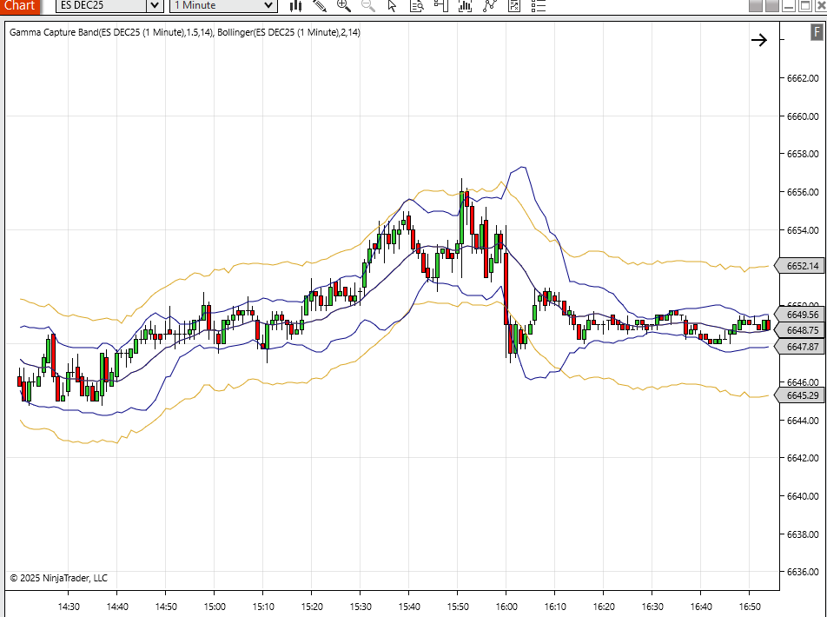
Why is Gamma Capture good?
Set an upper and lower barrier a fixed distance b above and below the current price.
When price touches a barrier, count one crossing and reset both barriers around the new price.
Each crossing is a discrete unit of motion — immune to bid-ask flicker that doesn't break the band.
Higher number (N) crossings per hour ⇒ higher realized volatility
More Stable and Accurate than Standard Dev LN Returns

Slide 5
What can Gamma Capture do?
Create Gamma Capture Volatility Bands
Define High and Low Intraday Volatility Regimes
Calculate Volatility on Trading Pairs
Compare to 0-DTE Implied Volatility

Slide 6


