Slide 1
MTA 98-366
Instructor: Justin Thomas

Slide 2
LDAP, DNS, and DHCP Basics

Slide 3
LDAP Basics

Slide 4
Lightweight Directory Access Protocol (LDAP) Domain Name System (DNS) & Dynamic Host Naming Protocol (DHCP)
On TCP/IP networks (including the Internet), the domain name system (DNS) is the directory system used to relate the domain name to a specific network address (a unique location on the network).
However, you may not know the domain name. LDAP allows you to search for an individual without knowing where they're located (although additional information will help with the search).
Lightweight Directory Access Protocol is the protocol that Exchange Server uses to communicate with Active Directory.
To really understand what LDAP is and what it does, it is important to understand the basic concept behind Active Directory as it relates to Exchange.
Active Directory contains information regarding every user account on the entire network (among other things). It treats each user account as an object. Each user object also has multiple attributes. An example of an attribute is the user's first name, last name, or e-mail address. All this information exists within a huge, cryptic database on a domain controller (Active Directory). The challenge is to extract information in a usable format. This is LDAP's job.
LDAP uses a relatively simple, string-based query to extract information from Active Directory (and other resources). The nice part is that this all happens behind the scenes. A regular end user will never have to manually perform an LDAP query, because Outlook is LDAP-enabled and knows how perform all the necessary queries on its own.

Slide 5
DNS Basics

Slide 6
Domain Name System (DNS)
DNS replaced NetBios.
NetBios resolved NetBIOS names to IP addresses.
DNS Resolves URLs to IP Addresses.

Slide 7
Domain Name System (DNS)
Forward DNS Lookups
The forward lookup, or simple DNS lookup, is the most used approach to DNS.
The forward approach to DNS is simply finding out the IP address of a domain using the URL.
People tend to find it difficult to remember long strings of numbers. Instead, it's easier to remember a domain name that uses words.

Slide 8
Domain Name System (DNS)
Reverse DNS Lookup
In a reverse DNS lookup, the steps are the same except that it starts out with an IP address and returns with the domain name.
In actual reality this can take a while and when a DNS is unable to find what it needs whether it is a domain name or an IP address, we end up with the screen we all hate that states “this webpage cannot be found”. This is due to the servers being busy or the web browser timing out.

Slide 9
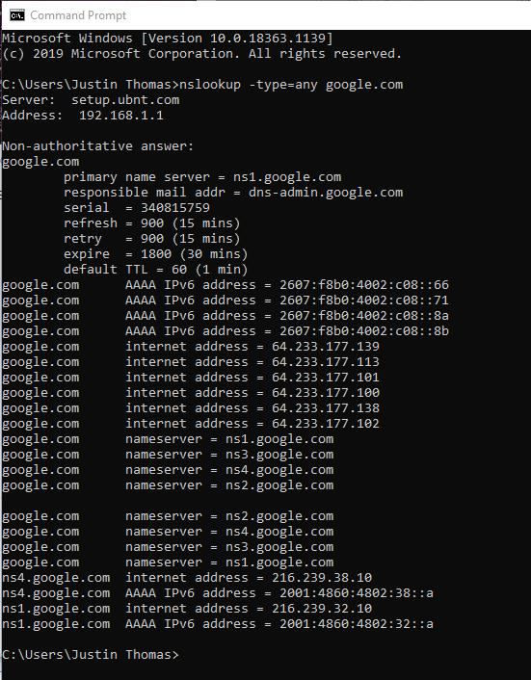
DNS Record Types
Start of Authority record (abbreviated as SOA record)
Name Server records (NS)—specifies that a specific DNS Zone, such as “example.com” is delegated to a specific authoritative name server
IPv4 Address Mapping records (A)—a hostname and its IPv4 address.
IPv6 Address records (AAAA)—a hostname and its IPv6 address.
Canonical Name records (CNAME)—points a hostname to an alias. This is another hostname, which the DNS client is redirected to
Mail exchanger record (MX)—specifies an SMTP email server for the domain.

Slide 10
A Start of Authority record (abbreviated as SOA record) is a type of resource record in the Domain Name System (DNS) containing administrative information about the zone, especially regarding zone transfers.

Slide 11
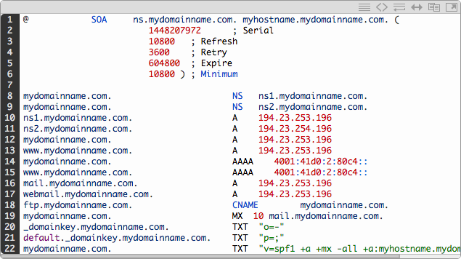
Domain Name System (DNS)

Slide 12
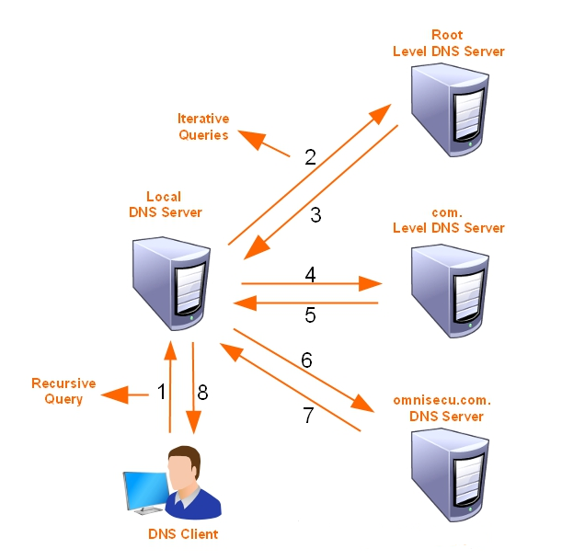
How Domain Name System (DNS) Lookups work. Recursive and Iterative

Slide 13
Troubleshooting Domain Name System (DNS) You ping a server by using fully qualified domain name (FQDN) and do not receive a response.
Notes:
Then you ping the same server by using its IP address and receive a response.
What is the problem?

Slide 14
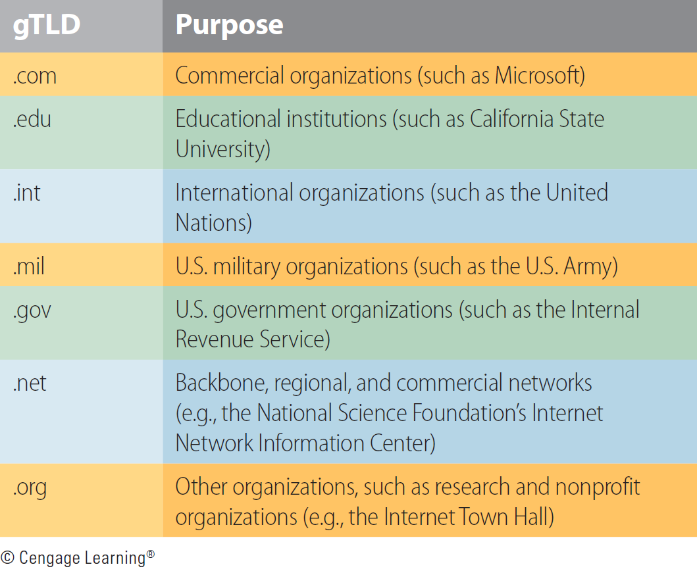
Generic Top-Level Domains

Slide 15
DHCP Basics

Slide 16
Understanding DHCP
Dynamic Host Configuration Protocol is a communication protocol that lets network administrators manage centrally and automate the assignment of Internet Protocol addresses in an organization’s network. (basically it frees a network administrator from having to manually configure each host connected to his network)

Slide 17
DHCP must
Guarantee unique network address. (Address Reservations or Assignment)
Retain DHCP client configuration across a client reboot.
Allow automated assignment of configuration parameters to new clients.
Support fixed allocation of configuration parameters to specific clients.
Exclusion of addresses that are already in use or set statically. (Address Exclusion)
When a client's DHCP-issued address expires, the client will attempt to get another IP address by broadcasting using the DORA process

Slide 18
DORA Process

Slide 19
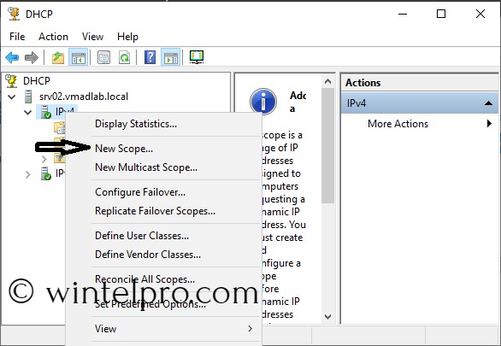
Create a Scope Screen

Slide 20
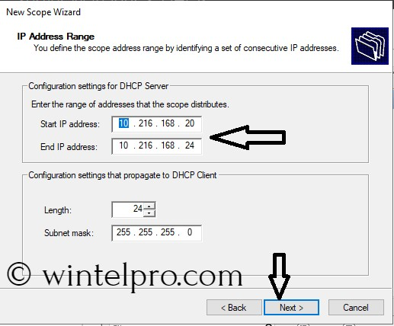
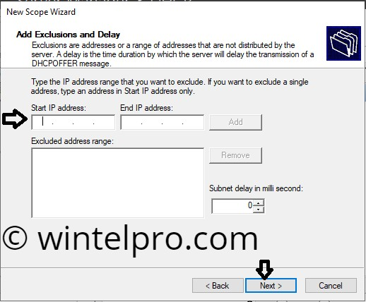
DHCP Scope setup screen
DHCP Scope Exemption setup screen

Slide 21
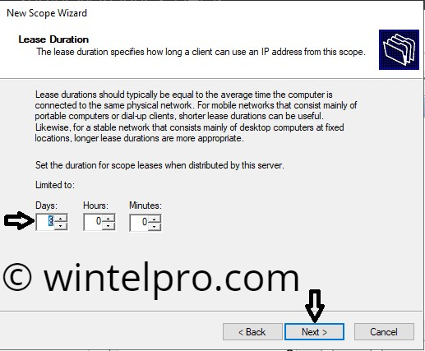
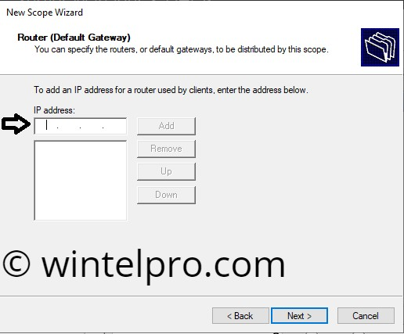
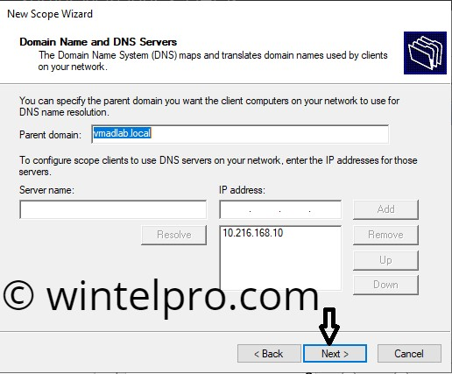
DHCP Scope Lease setup screen
DHCP Scope Gateway setup screen
DHCP Domain and DNS setup screen

Slide 22
The end any questions?

