Slide 1


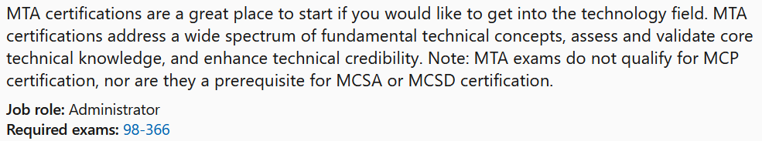

MTA 98-366
Instructor:
Justin Thomas

Slide 2
Internet Protocol version 4 (IPv4)
Internet Protocol version 6 (IPv6)
Subnetting

Slide 3
Understanding TCP/IP
Internet Protocol (IP) Addressing
What is an IP address
An Internet Protocol address is a numerical label assigned to each device connected to a computer network that uses the Internet Protocol for communication. An IP address serves two main functions: host or network interface identification and location addressing.
10.15.0.1
172.168.1.92
192.168.1.101

Slide 4
Understanding TCP/IP
Internet Protocol (IP) Addressing Terms
Term 1: What is a bit?
It’s a 1 or a 0
Term 2: What is an Octet?
An octet is 8 bits
11111111.11111111.11111111.00000000
Term 3: Doted Decimal Notation.
192.168.0.55
11111111.11111111.11111111.00000000
Term 4: Binary Notation
Counting using only 1 and 0
Term 5: Decimal Notation
Counting using only 0 thru 9
Term 6: Hexadecimal Notation
Counting using only 0 thru 9 and A thru F

Slide 5
Understand Numbering Systems for IPv4 and IPv6
 | 128 | 64 | 32 | 16 | 8 | 4 | 2 | 1
Hex | Binary |  | Decimal
0 | 0 |  | 0
1 | 1 |  | 1
2 | 10 |  | 2
3 | 11 |  | 3
4 | 100 |  | 4
5 | 101 |  | 5
6 | 110 |  | 6
7 | 111 |  | 7
8 | 1000 |  | 8
9 | 1001 |  | 9
A | 1010 |  | 10
B | 1011 |  | 11
C | 1100 |  | 12
D | 1101 |  | 13
E | 1110 |  | 14
F | 1111 |  | 15

Slide 6
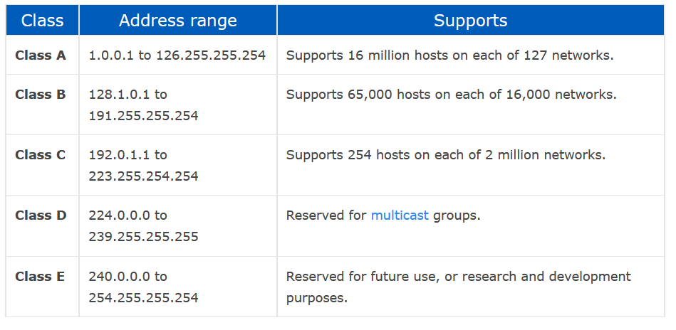
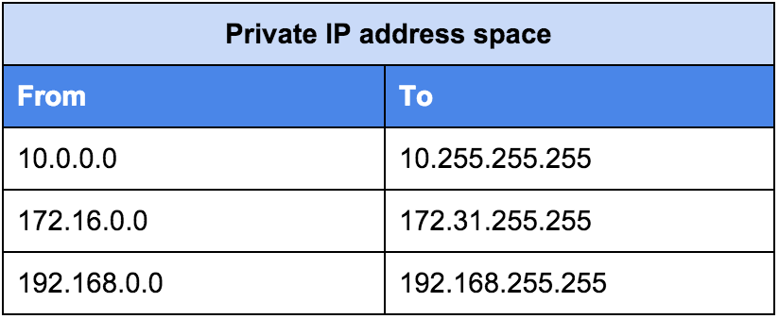
Understanding TCP/IP
Reserved address ranges for local use (including local loopback IP), protocols

Slide 7
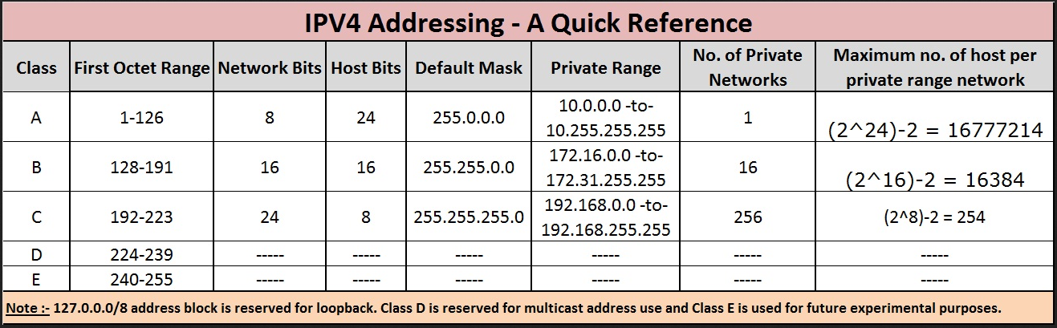
IP Addressing IPv4

Slide 8
IP Addressing IPv4
Loopback IP Addresses
The IP address range 127.0.0.0 – 127.255.255.255 is reserved for loopback, i.e. a Host’s self-address, also known as localhost address.
This loopback IP address is managed entirely by and within the operating system.
Loopback address is a type of IP address that is used to test the communication or transportation medium on a local network card and/or for testing network applications.
Data packets sent on a loopback address are re-routed back to the originating node without any alteration or modification.
Data sent on loopback is forwarded by the operating system to a virtual network interface within operating system.
This address is mostly used for testing purposes like client-server architecture on a single machine.
If a host machine can successfully ping 127.0.0.1 or any IP from loopback range, implies that the TCP/IP software stack on the machine is successfully loaded and working.
The most common loopback address for IPv4 is 127.0.0.1

Slide 9
IP Addressing IPv4
Link-local Addresses
In case a host is not able to acquire an IP address from the DHCP server and it has not been assigned any IP address manually, the host can assign itself an IP address from a range of reserved Link-local addresses. Link local address ranges from 169.254.0.0 -- 169.254.255.255.
Assume a network segment where all systems are configured to acquire IP addresses from a DHCP server connected to the same network segment. If the DHCP server is not available, no host on the segment will be able to communicate to any other.
Windows (98 or later), and Mac OS (8.0 or later) supports this functionality of self-configuration of Link-local IP address.
In absence of DHCP server, every host machine randomly chooses an IP address from the above-mentioned range and then checks to ascertain by means of ARP, if some other host also has not configured itself with the same IP address. Once all hosts are using link local addresses of same range, they can communicate with each other.
Remember the Link-local address is also known as an APIPA and starts with 169.254.x.x

Slide 10

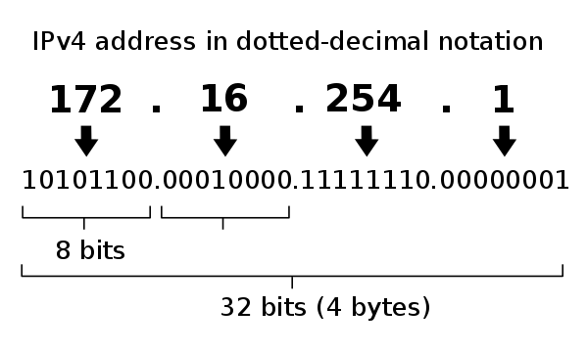
Understand IPv4
Internet Protocol version 4 (IPv4) is the fourth version of the Internet Protocol (IP). It is one of the core protocols of standards-based internetworking methods in the Internet and other packet-switched networks. IPv4 was the first version deployed for production in the ARPANET in 1983.
IPv4 uses 32-bit addresses which limits the address space to 4294967296 (2³²) addresses.
IPv4 reserves special address blocks for private networks and multicast addresses
They are most often written in dot-decimal notation, which consists of four octets of the address expressed individually in decimal numbers and separated by periods.

Slide 11
Understand IPv4
Breaking IP addresses into Binary
 | 128 | 64 | 32 | 16 | 8 | 4 | 2 | 1
Decimal
0 | 128 | 192 | 224 | 240 | 248 | 252 | 254 | 255
/24 | /25 | /26 | /27 | /28 | /29 | /30 | /31 | /32
 |  | 192 | 224 | 240 | 248 | 252 | 254 | 255
 | 128 | 64 | 32 | 16 | 8 | 4 | 2 | 1
1/0
N-2 | 2 | 4 | 8 | 16 | 32 | 64 | 128 | 256
H-2 | 256 | 128 | 64 | 32 | 16 | 8 | 4 | 2
C/24 | /25 | /26 | /27 | /28 | /29 | /30 | /31 | /32

Slide 12
Understand IPv4
What is an IP address and how does it work?
 |  | 192 | 224 | 240 | 248 | 252 | 254 | 255
 | 128 | 64 | 32 | 16 | 8 | 4 | 2 | 1
1/0
N-2 | 2 | 4 | 8 | 16 | 32 | 64 | 128 | 256
H-2 | 256 | 128 | 64 | 32 | 16 | 8 | 4 | 2
C/24 | /25 | /26 | /27 | /28 | /29 | /30 | /31 | /32
Let's say out IP address is 192.168.0.25
We have 4 octets
192
168
0
25
Each octet is converted to binary individually.

Slide 13
Understand IPv4
Converting IP to Binary
We will start with 192
192 |  | 192 | 224 | 240 | 248 | 252 | 254 | 255
 | 128 | 64 | 32 | 16 | 8 | 4 | 2 | 1
1/0 | 1 | 1 | 0 | 0 | 0 | 0 | 0 | 0
N-2 | 2 | 4 | 8 | 16 | 32 | 64 | 128 | 256
H-2 | 256 | 128 | 64 | 32 | 16 | 8 | 4 | 2
C/24 | /25 | /26 | /27 | /28 | /29 | /30 | /31 | /32
The first question is: Can 128 go into 192? (Yes or no not
how many times)
Answer is yes. So we add a 1 in the block below 128.
Next, what’s left over?
Answer: 64
Will 64 go into 64?
Answer: Yes, So we add a 1 in the block below 64
What’s left over?
Answer: 0 so all other blocks are 0
The binary conversion for 192 = 11000000

Slide 14
Understand IPv4
Next, we convert 168
168 |  | 192 | 224 | 240 | 248 | 252 | 254 | 255
 | 128 | 64 | 32 | 16 | 8 | 4 | 2 | 1
1/0 | 1 | 0 | 1 | 0 | 1 | 0 | 0 | 0
N-2 | 2 | 4 | 8 | 16 | 32 | 64 | 128 | 256
H-2 | 256 | 128 | 64 | 32 | 16 | 8 | 4 | 2
C/24 | /25 | /26 | /27 | /28 | /29 | /30 | /31 | /32
The first question is: Can 128 go into 168? (Yes or no not
how many times)
Answer is yes. So we add a 1 in the block below 128.
Next, what’s left over? Answer: 40
Will 64 go into 40? Answer: no, So we add a 0 in the block below 64
What’s left over? 40
Will 32 go into 40? Answer: Yes, so add a 0 to the 32 block.
What’s left over? Answer: 8
Will 16 go into 8? Answer: No, so add a 0 below the 16 block.
What is let over? 8
Will 8 go into 8? Answer: Yes, so add a 1 to the 8 block.
What is left over? Nothing, so add 0’s to all other blocks
The binary conversion for 168 = 10101000

Slide 15
Understand IPv4
Next, we convert 0
 |  | 192 | 224 | 240 | 248 | 252 | 254 | 255
0 | 128 | 64 | 32 | 16 | 8 | 4 | 2 | 1
1/0 | 0 | 0 | 0 | 0 | 0 | 0 | 0 | 0
N-2 | 2 | 4 | 8 | 16 | 32 | 64 | 128 | 256
H-2 | 256 | 128 | 64 | 32 | 16 | 8 | 4 | 2
C/24 | /25 | /26 | /27 | /28 | /29 | /30 | /31 | /32
Will 192 go into 0? No, add 0 to the block
Will 64 go into 0? No, add 0 to the block
And so on.
The binary conversion for 0 = 00000000

Slide 16
Understand IPv4
Next, we convert 25
25 |  | 192 | 224 | 240 | 248 | 252 | 254 | 255
 | 128 | 64 | 32 | 16 | 8 | 4 | 2 | 1
1/0 | 0 | 0 | 0 | 1 | 1 | 0 | 0 | 1
N-2 | 2 | 4 | 8 | 16 | 32 | 64 | 128 | 256
H-2 | 256 | 128 | 64 | 32 | 16 | 8 | 4 | 2
C/24 | /25 | /26 | /27 | /28 | /29 | /30 | /31 | /32
The first question is: Can 128 go into 25? (Yes or no not
how many times)
Answer is No. So we add a 0 in the block below 128.
Next, what’s left over? Answer: 25
Will 64 go into 25? Answer: no, So we add a 0 in the block below 64
What’s left over? 25
Will 32 go into 25? Answer: No, so add a 0 to the 32 block.
Will 16 go into 25? Answer: Yes, so add a 1 below the 16 block.
What is let over? 9
Will 8 go into 9? Answer: Yes, so add a 1 to the 8 block.
What is left over? 1
Will 4 go into 1? No, so add a 0 to the 4 block.
Will 2 go into 1? No, so add a 0 to the 2 block.
Will 1 go into 1? Yes, so add a 1 below the 16 block.
The binary conversion for 25 = 00011001

Slide 17
Understand IPv4
Final Binary conversion is:
 |  | 192 | 224 | 240 | 248 | 252 | 254 | 255
 | 128 | 64 | 32 | 16 | 8 | 4 | 2 | 1
1/0
N-2 | 2 | 4 | 8 | 16 | 32 | 64 | 128 | 256
H-2 | 256 | 128 | 64 | 32 | 16 | 8 | 4 | 2
C/24 | /25 | /26 | /27 | /28 | /29 | /30 | /31 | /32
192 | 168 | 0 | 25
1100000 | 10101000 | 00000000 | 0001100

Slide 18
Internet Protocol version 6 (IPv6)

Slide 19
Understand IPv6
Internet Protocol version 6 (IPv6) is the most recent version of the Internet Protocol (IP), the communications protocol that provides an identification and location system for computers on networks and routes traffic across the Internet.
The length of an IPv6 address is 128 bits, compared with 32 bits in IPv4.[
Supports source and destination addresses that are 128 bits (16 bytes) long
Hexadecimal instead of Binary
Rules for IPv6:
1. The 4 zero rule (Can be used as much as you want.)
1. The 4 zero rule
2001:0000:AF32:B7D8:1234:8C89:3214:EA55
2001:0:AF32:B7D8:1234:8C89:3214:EA55
2. The Multiple 4 zero rule (Can only be used once and
must be sequential)
2001:0000:0000:0000:0000:00000:3214:EA55
2001:0:0:0:0:0:3214:EA55
2001::3214:EA55

Slide 20
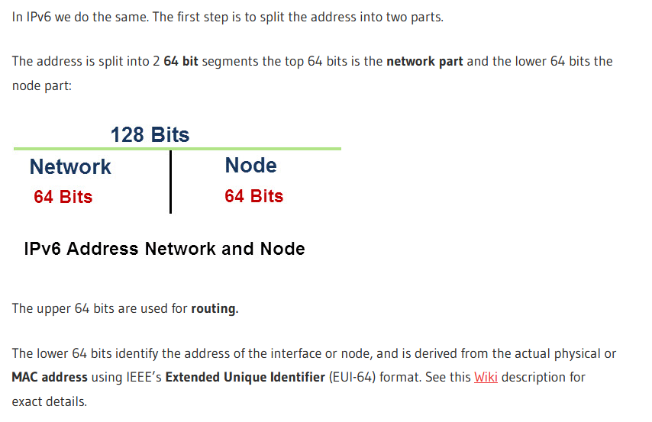
Understand IPv6

Slide 21
IP Addressing IPv6
fe80::/10 This is a link-local (APIPA) prefix offered by IPv6. This address prefix signifies that the address is valid only in the local physical link.
::1/128 or ::1 This is called the loop back address and is used to refer to the local host. An application sending a packet to this address will get the packet back after it is looped back by the IPv6 stack.
ff00::/8 This prefix is offered by IPv6 to denote the multicast addresses.

Slide 22
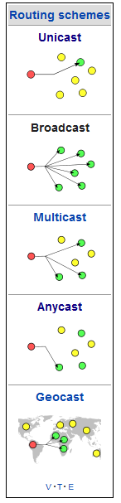
IP Addressing IPv6
IPv6 Routing Methods
Unicast addresses: A Unicast address acts as an identifier for a single interface. An IPv6 packet sent to a Unicast address is delivered to the interface identified by that address.
Broadcast: In computer networking, broadcasting refers to transmitting a packet that will be received by every device on the network.[
Multicast addresses: A Multicast address acts as an identifier for a group/set of interfaces that may belong to the different nodes. An IPv6 packet delivered to a Multicast address is delivered to the multiple interfaces.
Anycast addresses: Anycast addresses act as identifiers for a set of interfaces that may belong to the different nodes. An IPv6 packet destined for an Anycast address is delivered to one of the interfaces identified by the address.
Geocast refers to the delivery of information to a group of destinations in a network identified by their geographical locations. It is a specialized form of multicast addressing used by some routing protocols for mobile ad hoc networks.

Slide 23
Subnetting Basics

Slide 24
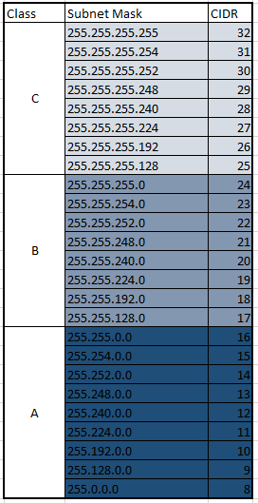
Understand Subnets
Subnetting is the process of diving a network into small networks and is a common task on IPV4 networks.

Slide 25
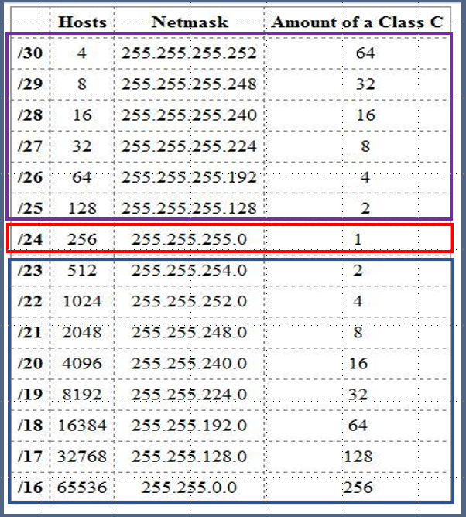
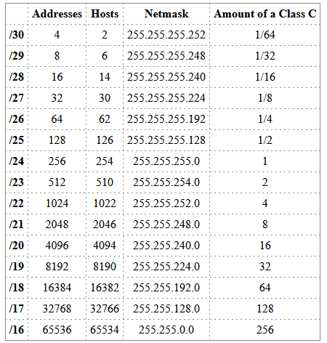
Understand Subnets
Subnetting is the process of dividing a network into small networks and is a common task on IPV4 networks.

Slide 26

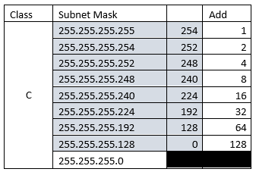
Understand Subnets

Slide 27
Network: 172.16.0.0/26
First: 172.16.0.1
Last: 172.16.0.62
Broadcast: 172.16.0.63
Hosts 64
Usable: 62
Network: 172.16.0.64/26
First: 172.16.0.65
Last: 172.16.0.126
Broadcast: 172.16.0.127
Hosts 64
Usable: 62
Network: 172.16.0.128/26
First: 172.16.0.129
Last: 172.16.0.190
Broadcast: 172.16.0.191
Hosts 64
Usable: 62
Network: 172.16.0.192/26
First: 172.16.0.193
Last: 172.16.0.254
Broadcast: 172.16.0.255
Hosts 64
Usable: 62
4 x 64
Total 256
Subnet: 255.255.255.192
/26
Network: 172.16.0.0/25
First: 172.16.0.1
Last: 172.16.0.126
Broadcast: 172.16.0.127
Hosts 128
Usable: 126
Network: 172.16.0.128/25
First: 172.16.0.129
Last: 172.16.0.254
Broadcast: 172.16.0.255
Hosts 128
Usable: 126
2 x 128
Total 256
Subnet: 255.255.255.128
/25
Network: 172.16.0.0/24
First: 172.16.0.1
Last: 172.16.0.254
Broadcast: 172.16.0.255
Hosts 256
Usable: 254
Total 256
Subnet: 255.255.255.0
/24
Network: 172.16.0.0/23
First: 172.16.0.1
Last: 172.16.0.255
Broadcast: 172.16.1.255
Hosts 256
Usable: 255
Network: 172.16.0.0/23
First: 172.16.1.0
Last: 172.16.1.254
Broadcast: 172.16.1.255
Hosts 256
Usable: 255
2 x 256
Total: 512
Subnet: 255.255.254.0
/23
Network: 172.16.0.0/22
Hosts 256
Usable: 255
172.16.1.0/22
Hosts 256
Usable: 256
172.16.2.0/22
Hosts 256
Usable 256
172.16.3.0/22
Broadcast: 172.16.3.255
Hosts 256
Usable: 255
4 x 256
Total 1024
Subnet: 255.255.252.0
/22

Slide 28
Understand IPv4
192 | 168 | 0 | 25 | /25
1100000 | 10011000 | 00000000 | 0001100
Binary conversion for Subnets:
 |  | 192 | 224 | 240 | 248 | 252 | 254 | 255
 | 128 | 64 | 32 | 16 | 8 | 4 | 2 | 1
1/0
N-2 | 2 | 4 | 8 | 16 | 32 | 64 | 128 | 256
H-2 | 256 | 128 | 64 | 32 | 16 | 8 | 4 | 2
C/24 | /25 | /26 | /27 | /28 | /29 | /30 | /31 | /32
192.168.0.0/24 | 192.168.0.0
Start Range | 192.168.0.1
End Range | 192.168.0.126
Broadcast | 192.168.0.127
Network | 192.168.0.0/25
Start Range | 192.168.0.1
End Range | 192.168.0.126
Broadcast | 192.168.0.127
Number of Networks | 2
Number of IP addresses | 128
Number of usable IP addresses | 126
Network | 192.168.0.128/25
Start Range | 192.168.0.129
End Range | 192.168.0.254
Broadcast | 192.168.0.255
Number of Networks | 2
Number of IP addresses | 128
Number of usable IP addresses | 126

Slide 29
The end !

