Slide 1
Instructor: Justin Thomas

Slide 2
Understanding network infrastructures (30–35%)
1. Understand the concepts of Internet, intranet, and extranet
-Virtual Private Network (VPN), security zones, firewalls
2. Understand local area networks (LANs)
-Perimeter networks; addressing; reserved address ranges for local use (including local loopback IP), VLANs; wired LAN and wireless LAN
3. Understand wide area networks (WANs)
-Leased lines, dial-up, ISDN, VPN, T1, T3, E1, E3, DSL, cable modem, and more, and their characteristics (speed, availability)
4. Understand wireless networking
-Types of wireless networking standards and their characteristics (802.11a,b,g,n,ac including different GHz ranges), types of network security (WPA, WEP, 802.1X, and others), point-to-point (P2P) wireless, ad hoc networks, wireless bridging
5. Understand network topologies and access methods
-Star, mesh, ring, bus, logical and physical topologies

Slide 3
Understanding network hardware (20–25%)
Understand switches
Transmission speed, number and type of ports, number of uplinks, speed of uplinks, managed or unmanaged switches, VLAN capabilities, Layer 2 and Layer 3 switches and security options, hardware redundancy, support, backplane speed, switching types and MAC table, understand capabilities of hubs versus switches, virtual switches
Understand routers
Transmission speed considerations, directly connected routes, static routing, dynamic routing (routing protocols), RIP vs. OSPF, default routes; routing table and how it selects best route(s); routing table memory, Network Address Translation (NAT), software routing in Windows Server, installing and configuring routing; Quality of Service (QoS)
Understand media types
Cable types and their characteristics, including media segment length and speed; fiber optic; twisted pair shielded or unshielded; catxx cabling, wireless; susceptibility to external interference (machinery and power cables); susceptibility to electricity (lightning), susceptibility to interception

Slide 4
Understanding protocols and services (45-50%)
Understand the Open Systems Interconnection (OSI) model
OSI model; Transmission Control Protocol (TCP) model; examples of devices, protocols, applications, and which OSI/TCP layer they belong to; TCP and User Datagram Protocol (UDP); well-known ports for most used purposes (not necessarily Internet); packets and frames
Understand IPv4
Subnetting, IPconfig, why use Internet Protocol version 4 (IPv4), addressing, ipv4toipv6 tunneling protocols to ensure backward compatibility, dual IP stack, subnetmask, gateway, ports, packets, reserved address ranges for local use (including local loopback IP)
Understand IPv6
Subnetting, IPconfig, why use IPv6, addressing, ipv4toipv6 tunneling protocols to ensure backward compatibility, dual IP stack, subnetmask, gateway, ports, packets, reserved address ranges for local use (including local loopback IP)
Understand names resolution
DNS, resource records, Windows Internet Name Service (WINS), steps in the name resolution process, HOSTS file, LMHOSTS file
Understand networking services
Dynamic Host Configuration Protocol (DHCP), Network Address Translation (NAT), firewalls, remote access, VPN
Understand TCP/IP
Tools (such as ping), tracert, pathping, Telnet, IPconfig, netstat, reserved address ranges for local use (including local loopback IP), protocols

Slide 5
Question Types Multiple Choice
Of the Colors listed below which two are primary colors
A. Red
B. Green
C. Blue
D. Purple

Slide 6
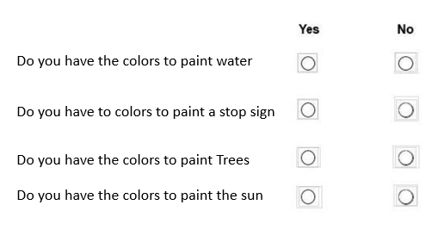
Question Types Scenario Yes & No type 2
Your are an artist and you have been assigned to paint a sign for ABC incorporated.
They want to the sign to have Water, Trees and a stop sign on it.
You are given a 5 gallon bucket of Yellow, Blue and White paint.

Slide 7
Question Types Dropdown
You are an artist, and you have to create lettering for a sign.
What is the best method for creating letters.
You are an artist, and you have to copy a drawing and it needs
To be exact. What is the best method to use.

Slide 8
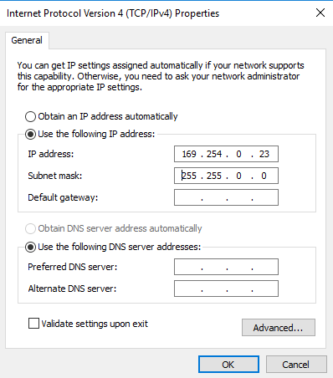
Question Types Scenario with picture
Based on the network card does this computer have internet access
a. Yes
b. No

Slide 9
Question Types Drag and drop
You need to start your car, place the 4 step in the proper order to
Safely start your car.
Place keys in ignition.
.
Place transmission in reverse
Press firmly on the breaks
Roll down window
.
Turn ignition to the start position
Ensure the transmission is in neutral.

Slide 10
The end any questions?

