Slide 1
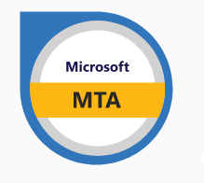

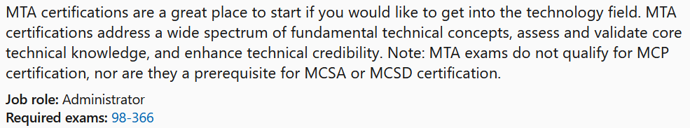

MTA 98-366
Instructor:
Justin Thomas

Slide 2
Local Area Networks (LAN)
Wide Area Networks (WAN)
Virtual Local Area Network (VLAN)

Slide 3

Local Area Networks (LANs)
Perimeter networks
Circuit Switching, Packet Switching
Media Types
Most common Media Access Method
Common network Topologies
VLANs

Slide 4

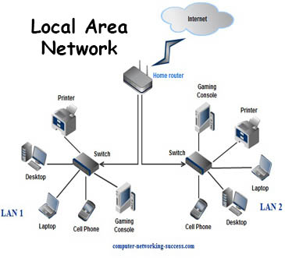
Local Area Networks (LANs)
LANs connect local computers together in a small geographical area.
Computers, Servers, Routers, Switches and Firewalls all connect to a LAN through a NIC (network interface card) or Wireless NIC.
A NIC has a Media Access Controller (MAC) Address burned into it.
A MAC address is how a switch knows who everyone is on the network at the Data Link Layer (Layer 2)
IP address is how the Router knows who everyone is at the Network Layer (Layer 3)

Slide 5
Perimeter networks

Slide 6
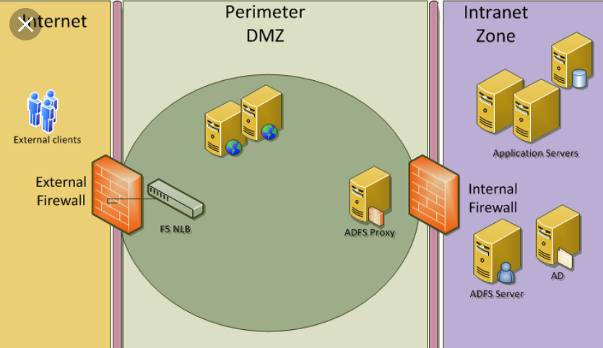
Local Area Networks (LANs)
Perimeter networks
A perimeter network is the network closest to a router that is not under your control.
A network that separates an organization's private network from a public network is
Separates private and public networks.
Makes resources available to the internet.

Slide 7
Local Area Networks (LANs)
Perimeter networks
Usually a perimeter network is the final step a packet takes traversing one of your networks on its way to the internet; and conversely the first network encountered by incoming traffic from the Internet.
Most administrators create perimeter networks in order to place their firewall in between them and the outside world so that they can filter packet traffic.
Most perimeter networks are part of the DMZ (Demilitarized Zone).

Slide 8
Circuit Switching
Packet Switching

Slide 9
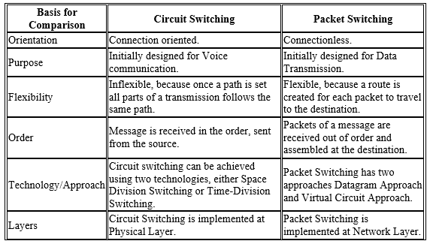
Local Area Networks (LANs)
Circuit Switching
Packet Switching
Circuit switching and packet switching are the two switching methods that are used to connect the multiple communicating devices with one another.
Circuit Switching was particularly designed for voice communication and it was less suitable for data transmission. So, a better solution evolved for data transmission called Packet switching.
The main difference between circuit switching and packet switching is that Circuit Switching is connection oriented whereas, Packet Switching is connectionless.

Slide 10
Media Type Basics

Slide 11
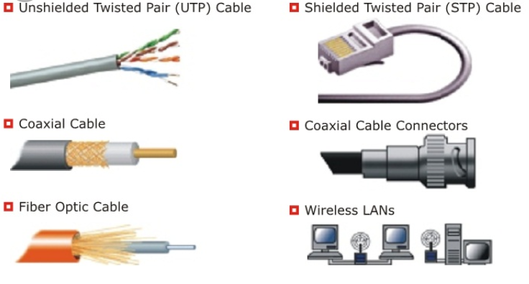
Understand Media Types
Cable types and their characteristics
Including media segment length and speed
Fiber optic
Twisted pair shielded or unshielded; Catxx cabling

Slide 12
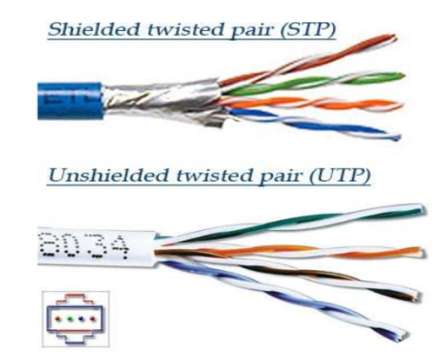
Understand Media Types

Slide 13
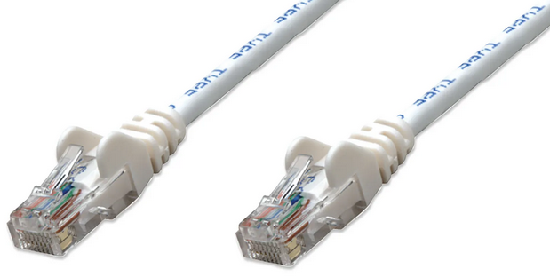
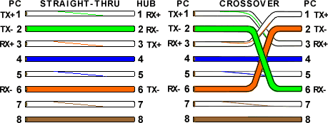
Understand Media Types
RJ-45 Connector
Most common Network Connector

Slide 14
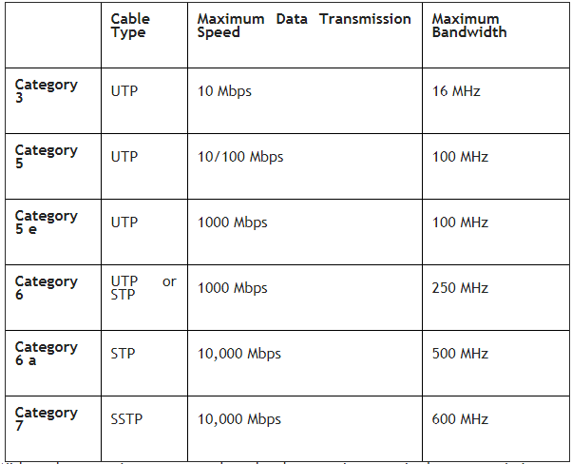
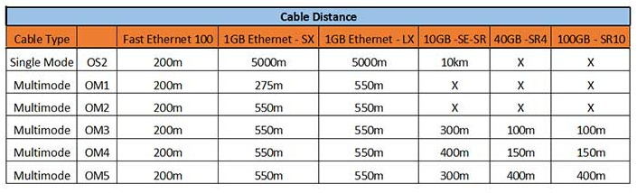
Understand Media Types
(Cable Speeds)

Slide 15
Media Access Control Methods

Slide 16
Local Area Networks (LANs)
What is Media Access Control Method?
A way to allow computers to transmit signals over network cabling while ensuring that only one computer transmits at a time.
If two computers simultaneously place signals on the wire, a collision can occur, and data might be corrupted unless a method is used to resolve the collision gracefully.

Slide 17
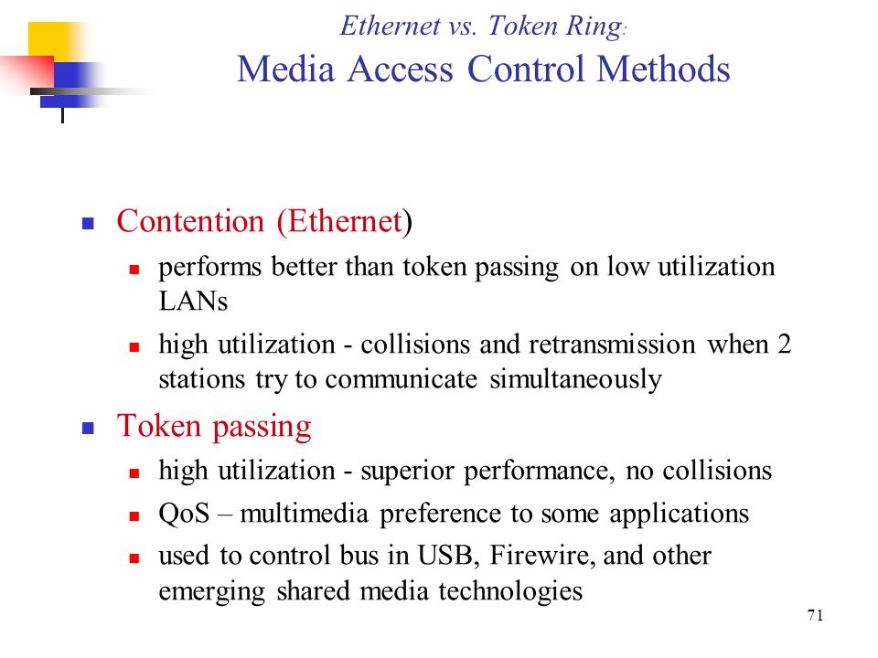

Slide 18
Local Area Networks (LANs)
2 Main types of media access control methods are used in networking:
Contention: Carrier Sense Multiple Access with Collision Detection (CSMA/CD), which is used in Ethernet networking
Token passing, which is used in Token Ring and Fiber Distributed Data Interface (FDDI) networking

Slide 19
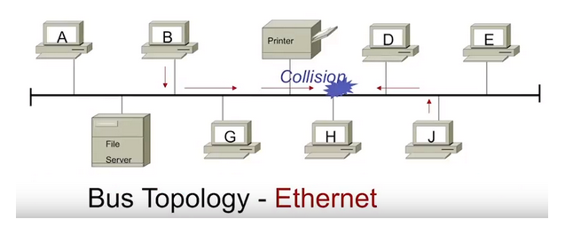
Local Area Networks (LANs)
Contention Methods
What is CSMA/CD (Carrier Sense Multiple Access with Collision Detection)?
CSMA/CD is a type of media access control method for placing signals on baseband transmission networks. Since baseband networks can carry only one data signal at a time, there must be some way of controlling which station has access to the media at any given time. Carrier Sense Multiple Access with Collision Detection (CSMA/CD) is one such control method.

Slide 20
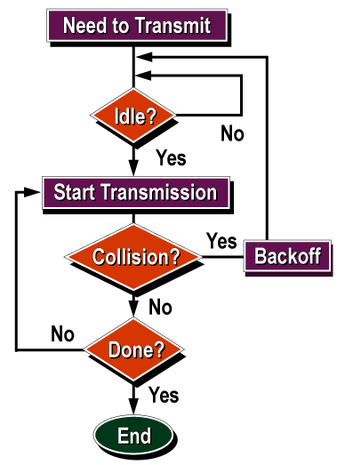
Local Area Networks (LANs)
Contention Methods
How it works

Slide 21
Local Area Networks (LANs)
Token Passing
On a local area network, token passing is a channel access method where a signal called a token is passed between nodes to authorize that node to communicate.
In contrast to polling access methods, there is no pre-defined "master" node. The most well-known examples are token ring and ARCNET, but there were a range of others, including FDDI (Fiber Distributed Data Interface), which was popular in the early to mid 1990s.
Token passing schemes degrade deterministically under load, which is a key reason why they were popular for industrial control LANs such as MAP, (Manufacturing Automation Protocol).
The advantage over contention-based channel access (such as the CSMA/CD of early Ethernet), is that collisions are eliminated, and that the channel bandwidth can be fully utilized without idle time when demand is heavy.
The disadvantage is that even when demand is light, a station wishing to transmit must wait for the token, increasing latency.

Slide 22
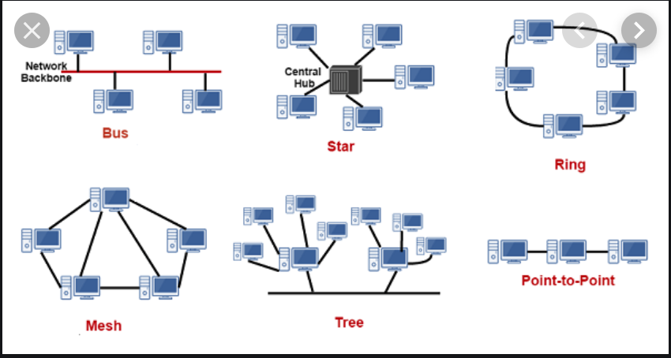
Network topologies

Slide 23
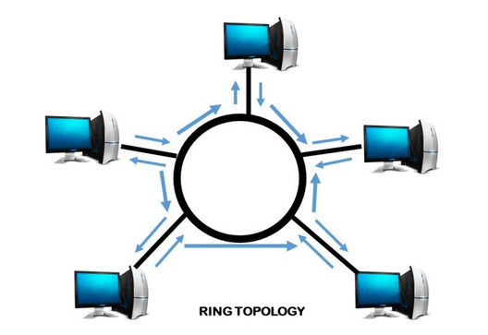
Network topologies
Ring Topology
Ring topology, also known as Ring network, is a type of network topology where each node is exactly connected to two other nodes, forward and backward, thus forming a single continuous path for signal transmission.
Advantages of Ring topology:
Reduced chances of data collision as each node release a data packet after receiving the token.
Token passing makes ring topology perform better than bus topology under heavy traffic
No need of server to control connectivity among the nodes
Equal access to the resources
Disadvantages of Ring topology:
In Unidirectional Ring, a data packet must pass through all the nodes.

Slide 24
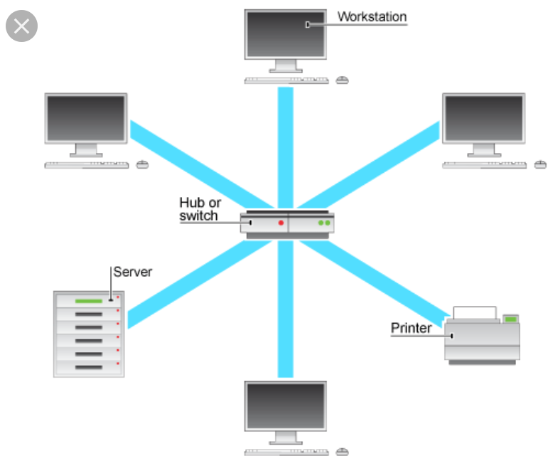
Network topologies
Star Topology
What is Star topology?
In Star topology, all the components of network are connected to the central device called “hub” which may be a hub, a router or a switch.
Unlike Bus topology (discussed earlier), where nodes were connected to central cable, here all the workstations are connected to central device with a point-to-point connection. So it can be said that every computer is indirectly connected to every other node by the help of “hub”.
Advantages of Star Topology
1) As compared to Bus topology it gives far much better performance, signals don’t necessarily get transmitted to all the workstations. A sent signal reaches the intended destination after passing through no more than 3-4 devices and 2-3 links. Performance of the network is dependent on the capacity of central hub.
2) Easy to connect new nodes or devices. In star topology new nodes can be added easily without affecting rest of the network. Similarly components can also be removed easily.
3) Centralized management. It helps in monitoring the network.
4) Failure of one node or link doesn’t affect the rest of network. At the same time its easy to detect the failure and troubleshoot it.
Disadvantages of Star Topology
1) Too much dependency on central device has its own drawbacks. If it fails whole network goes down.
2) The use of hub, a router or a switch as central device increases the overall cost of the network.
3) Performance and as well number of nodes which can be added in such topology is depended on capacity of central device.

Slide 25
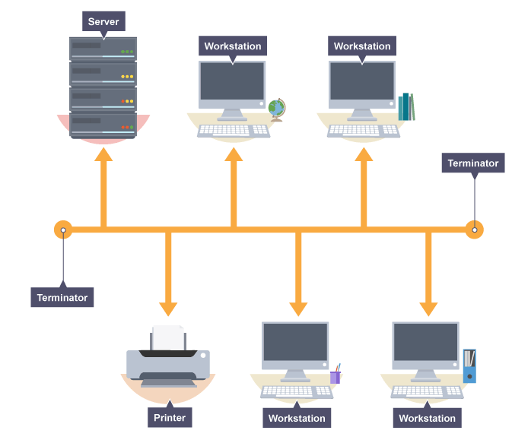
Network topologies
Bus Topology
The bus network
In a bus network all the workstations, servers and printers are joined to one cable (the bus). At each end of the cable a terminator is fitted to stop signals reflecting down the bus.
The advantages of a bus network are:
it is easy to install
it is cheap to install, as it doesn't require much cable
The disadvantages of a bus network are:
if the main cable fails or gets damaged the whole network will fail
as more workstations are connected the performance of the network will become slower because of data collisions
every workstation on the network "sees" all the data on the network – this is a security risk

Slide 26
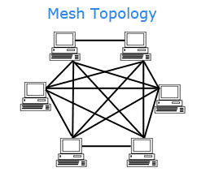
Network topologies
Mesh Topology
The Mesh network
A network setup where each computer and network device is interconnected with one another, allowing for most transmissions to be distributed even if one of the connections go down. It is a topology commonly used for wireless networks.
Advantages of a mesh topology
Manages high amounts of traffic, because multiple devices can transmit data simultaneously.
A failure of one device does not cause a break in the network or transmission of data.
Adding additional devices does not disrupt data transmission between other devices.
Disadvantages of a mesh topology
The cost to implement is higher than other network topologies, making it a less desirable option.
Building and maintaining the topology is difficult and time consuming.
The chance of redundant connections is high, which adds to the high costs and potential for reduced efficiency.

Slide 27
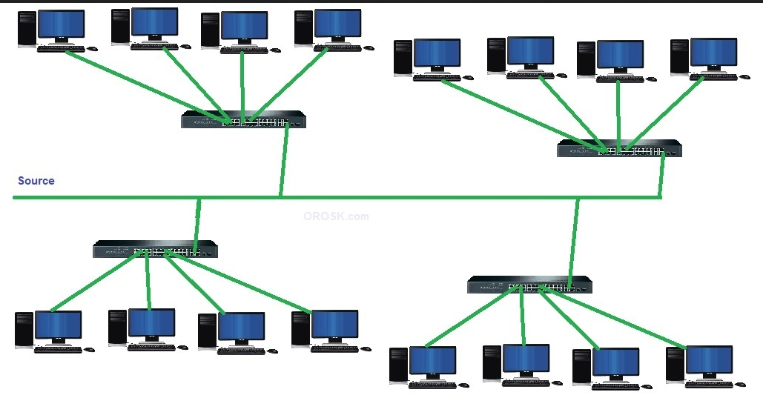
Network topologies
Tree Topology
A tree topology is a combination of a star network topology and a bus topology. In tree topology, nodes of the underlying bus network topology are replaced with a complete star topology.
Advantages of tree topology:
Scalable as leaf nodes can accommodate more nodes in the hierarchical chain.
A point to point wiring to the central hub at each intermediate node of a tree topology represents a node in the bus topology
Other hierarchical networks are not affected if one of them gets damaged
Easier maintenance and fault finding
Disadvantages of tree topology:
Huge cabling is needed
A lot of maintenance is needed
backbone forms the point of failure.

Slide 28
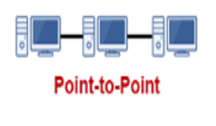
Network topologies
Point-to-Point Topology
While mesh and star networks are used to connect multiple ‘things’ to a network, point-to-point topology is used to connect two things together.
The advantage of point-to-point network topology is that it is much simpler than mesh or star, because the topology simply tunnels a flow of data either unidirectionally or bidirectionally between two points.
The disadvantage is that point-to-point networks are not very useful for IoT. They are still used in some SCADA systems, traffic data systems, or in point-to-point broadcast systems (like police or fire radios), but it rarely makes sense in IoT to have a receiver talk to a single node instead of multiple nodes.

Slide 29
Wide Area Networks (WAN)

Slide 30
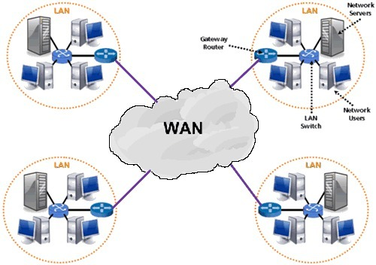
Wide Area Networks (WANs)
A WAN is a Wide Area Network which spans a large geographical area.
Even more WAN technologies exist, such as Frame Relay and ATM (Asynchronous Transfer Mode).
WAN links need to be optimized for efficient and fast performance.

Slide 31
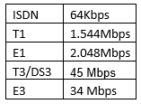
Leased Lines
Are types of connections for WANs
  E1 and E3 are WAN connections available in Europe
  T1 and T3 for the United States.
  Dial-up and ISDN
  DSL and Cable broadband Internet access technologies each have a corresponding modem.

Slide 32
VLAN Basics

Slide 33

VLANS
A VLAN (virtual LAN) is a subnetwork which can group together collections of devices on separate physical local area networks (LANs).
Advantages of VLANs
They reduce the number of nodes in a broadcast domain
They compartmentalize and reduce traffic. (Departments instead of floors)
Act Like they are on the same LAN regardless of physical location.
Allowed on both layer 2 and layer 3 switches
They increase the number of broadcast domains will reducing the size of each broadcast domain.

Slide 34
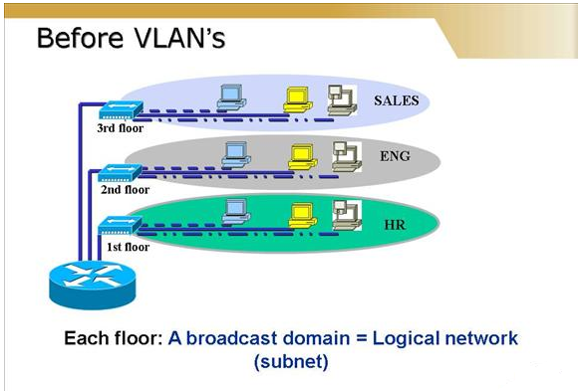
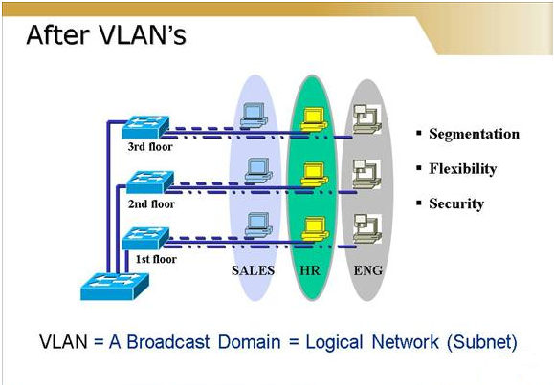
VLANS

Slide 35
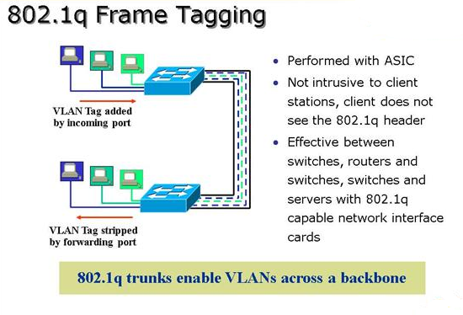
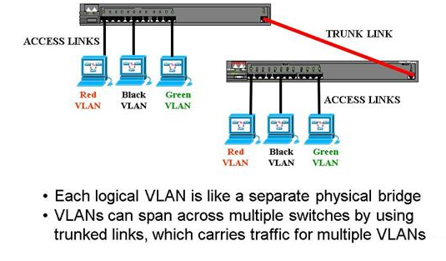
VLANS

Slide 36
The end any questions?

