Slide 1
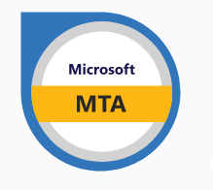

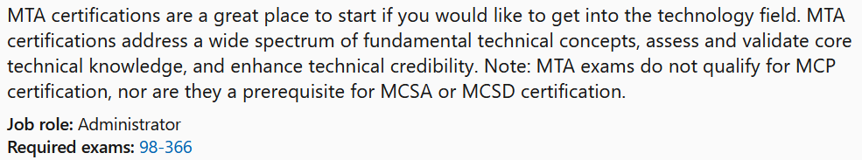

Instructor:
Justin Thomas

Slide 2

Understanding network infrastructures (30–35%)
1. Understand the concepts of Internet, intranet, and extranet
-Virtual Private Network (VPN), security zones, firewalls
2. Understand local area networks (LANs)
-Perimeter networks; addressing; reserved address ranges for local use (including local loopback IP), VLANs; wired LAN and wireless LAN
3. Understand wide area networks (WANs)
-Leased lines, dial-up, ISDN, VPN, T1, T3, E1, E3, DSL, cable modem, and more, and their characteristics (speed, availability)
4. Understand wireless networking
-Types of wireless networking standards and their characteristics (802.11a,b,g,n,ac including different GHz ranges), types of network security (WPA, WEP, 802.1X, and others), point-to-point (P2P) wireless, ad hoc networks, wireless bridging
5. Understand network topologies and access methods
-Star, mesh, ring, bus, logical and physical topologies

Slide 3
Understanding network hardware (20–25%)
Understand switches
  Transmission speed, number and type of ports, number of uplinks, speed of uplinks, managed or unmanaged switches, VLAN capabilities, Layer 2 and Layer 3 switches and security options, hardware redundancy, support, backplane speed, switching types and MAC table, understand capabilities of hubs versus switches, virtual switches
Understand routers
  Transmission speed considerations, directly connected routes, static routing, dynamic routing (routing protocols), RIP vs. OSPF, default routes; routing table and how it selects best route(s); routing table memory, Network Address Translation (NAT), software routing in Windows Server, installing and configuring routing; Quality of Service (QoS)
Understand media types
  Cable types and their characteristics, including media segment length and speed; fiber optic; twisted pair shielded or unshielded; catxx cabling, wireless; susceptibility to external interference (machinery and power cables); susceptibility to electricity (lightning), susceptibility to interception

Slide 4
Understanding protocols and services (45-50%)
Understand the Open Systems Interconnection (OSI) model
  OSI model; Transmission Control Protocol (TCP) model; examples of devices, protocols, applications, and which OSI/TCP layer they belong to; TCP and User Datagram Protocol (UDP); well-known ports for most used purposes (not necessarily Internet); packets and frames
Understand IPv4
  Subnetting, IPconfig, why use Internet Protocol version 4 (IPv4), addressing, ipv4toipv6 tunneling protocols to ensure backward compatibility, dual IP stack, subnetmask, gateway, ports, packets, reserved address ranges for local use (including local loopback IP)
Understand IPv6
  Subnetting, IPconfig, why use IPv6, addressing, ipv4toipv6 tunneling protocols to ensure backward compatibility, dual IP stack, subnetmask, gateway, ports, packets, reserved address ranges for local use (including local loopback IP)
Understand names resolution
  DNS, resource records, Windows Internet Name Service (WINS), steps in the name resolution process, HOSTS file, LMHOSTS file
Understand networking services
  Dynamic Host Configuration Protocol (DHCP), Network Address Translation (NAT), firewalls, remote access, VPN
Understand TCP/IP
  Tools (such as ping), tracert, pathping, Telnet, IPconfig, netstat, reserved address ranges for local use (including local loopback IP), protocols

Slide 5
Question Types
Multiple Choice
Of the Colors listed below which two are primary colors
A. Red
B. Green
C. Blue
D. Purple

Slide 6
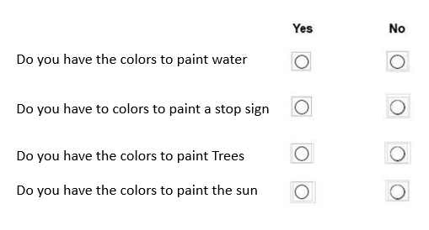
Question Types
Scenario Yes & No type 2
Your are an artist and you have been assigned to paint a sign for ABC incorporated.
They want to the sign to have Water, Trees and a stop sign on it.
You are given a 5 gallon bucket of Yellow, Blue and White paint.

Slide 7

Question Types
Dropdown
You are an artist, and you have to create lettering for a sign.
What is the best method for creating letters.
You are an artist, and you have to copy a drawing and it needs
To be exact. What is the best method to use.

Slide 8
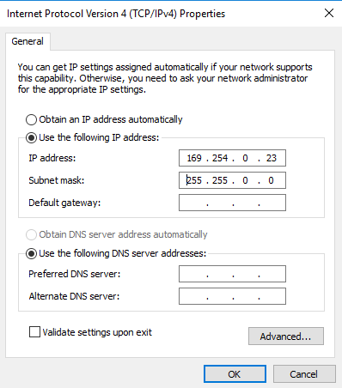
Question Types
Scenario with picture
Based on the network card does this computer have internet access
a. Yes
b. No

Slide 9
Question Types
Drag and drop
You need to start your car, place the 4 step in the proper order to
Safely start your car.
Place keys in ignition.
.
Place transmission in reverse
Press firmly on the breaks
Roll down window
.
Turn ignition to the start position
Ensure the transmission is in neutral.

Slide 10
Understand the concepts of Internet, intranet, and extranet
Notes:
Hi and welcome to my Microsoft MTA 98-366 Study video series. In this video we will be covering Intra and extranets.

Slide 11

Understand the concepts of Internet, intranet, and extranet
Intranet is shared content accessed by members within a single organization.
Intranet is shared content accessed by members within a single organization.
Extranet is shared content accessed by groups through cross-enterprise boundaries.
Internet is global communication accessed through the Web.

Slide 12
Intranets
Network within an organization that uses Internet protocols and technologies for:
  Collecting, storing, and disseminating useful information that supports business activities
Otherwise known as corporate portals
Facilitates internal use by employees
  Companies also allow trusted business partners to access their intranets

Slide 13
Intranets
Uses Internet technologies to solve organizational problems
Different from an LAN
Defining and limiting access is important for security reasons

Slide 14

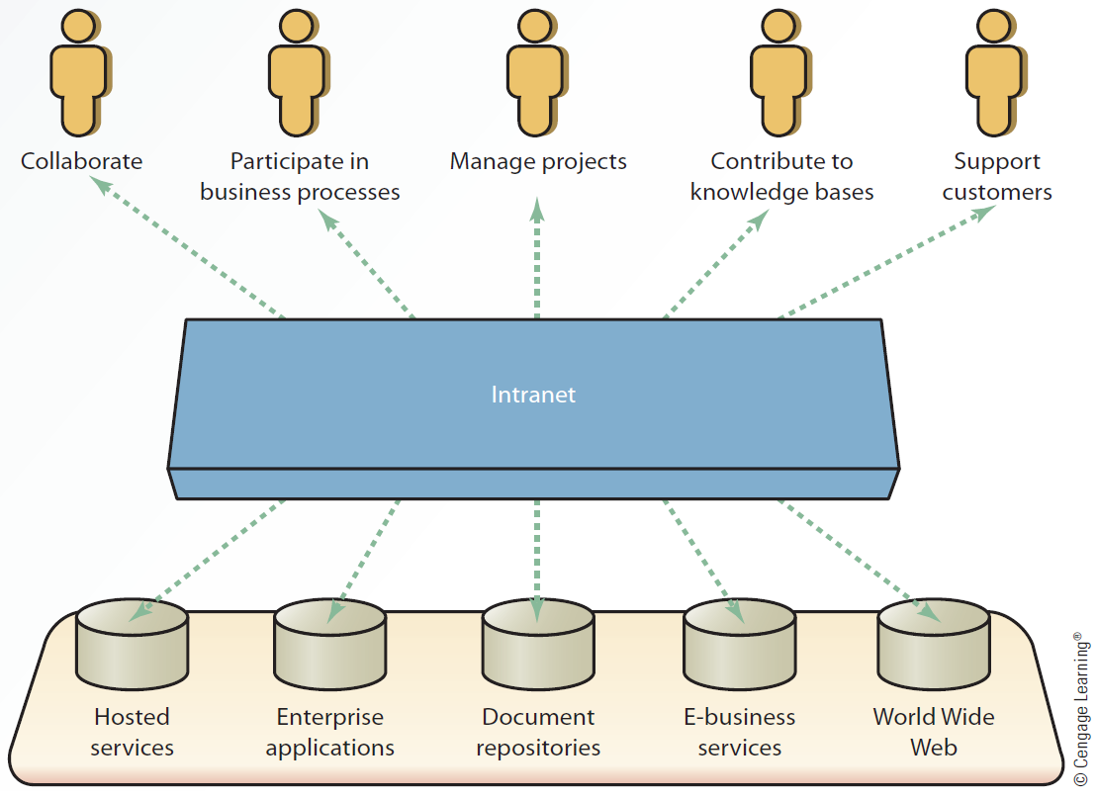
Simple Intranet
Architecture

Slide 15
Extranets
Secure network that:
  Uses the Internet and Web technologies to connect intranets of business partners
  Facilitates communication between organizations or between consumers
Considered to be a type of inter-organizational system (IOS)
  Electronic funds transfer (EFT)
  Electronic data interchange (EDI)

Slide 16
Extranets
Allow companies to reduce internetworking costs and give competitive advantage
  Leads to increased profits
Require a comprehensive security system and management control

Slide 17

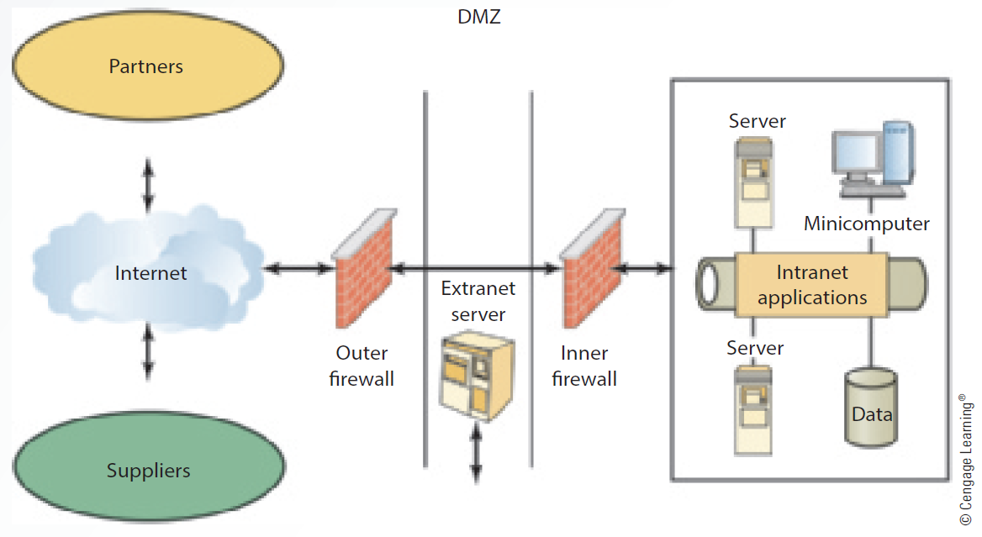
Simple Extranet Architecture

Slide 18
Virtual Private Network (VPN)

Slide 19
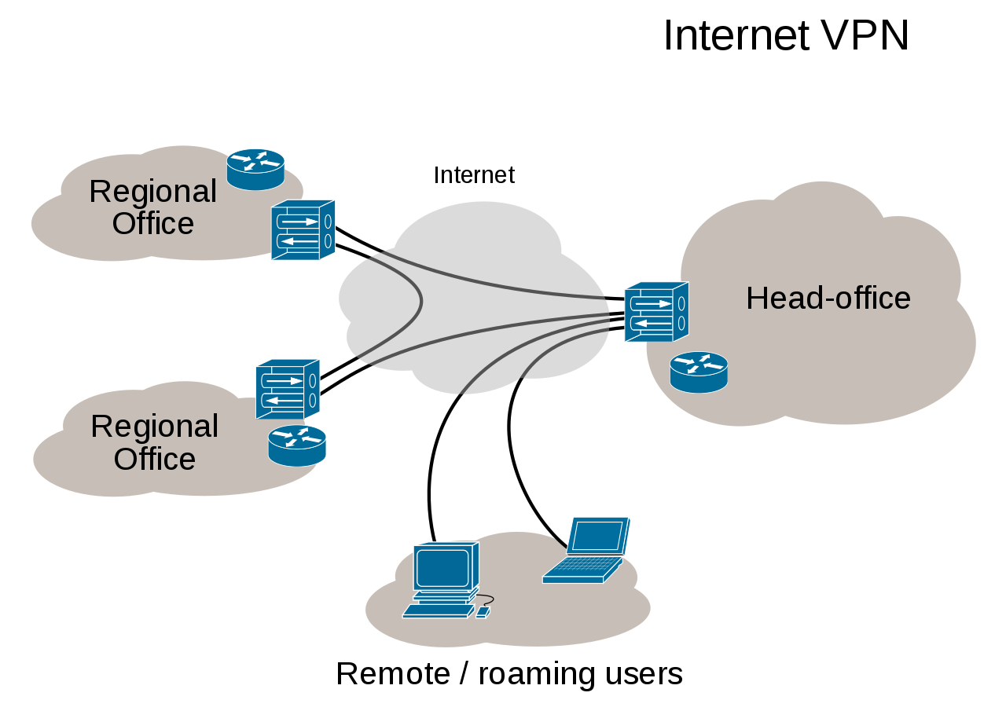
Virtual Private Network (VPN)
A virtual private network (VPN) extends a private network across a public network and enables users to send and receive data across shared or public networks as if their computing devices were directly connected to the private network. Applications running on a computing device, e.g., a laptop, desktop, smartphone, across a VPN may therefore benefit from the functionality, security, and management of the private network. Encryption is a common, though not an inherent, part of a VPN connection.

Slide 20
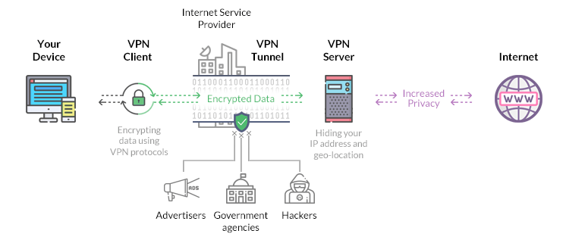
Virtual Private Network (VPN)
Why us a VPN
Access a Business Network While Traveling:
Access Your Home Network While Travelling
Hide Your Browsing Activity from Your Local Network and ISP:
Access Geo-Blocked Websites
Bypass Internet Censorship
Downloading Files

Slide 21
Virtual Private Network (VPN)
Things to know about VPN and how it works.
Uses IPSec to negotiate algorithm and IKE exchange information.
Uses Tunneling Protocols
SSL VPN- Allows connection from anywhere on internet.
Layer 2 Tunneling Protocol- Creates an unsecure connection between networks.
Site To Site VPN- Securely connects two portions of a private network.
Teredo tunneling is a protocol that allows IPv6 connectivity through IPv4 devices.
Uses public infrastructure to create private network.
Direct Connection: Can be used to connect securely to corporate network, without user interaction.

Slide 22
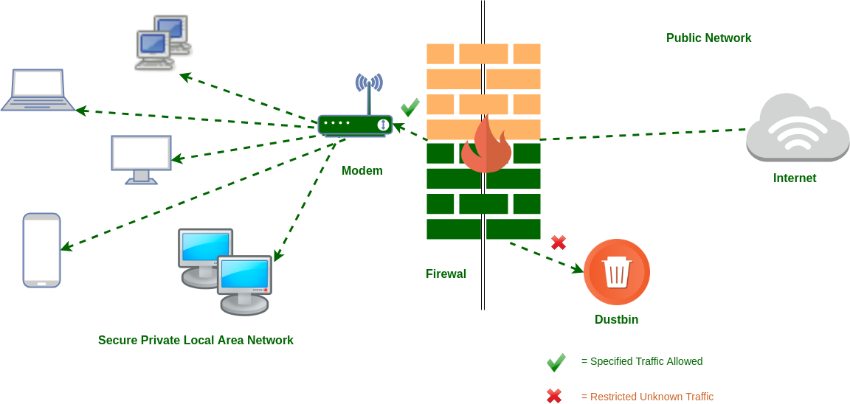
Firewalls

Slide 23
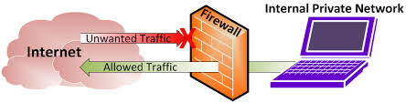
Firewalls
A firewall is a network security device that monitors incoming and outgoing network traffic and decides whether to allow or block specific traffic based on a defined set of security rules.
They establish a barrier between secured and controlled internal networks that can be trusted and untrusted outside networks, such as the Internet.
A firewall can be hardware, software, or both.

Slide 24
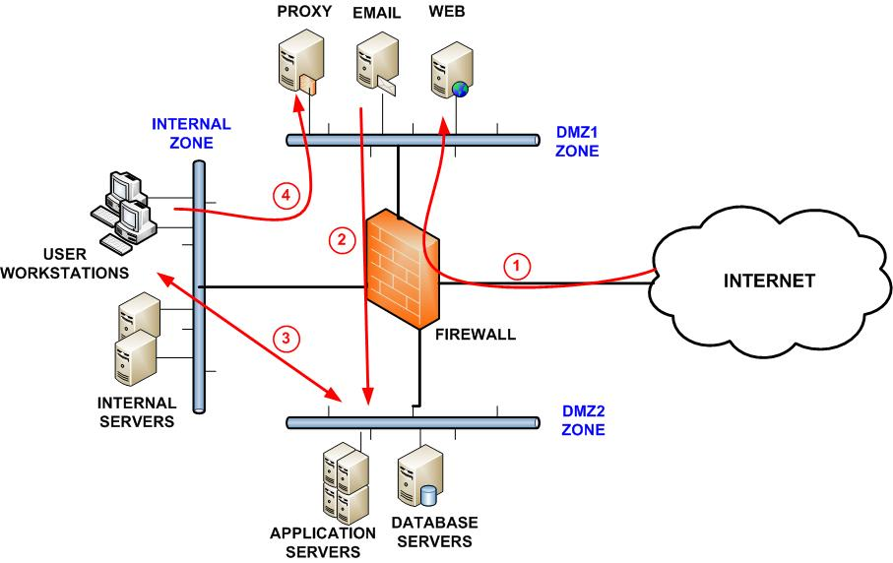
Security zones

Slide 25
Local Area Networks (LAN)

Slide 26
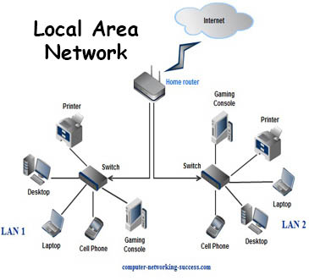
Local Area Networks (LANs)
LANs connect local computers together in a small geographical area.
Computers, Servers, Routers, Switches and Firewalls all connect to a LAN through a NIC (network interface card) or Wireless NIC.
A NIC has a Media Access Controller (MAC) Address burned into it.
A MAC address is how a switch knows who everyone is on the network at the Data Link Layer (Layer 2)
IP address is how the Router knows who everyone is at the Network Layer (Layer 3)

Slide 27
Local Area Networks (LANs)
Perimeter networks
IP addressing
Reserved address ranges for local use (including local loopback IP),
VLANs
Perimeter
Most common Media Access Method

Slide 28
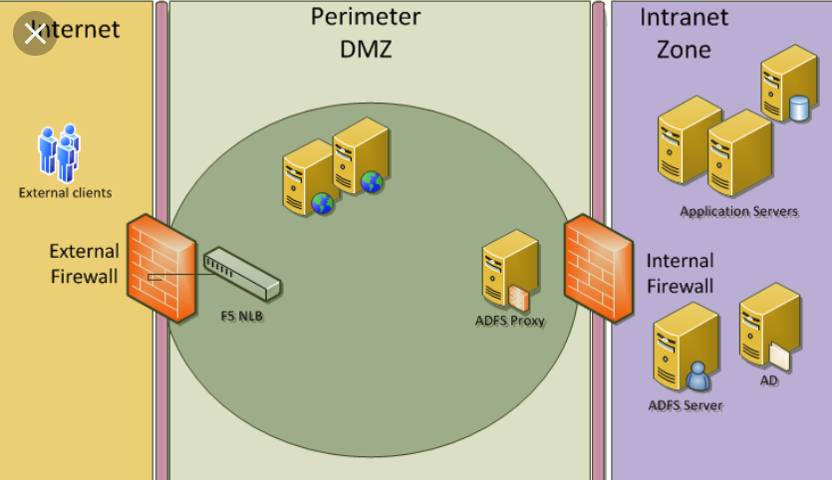
Local Area Networks (LANs)
Perimeter networks
A perimeter network is the network closest to a router that is not under your control.
A network that separates an organization's private network from a public network is
Separates private and public networks.
Makes resources available to the internet.

Slide 29
Local Area Networks (LANs)
Perimeter networks
Usually a perimeter network is the final step a packet takes traversing one of your networks on its way to the internet; and conversely the first network encountered by incoming traffic from the Internet.
Most administrators create perimeter networks in order to place their firewall in between them and the outside world so that they can filter packet traffic.
Most perimeter networks are part of the DMZ (Demilitarized Zone).

Slide 30
Local Area Networks (LANs)
What is Media Access Control Method?
A way to allow computers to transmit signals over network cabling while ensuring that only one computer transmits at a time.
If two computers simultaneously place signals on the wire, a collision can occur, and data might be corrupted unless a method is used to resolve the collision gracefully.

Slide 31
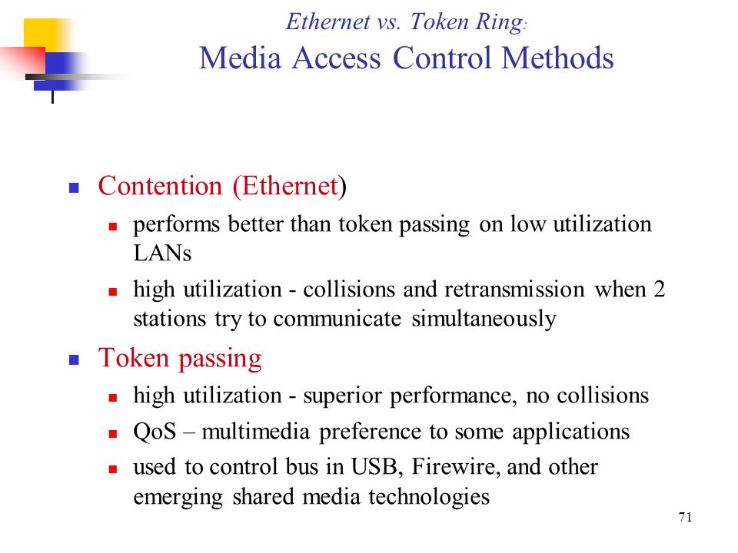

Slide 32
Local Area Networks (LANs)
2 Main types of media access control methods are used in networking:
Contention: Carrier Sense Multiple Access with Collision Detection (CSMA/CD), which is used in Ethernet networking
Token passing, which is used in Token Ring and Fiber Distributed Data Interface (FDDI) networking

Slide 33
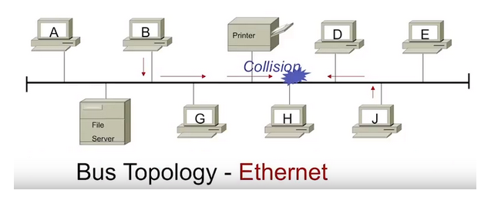
Local Area Networks (LANs)
Contention Methods
What is CSMA/CD (Carrier Sense Multiple Access with Collision Detection)?
CSMA/CD is a type of media access control method for placing signals on baseband transmission networks. Since baseband networks can carry only one data signal at a time, there must be some way of controlling which station has access to the media at any given time. Carrier Sense Multiple Access with Collision Detection (CSMA/CD) is one such control method.

Slide 34
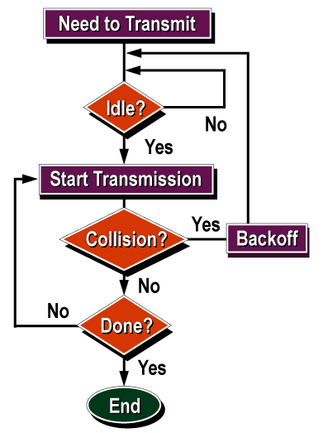
Local Area Networks (LANs)
Contention Methods
How it works

Slide 35
Local Area Networks (LANs)
Token Passing
On a local area network, token passing is a channel access method where a signal called a token is passed between nodes to authorize that node to communicate.
In contrast to polling access methods, there is no pre-defined "master" node. The most well-known examples are token ring and ARCNET, but there were a range of others, including FDDI (Fiber Distributed Data Interface), which was popular in the early to mid 1990s.
Token passing schemes degrade deterministically under load, which is a key reason why they were popular for industrial control LANs such as MAP, (Manufacturing Automation Protocol).
The advantage over contention-based channel access (such as the CSMA/CD of early Ethernet), is that collisions are eliminated, and that the channel bandwidth can be fully utilized without idle time when demand is heavy.
The disadvantage is that even when demand is light, a station wishing to transmit must wait for the token, increasing latency.

Slide 36
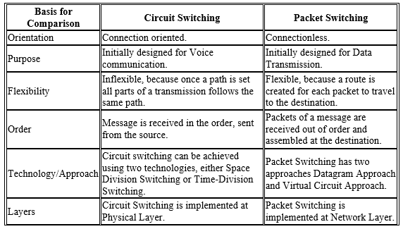
Local Area Networks (LANs)
Circuit Switching
Packet Switching
Circuit switching and packet switching are the two switching methods that are used to connect the multiple communicating devices with one another.
Circuit Switching was particularly designed for voice communication and it was less suitable for data transmission. So, a better solution evolved for data transmission called Packet switching.
The main difference between circuit switching and packet switching is that Circuit Switching is connection oriented whereas, Packet Switching is connectionless.

Slide 37
Wide Area Networks (WAN)

Slide 38
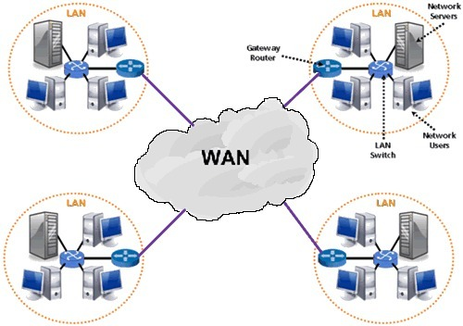
Wide Area Networks (WANs)
A WAN is a Wide Area Network which spans a large geographical area.
Even more WAN technologies exist, such as Frame Relay and ATM (Asynchronous Transfer Mode).
WAN links need to be optimized for efficient and fast performance.

Slide 39
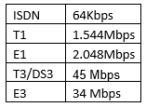
Wide Area Networks (WANs)
Leased Lines
Are types of connections for WANs
  E1 and E3 are WAN connections available in Europe
  T1 and T3 for the United States.
  Dial-up and ISDN
  DSL and Cable broadband Internet access technologies each have a corresponding modem.

Slide 40
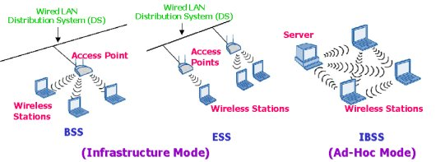
Wireless Networking
Basis Service Set (BSS)
Two of the popular networking standards being used are 802.11g and 802.11n
Each of the wireless networking standards has different characteristics, such as speed, distance, frequency, and so on.
WPA (Wi-Fi Protected Access) and WPA2 is more secure than WEP (Wired Equivalent Privacy).
WP-Enterprise and WP2-Enterprise are used in business environments and work with an 802.1X authentication server
The 802.1X authentication method is used in business environments and requires a certificate or smart card for network access.
Most vulnerable type of connection to hacking.
Extended Service Set (ESS)
Independent Basic Service Set (IBSS) or Peer to Peer

Slide 41
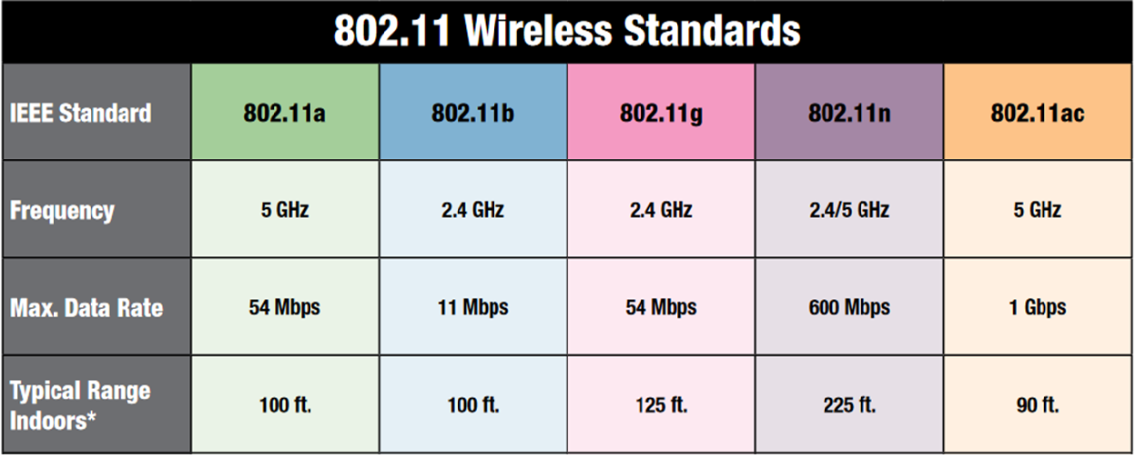
NOTE: The type of connection you are using has the biggest impact on data transmission speed in a wireless network?
Note: 802.11 standards with the same frequency and will establish a connection with one another.
Notes:
Note that 802.11g with the same frequency and will establish a connection with one another.

Slide 42
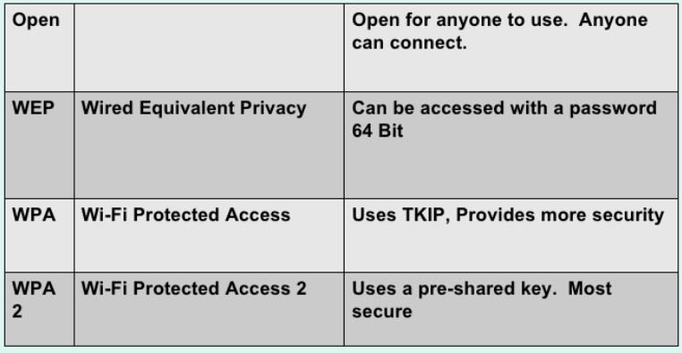
Wireless Networking
types of network security (WPA, WEP, WEP2 and others)
Worst
Best

Slide 43

Wireless Networking Security
The most common type is Wi-Fi
security are:
Wired Equivalent Privacy (WEP)
  Notoriously weak security standard
  802.11b
Wi-Fi Protected Access (WPA).
  Safer than WEP
  802.11a and 802.11b
  Backwards compatible with WEP
WI-FI Protected Access II (WPA 2)
  The most significant changes between WPA and WPA2 is
    the mandatory use of AES algorithms
    the introduction of CCMP (Counter Cipher Mode with Block Chaining Message Authentication Code Protocol) as a replacement for TKIP.
  TKIP is still preserved in WPA2 as a fallback system and for interoperability with WPA.
  802.1i

Slide 44
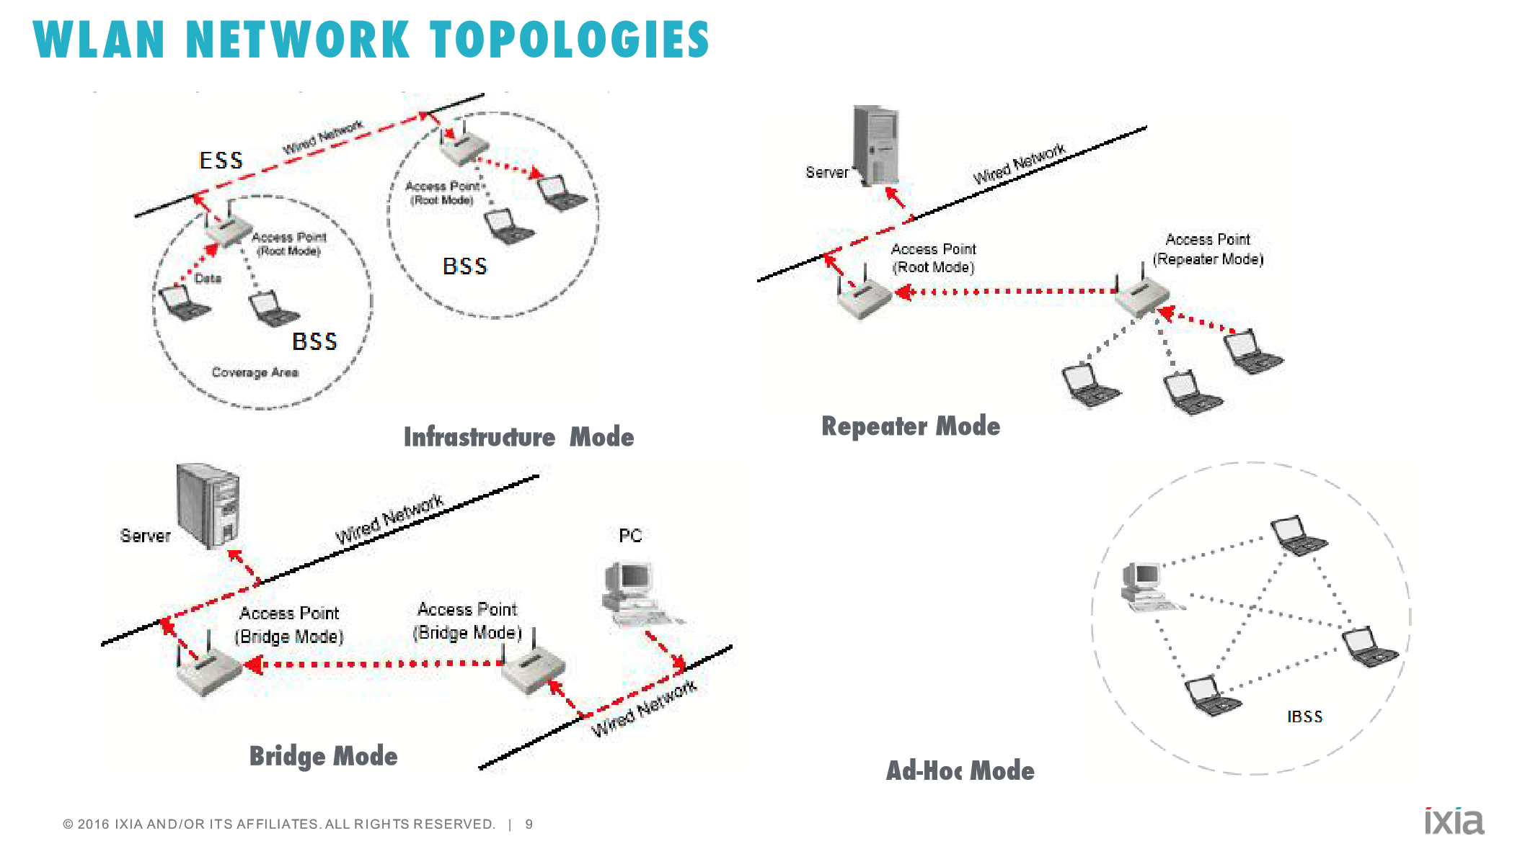
Types of Wireless Networks
Point-to-point (P2P) wireless
Ad hoc networks
Wireless bridging
Notes:
Ad-hoc networks are local area networks that are also known as P2P networks because the devices communicate directly, without relying on servers. Like other P2P configurations, ad-hoc networks tend to feature a small group of devices all in very close proximity to each other.

Slide 45
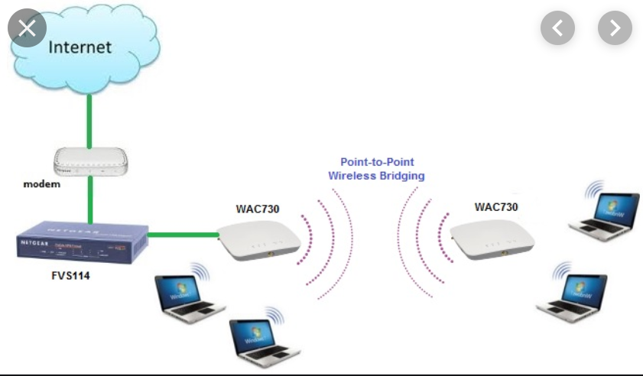
WIFI Bridging
Wi-Fi to Ethernet bridge: This hardware allows Wi-Fi clients to connect to an Ethernet network. The hardware is integrated with Wi-Fi wireless access points (APs) and is useful for older computers or devices that don't have Wi-Fi capability.
Wi-Fi to Wi-Fi bridge: This bridge joins two Wi-Fi networks, often to increase the coverage area of a Wi-Fi hotspot. Some wireless AP hardware supports bridging in Ethernet as well as Wi-Fi mode.
Bluetooth to Wi-Fi bridge: This bridge connects devices that communicate with consumer Bluetooth gadgets and interface with a Wi-Fi home network.
Notes:
Ad-hoc networks are local area networks that are also known as P2P networks because the devices communicate directly, without relying on servers. Like other P2P configurations, ad-hoc networks tend to feature a small group of devices all in very close proximity to each other.

Slide 46
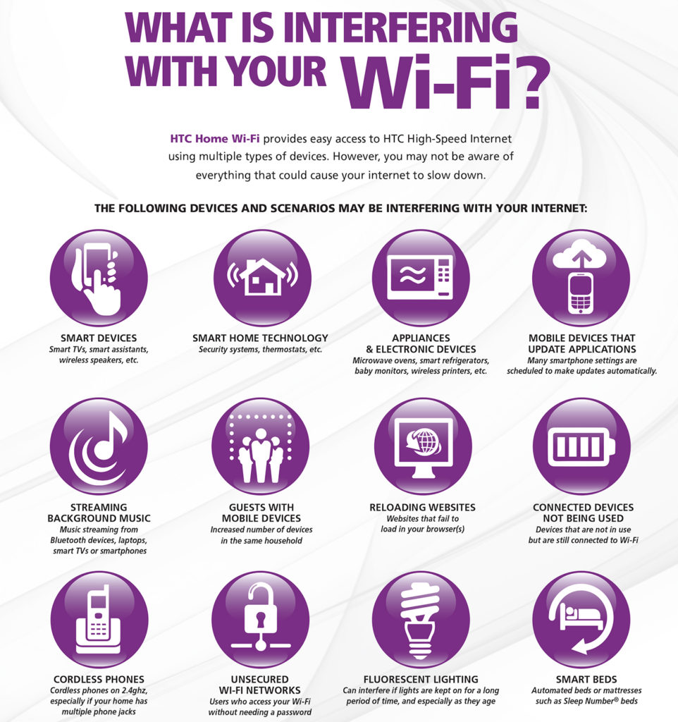
Wireless Networks (Electromagnetic Interference and other reasons for degradation of a WIFI network)
Attenuation in a wireless network signal is a result of the distance from the access point.
Signal Attenuation is a reduction of signal strength during transmission,

Slide 47
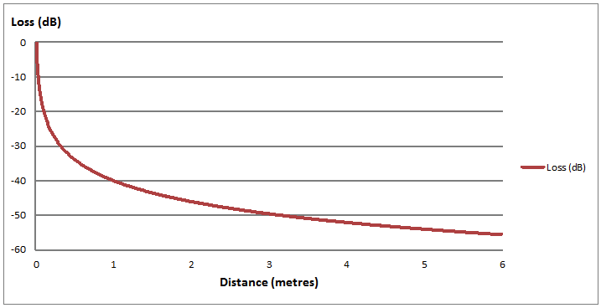
Wireless Networks (Electromagnetic Interference and other reasons for degradation of a WIFI network)
- Signal Attenuation is a reduction of signal strength during transmission,
- Attenuation in a wireless network signal is directly related to the distance from the signal source.

Slide 48
Wireless Networks (Electromagnetic Interference and other reasons for degradation of a WIFI network)
High vs Low. Having your WiFi router on the floor or behind other objects usually results in noticeably worse performance. Instead, place the router as high up as possible to extend the broadcasting range of the radio waves. This also helps clear the router of possible interferences.
Objects in the way. Materials like concrete, plaster and especially metal tend to be the worst for blocking Wi-Fi waves. Wireless routers broadcast Omni directionally, and the closer you place yours to an obstacle like a brick wall, the more you’ll restrict its signal.
Distance. The further away from your router you get, the weaker the Wi-Fi signal. This is called attenuation Therefore, the best option is to place your router as close to your devices as possible, but this is only practical if you have one main area where you tend to use your devices.

Slide 49
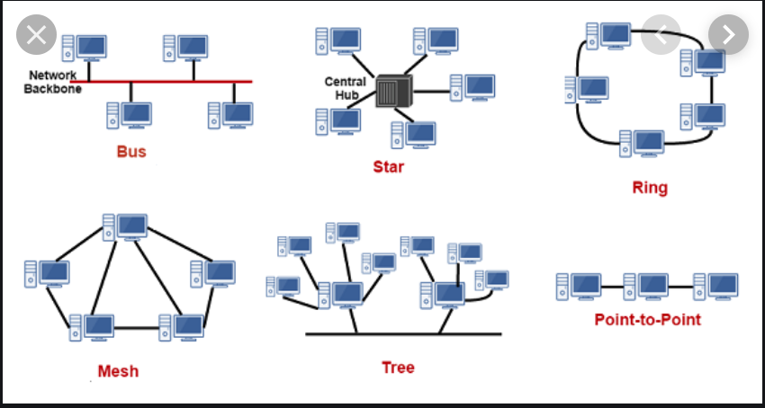
Network topologies

Slide 50
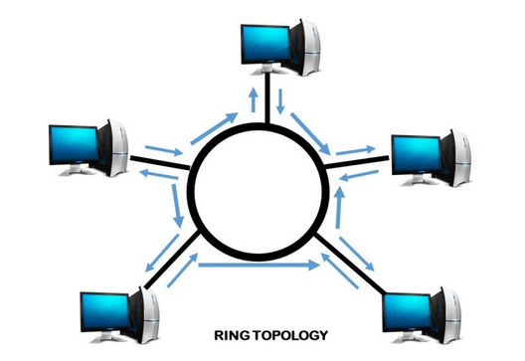
Network topologies
Ring Topology
Ring topology, also known as Ring network, is a type of network topology where each node is exactly connected to two other nodes, forward and backward, thus forming a single continuous path for signal transmission.
Advantages of Ring topology:
Reduced chances of data collision as each node release a data packet after receiving the token.
Token passing makes ring topology perform better than bus topology under heavy traffic
No need of server to control connectivity among the nodes
Equal access to the resources
Disadvantages of Ring topology:
In Unidirectional Ring, a data packet must pass through all the nodes.

Slide 51
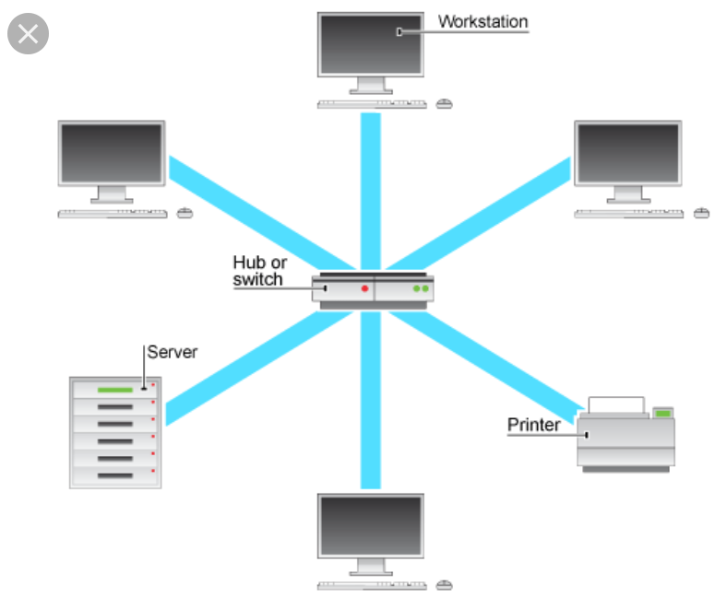
Network topologies
Star Topology
What is Star topology?
In Star topology, all the components of network are connected to the central device called “hub” which may be a hub, a router or a switch.
Unlike Bus topology (discussed earlier), where nodes were connected to central cable, here all the workstations are connected to central device with a point-to-point connection. So it can be said that every computer is indirectly connected to every other node by the help of “hub”.
Advantages of Star Topology
1) As compared to Bus topology it gives far much better performance, signals don’t necessarily get transmitted to all the workstations. A sent signal reaches the intended destination after passing through no more than 3-4 devices and 2-3 links. Performance of the network is dependent on the capacity of central hub.
2) Easy to connect new nodes or devices. In star topology new nodes can be added easily without affecting rest of the network. Similarly components can also be removed easily.
3) Centralized management. It helps in monitoring the network.
4) Failure of one node or link doesn’t affect the rest of network. At the same time its easy to detect the failure and troubleshoot it.
Disadvantages of Star Topology
1) Too much dependency on central device has its own drawbacks. If it fails whole network goes down.
2) The use of hub, a router or a switch as central device increases the overall cost of the network.
3) Performance and as well number of nodes which can be added in such topology is depended on capacity of central device.

Slide 52
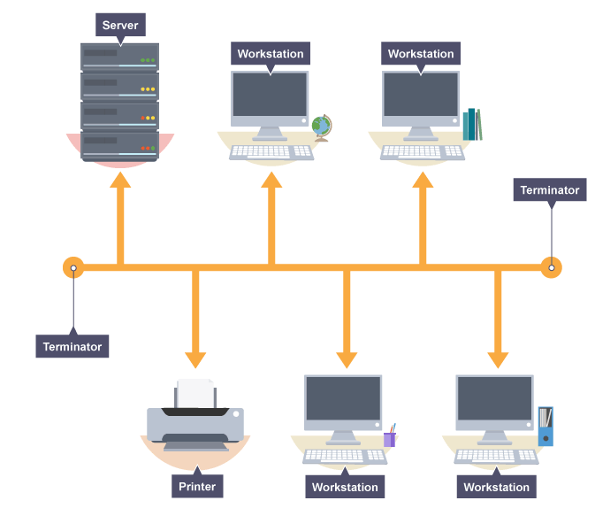
Network topologies
Bus Topology
The bus network
In a bus network all the workstations, servers and printers are joined to one cable (the bus). At each end of the cable a terminator is fitted to stop signals reflecting down the bus.
The advantages of a bus network are:
it is easy to install
it is cheap to install, as it doesn't require much cable
The disadvantages of a bus network are:
if the main cable fails or gets damaged the whole network will fail
as more workstations are connected the performance of the network will become slower because of data collisions
every workstation on the network "sees" all the data on the network – this is a security risk

Slide 53
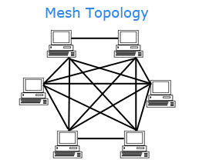
Network topologies
Mesh Topology
The Mesh network
A network setup where each computer and network device is interconnected with one another, allowing for most transmissions to be distributed even if one of the connections go down. It is a topology commonly used for wireless networks.
Advantages of a mesh topology
Manages high amounts of traffic, because multiple devices can transmit data simultaneously.
A failure of one device does not cause a break in the network or transmission of data.
Adding additional devices does not disrupt data transmission between other devices.
Disadvantages of a mesh topology
The cost to implement is higher than other network topologies, making it a less desirable option.
Building and maintaining the topology is difficult and time consuming.
The chance of redundant connections is high, which adds to the high costs and potential for reduced efficiency.

Slide 54
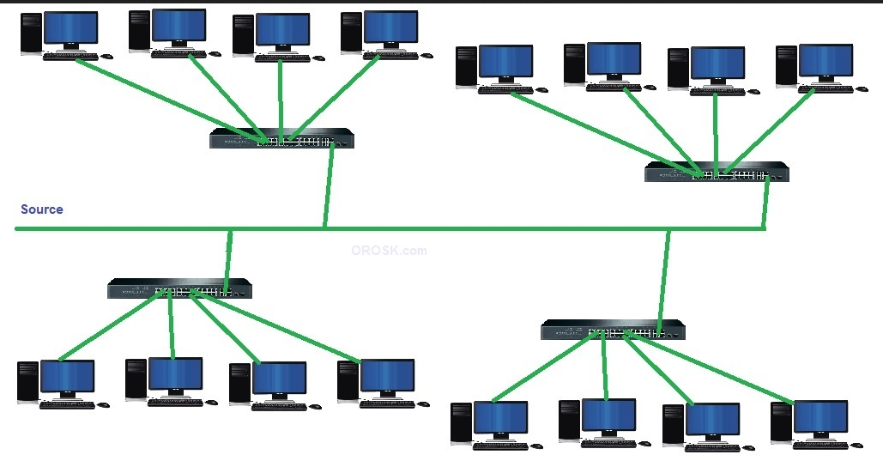
Network topologies
Tree Topology
A tree topology is a combination of a star network topology and a bus topology. In tree topology, nodes of the underlying bus network topology are replaced with a complete star topology.
Advantages of tree topology:
Scalable as leaf nodes can accommodate more nodes in the hierarchical chain.
A point to point wiring to the central hub at each intermediate node of a tree topology represents a node in the bus topology
Other hierarchical networks are not affected if one of them gets damaged
Easier maintenance and fault finding
Disadvantages of tree topology:
Huge cabling is needed
A lot of maintenance is needed
backbone forms the point of failure.

Slide 55
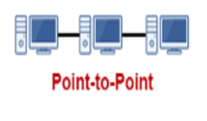
Network topologies
Point-to-Point Topology
While mesh and star networks are used to connect multiple ‘things’ to a network, point-to-point topology is used to connect two things together.
The advantage of point-to-point network topology is that it is much simpler than mesh or star, because the topology simply tunnels a flow of data either unidirectionally or bidirectionally between two points.
The disadvantage is that point-to-point networks are not very useful for IoT. They are still used in some SCADA systems, traffic data systems, or in point-to-point broadcast systems (like police or fire radios), but it rarely makes sense in IoT to have a receiver talk to a single node instead of multiple nodes.

Slide 56
Internet Protocol version 4 (IPv4)

Slide 57
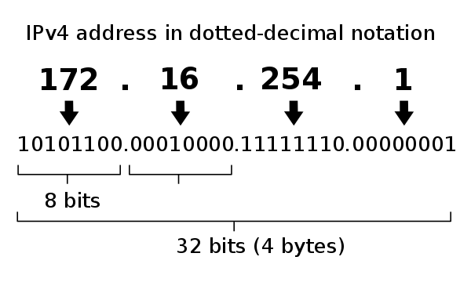
Understand IPv4
Internet Protocol version 4 (IPv4) is the fourth version of the Internet Protocol (IP). It is one of the core protocols of standards-based internetworking methods in the Internet and other packet-switched networks. IPv4 was the first version deployed for production in the ARPANET in 1983.
IPv4 uses 32-bit addresses which limits the address space to 4294967296 (2³²) addresses.
IPv4 reserves special address blocks for private networks and multicast addresses
They are most often written in dot-decimal notation, which consists of four octets of the address expressed individually in decimal numbers and separated by periods.

Slide 58
Understand IPv4
What is an IP address and how does it work?
 |  | 192 | 224 | 240 | 248 | 252 | 254 | 255
 | 128 | 64 | 32 | 16 | 8 | 4 | 2 | 1
1/0
N-2 | 2 | 4 | 8 | 16 | 32 | 64 | 128 | 256
H-2 | 256 | 128 | 64 | 32 | 16 | 8 | 4 | 2
C/24 | /25 | /26 | /27 | /28 | /29 | /30 | /31 | /32

Slide 59
Understand IPv4
What is an IP address and how does it work?
 |  | 192 | 224 | 240 | 248 | 252 | 254 | 255
 | 128 | 64 | 32 | 16 | 8 | 4 | 2 | 1
1/0
N-2 | 2 | 4 | 8 | 16 | 32 | 64 | 128 | 256
H-2 | 256 | 128 | 64 | 32 | 16 | 8 | 4 | 2
C/24 | /25 | /26 | /27 | /28 | /29 | /30 | /31 | /32
Lets say out IP address is 192.168.0.25
We have 4 octets
192
168
0
25
Each octet is converted to binary individually.

Slide 60
Understand IPv4
Converting IP to Binary
We will start with 192
192 |  | 192 | 224 | 240 | 248 | 252 | 254 | 255
 | 128 | 64 | 32 | 16 | 8 | 4 | 2 | 1
1/0 | 1 | 1 | 0 | 0 | 0 | 0 | 0 | 0
N-2 | 2 | 4 | 8 | 16 | 32 | 64 | 128 | 256
H-2 | 256 | 128 | 64 | 32 | 16 | 8 | 4 | 2
C/24 | /25 | /26 | /27 | /28 | /29 | /30 | /31 | /32
The first question is: Can 128 go into 192? (Yes or no not
how many times)
Answer is yes. So we add a 1 in the block below 128.
Next, what’s left over?
Answer: 64
Will 64 go into 64?
Answer: Yes, So we add a 1 in the block below 64
What’s left over?
Answer: 0 so all other blocks are 0
The binary conversion for 192 = 11000000

Slide 61
Understand IPv4
Next, we convert 168
168 |  | 192 | 224 | 240 | 248 | 252 | 254 | 255
 | 128 | 64 | 32 | 16 | 8 | 4 | 2 | 1
1/0 | 1 | 0 | 0 | 1 | 1 | 0 | 0 | 0
N-2 | 2 | 4 | 8 | 16 | 32 | 64 | 128 | 256
H-2 | 256 | 128 | 64 | 32 | 16 | 8 | 4 | 2
C/24 | /25 | /26 | /27 | /28 | /29 | /30 | /31 | /32
The first question is: Can 128 go into 168? (Yes or no not
how many times)
Answer is yes. So we add a 1 in the block below 128.
Next, what’s left over? Answer: 24
Will 64 go into 24? Answer: no, So we add a 0 in the block below 64
What’s left over? 24
Will 32 go into 24? Answer: No, so add a 0 to the 32 block.
Will 16 go into 24? Answer: Yes, so add a 1 below the 16 block.
What is let over? 8
Will 8 go into 8? Answer: Yes, so add a 1 to the 8 block.
What is left over? Nothing, so add 0’s to all other blocks
The binary conversion for 168 = 10011000

Slide 62
Understand IPv4
Next, we convert 0
 |  | 192 | 224 | 240 | 248 | 252 | 254 | 255
0 | 128 | 64 | 32 | 16 | 8 | 4 | 2 | 1
1/0 | 0 | 0 | 0 | 0 | 0 | 0 | 0 | 0
N-2 | 2 | 4 | 8 | 16 | 32 | 64 | 128 | 256
H-2 | 256 | 128 | 64 | 32 | 16 | 8 | 4 | 2
C/24 | /25 | /26 | /27 | /28 | /29 | /30 | /31 | /32
Will 192 go into 0? No, add 0 to the block
Will 64 go into 0? No, add 0 to the block
And so on.
The binary conversion for 0 = 00000000

Slide 63
Understand IPv4
Next, we convert 25
25 |  | 192 | 224 | 240 | 248 | 252 | 254 | 255
 | 128 | 64 | 32 | 16 | 8 | 4 | 2 | 1
1/0 | 0 | 0 | 0 | 1 | 1 | 0 | 0 | 1
N-2 | 2 | 4 | 8 | 16 | 32 | 64 | 128 | 256
H-2 | 256 | 128 | 64 | 32 | 16 | 8 | 4 | 2
C/24 | /25 | /26 | /27 | /28 | /29 | /30 | /31 | /32
The first question is: Can 128 go into 25? (Yes or no not
how many times)
Answer is No. So we add a 0 in the block below 128.
Next, what’s left over? Answer: 25
Will 64 go into 25? Answer: no, So we add a 0 in the block below 64
What’s left over? 25
Will 32 go into 25? Answer: No, so add a 0 to the 32 block.
Will 16 go into 25? Answer: Yes, so add a 1 below the 16 block.
What is let over? 9
Will 8 go into 9? Answer: Yes, so add a 1 to the 8 block.
What is left over? 1
Will 4 go into 1? No, so add a 0 to the 4 block.
Will 2 go into 1? No, so add a 0 to the 2 block.
Will 1 go into 1? Yes, so add a 1 below the 16 block.
The binary conversion for 25 = 00011001

Slide 64
Understand IPv4
Final Binary conversion is:
 |  | 192 | 224 | 240 | 248 | 252 | 254 | 255
 | 128 | 64 | 32 | 16 | 8 | 4 | 2 | 1
1/0
N-2 | 2 | 4 | 8 | 16 | 32 | 64 | 128 | 256
H-2 | 256 | 128 | 64 | 32 | 16 | 8 | 4 | 2
C/24 | /25 | /26 | /27 | /28 | /29 | /30 | /31 | /32
192 | 168 | 0 | 25
1100000 | 10011000 | 00000000 | 0001100

Slide 65
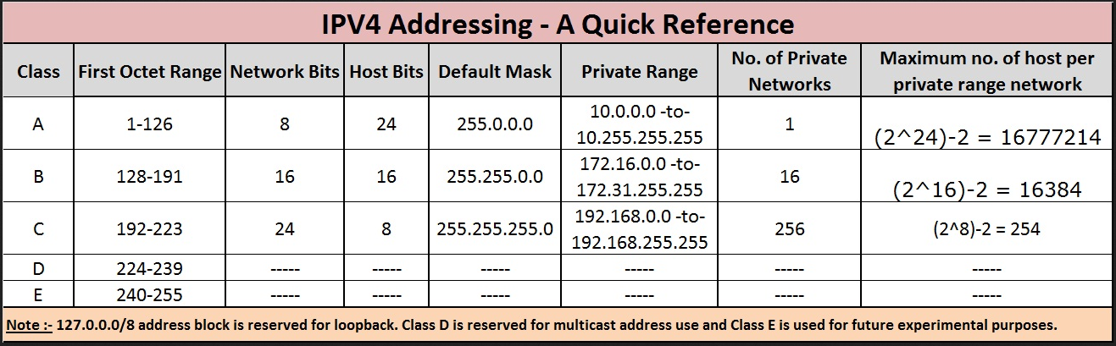
IP Addressing IPv4

Slide 66
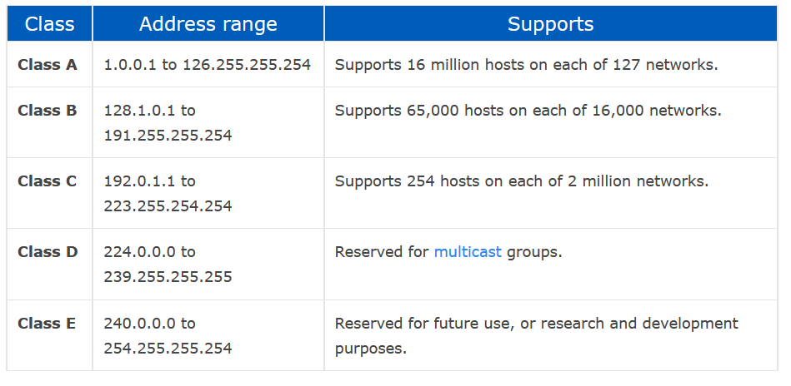
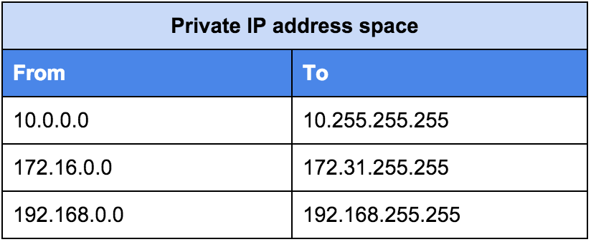
Understanding TCP/IP
Reserved address ranges for local use (including local loopback IP), protocols

Slide 67
Understanding TCP/IP local loopback IPs
A loopback address is a type of IP address that is used to test the communication or transportation medium on a local network card and/or for testing network applications. Data packets sent on a loopback address are re-routed back to the originating node without any alteration or modification.
In IPv4, 127.0.0.1 is the most commonly used loopback address
In IPv6, ::1/128 is the loopback address of choice.

Slide 68
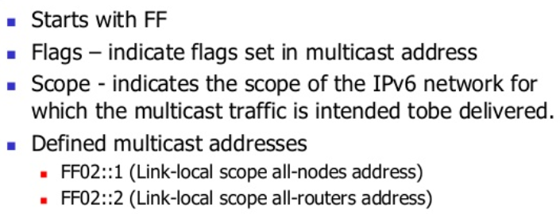
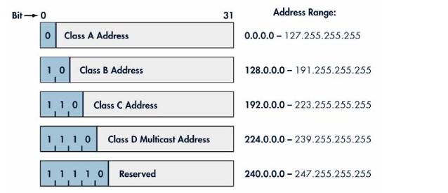
Understanding TCP/IP
Multicast Addresses
A multicast address is a logical identifier for a group of hosts in a computer network that are available to process datagrams or frames intended to be multicast for a designated network service.

Slide 69
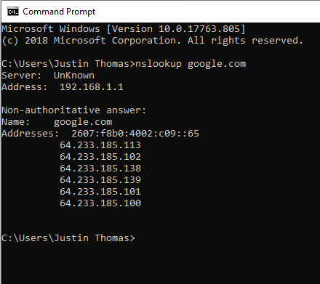
Understanding TCP/IP
NSLOOKUP
This command identifies which DNS server the computer is currently configured to use for its DNS lookups.
NsLookup queries the specified DNS server and retrieves the requested records that are associated with the domain name you provided.
These records contain information like the domain name’s IP addresses.

Slide 70
IP Addressing IPv4
Loopback IP Addresses
The IP address range 127.0.0.0 – 127.255.255.255 is reserved for loopback, i.e. a Host’s self-address, also known as localhost address. This loopback IP address is managed entirely by and within the operating system. Loopback addresses, enable the Server and Client processes on a single system to communicate with each other. When a process creates a packet with destination address as loopback address, the operating system loops it back to itself without having any interference of NIC.
Data sent on loopback is forwarded by the operating system to a virtual network interface within operating system. This address is mostly used for testing purposes like client-server architecture on a single machine. Other than that, if a host machine can successfully ping 127.0.0.1 or any IP from loopback range, implies that the TCP/IP software stack on the machine is successfully loaded and working.
Remember most common loopback address for IPv4 is 127.0.0.1

Slide 71
IP Addressing IPv4
Link-local Addresses
In case a host is not able to acquire an IP address from the DHCP server and it has not been assigned any IP address manually, the host can assign itself an IP address from a range of reserved Link-local addresses. Link local address ranges from 169.254.0.0 -- 169.254.255.255.
Assume a network segment where all systems are configured to acquire IP addresses from a DHCP server connected to the same network segment. If the DHCP server is not available, no host on the segment will be able to communicate to any other.
Windows (98 or later), and Mac OS (8.0 or later) supports this functionality of self-configuration of Link-local IP address.
In absence of DHCP server, every host machine randomly chooses an IP address from the above-mentioned range and then checks to ascertain by means of ARP, if some other host also has not configured itself with the same IP address. Once all hosts are using link local addresses of same range, they can communicate with each other.
Remember the Link-local address is also known as an APIPA and starts with 169.x.x.x

Slide 72
Understand Numbering Systems for IPv4 and IPv6
 | 128 | 64 | 32 | 16 | 8 | 4 | 2 | 1
Hex | Binary |  | Decimal
0 | 0 |  | 0
1 | 1 |  | 1
2 | 10 |  | 2
3 | 11 |  | 3
4 | 100 |  | 4
5 | 101 |  | 5
6 | 110 |  | 6
7 | 111 |  | 7
8 | 1000 |  | 8
9 | 1001 |  | 9
A | 1010 |  | 10
B | 1011 |  | 11
C | 1100 |  | 12
D | 1101 |  | 13
E | 1110 |  | 14
F | 1111 |  | 15

Slide 73
Internet Protocol version 6 (IPv6)

Slide 74
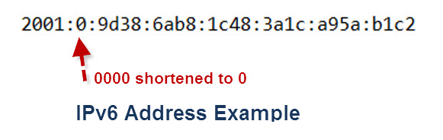
Understand IPv6
Internet Protocol version 6 (IPv6) is the most recent version of the Internet Protocol (IP), the communications protocol that provides an identification and location system for computers on networks and routes traffic across the Internet.
The length of an IPv6 address is 128 bits, compared with 32 bits in IPv4.[
Supports source and destination addresses that are 128 bits (16 bytes) long
Hexadecimal instead of Binary

Slide 75
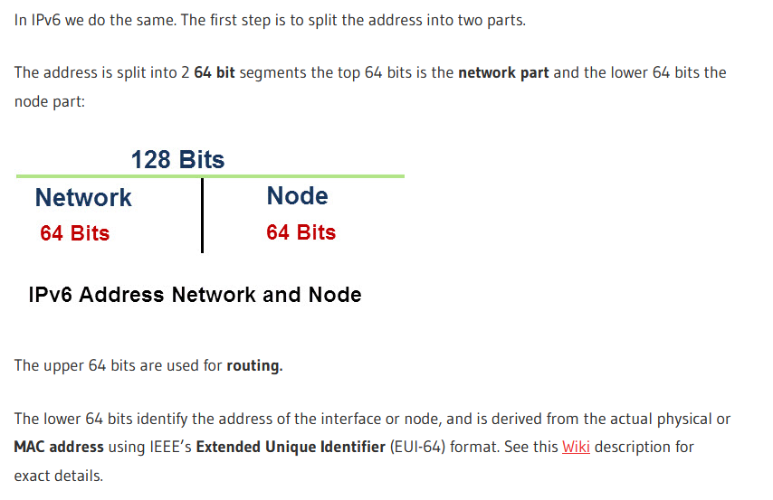
Understand IPv6

Slide 76
IP Addressing IPv6
fe80::/10 This is a link-local prefix offered by IPv6. This address prefix signifies that the address is valid only in the local physical link.
ff00::/8 This prefix is offered by IPv6 to denote the multicast addresses.
::1/128 or ::1 This is called the loop back address and is used to refer to the local host. An application sending a packet to this address will get the packet back after it is looped back by the IPv6 stack.
Unicast addresses: A Unicast address acts as an identifier for a single interface. An IPv6 packet sent to a Unicast address is delivered to the interface identified by that address.
Multicast addresses: A Multicast address acts as an identifier for a group/set of interfaces that may belong to the different nodes. An IPv6 packet delivered to a Multicast address is delivered to the multiple interfaces.
Anycast addresses: Anycast addresses act as identifiers for a set of interfaces that may belong to the different nodes. An IPv6 packet destined for an Anycast address is delivered to one of the interfaces identified by the address.

Slide 77
Subnetting Basics

Slide 78
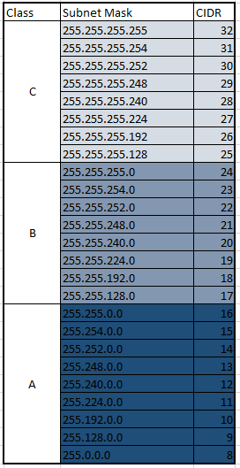
Understand Subnets
Subnetting is the process of diving a network into small networks and is a common task on IPV4 networks.

Slide 79
Subnetting
Network: 192.168.0.0/24
Broadcast: 192.168.0.255
HostMin: 192.168.0.1
HostMax: 192.168.0.254
Hosts: 256
Usable Hosts: 254
192.168.0.0/26
Broadcast: 192.168.0.63
HostMin: 192.168.0.1
HostMax: 192.168.0.62
Hosts: 64
Usable Hosts: 62
Network: 192.168.0.64/26
Broadcast: 192.168.0.127
HostMin: 192.168.0.65
HostMax: 192.168.0.126
Hosts: 64
Usable Hosts: 62
Network: 192.168.0.128/26
Broadcast: 192.168.0.191
HostMin: 192.168.0.129
HostMax: 192.168.0.190
Hosts: 64
Usable Hosts: 62
Network: 192.168.0.0/25
Broadcast: 192.168.0.127
HostMin: 192.168.0.1
HostMax: 192.168.0.126
Hosts: 128
Usable Hosts: 126
Network: 192.168.0.128/25
Broadcast: 192.168.0.255
HostMin: 192.168.0.129
HostMax: 192.168.0.254
Hosts: 128
Usable Hosts: 126
Network: 192.168.0.192/26
Broadcast: 192.168.0.255
HostMin: 192.168.0.193
HostMax: 192.168.0.254
Hosts: 64
Usable Hosts: 62

Slide 80
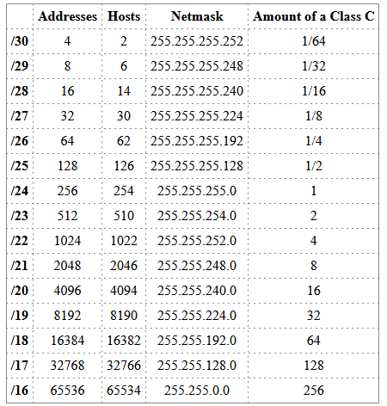
Understand Subnets
Subnetting is the process of diving a network into small networks and is a common task on IPV4 networks.

Slide 81

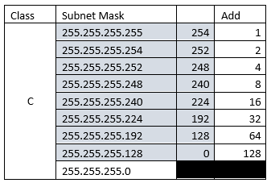
Understand Subnets

Slide 82
Understand IPv4
192 | 168 | 0 | 25 | /25
1100000 | 10011000 | 00000000 | 0001100
Binary conversion for Subnets:
 |  | 192 | 224 | 240 | 248 | 252 | 254 | 255
 | 128 | 64 | 32 | 16 | 8 | 4 | 2 | 1
1/0
N-2 | 2 | 4 | 8 | 16 | 32 | 64 | 128 | 256
H-2 | 256 | 128 | 64 | 32 | 16 | 8 | 4 | 2
C/24 | /25 | /26 | /27 | /28 | /29 | /30 | /31 | /32
192.168.0.0/24 | 192.168.0.0
Start Range | 192.168.0.1
End Range | 192.168.0.126
Broadcast | 192.168.0.127
Network | 192.168.0.0/25
Start Range | 192.168.0.1
End Range | 192.168.0.126
Broadcast | 192.168.0.127
Number of Networks | 2
Number of IP addresses | 128
Number of usable IP addresses | 126
Network | 192.168.0.128/25
Start Range | 192.168.0.129
End Range | 192.168.0.254
Broadcast | 192.168.0.255
Number of Networks | 2
Number of IP addresses | 128
Number of usable IP addresses | 126

Slide 83
Switch Basics

Slide 84
Understand switches
Transmission speed
Number and type of ports
Number of uplinks
Speed of uplinks
Managed or unmanaged switches
VLAN capabilities
Layer 2 and Layer 3 switches
Security options
Hardware redundancy
Support
Backplane speed
Switching types and MAC table
Understand capabilities of hubs versus switches
Virtual switches

Slide 85
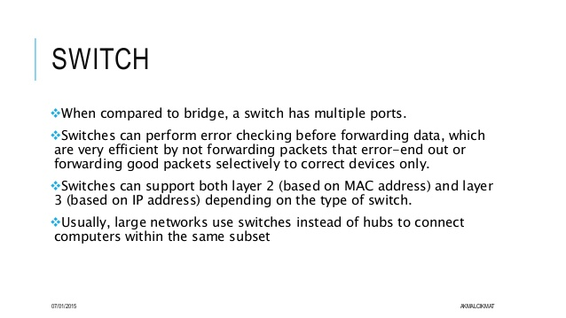
Understand switches

Slide 86
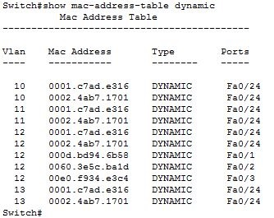
Understand switches
MAC Address Table

Slide 87
Routes a Routing Protocol Basics

Slide 88
Understand Routers
Transmission speed considerations
Directly connected routes
Static routing
Dynamic routing (routing protocols)
RIP vs. OSPF
Default routes
Routing table and how it selects best route(s)
Routing table memory
Network Address Translation (NAT)
Software routing in Windows Server
Installing and configuring routing
Quality of Service (QoS)

Slide 89
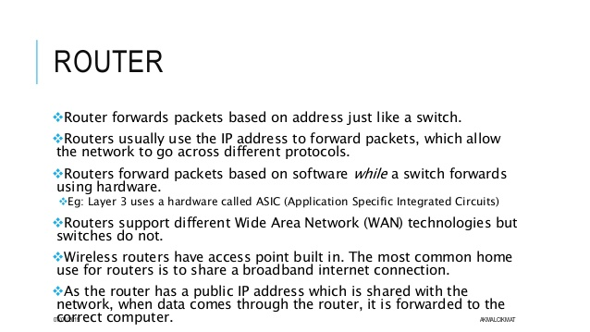
Understand Routers

Slide 90
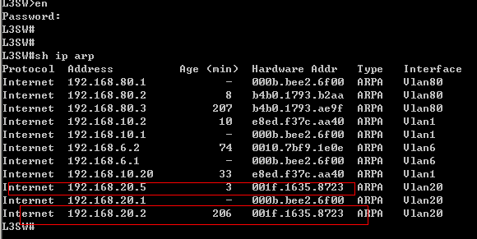
Understand Routers
ARP Table

Slide 91
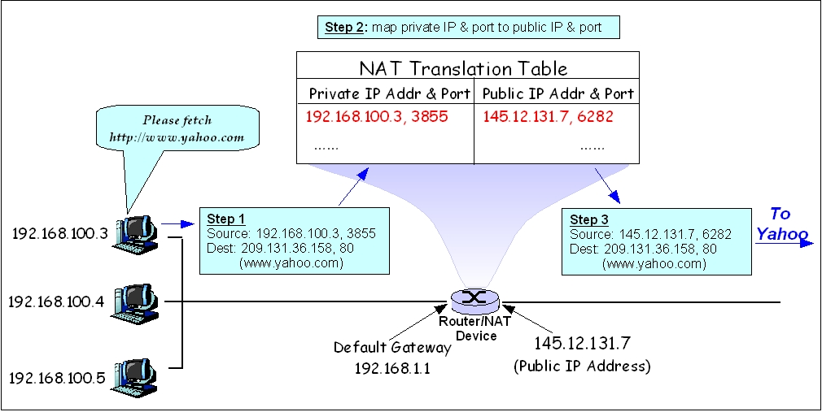
Understand Routers
Network Address Translation (NAT)

Slide 92
Understand Routers
Routing Protocols
Dynamic routing is a networking technique that provides optimal data routing. Unlike static routing, dynamic routing enables routers to select paths according to real-time logical network layout changes. In dynamic routing, the routing protocol operating on the router is responsible for the creation, maintenance and updating of the dynamic routing table. In static routing, all these jobs are manually done by the system administrator.
Dynamic routing uses multiple algorithms and protocols. The most popular are Routing Information Protocol (RIP) and Open Shortest Path First (OSPF).

Slide 93
Understand
Routing Protocols
Routing Information Protocol (RIP)
Routing Information Protocol (RIP) is a protocol that routers can use to exchange network topology information.
Updates of the network are exchanged every 30 seconds
Updates (routing information) are always broadcast.
Full routing tables are sent in updates.
Routers always trust on routing information received from neighbor routers.
Is a type of distance vector routing.
Uses Hop count to determine best route. (Hop Max is 15)
It is characterized as an interior gateway protocol and is typically used in small to medium-sized networks.
When a route is removed from the routing table, it is flagged as unusable by the receiving routers after 180 seconds and removed from their tables after an additional 120 seconds.

Slide 94

Understand
Routing Protocols
Routing Information Protocol (RIP)

Slide 95
Understand Routing Protocols
OSPF (Open Shortest Path First)
OSPF (Open Shortest Path First) is a router protocol used to find the best path for packets as they pass through a set of connected networks.
Using OSPF, a router that learns of a change to a routing table (when it is reconfigured by network staff, for example) or detects a change in the network immediately multicasts the information to all other OSPF hosts in the network so they will all have the same routing table information.
Unlike RIP, which requires routers to send the entire routing table to neighbors every 30 seconds, OSPF sends only the part that has changed and only when a change has taken place.
Rather than simply counting the number of router hops between hosts on a network, as RIP does, OSPF bases its path choices on "link states" that consider additional network information, including IT-assigned cost metrics that give some paths higher assigned costs.

Slide 96


Understand Routing Protocols
OSPF

Slide 97
Media Type Basics

Slide 98

Understand Media Types
Cable types and their characteristics
Including media segment length and speed
Fiber optic
Twisted pair shielded or unshielded; Catxx cabling

Slide 99

Understand Media Types

Slide 100


Understand Media Types
RJ-45 Connector
Most common Network Connector

Slide 101


Understand Media Types
(Cable Speeds)

Slide 102
Open Systems Interconnection (OSI) Model

Slide 103

Understand the Open Systems Interconnection (OSI) model
Notes:
TCP CONNECTION BASE W/GAURANTED SERVICE
UDP CONNECTIONLESS, BEST EFFORT

Slide 104

Understand the Open Systems Interconnection (OSI) model
Start
Away
Pizza
Sausage
Throw
Not
Do
Please
All
People
Seem
To
Need
Data
Processing
Start

Slide 105
Ports and Protocols

Slide 106
Port and Protocols
As per its word definition, a protocol is a set of rules. In computer networking, a protocol defines a standard way for computers to exchange information. Most common protocols used in computer networks and the internet are TCP (Transmission Control Protocol), UDP (User Datagram Protocol), and IP (Internet Protocol).
A port in computer networking is a logical access channel for communication between two devices. Bi-directional communications and more complex connections may use multiple ports (channels) simultaneously.
Data on the Internet is organized into standard TCP or UDP packets. Network clients use different ports (or channels) to transfer this data. Generally one port is used to send data and another to receive it, so packets don't collide. The port number (and the destination IP address) is included as part of the header each packet is given. Ports range from 1 to 65535 for the TCP and UDP protocols.
Port numbers are generally divided into three ranges:
1. The Well-Known ports: 0 to 1023
2. The Registered ports: 1024 to 49151
3. The Dynamic and/or Private ports: 49152 to 65535
Note: A list of all IANA assigned port numbers and their associated services can be found on their website. We also maintain a large database of all port assignments, known vulnerabilities, applications that use them and more here: SG Ports database

Slide 107

Port and Protocols

Slide 108

Port and Protocols
How they work.

Slide 109

Port and Protocols

Slide 110
LDAP, DNS, and DHCP Basics

Slide 111
Lightweight Directory Access Protocol (LDAP)
Domain Name System (DNS) & Dynamic Host Naming Protocol (DHCP)
On TCP/IP networks (including the Internet), the domain name system (DNS) is the directory system used to relate the domain name to a specific network address (a unique location on the network).
However, you may not know the domain name. LDAP allows you to search for an individual without knowing where they're located (although additional information will help with the search).
Lightweight Directory Access Protocol is the protocol that Exchange Server uses to communicate with Active Directory.
To really understand what LDAP is and what it does, it is important to understand the basic concept behind Active Directory as it relates to Exchange.
Active Directory contains information regarding every user account on the entire network (among other things). It treats each user account as an object. Each user object also has multiple attributes. An example of an attribute is the user's first name, last name, or e-mail address. All this information exists within a huge, cryptic database on a domain controller (Active Directory). The challenge is to extract information in a usable format. This is LDAP's job.
LDAP uses a relatively simple, string-based query to extract information from Active Directory (and other resources). The nice part is that this all happens behind the scenes. A regular end user will never have to manually perform an LDAP query, because Outlook is LDAP-enabled and knows how perform all the necessary queries on its own.

Slide 112
Domain Name System (DNS)
DNS replaced NetBios.
NetBios resolved NetBIOS names to IP addresses.
DNS Resolves URLs to IP Addresses.

Slide 113
Domain Name System (DNS)
Forward DNS Lookups
The forward lookup, or simple DNS lookup, is the most commonly used approach to DNS.
The forward approach to DNS is simply finding out the IP address of a domain.
People tend to find it difficult to remember long strings of numbers. Instead, it's easier to remember a domain name that uses words.

Slide 114

Domain Name System (DNS)
A Start of Authority record (abbreviated as SOA record) is a type of resource record in the Domain Name System (DNS) containing administrative information about the zone, especially regarding zone transfers.

Slide 115

Domain Name System (DNS)
Name Server records (NS)—specifies that a specific DNS Zone, such as “example.com” is delegated to a specific authoritative name server
IPv4 Address Mapping records (A)—a hostname and its IPv4 address.
IPv6 Address records (AAAA)—a hostname and its IPv6 address.
Canonical Name records (CNAME)—points a hostname to an alias. This is another hostname, which the DNS client is redirected to
Mail exchanger record (MX)—specifies an SMTP email server for the domain.

Slide 116

How Domain Name System (DNS) Lookups work.
Recursive and Iterative

Slide 117
Troubleshooting Domain Name System (DNS)
You ping a server by using fully qualified domain name (FQDN) and do not receive a response.
Notes:
Then you ping the same server by using its IP address and receive a response.
What is the problem?

Slide 118

Generic Top-Level Domains

Slide 119
Domain Name System (DNS)
Reverse DNS Lookup
In a reverse DNS lookup, the steps are the same except that it starts out with an IP address and returns with the domain name.
In actual reality this can take a while and when a DNS is unable to find what it needs whether it is a domain name or an IP address, we end up with the screen we all hate that states “this webpage cannot be found”. This is due to the servers being busy or the web browser timing out.

Slide 120

Understanding DHCP
Dynamic Host Configuration Protocol is a communication protocol that lets network administrators manage centrally and automate the assignment of Internet Protocol addresses in an organization’s network. (basically it frees a network administrator from having to manually configure each host connected to his network)

Slide 121
DHCP must
Guarantee unique network address. (Address Reservations or Assignment)
Retain DHCP client configuration across a client reboot.
Allow automated assignment of configuration parameters to new clients.
Support fixed allocation of configuration parameters to specific clients.
Exclusion of addresses that are already in use or set statically. (Address Exclusion)
When a client's DHCP-issued address expires, the client will attempt to get another IP address by broadcasting using the DORA process

Slide 122

DORA Process

Slide 123
Understanding TCP/IP
  Tools ping
    tracert
    Pathping
    Telnet
    Ipconfig
    Netstat
    reserved address ranges for local use (including local loopback IP), protocols

Slide 124
Network Command Line Tools

Slide 125

Understanding TCP/IP
TRACERT or Traceroute
The TRACERT diagnostic utility determines the route to a destination by sending Internet Control Message Protocol (ICMP) echo packets to the destination.
In these packets, TRACERT uses varying IP Time-To-Live (TTL) values. Because each router along the path is required to decrement the packet's TTL by at least 1 before forwarding the packet, the TTL is effectively a hop counter.
When the TTL on a packet reaches zero (0), the router sends an ICMP "Time Exceeded" message back to the source computer.

Slide 126

Understanding TCP/IP
Ping
The ping command is a Command Prompt command used to test the ability of the source computer to reach a specified destination computer (Host Self-test).
The ping command is usually used as a simple way to verify that a computer can communicate over the network with another computer or network device. (Network Connectivity)

Slide 127

Understanding TCP/IP
Ping (Continued)

Slide 128

Understanding TCP/IP
PATHPING
Pathping is a TCP/IP based utility (command-line tool) that provides useful information about network latency and network loss at intermediate hops between a source address and a destination address.
It does this by sending echo requests via ICMP and analyzing the results.

Slide 129

Understanding TCP/IP
NETSTAT
The netstat command, meaning network statistics, is a Command Prompt command used to display very detailed information about how your computer is communicating with other computers or network devices.
Specifically, the netstat command can show details about individual network connections, overall and protocol-specific networking statistics, and much more, all of which could help troubleshoot certain kinds of networking issues.

Slide 130

Understanding TCP/IP
NETSTAT
(Continued)

Slide 131

Understanding TCP/IP
IPCONFIG
In Windows, ipconfig is a console application designed to run from the Windows command prompt.
This utility allows you to get the IP address information of a Windows computer.
It also allows some control overactive TCP/IP connections.
Ipconfig replaced the older winipcfg utility.

Slide 132

Understanding TCP/IP
This utility allows you to get the IP address information all network adapters of a Windows computer.
Allows you to release the IP address
Allows you to renew the IP address
IPCONFIG /ALL
IPCONFIG /Release
IPCONFIG /Renew

Slide 133
VLAN Basics

Slide 134
VLANS
A VLAN (virtual LAN) is a subnetwork which can group together collections of devices on separate physical local area networks (LANs).
Advantages of VLANs
They reduce the number of nodes in a broadcast domain
They compartmentalize and reduce traffic. (Departments instead of floors)
Act Like they are on the same LAN regardless of physical location.
Allowed on both layer 2 and layer 3 switches
They increase the number of broadcast domains will reducing the size of each broadcast domain.

Slide 135


VLANS

Slide 136


VLANS

Slide 137
The end any questions?

