Slide 1
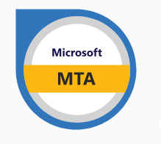

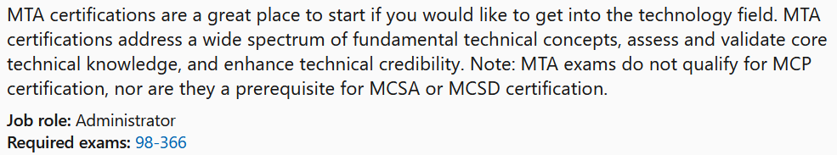

MTA 98-366
Instructor:
Justin Thomas

Slide 2
Switch Basics

Slide 3
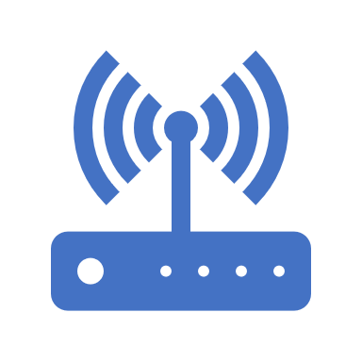
Understand switches
Transmission speed
Number and type of ports
Number of uplinks
Speed of uplinks
Managed or unmanaged switches
VLAN capabilities
Layer 2 and Layer 3 switches
Switching types and MAC table
Virtual switches

Slide 4
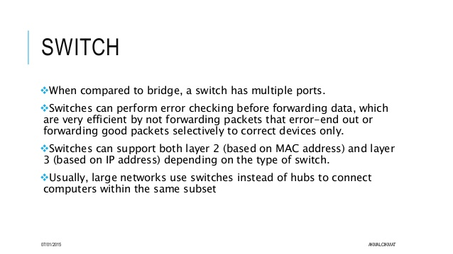
Understand switches

Slide 5
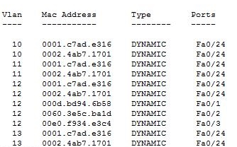
Understand switches
MAC Address Table

Slide 6
Routers & Routing Protocol Basics

Slide 7
Understand Routers
Transmission speed considerations
Directly connected routes
Static routing
Dynamic routing (routing protocols)
RIP vs. OSPF
Default routes
Routing table and how it selects best route(s)
Routing table memory
Network Address Translation (NAT)
Software routing in Windows Server
Installing and configuring routing
Quality of Service (QoS)

Slide 8
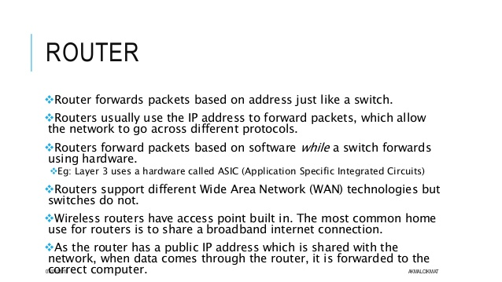
Understand Routers

Slide 9
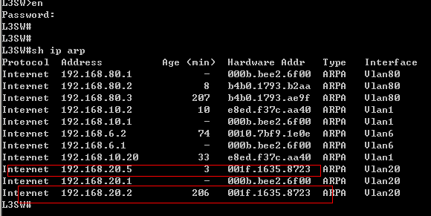
Understand Routers
ARP Table

Slide 10
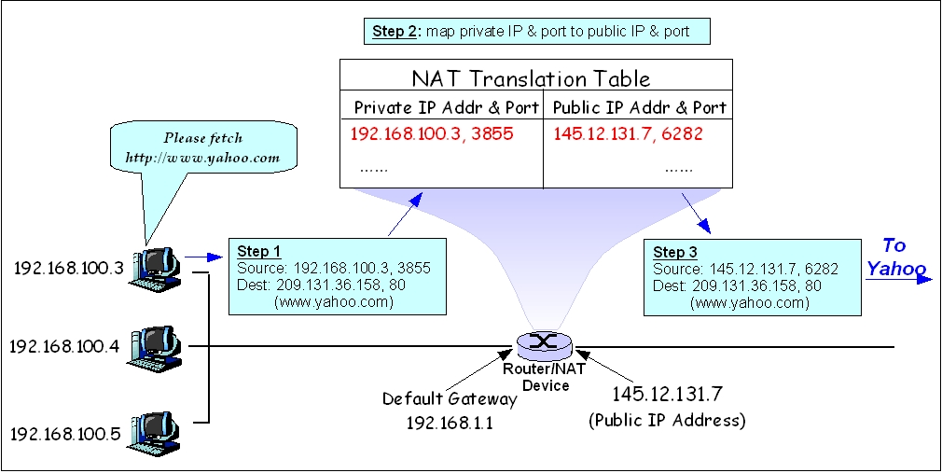
Understand Routers
Network Address Translation (NAT)

Slide 11
Understand Routers
Routing Protocols
Dynamic routing is a networking technique that provides optimal data routing. Unlike static routing, dynamic routing enables routers to select paths according to real-time logical network layout changes. In dynamic routing, the routing protocol operating on the router is responsible for the creation, maintenance and updating of the dynamic routing table. In static routing, all these jobs are manually done by the system administrator.
Dynamic routing uses multiple algorithms and protocols. The most popular are Routing Information Protocol (RIP) and Open Shortest Path First (OSPF).

Slide 12

Understand
Routing Protocols
Routing Information Protocol (RIP)
Routing Information Protocol (RIP) is a protocol that routers can use to exchange network topology information.
Updates of the network are exchanged every 30 seconds
Updates (routing information) are always broadcast.
Full routing tables are sent in updates.
Routers always trust on routing information received from neighbor routers.
Is a type of distance vector routing.
Uses Hop count to determine best route. (Hop Max is 15)
It is characterized as an interior gateway protocol and is typically used in small to medium-sized networks.
When a route is removed from the routing table, it is flagged as unusable by the receiving routers after 180 seconds and removed from their tables after an additional 120 seconds.

Slide 13
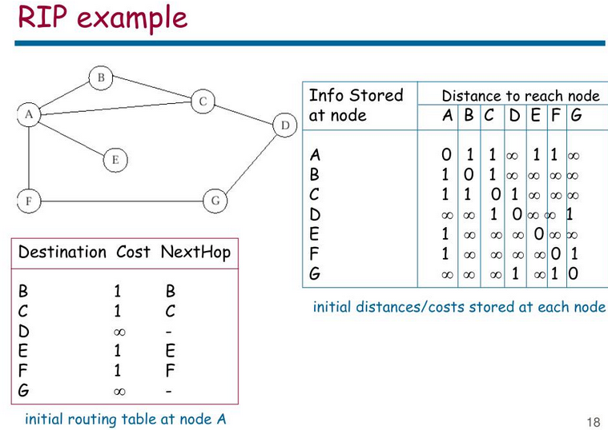
Understand
Routing Protocols
Routing Information Protocol (RIP)

Slide 14
Understand Routing Protocols
OSPF (Open Shortest Path First)
OSPF (Open Shortest Path First) is a router protocol used to find the best path for packets as they pass through a set of connected networks.
Using OSPF, a router that learns of a change to a routing table (when it is reconfigured by network staff, for example) or detects a change in the network immediately multicasts the information to all other OSPF hosts in the network so they will all have the same routing table information.
Unlike RIP, which requires routers to send the entire routing table to neighbors every 30 seconds, OSPF sends only the part that has changed and only when a change has taken place.
Rather than simply counting the number of router hops between hosts on a network, as RIP does, OSPF bases its path choices on "link states" that consider additional network information, including IT-assigned cost metrics that give some paths higher assigned costs.

Slide 15
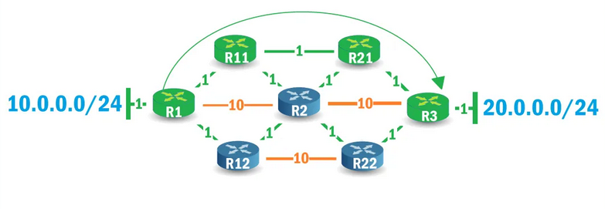
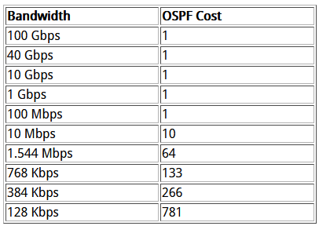
Understand Routing Protocols
OSPF

Slide 16

The end any questions?

