Slide 1
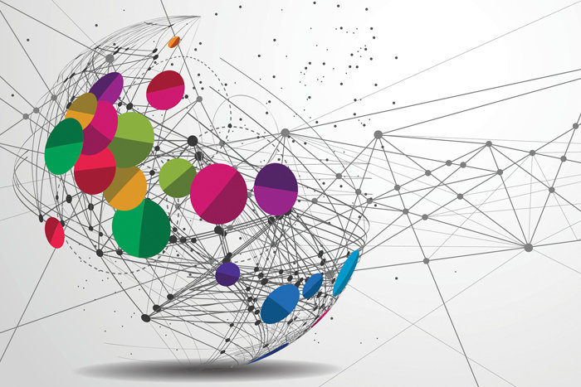
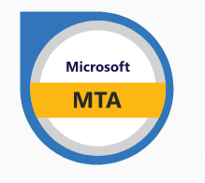
Study Session
Instructor: Justin Thomas

Slide 2
Virtual Private Network (VPN), Firewalls, and Security Zones

Slide 3
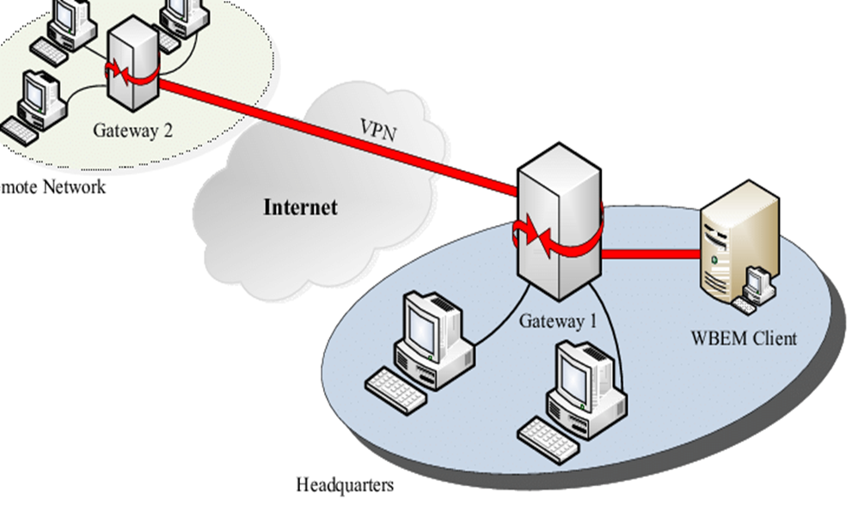
Virtual Private Network (VPN)
A virtual private network (VPN)
extends a private network across a public network and enables users to send and receive data across shared or public networks as if their computing devices were directly connected to the private network.
Applications running on a computing device, e.g., a laptop, desktop, smartphone, across a VPN may therefore benefit from the functionality, security, and management of the private network. Encryption is a common, though not an inherent, part of a VPN connection.

Slide 4
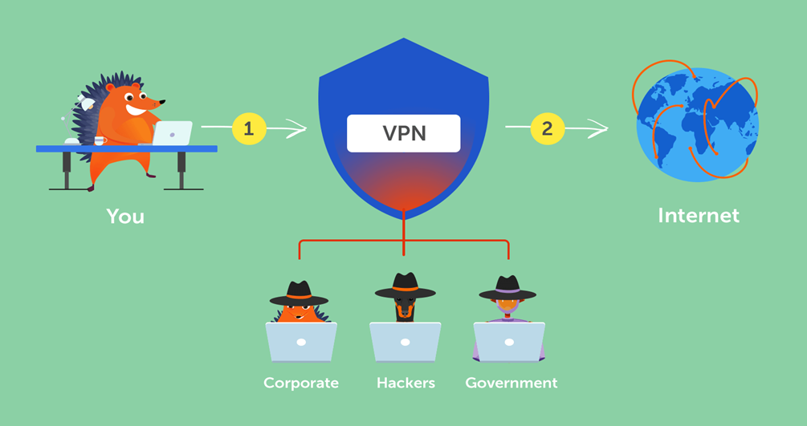
Virtual Private Network (VPN)
Why us a VPN
Access a Business Network While Traveling:
Access Your Home Network While Travelling
Hide Your Browsing Activity from Your Local Network and ISP:
Access Geo-Blocked Websites
Bypass Internet Censorship
Downloading Files

Slide 5
Virtual Private Network (VPN)
Things to know about VPN and how it works.
Uses IPSec to negotiate algorithm and IKE exchange information.
Uses Tunneling Protocols
SSL VPN- Allows connection from anywhere on internet.
Layer 2 Tunneling Protocol- Creates an unsecure connection between networks.
Site To Site VPN- Securely connects two portions of a private network.
Teredo tunneling is a protocol that allows IPv6 connectivity through IPv4 devices.
Uses public infrastructure to create private network.
Direct Connection: Can be used to connect securely to corporate network, without user interaction.

Slide 6
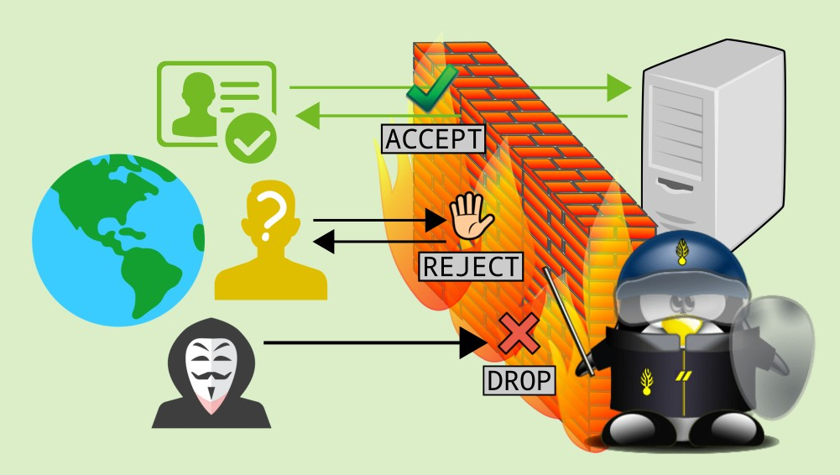
Firewalls

Slide 7
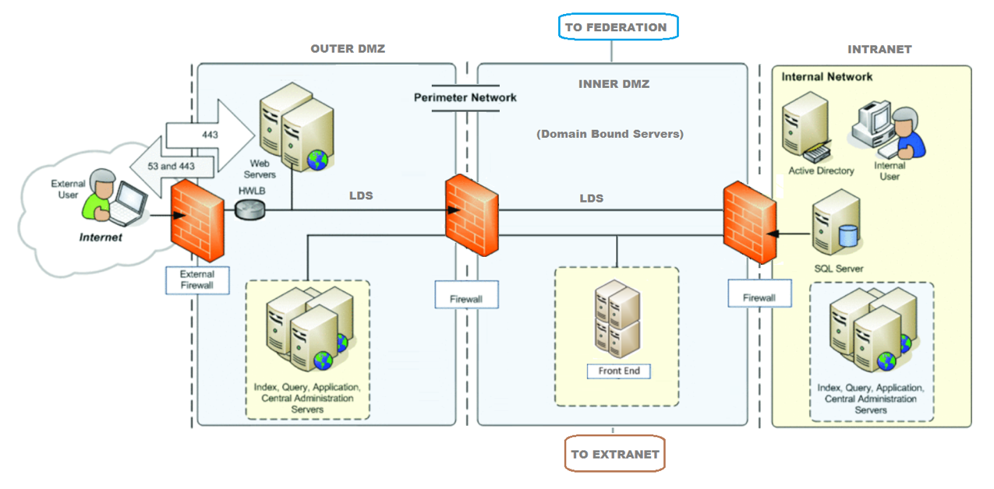
A firewall is a network security device that monitors incoming and outgoing network traffic and decides whether to allow or block specific traffic based on a defined set of security rules.
They establish a barrier between secured and controlled internal networks that can be trusted and untrusted outside networks, such as the Internet.
A firewall can be hardware, software, or both.

Slide 8
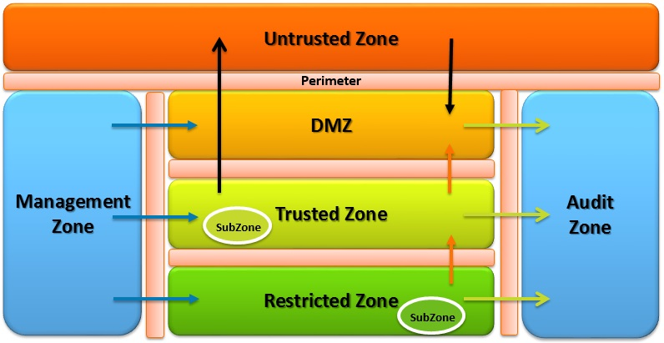
Security zones
Security zones are a logical way to group physical and virtual interfaces on the firewall to control and log the traffic that traverses specific interfaces on your network.
An interface on the firewall must be assigned to a security zone before the interface can process traffic.
A zone can have multiple interfaces of the same type assigned to it (such as tap, layer 2, or layer 3 interfaces), but an interface can belong to only one zone.
Policy rules on the firewall use security zones to identify where the traffic comes from and where it is going.
Traffic can flow freely within a zone but traffic cannot flow between different zones until you define a Security policy rule that allows it.
How do you contain an advanced threat?

Slide 9
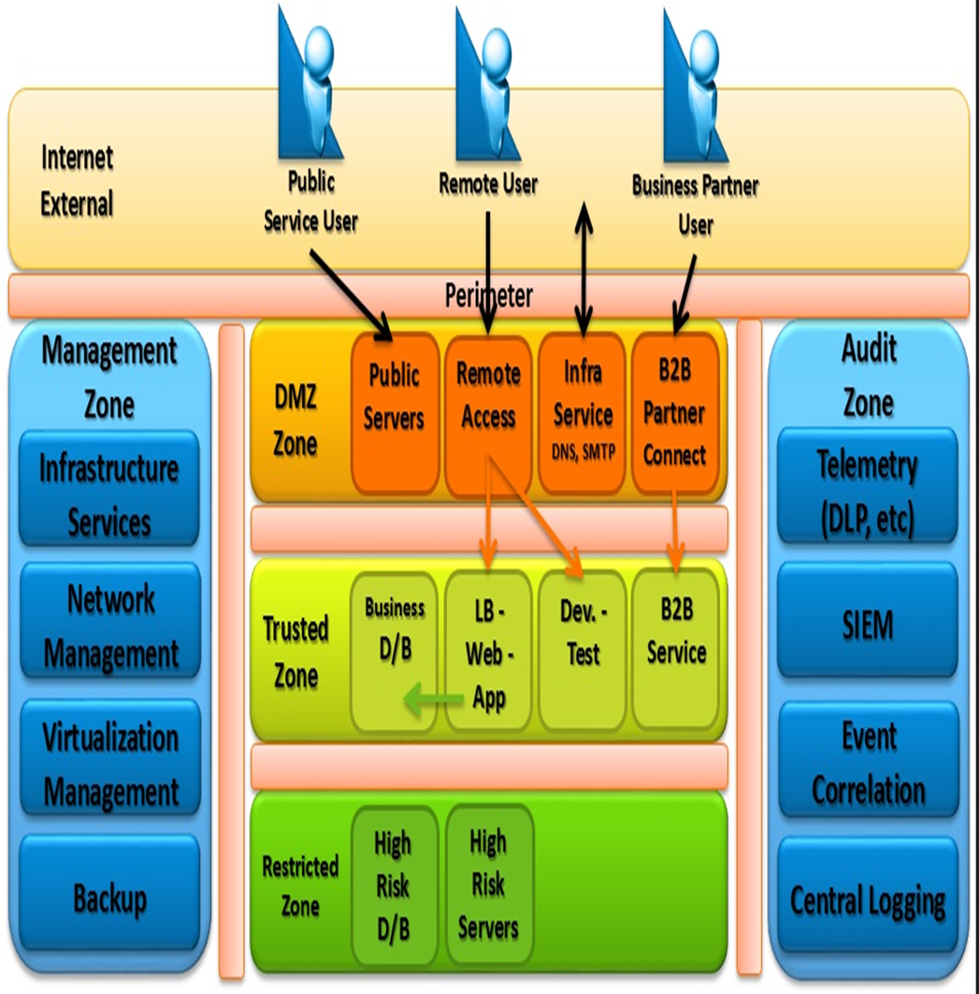
Security zones
How do you contain an advanced threat?

Slide 10
The end any questions?

