Slide 1


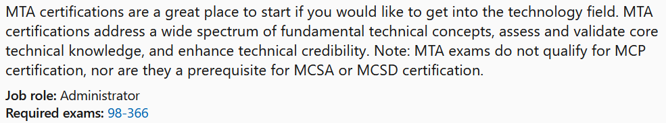

MTA 98-366
Instructor:
Justin Thomas

Slide 2
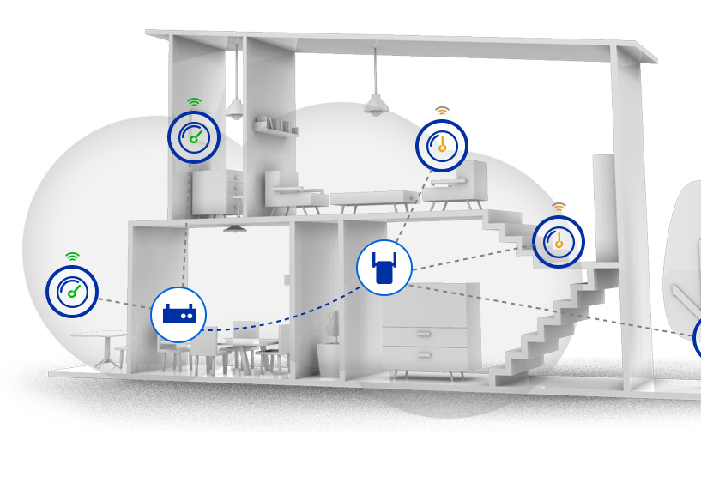
Wireless Fundamentals

Slide 3
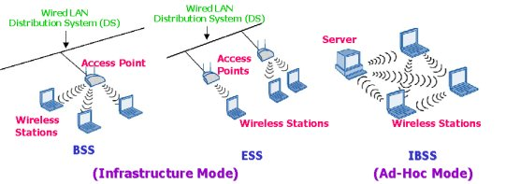
Wireless Networking
Two of the popular networking standards being used are 802.11g and 802.11n
Each of the wireless networking standards has different characteristics, such as speed, distance, frequency, and so on.
WPA (Wi-Fi Protected Access) and WPA2 is more secure than WEP (Wired Equivalent Privacy).
WP-Enterprise and WP2-Enterprise are used in business environments and work with an 802.1X authentication server
The 802.1X authentication method is used in business environments and requires a certificate or smart card for network access.
Most vulnerable type of connection to hacking.
Basis Service Set (BSS)
Extended Service Set (ESS)
Independent Basic Service Set (IBSS) or Peer to Peer

Slide 4
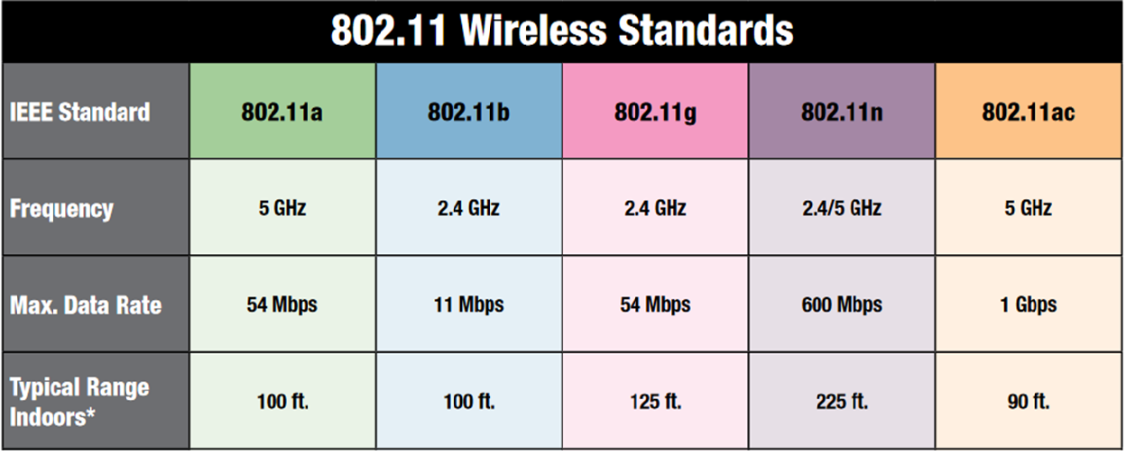
NOTE: The type of connection you are using has the biggest impact on data transmission speed in a wireless network?
Note: 802.11 standards with the same frequency and will establish a connection with one another.
Notes:
Note that 802.11g with the same frequency and will establish a connection with one another.

Slide 5
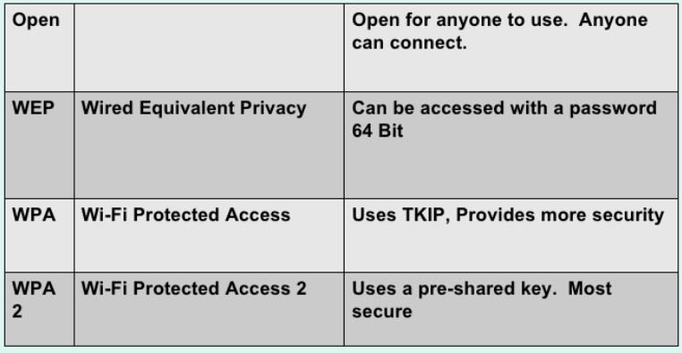
Wireless Networking

Slide 6

Wireless Networking Security
The most common type is Wi-Fi security are:
Wired Equivalent Privacy (WEP)
  Notoriously weak security standard
  802.11b
Wi-Fi Protected Access (WPA).
  Safer than WEP
  802.11a and 802.11b
  Backwards compatible with WEP
WI-FI Protected Access II (WPA 2)
  The most significant changes between WPA and WPA2 is the mandatory use of AES algorithms
  the introduction of CCMP (Counter Cipher Mode with Block Chaining Message Authentication Code Protocol) as a replacement for TKIP.
  TKIP is still preserved in WPA2 as a fallback system and for interoperability with WPA.

Slide 7
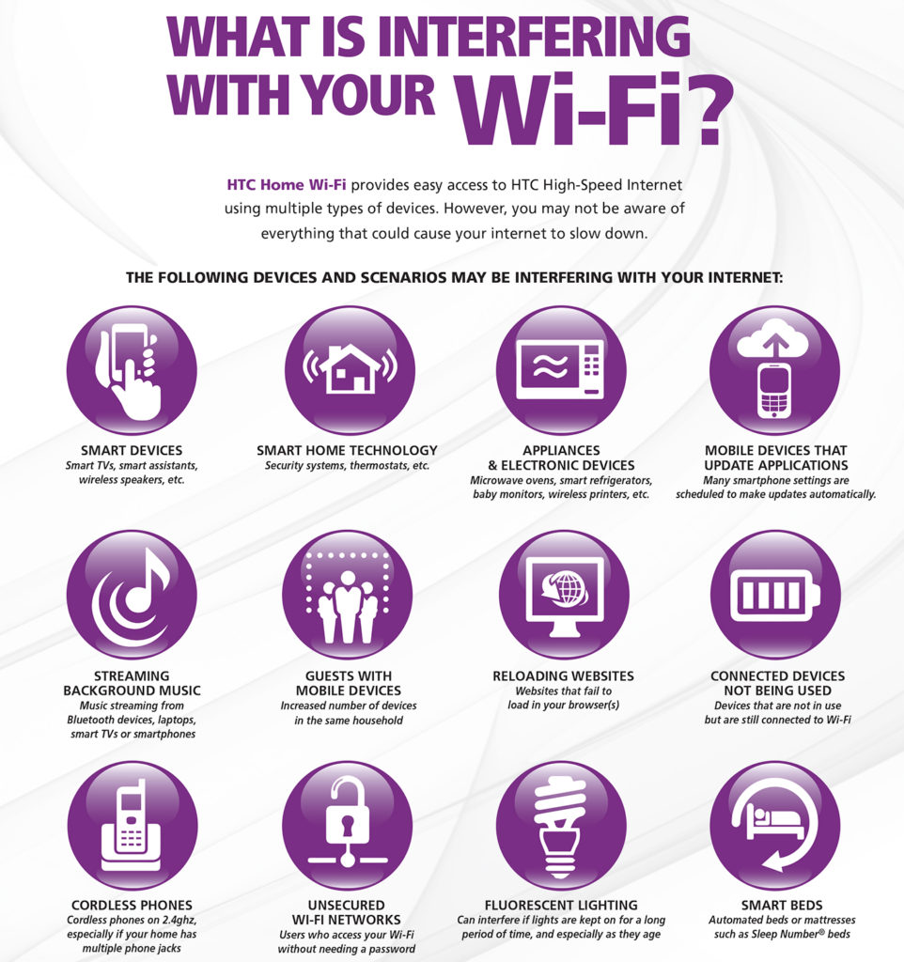
Wireless Networks (Electromagnetic Interference and other reasons for degradation of a WIFI network)
Attenuation in a wireless network signal is a result of the distance from the access point.
Signal Attenuation is a reduction of signal strength during transmission,

Slide 8
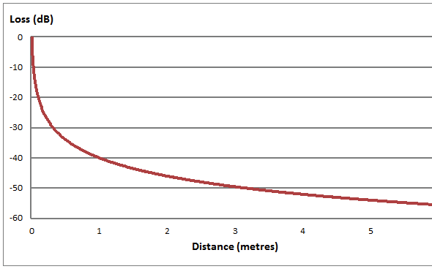
Signal Attenuation is a reduction of signal strength during transmission,
Attenuation in a wireless network signal is directly related to the distance from the signal source.

Slide 9
Wireless Networks (Electromagnetic Interference and other reasons for degradation of a WIFI network)
High vs Low. Having your WiFi router on the floor or behind other objects usually results in noticeably worse performance. Instead, place the router as high up as possible to extend the broadcasting range of the radio waves. This also helps clear the router of possible interferences.
Objects in the way. Materials like concrete, plaster and especially metal tend to be the worst for blocking Wi-Fi waves. Wireless routers broadcast Omni directionally, and the closer you place yours to an obstacle like a brick wall, the more you’ll restrict its signal.
Distance. The further away from your router you get, the weaker the Wi-Fi signal. This is called attenuation Therefore, the best option is to place your router as close to your devices as possible, but this is only practical if you have one main area where you tend to use your devices.

Slide 10
The end any questions?

