Slide 1
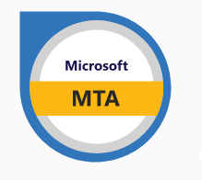

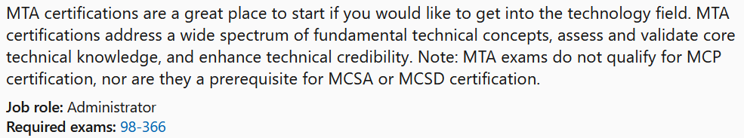

Instructor:
Justin Thomas

Slide 2
Understand the concepts of Internet, intranet, and extranet
Notes:
Hi and welcome to my Microsoft MTA 98-366 Study video series. In this video we will be covering Intra and extranets.

Slide 3

Understand the concepts of Internet, intranet, and extranet
Intranet is shared content accessed by members within a single organization.
Intranet is shared content accessed by members within a single organization.
Extranet is shared content accessed by groups through cross-enterprise boundaries.
Internet is global communication accessed through the Web.

Slide 4

Intranets
Network within an organization that uses Internet protocols and technologies for:
  Collecting, storing, and disseminating useful information that supports business activities
Otherwise known as corporate portals
Facilitates internal use by employees
  Companies also allow trusted business partners to access their intranets

Slide 5
Intranets
Uses Internet technologies to solve organizational problems
Different from an LAN
Defining and limiting access is important for security reasons

Slide 6

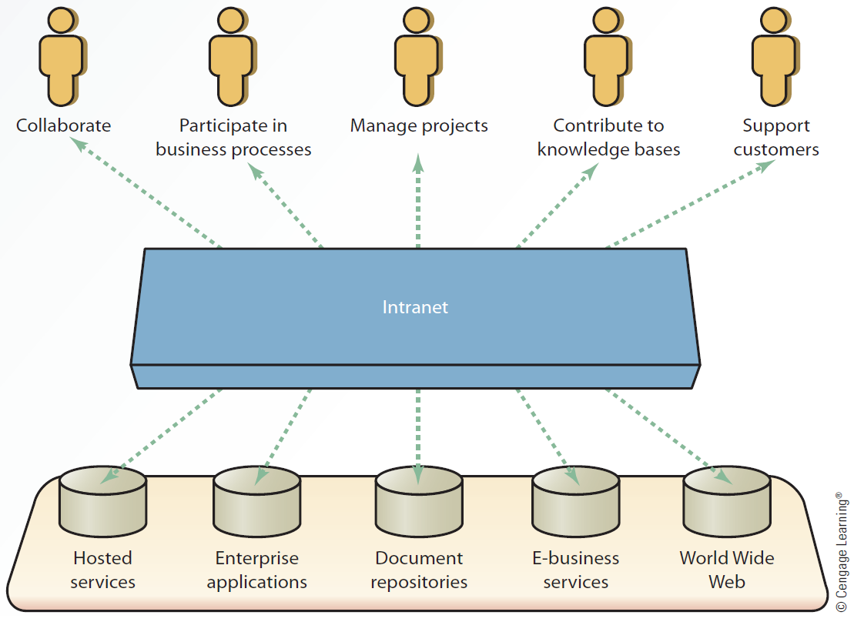
Simple Intranet
Architecture

Slide 7
Extranets
Secure network that:
  Uses the Internet and Web technologies to connect intranets of business partners
  Facilitates communication between organizations or between consumers
Considered to be a type of inter-organizational system (IOS)
  Electronic funds transfer (EFT)
  Electronic data interchange (EDI)

Slide 8
Extranets
Allow companies to reduce internetworking costs and give competitive advantage
  Leads to increased profits
Require a comprehensive security system and management control

Slide 9

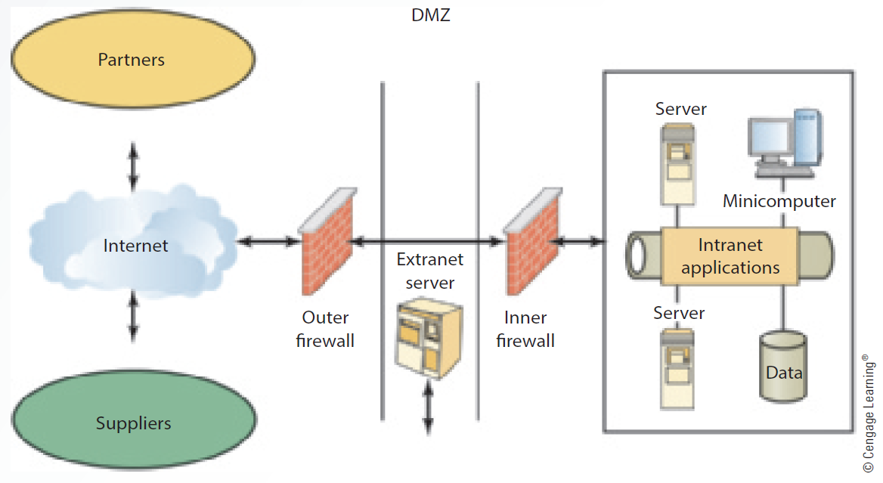
Simple Extranet Architecture

Slide 10
The end any questions?

