Slide 1
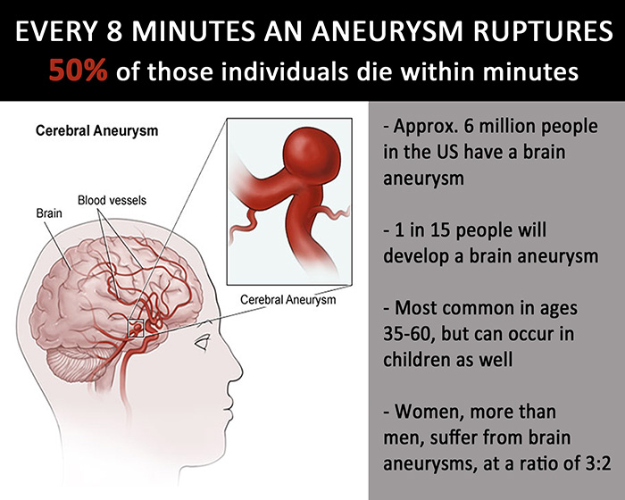
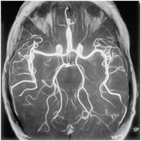
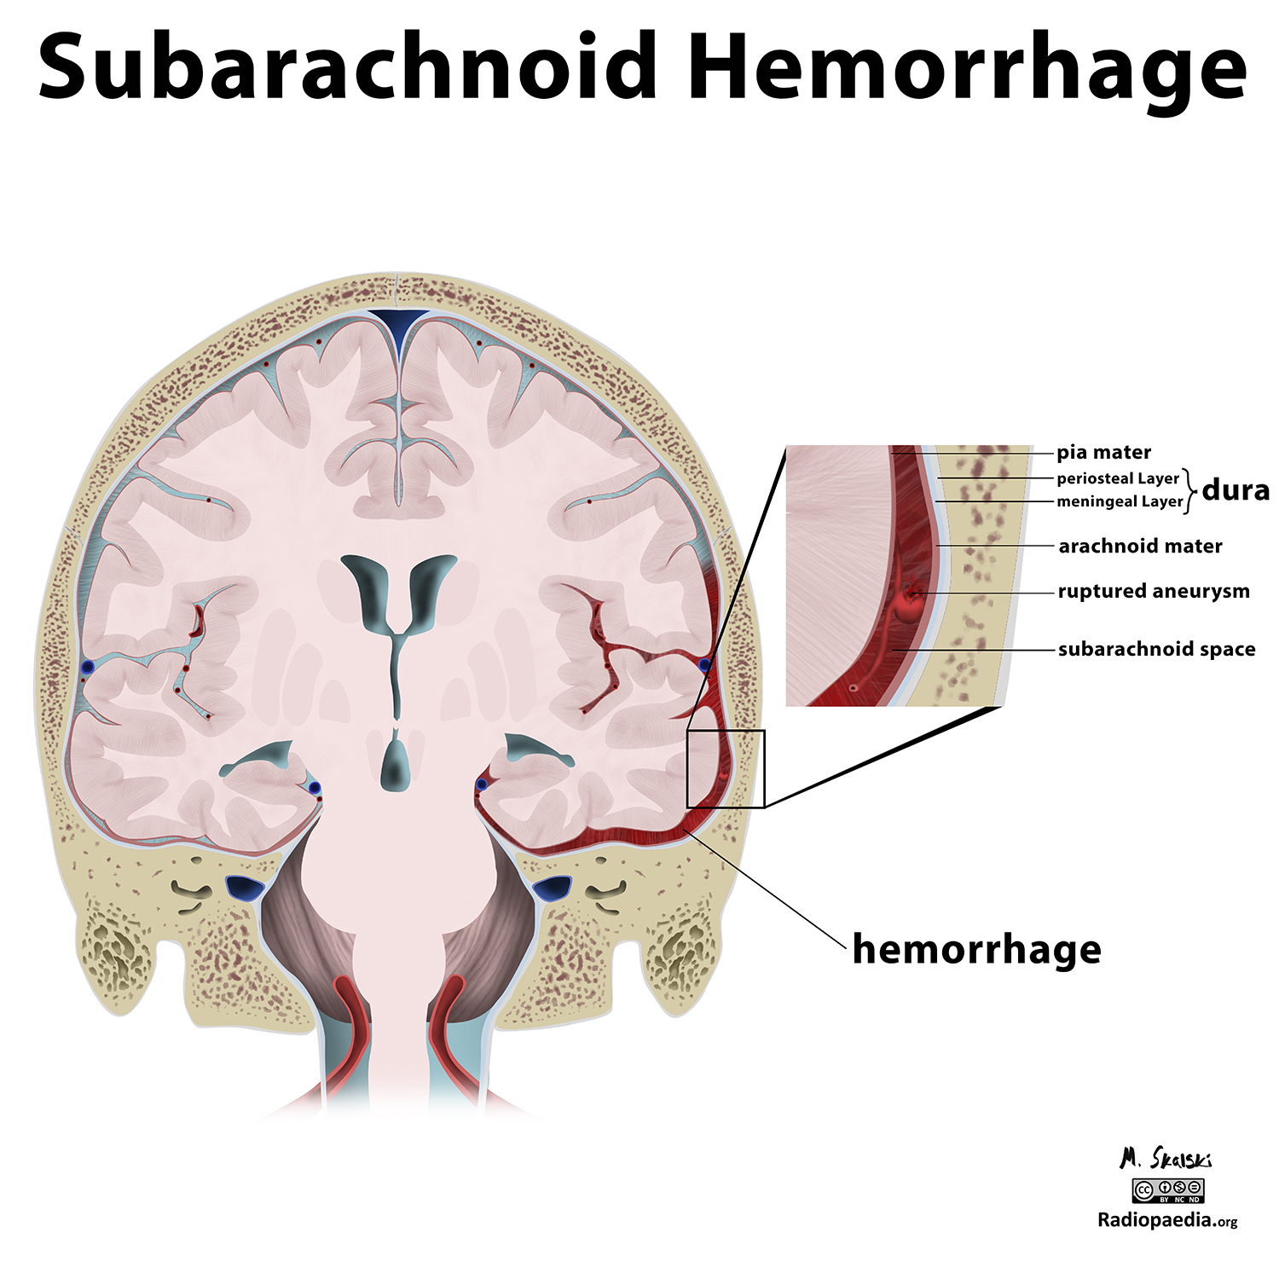
Assessment of Intracranial Aneurysms
Through Medical Imaging
What is it?
What causes cranial aneurysms?
What’s Next?
Statistics
It’s a cerebral disorder where the arteries of the brain begin to “balloon” causing increased pressure on the wall of the artery.
It is unknown the exact cause of weakening vessel walls; that lead to intracranial aneurysms. However, there could be factors associated with them such as;
Smoking
high blood pressure
genetic disorder
Age
Benefit over Risk
As with any procedure, benefit must always outweigh risk. Options
There are three options for treatment that patients could choose from
Observation
Endovascular therapy
Surgical therapy.
Aneurysms could grow without warning so it is very important to monitor them. Those who wouldn’t be considered to undergo an invasive procedure are patients that don’t acquire symptoms, if the patient's aneurysm measures less than 7 mm, lesions are apart of the anterior circulation, if the patient is over 64 years of age, and patients that don’t have a personal or family history of a subarachnoid Hemorrhage.
Noninvasive procedures include MRA, CTA, or trans cranial ultrasonography with Doppler. (2)
1 in 50 people have an unruptured brain aneurysm and don’t know about it.
30,000 people in the U.S. suffer from a brain aneurysm annually.
Ruptured brain aneurysms are fatal in about 50% of cases. Of those who survive, about 66% suffer some permanent neurological deficit.
Ruptured brain aneurysms account for 3-5% of all new strokes
20% of people diagnosed with a brain aneurysm have more than one aneurysm.
Women, particularly those over the age of 55, have a higher risk of brain aneurysm rupture than men (about 1.5 times the risk). (6)
All of these statistics came from the Brain Aneurysm Foundation.
Types
Intradural- Present deep within the brain.
Extradural- Occur in the skull, but outside the dura sac.
Studies show that there are four main types of brain aneurysms. Micotic, dissecting, fusiform, and saccular. (Saccular being the most common.) (2)
Saccular aneurysms are often found in the Circle of Willis- specifically the anterior communicating artery
Produced by a loss of protective collagen in the vessels causing the inner wall to breakdown. Allowing blood to pool or “bubble” against the otter wall. (2)
How do you know?
Diagnosing Modalities
IADSA- Intra-arterial digital subtraction angiography
In cerebral angiography, a long, thin, flexible tube (catheter) is inserted into an artery. Using the catheter, a technician injects a special dye into the blood vessels that lead to the brain. In cerebral angiography, X-ray images show blood vessel abnormalities in the brain.
CTA- Computed tomography angiography
Diagnostic imaging procedure that uses contrast to view the vessels and arteries. By using CT, you are able to construct multiple planes which are helpful when identifying exactly where the aneurysm may lay. (1)
MRA- Magnetic resonance angiography
By using a magnetic field, the radiologist can detect small changes in the within the brain. MRA is a noninvasive procedure that uses contrast dye to visualize blood vessels at interest. (1)
DSA- Digital subtraction Angiography
A procedure that requires inserting a catheter into an artery of the leg where they insert it up to the blood vessels of the brain to check blood flow by using contrast. (1)
Clinical Outlook
Extradural Aneurysms also called cavernous aneurysms present symptoms of severe pain behind the oculus, preceded by swelling and redness.
Despite these alarming symptoms, extradural aneurysms are less threatening than Subarachnoid hemorrhage (SAH). (3)
Acknowledgments
Brain aneurysm. Mayo Clinic. https://www.mayoclinic.org/diseases-conditions/brain-aneurysm/symptoms-causes/syc-20361483. Published August 9, 2019. Accessed March 18, 2020.
Current Imaging Assessment and Treatment of Intracranial Aneurysms : American Journal of Roentgenology : Vol. 196, No. 1 (AJR). American Journal of Roentgenology. https://www.ajronline.org/doi/full/10.2214/AJR.10.5329. Published October 22, 2014. Accessed January 8, 2020.
Facts- Radiology. Brain Aneurysm | Radiology. https://med.nyu.edu/radiology/about-us/subspecialties/neuro-interventional/our-services/brain-aneurysm. Accessed December 28, 2019.
Keedy A. An overview of intracranial aneurysms. McGill journal of medicine : MJM : an international forum for the advancement of medical sciences by students. https://www.ncbi.nlm.nih.gov/pmc/articles/PMC2323531/. Published July 2006. Accessed January 8, 2020.
Radiology. Brain Aneurysm | Radiology. https://med.nyu.edu/radiology/about-us/subspecialties/neuro-interventional/our-services/brain-aneurysm. Accessed January 24, 2020.
Statistics and Facts. Brain Aneurysm Foundation. https://bafound.org/about-brain-aneurysms/brain-aneurysm-basics/brain-aneurysm-statistics-and-facts/. Accessed March 19, 2020.
Surgical Treatments
Open craniotomy- clipping
This is a surgery that involves removing part of the skull, clipping the aneurysm, and then securing the skull back in place.
Endovascular coiling
This procedure requires a catheter that’s guided to the vessels of the brain. Once the catheter is placed, tiny coils are placed in the aneurysm to clot in and prevent a rupture. (1)
Intradural Aneurysms deliver an extreme headache caused by pressure from blood pooling around the brain. The pressure of the surrounding blood may cause a decrease of blood flow to the brain causing LOC. Some other potential symptoms may include vomiting ,weakness, and seizing. (3)

