Slide 1
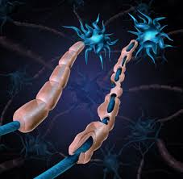
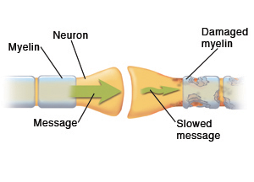
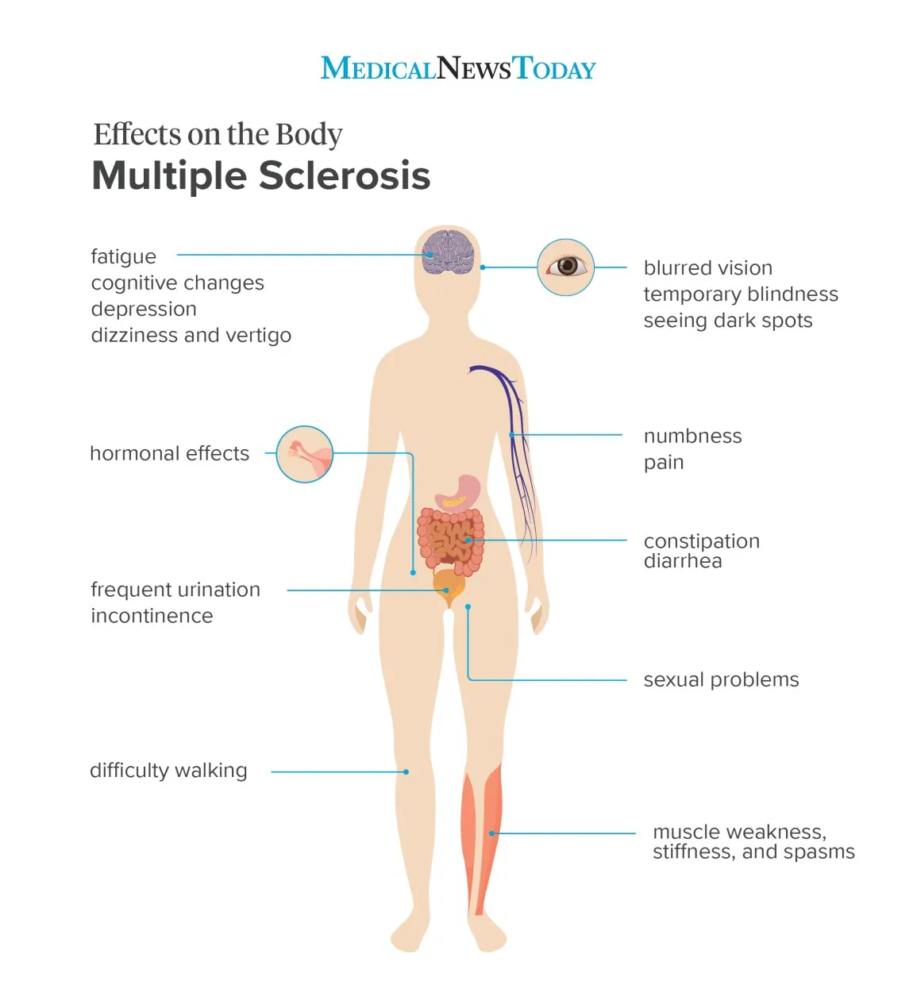
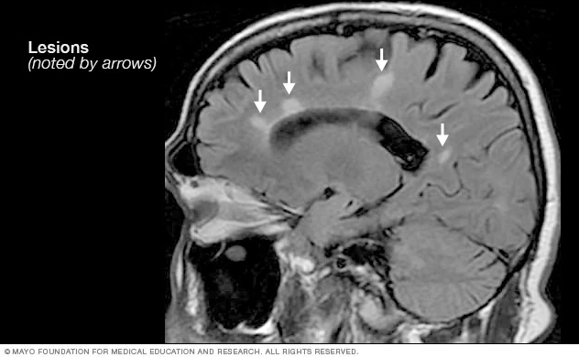
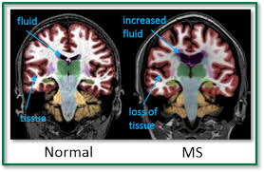
Multiple Sclerosis and the
Effect it has on the Body
Introduction
Forms
Treatment
Multiple Sclerosis, also known as MS, is a rare autoimmune disease that consists of the human body’s own antibodies destroying the substance that surrounds and protects a part of our nerves in our central nervous system called the myelin sheath. Myelin is an insulating layer that forms around nerves. It allows electrical impulses to transmit quickly along the nerve cells so if this sheath is at all damaged it will slow down and block these electrical messages. With this electrical disconnection between the brain and the rest of the body the symptoms can range from minor to detrimental.
Clinically Isolated Syndrome: 24-hour period with neurological symptoms that are similar to MS occur. It is caused by swollen and damaged myelin.
Relapsing-remitting MS: Most common form. Person will have flare up of symptoms which is followed by a recovery where they go away. This is triggered by something like the flu or an infection.
Primary progressive MS: 15%-20% of people diagnosed with MS will develop this. The disease will slowly get worse and will have no recoveries and will likely have more brain lesions.
Secondary progressive MS: Occurs in about 50% of people that have relapsing-remitting MS will develop repetitive recovery and relapse that increases disabilities and will create new brain lesions.
Although there is no treatment for MS, there is action that can be taken against its symptoms. Medications can be used to decrease attack frequency, decrease relapsing, and decrease inflammation. Exercise has been proven to help preserve the remaining physical abilities and walking aids can preserve mobility and independence.
.
Cause
There are nearly 1 million people in the US that have been diagnosed with MS. Although researchers have not found out the direct cause, they believe that it could be genetics, and environmental factors. It is also believed that the immune system may mistake a healthy normal brain cell as a foreign one.
Symptoms
The Diagnosed
Acknowledgements
Dizziness
Fatigue
Memory loss
Muscle weakness
Loss of balance
Numbness or weakness
Loose control of bodily functions
Tremors
Spasms
Seizures
Electric-shock sensation
Erectile dysfunction
Plieth J. Multiple sclerosis "win" makes the Principia shorts squirm. Evaluate.com. https://www.evaluate.com/vantage/articles/news/trial-results/multiple-sclerosis-win-makes-principia-shorts-squirm. Published February 7, 2020. Accessed March 1, 2020.
MS is physically and emotionally draining but certain lifestyle changes can help improve quality of life. Paying attention to what the body needs is a huge factor. MS causes fatigue so setting aside time to rest and eating a well balanced diet will have benefits. Too much heat can cause nerve pain and lead to extreme muscle weakness. About 50% of people will have cognitive impairments such as confusion, memory loss, and poor judgement.
Huizen J. 15 symptoms of MS in women. Medical News Today. https://www.medicalnewstoday.com/articles/324944. Published April 11, 2019. Accessed March 5, 2020.
Patient Education. Understanding Multiple Sclerosis (MS) | MHealth.org. https://www.mhealth.org/patient-education/40474. Accessed March 6, 2020.
MRI multiple sclerosis lesions. Mayo Clinic. https://www.mayoclinic.org/diseases-conditions/multiple-sclerosis/multimedia/multiple-sclerosis-mri-scan/img-20135010. Accessed March 15, 2020.
Staff FE. Multiple Sclerosis Symptoms: Treatment and Causes. familydoctor.org. https://familydoctor.org/condition/multiple-sclerosis/. Published April 24, 2019. Accessed March 18, 2020.
Multiple Sclerosis Information Page. National Institute of Neurological Disorders and Stroke. https://www.ninds.nih.gov/Disorders/All-Disorders/Multiple-Sclerosis-Information-Page. Accessed March 20, 2020.

