Slide 1
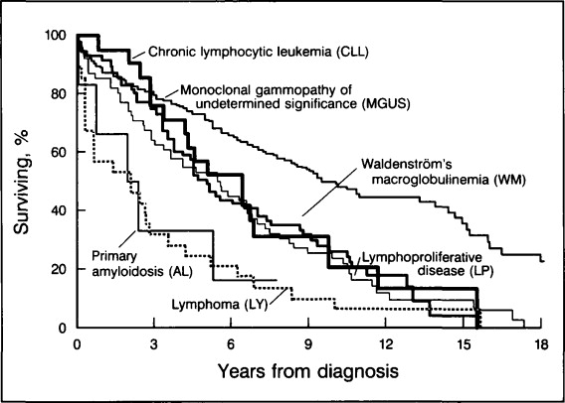
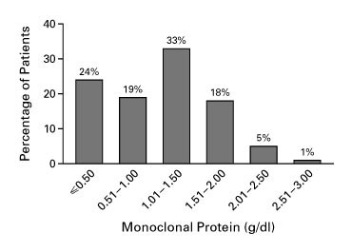
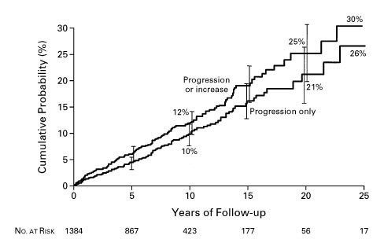
What is Monoclonal Gammopathy?
Definition
Studies
Chronic Lymphocytic Leukemia
Monoclonal gammopathy of undetermined significance (MGUS) is a condition in which the monoclonal protein or M protein is in your blood. This protein is considered abnormal and is formed within your bone marrow.
MGUS typically has causes no problems, but it can sometimes progress to more serious diseases which can include some forms of blood cancers. Reliable predictors of progression have not been identified and the information on prognosis is limited
If there are high amounts of this protein in your blood, it's important to have regular checkups to look for progression. If there is no disease progression, MGUS does not require treatment.
1. Monoclonal gammopathy has a broad spectrum of diseases. The condition of these diseases can range from benign to malignant. In a long term study, 430 patients that had the protein were identified and then separated by their disease types.
242 diagnosed with MGUS
71 diagnosed with Waldenström's macroglobulinemia
28 diagnosed with lymphoma
21 diagnosed with chronic lymphocytic leukemia
6 diagnosed with primary amyloidosis
62 diagnosed with other malignant lymphoproliferative diseases
More than two thirds of the patients became deceased. Majority of deaths were from a lymphoid malignant process. An increased number of lymphocytes or plasma cells on bone marrow examinations was not a reliable indicator for the outcome. These patients follow-up appointments should be conducted indefinitely.
2. A facility identified 1,384 patients that were diagnosed with MGUS. This study was to determine if monoclonal gammopathy of undetermined significance progressed to multiple myeloma or another plasma cell cancer. 115 of the 1384 patients progressed to further conditions such as:
multiple myeloma
IgM lymphoma
primary amyloidosis
Macroglobulinemia
chronic lymphocytic leukemia
Plasmacytoma
In 32 more patients, the protein concentration increased to more than 3 g per deciliter or the percentage of plasma cells in the bone marrow increased to more than 10 percent but with no progression to manifest myeloma or other related disorders. The probability of progression:
12% at 10 years
25% at 20 years
30% at 25 years
At the progression of 20 years the initial concentration of the monoclonal protein was a significant predictor.
Conclusion
Multiple Myeloma
The risk of progression of monoclonal gammopathy of undetermined significance to multiple myeloma or other related blood disorders is about 1% per year. If the protein value remains the same for three to five years the process is considered to be benign and they do not require additional follow-ups.
References
Monoclonal gammopathy of undetermined significance (MGUS). (2019, May 21). Retrieved from https://www.mayoclinic.org/diseases-conditions/mgus/symptoms-causes/syc-20352362
Kyle, R. A., & Garton, J. P. (1987). The Spectrum of IgM Monoclonal Gammopathy in 430 Cases. Mayo Clinic Proceedings, 62(8), 719–731. doi: 10.1016/s0025-6196(12)65225-2
Kyle, R. A., Therneau, T. M., Rajkumar, S. V., Offord, J. R., Larson, D. R., Plevak, M. F., & Melton, L. J. (2002). A Long-Term Study of Prognosis in Monoclonal Gammopathy of Undetermined Significance. New England Journal of Medicine, 346(8), 564–569. doi: 10.1056/nejmoa01133202
Google Images

