Slide 1


Slide 2


Slide 3
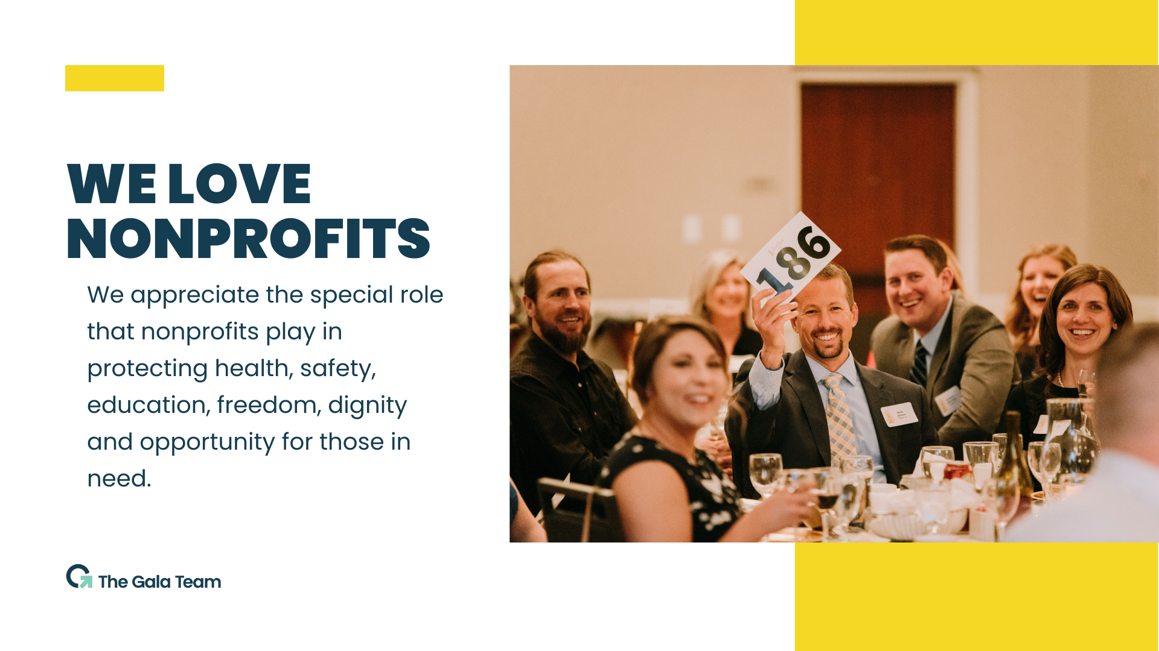

Slide 4

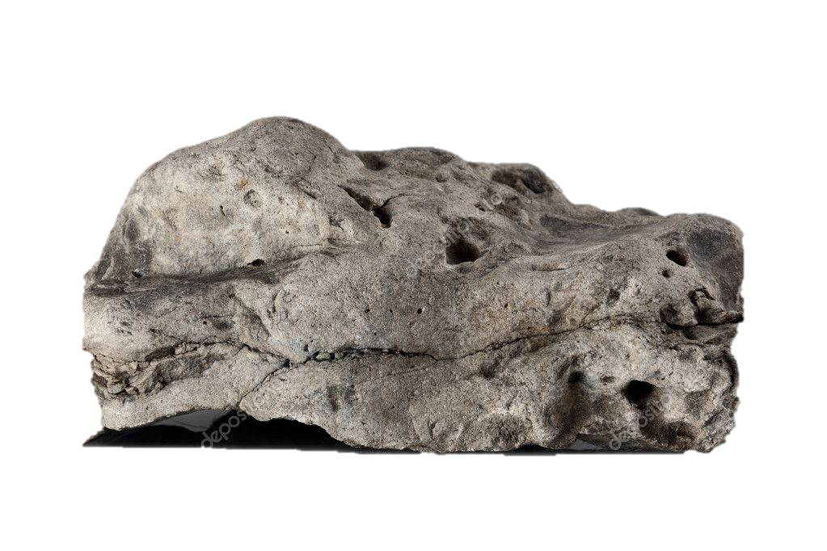

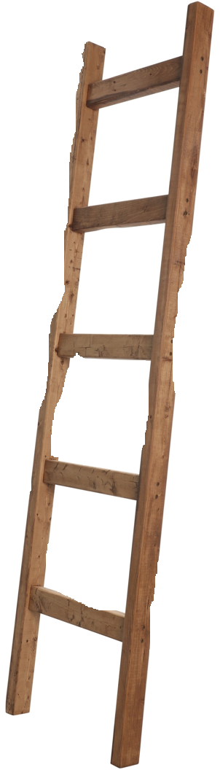

The Vital Role of Nonprofits in our Communities
Nonprofits
Market Economy
Government Services

Slide 5
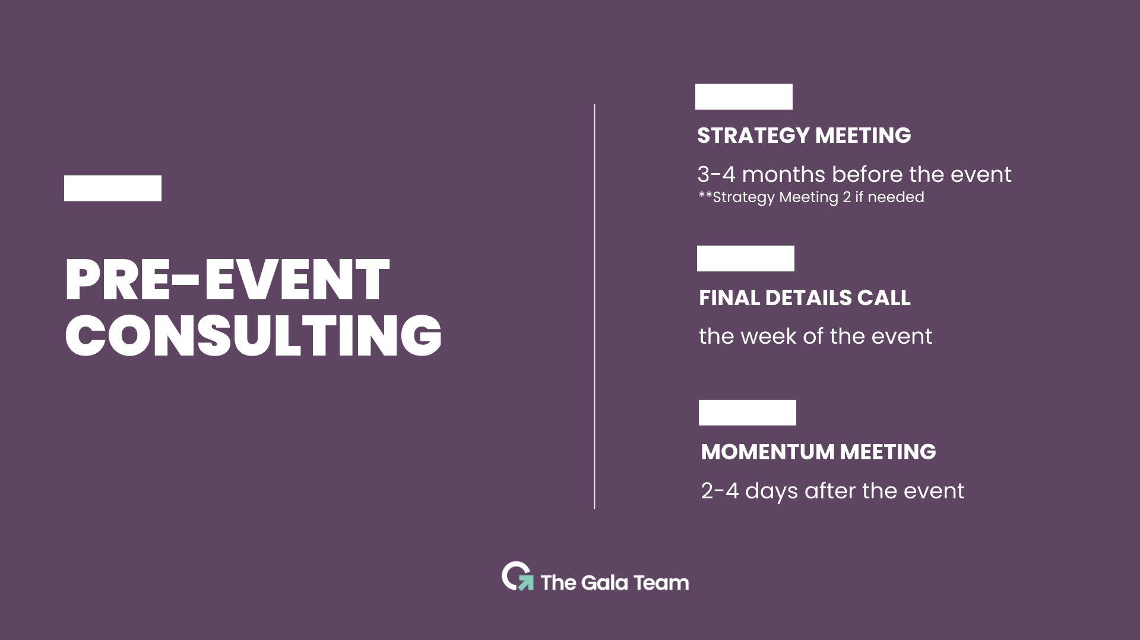

Slide 6
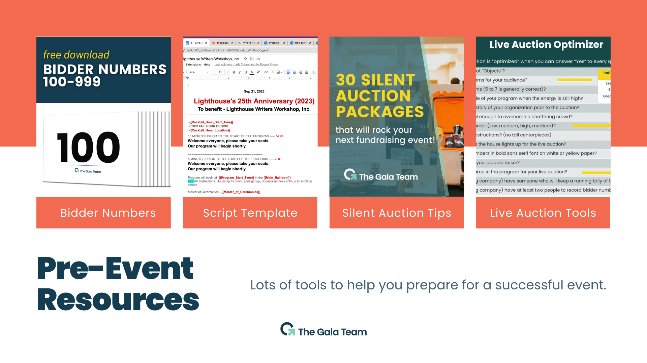

Slide 7


Slide 8



Slide 9
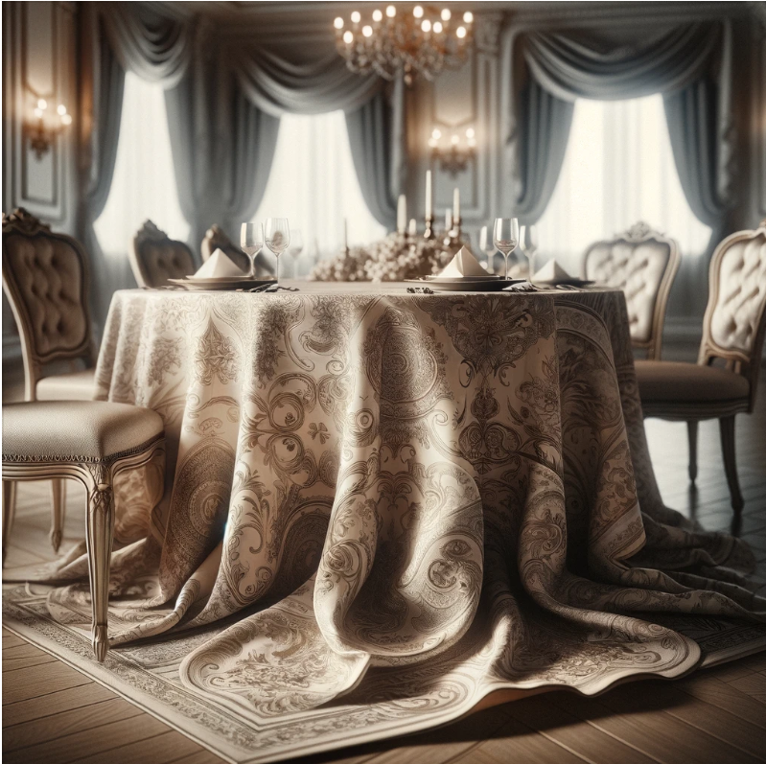
THE GALA TEAM’S
PADDLE RAISER STRATEGY
IS A
STURDY AND CONSISTENT
“TABLE.”
THE
SPECIFIC AUCTIONEER
IS A “TABLE CLOTH”
DRAPED OVER THAT
STURDY TABLE.

Slide 10
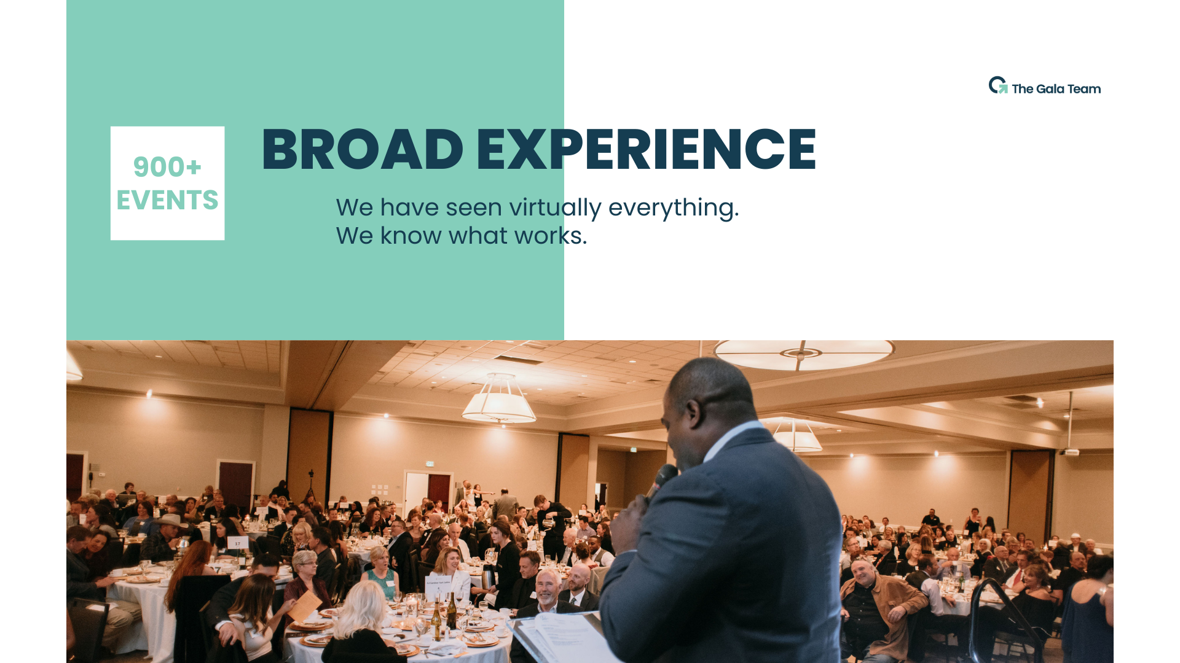
1,300+ EVENTS

Slide 11
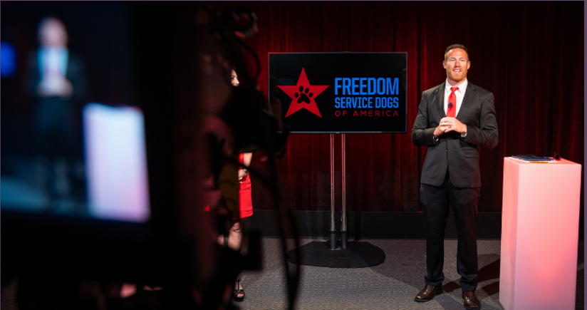

WE ARE TEAM PLAYERS
Fundraising
Mission Well Communicated
Board Members feel good.
Sponsors get Money’s and Mission Worth
Food has to be served when it’s hot.
Guests have a good time.
Sometimes dirty plates have to be picked up.
Event runs on time.

Slide 12
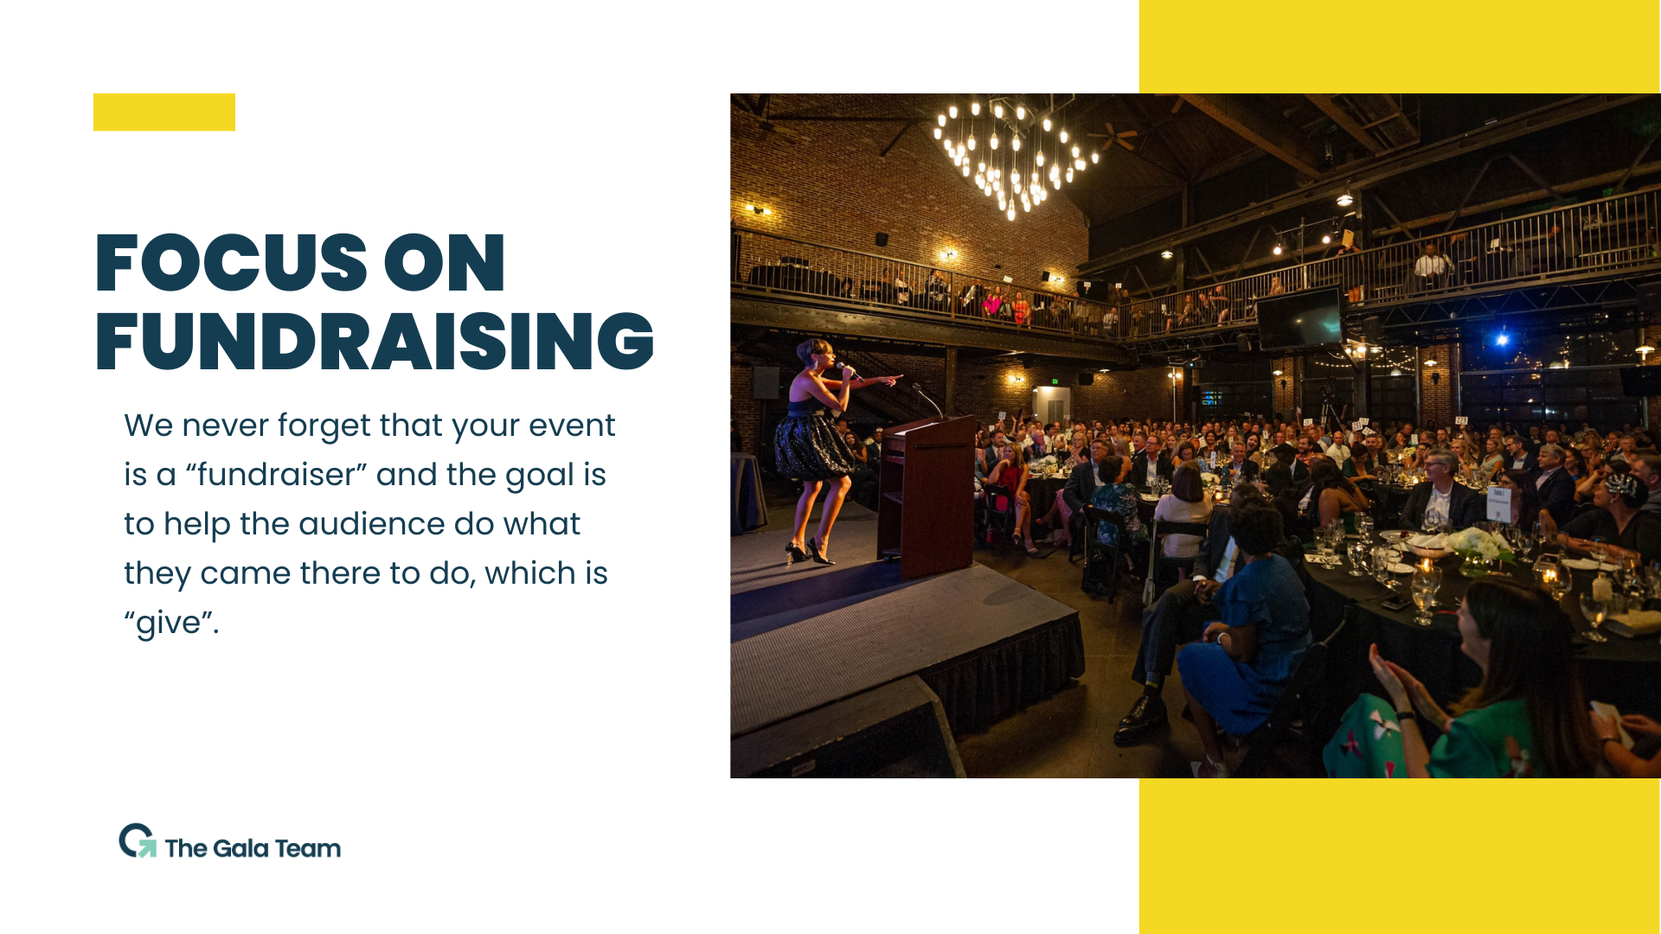

Slide 13
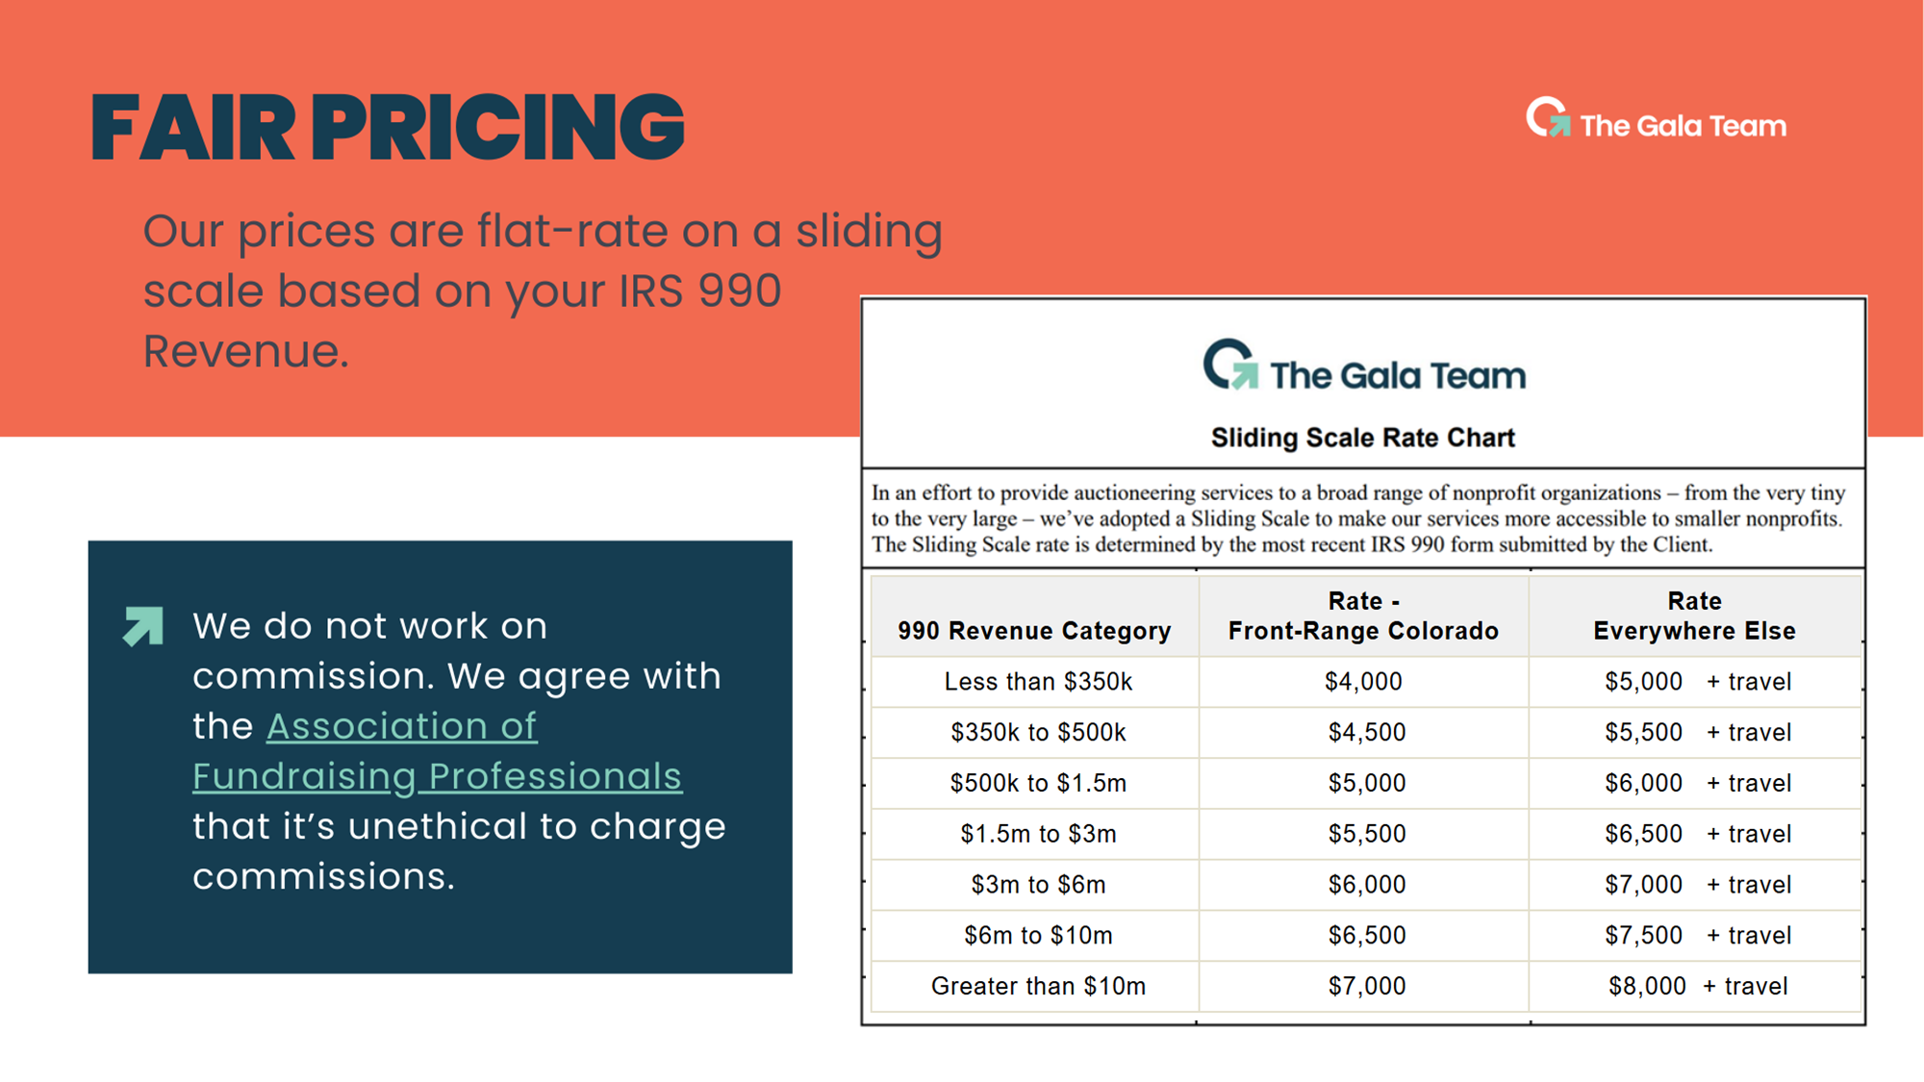

Slide 14


Slide 15
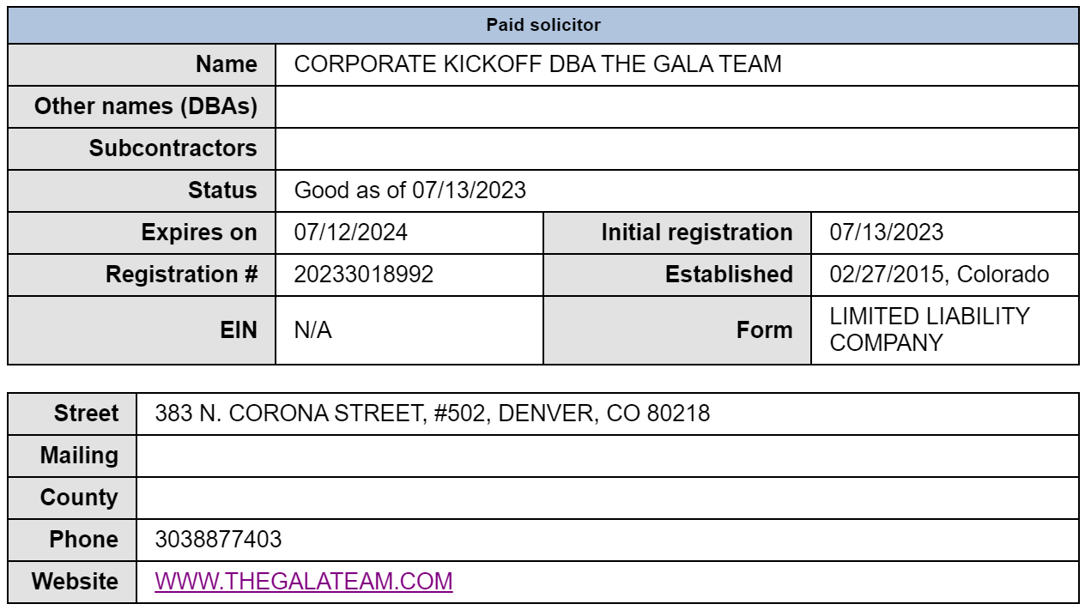
The Gala Team is Registered as a Paid Solicitor as required by Colorado Law

Slide 16
