Slide 1
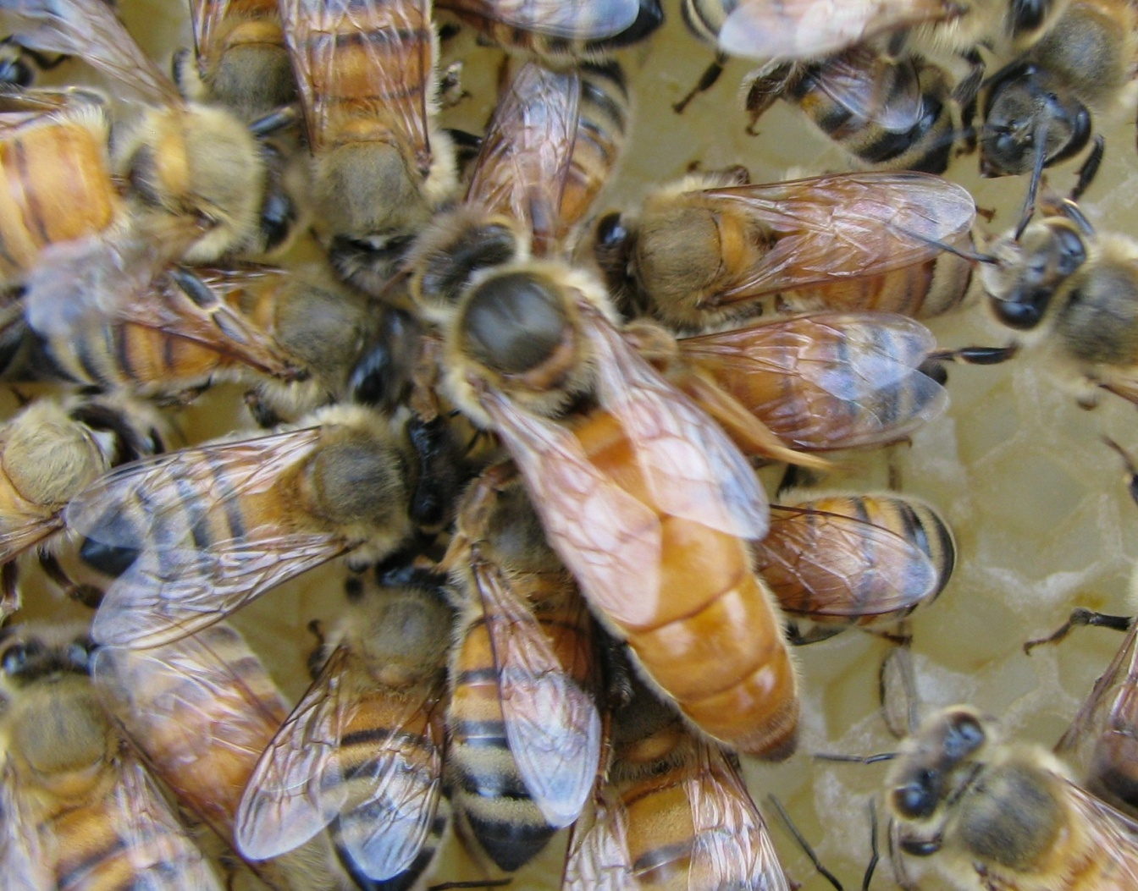
Introducing the Queen
Jerry Gordon – Indiana Honey Bees, Lake Village, IN

Slide 2
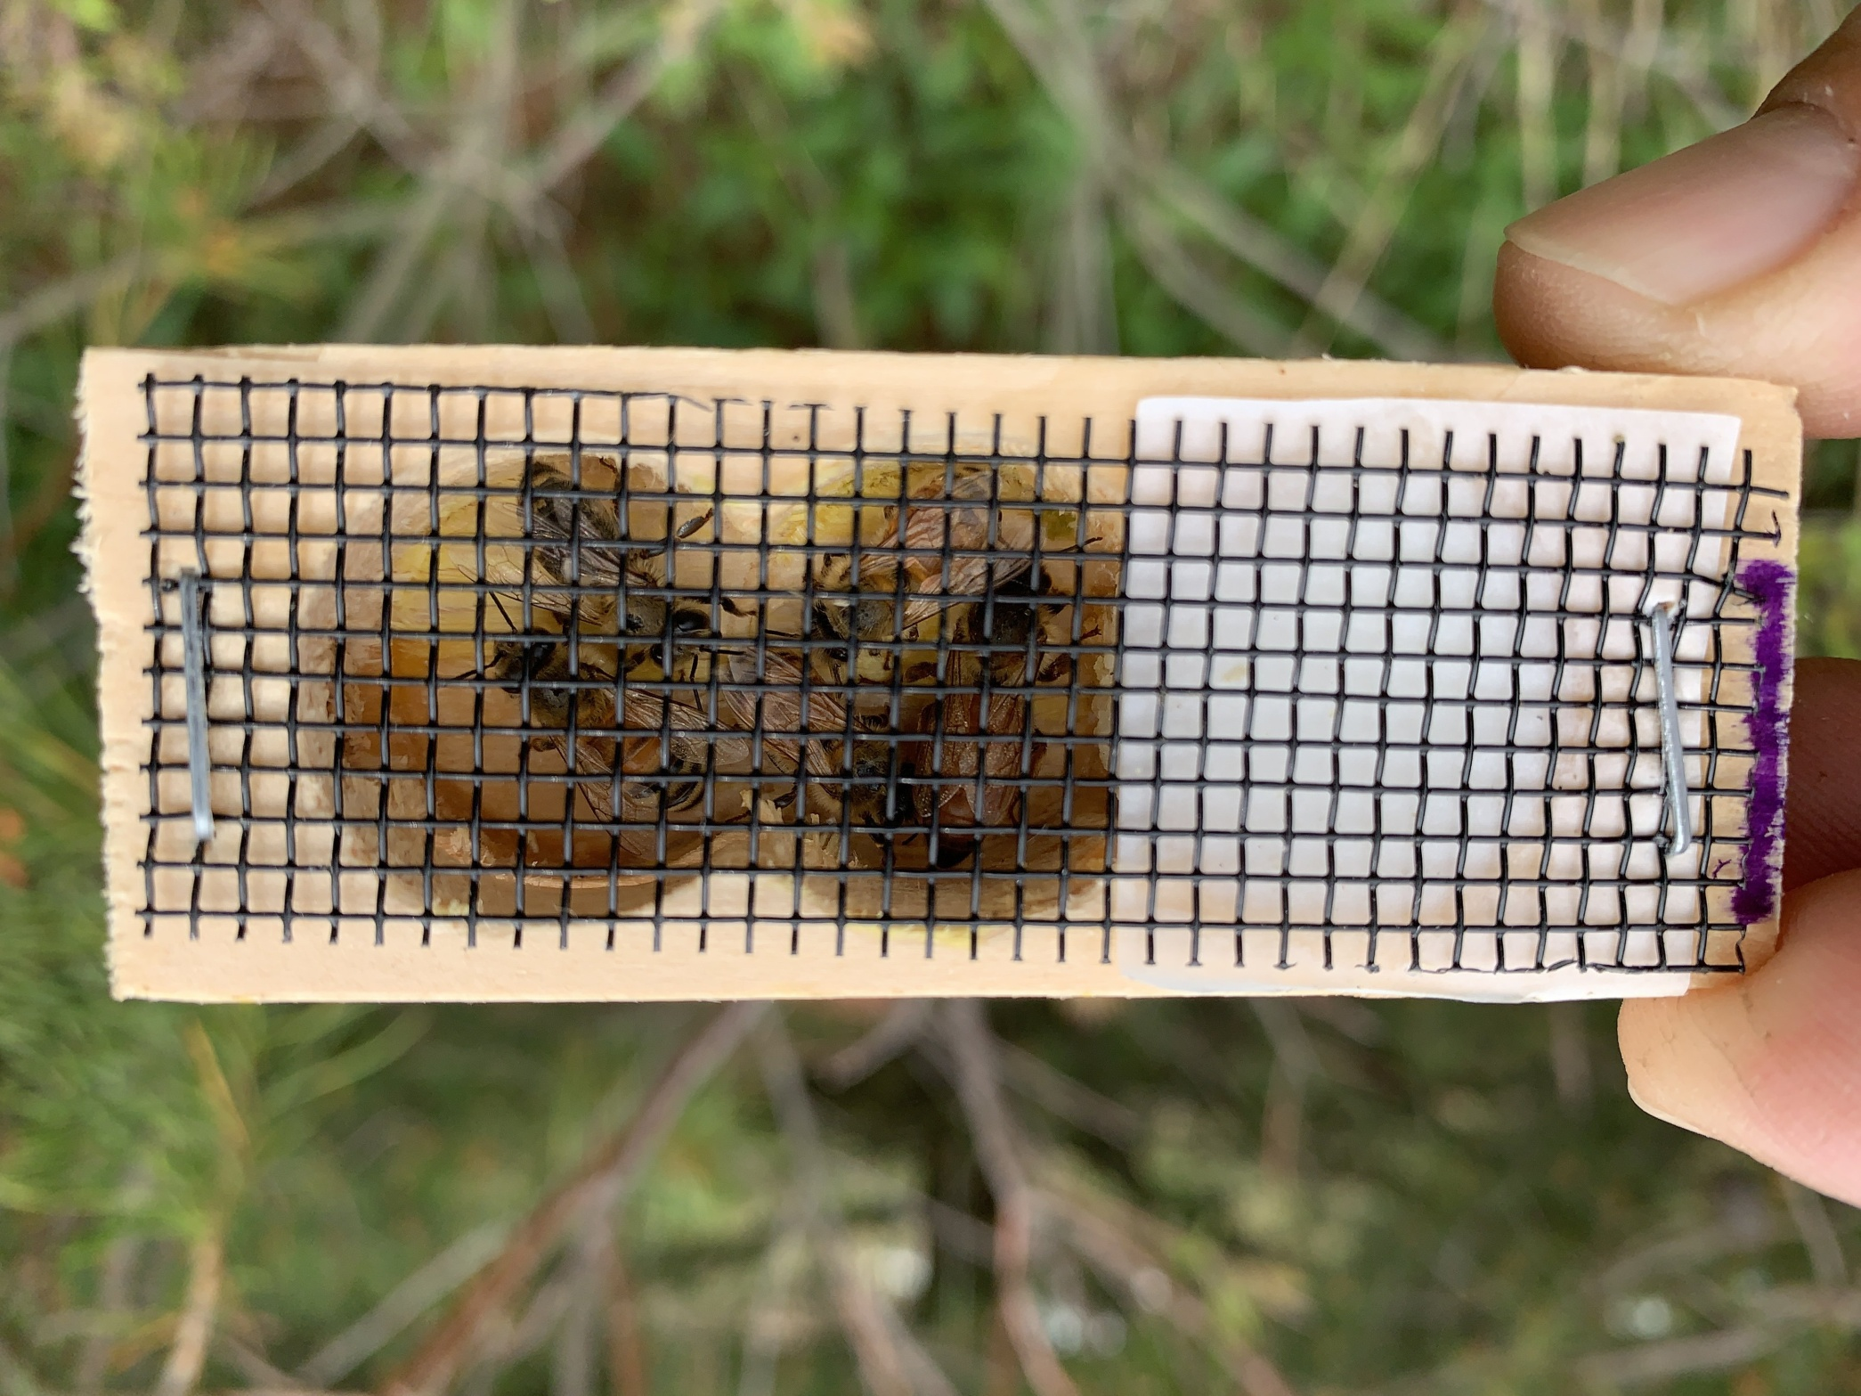

Slide 3
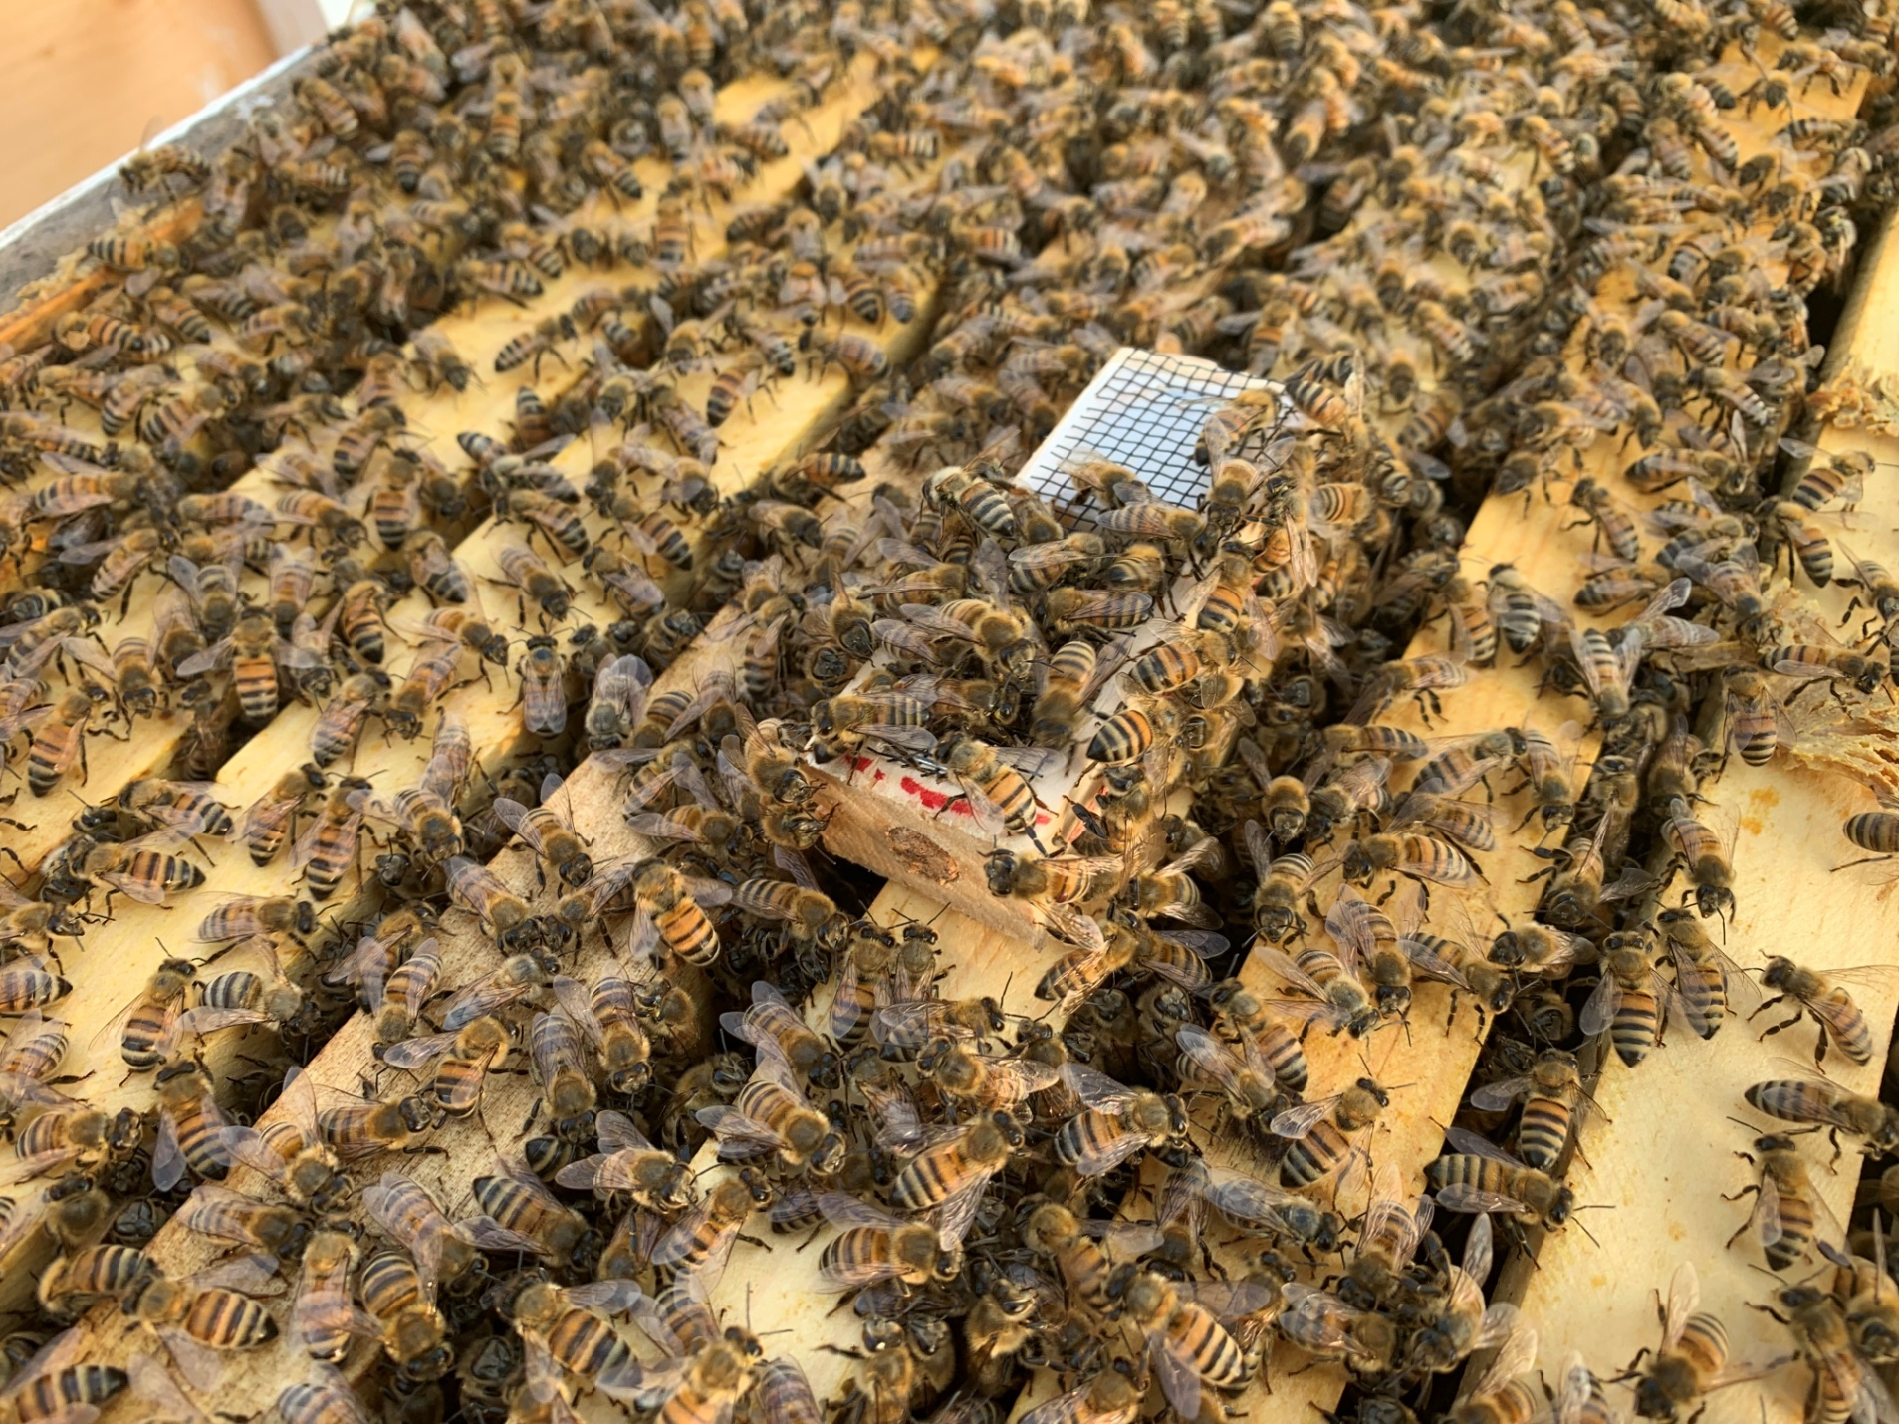

Slide 4
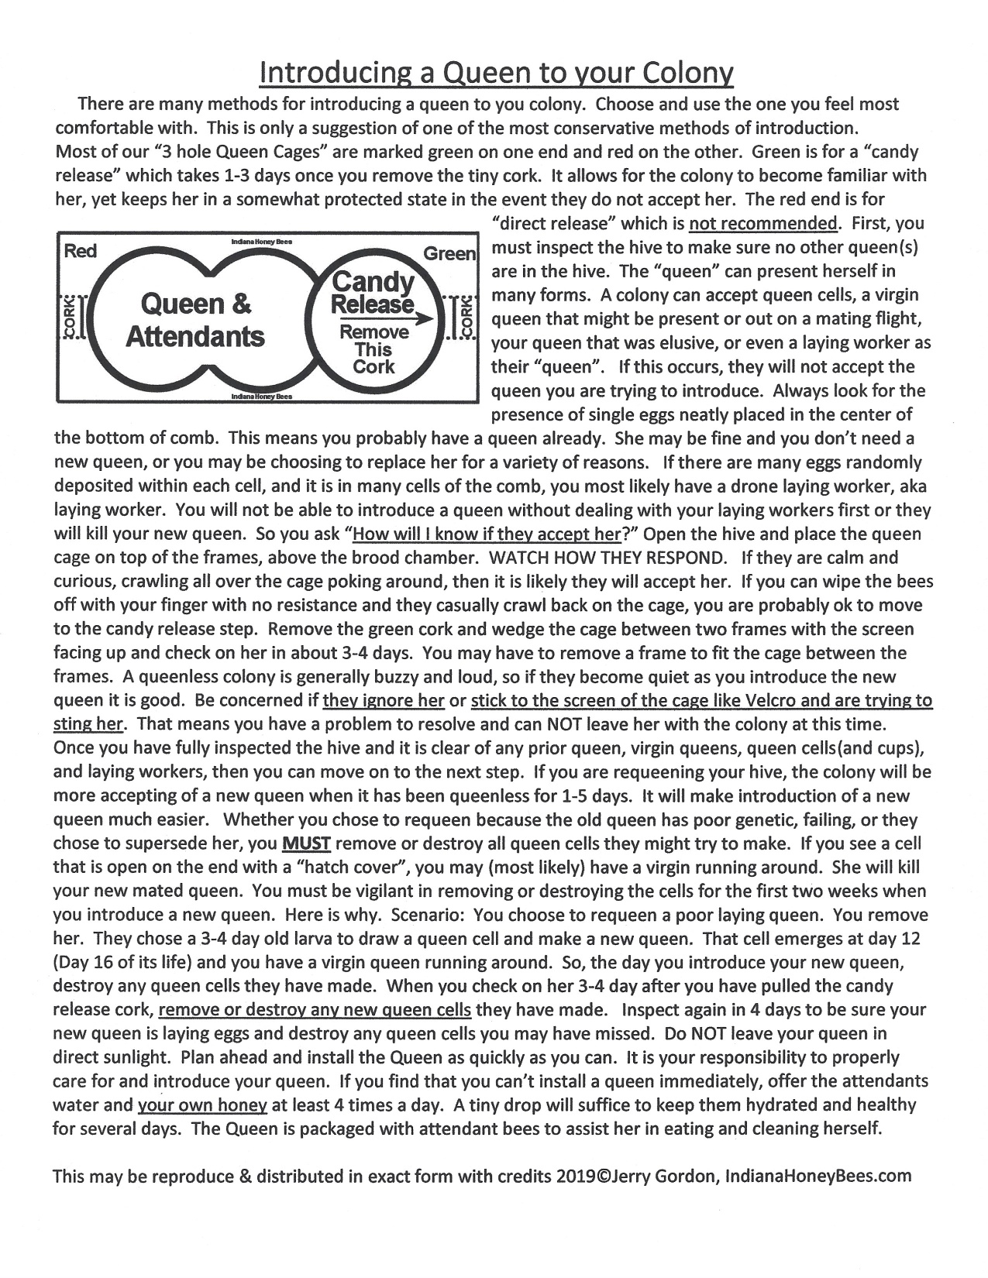

Slide 5
