Slide 1
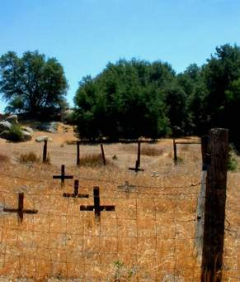
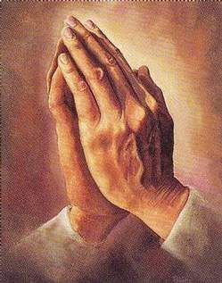
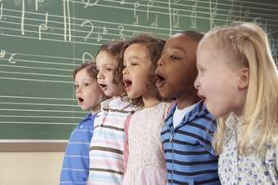
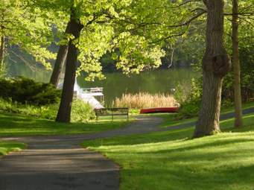
Holy Ground

Slide 2
Holy Ground
This is holy ground, we’re standing on holy ground,
For the Lord is present and where He is, is holy.
This is holy ground, we’re standing on holy ground,
For the Lord is present and where He is, is holy.

Slide 3
Holy Ground
These are holy hands, God’s given us holy hands,
God works through these hands and so these hands are holy.
These are holy hands, God’s given us holy hands,
God works through these hands and so these hands are holy.

Slide 4
Holy Ground
These are holy lips, God’s given us holy lips,
God speaks through these lips and so these lips are holy.
These are holy lips, God’s given us holy lips,
God speaks through these lips and so these lips are holy.

Slide 5
Holy Ground
We have holy hearts, God’s given us holy hearts,
God loves through these hearts and so our hearts are holy.
We have holy hearts, God’s given us holy hearts,
God loves through these hearts and so our hearts are holy.

Slide 6
Holy Ground
This is holy ground, we’re standing on holy ground,
For the Lord is present and where He is, is holy.
This is holy ground, we’re standing on holy ground,
For the Lord is present and where He is, is holy.

