Slide 1
Joyful, Joyful We Adore Thee

Slide 2

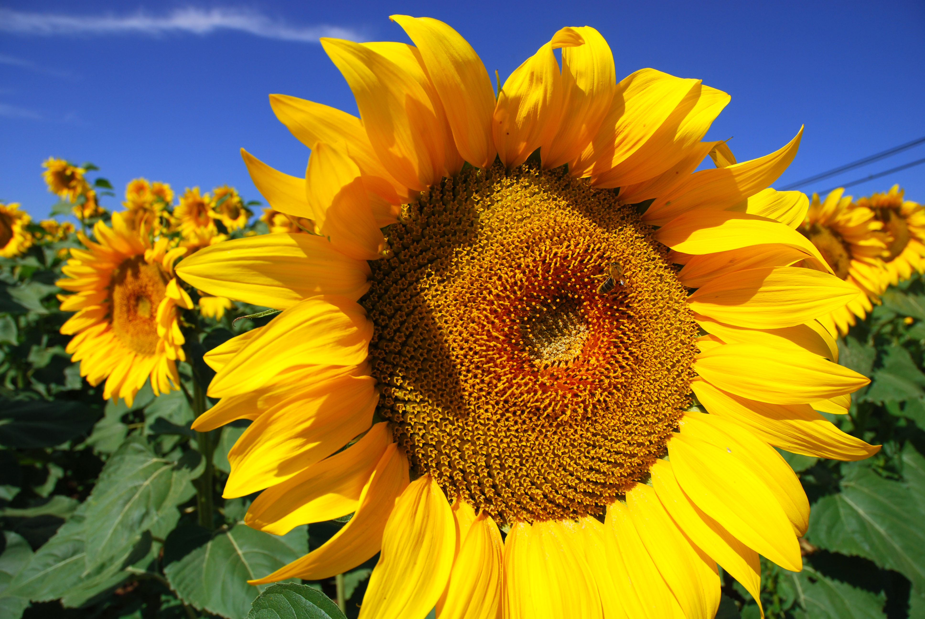
Joyful, joyful, we adore Thee,
God of glory, Lord of love;
Hearts unfold like flow’rs before Thee,
Op’ning to the sun above.

Slide 3
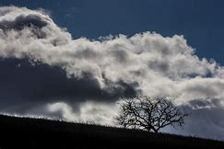
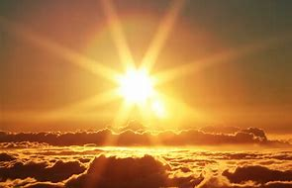
Melt the clouds of sin and sadness;
Drive the dark of doubt away;
Giver of immortal gladness,
Fill us with the light of day!

Slide 4
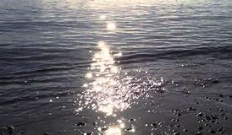
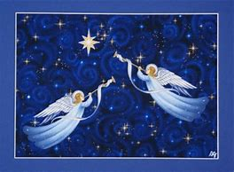
All Thy works with joy surround Thee,
Earth and heav’n reflect Thy rays,
Stars and angels sing around Thee,
Center of unbroken praise.

Slide 5
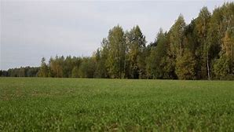
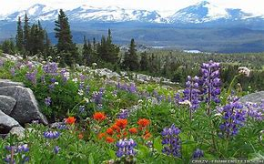
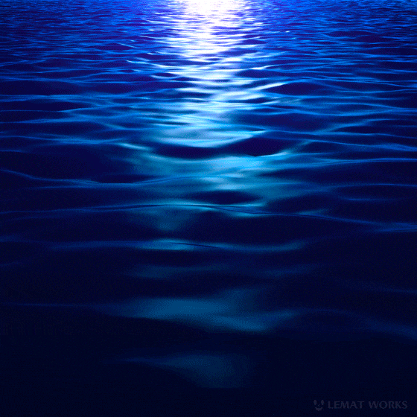
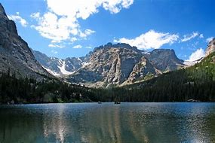
Field and forest, vale and mountain,
Flow’ry meadow, flashing sea,

Slide 6
Singing bird and flowing fountain
Call us to rejoice in Thee.

