Slide 1


Teachers’ Retirement System
of the State of Kentucky
Fall Workshops 2024
Gary L. Harbin, CPA
Executive Secretary
Notes:
Good morning. It’s wonderful to see you again.

Slide 2



Kentucky’s Olympic Medals
Notes:
I don’t know about you, but watching this year’s Olympics I was stunned by how many medal winners had Kentucky ties. Of course, we know a few of them were some of our favorite former UK basketball players who won gold in basketball.
But there were others who were new to many of us, but they may not have been new to you or your successors in Kentucky classrooms.

Slide 3

Behind the Medals
Every Olympian Had Teachers
Notes:
Lee Kiefer (Keefer) won two gold medals – in women’s individual foil (a repeat of the Tokyo Olympics) and women’s team foil. She’s a Paul Laurence Dunbar High School graduate!

Slide 4


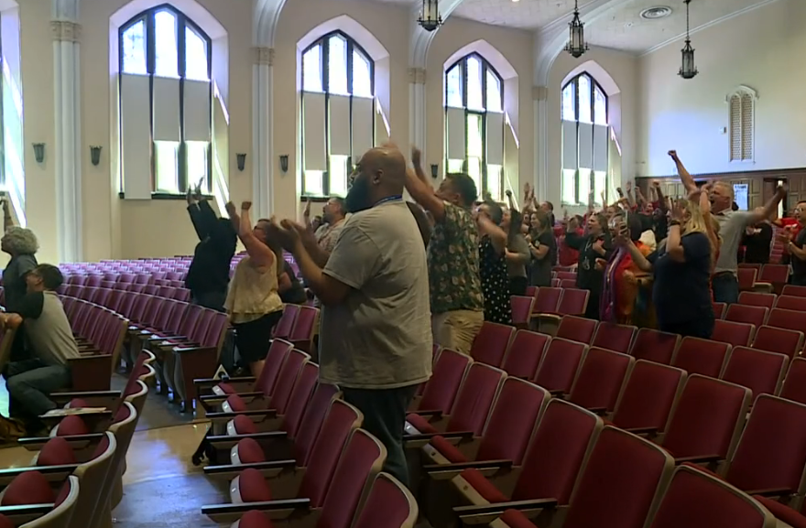
Behind the Medals
Every Olympian Had Teachers
Notes:
The watch party you see is for Yared (Yar-ed) Nuguse (nuh-goose) and his photo-finish bronze medal in the men’s 1,500-meter.
He graduated from Louisville’s Manual High School.
Besides coaches, something all Olympians have in common is teachers who helped them reach the medal stand.
And in cases like Lee and Yared, the teachers who helped them are TRS members. These Kentucky athletes can thank you and your colleagues.
What you all have done and what your successors continue to do has, literally, international impact – and we can’t thank you enough for your service to our Olympic efforts – and to every other role of society.
Now, let’s discuss the monthly medal you’ve earned, your TRS retirement benefits.

Slide 5
Doing It Right
What That Means at TRS
Providing security for Kentucky’s retired teachers using a long-term investing process proven and refined over decades to achieve top returns on investments at the lowest costs.
Notes:
As we have for some time now, we begin with what is a mission statement – doing it right. We decided to emphasize this in many presentations on the advice of a seminar speaker whose point was that with the firehose of opinions and social media bombarding us from every corner, it’s critical to provide your story, your purpose and how you achieve that purpose. And then repeat it and repeat it. So we do.
Our purpose every day is providing security for Kentucky’s retired teachers using a long-term investing process proven and refined over decades to achieve top returns on investments at the lowest costs. This provides you with a dignified retirement.
You’ll hear today how we do that.

Slide 6
Investment Performance
Retirement Annuity Trust Gross Returns as of June 30, 2024
 | TRS | Aon Rank
1-year | 12.27% | Top 10%
3-year | 3.52% | Top 41%
5-year | 8.81% | Top 12%
10-year | 7.94% | Top 8%
20-year | 7.57% | N/A
30-year compounded
8.1%
Notes:
Speaking of medals, if I could provide a medal for our trustees, Investment Committee and our investment team, I would. We had another great year. A return of 12.27% after a return of 10.61% in 2023. With the bars on the right, for every time period, the TRS return in blue was better than the grey, which is Aon’s compilation of similar pension plans with more than $1 billion in assets. For the year, TRS’s return was in the top 10% of pension plans, the five-year return is in the top 12% and the 10-year return was in the top 7%.
Remember, we’re a long-term investor. The 30-year return of 8.1% continues to be above the 7.1% that the actuary assumes we’ll get.

Slide 7
Investment Performance
TRS vs. Average Retirement Plan
From 2008 to June 2024, TRS investment returns resulted in net assets of $26.1 billion, compared to the average plan’s $20 billion.
This outperformance generated $6.1 billion to the benefit of Kentucky’s teachers and all taxpayers.
Cumulative Outperformance
2008-2024
6
5
4
3
2
1
Billions ($)
Notes:
Over that long term, we’ve outinvested the average pension plan. What does this outperformance mean? If you look at the period since the Great Recession, TRS’s investment returns versus the average plan cumulatively resulted in $6.1 billion more in assets. That’s enough money to run the state for half a year. It would take care of our pension benefits for 2.5 years.
Of these 16 years, TRS has outperformed the average 11 times, matched it twice and underperformed three times. So, 13 of last 16 years, TRS has either matched or out performed the average plan. This is exceptional.
As you can see, our investment philosophy and investment processes are working well and remain unchanged. … This is important because investment earnings represent about 70% of the lifetime benefits that TRS provides to retired Kentucky school teachers.

Slide 8
TRS Benefits Protect Teachers
Retirees Over 80 as of Dec. 31
Age 100 or more:
43
Notes:
And retired Kentucky school teachers are living longer. As you can see, the trend continues of TRS having more and more retirees over age 80 each year.
On this chart as of December 31, 9,293 retirees were over age 80 and 43 were over the age of ONE-hundred!

Slide 9

Retired Teachers Benefit Kentucky
TRS pays retired teachers:
  $211.3 million in retirement annuity benefits (July 2024)
  $17.1 million in medical benefits (monthly average)
90% of TRS pension benefits stay in Kentucky
87% of TRS retirees live in Kentucky
$2.2 billion a year paid into Kentucky’s economy because of pension benefits
Notes:
And you living longer provides a tremendous economic impact all across Kentucky. Overall, TRS pays retired teachers about $228 million a month in benefits, either pension or health insurance. Since 90% of those benefits go to the 87% of retirees who stay in Kentucky, that means more that $2.2 billion a year injected into Kentucky’s economy from the pension benefits alone.

Slide 10
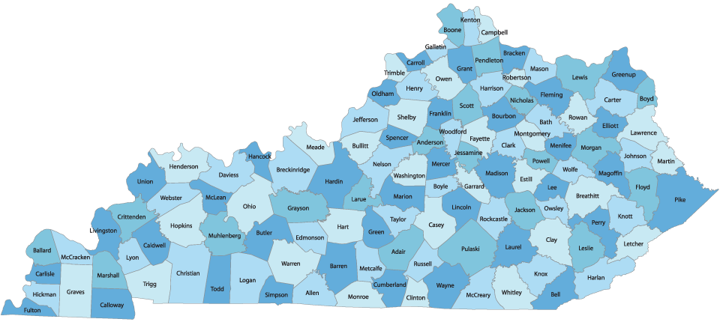

Retired Teachers Benefit Kentucky
Fiscal Year 2024 Annuity Benefits (in millions) by KRTA District
Fifth
$140.3
Northern
$161.7
Eastern
$127.4
Upper
Kentucky
River
$69
Jefferson
$364.4
Big
Sandy
$93.4
Fourth
$157.1
Second
$137.4
Upper Cumberland
$121.4
First
$135.4
Central East
$141.2
Third
$191.2
Central West
$297
Middle Cumberland
$89.8
Notes:
Here’s a favorite slide of these workshops. All of these KRTA districts saw increases in the last year. (Highlight group you’re speaking to).

Slide 11
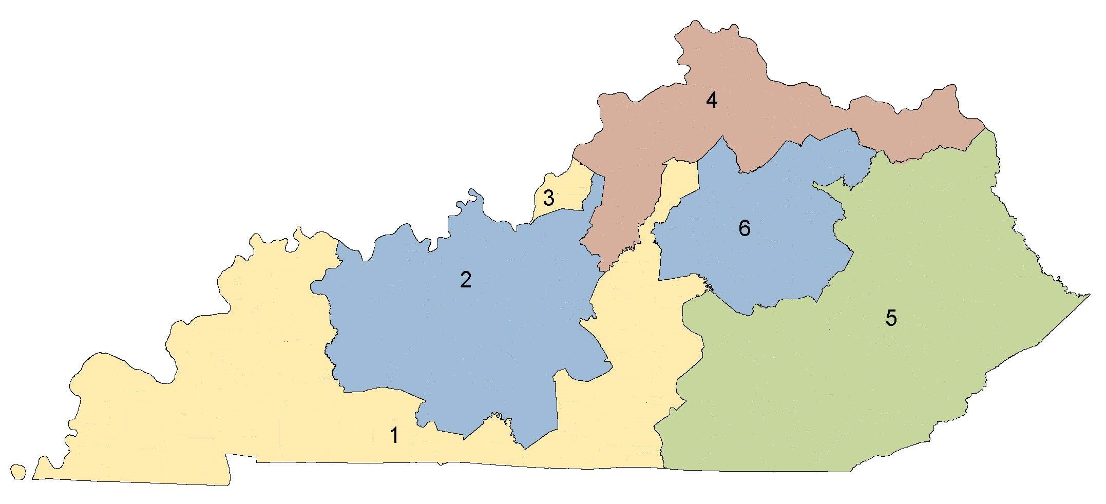

Retired Teachers Benefit Kentucky
FY 2024 Annuity Benefits by Congressional District (est.)
$342 million
7,400 recipients
$279 million
6,800 recipients
$396 million
9,900 recipients
4
$443 million
11,700 recipients
$360 million
9,400 recipients
3
6
2
5
$405 million
10,500 recipients
1
Notes:
Breaking down that monthly pension amount into congressional districts, you can see how those pension benefits are helping the people in your region and the economic impact it is having across every county in Kentucky.

Slide 12
Annualized Gross Benefits
Service Retirees as of June 30, 2024
Average Years of Service
Numbers of Retirees
Years of Service
Notes:
Here’s what service retirements look like now – don’t worry, the Cliff’s Notes is on the next slide, but let me help.
Across the bottom, we see retirement income in $10,000 increments. The blue bars show how many people fall in each of those ranges. The tallest bars with the most people cover retirement benefits of between $30,000 and $50,000 – about 22,000 members. As you’d probably expect, they average about 28 years of service credit.
The blue bar at the far left shows 5,587 members receiving up to $10,000 as an annual benefit. Those folks average less than 12 years, so most of the people in this column either weren’t career teachers or had reciprocity with another Kentucky system.
Moving to the right, the tallest bar is 12,796 members earning between $40,000 and $50,000.
Along the right-hand side and represented by the orange line, we see the years of service at retirement.
So, those individuals who are earning more in retirement – shown as you move to the right – also have earned more service credit by working more years. And as you’d expect, the farther you get to the right, the fewer the number of people.
Another item to remember is these amounts increase annually, reflecting the 1.5% cost of living adjustment, or COLA, that retired teachers receive. This was a state policy decision many years ago and is intended to approximate the increase that people on Social Security get. During the recession, the teacher COLA was greater than Social Security several years. With higher-than-normal inflation recently, it’s not as high as the Social Security increase, but, remember, that retired teachers are fortunate in the respect that there is a guaranteed increase each year. Other state retirement system retirees in Kentucky do not have an automatic annual increase in their pension benefit.

Slide 13
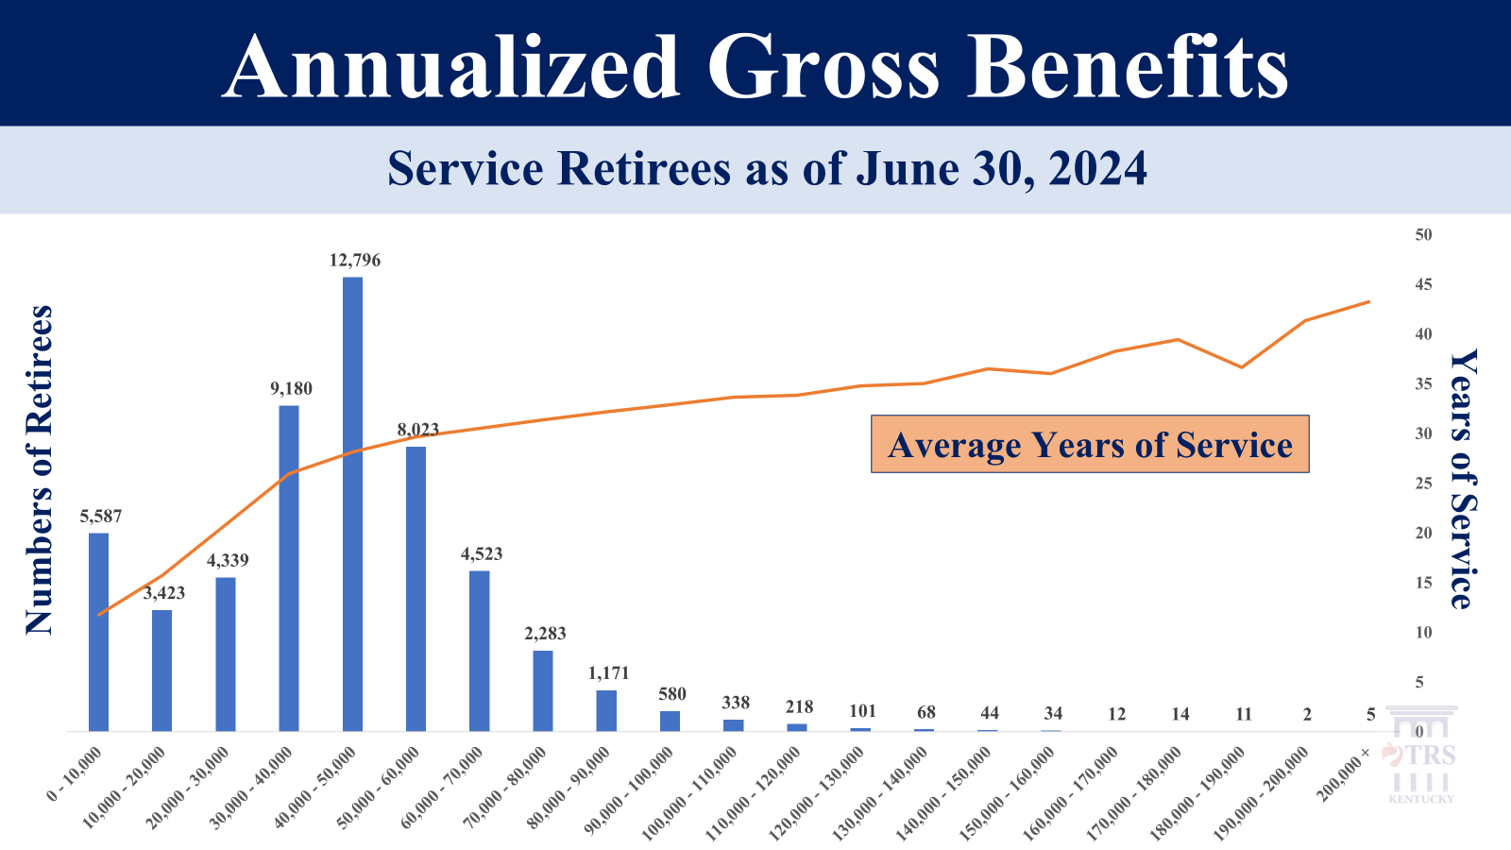
What the Chart Shows
66.96
50k or less
82% of retired teachers receive $60,000 or less
1.6% of retirees receive more than $100,000
  On average worked a decade more than retirees receiving $60,000 or less
Remember: TRS replaces Social Security
Note: Excludes disability retirement payments
Notes:
As I mentioned, here’s some takeaways from the previous slide.
In summary, 82% of retirees receive $60,000 or less.
Only 1.6% earn more than $100,000, but they averaged a career more than a decade longer that those who get $60,000 or less.
And, when considering the amounts, remember that these benefits replace Social Security.

Slide 14
Retirees By Age At Retirement
Fiscal Year 2024: 2,016 Service Retirements
Average retirement age
58
Only 3% retire before age 50
Five times as many people retire at 65 and over than retire under age 50
Average career teacher retiring in FY 2023 worked 29 years
Notes:
This slide for service retirements shows some continuing trends. What you see includes return-to-work retirements but not disability retirements. You can see, by far, the biggest numbers are at 55 and 60.
Of course, 55 is highest at 372 because that is retirement eligibility, and it also allows for the high three salaries to be used once the member has 27 years of service. In comparison, look at the number of individuals retiring at the age of 54 – just 44 people. Obviously, people hang in there one more year to retire at age 55 to get the average of the high three salaries for the calculation.
The next highest bar is age 60 where there no longer is a penalty for individuals retiring with fewer than 27 years. That was 182 people.
The average retirement age for service retirements in fiscal 2024 was 58, and five times as many teachers retired at 65 and older as retires under age 50.
All these trends are watched by the Board of Trustees and TRS administration.

Slide 15
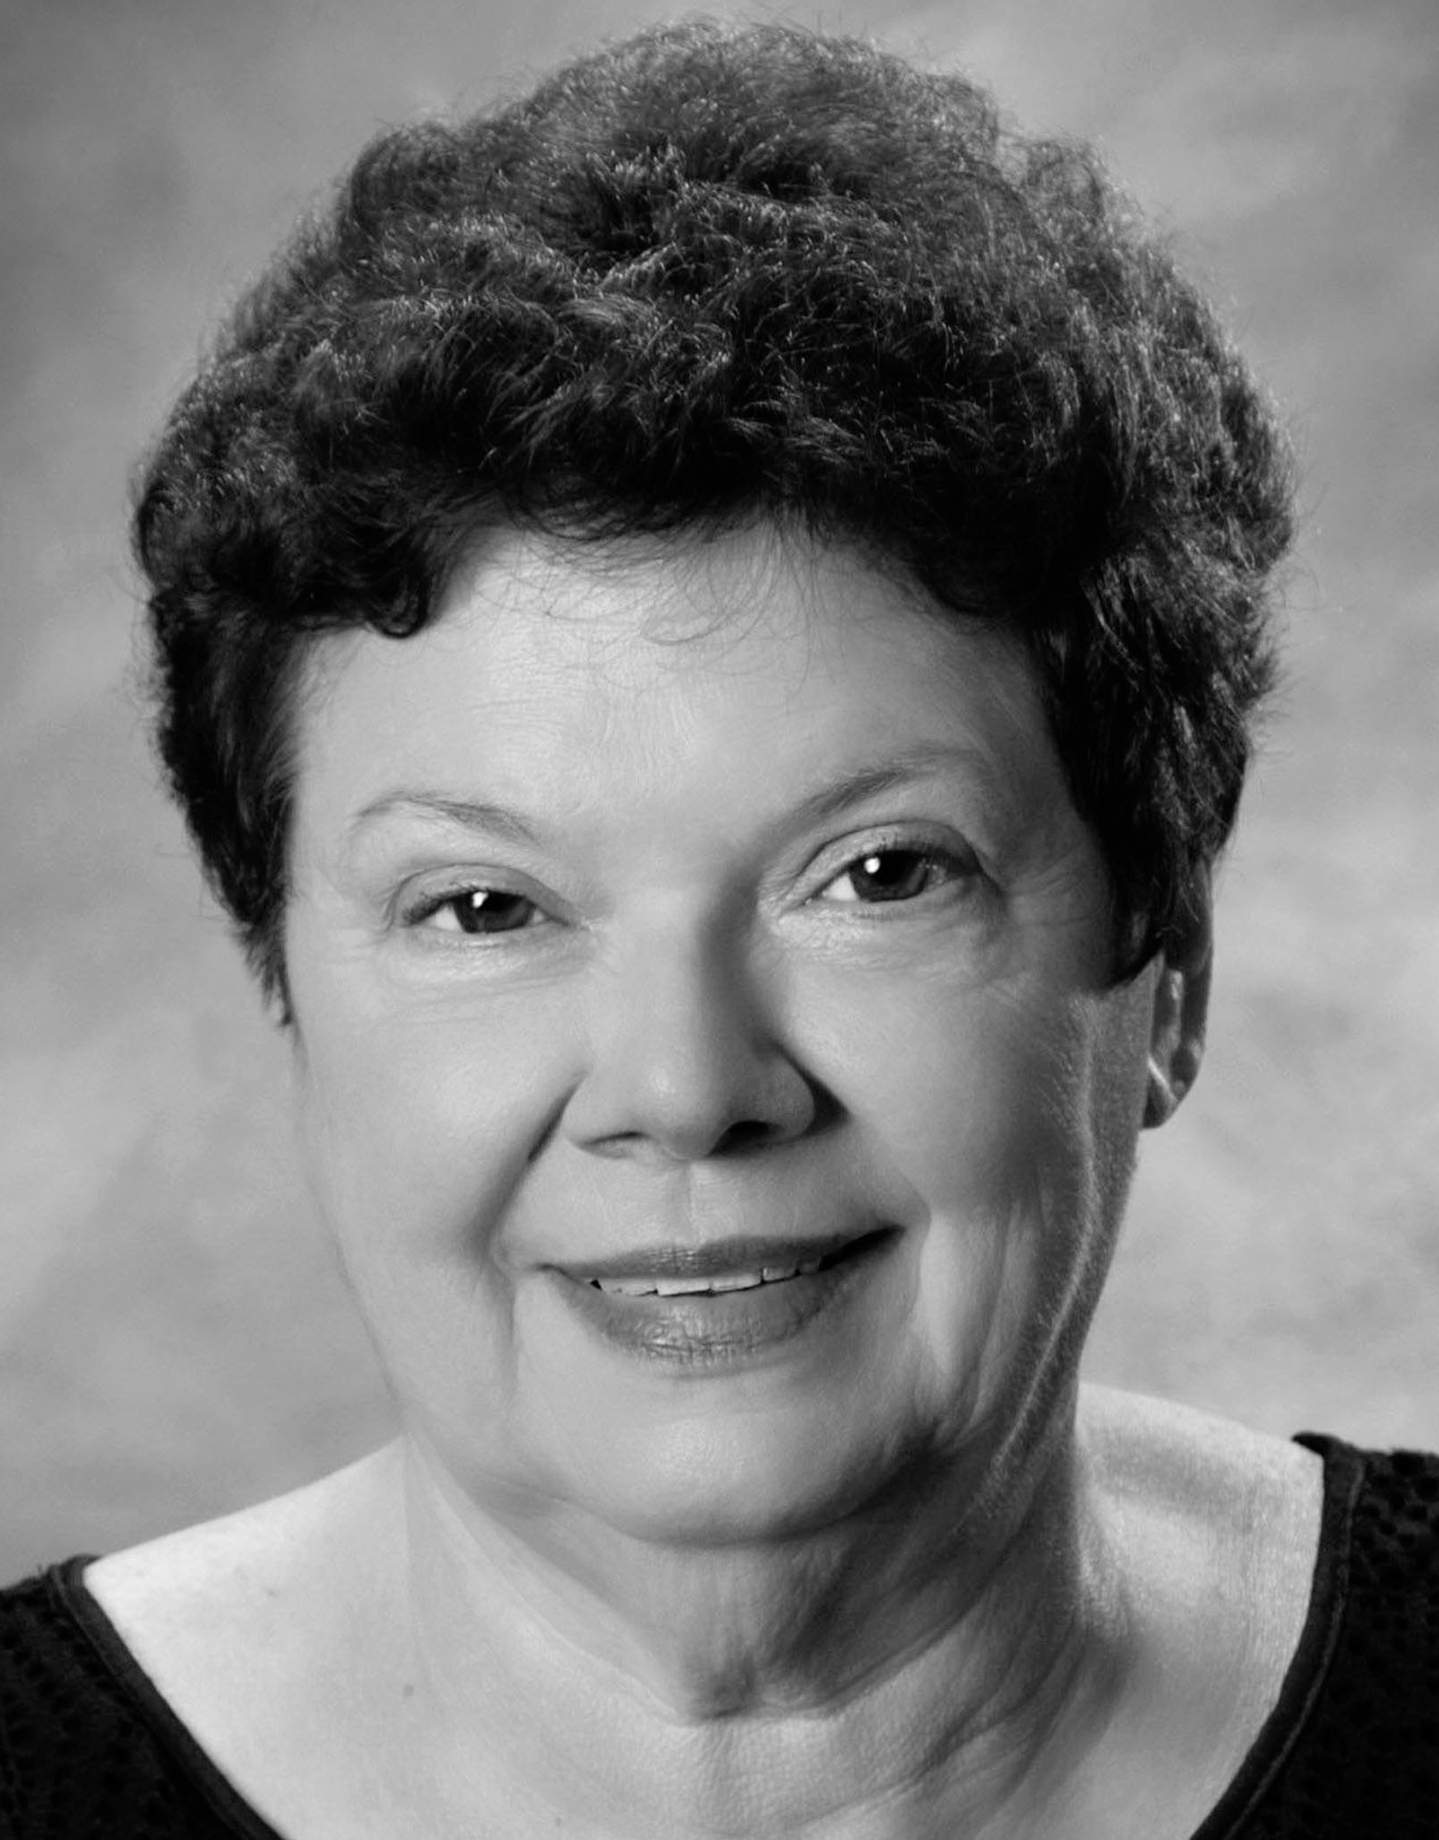
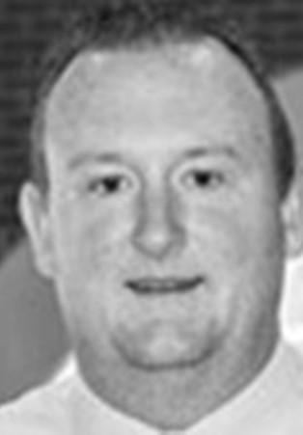


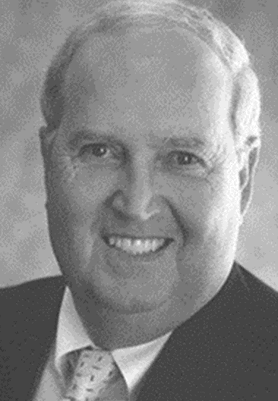
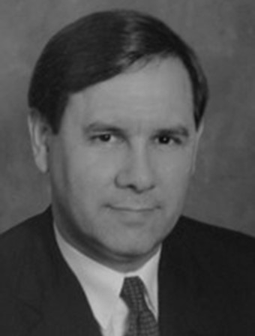

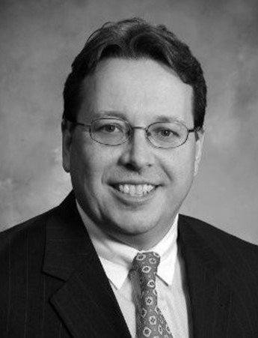


Board of Trustees
Fiduciaries of TRS
BRENDA MCGOWN Chair, Bowling Green | BEN LITTLEPAGE, Ed.D Vice Chair, Murray | PAUL Bruce Louisville | ROBBIE FLETCHER Education Commissioner | HOLLIS GRITTON Union
MARK METCALF State Treasurer | LAURA SCHNEIDER Walton | LOUIS STRAUB Louisville | JOSH UNDERWOOD Tollesboro | ALISON WRIGHT Georgetown | VACANT
Notes:
Speaking of the Board of Trustees, the administration of TRS is the responsibility of its 11-member board that is comprised of the education commissioner, the state treasurer, two gubernatorial appointees with investment experience and seven elected trustees. The trustees are an essential element of TRS’s consistency and investment success.
Here’s your current Board of Trustees. Most of these trustees are elected by members and retirees. This model has served Kentucky’s public school teachers well for more than 80 years. Josh Underwood was re-elected this spring.

Slide 16
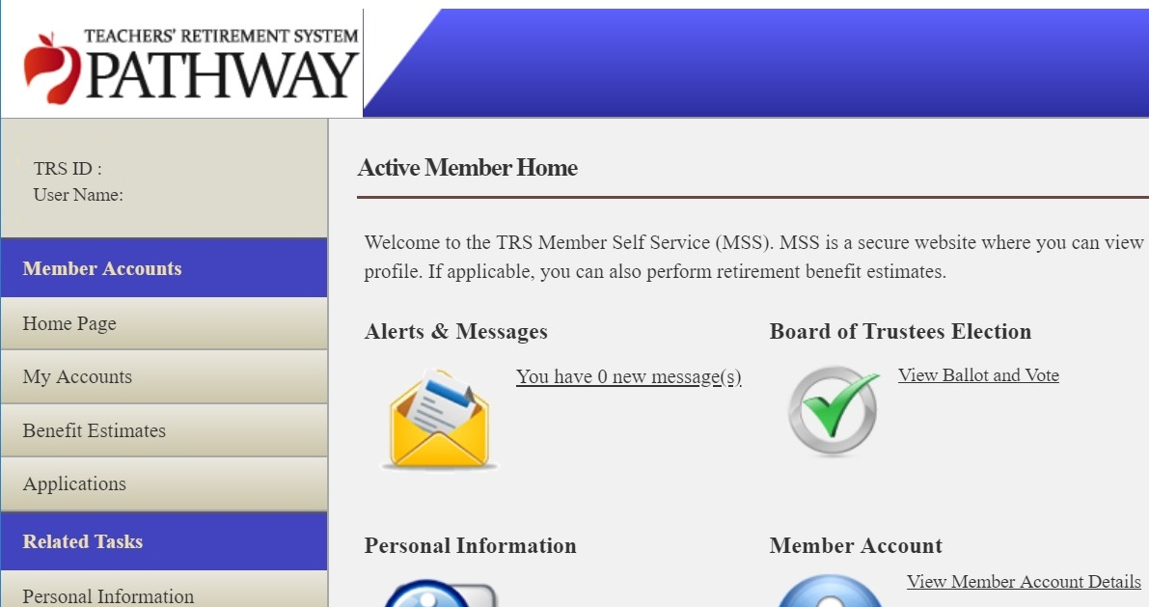



Trustee Elections Each Spring
By Pathway or Paper
April
May
All contributing members and retirees have the privilege to vote.
Notes:
Speaking of the elections, every year, elections are conducted online and by mail for usually two trustee seats. (Every fourth year, there’s one.)

Slide 17
TRS Expenses vs. Other Systems
As of June 30, 2023
 | Percentage of Liabilities
TRS Kentucky | 0.0357%
Louisiana Teachers | 0.0425%
Indiana Public Employees | 0.0427%
New Mexico Public Employees | 0.0619%
Georgia Employees | 0.0650%
Kansas Public Employees | 0.0673%
Ohio Teachers Retirement System | 0.0708%
Kentucky Public Pensions Authority | 0.2326%
Notes:
Something the trustees watch is TRS’s administrative expenses. The board’s leadership has allowed TRS to keep costs down, not only in investing but in all the operations. This shows you that the administrative cost for TRS is among the lowest in the country. Ohio is the only other state on this list that provides health insurance coverage like the two Kentucky systems shown. This is measured as a percentage of liabilities, because with greater liabilities, it behooves you to be even more frugal.

Slide 18
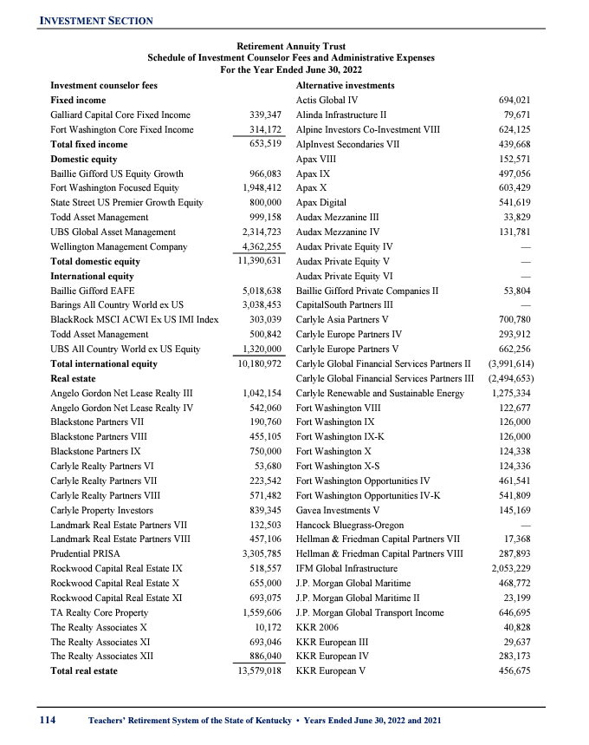
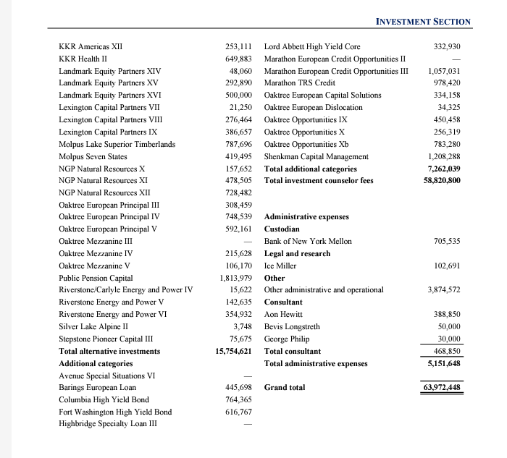
Transparent Low Investment Fees
From Most Recent TRS Annual Report (pages 112-114)
FY 2023
Total $78.9 M
33/100 of 1%
of annuity assets
Notes:
Just like the administrative costs, TRS has some of the lowest investment fees around. All investment fees are reported quarterly on the TRS website and annually in the comprehensive report, an example of which is shown here on this slide. This information is on pages 112 through 114 of the most recent report. The $78.9 million in investment fees is 33 one-hundredths of one percent. How small is that compared to the assets? Imagine one of your young grandchildren …

Slide 19


Transparent Low Investment Fees
What Is 33/100 of 1%?
A 4-foot, 9-inch-tall child standing beside the Empire State Building.
Notes:
Standing next to the Empire State Building. (1,454 feet high at the antenna’s tip)

Slide 20
Actuarial Status
As of June 30, 2023
Dollars in billions
Assets
$ 24.7
Liabilities
$ 42.2
Unfunded
$ 17.5
Percent
58.6%
Retirement Annuity Trust
Actuarial values
Notes:
Here’s where TRS stands on the road to being fully funded.

Slide 21
Funding
2024-26 Biennial Budget
Means 10 straight years of full or nearly full annuity funding
More than $1.75 billion to meet actuarially required contribution for annuities
$161 million for state statutory contribution for under-65 health insurance under Shared Responsibility
Beyond requested amounts appropriated in the budget (House Bill 6), House Bill 1 provides an additional $80 million
Notes:
These are the specifics of the current budget, which provides full funding. This biennium of full funding means a decade of full funding ((read remainder of slide))

Slide 22
Funding
A Tale of Two Different Decades
A decade of full or nearly full funding appropriated
Followed a decade of underfunding
Funding progress is steady and on track with funding plan
Impacts of underfunding take time to overcome and the higher contributions required as a result don’t disappear when full funding starts
Notes:
Some things to remember about funding.

Slide 23
Actuarial 30-Year Projections
At Full Funding, TRS Required Contributions Decrease
Actuary’s retirement annuity projections at assumed 7.1% investment return.
Thick lines show projections; thin lines show projections adjusted for investment returns 1% higher and lower.
Funded
ratio
Unfunded
liabilities
Required contributions
Notes:
And where do we go from there? If full funding is maintained, we hit 100% around 2048. What you see here is the actuary’s 30-year projection of the road to being 100% funded.
Where we are now, in both of these charts, is at the left.
The top chart shows how the funded ratio in blue improves over time as the unfunded liabilities in gold come down. The lighter lines show ranges of 1% above and below the bold lines.
On the bottom, the green lines show the contributions required – and here’s the real significance of this slide – when the funded ration hits 100 and the liability is addressed, the cost of this plan drops significantly.

Slide 24
Two Plans for TRS Health Benefits
KEHP
Kentucky Employees’ Health Plan
Under 65 and not Medicare-eligible
Same fund as active teachers and state employees
Coverage options
MEHP
Medicare Eligible Health Plan
Medicare-eligible or 65 & over
Exclusively TRS members
One plan
Notes:
So, now let’s discuss retiree health insurance. As you remember, TRS offers two health plans for retirees
The Kentucky Employees’ Health Plan for members under the age of 65 and not Medicare-eligible
And the Medicare Eligible Health Plan for members age 65 and over or who are Medicare-eligible.

Slide 25
Insurance Details Can Change
Kentucky law guarantees retired teachers access to group coverage, but the details of that coverage – including costs, subsidy and level of coverage – can change.
Notes:
And before we discuss details, here’s our annual reminder that retirees are guaranteed access to group health insurance coverage, but the details around that coverage can change.
That said no major changes are planned in terms of what’s offered.

Slide 26






KEHP
MEHP
Consists Of
Notes:
The two plans use many vendors to help TRS provide you with the retiree health insurance coverage.
These are the current KEHP providers. Open enrollment is passive and will be October 7 through October 25, 2024. If you don't want to change your coverage for 2025 you don't do anything. Watch for your Open Enrollment packets for any changes and review your options to ensure the plan you currently have is still available and will meet your needs for 2025. A fourth plan option, the LivingWell High Deductible Health Plan (HDHP), will be added back. Again, you don’t have to do anything unless you want to change something.

Slide 27




MEHP
MEHP
Consists Of
Notes:
Here are the vendors for the MEHP. They’re all familiar names and faces. There are no vendor changes upcoming.
Open enrollment is passive and if currently covered, there’s no need to do anything to continue coverage for 2025. Open enrollment dates are Nov. 1 to Dec. 7. Reminder: Spouses are not allowed to enroll during open enrollment. Lastly, if you are currently enrolled in the MEHP, you will receive a new UnitedHealthcare card for 2025 due to the 24-hour nurses line being discontinued. No new ESI ID cards will be sent for 2025.

Slide 28
MEHP
MEHP
Part B Premium Reminder
Ways to Pay
Either deducted automatically from a Social Security benefit check or billed quarterly.
Options if you are billed:
Medicare Easy Pay – deducted from checking, automatic payment
Mail
Direct payment using your bank’s website
Credit card at MyMedicare.gov
Failure to pay the Part B premium results in termination of MEHP coverage.
Notes:
This slide is a reminder for folks who don't draw a Social Security check to have their Part B premium withheld and encourage them to enroll in Medicare Easy Pay. Unfortunately, we’ve had a number of folks lose their coverage because their Part B premium was not paid. This is a good time for those under 65 to understand that they have to pay a Part B premium to Medicare once they turn 65...

Slide 29
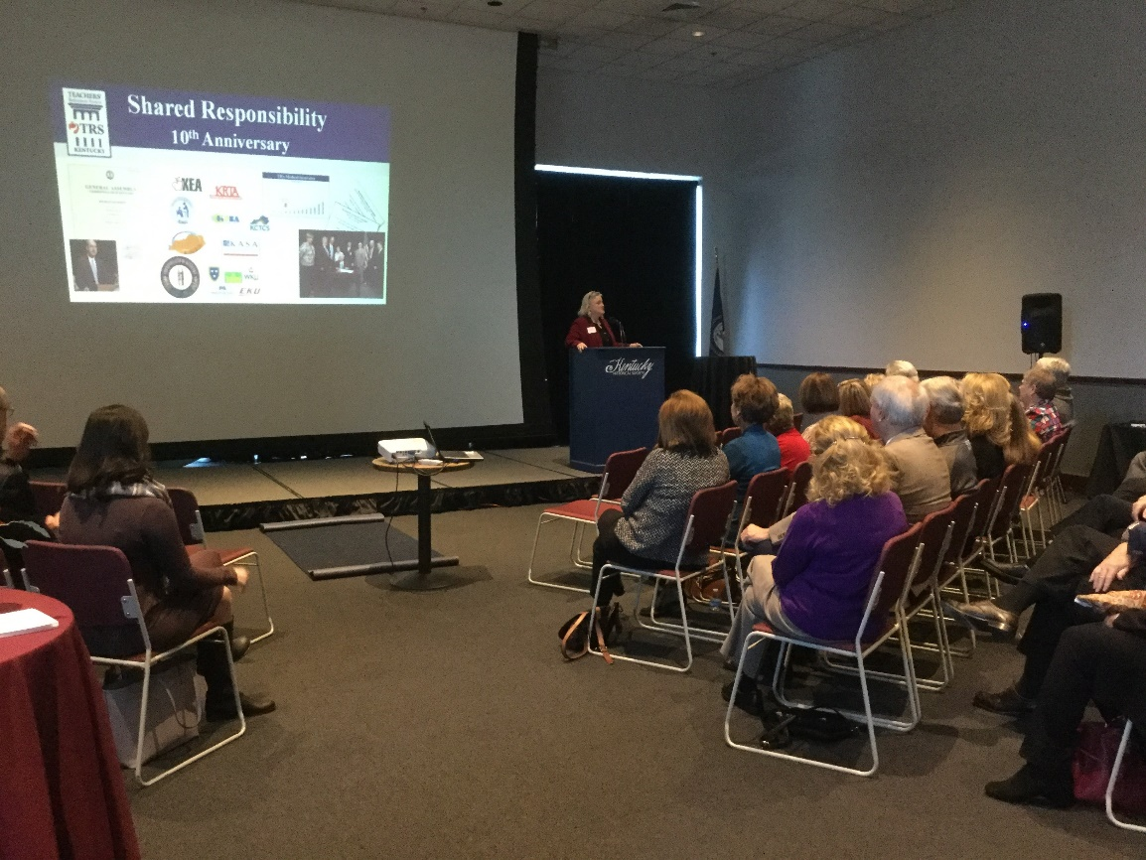
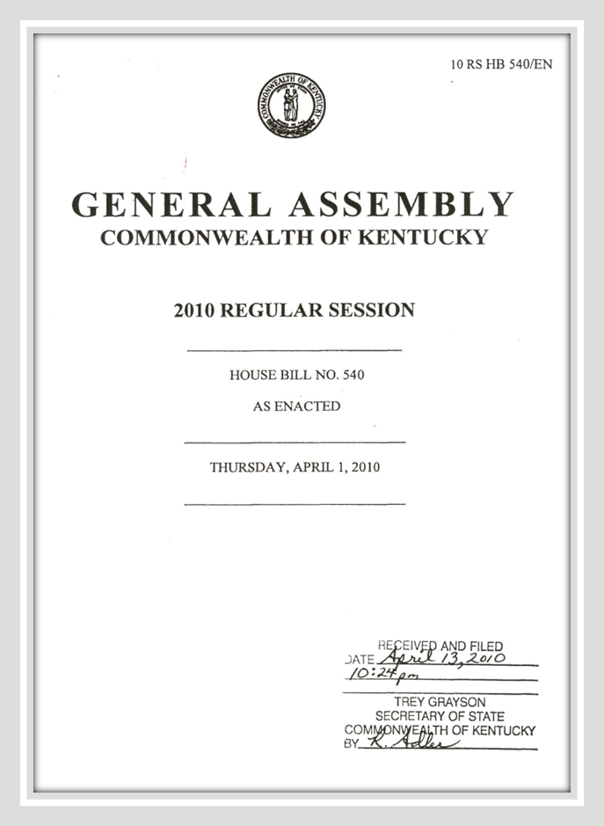
Shared Responsibility
In Second Decade
Shared solution providing permanent funding for retiree health care
Notes:
TRS is able offer this retiree coverage because of the tremendous success of Shared Responsibility. Regardless of which plan a retiree is on, the bedrock for everything in the retiree health insurance plan is Shared Responsibility, which continues in its second decade!!
This plan is ensuring that insurance will be available for retirees for years to come.

Slide 30
Shared Responsibility
How the Cost Has Been Shared
Teachers and retirees
School districts and universities
State
Notes:
This chart shows how the cost has been shared. Everyone – teachers and retirees, districts and other employers and the state – pays something as part of this shared responsibility.

Slide 31
TRS Health Insurance
Funded Status
Shared Responsibility
Becomes law
9
Notes:
We’re well on our way to full funding of the health insurance trust.

Slide 32
MEHP
MEHP
Premiums
Employer Group Waiver Plan starts
Medicare Advantage starts
Premiums Held Almost Constant For 20 Years
Notes:
Premiums have been held constant for 20 years.

Slide 33

Know Your Rx Coalition Pharm-Assist
KEHP
MEHP
Know Your Rx Coalition
Free counseling with live pharmacists
Hours: Monday to Friday, 8 a.m. to 6 p.m. ET
Phone: 855-218-5979
Email: KYRx@uky.edu
Website: www.KYRx.org
Notes:
One of our greatest successes continues to be the Know Your Rx Coalition. …

Slide 34


TRS Solution:
Personalized Medicine
Partnership
KEHP
MEHP
Personalized Medicine
You
Your Doctor
Your Pharmacist
Notes:
The KnowYourRx Coalition in an essential piece of the Personalized Medicine program that provides you with DNA testing to help ensure you’re taking medications that work for you.

Slide 35
KEHP
MEHP
Personalized Medicine
Why It Works
Helps avoid taking ineffective medications that even could be fatal
Saves money for retirees and their insurance trust
Uses DNA testing to help doctors making treatment decisions
Results help make sure medications are beneficial from the start
Avoids traditional trial-and-error process without DNA information
Notes:
Why does Personalized Medicine work for our retirees?

Slide 36
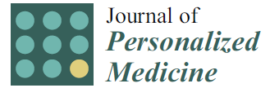
KEHP
MEHP
Personalized Medicine
Peer-Reviewed Initial Results Receive Attention
66% had genetic risks detected in a current medication
14.9% reduction in inpatient visits
6.8% reduction in emergency room visits
$37 million savings in direct medical charges over 32 months
Notes:
Here’s the results of our experience from a peer-reviewed journal. But I’m sure many of you have personal stories of how this program has benefitted you or someone you know.
36

Slide 37
KEHP
MEHP
Personalized Medicine
How to Sign Up
MEHP
KEHP
Contact Coriell at 888-454-9024 or www.coriell.com/trs to request free DNA kit.
Discuss with your doctor whether a DNA test could be covered because of medical necessity.
or
Retirees on KEHP can contact Coriell and use HRA funds to pay the $360 cost.
Notes:
It’s never too late to register, especially if you’re a new retiree. Here’s how to take part.

Slide 38
Retirements and Counseling
Fiscal 2024
7,468
Scheduled
Visitors
*Unaudited
Notes:
Now let’s move into member benefits. The number of retirements in the last year, preliminarily 2,010, is right in the normal range of about 2,000 retirements a year that we’ve seen for most of the last decade.
As you can see on the right, we talked to A LOT of you and your successors about retirement issues, and we’re happy to do so. With modern conveniences, not all of those visitors are in person. Almost four in 10 visitors took advantage of video counseling, which continues to be an extremely popular way to meet with a counselor. (Only 160 cancelations.) (Last year’s visitor number was 6,272.)

Slide 39
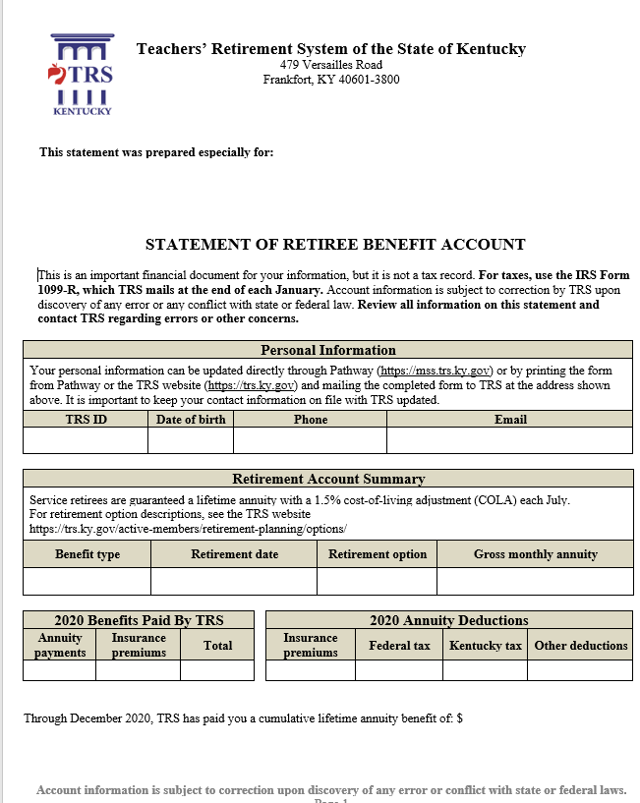
Retiree Annual Statements
Summarizes
Personal information on file with TRS
How to update that
Annuity benefits received
Federal and Kentucky state tax withholding
How to change withholding
Retiree health insurance
Beneficiary information
Annuity automatic deposit information
Payment dates
Don’t return with changes; using appropriate form or Pathway (https://mss.trs.ky.gov).
Notes:
Again this year, TRS sent retiree annual statements. These statements provide a wealth of information. (Read list if needed, or not, as time permits)
Much of the information on this statements is available in Pathway.

Slide 40
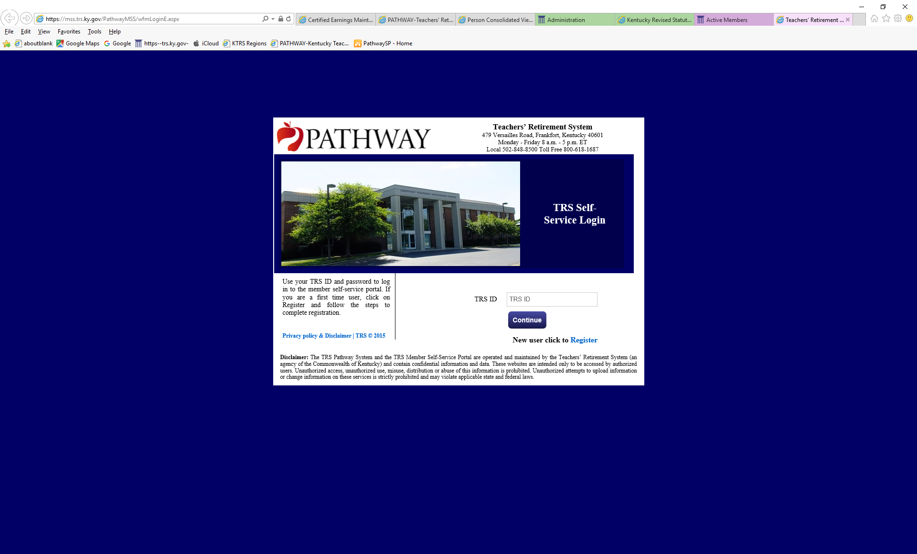
What is Pathway?
Pathway provides secure online access for members and retirees to access their TRS account information in real time.
Notes:
Hopefully, by now, you know by now that Pathway is the website that provides retirees with secure access to benefit information. Remember all the things you can do in Pathway
Edit or view personal information
View active or payee account details
Submit a request
View schedule of upcoming seminars and webinars
Vote in annual trustee elections
Find links to TRS forms
Submit health insurance applications

Slide 41
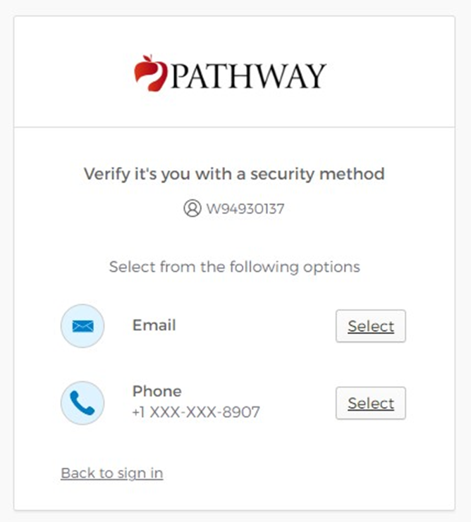
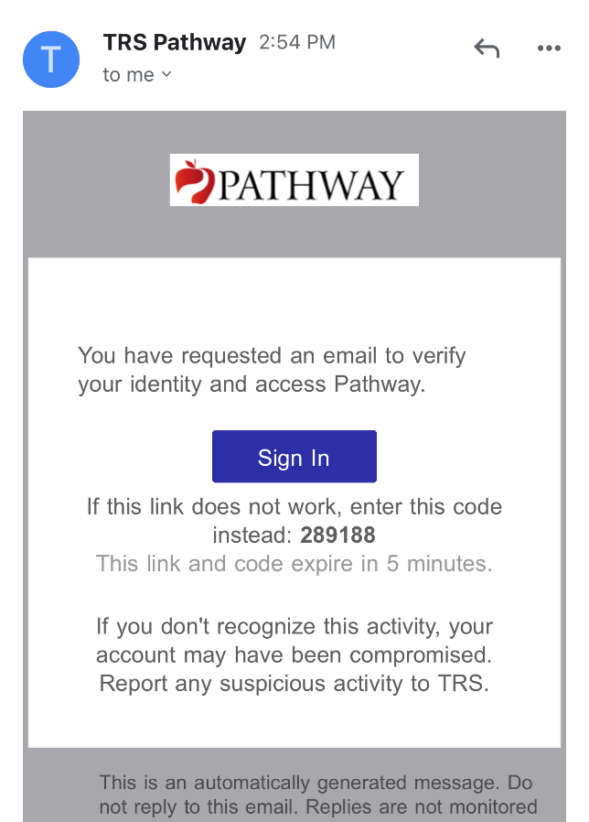
Using Pathway
Multifactor Authentication
Registration process handout
Select verification
method
Receive code
Notes:
In April of last year, we upgraded security by changing the login process to include multifactor authentication. After logging in, select how you want to verify your identity – email, voice call or text. You’re sent a code to enter or if you’ve selected email, you can just click the link in the email. Initially, you have to register or, if you’ve used Pathway in the past, reregister one time.

Slide 42
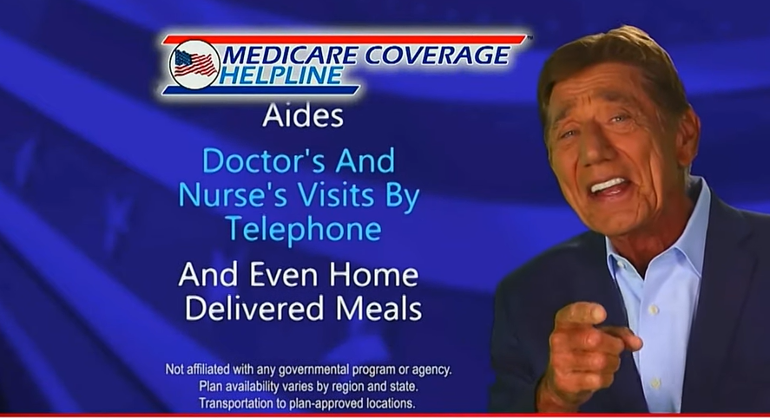
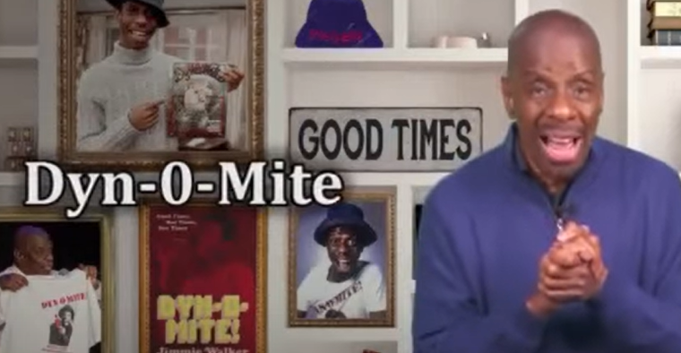
MEHP
What’s Jane Say
If Some Old Quarterback Says You Need More Coverage …
Tell Joe (and others like him), “No!”
If you are enrolled in the TRS Medicare Eligible Health Plan (MEHP), enrolling in another Medicare Advantage plan would “dynomite” your TRS MEHP coverage.
Watch video: https://youtu.be/r07m_jwc-wY
or https://trs.ky.gov/videos
Notes:
Now for some reminders.
First, remember not to fall for catchy commercials …

Slide 43

Don’t Be Fooled
Make Sure You’re Talking to TRS
Third-party solicitations are not from TRS, and nor does TRS offer counseling through third parties.
Notes:
Second, be careful of what you receive from others. This slide primarily is for our active members, but it also can apply to retirees too. We’re aware of third parties soliciting business saying they’re offering a KTRS or TRS retirement review. Or they say they’ll buy your pension benefit. Third-party solicitations are not from TRS, and nor does TRS offer counseling through third parties. Look for the TRS logo and don’t hesitate to call and ask us.

Slide 44
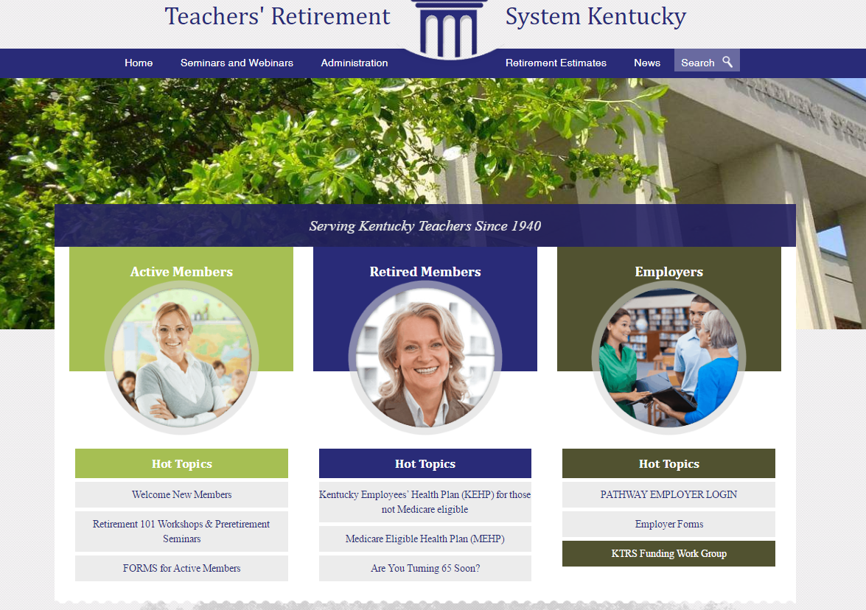






TRS News and Information
https://trs.ky.gov
https://mss.trs.ky.gov/
@KyTeachersRS
facebook.com/KyTeachersRS
https://www.youtube.com/@trskentucky
Notes:
Let’s wrap up today also reminding you of places and sources you can trust for TRS information. These are the TRS website, Pathway and our pages on Facebook, YouTube and X, formerly known as Twitter.

Slide 45
Doing It Right
What That Means at TRS
Providing security for Kentucky’s retired teachers using a long-term investing process proven and refined over decades to achieve top returns on investments at the lowest costs.
Notes:
Finally, I’ll wrap up where I began. As we mentioned at the outset, our goal every day is to do it right.

Slide 46

Appreciation
Notes:
And, again, thank you for your gold medal of service to Kentucky.

Slide 47
Our Members Come First!
800-618-1687
8 a.m. – 5 p.m. ET
Monday – Friday
info@trs.ky.gov
https://trs.ky.gov
Protecting & Preserving Teachers’ Retirement Benefits
Notes:
Feel free to contact teachers’ retirement if you have any questions about your account or about retirement in general. We are open 5 days a week from 8 to 5 Eastern Time.
Before we close out are there any final questions?

