Slide 1
Madison Quilt Guild 2025 Challenge

Slide 2
Our Challenge is based on:

Slide 3

Our Challenge is based on:
The Board Game

Slide 4
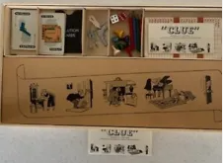
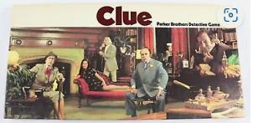
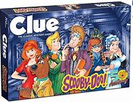
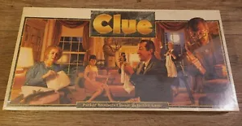
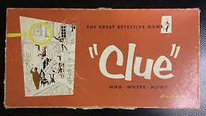

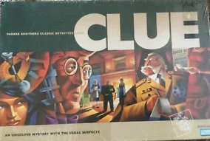
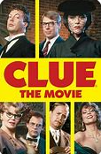
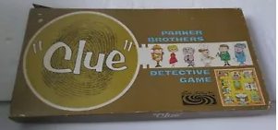
1972
History
1950
1992
1956
1963
1996

Slide 5
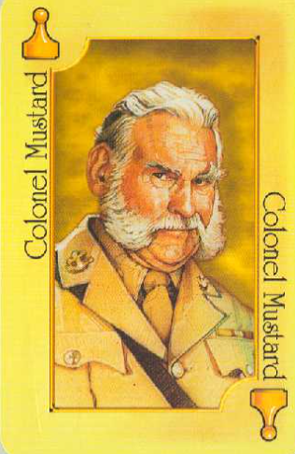
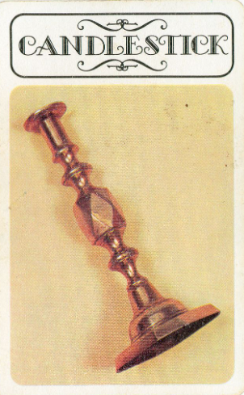

Suspect
Weapon
Room

Slide 6
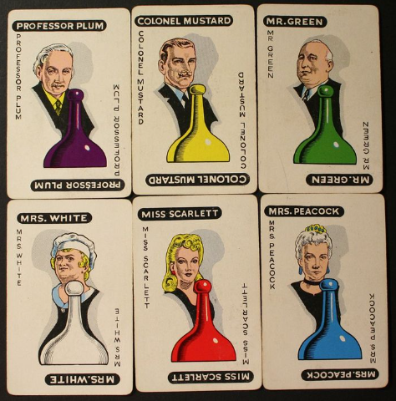
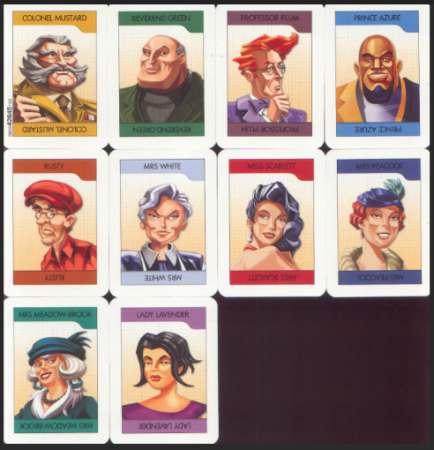
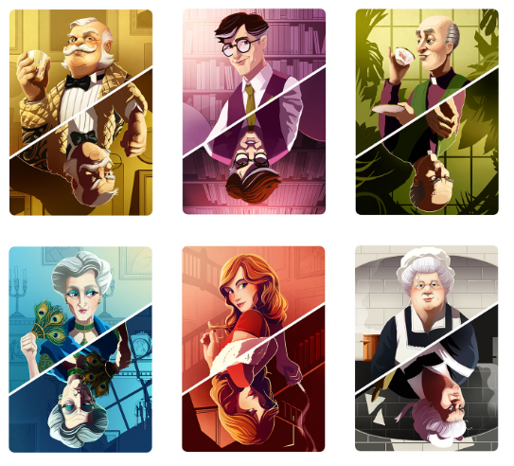

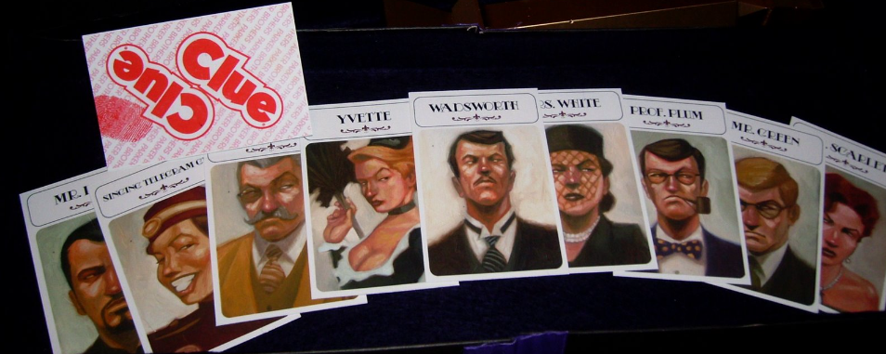
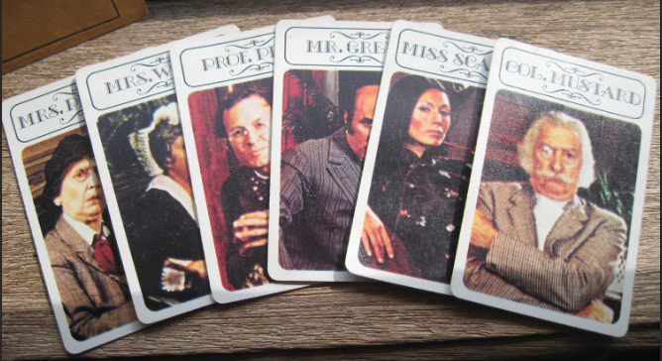
Suspect

Slide 7
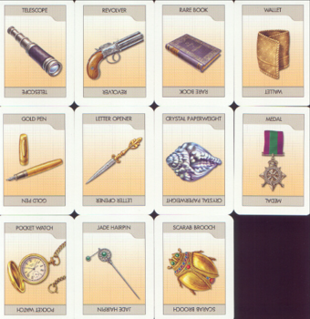

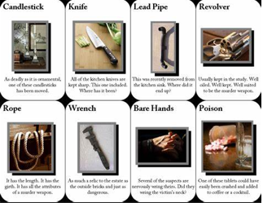
Weapon

Slide 8
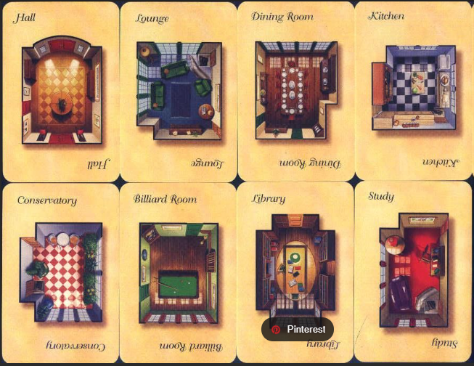
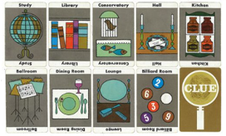
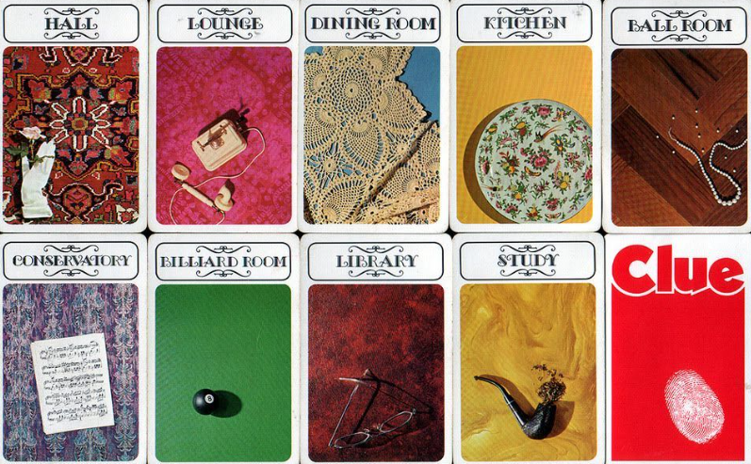
Room

Slide 9
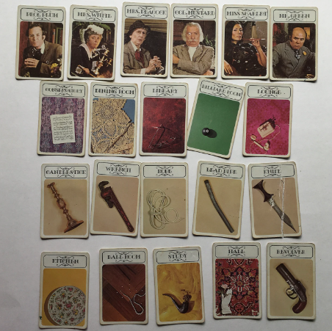
Drawing a Clue Card
It does not have to be exactly what is on the card only inspired by it.
It can be any topic, as long as you can explain the “Inspiration Route”.
This can be serious, whimsical, or just plain CrAzY!

Slide 10
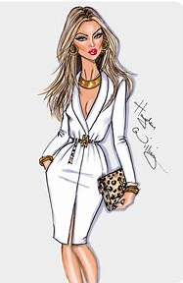
Example 1
The Ms. Pinkerton card was chosen
Ms. Pinkerton

Slide 11
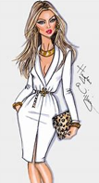
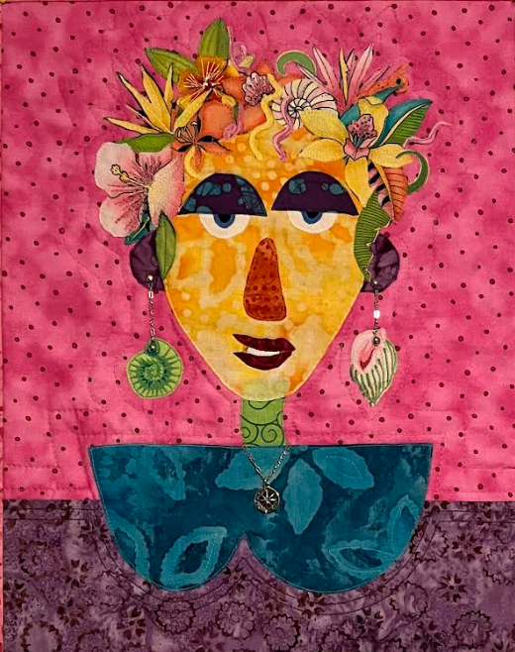
Inspiration Route
Ms. Pinkerton
Self portrait

Slide 12
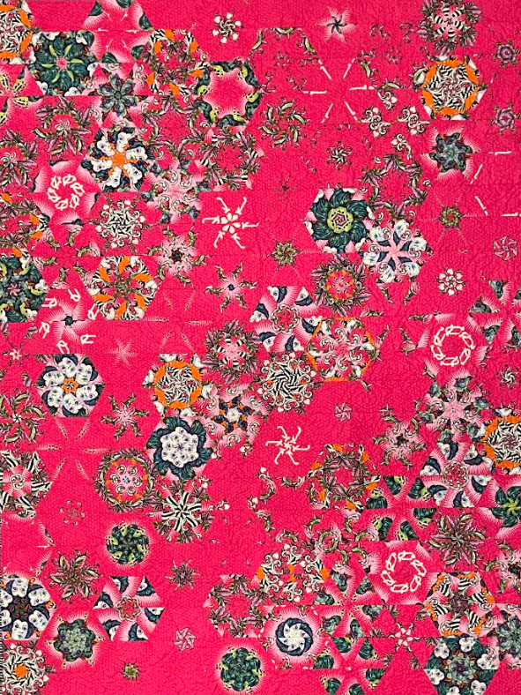
Inspiration Route
Ms. Pinkerton
Pink quilt
Self portrait

Slide 13
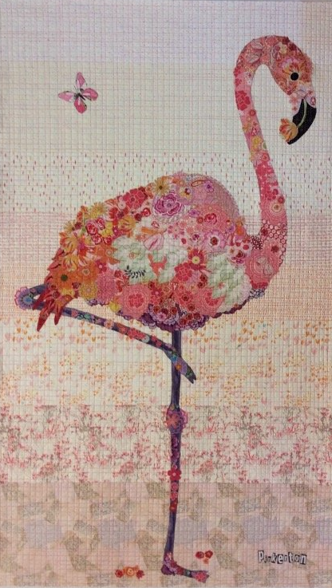
Inspiration Route
Ms. Pinkerton
Pink quilt
Self portrait
Pinkerton

Slide 14
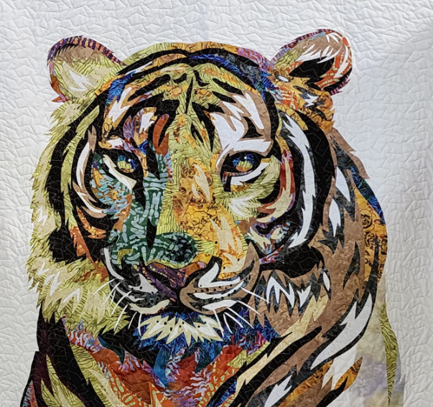
Inspiration Route
Ms. Pinkerton
Pink quilt
Self portrait
Pinkerton
Ms. P’s clutch

Slide 15
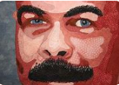
Inspiration Route
Ms. Pinkerton
Pink quilt
Self portrait
Pinkerton
Ms. P’s clutch
Ms. P’s - Mr. P

Slide 16

Example 2
The Rope card was chosen
Rope

Slide 17
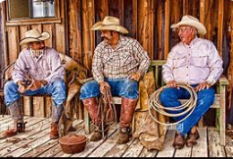
Rope
Cowboys carry ropes
Inspiration Route

Slide 18
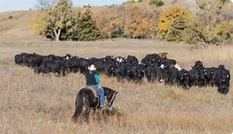
Cowboys lasso cows
Rope
Cowboys carry ropes
Inspiration Route

Slide 19
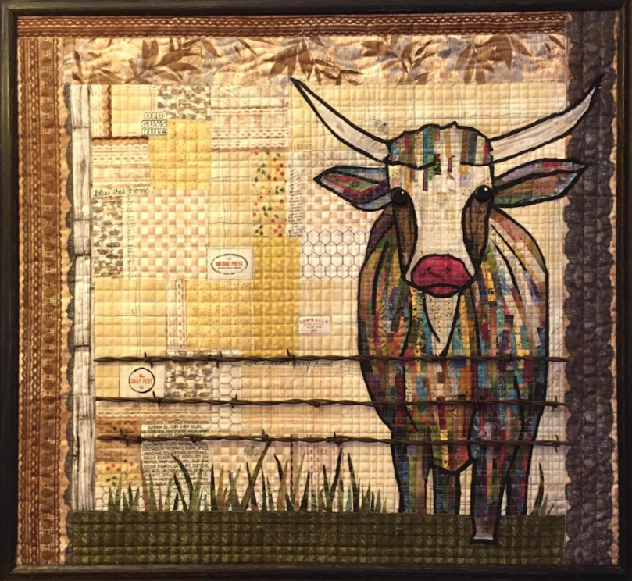
Cowboys lasso cows
Rope
Cowboys carry ropes
Cow
Inspiration Route

Slide 20
Example 2.1
The Rope card was chosen
Rope

Slide 21
Rope
Cowboys carry ropes
Inspiration Route

Slide 22

Rope
Cowboys carry ropes
Cowboys drink
Inspiration Route

Slide 23
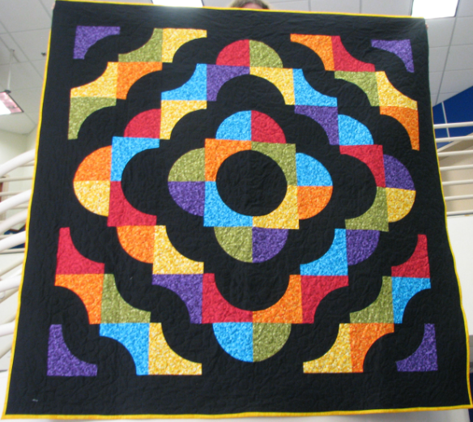
Rope
Cowboys carry ropes
Cowboys drink
Drunkards Path
Inspiration Route

Slide 24
Cowboys lasso cows
Rope
Cowboys carry ropes
Cow
Cowboys drink
Drunkards Path
Inspiration Route

Slide 25
The 2025 Challenge Rules
Must have 3 layers: top, batting, and backing
Can be a quilt or project made with fabric
Quilt can be any width/length
Non-quilts/projects must make arrangements for display
Only one judged entry per guild member
Must explain the “Inspiration Route”

Slide 26
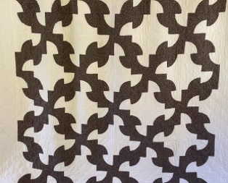
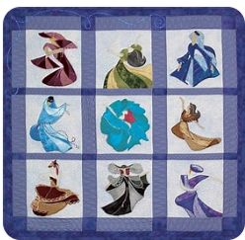
Inspiration Routes
Rope. Cowboys carry ropes cowboys drink drunkards path quilt.
Inspiration route:
MSQG
Challenge 2025
Inspiration route:
Ballroom.. Women dancing in the ballroom.
MSQG
Challenge 2025

Slide 27

Challenge Categories 2025
Best Suspect
Best Weapon
Best Room
Best Quilted “Project” (Best non-quilt)
Best Execution of Inspiration Logic
Viewers Choice

Slide 28

Turn In
8 November
Saturday 10-2
102 Stanley Ave, Madison

Slide 29

MSQG
Challenge 2025

