Slide 1
Please Dial In to Hear the Call
973-348-3030 PIN: 101816
Bit Mining Made Easy

Slide 2
disclaimer
SparMiner is a division on Spartech Solutions, LLC, a technology company. SparMiner is not an investment company and does not provide investment guidance, we are selling the technology and the storage for BitMining. As with any investment, it is your responsibility to make sure that you are doing your own independent research for this or any venture. Spartech cannot guarantee the future of BitCoin or the BitMining industry.

Slide 3
What is bit mining?
Bitcoin mining is the process by which transactions are verified and added to the public ledger, known as the block chain, and also the means through which new bitcoin are released. Anyone with access to the internet and suitable hardware can participate in mining. The mining process involves compiling recent transactions into blocks and trying to solve a computationally difficult puzzle. The miner is a server that helps complete the transaction and collects a fee for doing so.

Slide 4
What does that mean?
As a Bitcoin Miner, you are mining a percentage of a Bitcoin transaction, that is considered your fee for performing that service. This percentage is based on the price of Bitcoin, you are essentially waiting for the price of Bitcoin to raise or lower and your percentage increases and decreases in real time. Like anything, the market will fluctuate but the higher the price goes the higher the payout is.

Slide 5
What does the mining?
The ANTMINER S9 is the most efficient Miner on the market.
The server helps create and complete the computational block chain and the mines a percentage for you.
It depends on a secure and fast connection, the better the connection and the faster the speed the more mining it can do.
This is where SparMiner helps you compete.

Slide 6
Why sparminer?
The Data Center
Ease of Maintenance
State of the Art climate controlled, biometrically secured data center
Redundant power, redundant internet and firewall protected
Running Time 24/7/365 (99.99%)
On-Site Technicians Inspecting Daily
Fire Suppression
Enhanced Physical Security
Bit Miners are loud!
They are hot!
They consume a lot of power!
You need BitCoin to buy them.
Your home firewall can’t protect them.
SparMiner does the setup and programming of the server.
Sparminer sets the AntMiner at the optimal running rate.
We only use reputable vendors for the Bit Miners.

Slide 7
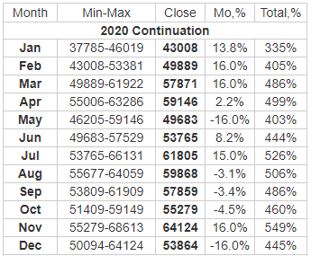
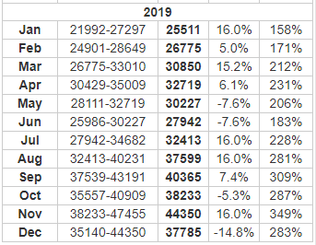
What is the future of BitCoin?

Slide 8
2018

Slide 9
2019

Slide 10
2020

Slide 11
The Ant Miner S9
Currently the most efficient miner on the market
13.5 TH/s in mining capability
1 Miner mines 1% of the price of Bitcoin every 3 days
A second miner will increase to 27 TH/s and is currently mining 1% every 1.75 days
The more miners you add the more efficiently you operate
The most efficient power consumption

Slide 12
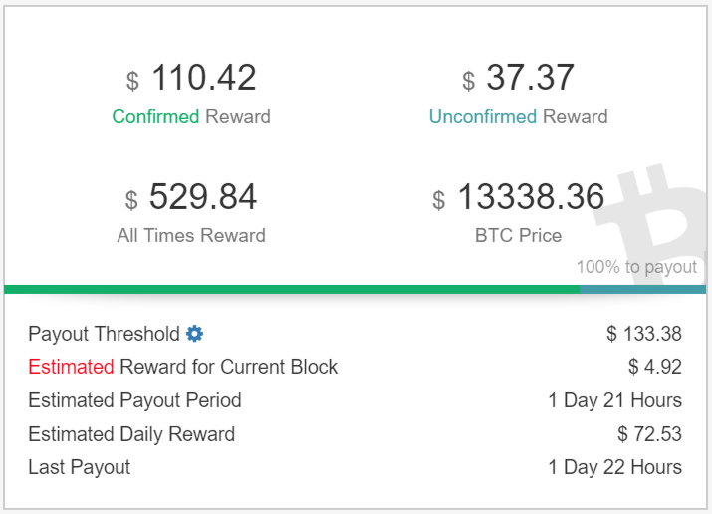
The slush account and Coinbase

Slide 13
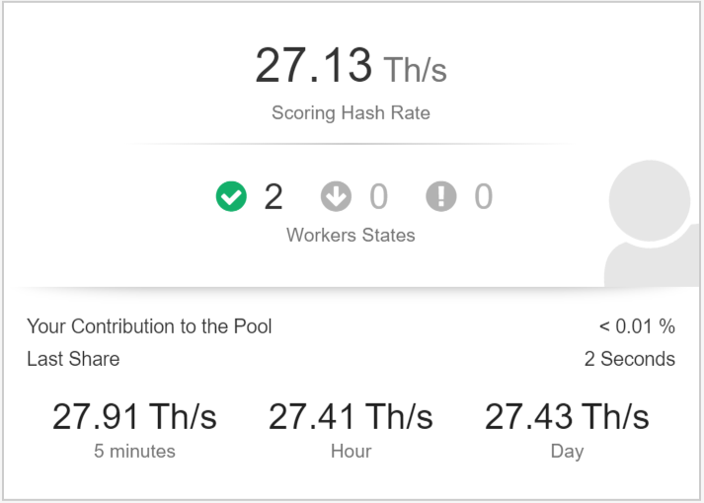
The slush account and Coinbase

Slide 14
2018 Projected Value

Slide 15
What is the future of BitCoin?

Slide 16
Whats next?
The next round of Bit Miners open for purchase is Mid-February
The current cost of the Ant Miner S9 is $7,000.00 US
We can’t guarantee that the price won’t increase, but we will guarantee the 7k for this round.
We have access to pre-order AntMiners for the next round and will honor everyone on a first come first serve basis.
To do so we have to convert money to Bitcoin
With your paid pre-order you will secure your AntMiner S9 for the February release.
You do not pay any hosting fees until your AntMiner S9 is successfully installed and running.

Slide 17
How do you get started?
Go to www.sparminer.com
Click on the “contact” link
Give your Name, Email, Message, Number of Miners and most importantly who referred you
You will receive a contract via Docusign, included in that agreement is a link to pay for the miner
You can pay via Credit Card or ACH
As the contracts are received you are placed in line a secured your position for the next round.
You will receive updates on the arrival of the miners as well as instructions for you Slushpool and Coinbase accounts.

Slide 18
Questions?

Slide 19
Q&A
Q: What is the warranty on the Ant Miner S9?
A: 90 Days
Q: If a fan blade or a power supply goes bad will Spartech fix the machine as a part of the service/storage agreement?
As long as you are a customer we will make standard replacements on the Ant Miner S9.
Q: When a new and better machine comes out, am I required to replace the current machine?
No, you can run your machine as long as you want. If you want to buy a new model it would run concurrently with the S9 increasing your overall TerraHash output.

Slide 20
Q&A
Q: How secure are these machines from a cyber attack?
Although nothing is 100% hack proof, the nature of the machines and the way it computes the block chain makes it difficult to expose. These machines sit behind Spartech’s Enterprise firewall in our data center.
Q: How secure is the Coinbase and Slushpool accounts used for the mining process?
Both Coinbase and Slushpool are two of the larger more reputable vendors for Bit Mining and are web based programs. They have better control over their security and access to their systems.

