Slide 1
9th – 12th Grades
Lesson 2
Notes:
WELCOME & INTRODUCTION 1:30
CLASS WELCOME
» Begin by welcoming students and discussing lesson and behavior expectations.
LESSON INTRODUCTION
» Today we are going to do the second lesson from the MBF Teen Safety Matters program. You will need your MBF Class Notes Sheet and a pen or pencil out and ready.
» During Lesson 1, we learned about digital safety and discussed peers and risky online behaviors including sexting and sextortion.
» Today we’re going to expand on those ideas and discuss healthy and unhealthy relationships, abuse and trafficking, and how to use the 5 Safety Rules to help you stay safe.
» Because this is such important information, I ask that everyone please pay attention and participate in the discussion and activities.
» Everyone should have their Class Notes Sheet. Throughout the lesson, as you learn key terms and other important information, I want you to write it on your sheet, so you will need to pay attention and follow along.
» Remember, we will be covering some sensitive topics. The expectation is that everyone will act maturely and be respectful of others’ feelings, emotions, and privacy.
» And if the information we discuss is difficult to hear or talk about, you may excuse yourself to the hall and/or talk to me, your school counselor, or another Safe Adult after the lesson.
» I also ask that if you have any personal stories to share related to what we are discussing today, you wait and share them after the lesson, not because they’re not important, but because we have a limited amount of time to get through the lesson today.

Slide 2
Safety Rules Review
SAMPLE
Notes:
SAFETY RULES REVIEW 1:30
» As we learned in Lesson 1, there are 5 Safety Rules you can use to help you stay safe. Each rule has an emoji to go with it to help you remember it. As we talk about different topics today, you will learn how these rules can help you stay safe. Let’s start with a quick review of each rule.
» Click to advance slide.
» Safety Rule #1 is Know What’s Up. Knowing What’s Up means you are aware of your environment and people around you, both online and offline. It includes things like:
knowing your personal information and your parents’ or Safe Adults’ work or cell phone numbers (many people have numbers saved in their phones but do not have the numbers memorized). This allows you to contact them during emergencies, or in times of need, even if you don’t have your cell phone.
being aware of the social interactions of those around you, called social awareness, and knowing whether situations are safe and appropriate, and if people’s behaviors are safe or not.
understanding if websites, apps, and online behavior is safe and appropriate.
knowing as you get older and assume more responsibility, how to make decisions that will help keep you safe.
» Click to advance slide.
» Safety Rule #2 is Spot Red Flags. Spotting Red Flags means recognizing potential dangers, online or offline. Red Flags may include:
bullying, cyberbullying, or other inappropriate online behavior.
adults or other teens trying to trick, force, or manipulate you into unsafe or inappropriate situations.
controlling behaviors or emotional or physical abuse between partners in a relationship.
» Click to advance slide.
» Safety Rule #3 is Make a Move. After you Spot a Red Flag, or recognize that a situation or person is unsafe, you can Make a Move by:
getting away from an unsafe situation or person if you can, or
staying away from unsafe or inappropriate people and situations.
» Click to advance slide.
» Safety Rule #4 is Talk It Up. Talking It Up means using your voice to help keep you and others safe. Here are some ways you can Talk It Up:
Use an assertive voice to say no to an adult or another teen violating your personal boundaries or demonstrating unsafe or inappropriate behaviors to you or others.
Report unsafe situations or behaviors to a Safe Adult. Not reporting, to avoid being seen as a snitch, allows problems to continue to grow, and may cause more damaging long-term consequences.
Talk to a Safe Friend who will support you and help you talk to a Safe Adult.
» Click to advance slide.
» Safety Rule #5 is No Blame | No Shame. This rule reminds you that you should never feel ashamed to talk to a Safe Adult if you’ve been hurt or about decisions you’ve made, because making mistakes is inevitable as you mature. Talking to a Safe Adult can help you learn and help you avoid negative consequences.
» It also reminds you that it is never too late to tell a Safe Adult and seek help if you have been hurt.
» Let’s review all 5 Safety Rules. Everyone say them with me.
Safety Rule #1 is Know What’s Up
Safety Rule #2 is Spot Red Flags
Safety Rule #3 is Make a Move
Safety Rule #4 is Talk It Up
Safety Rule #5 is No Blame | No Shame

Slide 3
Abuse
1
Physical Abuse
SAMPLE
2
Emotional Abuse
3
Neglect
About 90% of the time, abuse happens by someone the victim knows.
Notes:
ABUSE 1:30
» Let’s start our discussion by talking about safety and abuse.
» Many people think of abuse as physical injuries such as bruises or broken bones. That is one type of abuse, but abuse can happen in many ways, and it can happen to children and teens at any age.
» Do you think children and teens are most often abused by a stranger or someone they know? (Elicit responses)
» It is not usually strangers who commit acts of abuse.
» Click to advance slide.
» About 90% of the time, abuse happens by someone the victim knows. It can happen by family members, relatives, siblings, or friends. It can also happen in social relationships by dating partners.
» There are four types of abuse. Remember, as I define new words throughout the lesson, write the definition or a few key words on your Class Notes Sheet.
» Click to advance slide.
» Physical Abuse is when someone intentionally hurts a person’s body by hitting, punching, kicking, shaking, or grabbing them. Physical abuse can leave injuries like bruises, broken bones, and scratches.
» Click to advance slide.
» Emotional Abuse is when a person is repeatedly told harmful or hateful things about themselves. Examples of emotional abuse include being called degrading names like “stupid” over and over again by an adult or being manipulated, isolated or controlled by someone.
» Click to advance slide.
» Neglect is when a child or teen is not getting what he or she needs to be healthy and safe, including food, clothing, medical attention, and adequate shelter.

Slide 4
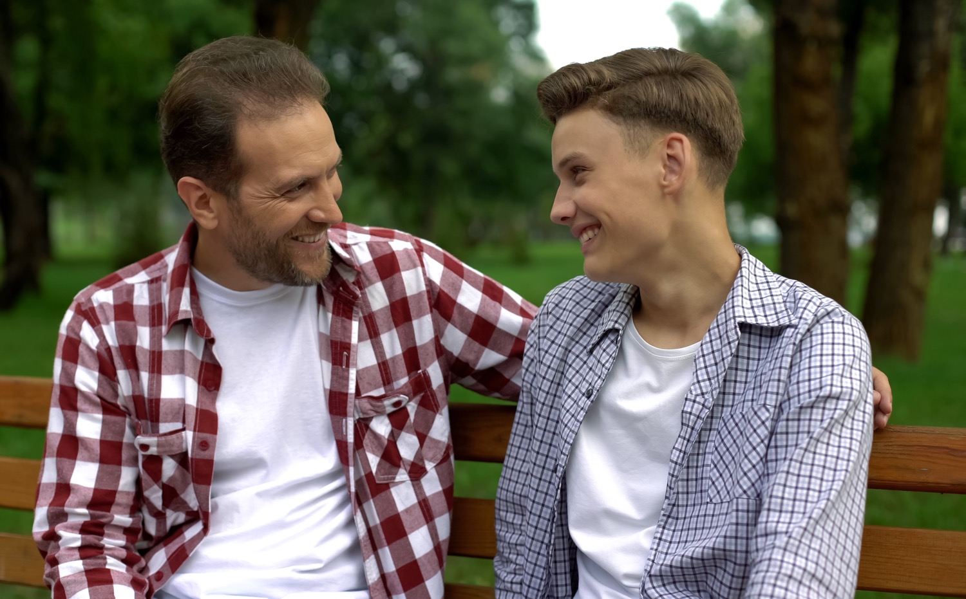
Red Flags
Grooming behaviors can include:
1
Someone getting close or touching you in inappropriate or “accidental” ways.
6
Someone offering you drugs or alcohol.
SAMPLE
2
Someone singling you out; giving you gifts or flattering you.
7
Someone forcing or threatening you to do things you don’t want to do.
3
Someone asking you about your romantic life or talking to you in sexual ways.
8
Someone asking you to keep inappropriate or unsafe behaviors a secret.
4
Someone showing you sexual images.
9
Someone older trying to begin a romantic relationship with you.
5
Someone trying hard to be alone with you.
10
Someone trying to isolate you or
Notes:
RED FLAGS 1:30
» Often, when sexual abuse happens, a perpetrator first grooms their victim.
» What is grooming? (Elicit responses)
» Grooming is when someone older or in a position of authority builds an emotional connection with a child or teen to gain their trust for the purposes of sexual abuse, sexual exploitation, or trafficking.
» Grooming can include someone:
» Click to advance slide.
getting physically close or touching you in ways that make you uncomfortable or that don’t seem right for the kind of relationship you have. This can include hugs, pats, kisses or “accidentally” touching you in ways that don’t really seem accidental.
giving you gifts or flattering you in ways that single you out, seem too generous, or make you uncomfortable.
asking you about your romantic or sexual interests, or talking to you in sexual ways.
trying to show you sexual images.
trying very hard to be alone with you.
offering you drugs or alcohol.
saying you have a duty or obligation to engage in sexual activity, threatening you, or saying they will harm you or others if you don’t do what they want.
asking you to keep inappropriate or unsafe behaviors, or their activities with you a secret.
older trying to begin a romantic relationship with you.
trying to isolate you or come between you and your parents or friends.

Slide 5
Responding to Red Flags
SAMPLE
If you notice Red Flags in your own life, no matter who it is, you need to use the Safety Rules to respond.
Red Flags are a cause for concern. You should use the Safety Rules to help.
Notes:
RESPONDING TO RED FLAGS 2:00
» Once you understand self-awareness, you can then use responsible decision-making skills to help keep you and others safe.
» What could you do if this was your friend? (Elicit responses)
» What if you saw bruises on a friend’s arms? (Elicit responses)
» What if you have a friend that seems withdrawn, stopped hanging out with you, and started skipping school? (Elicit responses)
» Click to advance slide.
» Sometimes your response will depend on how serious the situation seems or how many or what Red Flags you notice. But any Red Flags, especially behaviors that seem to be escalating, are a cause for concern, so you should use the Safety Rules to help.
» In those situations, use Safety Rule #4, Talk It Up, to talk to a Safe Adult. You can also be a Safe Friend and help someone talk to a Safe Adult. Reporting concerns about someone else that you care about is not snitching, it is getting them help.
» Click to advance slide.
» What if you see Red Flags in your own life?
» Sometimes, recognizing and responding to Red Flags might be difficult or confusing, especially if the person demonstrating Red Flags is someone you trust and respect, an authority figure, or someone you look up to, such as a coach, teacher, or family member.
» If you notice any Red Flags in your own life, no matter who it is, you need to use your Safety Rules to respond.
» You can try to use Safety Rule #3 to Make a Move and get away, or if you know a person is demonstrating Red Flag behaviors, you can stay away.
» You can also use Safety Rule #4 to Talk It Up by using an assertive voice to tell someone to stop doing things that you know are unsafe or that make you uncomfortable. And, you should always tell a Safe Adult.

Slide 6
Healthy or Unhealthy Relationships
SAMPLE
Can you recognize healthy, unhealthy and abusive relationship behaviors?
Notes:
HEALTHY VS UNHEALTHY RELATIONSHIPS 1:00
» Abuse can also happen in a “dating” or “going out” type of relationship.
» It is normal for relationships at your age to be confusing sometimes. You may like each other one day and not the next, and you may break up and get back together again. But, a relationship that is abusive is not normal.
» To know when a relationship is unhealthy, you’ve first got to understand what a healthy relationship looks like.
» Your Home Learning Assignment included visiting the OneLove site and listing signs of a healthy relationship and unhealthy relationship.
» So who can share some signs of a healthy relationship? (Elicit responses)

Slide 7
Relationship Behavior Continuum
Healthy
SAMPLE
Abusive
Extremely Healthy
Somewhat Healthy
Somewhat Unhealthy
Extremely Unhealthy/Abusive
Notes:
RELATIONSHIP BEHAVIOR CONTINUUM 3:30
» Sometimes it’s hard to figure out if particular behaviors in a relationship are unhealthy or abusive.
» We are going to do an activity to help us think about this more by looking at relationship behaviors along a continuum from healthy to unhealthy/abusive.
» I’m going to read a statement about a relationship and then I’d like a volunteer to come to the board and show where you think that behavior falls on the continuum. You may ask for guidance from your classmates if you’d like.
RELATIONSHIP BEHAVIORS
Your partner often says you are ugly and threatens to break up with you.
Your partner often says you are pretty and sweet.
Your partner asks you to meet their grandparents.
Your partner tells you they want to spend all their free time with you.
Your partner tells you they want to be with you all the time and gets mad when you spend time with your friends.
Your partner tries to control who you spend time with, including your family.
Your partner gets mean and hurts you when you don’t do what they want.

Slide 8
What You Need To Know
SAMPLE
1 in 3 teens in the U.S. is a victim of physical, sexual, emotional, or verbal abuse.
Both boys and girls may demonstrate unhealthy or abusive behaviors in a relationship.
Notes:
WHAT YOU NEED TO KNOW 1:30
» In fact, nearly 1.5 million high school students nationwide experience physical abuse from a dating partner in a single year.
» Here are some other facts:
» 1 in 3 teens in the U.S. is a victim of physical, sexual, emotional, or verbal abuse from a dating partner and violent behavior typically begins between the ages of 12 to 18.
» Click to advance slide.
» And both boys and girls may demonstrate unhealthy or abusive behaviors in a relationship.
» Violent relationships in adolescence can have serious consequences by putting the victims at higher risk for substance abuse, eating disorders, risky sexual behavior, further domestic violence, teen pregnancy, and suicide.
» It is important for you to build your self-management skills, or ways to take responsibility for your own actions, to help you stay safe. For example, using the Safety Rules can help you set boundaries and also help you have expectations for how you treat others and how you allow others to treat you. This is especially true in dating relationships.

Slide 9
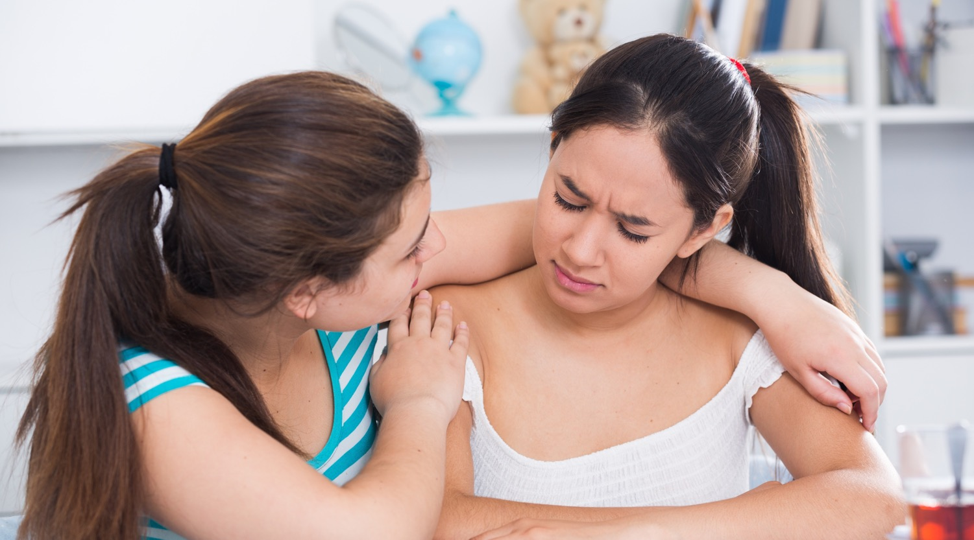
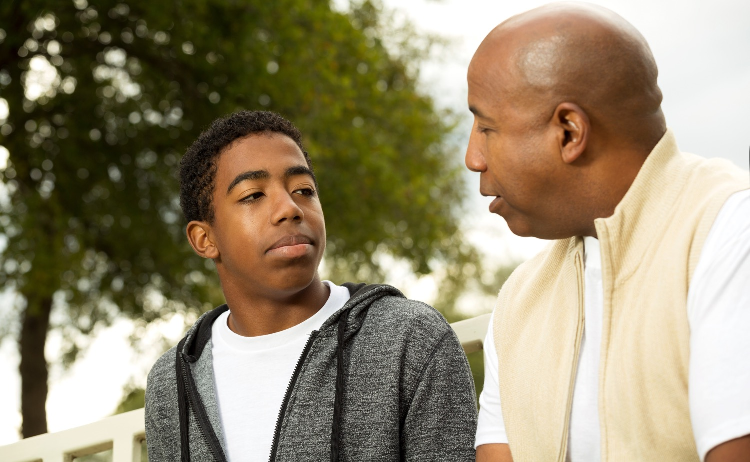
Relationship Abuse Help
1 in 3
Only 33% of teens who were in a violent relationship ever told someone about the abuse.
SAMPLE
I hope if you or someone you know is ever in an unhealthy or abusive relationship, you will remember to use the Safety Rules.
Notes:
RELATIONSHIP ABUSE HELP 2:30
» Raise your hand if you think that most teens in an abusive relationship will tell someone? (Raise hands)
» Click to advance slide.
» Only 1 in 3 teens who were in a violent relationship ever told anyone about the abuse.
» What can we do about this? (Elicit responses)
» Many times, victims don’t report abuse or controlling behaviors. It’s important for all of you to be Upstanders and look out for each other.
» Click to advance slide.
» I hope if you or someone you know is ever in an unhealthy or abusive relationship, you will remember to use Safety Rule #3 to Make a Move, and Safety Rule #4 to Talk It Up and seek help from a Safe Adult, or have a Safe Friend help you reach out to a Safe Adult.
» If you are involved in a controlling or abusive relationship, or you know a friend who is, seek help. Don’t be the person who suffers from mistreatment or abuse in silence. And don’t be the friend who suspects something and doesn’t speak up.
» Being self-aware and socially-aware will help keep you and the people you care about safe.
» And, if you are the person that is controlling, isolating, or abusing your partner, please get help before you do something you cannot take back. Use the Safety Rules and seek help.
» At the end of today’s lesson, you will receive a Student Resource Card with resources and hotlines if you ever need help.
» And if you’re not sure if your relationship is healthy or if you need help, retake the relationship quiz from the Home Learning Assignment at www.loveisrespect.org and talk about it with a Safe Adult.
***STOP AFTER THIS SLIDE IF YOU ARE IMPLEMENTING THIS LESSON IN TWO SHORTER LESSONS***

Slide 10
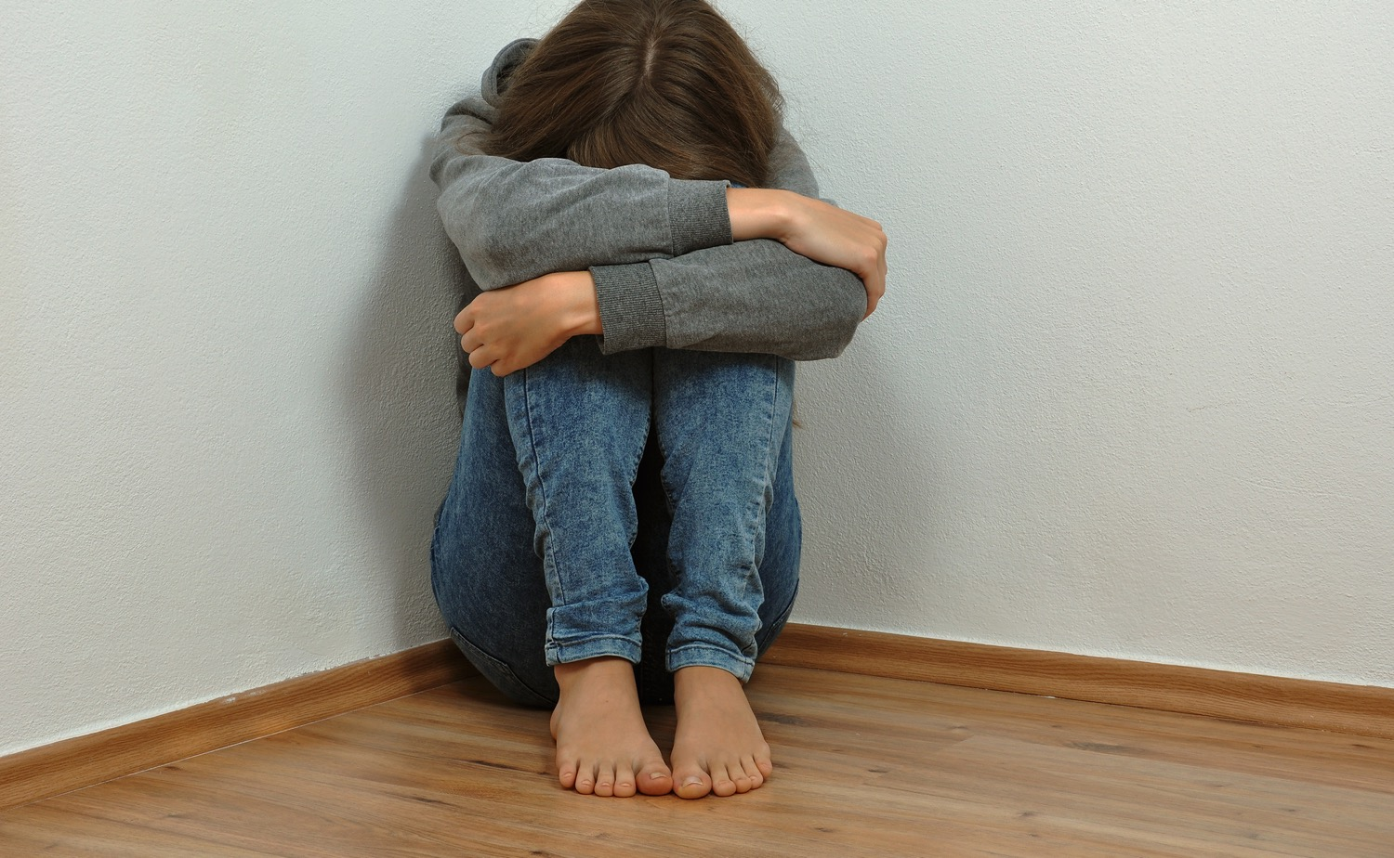
Sexual Assault
Of all victims under 18,
2 out of 3 are between ages 12-17.
66% age 12 - 17
34% under age 12
SAMPLE
National Sexual Assault Hotline (800.656.HOPE) online.rainn.org
Please visit rainn.org/statistics/scope-problem for full citation ²
Sexual assault is any type of sexual activity that you do not agree to, whether by someone you are in a relationship with or someone you don’t know.
Notes:
SEXUAL ASSAULT 1:30
» Next, we’re going to talk about a tough but necessary topic, sexual assault.
» Sometimes abuse in a relationship can lead to sexual assault. Other times sexual assault is done by someone the victim doesn’t know, or doesn’t know well.
» Sexual assault is any type of sexual contact or behavior that occurs without the explicit consent of the recipient; it is any type of sexual activity that you do not agree to, whether by someone you are in a relationship with or someone you don’t know.
» It is anything that forces a person into unwanted sexual contact or attention and can include rape or attempted rape.
» Sometimes teens are assaulted by people they don’t know, but most of the time, approximately 68% of the time, victims know their rapist - a boyfriend, friend, or casual acquaintance.
» And 6 out of 10 rapes occur in the victim’s own home or in a friend or relative’s home, not in a dark alley.
» Click to advance slide.
» In the United States, out of all sexual assaults, the majority of victims are between ages 12 to 17. And it doesn’t just happen to girls.

Slide 11
Sex Trafficking
SAMPLE
Sexual exploitation means using pictures, messages, web cams, or real-life interactions for sexual purposes or sex crimes.
Sex trafficking is when a person is involved in a sex act in exchange for money or something of value.
Notes:
SEX TRAFFICKING 1:30
» Another type of sexual abuse is sexual exploitation.
» What does it mean to be sexually exploited? (Elicit responses)
» Click to advance slide.
» Sexual exploitation means using pictures, messages, web cams, or real-life interactions for sexual purposes or sex crimes.
» Sex trafficking is when a person is involved in a sex act in exchange for money or something of value (food, drugs or a place to stay). Victims often endure emotional, physical and sexual abuse, violence, exploitation and control.
» Sex traffickers, or pimps, can be adults, or even older teens, who target someone, typically a minor, or seek them out, online, in malls, at schools, or at other teen hangouts to groom them for sexual abuse or sex trafficking.
» A trafficker/pimp’s main purpose is to exploit the child for monetary gain.

Slide 12
Exploitation/Trafficking Red Flags
1
Presence of older boyfriend/girlfriend
6
Seeming anxious, hostile
SAMPLE
2
Having new or expensive things
7
Risky sexual behavior
3
Being secretive
8
Using language about ”the life”
4
Becoming isolated
9
Signs of physical abuse
5
New job offer
10
New tattoo
Notes:
EXPLOITATION/TRAFFICKING RED FLAGS 1:30
» Other Red Flags may include:
the sudden presence of an older boyfriend/girlfriend.
having new or expensive items.
being secretive about who they are talking to or meeting, or about their online activity.
becoming isolated from their friends or family.
responding to a job offer online such as modeling/acting.
suddenly seeming anxious or hostile.
engaging in risky sexual behavior.
using language not previously used about “the life” (the game, clients, pimps, recruiters).
signs of physical abuse (e.g., cuts and bruises).
a tattoo that they are unable/hesitant to explain.
» The best way to avoid becoming a victim of sex trafficking is to know how traffickers work, to know how children and teens are manipulated into sex trafficking, to be alert to the Red Flags, and to use the Safety Rules to avoid this type of behavior from anyone.

Slide 13
Exploitation/Trafficking Help
SAMPLE
To report and get help for sexual exploitation or trafficking, text “HELP” to 233733 (BEFREE), or call the National Human Trafficking Hotline at 1-888-373-7888.
Notes:
EXPLOITATION/TRAFFICKING HELP 4:00
» The most important thing I want you to walk away with from this discussion is that you should never think this couldn’t happen to you or your friends.
» It doesn’t matter where you live, what your parents do, or what school you go to. It is happening everywhere in our country, and it is happening here.
» If you recognize Red Flags in someone who is being trafficked, it is important to act to get them help because they are often scared and don’t seek help on their own.
» If you do identify any Red Flags, or if you suspect someone is trying to begin a relationship with you for sex trafficking, you can call the Trafficking Hotline at 888-373-7888 to get advice and help.

Slide 14
Essential Review
If you disagree/think a statement is false, point to the left.
SAMPLE
If you agree/think a statement is true, point to the right.
Notes:
ESSENTIAL REVIEW 2:00
» We’re almost out of time, so let’s do a final review.
» For our review, if you agree with a statement or think it’s true, like you would swipe right on an app, raise your right hand or point to the right.
» Like you would swipe left to disagree, if you think a statement is false, raise your left hand or point to the left.
REVIEW STATEMENTS
Children and teens are more likely to be abused by strangers, or people they do not know. (Left/False. Remember, 90% of abuse happens by someone known by the victim.)
Sexual assault is any type of sexual contact or behavior that occurs without the explicit consent of the recipient. (Right/ True)
If someone is under the influence of drugs and alcohol, they can still give consent for sexual activity. (Left/ False)
Relationship abuse is always when one person uses physical violence against their partner. (Left/False. It can also be verbal abuse, isolation, control, etc.)
Sex traffickers often target young people, or seek them out online, in malls, at schools, and other teen hangouts in order to groom them for sexual abuse or sex trafficking. (Right/ True)
Red Flags for sexual exploitation can include: someone trying to manipulate, or control you, someone offering to make you a model, someone trying to isolate you or come between you and your family or friends, or someone offering you gifts, money, or drugs in exchange for sexual acts or pictures. (Right/True)

Slide 15
SAMPLE
THANK YOU!
Notes:
WRAP UP & CLOSE 1:30
» I hope you all have enjoyed this MBF Teen Safety Matters lesson and learned a lot.
» To finish up today, I have a few things for you.
» Option 1: I have a Parent Information & Activity Sheet for your parents/guardians. The sheet has information about what you learned today, and there is also an activity for you to do together. It is very important that your parents receive this information, so please make sure you give it to them when you get home.
» Option 2: Your parents/guardians will receive an email with a digital copy of a Parent Information & Activity Sheet. This sheet has information about what you learned today, and there is also an activity for you to do together. Please ask your parents to check their email for this information.
» I also have a Student Resource Card for each of you. It’s small enough to tuck in your phone or wallet and has a variety of help hotlines inside, so if you or a friend ever need help, you have the numbers and websites easily accessible.
» Does anyone have any questions before I leave?
» If you think of any questions, you can ask your teacher, *or you can ask me. (*If you are a school employee)
» Thank you all again for being so attentive during these MBF Teen Safety Matters lessons.
» I hope you’ll all remember your Safety Rules and remember that you deserve to be safe!

