Slide 1
7th Grade
Lesson 2
Notes:
WELCOME & INTRODUCTION 1:30
CLASS WELCOME » Begin by welcoming students and discussing lesson and behavior expectations. LESSON INTRODUCTION » Today we are going to do a lesson from the MBF Teen Safety Matters program. It is a program that helps teach students how to be safe and how to make the most out of their middle school experience.
» Much of this information may be new to you. I ask that everyone please pay attention and participate in the discussion and activities. » If you have any personal stories to share related to what we are discussing today, I want you to know they are very important, but because we have a limited amount of time to get through the lesson, I ask that you wait to share them with your teacher or with me after the lesson.
» Like I did in Lesson 1, throughout this lesson, I will mention your Class Notes Sheet and have you fill in related information. You can also write down any words or concepts you don’t understand, questions you may have, or stories you may wish to share with me or a Safe Adult later. » During Lesson 1, we learned about digital safety, and today we’re going to talk about physical safety.
» What are some ways you’ve learned that you can keep yourself safe? (Elicit responses such as follow rules, watch for unsafe situations, etc.)
» We also talked about how adults are responsible for keeping kids safe. However, as you get older and gain more independence, you have to become more responsible for your safety.

Slide 2
Check-in: Stand Up/Sit Down
Messages
Contact
STAND UP
SIT DOWN
SAMPLE
Notes:
CHECK-IN: STAND UP/SIT DOWN 2:00
» Before we get started with today’s lesson, let’s do a quick check-In to review Lesson 1.
» I’m going to read a statement to you. STAND UP if the statement is true and SIT DOWN or STAY SEATED if it is false.
CHECK-IN STATEMENTS
If I meet someone online, it is okay to give them my personal information, like phone number and address, so we can meet up. (Allow students to sit down, then click to advance slide.)
» This is false. It is never a good idea to give your personal information to strangers, even if you think it’s another student, because you never know who it really is.
The Internet is a good tool to use appropriately, because it allows you to learn about resources you otherwise would not know. (Allow students to stand up, then click to advance slide.)
If you have been hurt, you can tell a Safe Friend instead of a Safe Adult. (Allow students to sit down, then click to advance slide.)
Cyberbullying is repeated online harassment, or bullying, like posting rumors or gossip on social media. (Allow students to stand up, then click to advance slide.)
If you send a private image to another person online, you can get in trouble for sending/receiving the images by your school and law enforcement. (Allow students to stand up.)

Slide 3
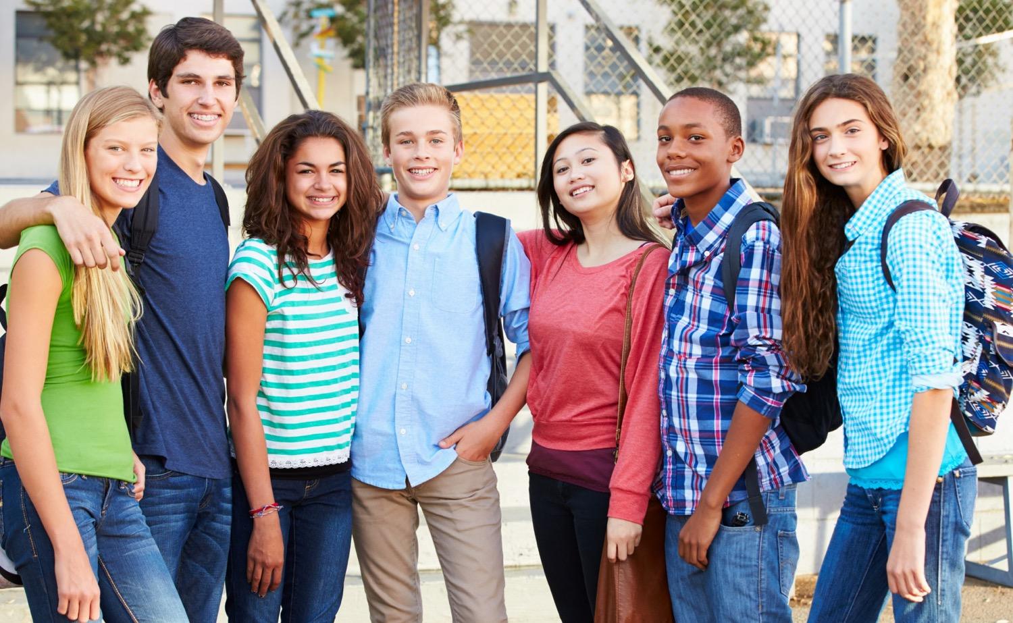
Safety Rules Review
SAMPLE
Notes:
SAFETY RULES REVIEW 2:00
» As we learned in Lesson 1, there are 5 Safety Rules you can use to help you stay safe. Each rule has an emoji to go with it to help you remember it. As we talk about different topics today, you will learn how these rules can help you stay safe.
» Let’s start with a quick review of the rules.
» Click to advance slide.
– Safety Rule #1 is Know What’s Up
» Knowing What’s Up means you are aware of your environment and the people around you, both online and offline.
» Click to advance slide.
– Safety Rule #2 is Spot Red Flags
» Spotting Red Flags means being aware of potential dangers when you’re online or out in the real word.
» Click to advance slide.
– Safety Rule #3 is Make a Move
» Making a Move involves using positive decision-making skills to respond to any new or unsafe situations. You can Make a Move by getting away and staying away from unsafe situations or people.
» Click to advance slide.
– Safety Rule #4 is Talk It Up
» Talking It Up means using an assertive voice if you or others are in an unsafe situation. It also means talking to a Safe Adult about unsafe situations or people, and talking to your peers to be a role model for creating a culture of kindness and safety.
» Click to advance slide.
– Safety Rule #5 is No Blame | No Shame
» No Blame | No Shame reminds you that you are never at fault and you are never to blame if an adult or another teen hurts, bullies, or abuses you. It is never too late to tell.
» Let’s review all the Safety Rules. Please say them with me.
Safety Rule #1 is Know What’s Up
Safety Rule #2 is Spot Red Flags
Safety Rule #3 is Make a Move
Safety Rule #4 is Talk It Up
Safety Rule #5 is No Blame | No Shame

Slide 4
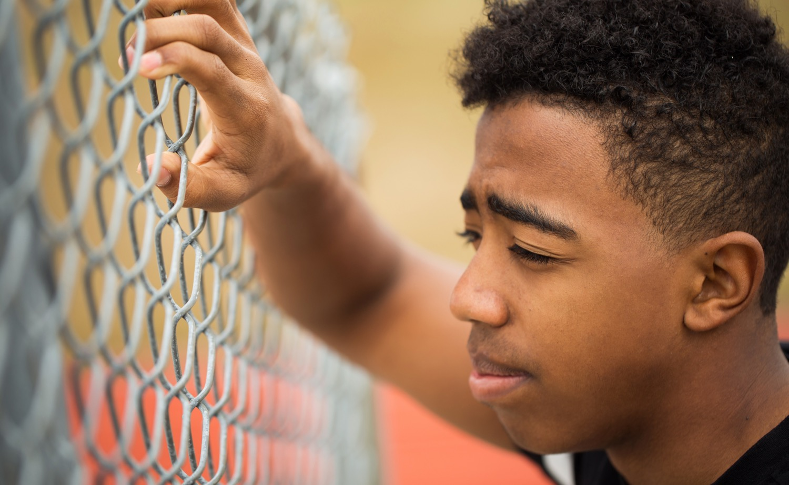
Abuse
Different Types of Abuse
1
Neglect
2
Physical Abuse
SAMPLE
3
Emotional Abuse
4
Bullying
5
Relationship Abuse
6
Sexual Abuse
Notes:
ABUSE 1:30
» Let’s start our discussion about physical safety and talk about abuse.
» How many of you have heard the term abuse? (Raise hands)
» Abuse is when another person hurts someone on purpose.
» Child abuse can happen to anyone under the age of 18.
» Sadly, it is usually not strangers that abuse children and teens. About 90% of the time, abuse happens by someone the child knows, such as a parent, step-parent, sibling, other relative, family friend, or a neighbor, coach, pastor, etc.
» There are laws against abuse in every state. These laws exist to help protect children from abuse. No child ever deserves to be hurt or abused.
» Many people think of abuse as physical injuries such as bruises or broken bones. That is one type of abuse, but abuse can happen in many different ways.
» Today we are going to talk about 6 different types of abuse. As we go through each of these during the lesson, I want you to write them on your Class Notes Sheet.
Neglect
Physical Abuse
Emotional Abuse
Bullying
Relationship Abuse
Sexual Abuse

Slide 5
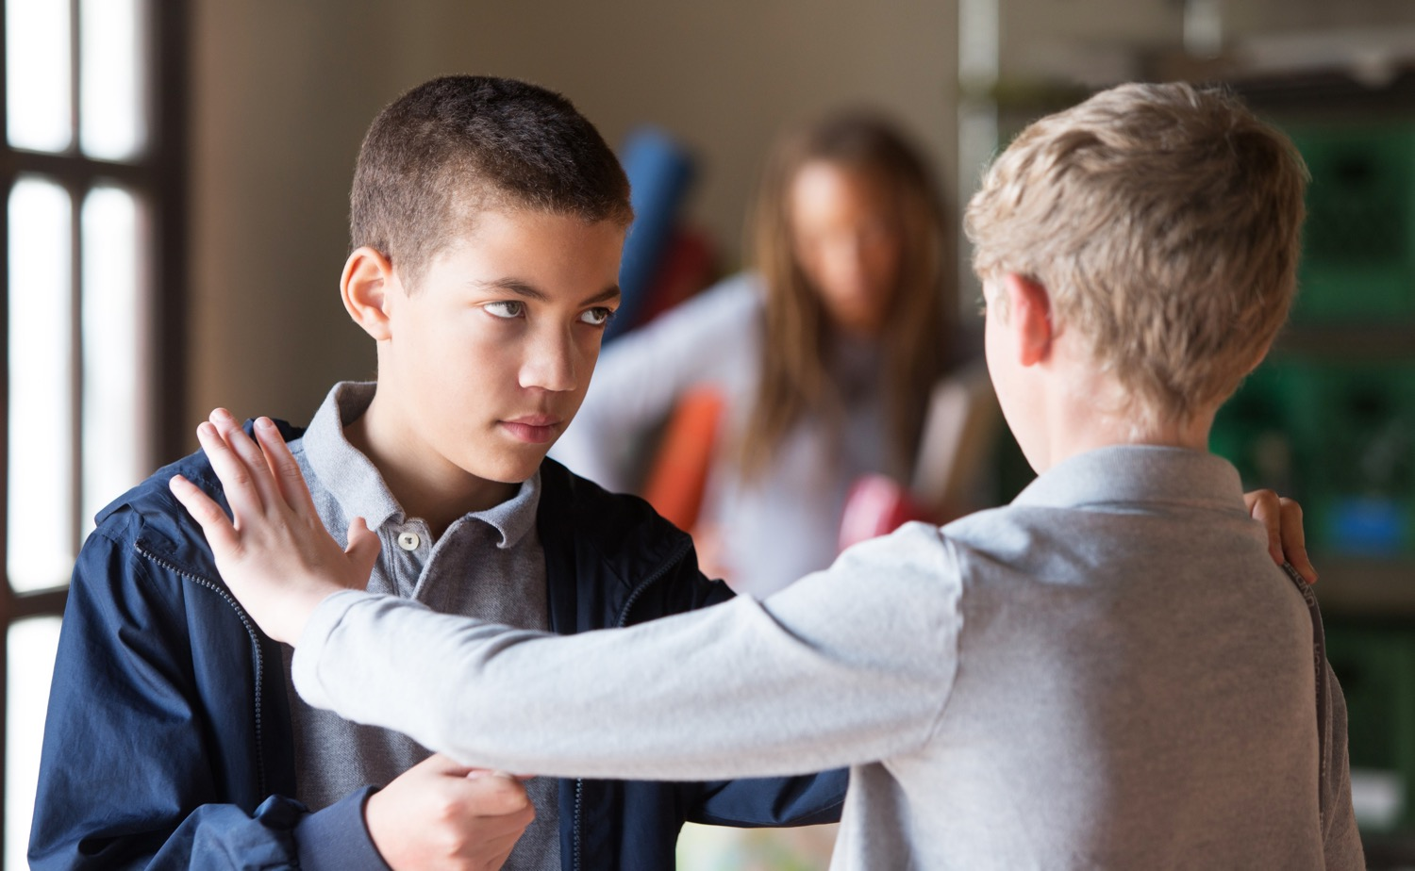
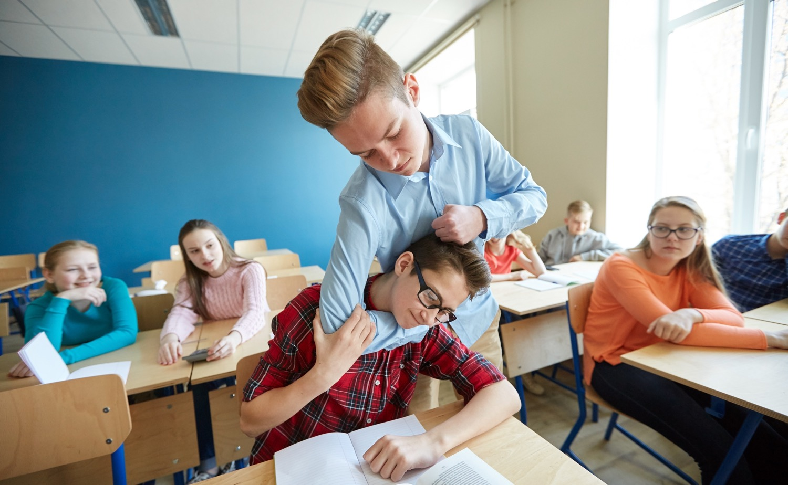
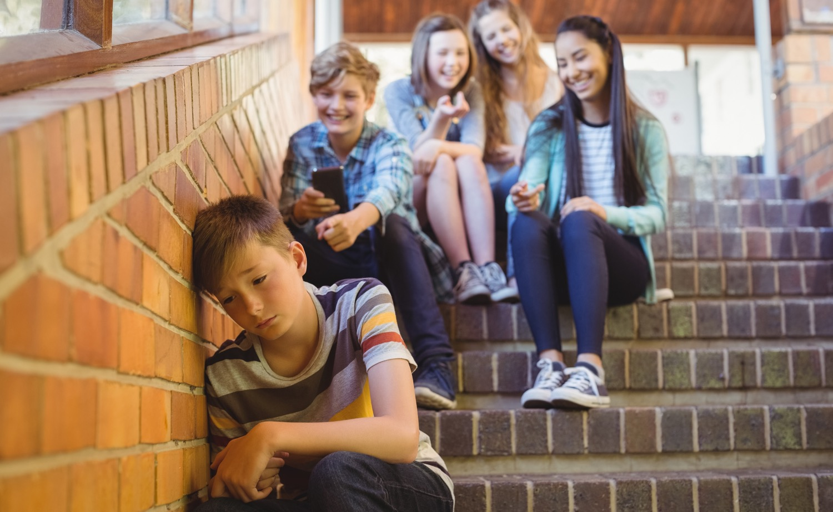
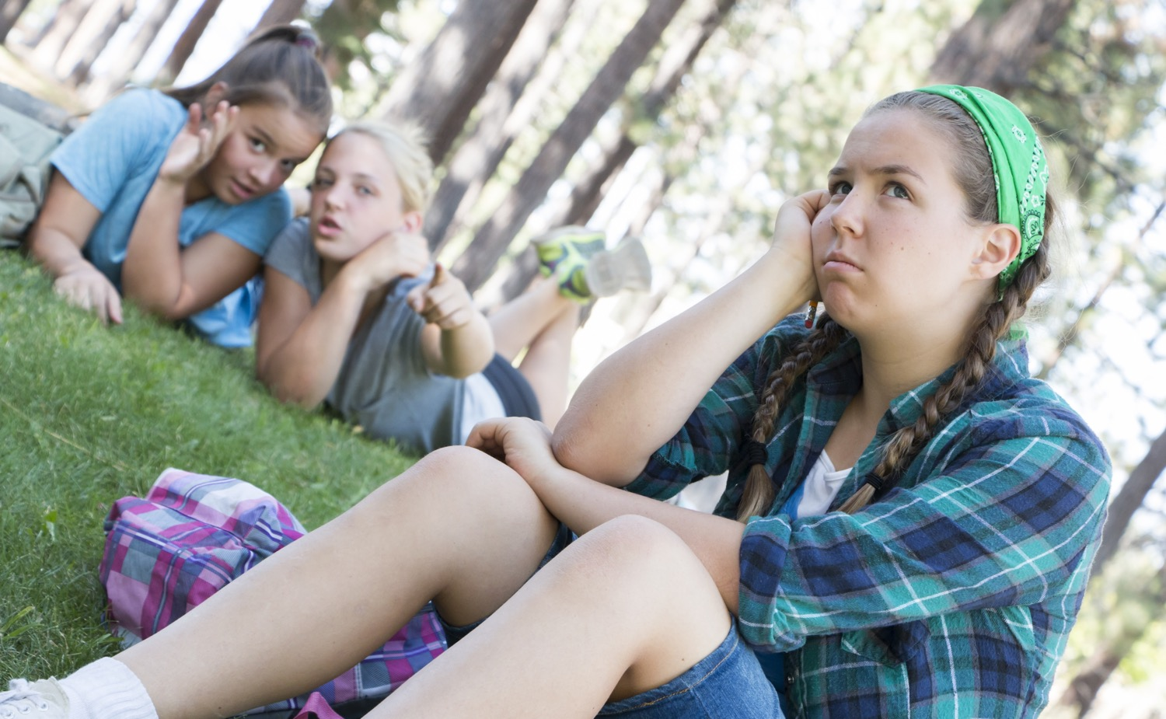
Bullying
SAMPLE
Bullying is repeatedly harassing, threatening, or insulting another person when one person is more powerful or seems more powerful.
Notes:
BULLYING 2:00
» Physical and emotional abuse can happen in other ways, such as bullying and relationship abuse.
» Can anyone tell me the legal definition of bullying? (Elicit responses)
» Click to advance slide.
» To meet the definition of bullying, the behavior must be repeated, it must be intentional, and there must be a real or perceived imbalance of power. Bullying may take the form of harassment, threats, insults, or even social exclusion.
» There are different types of bullying:
Physical (hitting, shoving, etc.)
Verbal (threatening, calling names)
Social/Isolation (excluding people, starting rumors, gossiping)
Sexual (jokes, comments, calling derogatory names)
» Raise your hand if you have seen bullying happen at our school. (Raise hands)
» Turn and talk with a neighbor about why you think bullying happens. (After a minute or two, elicit responses such as: some people think they are better than others, or think they can get away with it, some kids want to be popular, and others are jealous.)

Slide 6
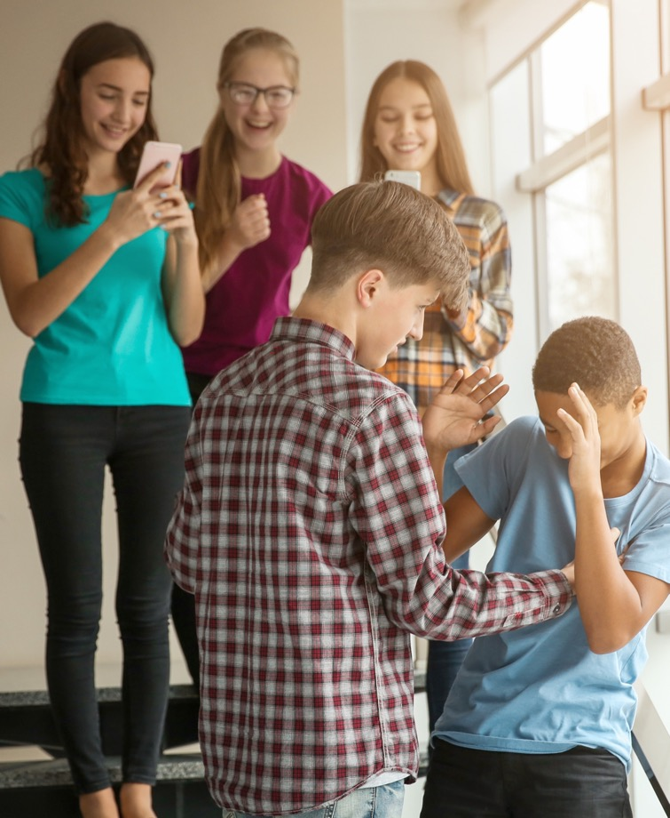
Bystanders vs. Upstanders
SAMPLE
Bystanders
Upstanders
Notes:
BYSTANDERS VS. UPSTANDERS 2:00
» Do bullies act alone? (Elicit responses)
» What do students usually do in response to bullying? (Elicit responses)
» What about teachers and other adults? (Elicit responses)
» When we witness bullying, we have two choices. We can either be a Bystander or be an Upstander.
» Click to advance slide.
Bystanders - allow the bullying to happen by standing by and watching, doing nothing to stop it.
Upstanders - speak up and try to help the person who is being bullied. There may or may not be an Upstander in a bullying situation.
» Turn and talk with a neighbor and together, come up with one sentence to describe the difference between a Bystander and an Upstander. Write the difference on your Class Notes Sheet.
» Many people fear standing up to a bully. They are afraid of being bullied themselves, or they may not want to be seen as uncool.
» However, when someone stands up to a bully, over half of the time, the bullying stops within 10 seconds.
» Remember, with our Safety Rules we talk about creating a culture of safety and kindness.

Slide 7
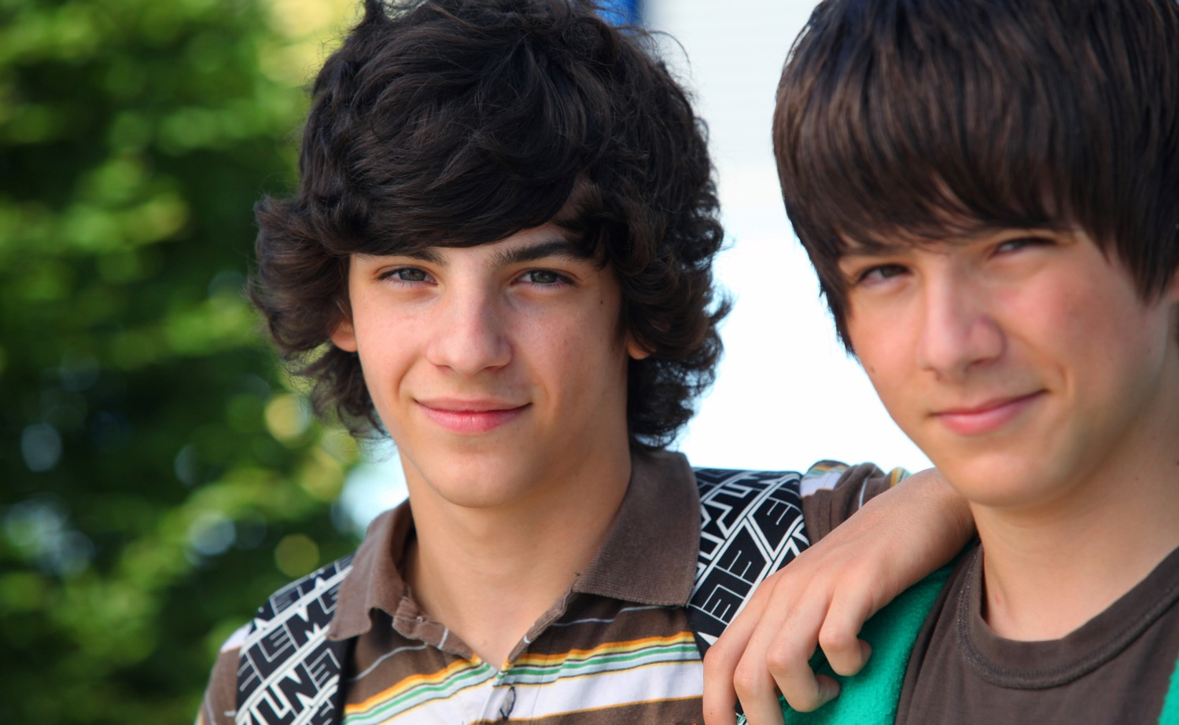
Being an Upstander
SAMPLE
What are some of the things you can do to overcome fears of being an Upstander and doing the right thing?
Notes:
BEING AN UPSTANDER 2:00
» Many people fear standing up to a bully. They are afraid of being bullied themselves, of getting hurt, or they may not want to be seen as uncool.
» Let’s think about our Safety Rules and how they apply to bullying situations.
» What about Safety Rule #3 - Make a Move? How can you use this rule? (Elicit responses. You can help the target of the bully to get away and stay away.)
» What about Safety Rule #4 - Talk It Up? How can you use this rule? (Elicit responses)
» Some things to remember are:
If you feel safe, you can stand up to the bully directly and tell him or her to stop.
You could talk to a friend, or with several friends. It may be easier to be an Upstander if you have support or backup.
You can also tell a Safe Adult about what is happening to try to get help.
You can also report the bullying. Here’s how you can report bullying at our school:
__________________________________________________________
__________________________________________________________
__________________________________________________________
__________________________________________________________
» I hope if any of you see bullying, you will have empathy for the person being bullied and be an Upstander.
» You can also talk to your peers about being more empathetic and kind to help you create a culture of kindness and safety at our school. Remember, kindness matters.
» And if you are being bullied, you need to remember to use these Safety Rules as well, because ignoring it will not make it stop.

Slide 8
Relationship Abuse
SAMPLE
Relationship abuse occurs when one person in a relationship tries to dominate and control the other person, or is emotionally or physically hurtful.
Notes:
RELATIONSHIP ABUSE 2:00
» Abuse can also happen in a “dating” or “going out” type of relationship.
» In middle school, many students’ relationships are starting to change. Students may find themselves becoming romantically interested in someone.
» That is normal, and it is also normal for relationships to be confusing sometimes, especially when it is all so new. Students may like each other one day and not the next, and may break up and get back together again.
» But relationships should never be harmful or abusive.
» Click to advance slide.
» Relationship abuse occurs when one person in a relationship tries to dominate and control the other person, or is emotionally or physically hurtful.
» To know what an unhealthy relationship looks like, you have to understand what a healthy relationship looks like.
» What do you think are the signs of a healthy relationship? (Elicit responses)
» A healthy relationship between two people exists when:
are supportive of each others’ time, activities, and friends.
can disagree without emotional or physical harm.
respect each other, including their thoughts, privacy, and boundaries.

Slide 9
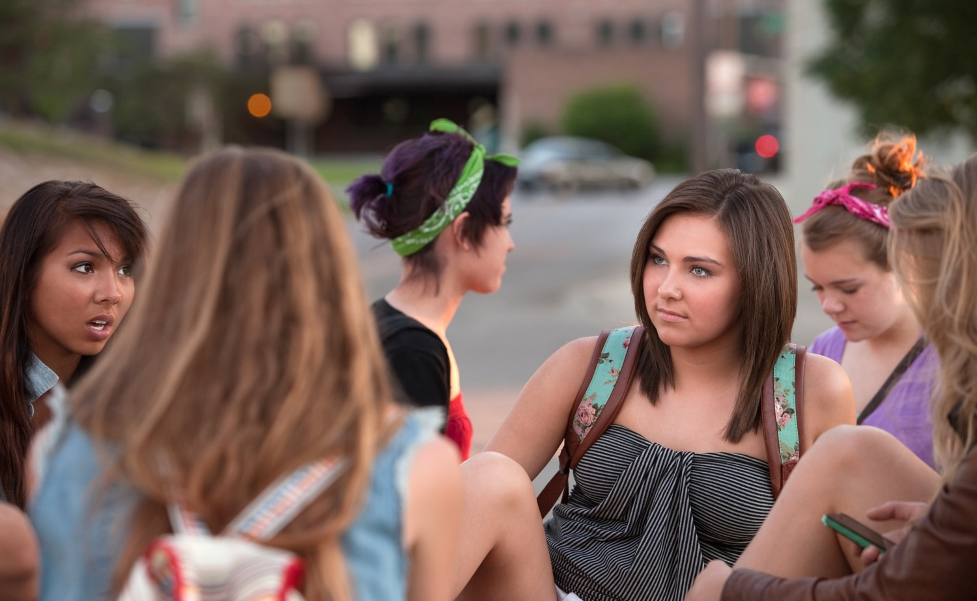
What Would You Do?
Your friend has a new boyfriend. Whenever you ask your friend to hang out, she says she can’t. She says he doesn’t like her hanging out with her friends. When you’re around them both, she can never talk and her boyfriend is always pulling her away.
SAMPLE
What Would You Do?
Notes:
WHAT WOULD YOU DO? 3:30
» Let’s get into groups again and do one more activity.
» Click to advance slide.
» Read the scenario on the slide, and I would like your group to spend a few minutes discussing how you might use empathy to respond.
SCENARIO
» Your friend has a new boyfriend. Whenever you ask your friend to hang out, she says she can’t. She says he doesn’t like her hanging out with her friends. When you’re around them both, she can never talk and her boyfriend is always pulling her away.
» Discuss with your group what you would do in this situation and be prepared for me to ask, “What would you do?”
FOLLOW-UP
» Share what your group would do. (Elicit responses from several groups.)
» Remember, in situations like these, it’s important to use Safety Rule #4 and Talk It Up to a Safe Adult because relationships that start like this will often escalate and get worse.

Slide 10
Unhealthy Relationships – Check-In
Messages
Contact
HEALTHY
SAMPLE
UNHEALTHY
Notes:
UNHEALTHY RELATIONSHIPS – CHECK-IN 3:30
» Only 54% of students in a relationship know the signs of emotional abuse. Without knowing the signs, it is hard to get help from a Safe Adult.
» Let’s do a check-In to see if you can recognize the signs of an unhealthy relationship.
» I’m going to read a statement. If you think it is a healthy relationship, show me a thumbs up. If you think it is an unhealthy relationship, show me a thumbs down.
Constant jealousy (Allow students to demonstrate a thumbs down, then click to advance slide.)
Trying to control the other person (Allow students to demonstrate a thumbs down, then click to advance slide.)
Being angry occasionally (Allow students to demonstrate a thumbs up, then click to advance slide.)
However, if it is frequent and about little things, it can be unhealthy.
Isolating them from friends (Allow students to demonstrate a thumbs down, then click to advance slide.)
Supporting them in things they like to do (Allow students to demonstrate a thumbs up, then click to advance slide.)
Pressuring the other person to do things they do not want to do (Allow students to demonstrate a thumbs down, then click to advance slide.)
Grabbing the other person’s arm or hitting them. (Allow students to demonstrate a thumbs down, then click to advance slide.)
Calling the other person names like stupid or ugly when they are mad. (Allow students to demonstrate a thumbs down.)
It doesn’t matter if they are mad; this is never acceptable and is sometimes a sign that physical violence may follow.
» Take a minute and write 3 signs of a healthy relationship and 3 signs of an unhealthy relationship on your Class Notes Sheet.

Slide 11
Unhealthy Relationships
SAMPLE
Notes:
UNHEALTHY RELATIONSHIPS 1:00
» Signs of an unhealthy or abusive relationship may also include:
Calling
Intensity
Control
Isolation
Changes in behavior
Showing up unannounced
» And I don’t want you to ever think, “This won’t happen to me or my friends,” because it is happening to a lot of students.
» In fact, among 11- to 14-year-olds, 62% say they know friends in a relationship who have been emotionally abused by a partner.
» And 20% say they know friends who have been physically abused.

Slide 12
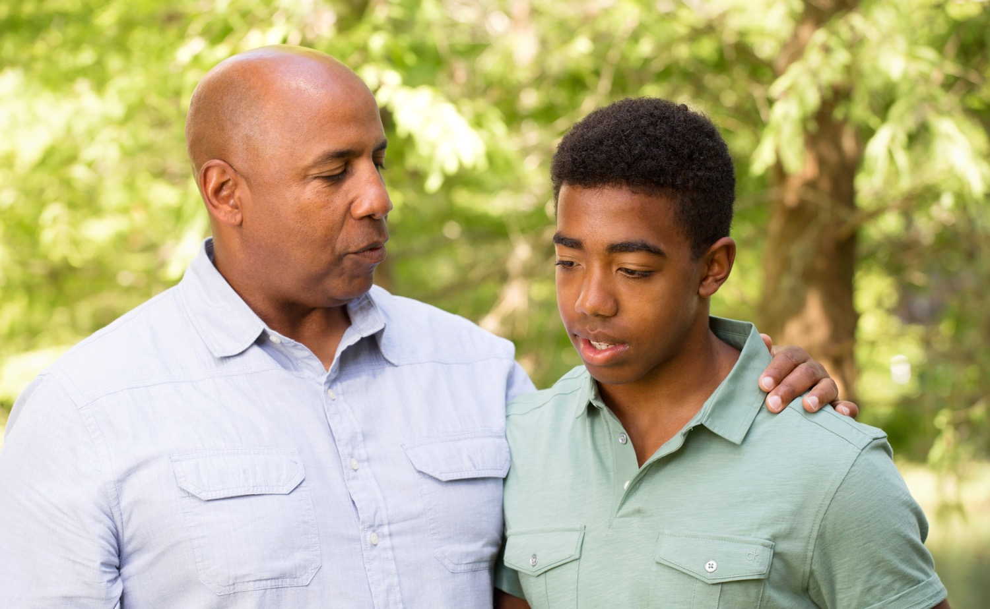
Relationship Abuse Help
SAMPLE
Use Safety Rule #3 to Make a Move, and Safety Rule #4 to Talk It Up and seek help from a Safe Adult, or have a Safe Friend help you reach out to a Safe Adult.
Notes:
RELATIONSHIP ABUSE HELP 1:00
» If you are involved in a controlling or abusive relationship, or you know a friend who is, it is important to seek help.
» You can use Safety Rule #3 to Make a Move, and Safety Rule #4 to Talk It Up and seek help from a Safe Adult, or have a Safe Friend help you reach out to a Safe Adult.
» If you are the person that is controlling or isolating, or abusing your girlfriend or boyfriend, please seek help before you do something that you cannot take back.
» You need to use Safety Rule #4 to Talk It Up and seek help from a Safe Adult, or to have a Safe Friend help you reach out to a Safe Adult.
» Remember, it is not just boys that are abusive towards girls, there are girls that act this way as well.
» If you need help, you can find support and resources on the website: loveisrespect.org.
» If you’re not sure if your relationship is healthy, there is a relationship quiz that you can take at www.loveisrespect.org.

Slide 13
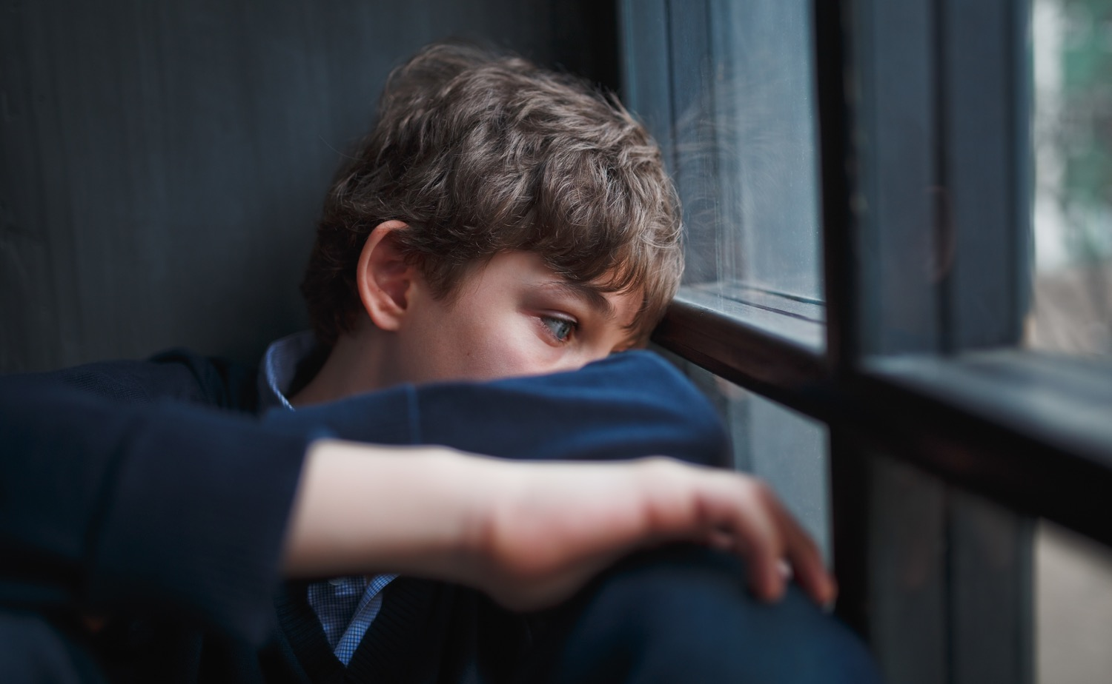
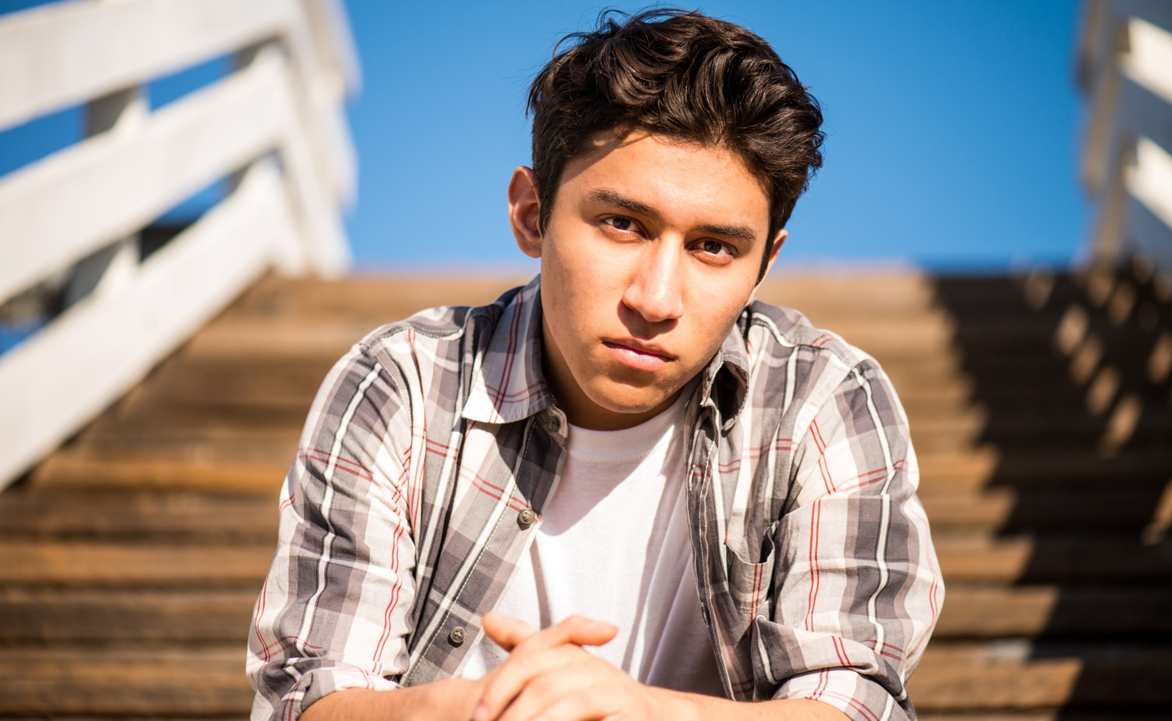
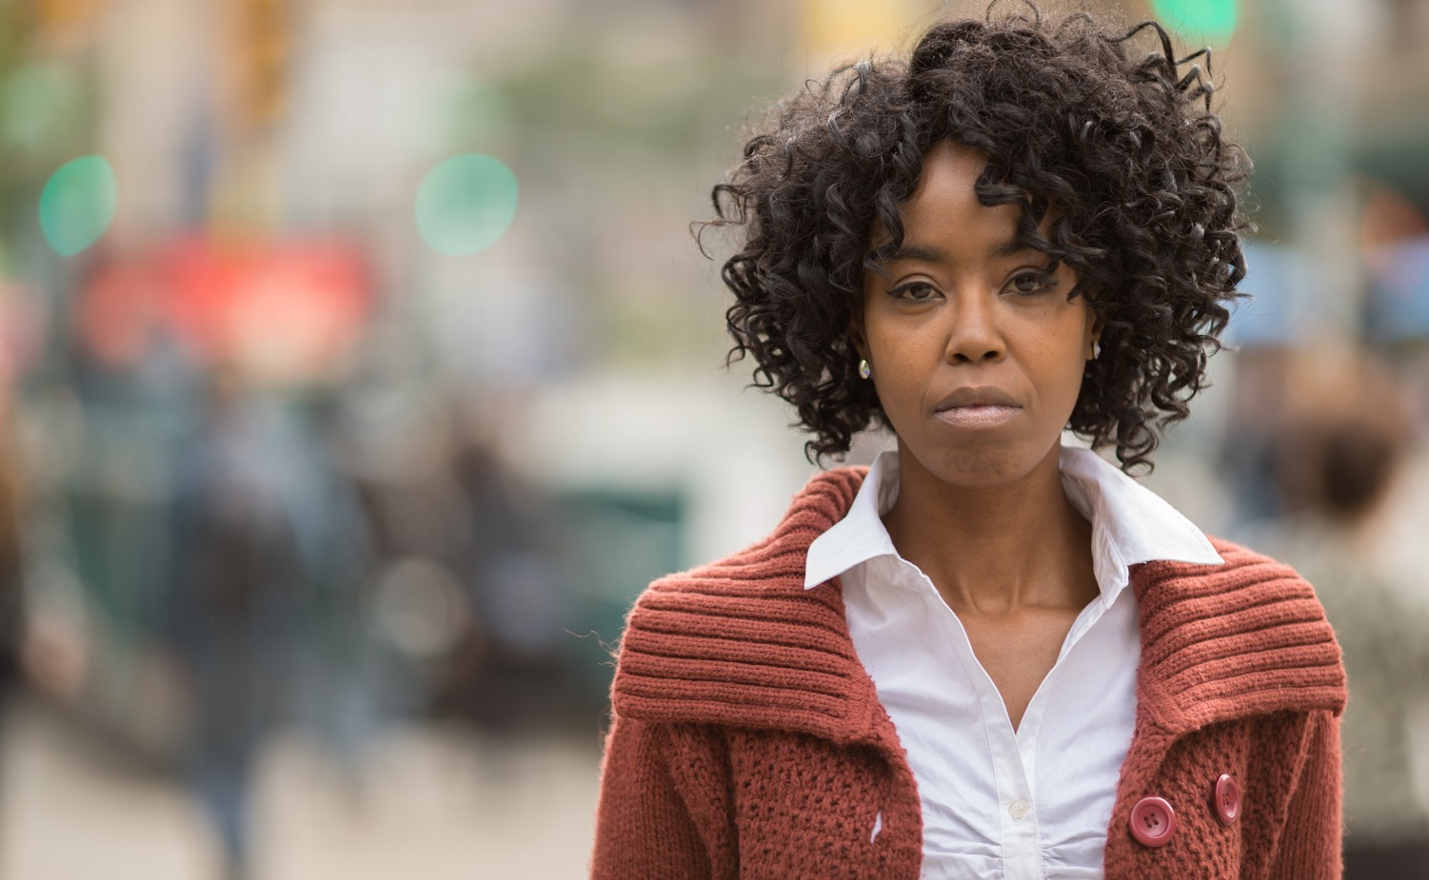
Sexual Abuse
SAMPLE
Sexual abuse occurs when anyone, an adult, an older youth, or even a peer, uses power, force, or threats to engage in sexual activity.
Notes:
SEXUAL ABUSE 2:30
» The last type of abuse we will talk about today is sexual abuse. This may be an uncomfortable topic for us to talk about. However, this is very important, because 1 in 10 people will be sexually abused before their 18th birthday.
» Sexual abuse is unwanted sexual activity, usually with the abuser using force, manipulation, or taking advantage of victims not able to give consent.
» Sexual activity is not just sexual intercourse, or sex. It is the intentional looking or talking about another person’s private parts, or touching inside or outside of clothing.
» It can happen in different ways, and by both adults and other youth.
If an adult engages in any sexual activity with you, that is sexual abuse. This includes touching your private body parts or asking you to touch theirs.
It could be a family member or relative, a friend’s parent, or someone you know and trust, like a teacher or coach.
If an older youth engages in any sexual activity with a younger child, that is sexual abuse.
It is never okay for an older youth to touch your private parts, and it is never okay for you to touch a younger child’s private parts.
If an adult shows you pictures of others without their clothes on or tries to take pictures of you without your clothes on, that is sexual abuse.
If another youth tries to force or threaten you to touch their private body parts, or if they touch yours, that is also sexual abuse.
If anyone, an adult, an older youth, or even a peer uses power, force, or threats to engage in sexual activity with you, that is sexual abuse.
If an adult talks to you in a sexual way, shows you sexual images or pornography, or tries to take pictures of you without your clothes on, that is sexual abuse.

Slide 14
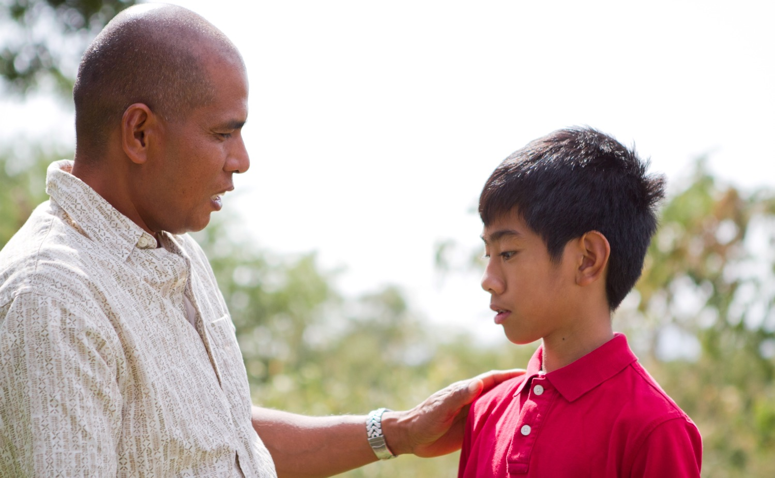
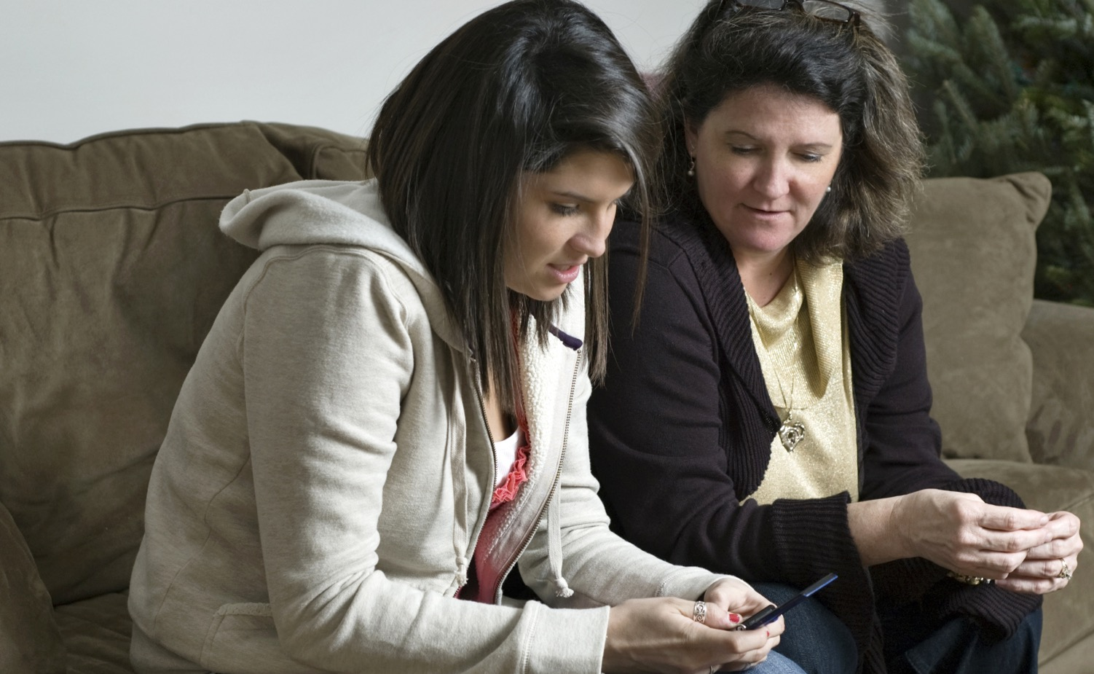
Sex Trafficking
Target
SAMPLE
Trick
Traumatize
Notes:
SEX TRAFFICKING 1:00
» One particular type of sexual abuse that is on the rise among teens, is sex trafficking.
» Sex trafficking is forcing someone into sex acts against their will.
» It often involves an older person that begins a friendship or relationship with a teen and ultimately forces them to have sex with others for money, and it happens to both girls and boys.
» Young people are often targeted by someone they meet in person or online, who tries to establish a relationship for the purpose of sexually abusing and trafficking them.
» Click to advance slide.
Teens are targeted, or sought out, online, in malls, at schools, or at other teen hangouts.
They are tricked, or fooled into a relationship with another person who they think cares for them while hiding their true motives and their real identity.
They are traumatized, or hurt by emotional, physical, and sexual abuse.

Slide 15
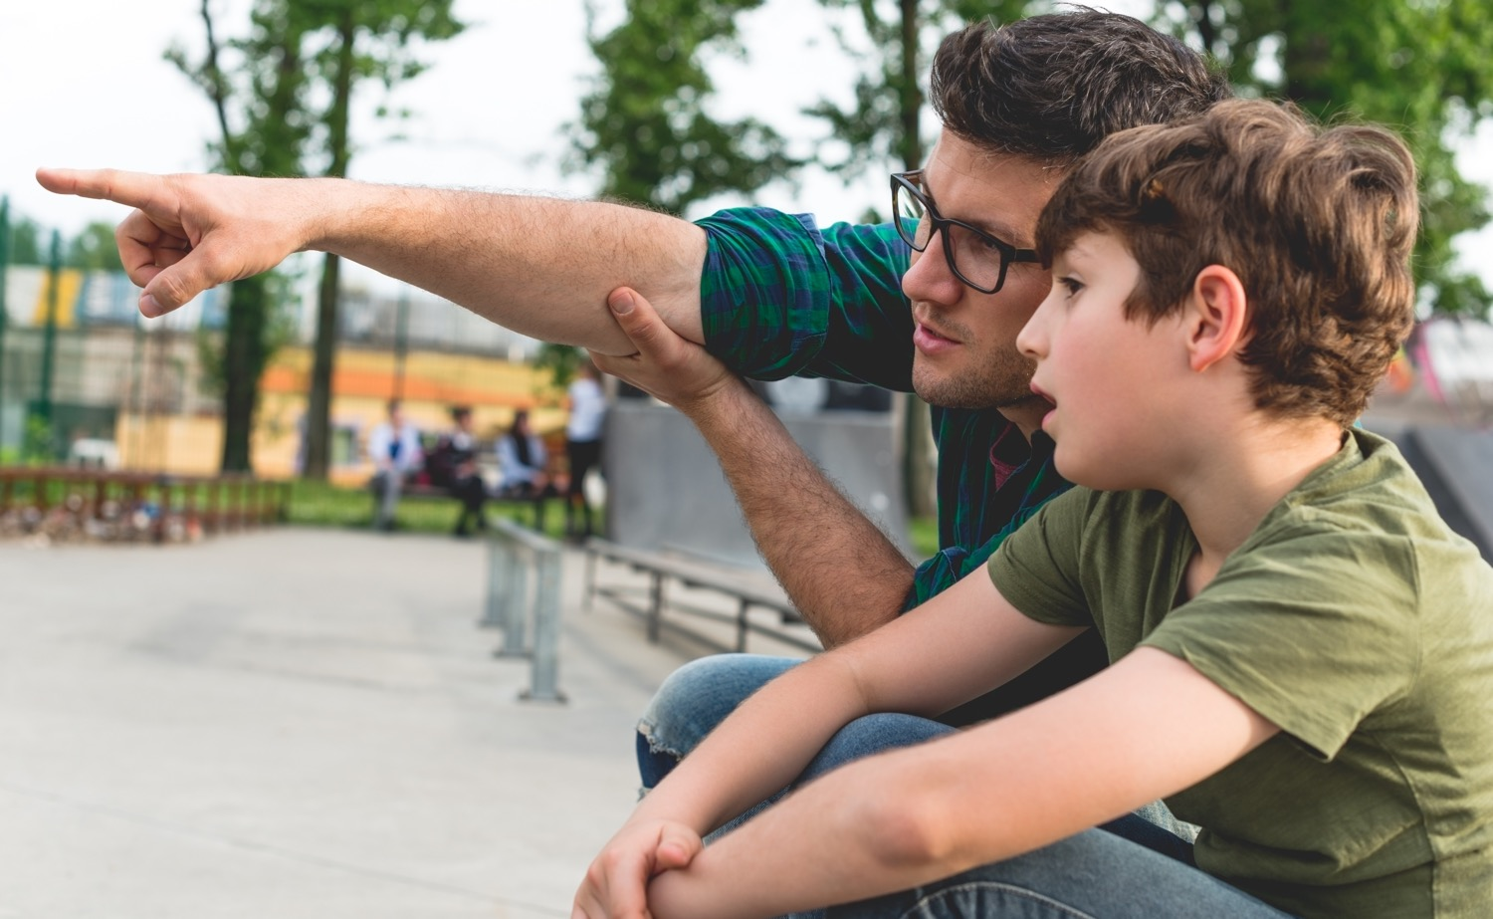
Red Flags for Trafficking
SAMPLE
There are also Red Flags if someone is trying to traffic you. Traffickers often groom their victims by taking advantage of their vulnerabilities.
Notes:
RED FLAGS FOR TRAFFICKING 1:30
» There are also Red Flags if someone is trying to traffic you. Traffickers often groom their victims by taking advantage of their vulnerabilities. Sometimes a trafficker can spend weeks or months building a false relationship and isolating their victims, who do not even realize that they are being groomed or exploited.
» The best way to avoid becoming a victim of sex trafficking is to know how traffickers work, to know how children and teens are manipulated into sex trafficking, and to use the Safety Rules to avoid this type of behavior from anyone.
» Grooming can involve a variety of behaviors, and it happens online and in real life. Signs include things like:
the trafficker providing the victim their basic needs or more expensive items.
meeting the emotional needs of the victim who feels alone and not understood (spending time, listening, giving compliments).
using pictures, personal information, or anything else to embarrass their victim or lead them to believe they will get into trouble.
making false promises about getting them modeling or other jobs, or about helping their family out financially.
coercing the victim to send pictures online and using those to blackmail them to send more, meet offline, and eventually to have sex with others. This is called sextortion.

Slide 16
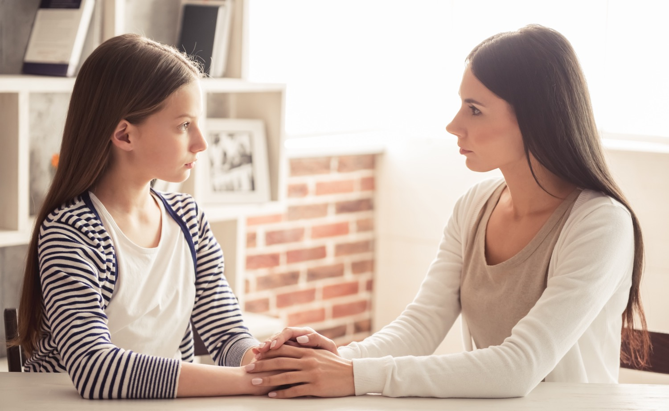
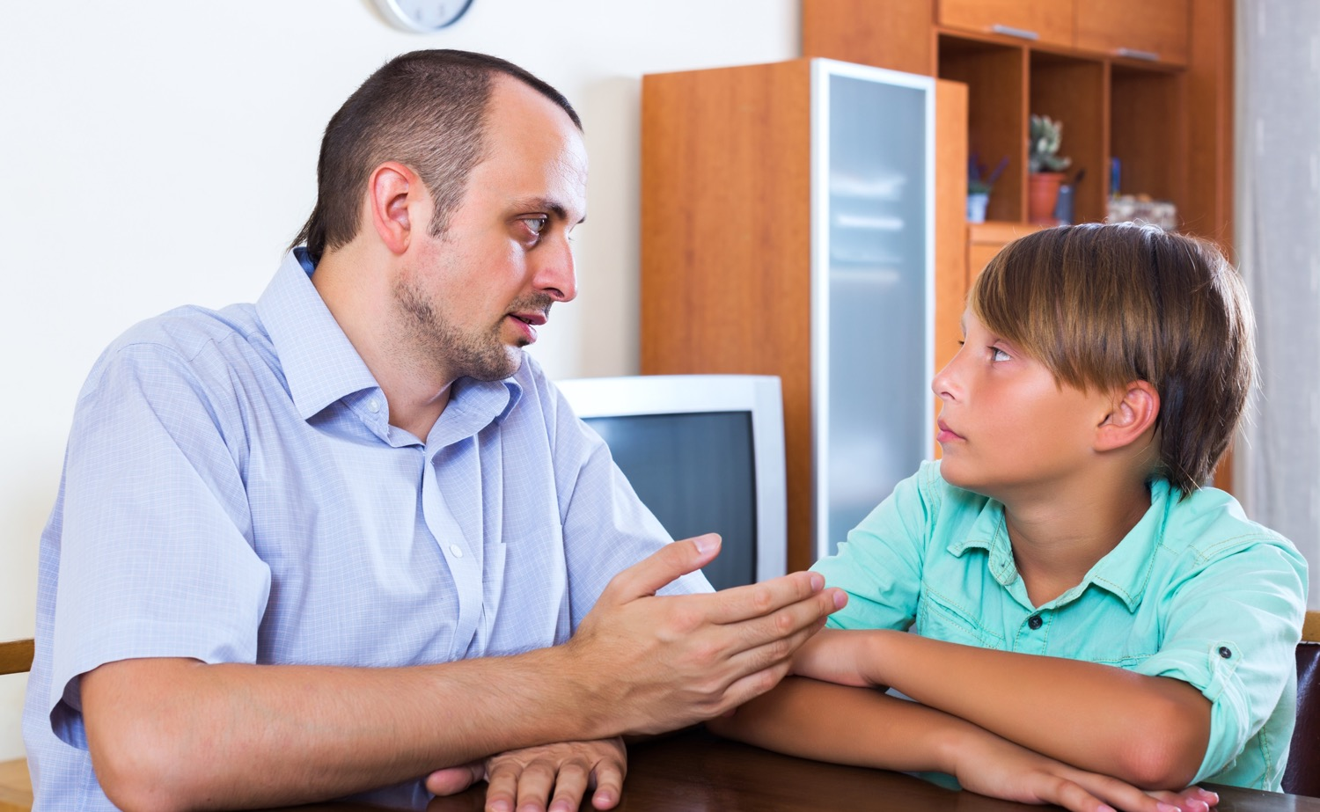
Responding to Red Flags
SAMPLE
If you notice any of these Red Flags, no matter who it is, you can use your Safety Rules to respond.
Notes:
RESPONDING TO RED FLAGS 2:30
» Sometimes, recognizing Red Flags of abuse can be difficult, especially if they are from an authority figure, someone you trust and respect, such as a coach, teacher, or family member.
» If you notice any of these Red Flags, no matter who it is, you can use your Safety Rules to respond.
» You can try to use Safety Rule #3 to Make a Move and get away. If you know a situation or person is demonstrating Red Flag behaviors with you, you can try to stay away from that person.
» How can you use Safety Rule #4 to Talk It Up? (Use an assertive voice to say no, tell a Safe Adult)
» You can use an assertive voice to tell someone to stop doing things that you know are unsafe or make you uncomfortable. For example, you can say:
“I’m sorry, but it makes me uncomfortable when you touch me in that way,” or “ask me those kinds of questions,” or “say those kinds of things about me.”
“Thank you very much for the gift (or saying these nice things, or offering to do that for me), but I don’t feel right about it.”
“I really need to leave now.”
» If you recognize Red Flags in someone who is being trafficked, it is important to act to get them help, because they are often scared and don’t seek help on their own. Examples of these Red Flags include:
the sudden presence of an older boyfriend/girlfriend.
having new or expensive items.
being secretive about who they are talking to or meeting.
being secretive about their online activity.
becoming isolated from their friends or family.
responding to a job offer online such as modeling/acting.
suddenly seeming very anxious, hostile, or secretive.
engaging in risky sexual behavior.
using language not previously used about “the life” (the game, clients, pimps, recruiters).
signs of physical abuse (e.g., cuts and bruises).
a tattoo that they are unable/hesitant to explain.

Slide 17
Essential Review
Messages
Contact
TRUE
FALSE
SAMPLE
Notes:
ESSENTIAL REVIEW 1:30
» Let’s do a thumbs up/thumbs down review to make sure you understand all the types of abuse we discussed today.
» If you agree with a statement, show me a thumbs up. If you disagree, show me a thumbs down.
REVIEW STATEMENTS
Children and teens are more likely to be abused by strangers, or people they do not know. (Allow students to demonstrate a thumbs down, then click to advance slide.)
» This is false. About 90% of abuse happens by someone the child knows.
When you see bullying happening you should use Safety Rule #4, Talk It Up, to be an Upstander or get help from a Safe Adult. (Allow students to demonstrate a thumbs up, then click to advance slide.)
Relationship abuse is always when one person uses physical violence against their partner. (Allow students to demonstrate a thumbs down, then click to advance slide.)
» This is false. It can also be verbal abuse, isolation, control, etc.
Trafficking doesn’t happen to students in middle school. It typically happens to older teens in high school. (Allow students to demonstrate a thumbs down, then click to advance slide.)
» This is also false. Trafficking happens to girls and boys of all ages.
An Upstander is someone who sees bullying or trafficking happening and does something to stop it. (Allow students to demonstrate a thumbs up.)

Slide 18
SAMPLE
GREAT JOB! Every child deserves to be safe!
Notes:
WRAP UP & CLOSE 1:00
» I hope you all have enjoyed this MBF Teen Safety Matters lesson and learned a lot.
» I am very proud of you all. You have been a great class, and I appreciate your attention and participation.
» To finish up today, I have a few things for you.
» Option 1: I have a Parent Information & Activity Sheet for your parents/guardians. The sheet has information about what you learned today, and there is also an activity for you to do together. It is very important that your parents receive this information, so please make sure you give it to them when you get home.
» Option 2: Your parents/guardians will receive an email with a digital copy of the Parent Information & Activity Sheet. This sheet has information about what you learned today, and there is also an activity for you to do together. Please ask your parents to check their email for this information.
» I also have two Safe Adult Bookmarks for each of you. I want you to personalize these and give them to your two Safe Adults, so if you ever need their help, they will know how to help you.
» And I have a Student Resource Card for each of you. This card has resources and hotline numbers for a variety of organizations that can offer you help if you ever need it. Tuck this away somewhere safe and if you or a friend are ever in need of help, you’ll be able to easily access these support hotlines.
» Does anyone have any questions before I leave?
» If you think of any questions, you can ask your teacher, *or you can ask me. (*If you are a school employee)
» Thank you all again for being so attentive during this MBF Teen Safety Matters lesson.
» I hope you’ll all remember your Safety Rules and remember that you deserve to be safe!

