Slide 1
Nursing Quarterly Training/Med Training/First Aid and CPR
Presented by:
Jonah Dahlman RN, PHN

Slide 2

Supportive Lifestyles Nursing On-Call System and relaying information to the Nurses
Listen to media above

Slide 3
Medication Administration
Policies
(Play media box below)
Must be 18 years or older to pass medication
Staff must complete a med course taught or approved by the Supervising RN to pass medications
Medications must have a label or physician’s order and kept under lock and key
Medication information sheets will be kept for all prescribed medications
A Supportive Lifestyles Nurse is the only one who can destroy medications
Only trained staff can administer subcutaneous injections. Staff are not allowed to give an IM injection
Staff cannot give vaginal medications unless approved by the consumer’s team and is stated in the consumer’s Care Plan

Slide 4
Medication Administration
Policies
(Play media box below)
Only trained staff can administer rectal medications
All staff will be trained on all relevant consumer’s Care Plan’s
Never leave medication unattended
Medication is intended for one consumer and will not be used for any other consumer
Never use the buddy system when passing medications.
Each consumer has a medication sheet (MAR) that will be documented on
Scheduled staff is responsible to ensure medication administration is completed. Passing medications for one consumer at a time, observe them their medications, and documenting it properly
Report all med errors to the on-call nurse

Slide 5
Medication Administration Video
https://www.youtube.com/watch?v=H9t-Hy69ZEY
Click on link above to watch how to properly administer oral medications

Slide 6
Review Medication Passing
7 Rights
  Right Person
  Right Medication
  Right Time
  Right Dose
  Right Route
  Right Documentation
  Right Purpose

Slide 7
Triple Checking the 7 rights
1st Check- Remove the medication from the locked area and check the prescription label against the medication sheet to make sure all 7 rights match.
2nd Check- Before dispending the medication: Double check the prescription label against the medication order to make sure they match
3rd Check- After dispensing the medication into the med cup, and before giving the medication to the consumer do a final check with the prescription label and med sheet and count the total number of pills in the cup and ensure that matches the total number of pills on the med sheet

Slide 8
PRN’s
(Play media box below)
What is a PRN Medication?- “Per Resident’s Need” Medication. A medication that is not scheduled daily. A PRN medication is a medication that is only used as the consumer needs. Examples of a PRN could be, Cough syrup, Tylenol, Antacids, Inhalers, Nebulizers, etc.
Where are the PRN Medications listed?- In each consumer’s med book, either on the bottom of the consumer’s med sheet or on a separate PRN sheet
When is a PRN Medication given?- At consumer’s request or based on consumer’s symptoms.
Documentation on a PRN Medication- Document the medication given, date, time, reason for giving, and initials on the back of the medication sheet.
Follow up on a PRN Medication- Document the effectiveness of the medication 1-2 hours after the medication was given. IMPORTANT TO NOTE- PRN’s can only be given within certain time frames. Example: Every 4-6 hours. Be sure to always check when the last time the medication was given to make sure you are able to administer a dose of that PRN medication.

Slide 9
Visit Checklist Form
Play Media box above while following along with the copy of a Visit Checklist Form in your packet

Slide 10
Taking Vitals
Click on links below
Taking a Blood Pressure and pulse with Automatic Blood Pressure: https://www.youtube.com/watch?v=J4Y9i9TQpS0
How to manually take a pulse https://www.youtube.com/watch?v=s2k9-qzx9-A
Taking a consumer’s temperature:
  *Staff are to never take a rectal temperature on a consumer
  *Temperatures over 104 degrees put someone at risk for seizures
https://www.youtube.com/watch?v=nvl1qQfgzuw
Using an Oximeter: https://www.youtube.com/watch?v=Y-CWTqKiIhQ

Slide 11
Balanced Diet
Open Work Document below. Read through the Healthy Diet information and answer the corresponding questions in your packet.

Slide 12
First Aid
Watch the following video links on the next slides while answering the questions on your packet

Slide 13
Universal Precautions
Finding The Problem
Breathing Problems
https://youtu.be/m-IFEFPW1yI

Slide 14
Breathing Problems continued
Choking
Sereve Allergic Reactions
https://youtu.be/FHGqpYZ2nis

Slide 15
Heart Attack
https://youtu.be/h3DQXYUsjm8

Slide 16
Diabetes
Stroke
https://youtu.be/4lrANdvAJkY

Slide 17
Seizures
https://youtu.be/1Xb3CJaEQx4

Slide 18
CPR
https://youtu.be/k9P4efDaxHg

Slide 19
Medical Appointment Sheets and Data Presentation
https://youtu.be/FL7XdOnteCY

Slide 20
Needle Sticks
https://youtu.be/-gjzr4nYcoo

Slide 21
Home Safety
Emergency Water and Gas Shut-Offs
All gas shut-offs are marked with yellow paint.
All water shut-offs are marked with blue paint.
Be sure to review these locations as well as the location of the first aid kit with your Site Coordinator

Slide 22
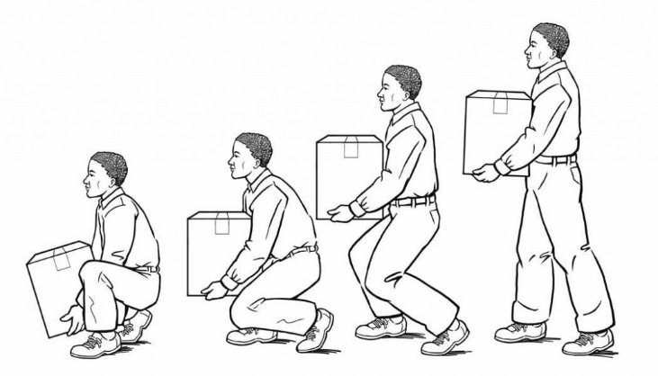

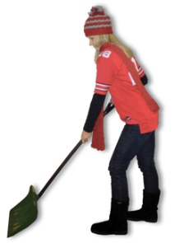
Lifting and Transfering
Home Safety
4 Main Points of Safe Lifting
Keep your head up
Keep the load Close
Use a Staggered Stance
Turn, Don’t twist
  Additional Tips
  Plan your path and get rid of obstacles
  Get help if the load is too heavy
  Make sure the load is safe
  Reduce weight as possible
  Keep your elbows close
  Avoid leaning
  Avoid going to fast
  Avoid distractions – like cell phones
  Look where you are going
  Non-slip footwear for lifts/transfers
  When transferring to or from a wheelchair, be sure the brakes are locked.
  Bend your knees and keep your back straight

Slide 23
SAFETY MANUAL
EMPLOYEE RIGHT TO KNOW
AWAIR POLICY
Open attached document below and read our Safety Manual, Employee Right to Know (ERTK) and AWAIR Policy. Use this Manual to answer questions in your packet.

Slide 24
Ombudsman
Summer Precautions
Apply sunscreen 15-30 minutes before going outside and reapply at least every two hours
Some medications, including some antipsychotic meds and certain antibiotics, can put people at a higher risk for sunburn.
Heat and humidity can put people at risk for heat stroke or heat exhaustion as body temperature can rise to 106 or higher within 15 minutes.
  Signs and Symptoms of Heat Stroke or Heat Exhaustion
    High body temperature, which can lead to seizures
    Red, hot, dry skin (NOT sweating when they should be)
    Throbbing headache
    Rapid breathing
    Dizzy/nauseous/not responsive or unconscious
  What to do, including remove them from the heat
    Call 911 and start to cool the person (i.e. apply cool water or ice packs)

Slide 25
Ombudsman
Winter Precautions
Frostbite
Frostbite can cause permanent damage and typically occurs on exposed skin (nose, ears, cheeks, chin, fingers, toes)
  Signs and Symptoms
    A feeling of pins and needles, followed by numbness/loss of feeling
    Cold, pale, hard skin
    If the frostbite is severe, blisters and blackened skin may appear.
    Changes in the skin color might be difficult to see on darker skin.
Best prevention tips
  Wear several layers
  Wear a warm hat, since a lot of body heat is lost if the head is not covered.
  If gloves, hats, socks, or other clothes get wet, change into dry clothes
  When traveling in cold weather, carry emergency supplies such as extra warm clothing and a cellphone with a charger
  When outside for a longer period of time, cover your ears, nose, and chin.
  Decisions on whether people should stay home below certain temperatures should be made on an individual basis and consult your supervisors as needed.

Slide 26
Ombudsman
Winter Precautions
Hypothermia
Hypothermia can even happen at cool temperatures (i.e. 40⁰F -50⁰F) if someone is wet from rain, sweat, or submersion.
Signs and symptoms
    Shivering, weakness, loss of coordination, feeling very tired, difficulty thinking, fumbling hands, memory loss, slurred speech, and drowsiness.
First aid and treatment for hypothermia or frostbite
  Get into a warm place and remove any wet clothes.
  If any signs or symptoms of hypothermia, call 911
  Soak frostbitten areas in warm (never hot) water - for 20 to 30 minutes. For ears, nose, and cheeks, apply a warm cloth repeatedly. Severe burning pain, swelling, and color changes are expected during warming.
  Do not rub areas with frostbite, and do not disturb blisters.
  Cover the person with warm blankets, ensuring head & neck are covered.
  Give warm drinks to replace lost fluids and help increase the body temperature, if the person is able to drink.

