Slide 1

Resume Workshop Fall Quarter 2025
BFS Fall 2025 | October 13, 2025

Slide 2

Sign in sheet
Look out for the password later in the presentation! →

Slide 3

BFS X LBSA Social
Date: October 22, 2025 from 6 - 8 pm
Location: DipNMix in Westwood which serves smoothies and bowls
Get to know fellow BFS members as well as LBSA members who have similar interests in business and finance industries
Please fill out interest form to gage attendance!
Interest Form!

Slide 4
Table of contents
01
02
03
04
RESUME BASICS
SAMPLE VIEWING
1-1 CRITIQUE
QUESTIONS?
Go over the basic requirements for a perfect resume
Critique a few resume samples together as a group
Board members help critique individual resumes
Network and answer residual questions

Slide 5

01
The Basics

Slide 6

What goes on
a good resume?
WORK EXPERIENCE
Bruin Finance Society Los Angeles, CA
Intern September 2025 - Present
Created….
Pitched….
LEADERSHIP & INVOLVEMENT
HEADER
Bruin Finance Society Family Head
Bioelectronics Laboratory Researcher
Daily Bruin Chief Editor
SKILLS & INTERESTS
Languages and Skills: Microsoft Office Suite, C++, Python, Spanish
Interests: Poker, Travel Blogging, Basketball
EDUCATION
University of California, Los Angeles (UCLA); Los Angeles, CA Expected June 2028
Bachelor’s Degree in Business Economics
Cumulative GPA: 4.00/4.00
College Honors; UCLA Alumni Scholar
Relevant Coursework: Statistical Reasoning; Principles of Accounting
Notes:
Header - Include your first and last name, the city in which you currently reside, your phone number, and personal email address
Education - Include the university name, major/degree you’re pursuing, your GPA, and expected graduation date (some people also put relevant coursework)
Work experience - Include any relevant work/internship experience you may have had in the past
Leadership and involvement - Include any campus involvements and/or extracurricular activities that demonstrate & highlight leadership
Skills and interests - Include any relevant skills you may have along with personal interests at the very end

Slide 7
How to elaborate effectively
WHAT
HOW
AND?
What were your responsibilities?
List all tasks, projects, and accomplishments from your internships and club involvement to help identify key points for your resume
Be sure to quantify your work and achievements!
Write 3–4 bullet points for each activity or experience
**BE AS SPECIFIC AS POSSIBLE FOR THIS PART
What were the results of your work?
End each point with the impact you made
Notes:
What:
What were your responsibilities?
List all tasks, projects, and accomplishments from your internships and club involvement to help identify key points for your resume
How
Be sure to quantify your work and achievements!
Write 3–4 bullet points for each activity or experience
**BE AS SPECIFIC AS POSSIBLE FOR THIS PART
And
What were the results of your work?
End each point with the impact you made

Slide 8
Elaborating Effectively
WHAT
HOW
AND?
Responsibilities
Tasks, projects
Accomplishments
What, specifically, did you do in this role?
Quantify, quantify, quantify!
3-4 bullets
Be specific!
So what?
Highlight YOUR impact… not the organization’s
What did you contribute to the cause?
Notes:
What:
What were your responsibilities?
List all tasks, projects, and accomplishments from your internships and club involvement to help identify key points for your resume
How
Be sure to quantify your work and achievements!
Write 3–4 bullet points for each activity or experience
**BE AS SPECIFIC AS POSSIBLE FOR THIS PART
And
What were the results of your work?
End each point with the impact you made
Try to mention achievements over responsibilities
Back up claims

Slide 9
Resume power verbs
Administrative
Financial
Organizational
allocated
analyzed
appraised
audited
balanced
budgeted
calculated
compiled
computed
controlled
disbursed
distributed
estimated
figured
financed
forecasted
journalized
projected
reconciled
tabulated
acquired
anticipated
catalogued
categorized
classified
consolidated
delegated
directed
edited
eliminated
arranged
collected
coordinated
dispensed
established
executed
implemented
installed
outlined
performed
prepared
processed
provided
purchased
recorded
rendered
served
serviced
sourced
supported
employed
grouped
initiated
managed
monitored
planned
recruited
regulated
scheduled
structured
Notes:
Every bullet point on your resume should start with a strong action verb
Helps highlight accomplishments/skills effectively and capture attention of person reading it
Don’t overuse the same verb, search up synonyms

Slide 10
Consistency is key
Formatting
Extra tips
One page
Capitalization
Standardized bold & italics
Standardized font size/style (10-12pt font, 0.5-1 inch margins)
No headshots, no color
Past tense for ALL experiences
Fill all white space!
Experiences listed in reverse chronological order
Notes:
Formatting:
Standardize all formatting choices
Use the same font/font size
Capitalize appropriately
Use bold and italics uniformly across all sections
Ensure your entire resume fits on one page.
Extra tips:
Use past tense for all experiences - even current roles
Keeps things consistent and easier to follow
Should be focusing on achievements
Experiences in reverse chronological order, with most recent at the top

Slide 11
Don'ts
No typos
No color or fancy fonts
No headshots
Proofread for typos and grammar, and ask a friend to peer-review.
Keep your resume black and white, using a serif font.
Don’t include any headshots and pictures
No inconsistency
No strange file formats
Keep formatting consistent throughout and ensure spacing is uniform
No super long bullets
Always use PDF format (this is very important for applications)
Keep bullet points to 1–2 lines and focus on the most important information
Notes:
No typos:
Proofread for typos and grammar, and ask a friend to peer-review.
No color or fancy fonts:
Keep your resume black and white, using a serif font.
No headshots:
Don’t include any headshots and pictures
No strange file formats
Always use PDF format (this is very important for applications)
No inconsistency
Keep formatting consistent throughout and ensure spacing is uniform
No super long bullets
Keep bullet points to 1–2 lines and focus on the most important information

Slide 12
Don'ts
No typos
No color or fancy fonts
No headshots
Proofread & peer review
Black & white, serif font
No strange file formats
No inconsistency
No super long bullets
Always use PDF-format
Consistent spacing
1-2 lines
Notes:
Common mistakes you should avoid doing
No typos:
Proofread for typos and grammar, and ask a friend to peer-review.
No color or fancy fonts:
Keep your resume black and white, using a serif font.
No headshots:
Don’t include any headshots and pictures
No strange file formats
Always use PDF format (this is very important for applications so formatting doesn’t get messed up)
No inconsistency
Keep formatting consistent throughout and ensure spacing is uniform
No super long bullets
Keep bullet points to 1-2 lines and focus on the most important information
Split information into 2 bullets if you have to

Slide 13


Resources
BFS Resume Critique
Resume Checker
Get your resume personally checked by a BFS board member with specific feedback
sites like
Resume Worded will use AI to scan your resume and score you out of 100
Notes:
Resources to get feedback on your resume

Slide 14
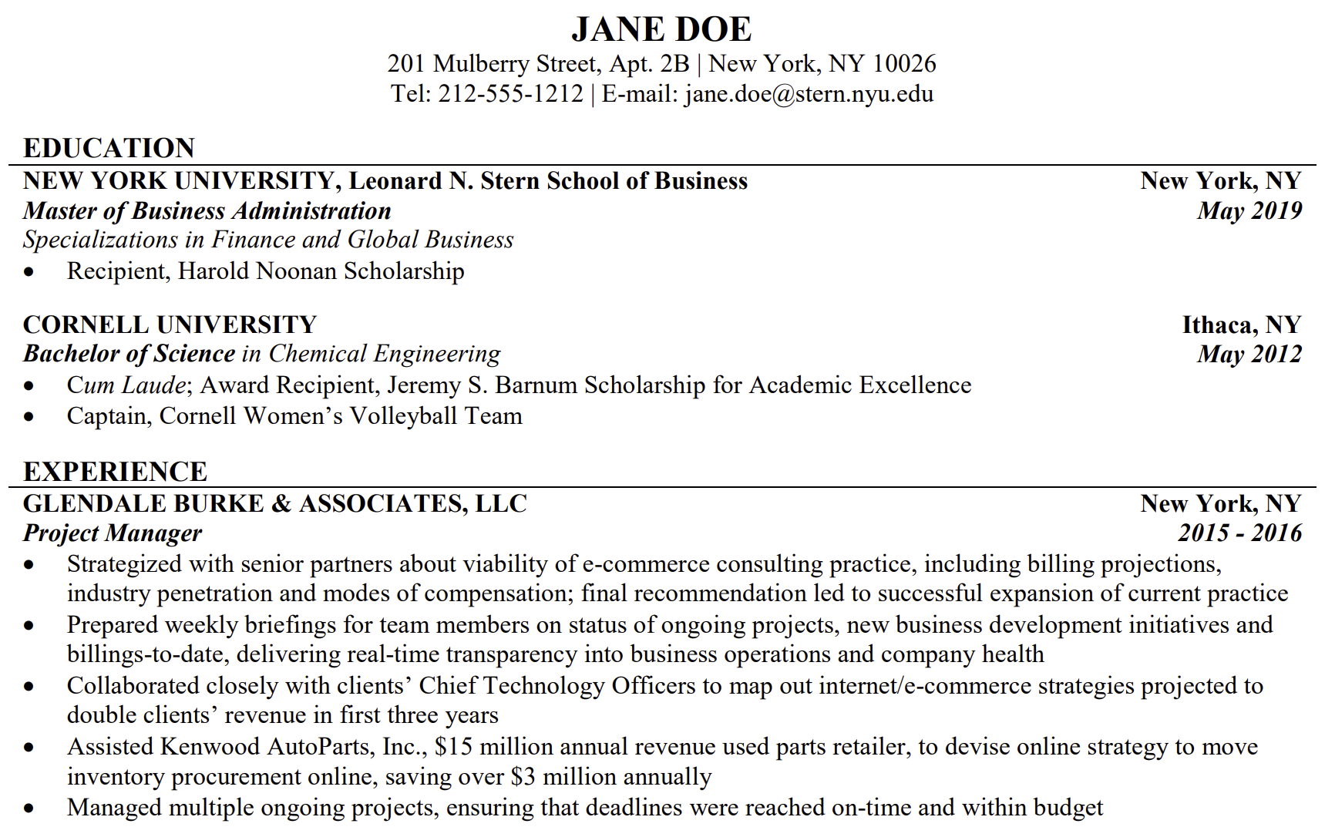
Formatting
Presentation is just as important as content, reflecting the care and effort you invested in your work!
Notes:
Presentation is just as important as content
Templates are great, try not to pick one that’s too flashy or stylish
Simple formats are great and easy to read

Slide 15

02
Resume Samples

Slide 16
On the next slide is a resume sample.
What could be improved?

Slide 17
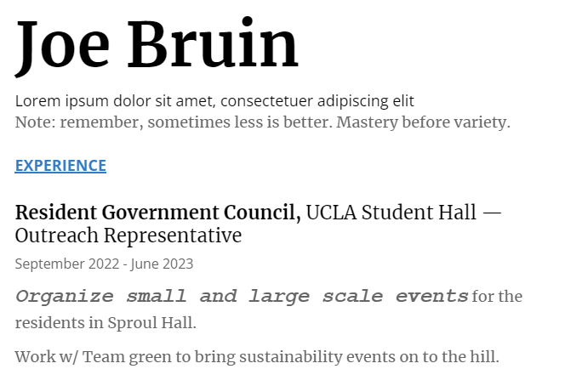
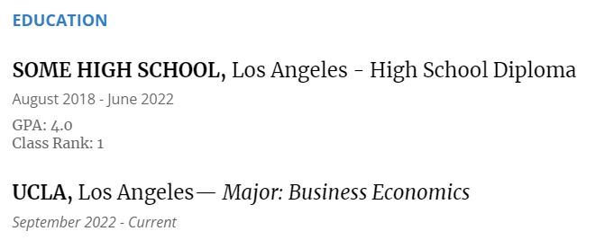
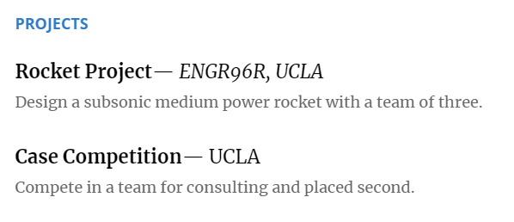
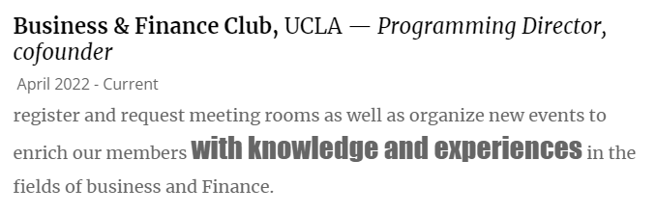

Slide 18
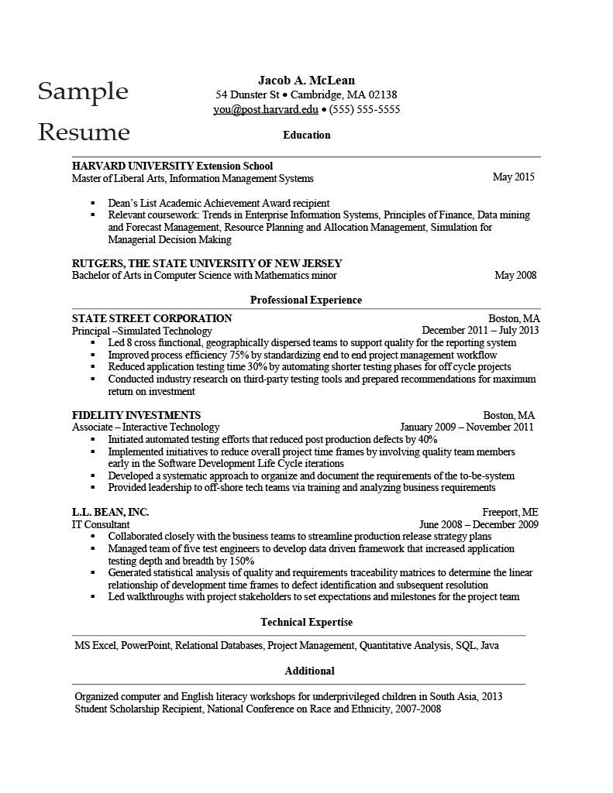
A Better
Resume Sample… but not perfect.
Notes:
**black space - lines don’t go all the way
Roles are not standardized - for the first two, the position is listed, then the industry/vertical it is in, but the last is different
No interests/hobbies, despite their underrated importance

Slide 19

03
1-1 Critiques

Slide 20
03
1-1 Critiques

Slide 21
Questions?
Fill out the Sign-In/Survey if you haven’t already!
Come to the front of the room and get feedback or network with BFS officers and associates!
Follow us on Instagram @bruinfinance
Link to our substack!
Password for sign in sheet: Format
Dining Hall run after the meeting!

Slide 22
Pair up with an Officer/Associate for a personalized resume review!

Slide 23



Photo showcase
A photo showcase can be a useful addition to a business project proposal as it can help to visually communicate the concept or idea being proposed

Slide 24
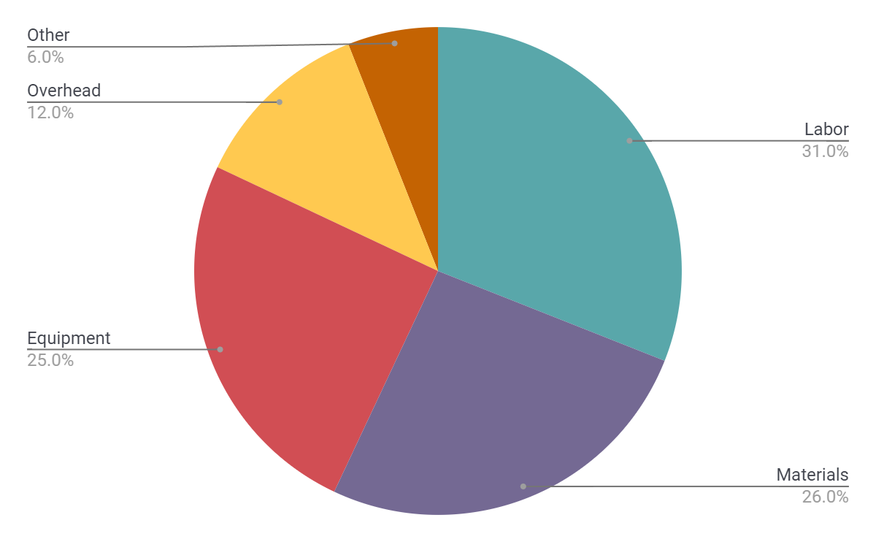
Project expenses
Labor
Materials
Equipment
Overhead
Other
Follow the link in the graph to modify its data and then paste the new one here. For more info, click here

Slide 25
Resources
Did you like the resources on this template? Get them for free at our other websites:
Vectors:
Hand drawn reseller illustration
Flat design cryptocurrency concept
Photos:
Close up on young colleagues having a meeting
Couple getting a delivery of groceries
Medium shot employees working together
Side view employees working together

