Slide 1

Accounting Workshop
BFS Fall 2025 | November 17, 2025

Slide 2
BFS Family Clay & Cookies Event
📅 Friday, November 21 🕓 6:30–7:30 PM 📍 Hitch Lounge
Bring your BFS family and unwind with a cozy evening of clay-making and a cookie bake sale!
🎯 20 points awarded per family member who attends

Slide 3

IB 103: Speaker Panel — Investment Banking
Thursday, November 20 🕓 6:30–7:30 PM 📍 Kaplan 135
Hear directly from people who’ve sat where you are now
Our guest speakers, current MBAs and incoming IB associates, will share candid insight into recruiting, navigating internships, and breaking into the fast-paced world of investment banking
RSVP Form:

Slide 4

Sign in sheet ->
Keep an eye out for the password!

Slide 5
Table of contents
01
04
02
05
03
Why accounting?
Want to know more?
Basic Ideas
Questions?
Financial Statements

Slide 6

01
Why accounting?

Slide 7

What is accounting?
A systematic recording, summarizing, and reporting of financial transactions to provide useful information for decision-making.
Notes:
Accounting is often called the "language of business." It involves the entire process of identifying, measuring, and communicating economic information to permit informed judgments and decisions by users of the information. Essentially, it transforms raw financial data (like sales, purchases, and expenses) into meaningful reports—primarily financial statements (the Balance Sheet, Income Statement, and Cash Flow Statement). These reports help various stakeholders, such as managers, investors, creditors, and regulators, understand a company's financial health, performance, and cash movements. It provides the crucial framework for budgeting, planning, and assessing profitability.

Slide 8


Managerial vs Financial accounting
Managerial Accounting
Provides information to internal decision-makers (managers) to aid in future planning
Financial Accounting
Provides information about historical performance to external users (investors, creditors)
Notes:
Managerial Accounting is for internal users—the company's managers. Its purpose is to provide timely, specific, and often forward-looking information to help managers with operational decisions, planning, and control. This includes things like budgeting, cost analysis (e.g., product pricing), performance evaluation, and segment reporting. It is not required to follow GAAP/IFRS and is tailored to the specific needs of management, allowing it to be more flexible and subjective.
Financial Accounting is focused on providing information to external parties like investors, creditors, government agencies, and the general public. Its goal is to summarize the company's past financial performance and position using standardized, historical data. It must adhere to rigid rules, like Generally Accepted Accounting Principles (GAAP) or International Financial Reporting Standards (IFRS), to ensure reports (the financial statements) are credible and comparable across different companies.

Slide 9
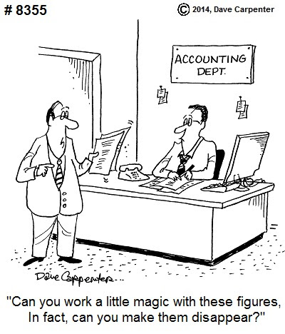
What it is like to be an accountant
Involves providing strategic advice through financial analysis compliance checks
Requires strong analytical skills, attention to detail, and integrity
Salary: Median at 75k
Applicable to many industries
Cyclical schedule
Notes:
Key Responsibilities: An accountant's day-to-day work often involves auditing financial records, preparing tax returns, maintaining general ledgers, conducting financial analysis to identify trends, and creating budgets. For management, they provide strategic advice on business decisions, risk management, and profitability improvements.
in accounting demands meticulous attention to detail and a high degree of analytical and critical thinking skills to interpret complex data. Since they deal with sensitive information, integrity and ethical conduct is needed as well
Career Diversity: The profession offers diverse paths, including public accounting (auditing and tax services), corporate accounting (working for a single company), forensic accounting (investigating fraud), and government accounting. It's a stable and respected career with significant opportunity for growth and specialization.

Slide 10
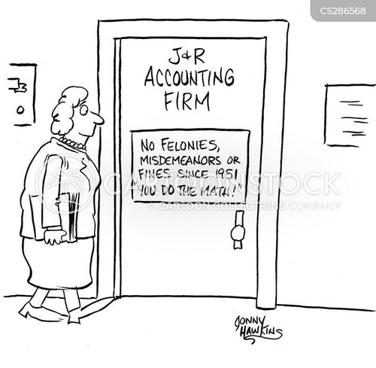




Accounting firms
Big Four
Competitive landscape
]
Analyze the competitive landscape for your industry, identify key competitors and their strengths and weaknesses. Then, you can explain how you plan to differentiate yourself and your business from them
Notes:
Accounting firms are professional services organizations that advise businesses and individuals on financial matters.
Core Services: They typically specialize in three main areas:
Audit & Assurance: Providing independent verification of a client's financial statements to ensure accuracy and compliance.
Tax Services: Helping clients with tax planning, compliance, and preparation of tax returns.
Consulting/Advisory Services: Offering strategic advice on business processes, risk management, technology implementation, and mergers and acquisitions.
The "Big Four": The global accounting landscape is dominated by the "Big Four" firms: Deloitte, PricewaterhouseCoopers (PwC), Ernst & Young (EY), and Klynveld Peat Marwick Goerdeler (KPMG). These firms audit the vast majority of publicly traded companies worldwide and offer enormous opportunities for entry-level accountants.
Other Firms: Beyond the Big Four, there are numerous other firms, often categorized as "Mid-Tier" (like Crowe or Grant Thornton) and smaller regional/local firms, all providing essential accounting services tailored to different client sizes and needs.

Slide 11


Cisco’s Experience - KPMG
Co-President of Bruin Finance Society
Notes:
Cisco - Co President of Bruin Finance Society
2024: Rotational Internship
2025: Audit Internship
Completed a 2024 rotational internship across Audit, Tax, and Consulting/Advisory, returned in 2025 as an Audit Intern supporting public and private clients.
Some of the things he worked on include audit procedures for biotech and asset-management clients, including one of the largest multi-generational family offices in the U.S. He also contributed to an East Coast university M&A engagement, assisting with synergy analysis, operational modeling, and integration considerations.
Feel free to ask him any questions about his experience or recruitment process afterwards.

Slide 12






Accounting firms (Cont.)
Mid-Tier
Notes:
Other Firms: Beyond the Big Four, there are numerous other firms, often categorized as "Mid-Tier" (like Crowe or Grant Thornton) and smaller regional/local firms, all providing essential accounting services tailored to different client sizes and needs.

Slide 13

02
Basic Ideas

Slide 14





Key terms
Revenue
Assets
Expenses
Liabilities
Equity
Notes:
1. Assets: Valuables you own
Definition: These are resources controlled by the company that are expected to provide future economic benefits. Think of them as anything the business has that can be turned into cash or used to make money
Examples:
Cash (money in the bank)
Equipment (computers, machinery)
Accounts Receivable (money that customers owe the business)
Buildings and Land
2. Liabilities: What you owe
Definition: These are the company’s obligations—things the business has to pay back to outside parties in the future
Examples:
Accounts Payable (money the business owes to its suppliers)
Salaries Payable (money owed to employees)
Loans (money borrowed from a bank)
3. Equity: Owner's share of the business
Definition: This represents the amount of money invested in the business by its owners plus any profits the business has kept (retained earnings). It's the residual claim on assets after liabilities are paid off
The Accounting Equation: This is the core equation of accounting: Assets = Liabilities + Equity. Equity is what is left over for the owners if the company sold everything and paid all its debts
4. Revenue: Money earned from selling products or performing services
Definition: The income generated from the company's primary business activities. This is money coming into the business from sales
Examples:
Selling a physical product (like a shirt)
Providing a service (like giving a haircut or consulting)
Subscription fees
5. Expenses: Costs incurred to run the business
Definition: The costs incurred to generate revenue. You have to spend money (expenses) to make money (revenue)
Examples:
Rent for the office or store
Salaries and wages for employees
Utilities (electricity, internet)
Supplies and raw materials

Slide 15

03
Financial Statements

Slide 16
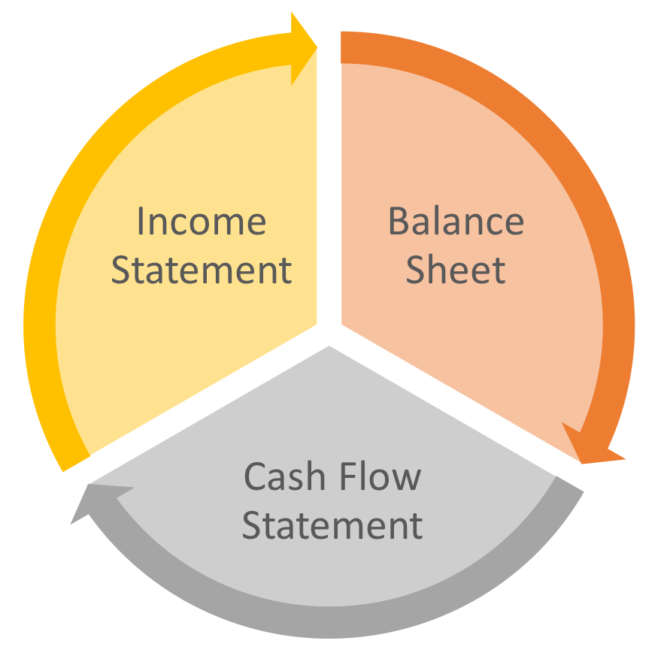


What are financial statements?
Shareholder’s equity
Summarize a company’s financial activities and performance
Comprehensive overview of business health
Profitability
Liquidity
Solvency
Operational efficiency
Notes:
Start of Melody’s slides:
Financial Statements
Summarize a company’s financial activities and performance
Gives a comprehensive overview of business health
3 main components: income statement, balance sheet, cash flow statement
Balance sheet includes a statement of shareholder’s equity (company net worth after all liabilities are paid)
We will get into more specifics later in the presentation
Can help the business answer several important questions:
Profitability: What are my margins?
Liquidity: Am I able to meet my business’ financial obligations?
Solvency: How stable is my business?
Operational efficiency: Am I getting the best return on investment I can?

Slide 17
Purpose?
Measure Impact
Cut Costs
Decision Making
Clear picture of financial performance and position
See company expenses line by line
Used by analysts, lenders, creditors, and managers
Team Motivation
Helps Investors
It’s the Law
Gives big-picture mindset and can see tangible impact
Understand financial standing of companies
Accounting standards (GAAP, IFRS)
Notes:
Financial health of a company
Companies must file these regularly (10Q vs 10K)
If the company is publicly traded, it’s public information
Importance: Helps investors make better informed decisions
Financial statements are essential for several reasons:
Measure Impact:
Give a clear picture of a company’s financial performance and position, helping business owners make informed decisions
Monitor financial health and progress of a company
Allows business owners to identify areas of improvement
Cut Unnecessary Costs:
Allows you to see company expenses line by line
Can highlight areas where it’s possible to cut costs
Save money and realocate $$ to where it’s needed the most
Decision Making:
Critical for decision making
Analysts and investors rely on company financial statements for evaluation
Evaluate potential return on investment
Assess associated risks
Make informed decisions to buy, hold, or sell stocks
Lenders and creditors use financial statements to determine the org’s creditworthiness and ability to pay loans
Internally, managers use the info on financial statements to:
Make strategic decisions
Plan budgets
Allocate resources
Improve operational efficiency
Team Motivation:
Can show how employee projects positively impact company revenue
Boost their performance and drive
Provides context on why specific benchmarks were targeted and the thought process behind plans
Gives employees big-picture mindset and knowledge that their efforts make a tangible difference to the company
Helps Investors:
Helps investors and stakeholders understand the financial standing of a company before making investments/partnerships
Required by Law:
Required by law for businesses to assess their tax liabilities and comply with accounting regulations
Comply with accounting standards such as:
Generally Accepted Accounting Principles (GAAP)
Framework of accounting standards, rules, and procedures used in the U.S.
International Financial Reporting Standards (IFRS)
Globally recognized set of accounting standards used in many other countries
These standards are essential for meeting regulatory requirements
Helps ensure transparency and consistency in financial reporting

Slide 18


Income Statement
Profit and Loss Statement (P&L)
Overview of income and expenses
Analysis of income/expense trends
Key components:
revenues, expenses, gains, losses
Notes:
What is an income statement? (otherwise known as a profit and loss statement (P&L))
Provide an overview of income and expenses
Shows a business's revenue, expenses, gains, and losses
Starts with revenue and ends with net income
Help stakeholders assess financial health and management success
Crucial for understanding a company’s profitability and ability to generate income
Comparison of trends in income/expenses
Typically presented annually or quarterly
Allows businesses to compare trends in income and expenses over time
Can analyze trends in results of company operations
Analyze proportions of expenses in a single reporting period
Key Components
Revenues: inflows generated from primary operations
Expenses: outflows or use of assets generated from the ongoing operations
Gains: increase in equity related to non-operational transactions
Losses: decrease in equity related to the non-operational transactions
Answers the question: Did the company make money?
Basically used to assess profitability

Slide 19
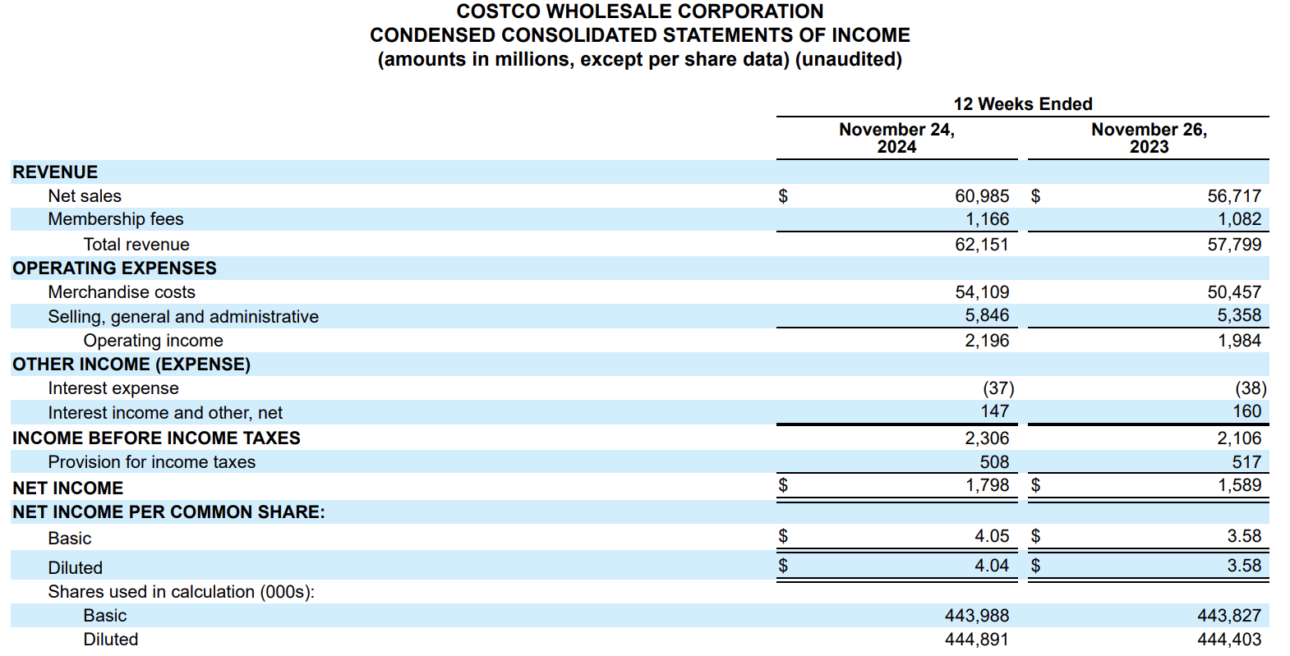
Income Statement
Notes:
Transitions move the red boxes down
Header
Company is Costco
This is a report for a 12 week period (one quarter)
Comparing numbers from two years: 2023 and 2024
Top line: Revenue
always displayed at the top
Costco has 2 revenue streams: sales and membership fees
Operating Expenses
Costs required to run the business
Operating Income: what’s left after subtracting the operating expenses from revenue
62151 - 54109 - 5846 = 2196
The profit from core business operations
Other Income (expense)
Financial activities outside of core operations
Debt, investment returns, non-operational income
Income before income taxes
Operating profit adjusted for the non-operating items
Also called pre-tax income or EBT (earnings before tax)
Net Income
The bottom line
The final profit belonging to shareholders
Net income per common share
Shows profit per share of stock

Slide 20

Balance Sheet
Shows a company’s financial position at a specific point in time
Assets = Liabilities + Shareholders’ Equity
Divides resources into what the company owns, owes, and retains
Helps evaluate liquidity, leverage, and overall financial health
Notes:
Moving forward to the Balance Sheet…
This statement shows a company’s financial position at a specific point in time, it is like a financial snapshot taken on a single day.
Accounting Equation:
The foundation of the B/S is the equation: Assets = Liabilities + Shareholders’ Equity
This relationship must always balance, as one side represents what the company currently owns and the other show how are those assets financed (either with debt or equity).
Assets: Resources owned by the company that provide it value (for example, Inventory and Lands)
Liabilities: Obligations the company must pay (can be short-term, within 12 months, or long-term)
Equity: The owners’ claim to the value generated after the liabilities have been paid
The B/S provides information that allow analysts to evaluate its liquidity leverage and financial health

Slide 21
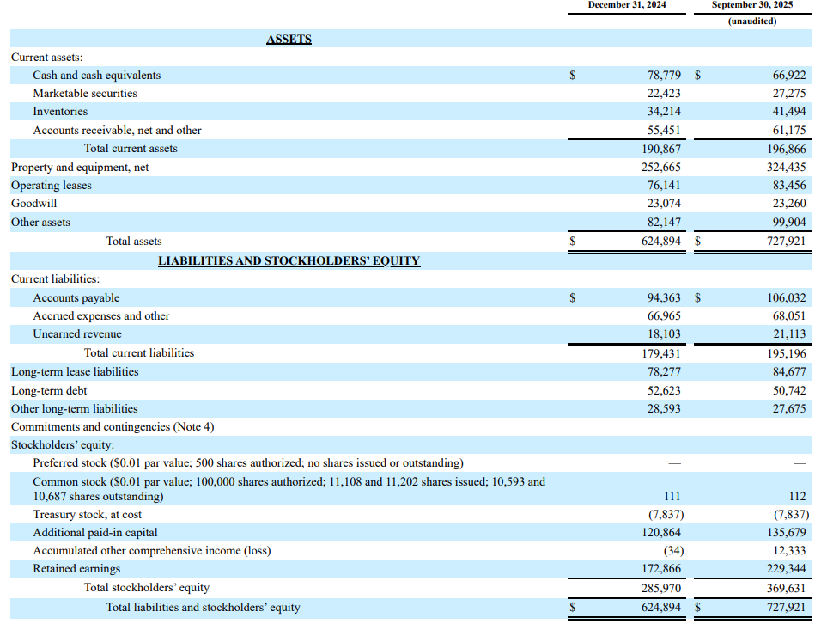
Balance Sheet
Assets: What the company owns or controls that has measurable value and can bring future economic benefit
Liabilities: What the company owes, obligations from past events that will require future payment or resources
Equity: The owner's’ share of the company, funds from shareholders and profits kept in the business.
Notes:
Assets:
Assets represents what the company owns that has measurable value and can generate future economic benefit
At the top you can see current assets, these are items that are expected to be converted into cash within the operating period (usually 12 months), typical examples include: Accounts Receivable, Inventory, and marketable securities
Below is the long-term assets section, which include property plant and equipment, good will, and other assets that provide value over many years.
Liabilities:
Shows what the company owes. These are obligations arising from past events that will require payment or use of resources
They are also broken into current (accounts payable) and long-term obligations (debt with maturity higher than 12 months).
Equity:
Represents the owners’ share of the business, i.e. the funds provided by the shareholders plus the profits retained by the company.
Includes common stock, retained earnings, additional paid-in capital, and treasury stock.
Shows how much value belongs to the shareholders after all liabilities are paid

Slide 22
Statement of Cash Flows
Shows how cash moves in and out of the business during a period
Divided into Operating, Investing, and Financing activities
Helps reveal if a company is generating enough cash to sustain operations
Cash from Operations
Cash from Investing
Cash from Financing
Cash made or spent from the company’s main business
Shows if the core business brings in cash
Cash used to buy or sell LT assets like equipment, buildings, or investments
How the company grows or shrinks its assets
Cash received from or paid to investors and lenders
Shows how the company funds its operations
Notes:
Statement of Cash Flows:
This statement shows how cash actually moves in and out of the business during a specific period
It focuses only on cash transactions, which makes it useful for understanding whether the company can meet its immediate financial needs
The statement is divided into three sections, each explaining a different source or use of cash
Together, they help determine if the company is generating enough cash to sustain its day-to-day operations and fund its growth
Cash from Operations:
This section reflects cash that comes directly from the company’s core business activities
It tells us whether the main operations generate more cash than they consume
Typical examples include cash collected from customers and cash paid to suppliers and employees
Cash from Investing:
This part shows how cash is used for long-term growth
It includes purchases or sales of long-term assets such as equipment, buildings, or financial investments
A negative number here often means the company is investing in its future, while a positive number suggests it is selling assets or reducing investment
Cash from Financing:
This section tracks cash movements between the company and its investors or lenders
It includes cash received from issuing debt or equity, as well as cash paid out for dividends or loan repayments
It helps reveal how the company funds its operations and how reliant it is on external financing.

Slide 23
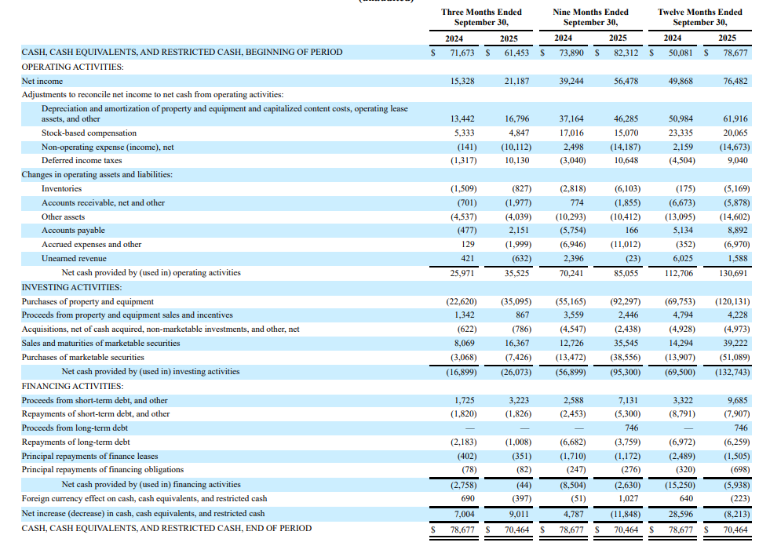
Statement of Cash Flows
Notes:
This slide shows a real example of a company’s full cash flow statement
It breaks down the actual cash entering and leaving the business across the three main sections: Operating, Investing, and Financing activities
At the top, we see the beginning cash balance, which represents how much cash the company had at the start of the period
At the bottom, the statement shows the ending cash balance, revealing how the company’s cash position changed over time
Operating Activities:
This section starts with net income and then adjusts it for non-cash items and changes in working capital
Items such as depreciation, stock-based compensation, and movements in accounts receivable or payable help convert net income into operating cash flow
The final number here tells us whether the core business is generating positive cash
Investing Activities:
These lines show how much cash the company spent on long-term assets or received from selling them
Typical items include purchases of property and equipment or investment securities
A negative number usually indicates the company is reinvesting in its operations, while a positive number may mean it is selling assets
Financing Activities:
This section outlines cash flows linked to investors and lenders
It includes issuing or repaying debt, buying back shares, paying dividends, or receiving proceeds from stock issuances
This tells us how the company is funding itself and whether it relies more on debt, equity, or internal cash generation
Final Cash Position:
The last line shows the total cash, cash equivalents, and restricted cash at the end of the period
Comparing the beginning and ending balances helps assess whether the company strengthened or weakened its liquidity during the period

Slide 24

Statement of Owner’s Equity
Shows how the owner’s capital changes during a period
Includes investments, profits, and withdrawals
Explains why the owner’s equity increased or decreased
Ends with the final owner’s equity balance
Beginning Equity
+ Net Income
+ Investments
- Withdrawals
Ending Equity
Notes:
Statement of Owner’s Equity
This statement shows how the owner’s capital changes over a specific period
It tracks all movements that increase or decrease equity, making it easy to understand how much of the business value belongs to the owner at the end of the period
The statement includes three main components: investments contributed by the owner, profits earned by the business, and withdrawals taken out
By listing these items separately, it becomes clear what drove the increase or decrease in equity
It also explains why owner’s equity did not stay the same
For example, equity grows when the business earns net income or when the owner makes additional investments.
It decreases when the owner takes money out for personal use
At the bottom of the statement, we see the final owner’s equity balance
This is the updated value of the owner’s claim on the business after all additions and withdrawals for the period
Flow of Equity:
The graphic at the bottom summarizes the process
You start with beginning equity, add net income, add any new investments, subtract withdrawals, and the result is the ending owner’s equity
This simple flow helps visualize how each component affects the final number

Slide 25
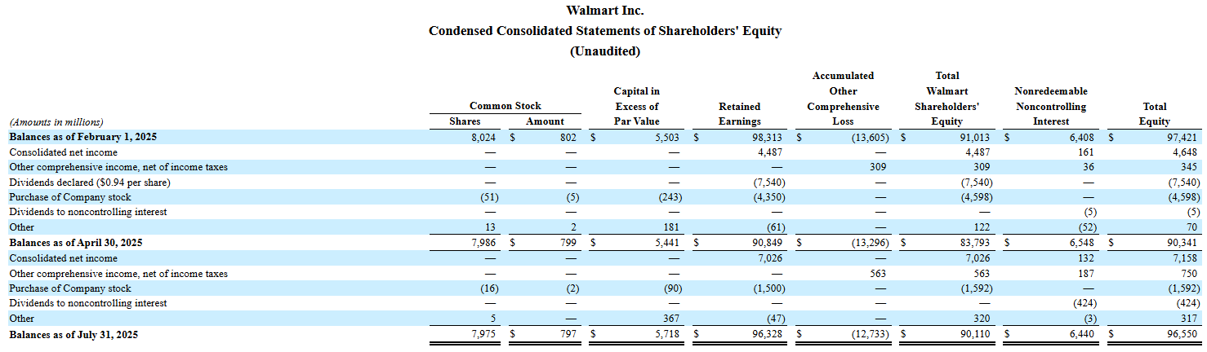
Statement of Owner’s Equity
Notes:
This slide presents a real example of the Statement of Shareholders’ Equity of Walmart
It shows how different components of equity changed during the period and what transactions caused those changes
At the top, the statement begins with the opening balances for each equity account
These include common stock, capital in excess of par value, retained earnings, accumulated other comprehensive loss, and noncontrolling interest
Each row then shows specific events that affected equity
Examples include net income, dividends paid, share repurchases, stock issuances, and movements in other comprehensive income
Every one of these items either increases or decreases the total equity
Retained earnings is one of the most important sections
It grows when the company earns net income and shrinks when dividends are paid out to shareholders
This makes retained earnings a key indicator of how much profit the company is keeping for reinvestment
You can also see how share repurchases reduce equity
When the company buys back its own stock, both cash and shareholders’ equity decline
At the bottom, the statement presents the ending balance of each equity account
Adding all of them together gives the total shareholders’ equity at the end of the period, which shows the updated value belonging to the shareholders after all activity for the year
This format allows investors to clearly track how the company created or used value over time and what drove the final equity position

Slide 26

Want to know more?
MGMT class series (accounting minor)
Accounting canvas page hosted by Anderson
UCLA BAY or VITA (tax)
Coursera
Notes:
MGMT class series (accounting minor) which we will talk more about shortly
Accounting canvas page hosted by Anderson
UCLA BAY or VITA (tax) Which are clubs here on campus that relates to accounting
Coursera : Website that gives you the information and intro courses for accounting

Slide 27

Accounting Minor
Offers comprehensive training in financial & managerial accounting, taxation, and financial analysis
Builds analytical and financial skills applicable to diverse business roles
Prepares students for CPA careers and roles in auditing, banking, consulting, and finance
Provides strong foundation for graduate studies in accounting, business, or law
Notes:
The UCLA Anderson Accounting Minor program provides students with a comprehensive education in financial and managerial accounting, taxation, financial statement analysis and more. The Accounting Minor not only prepares students for a career as a CPA but can also help them acquire foundational analytical and financial skills for entry into varied roles within organizations, such as accounts payable/receivable, auditing, banking, bookkeeping, consulting, entrepreneurship, finance, investments, general management and taxation. The program also provides excellent preparation for graduate programs in accounting, business and law.

Slide 28
Accounting Minor Requirements
Need 90+ units completed before entering the minor
Minimum UCLA GPA: 3.0+
Transfer students with <3.0 UCLA GPA → can apply after 2 quarters at UCLA
Required grades:
B or better in MGMT 1A & 1B (or equivalents)
If not → must earn B or better in MGMT 120A & MGMT 122 instead
Must complete the Accounting Minor Interview Workshop
Submit the minor application form
Notes:
You must be a current full-time UCLA undergraduate student in good academic standing to apply. If you are not enrolled at UCLA, please visit the UCLA admissions web page.
To enter the minor, students must:
Have completed 90 units of study prior to entry into the minor at UCLA or as an accepted UCLA transfer student.
Be in good academic standing with a minimum cumulative UCLA grade-point average or equivalent (for transfer students) of 3.0 or better.
Transfer students whose GPA is not at least 3.0 UCLA GPA, may only apply to the minor after they have completed two regular academic quarters at UCLA, and have completed MGMT 120A Intermediate Financial Accounting I and MGMT 122 Management Accounting, with a grade of B or better in each.
Have achieved grades of B or better in both MGMT 1A Principles of Accounting and MGMT 1B Principles of Accounting or their equivalents. Students who did not achieve these grades must take MGMT 120A Intermediate Financial Accounting 1 and MGMT 122 Management Accounting and earn a grade of B or better in each before being admitted to the minor.
Have completed the Accounting Minor Interviewing Workshop.
Complete the minor application form.

Slide 29
Questions?
Come to the front of the room and get feedback or network with BFS officers and associates!
Follow us on Instagram @bruinfinance
Link to our substack!
Password for sign in sheet: Balance
Dining Hall run afterwards!

Slide 30
Alternative resources
Here’s an assortment of alternative resources whose style fits the one of this template:
Vectors:
Online tax concept illustration

Slide 31
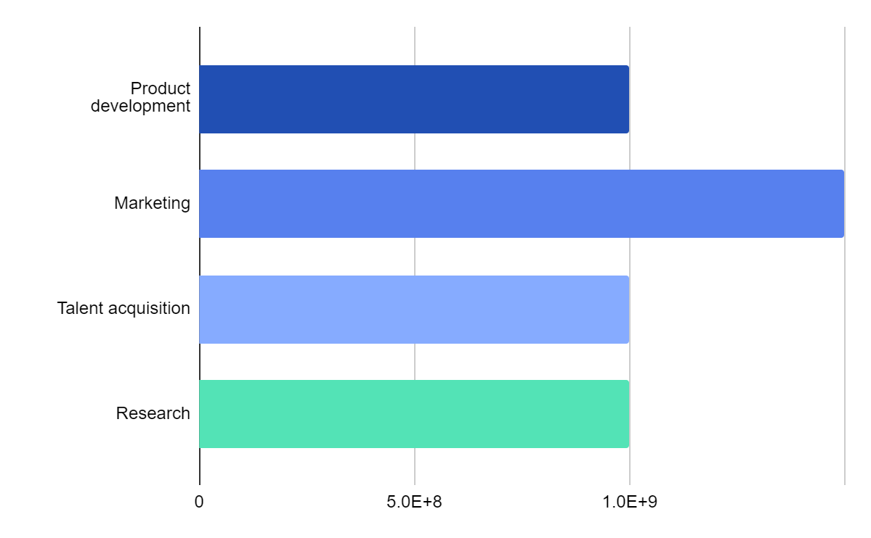
Income Statement
$1,000,000,000
$1,500,000,000
$998,300,000
$1,000,000,000
Product development
Marketing
Talent acquisition
Research
Follow the link in the graph to modify its data and then paste the new one here. For more info, click here

Slide 32
Resources
Did you like the resources in this template? Get them at these websites:
Vectors:
Financial accounting instagram stories
Photos:
Medium shot smiley colleagues working together
Side view men working together
Medium shot smiley people fist bump

