Slide 1

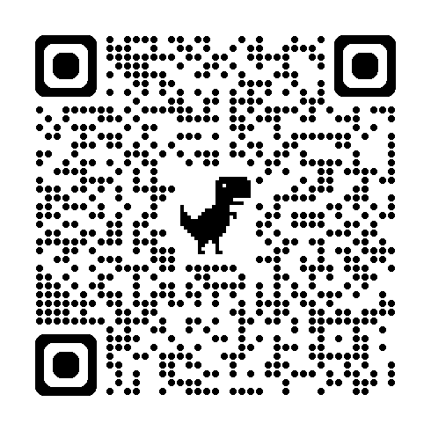
UCLA Business
BFS Fall 2025 | September 29, 2025
$
Sign in sheet ->
Keep an eye out for the password!
Notes:
Intro Exec
Ernesto
Hi everyone, thank you for coming to our first meeting of the year where we will be covering an intro to business clubs here at ucla. We have a sign in sheet here where you can scan the QR code and we will show the password later in the presentation so look out for that.

Slide 2
Bruin Finance Society
What We Do
Meetings
Socials
Events
Career
Resources
Benefits of BFS
Learn about careers, clubs on campus, get resources
Network and make connections across professions
Participate in a business- and finance-oriented community

Slide 3
Table of contents
01
02
03
04
Business Clubs
Recruitment Help
Everything business!... consulting, IB, accounting, entertainment, and more!
Advice and tips that can help along the recruitment process, for jobs and clubs!
Resources
Networking
Resources to prepare you for interviews, casing, and the like
Meet and interact with current BFS members and other students
Notes:
Ernesto
Table of contents:
We will be first discussing the different kinds of business clubs that can be found here at UCLA including, consulting, investment banking, accounting, entertainment, and more
Next, we will be give you all some advice and tops that can help getting into many of these clubs as well as for the recruitment process which can also be applied to jobs and internships
Also, we will show you some resources that can help prepare you for interviews, technical questions, casing and more
Lastly, at the end of presentation you will have an opportunity to meet some current BFS members and other students

Slide 4
01
Clubs:
Consulting
$
$
Notes:
Ernesto
First, we will start with consulting

Slide 5
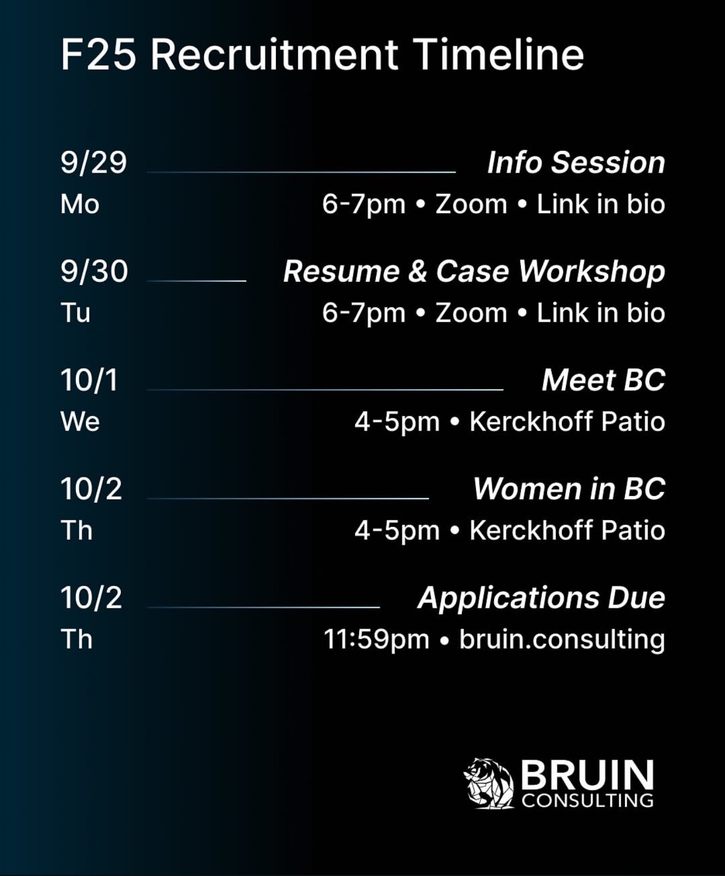
Bruin Consulting
Competitive club with strong career placements
Recruiting: Fall & Winter
Coffee Chats → 2 Interviews → Candidate Dinner
Casing emphasized in interviews
Applications due: Thu 10/2, 11:59 PM
Notes:
Ernesto
The first club is Bruin consulting
Main Focus: Consulting
Recruits fall and winter
Tends to be a competitive club to get into
Has good placement in terms of internships and post grad offers
Their recruitment process includes Coffee Chats, two rounds of interviews and candidates dinner to get to know the members better
Casing is a big part of their interview process
Applications due Thursday 10/2 at 11:59pm

Slide 6
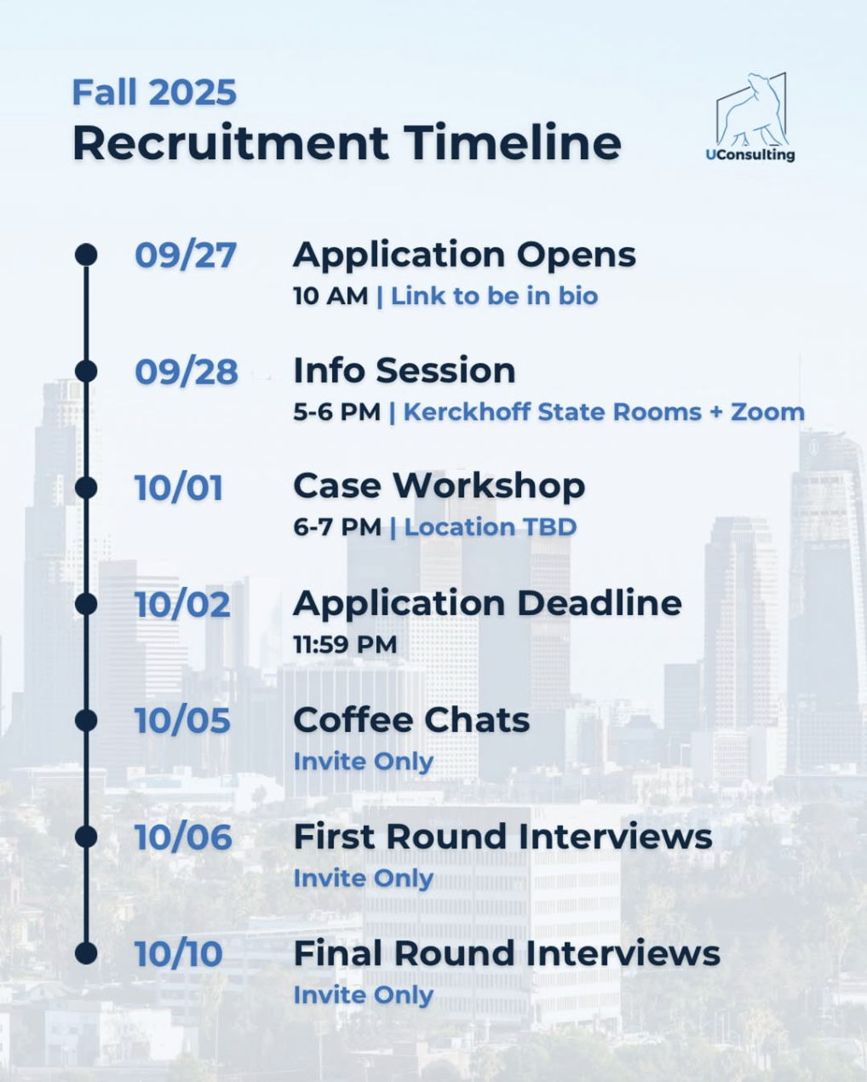
UConsulting
Recruits: Fall & Winter
Promotes professional development through workshops, case comps, alumni network
Accelerator program for new members
BCG, Bain, Amazon
Coffee Chats → 2 Interviews (casing)
Apps due: Thu 10/2, 11:59 PM
Notes:
Ernesto
Next is UConsulting
Main Focus: Consulting
Recruits fall and winter
UConsulting (they) help(s) promote professional success of their members with workshops, case comps, and alumni network
They also have an accelerator program for new members who may not be too experienced in consulting and it allows them to join projects and committees to get that hands on experience
Good placement in firms like BCG, Bain, Amazon
Requires coffee chats and two rounds of interviews (casing included)
Applications due Thursday 10/2 at 11:59pm

Slide 7
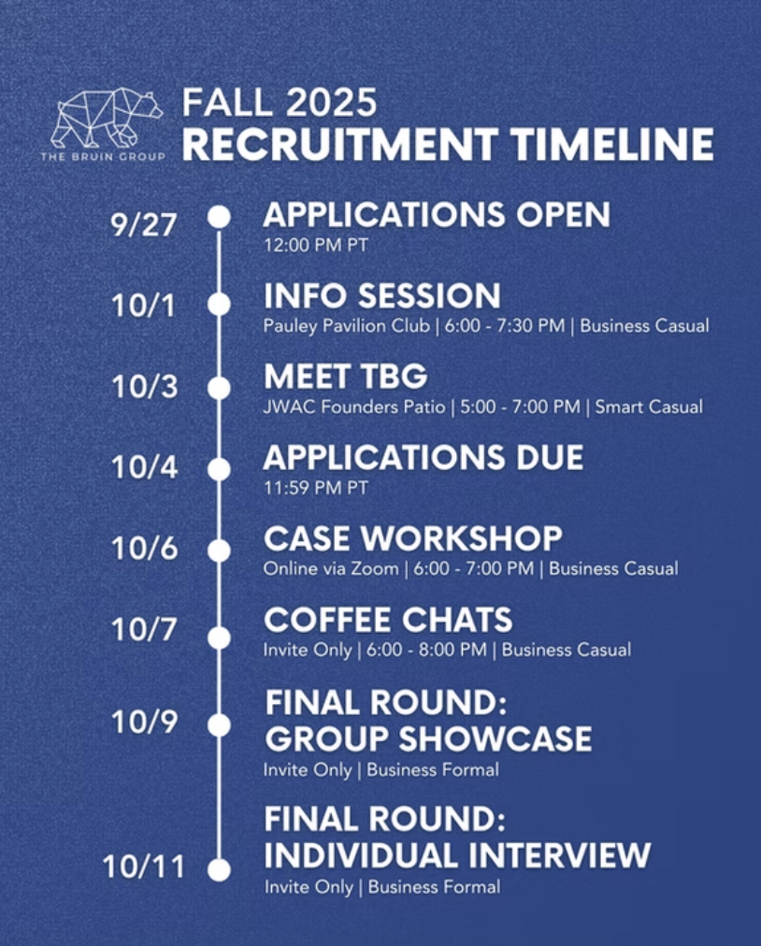
The Bruin Group
Recruits: Fall & Winter
Networking & workshops
Projects with startups & firms (tech, healthcare, fashion, etc.)
McKinsey, Deutsche Bank, Google
Coffee Chats → Group + Individual Interviews (behavioral & casing)
Apps due: Sat 10/4, 11:59 PM
Notes:
Ernesto
Next, the bruin group which recruits during both the fall and winter
Recruits fall and winter
Provides members with career development, networking, and workshops
Works with startups and companies from tech, healthcare, fashion, and more
Good placement in firms like McKinsey, Deutsche (doycha) Bank, and Google
Requires coffee chats, a group interview, and an individual interview (includes behavioral and casing questions)
Applications due Saturday 10/4 at 11:59pm

Slide 8
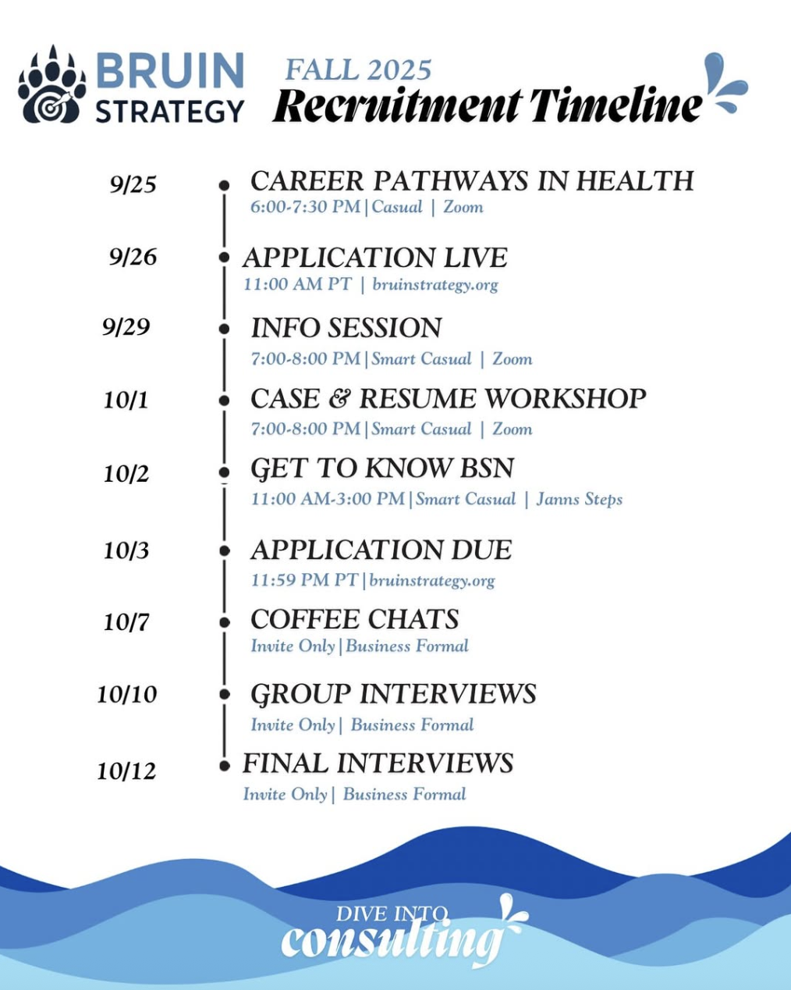
Bruin Strategy
Recruits: Fall & Winter
Management & Health tracks
Time: 5–15 hrs/week
Training, projects, networking, case comps
Deloitte, Accenture, BofA
Coffee Chats → Group + Individual Interviews (behavioral & casing)
Apps due: Fri 10/3, 11:59 PM
Notes:
Ernesto
Recruits fall and winter
2 consulting tracks: management and health which is something unique about this club and shows the different paths you can take in consulting and how diverse the industry is
Time commitment: would be 5-15 hrs/week which includes training and projects but they also offer networking and case competition opportunities
Offers comprehensive training, projects, networking, and case comps
Good placement in firms like Deloitte, Accenture, Bank of America
Requires coffee chats, group interviews, and individual interviews
Includes behavioral and casing
Applications due Friday 10/3 at 11:59pm

Slide 9
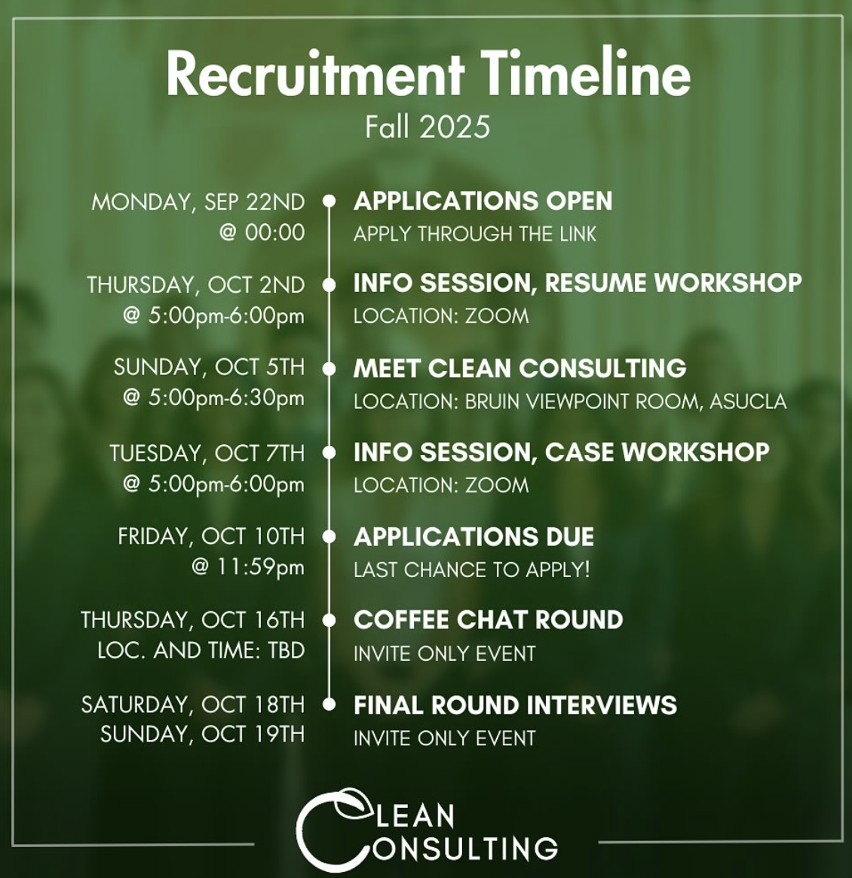
Clean Consulting
Recruits: Fall & Winter
Sustainable consulting
Fortune 500s, NGOs, startups
Training + real project for new members
Morgan Stanley, PwC, Facebook
Coffee Chats → 1 Interview
Apps due: Fri 10/10, 11:59 PM
Notes:
Ernesto
Recruits fall and winter
Focused on sustainable consulting and works with sustainable firms and promotes environmental consciousness
Works with Fortune 500 companies, NGOs, and startups
They have a roots program where new members learn consulting fundamentals and work on a real project so they get hands on experience
Good placement in firms like Morgan Stanley, PwC, Facebook
Requires coffee chats and 1 interview
Applications due Friday 10/10 at 11:59pm

Slide 10
01
Clubs: Investment Banking
$
$
Notes:
Melody

Slide 11
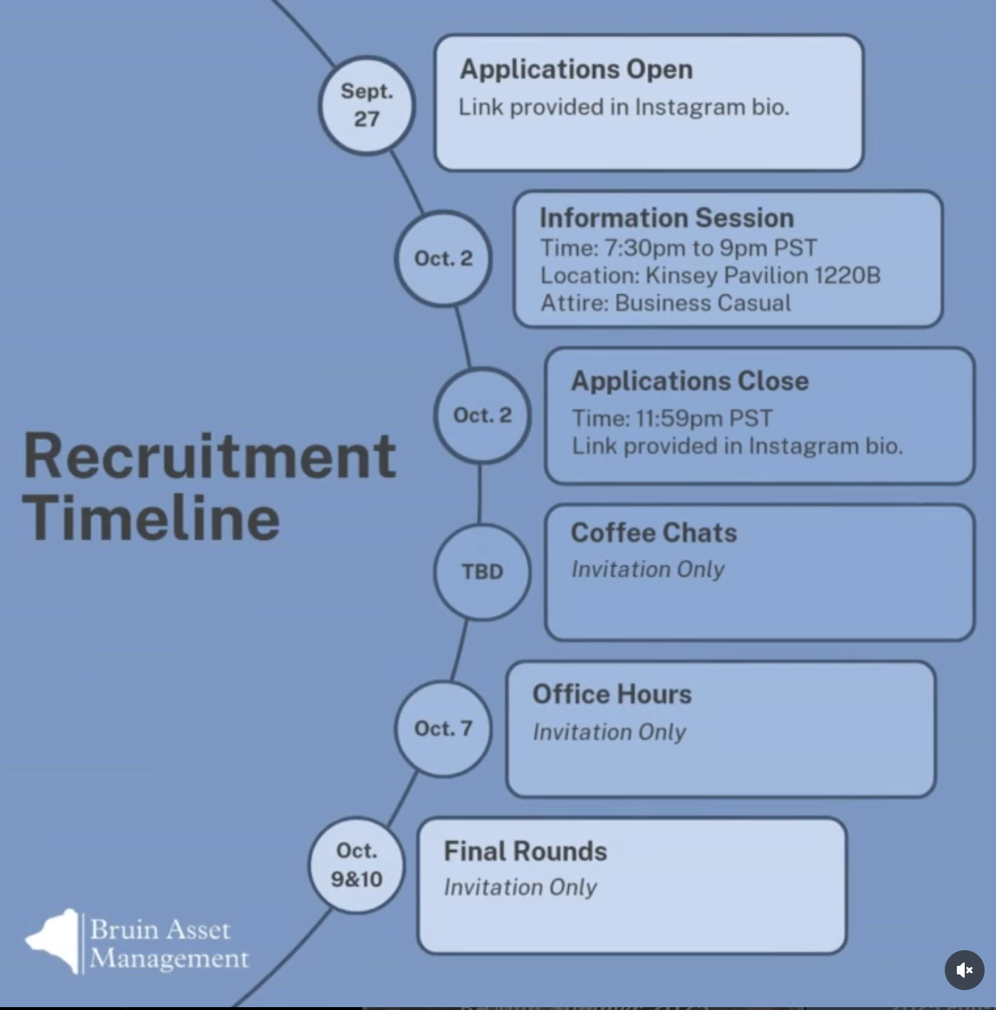
Bruin Asset Management
Recruits: Fall & Winter
Software, healthcare, consumer/retail
Training (Valuation & stock pitches)
JPMorgan, Goldman Sachs, BofA
Coffee Chats → 1 Interview (technical and behavioral)
Apps due: Thu 10/2, 11:59 PM
Notes:
Melody
Recruits fall and winter
Focuses on sectors including software, healthcare, consumer/retail, etc.
Provide training in valuation and stock pitches
Good placement in firms like JP Morgan, Goldman Sachs, Bank of America
Requires coffee chats and 1 interview
Technical interview covers key finance concepts(study material provided)
Applications due Thursday 10/2 at 11:59pm

Slide 12
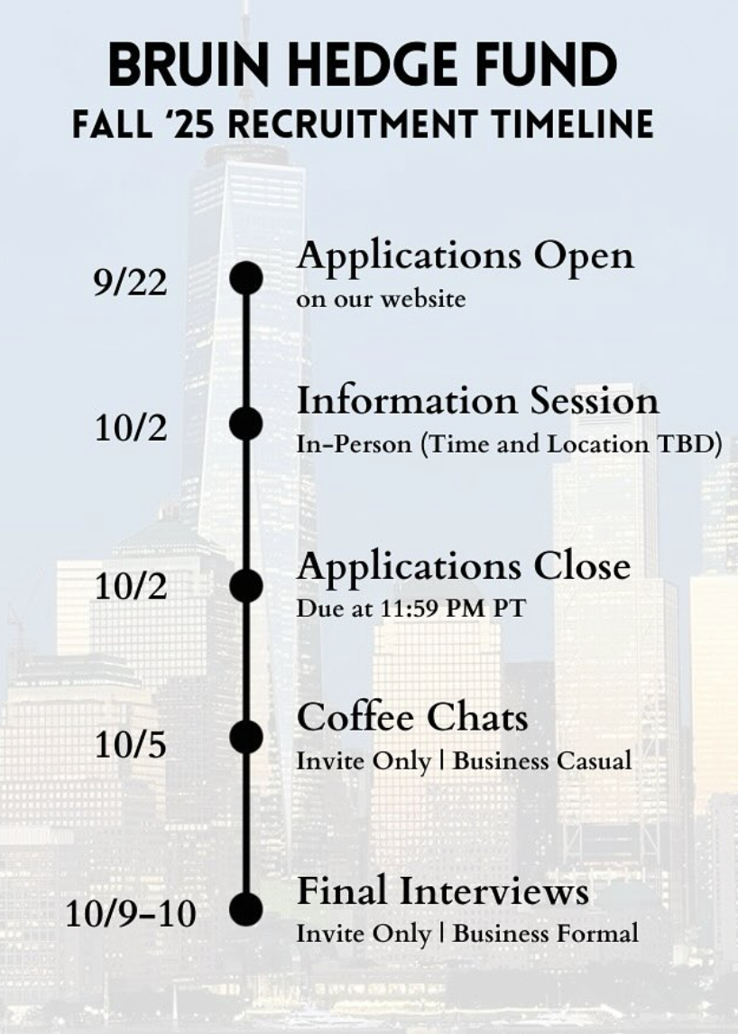
Bruin Hedge Fund
Recruits: Fall & Winter
Stock pitches, financial modeling, risk assessment
Citi, Deutsche Bank, HSBC
Case comps (e.g., Houlihan Lokey)
Coffee Chats → 1 Interview (technical + behavioral)
Apps due: Thu 10/2, 11:59 PM
Notes:
Melody
Recruits fall and winter
Training covers stock pitches, financial modeling, and risk assessment
Good placement in firms like CitiBank, Deutsche Bank, HSBC
Members participate in case competitions like Houlihan Lokey case competition
Requires coffee chats and 1 interview
Technical interview covers key finance concepts(study material provided)
Applications due Thursday 10/2 at 11:59pm

Slide 13
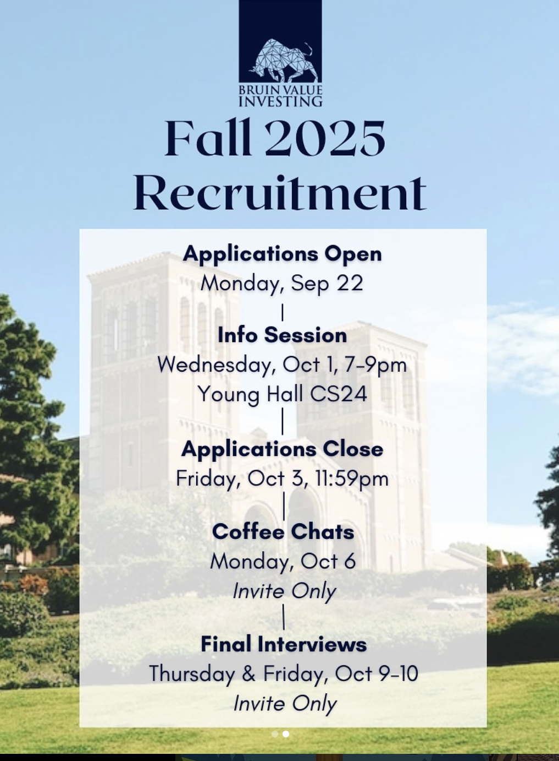
Bruin Value Investing
Recruits: Fall & Winter
Present investment theses for real money fund during weekly meetings
Value investing, accounting, valuation
Morgan Stanley, BlackRock
Coffee Chats → 1 Interview + Stock Pitch Idea
Apps due: Fri 10/3, 11:59 PM
Notes:
Melody
Recruits fall and winter
Members present investment theses for a real money fund during weekly meetings
Members trained in principles of value investing, accounting, and valuation
Good placement in firms like Morgan Stanley, Blackrock
Requires coffee chats and 1 interview
Application requires a stock investment idea
Recommended resources: Investopedia, WSJ, Bloomberg, and Morningstar
Applications due Friday 10/3 at 11:59pm

Slide 14
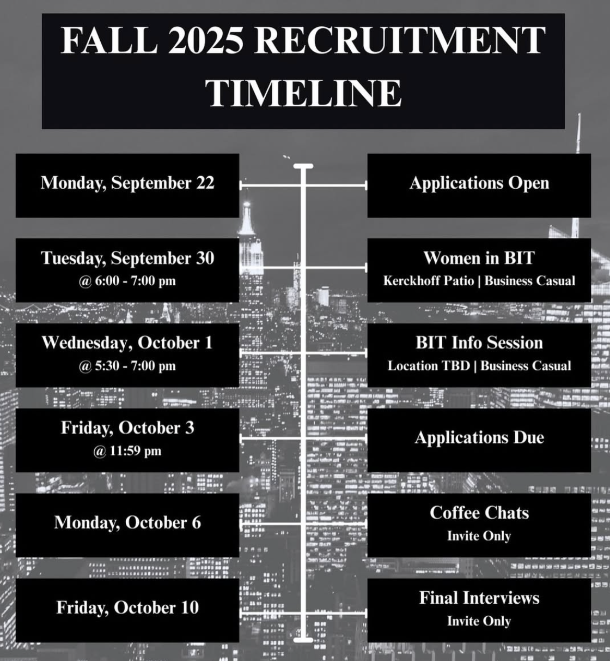
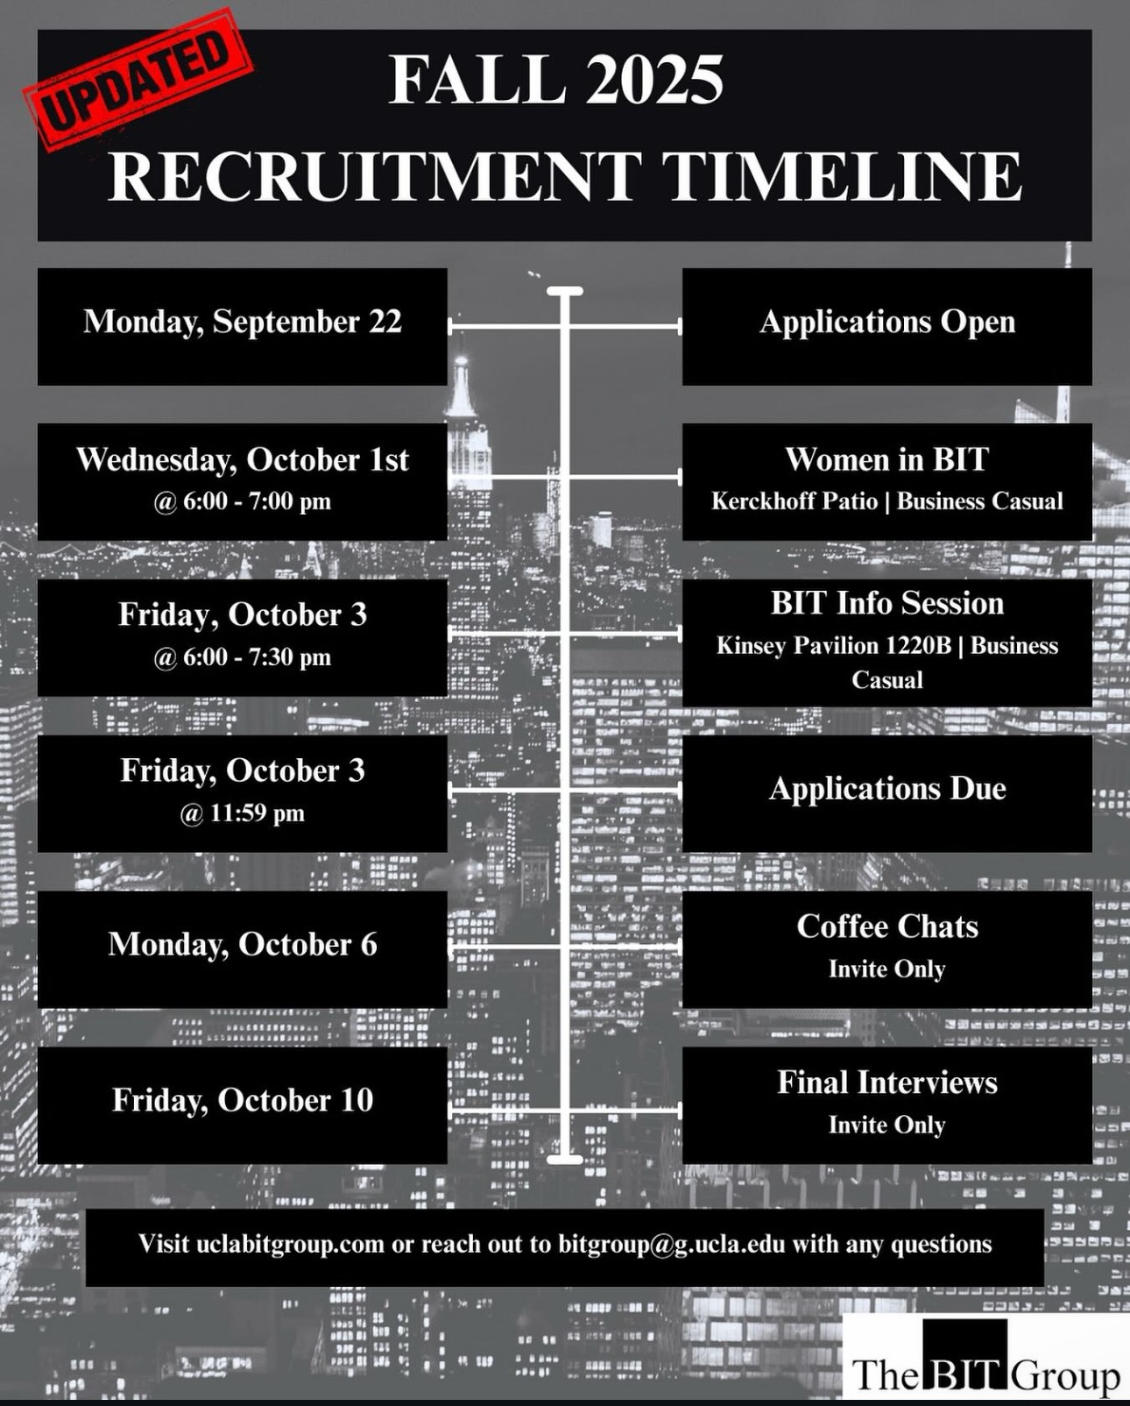
Bruin Investing and Trading
Recruits: Fall & Winter
Networking seminars, behavioral workshops, resume tips
Accounting, Excel, valuation, technical prep
JPMorgan, BofA, Evercore
Coffee Chats → 1 Interview (technical + behavioral)
Apps due: Fri 10/3, 11:59 PM
Notes:
Melody
Recruits fall and winter
Hosts networking seminars, workshops for behavioral questions, and provides resume tips
Training covers accounting, Excel, valuation methodologies, and technical interviews prep
Good placement in firms like JP Morgan, Bank of America, Evercore
Requires coffee chats and 1 interview
Technical interview covers key finance concepts
Study resource: link
Applications due Friday 10/3 at 11:59pm

Slide 15
01
Clubs:
Other Industries
$
$
Notes:
Ernesto
Next we will move on to other clubs that focus on other industries

Slide 16
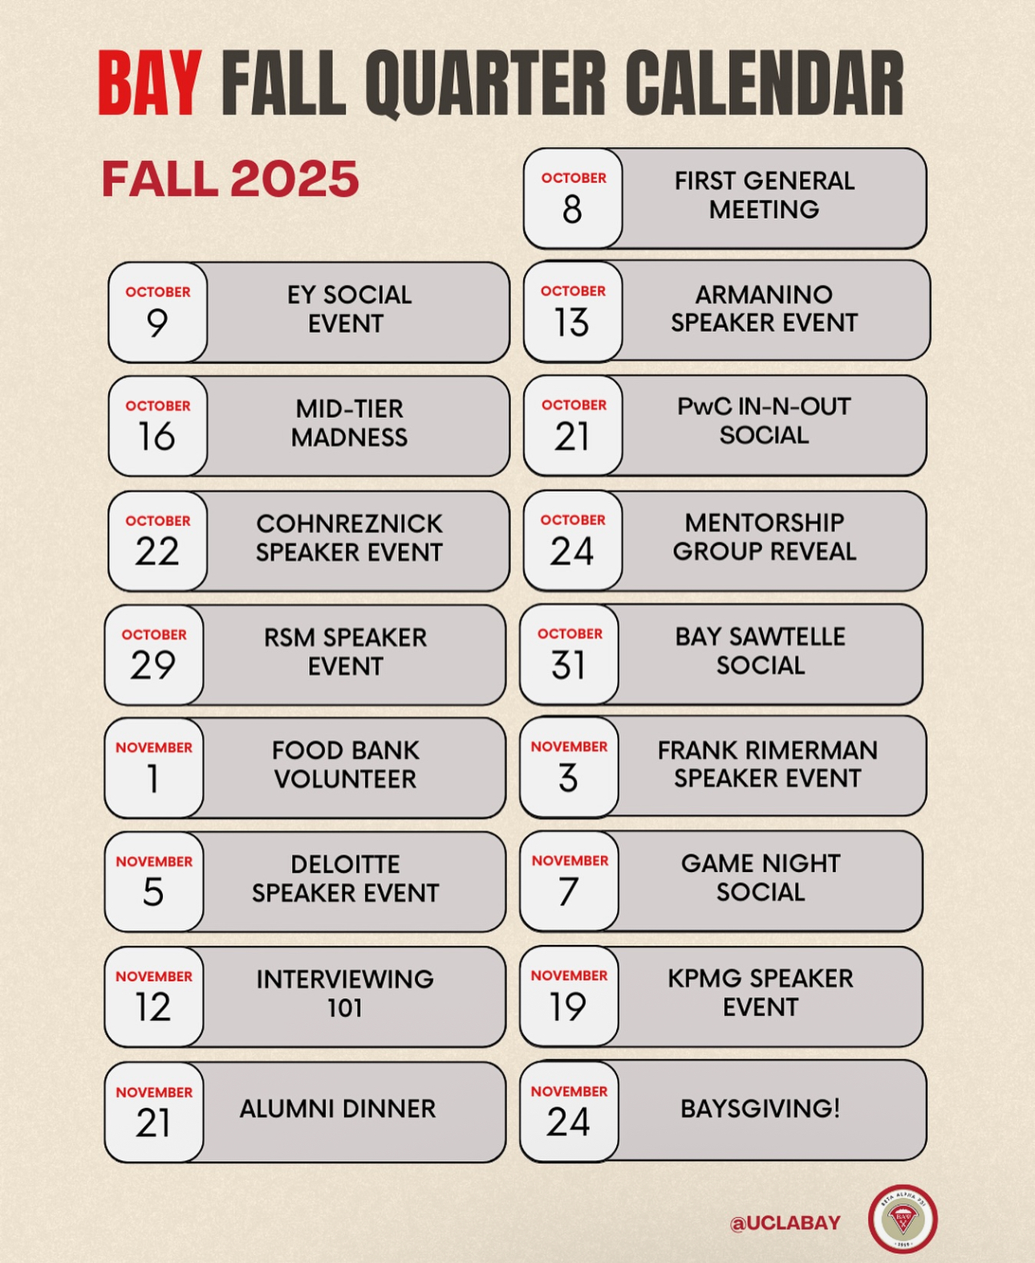
Beta Alpha Psi
Main Focus: Accounting
3.0 GPA + unofficial transcript required
One-time membership fee: $130
General membership less competitive
Recruits year-round; speaker events all year
Prepares for CPA exam & connects with Big 4 (KPMG, PwC, EY, Deloitte)
Notes:
Ernesto
Beta Alpha Psi is one of the only clubs on campus that has a focus on accounting and is a part of a national organization at other universities
Main Focus: Accounting
Requires a 3.0 GPA and an unofficial transcript
Requires a one time lifetime membership fee of $130 but once you pay that fee you do not have to pay it again
Less competitive to get into as a general member
The fee comes with perks such as exclusive speaker and networking opportunities
Recruits year round and has speaker events all year
Helps prepare you for the CPA or the certified public accountant exam, helps you know what MGMT classes to take and introduces you to the big 4 accounting firms: KPMG, Pwc, EY, and Deloitte

Slide 17
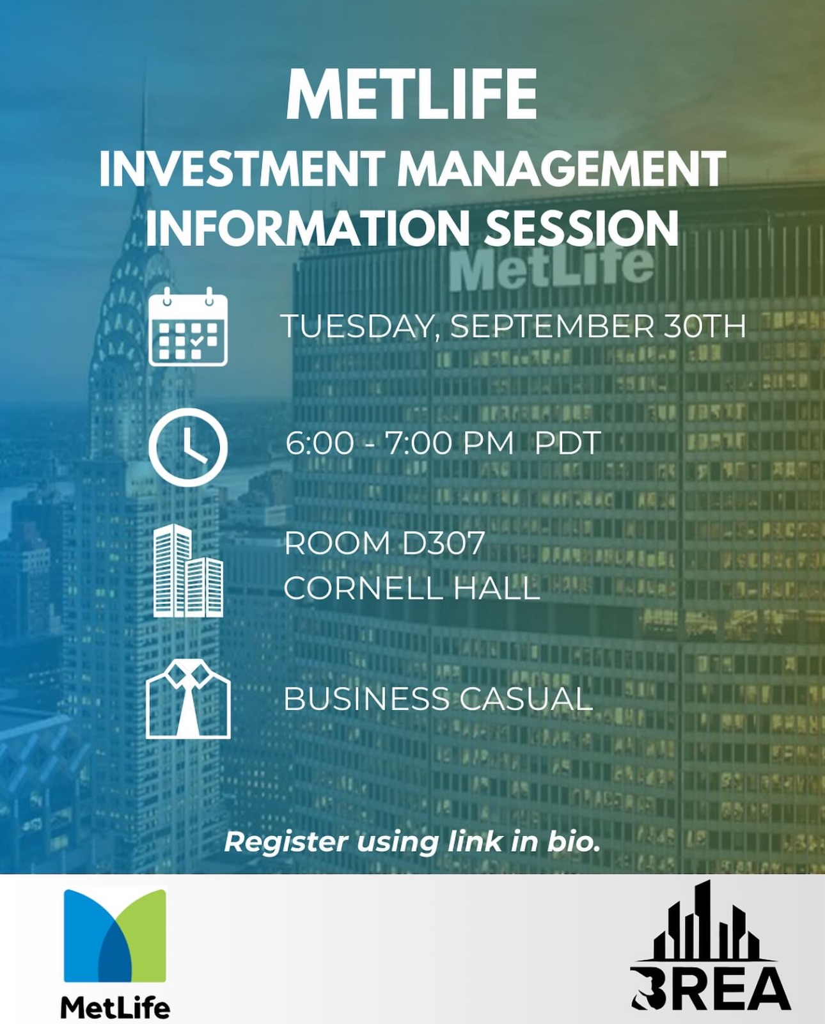
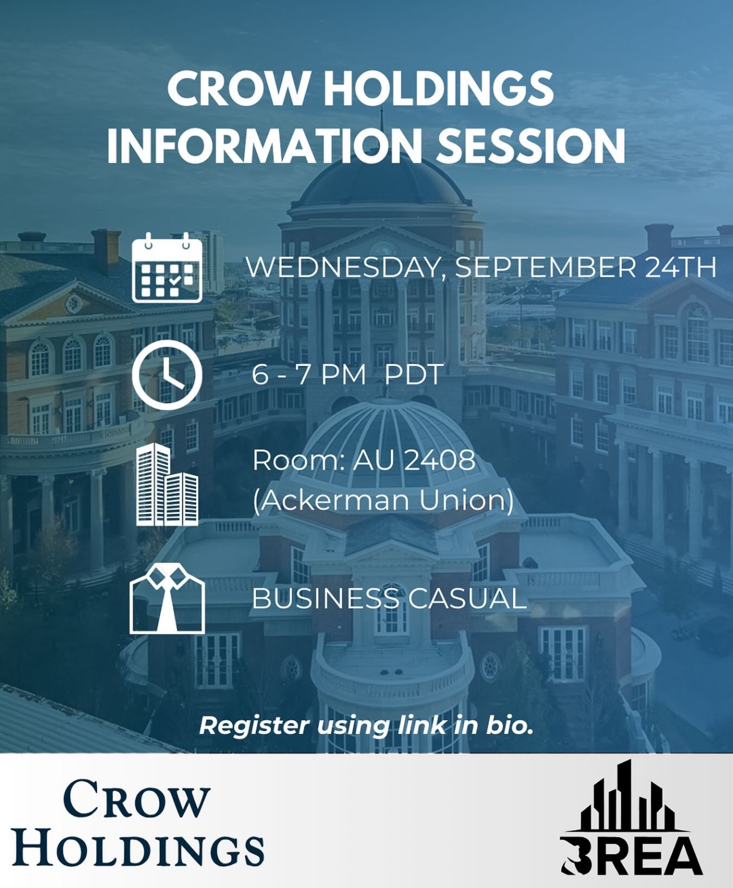
Bruin Real Estate Association
Main Focus: Commercial real estate
Recruits: Fall & Winter (starts weeks 3–4)
Strong internships & post-grad offers
Coffee Chats → 1 Interview + Meeting Attendance
BREA hosts fall quarter meetings with major CRE firms
Notes:
Ernesto
Main Focus: Commercial real estate and is one of the only clubs on campuses that focuses on CRE or commercial real estate
Recruits during fall and winter
Has good placement in terms of internships and post grad offers
BREA holds meetings throughout fall quarter with big CRE firms and attending these info sessions before applying to be a member is important because they track attendance and interest
They actually have a meeting tomorrow that you can attend if interested but will hold more throughout this quarter
Requires Coffee Chats, one round of interviews and meeting attendance
BREA holds meetings throughout fall quarter with big CRE firms
Recruitment starts around weeks 3 - 4

Slide 18
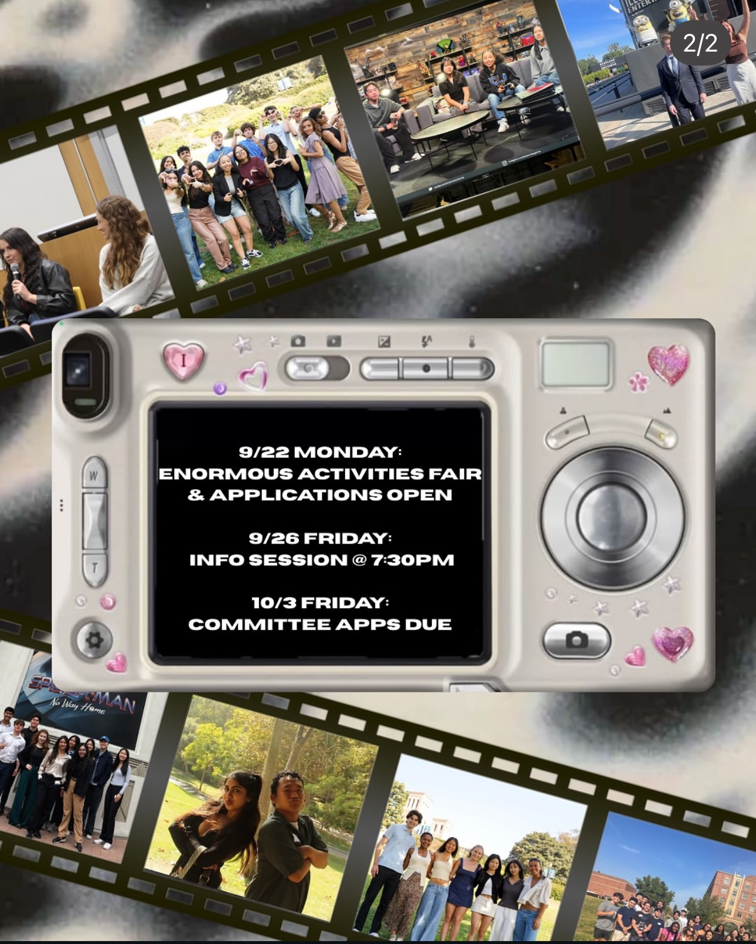
Business Entertainment Association at UCLA
Main Focus: Business Entertainment
Recruits: Fall
Committees: Film, TV, Music, Sports, Digital Media, Cosmetics, Gaming
Application → Interview (if selected)
Committee apps due: Fri 10/3, 11:59 PM
Notes:
Ernesto
Main Focus: Business Entertainment and is unique in this way
Recruits during fall
Has different committees you can be a part of such as film, television, music, sports, digital media, cosmetics, and video games so you can find the industry you are most interested in
Requires an interview if chosen after application is submitted for a certain committee
Committee applications due Friday 10/3 at 11:59pm

Slide 19

UCLA Undergraduate Business Society
Main Focus: Business (General)
Recruits: Winter and Spring
General member or board role
Career fairs, workshops, speaker series, meetings
Open to all interested students
Notes:
Ernesto
Main Focus: Business overall
Recruits winter and spring
Can be a general member or be on the board
Holds career fairs, workshops, speaker series, and meetings all year round welcome to anyone interested
Ubs have general members which are just newsletter. BFS has interns and associates and ubs members give access to everything at a big scale but bfs we interns and associates which is smaller and builds community and people can recruit together. 3 professionals for about 30-40 people whereas 5 speakers for 200 members (much larger). UBS is less directed and less focused on members. Ratio of guest speaker to students for bfs is much larger than ubs which gives more opportunity to network and find connections and have a closer connection with speakers. Provide more resources, connections.

Slide 20
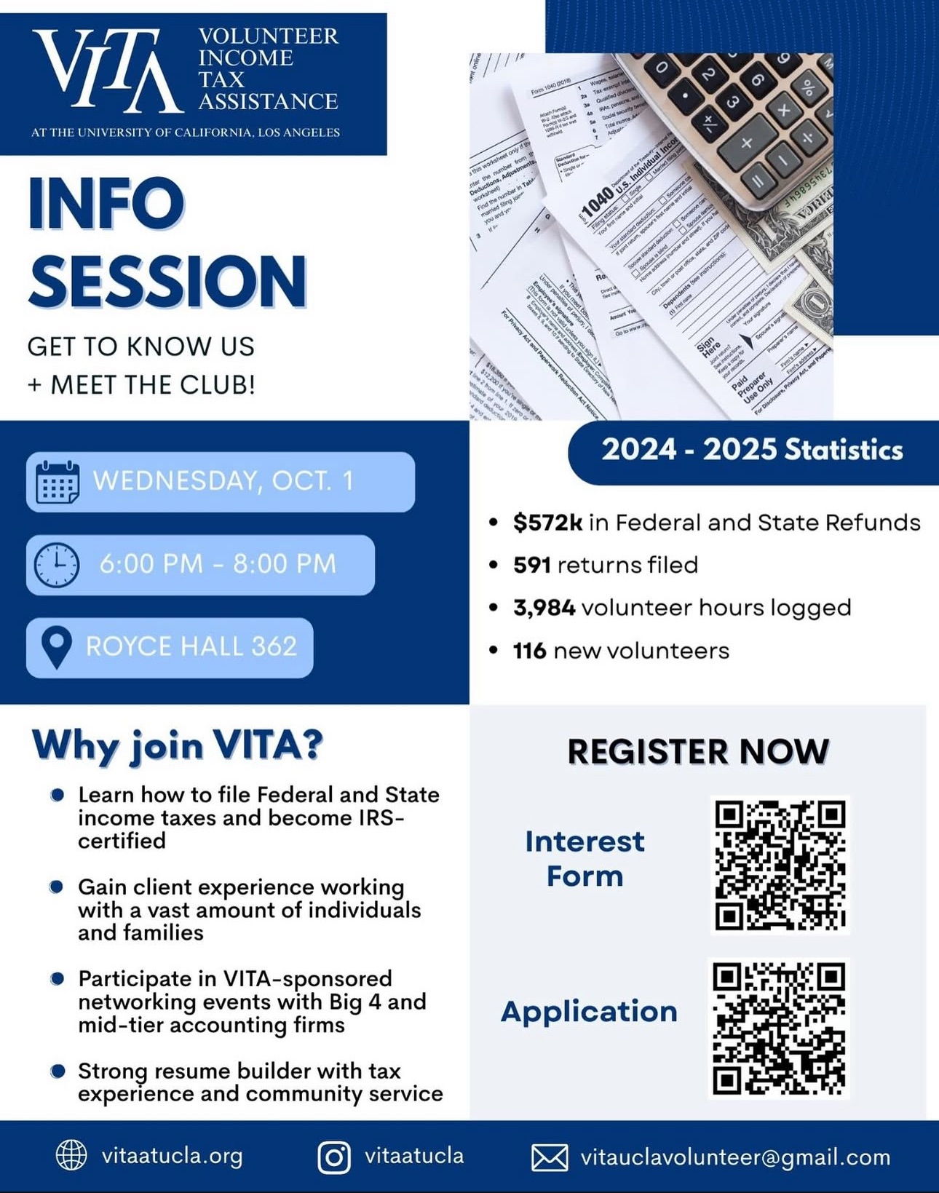
Volunteer Income Tax Assistance (VITA)
Main Focus: Income Tax Volunteer Program
Recruits: Fall & Winter
Work with tax docs & clients
IRS certification included
Strong ties with Big 4 & mid-tier firms
Apps due: Sat 10/4, 11:59 PM
Notes:
Ernesto
Main Focus: Income tax volunteer help
Recruits during fall and winter
Has good relationship and placement with the big 4 and mid tier accounting firms
There is no interview process just an application and you will be emailed if you were admitted or not
After that you have a multi week long training to prepare you to help clients and get familiar with the different tax forms and documents
Gives you hands on experience with tax documents and clients
Helps build your resume and allows you to become IRS certified
Applications due Saturday 10/4 at 11:59pm

Slide 21
02
Recruitment
$
Notes:
Melody

Slide 22
Tips and advice
Resume
Coffee Chats
Network!!
Error-free
Properly formatted (10-12pt font, 1 inch margins)
Less HS exp the older you get
Clear sections
These are for advice & visibility… company vibes…
“Grab a quick coffee” “hop on a quick call”
Reach out via IG, LinkedIn, email…
Don’t spam 🙄
USE YOUR SWIPES!
Notes:
Melody
Resume - Make sure your resume is formatted correctly and has no grammatical or spelling errors, many clubs do resume workshops to help with this - we do too! Week 3?????
HS exp: good for frosh recruiting fall… soph try to avoid HS (what have you been doing then, bumming?)
Sections: Education, Work experience, (optional: leadership), extracurriculars, skills, hobbies
Hobbies esp! Everyone’s qualified (exp, entrepreneurial spirit, python c++ java, excel)... how do you differentiate?
They’re ppl too! Want to know u, connect on a personal level - talk about will li + golf interview
Conversational, nice memorable discussion
Coffee Chats - more applicable to job apps, but actively schedule coffee chats with employees (club members - UBS) for advice & visibility. The worst outcome is you get advice, vibes don’t match, thx & bye. The best? Maybe a referral. U never know.
Learning & visibility goes both ways instead of website, interview, presentation, etc.
Networking - Cold message or email people from the club you may have met at EAF or are simply interested in getting to know. Reach out on instagram as well but don’t be persistent if they don’t respond, move on. Don’t spam. Ask people to lunch.
Meet older/upperclassmen, swipe them in! Small favor, you get a lot out of it (network!)

Slide 23
Tips and advice
Research
Genuine Interest
Do your own research!
What is unique?
What is their vibe?
What kinds of projects do they work on?
Show up to as many events as possible
Show you are genuine in wanting to join
Ex: BIT - women in BIT AND info/networking session.
GO TO BOTH!
Notes:
Melody
Research - do ur own research! Don’t pu and ask “what makes u different from everyone else”
U didn’t do ur homework, u made an impression of not knowing what they do
Best: Relate what you’ve previously done to a project they’ve done… match the vibes, match the purpose, match the intentions
Show genuine interest
Go to as many events as you can. Again: VISIBILITY. So important esp when everyone is just as qualified.
Differentiate yourself, make urself known.
WOMEN IN BIT + BIT INFO SESSION

Slide 24
03
Resources
$
$
$
Notes:
Ernesto

Slide 25

Consulting
McKinsey Slide Formatting
47 case interview examples
https://slidemodel.com/mckinsey-presentation-structure/
https://igotanoffer.com/blogs/mckinsey-case-interview-blog/case-interview-examples
Ex-McKinsey Youtuber
Million Dollar Consulting by Alan Weiss
http://www.youtube.com/@FirmLearning

Slide 26
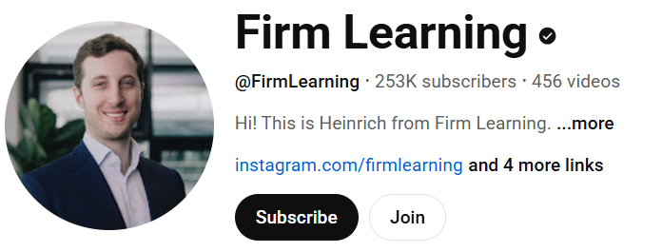


Consulting
Million Dollar Consulting by Alan Weiss
Notes:
Ernesto
McKinsey Slide Formatting - MBB firms - Mikcensy, Bain, BCG
This resource is a great way to see how the MBB firms which are Mikcensy, Bain, BCG format their slides. Also, it shows some tips and advice when it comes to interviewing and the culture of these firms
Introduces foundational principles of the McKinsey presentation style, such as:
• Pyramid Principle — lead with the conclusion, then support it with organized arguments SlideModel
• Also shows how they have an emphasis on data-driven insights and evidence-backed recommendations SlideModel
• Minimalist, consistent visual design to reduce clutter and maintain professionalism SlideModel
• Strong narrative/storyline structure (e.g. Situation → Complication → Resolution) SlideModel
Includes sample templates from SlideModel designed in McKinsey’s style. SlideModel
47 case interview examples - from I gotanoffer shows you the different kinds of questions you can get during a case interview and shows you example answers so you can start thinking about how you can answer them and format them in your own way
Ex-McKinsey Youtuber - Firm learning is an ex mickensy youtuber and he talks about his experience at Mckinsey and the culture as well as his process into getting in and advice so this is a different format of learning and practicing how to case and if you just search up on youtube casing practice many videos will show up.
Lastly, Million Dollar Consulting by Alan Weiss is a book that can be found on amazon for about 15 dollars which talks about networking, marketing, and again practicing how to case and this is just a different format and a great resource which might have somethings you can’t necessarily find online.

Slide 27

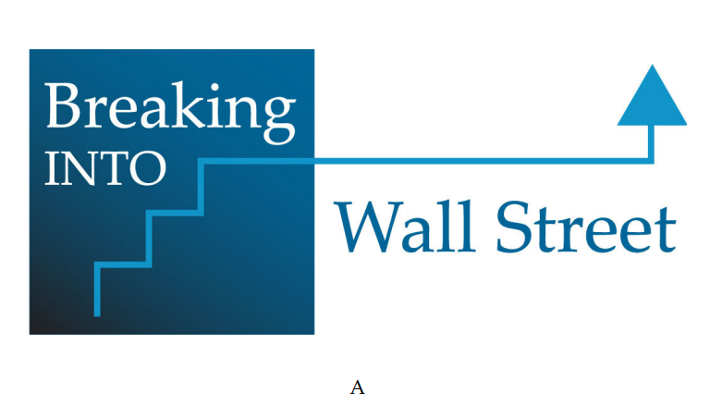
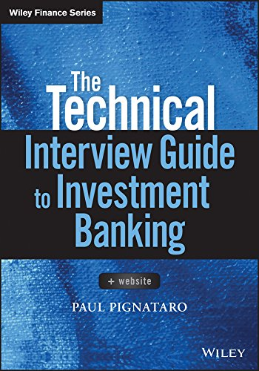

Investment Banking
The Technical Interview Guide to Investment Banking By Wiley Finance
Notes:
Ernesto
Wall Street Prep questions - A great resource for investment banking as it helps you understand why people go into investment banking, what it is, practice technical questions as some are unique to this industry. It is a mix of readings, videos, and different learning modules to help you prepare for interviews.
Mergers and Inquisitions – Provides resume templates that have helped people land investment banking roles as well as other advice on how to interview and some possible questions that might be asked
Breaking Into Wall Street (BIWS) -lots of clubs use these guides to prepare candidates for technical interviews not only for clubs but also for internships and full time offers. Introduces you to not only investment banking but also private equity, and similar finance careers. Provides different ways of practicing such as quizzes, vidoes. Also, offers real modeling tests and interview case studies.
Lastly, another book but for investment banking is The Technical Interview Guide to Investment Banking By Wiley Finance which is a bit more expensive around 30 - 40 dollars but a great way to practice technical questions and you can use it to make flashcards to practice the most common questions. Also, shows the technical analyses behind core models and analyses

Slide 28
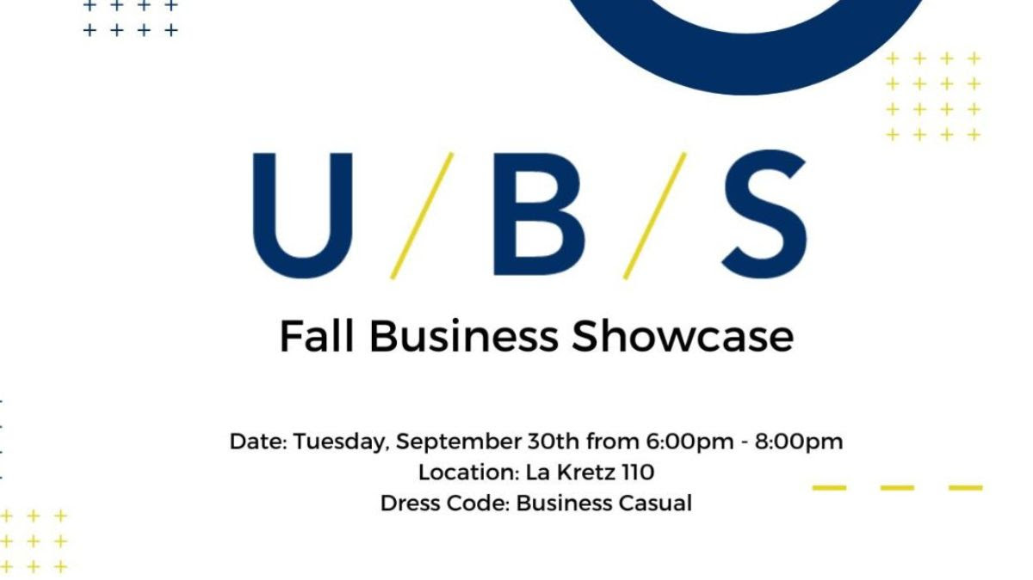
Want more?
Please note…
Many of these clubs are selective/competitive!
Multiple rounds
BFS can help!
Notes:
Melody
UBS business showcase:
If you want to learn more about all of these clubs the UBS Business Showcase is tomorrow night from 6:00 - 8:00 pm in La Kretz 110, dress business casual.
General Rule of thumb - when in doubt dress up and not down (shows respect, gives u confidence)
Smthg you do need to understand! Mentioned before → a lot of these clubs are extremely selective and (to a degree competitive - explain later). Rumor has it that club acceptance <<< ucla acceptance. Multiple rounds of coffee chats, behavioral and technical interviews.. Recruitment is rigorous
Competitive? Kinda… but also… fit. open to public events are vibe check on vibe check. Doesn’t seem like theres a diff rn, but as u go on and attend these events, u see patterns… don’t be disappointed, if u don’t vibe well, why join the community anyway
We can help prepare u! Ofc: we can’t change personality, but we can help prep for technicals

Slide 29
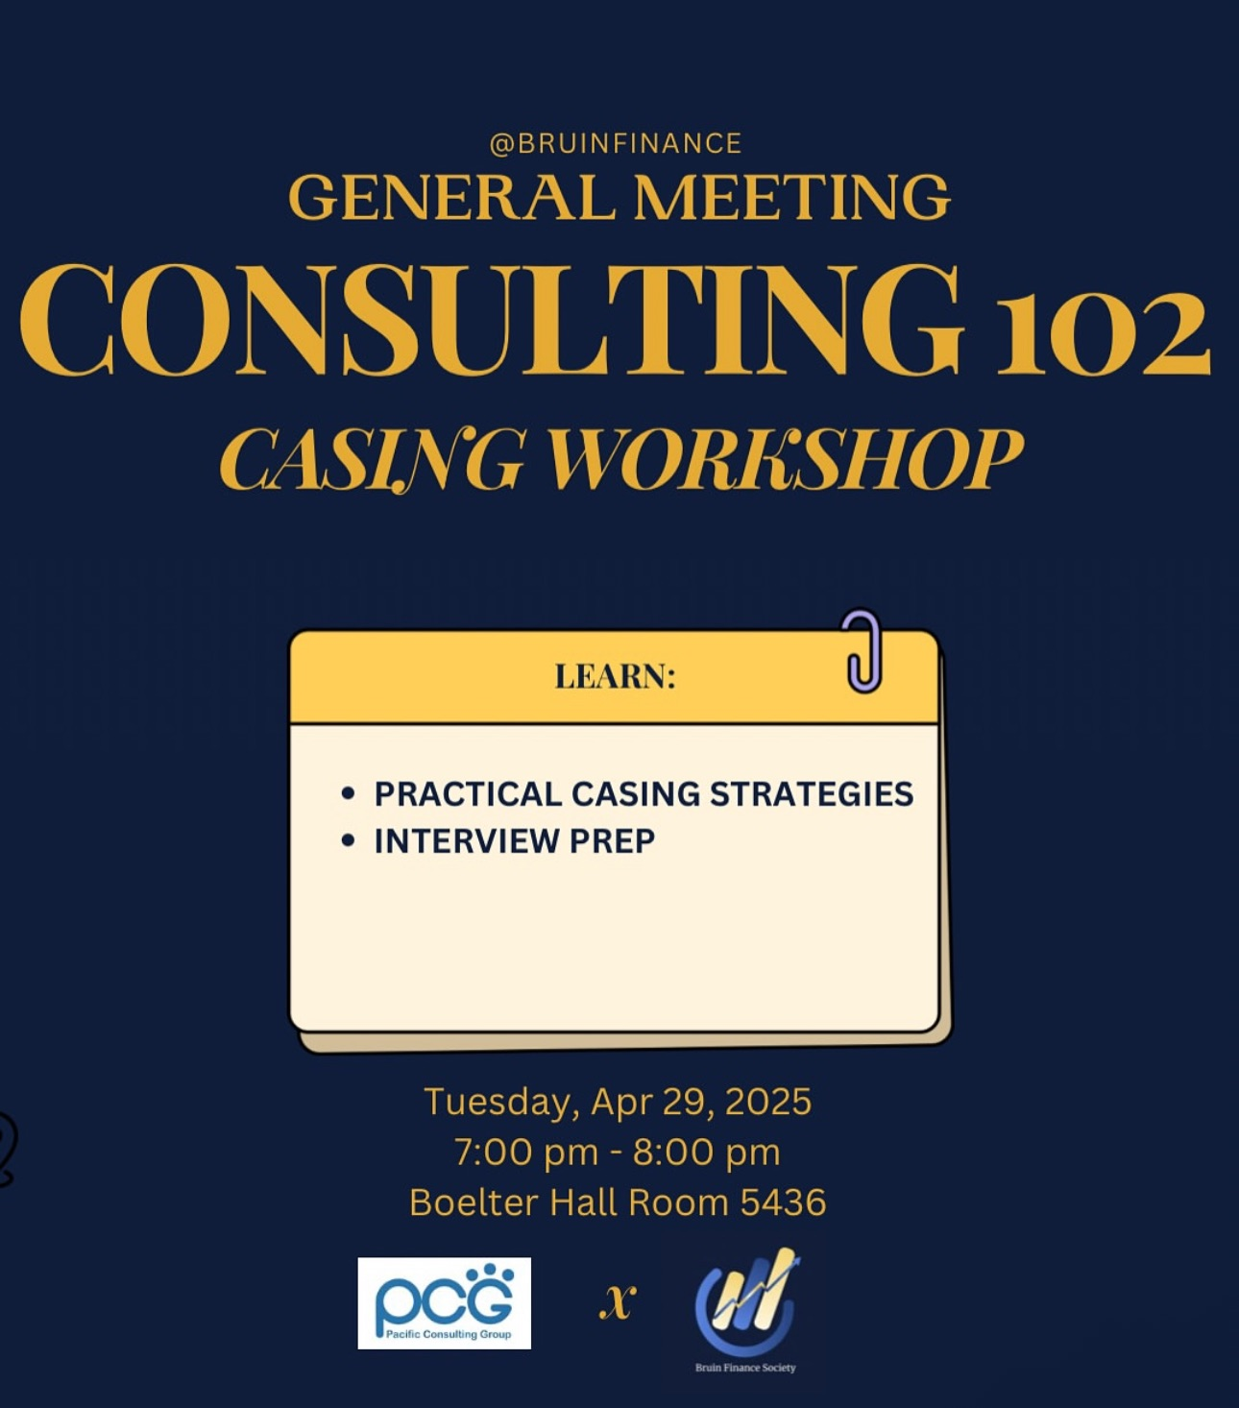
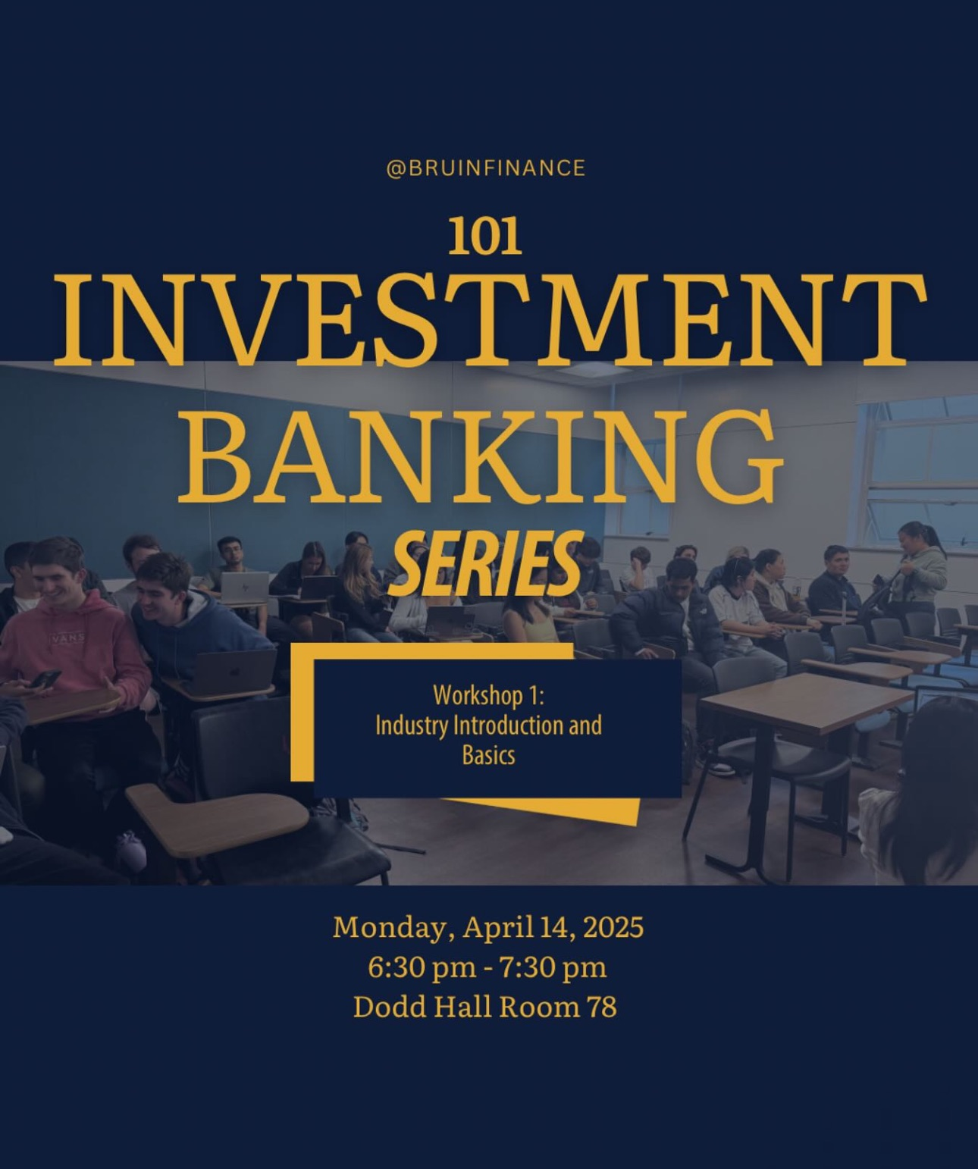
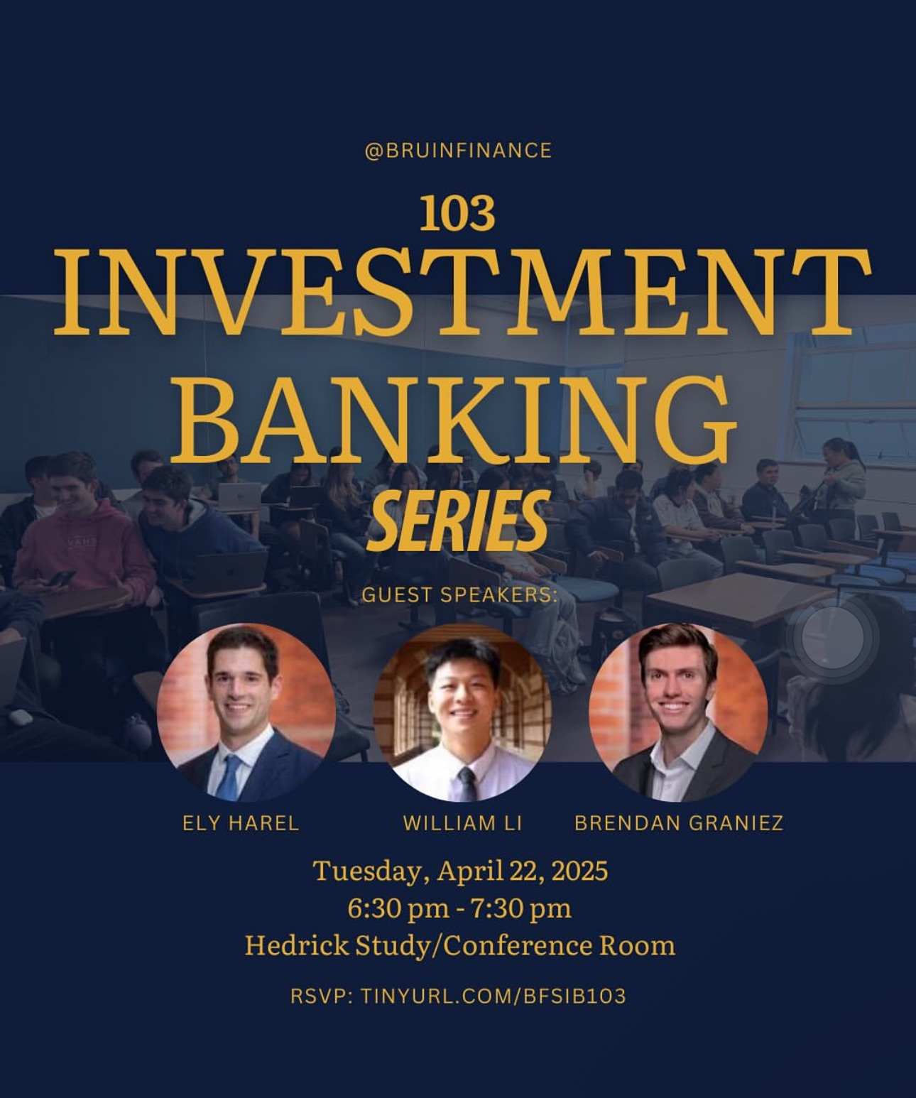
Stay involved with BFS!
Notes:
Melody
BFS is here to help you and provide you with as many resources as we can!
In high demand last year: our consulting and investment banking workshop series which we will host again this quarter
We go in depth for whatever you need for interviews (consulting casing, ib technicals) - 101, 102, 103
These are ONLY for our interns!!!!
Clubs recruit fall and winter!!!!!!! If you don’t get into ur dream club, don’t miss your chance of learning with us and having our resources on hand to prepare for winter recruitment
Our app process isn’t selective in the same sense as other clubs - make sure you can use our resources to the fullest, not taking up the intern spot but being inactive & cheating other students out of their opportunities to learn
The application is linked on our newsletter, make sure you subscribe to stay updated (we just sent one out today) (we don’t spam promise)

Slide 30
Sign in Sheet!
Password:
BFS2025
Notes:
Ernesto
https://docs.google.com/forms/d/e/1FAIpQLSdYBW9MqPnjO8fKaiJAWe13rRAviqf0WwxvOGc6TAKveKQQsQ/viewform
Here is the sign in sheet again if you did not get in the beginning and here is the password as well which is BFS2025 in all caps
I hope that was not too much information all dumped onto you guys all at once and it was not too overwhelming many of these clubs have their timelines already posted on their instagrams
Does anyone have any broad questions right now? If not you will also have the chance to speak to BFS members more one on one for more personal questions

Slide 31
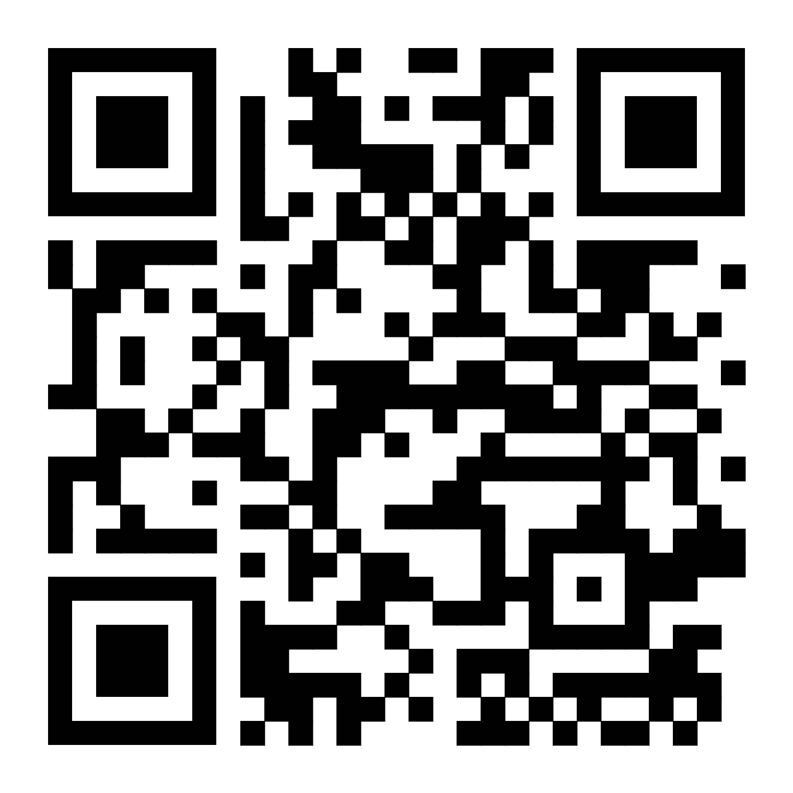
04
Questions?
Sign in Sheet
BFS Info Session RSVP
Dining Hall run after the meeting!
6:30pm in
Haines Hall A25
OR Zoom
Password: BFS2025
Notes:
Ernesto
Here is the sign in sheet again but we also have two info sessions for BFS next week. We have both an in person and zoom option and if you scan this QR code you will be able to RSVP and we will be sending the zoom link later. If you liked what you heard here this is just a taste of what BFS is as we will hold more meetings and workshops throughout the quarter so please attend if you are interested.
Also after the meeting at 7:30 we will have a dining hall run and we will vote on where we should go
But if you have any personal questions right now or want to get to know the BFS members better please come up and anyone would be happy to talk to you!

