Slide 1
The Two Types of Subnetting Problems
Type I: “How many?”
  How many subnets are supported?
  How many hosts are provided in each subnet?
Type II: “Which one(s)?”
  In which subnet does an address fall?
  What is the broadcast address of a subnet?
  What is the valid host range of a subnet?
1

Slide 2
The Four Clues
There are four pieces of information that unlock the secrets of subnetting problems:
The original subnet mask (osm) we started with
The revised subnet mask (rsm) to be used
Bit 32 is always the end of the host ID. (the eoh)
The next multiple of 8 (nm8) that is greater than the rsm (can only be 8, 16, 24, or 32)
2

Slide 3
Using the Four Clues
Only some of the four clues are required for each type of problem, but the rsm is required for both types.
Type I requires:
  The osm
  The rsm
  The eoh (always 32)
Type II requires:
  The rsm
  The nm8
3

Slide 4
Using the Four Clues
When finding the number of subnets and hosts, you have to pay attention to where their bits begin and end.
Type I requires:
  The osm
  The rsm
  The eoh (always 32)
rsm
– osm
^{# of subnet} ^{bits}
2
= # of subnets
subnet bits
host bits
0
osm
rsm
32 (eoh)
4

Slide 5
Using the Four Clues
When finding the number of subnets and hosts, you have to pay attention to where their bits begin and end.
Type I requires:
  The osm
  The rsm
  The eoh (always 32)
eoh
– rsm
^{# of host bits}
2
– 2 = # of hosts
per subnet
subnet bits
host bits
0
osm
rsm
32 (eoh)
5

Slide 6
Using the Four Clues
The secret to listing the subnets is to identify the octet that changes and by which power of 2.
Type II requires:
  The rsm
  The nm8
0
8
16
rsm
24 (nm8)
32
interesting octet
number of host bits in the interesting octet dictate how the octet will increment from one subnet to the next

Slide 7
Using the Four Clues
The secret to listing the subnets is to identify the octet that changes and by which power of 2.
Type II requires:
  The rsm
  The nm8
0
8
16
rsm
24 (nm8)
32
number of the octet that is interesting
nm8 / 8 =
– rsm
^{# of host} ^{bits in the}
^{interesting octet}
2 =
increment of the
interesting octet

Slide 8
Subnetting Class C Addresses
Step | Action
1 | Consider a host with Class C address and mask 192.168.1.150/27 and a classful osm of /24.

Slide 9
Subnetting Class C Addresses
Step | Action
1 | Consider a host with Class C address and mask 192.168.1.150/27 and a classful osm of /24.
2 3 4 | Use the following four clues to determine the number of subnets, the number of hosts per subnet, the interesting octet, and its increment. The osm is 24 bits. The rsm is 27 bits. The eoh is always bit 32. The next multiple of 8 (nm8) that is greater than the rsm is 32.

Slide 10
Subnetting Class C Addresses
Step | Action
2 | How many subnets does the chosen mask produce? Because raising 2 to the number of bits that we converted to ones in the mask gives us the number of subnets available, we need to determine how many bits in the mask were changed from zeros to ones. Subtract the number of ones in the default mask for the class of address (24) from the number of ones in the non-default mask (27). Raise 2 to that value. The result is 27 – 24 = 3 → 2³ = 8 subnets.
rsm
– osm
^{# of subnet} ^{bits}
27
– 24
³
2
= # of subnets
2
= 8

Slide 11
Subnetting Class C Addresses
Step | Action
2 | How many subnets does the chosen mask produce? Because raising 2 to the number of bits that we converted to ones in the mask gives us the number of subnets available, we need to determine how many bits in the mask were changed from zeros to ones. Subtract the number of ones in the original mask before subnetting (osm=24) from the number of ones in the final production mask (rsm=27). Raise 2 to that value. The result is 27 – 24 = 3 → 2³ = 8 subnets.

Slide 12
Subnetting Class C Addresses
Step | Action
3 | How many valid hosts per subnet are available? Because raising 2 to the number of bits that are left as zeros in the mask (then subtracting two) gives us the number of hosts per subnet, we need to determine how many bits in the mask remain set to zero. Subtract the number of ones in the non-default mask (27) from the number of bits in an IP address (32), yielding the number of zeros. Raise 2 to that value. The result is 32 – 27 = 5 → 2⁵ – 2 = 30 hosts/subnet.
eoh
– rsm
^{# of host bits}
32
– 27
⁵
2
– 2 = # of hosts
per subnet
2
– 2 = 30

Slide 13
Subnetting Class C Addresses
Step | Action
4 | What are the valid subnets? Determining the valid subnets requires you first to determine which octet increases in increments other than 0 or 1 between successive subnet boundaries. Find the next multiple of 8 greater than the number of ones in the non-default mask (27), which is 32. Divide this multiple of 8 by 8, yielding 4. This tells you that the fourth octet is interesting and will increase by the incremental value, determined next. Other possible The 4th octet increments by 32.
number of the octet that is interesting
32 / 8 = 4
– 27
⁵
nm8 / 8 =
– rsm
^{# of host} ^{bits in the}
^{interesting octet}
increment of the
interesting octet
2 = 32
2 =

Slide 14
Subnetting Class C Addresses
Step | Action
4 | What are the valid subnets? Always start with zero in the interesting octet (the 4th, in this example). Then, repeatedly add the incremental value in the interesting octet.
192.168.1.0

Slide 15
Subnetting Class C Addresses
Step | Action
4 | What are the valid subnets? Always start with zero in the interesting octet (the 4th, in this example). Then, repeatedly add the incremental value in the interesting octet.
192.168.1.0
192.168.1.32

Slide 16
Subnetting Class C Addresses
Step | Action
4 | What are the valid subnets? Always start with zero in the interesting octet (the 4th, in this example). Then, repeatedly add the incremental value in the interesting octet.
192.168.1.0
192.168.1.32
192.168.1.64

Slide 17
Subnetting Class C Addresses
Step | Action
4 | What are the valid subnets? Always start with zero in the interesting octet (the 4th, in this example). Then, repeatedly add the incremental value in the interesting octet.
192.168.1.0
192.168.1.32
192.168.1.64
192.168.1.96

Slide 18
Subnetting Class C Addresses
Step | Action
4 | What are the valid subnets? Always start with zero in the interesting octet (the 4th, in this example). Then, repeatedly add the incremental value in the interesting octet.
192.168.1.0
192.168.1.32
192.168.1.64
192.168.1.96
192.168.1.128

Slide 19
Subnetting Class C Addresses
Step | Action
4 | What are the valid subnets? Always start with zero in the interesting octet (the 4th, in this example). Then, repeatedly add the incremental value in the interesting octet.
192.168.1.0
192.168.1.32
192.168.1.64
192.168.1.96
192.168.1.128
192.168.1.160

Slide 20
Subnetting Class C Addresses
Step | Action
4 | What are the valid subnets? Always start with zero in the interesting octet (the 4th, in this example). Then, repeatedly add the incremental value in the interesting octet.
192.168.1.0
192.168.1.32
192.168.1.64
192.168.1.96
192.168.1.128
192.168.1.160
192.168.1.192

Slide 21
Subnetting Class C Addresses
Step | Action
4 | What are the valid subnets? Always start with zero in the interesting octet (the 4th, in this example). Then, repeatedly add the incremental value in the interesting octet, until adding again results in a value of 256 in the interesting octet. If you are not allowed to alter the next octet to the left, you are done.
192.168.1.0
192.168.1.32
192.168.1.64
192.168.1.96
192.168.1.128
192.168.1.160
192.168.1.192
192.168.1.224

Slide 22
Subnetting Class C Addresses
Step | Action
5 | Use the fast way to figure broadcasts and valid host addresses. Instead of using the slower binary method of plugging in zeros and ones, start with each newly discovered subnet boundary and use the efficient steps on the following slide. The following example uses the 192.168.1.32 subnet to illustrate the fast way to spot the four special numbers in any subnet: subnet address, broadcast, first valid address, last valid address.

Slide 23
Subnetting Class C Addresses
Following is the fast way to spot the four special addresses (for subnet 192.168.1.32):
  Start with the subnet address.
  The broadcast is right before the next subnet address.
  The first address is right after the subnet address.
  The last address is right before the broadcast address.

Slide 24
Subnetting Class C Addresses
Following is the fast way to spot the four special addresses (for subnet 192.168.1.32):
  Start with the subnet address.
  The broadcast is right before the next subnet address.
  The first address is right after the subnet address.
  The last address is right before the broadcast address.
192.168.1.32

Slide 25
Subnetting Class C Addresses
Following is the fast way to spot the four special addresses (for subnet 192.168.1.32):
  Start with the subnet address.
  The broadcast is right before the next subnet address.
  The first address is right after the subnet address.
  The last address is right before the broadcast address.
192.168.1.32
192.168.1.63 is right before 192.168.1.64

Slide 26
Subnetting Class C Addresses
Following is the fast way to spot the four special addresses (for subnet 192.168.1.32):
  Start with the subnet address.
  The broadcast is right before the next subnet address.
  The first address is right after the subnet address.
  The last address is right before the broadcast address.
192.168.1.32
192.168.1.63 is right before 192.168.1.64
192.168.1.33 is right after 192.168.1.32

Slide 27
Subnetting Class C Addresses
Following is the fast way to spot the four special addresses (for subnet 192.168.1.32):
  Start with the subnet address.
  The broadcast is right before the next subnet address.
  The first address is right after the subnet address.
  The last address is right before the broadcast address.
192.168.1.32
192.168.1.63 is right before 192.168.1.64
192.168.1.33 is right after 192.168.1.32
192.168.1.62 is right before 192.168.1.63

Slide 28
The Formulas
rsm
– osm
^{# of subnet} ^{bits}
32
– rsm
^{# of host bits}
2
= # of subnets
2
– 2 = # of hosts
per subnet
number of the octet that is interesting
nm8 / 8 =
– rsm
^{# of host} ^{bits in the}
^{interesting octet}
2 =
increment of the
interesting octet

Slide 29
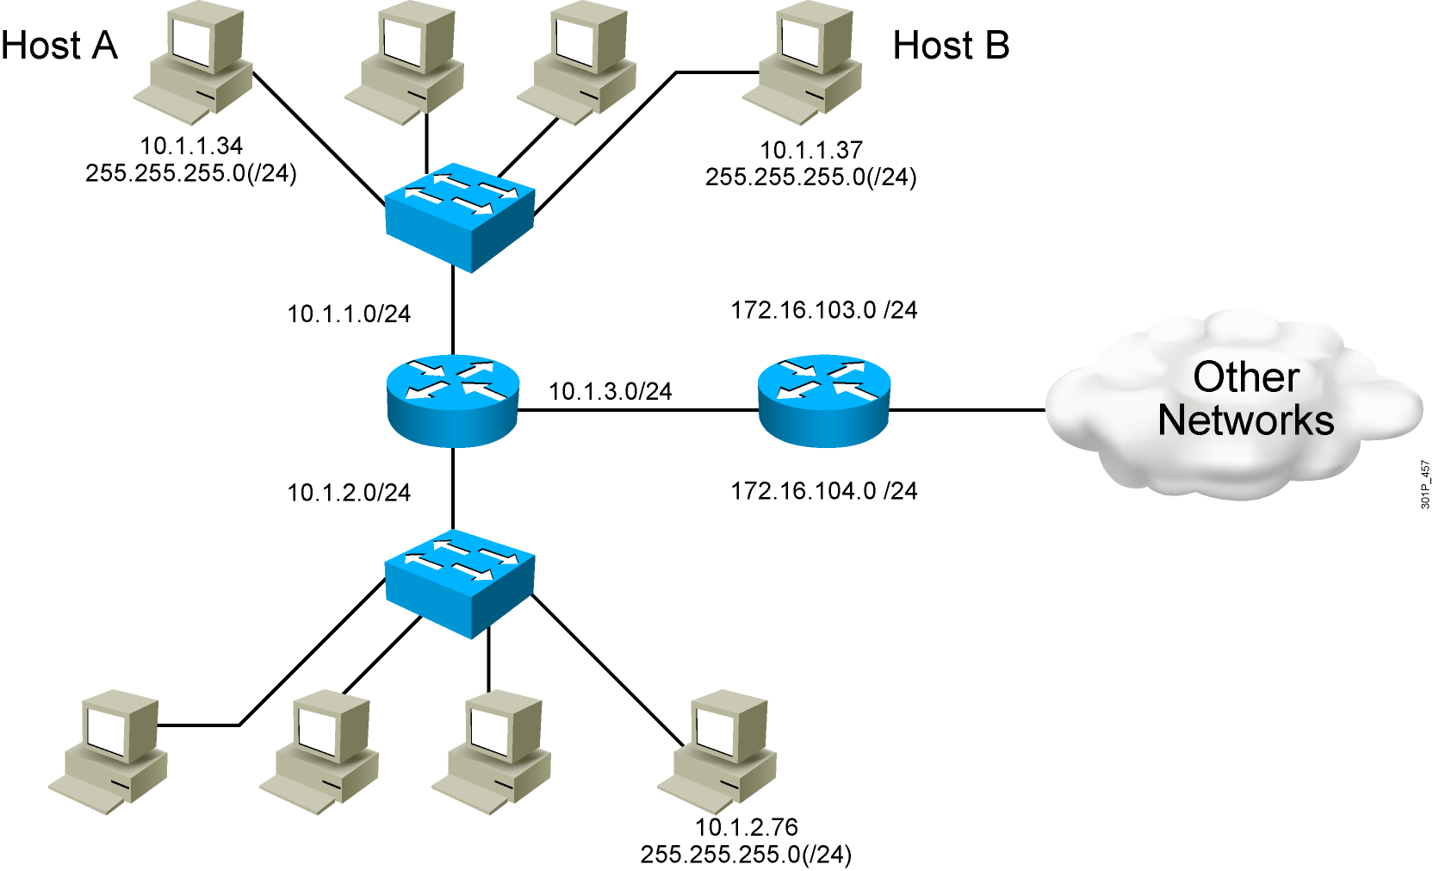
End System Subnet Mask Operation
29

