Slide 1
SMP: Healthy Bronx Culture Plate
Syed Akbar,DO PGY3-DFSM
June 10,2025

Slide 3
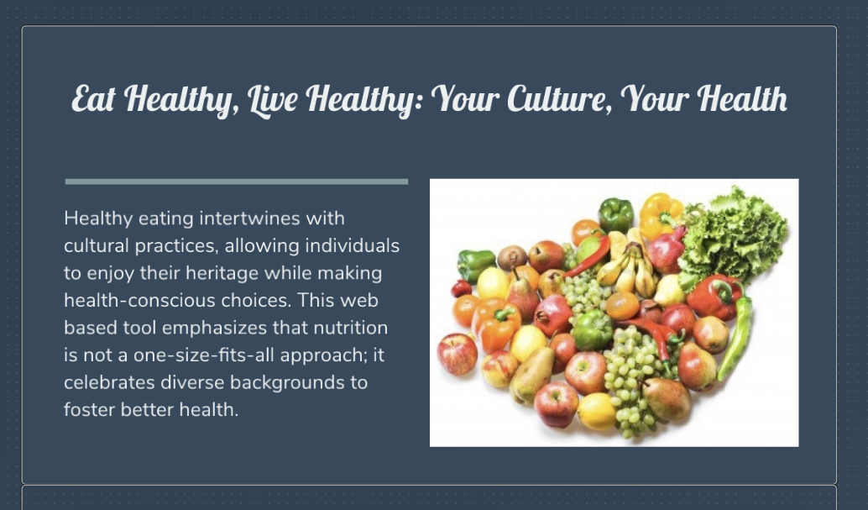
Hope to achieve with my tool?
Fill the gap in the health/nutrition field from not involving different cultures and traditions as well as making it much easier for patients of all health literacy levels to be healthy!

Slide 4
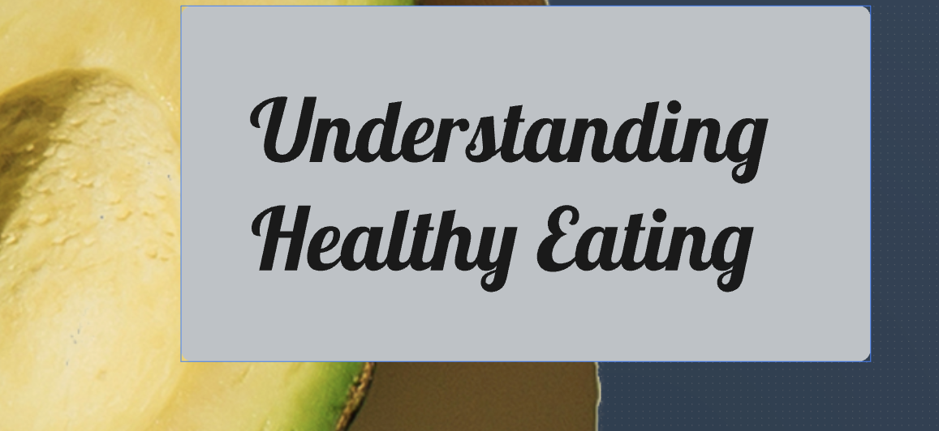

Slide 5
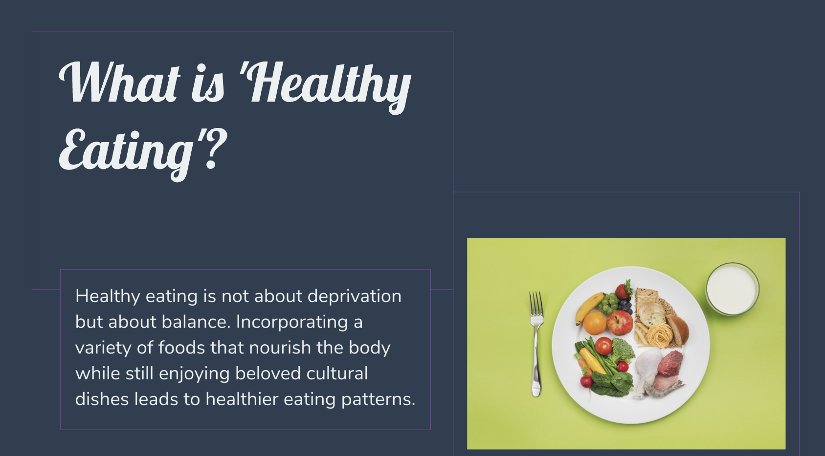

Slide 6
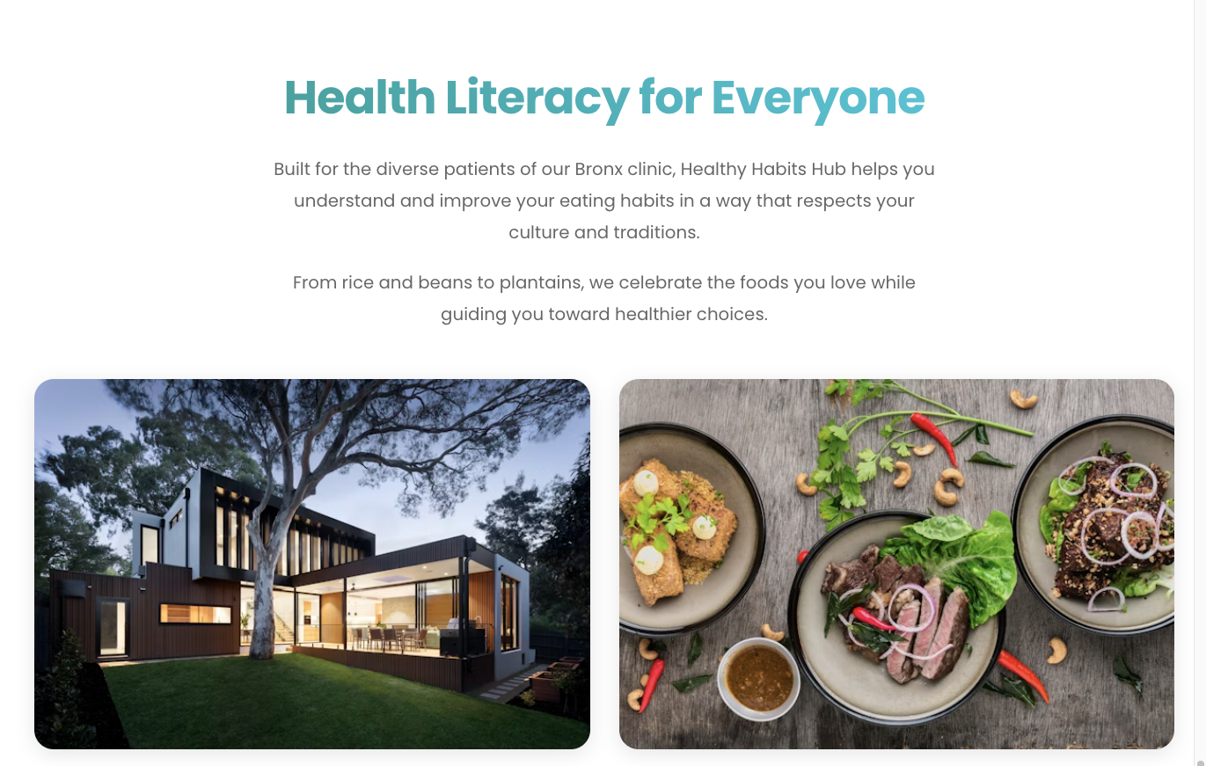

Slide 7
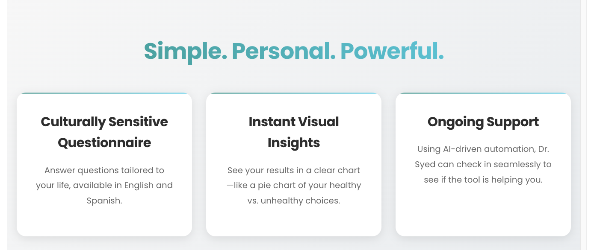

Slide 8
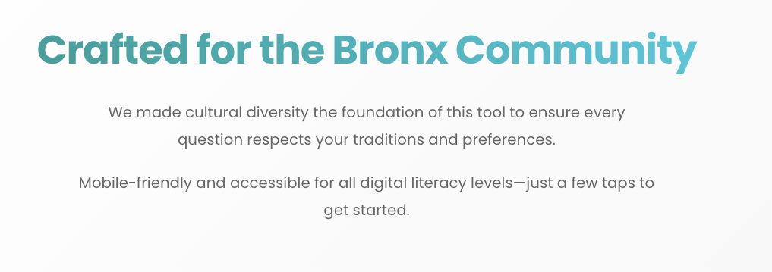

Slide 9
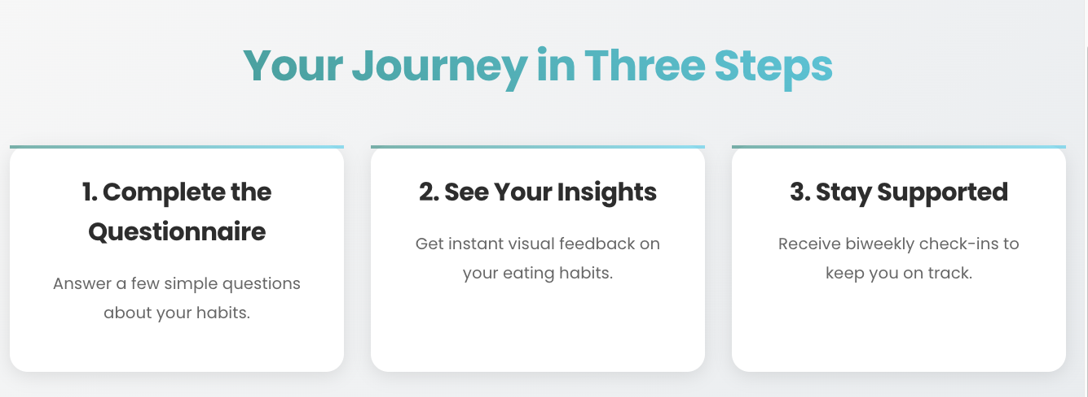

Slide 11
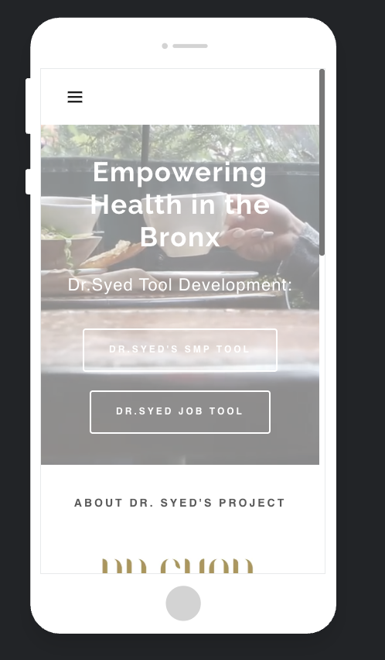

Slide 12
Some Examples!

Slide 14
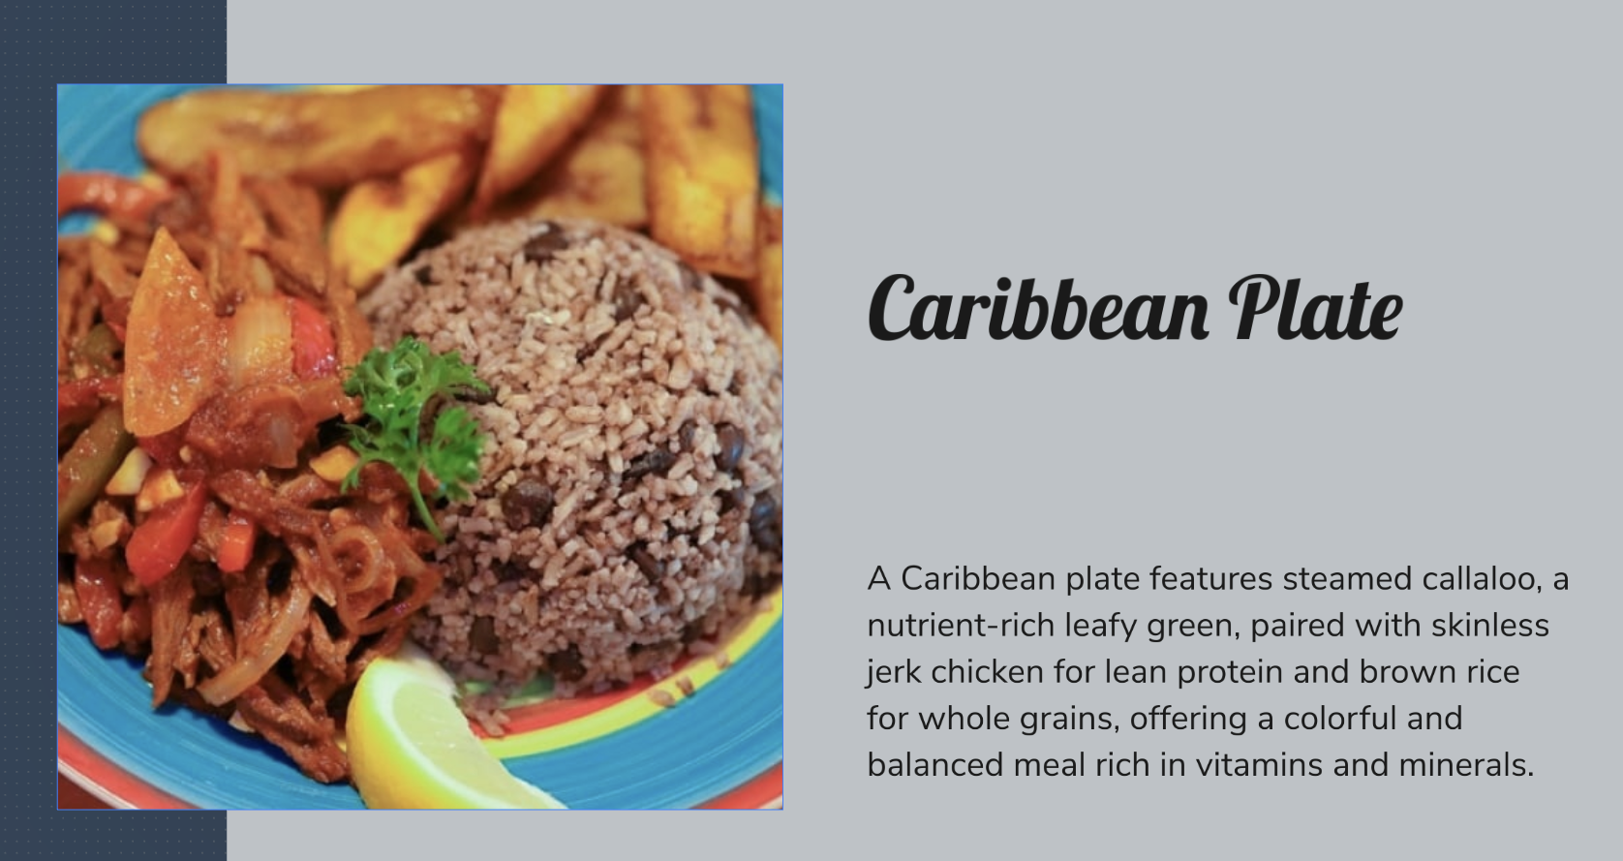

Slide 16
Targets socioeconomic barriers!

Slide 19
Video showcase/demo...
​ https://vimeo.com/1092120507?share=copy#t=0​

Slide 20
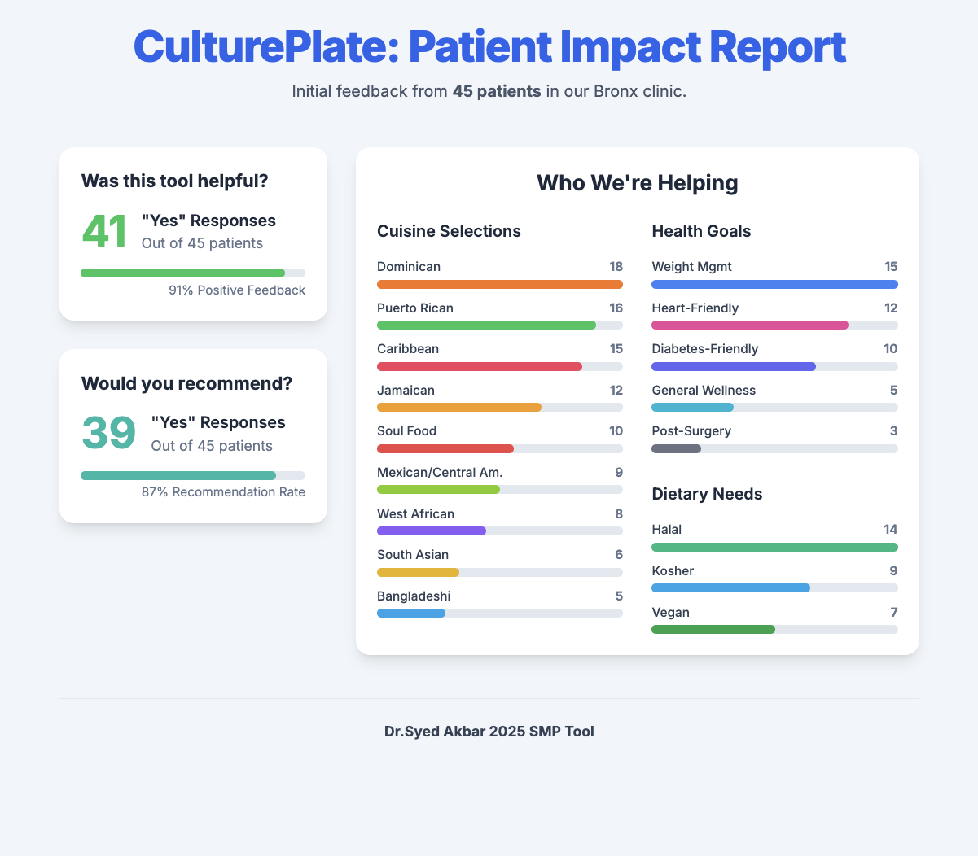
The data/results?

Slide 21
Interactive data report:
<place holder for now, insert short video here>

Slide 22
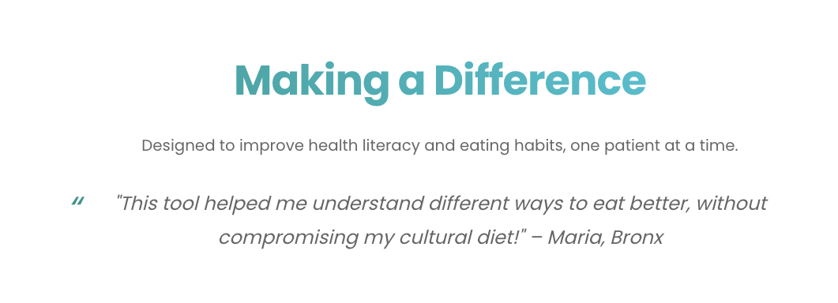
THANK YOU
Syed Akbar,DO
www.healthybronx.com

