Slide 1
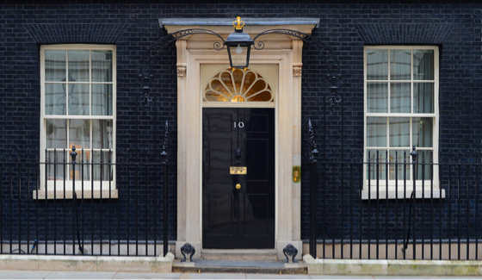

How important is the House of Lords?
Learning Objectives:
To be able to describe the House of Lords.
To be able to explain and evaluate the different functions of the House of Lords.
To assess the importance of the House of Lords in our democracy.
Political Education For Students

Slide 2
What do we already know about the House of Lords?
Political Education For Students

Slide 3
What has been the evolution of the House of Lords?
Read through the overview of changes, and planned changes, to the House of Lords.
What do you think have been the three most significant changes to the House of Lords? Why?
Do you think there has been more change about the powers of the Lords, or the composition of the Lords?
Can you envisage the House of Lords being abolished and replaced with a fully-elected chamber, or not?
Political Education For Students

Slide 4


How important is the House of
Lords?
PRIME MINISTER:
Carefully read the different features, functions and impact of the House of Lords on British government and politics.
Do you think the abolition of the hereditary peers goes far enough, or are further reforms of the House of Lords necessary? Or, you might think, the changes made have been damaging to British democracy.
Write an opinion piece, providing your central argument about what should be done with the House of Lords (if anything!), and your arguments to support your central opinion.
MEMBER OF PARLIAMENT:
Carefully read the different features, functions and impact of the House of Lords on British government and politics.
Ask your teacher for an opinion line print out.
For each of the different statements, stick it down on the opinion line in the appropriate place in relation to how much it agrees with the statement:
The House of Lords is of importance to our democracy.
When you are finished, annotate each statement with why you have placed it here.
COUNCILLOR:
Carefully read the different features, functions and impact of the House of Lords on British government and politics.
Cut these out and divide in to two piles; one pile that shows that the House of Lords is important to our democracy and another pile that shows that the House of Lords is of limited importance. Stick these down under each of these headings.
When you are finished, write your opinion. Do you think that the House of Lords is important?
CHALLENGE Q: Should Reform be granted members of the House of Lords?
Political Education For Students

Slide 5
‘The House of Lords is of importance to our democracy.’
0%
20%
40%
60%
80%
100%
10%
30%
50%
70%
90%
Political Education For Students

Slide 6
What do we already know about the House of Lords?
Political Education For Students

Slide 7
Closing Question
Why do you think reform of the House of Lords has been always been problematic?

