Slide 1
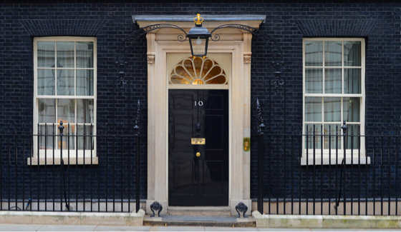

How important is the House of Lords?
Learning Objectives:
To be able to recap our learning so far on the House of Lords.
To be able to explain and evaluate the different functions of the House of Lords.
To assess the importance of the House of Lords in our democracy.
Political Education For Students

Slide 2
Recap Quiz: How much can you remember about the House of Lords?
In what year was the first Parliament Act which stopped the House of Lords from being able to block legislation?
How was the Act amended in 1949?
What is the ‘nickname’ for the House of Lords in our bicameral system?
What part of the Lords membership was mostly abolished under Tony Blair?
How many could remain in the House of Lords?
What replaced the House of Lords as the highest UK court? What was the legislation that facilitated this?
What two powers do the Lords have access to?
Why did the 2012 House of Lords Reform fail?
What was the 2014 House of Lords Reform Act?
What were the recommendations of the 2017 Burns Committee?
What are the main proposals in the September 2024 House of Lords (Hereditary Peers) Bill?
What other reforms has the Labour Government proposed?
Political Education For Students

Slide 3
In what year was the first Parliament Act, which stopped the House of Lords from being able to block legislation? 1911
How was the Act amended in 1949? Reduced the delay to 1 year
What is the ‘nickname’ for the House of Lords in our bicameral system? Upper House / ‘Other Place’
What part of the Lords membership was mostly abolished under Tony Blair? Hereditary Peers
How many could remain in the House of Lords? 92
What replaced the House of Lords as the highest UK court? What was the legislation that facilitated this? Supreme Court (2009) - Constitutional Reform Act (2005)
What two powers do the Lords have access to? Legislative scrutiny and power to delay.
Why did the 2012 House of Lords Reform fail? Senior Conservatives refused to support.
What was the 2014 House of Lords Reform Act? Allowed members to resign; removed peers for non-attendance, expelled members for criminal offences.
What were the recommendations of the 2017 Burns Committee? Cap the size of the Lords to 600, ‘two out, one in system’, 15-year term limits.
What are the main proposals in the September 2024 House of Lords (Hereditary Peers) Bill? Remove hereditaries, abolish by-elections
What other reforms has the Labour Government proposed? Mandatory retirement age, participation requirement, and removal of “disgraced members”.
Political Education For Students

Slide 4
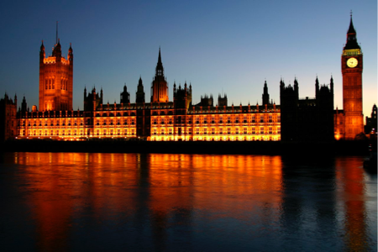

How important is the House of
Lords?
PRIME MINISTER:
Carefully read the different features, functions and impact of the House of Lords on British government and politics.
Do you think the current Labour proposals are good for parliamentary democracy? Write a detailed response, including:
* Why are the proposals good ones? What positive impact will they have on democracy and the workings of the Lords?
* Why are the proposals not good? What problems have they caused, or could cause?
* Your personal thoughts - is the Labour government on the right ‘journey’ when it comes to the Upper House?
MEMBER OF PARLIAMENT:
Carefully read the different features, functions and impact of the House of Lords on British government and politics.
Ask your teacher for a piece of A3 paper and draw an opinion line across the middle, like we use in class debates. Label one end with 0% and the other end with 100%.
For each of the different statements, stick it down on the opinion line in the appropriate place in relation to how much it agrees with the statement:
The House of Lords is of incredible importance in our democracy.
When you are finished, annotate each statement with why you have placed it here.
COUNCILLOR:
Carefully read the different features, functions and impact of the House of Lords on British government and politics.
Cut these out and divide in to two piles; one pile that shows that the House of Lords is important to our democracy and another pile that shows that the House of Lords is of limited importance. Stick these down under each of these headings.
When you are finished, write your opinion. Do you think that the House of Lords is important?
CHALLENGE Q: Should Reform be granted members of the House of Lords?
Political Education For Students

Slide 5
Closing Question
Why do you think reform of the House of Lords has been problematic since 1911?

