Slide 1
Let’s Get Real About Rates (AKA Shriners on Parade)
A Wing-O-Metrics Presentation Tuesday February 21st, 2017 Minneapolis, mn

Slide 2
It’s Not The Amount of Debt in the economy that matters….

Slide 3
….it’s the amount of economics in the debt that does

Slide 4
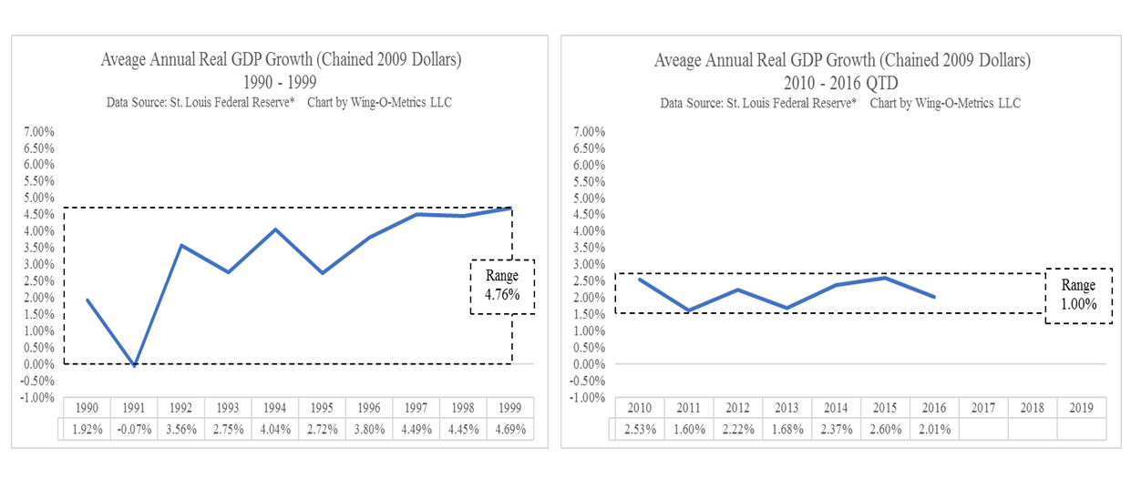
Enjoy the acts but mind the Procession

Slide 5
The Price Is Righting…..

Slide 6
…And The Income Fix Is In

Slide 7
This isn’t 1985

Slide 8
This Kid Is getting tired of being dragged along.

Slide 9
The parade march continues….

Slide 10
…with flattening right around the corner

Slide 11
Questions, Comments, Disclosures
Paul Allen Winghart
Wing-O-Metrics LLC Founder & Chief Knowledge Officer, Author of ConsterNation! ~ The Economics Behind The Angst
www.surplusproductivity.com
pwinghart@surplusproductivity.com
Twitter
www.linkedin.com/pub/paul-winghart/12/779/390
The material contained herein is not a product of any research department . Nothing herein constitutes a recommendation of any security or regarding any issuer; nor is it intended to provide information sufficient to make an investment decision. The information contained in this communication has been compiled by Wing-O-Metrics LLC from sources believed to be reliable, but no representation or warranty, express or implied, is made by Wing-O-Metrics LLC its affiliates or any other person as to its accuracy, completeness or correctness. All opinions and estimates contained in this communication constitute Wing-O-Metrics LLC's judgment as of the date of this communication, are subject to change without notice and are provided in good faith but without legal responsibility. Nothing in this communication constitutes legal, accounting or tax advice or individually tailored investment advice. This material is prepared for general circulation to clients and may have been prepared without regard to the individual financial circumstances and objectives of persons who receive it. The investments or services contained in this communication may not be suitable for you and it is recommended that you consult an independent investment advisor if you are in doubt about the suitability of such investments or services. Past performance is not a guide to future performance, future returns are not guaranteed, and a loss of original capital may occur. Every state in the U.S., and most countries throughout the world have their own laws regulating the types of securities and other investment products which may be offered to their residents, as well as the process for doing so. As a result, any specific securities discussed in this communication may not be eligible for sale in some jurisdictions. This communication is not, and under no circumstances should be construed as, a solicitation to act as securities broker or dealer in any jurisdiction by any person or company that is not legally permitted to carry on the business of a securities broker or dealer in that jurisdiction to the fullest extent permitted by law neither Wing-O-Metrics LLC nor any of its affiliates, nor any other person, accepts any liability whatsoever for any direct or consequential loss arising from any use of this communication or the information contained herein.

