Slide 1

Consumerism and COVID-19 COVID-Related Advertisements and Their Effects on Generation Z’s Opinions of Corporate America
Karli George
Department of ACCT & MIS
7 April 2022

Slide 2
Statement of Purpose
Investigate how Generation Z’s opinions of companies have changed since the COVID-19 pandemic.
Many companies have built advertising campaigns around the COVID-19 pandemic.
Discuss how businesses and consumers have been affected.
BUT: Does this advertising method hold up?
If so, it could uncover the value in using social issues in advertising.
If not, then that indicates that advertisers should try out other methods to attract new consumers.

Slide 3
Procedures
Target University of Delaware Students
Generation Z (Ages 18-24)
Open to all backgrounds, genders, races, etc.
Distributed fliers via email and social media (i.e., Instagram, Twitter)
Two surveys distributed to students.
Survey #1: Demographics and Current Attitudes Towards Companies
Year, gender identity, race, economic views, etc.
Survey #2: Reactions to Pre-Covid and COVID-Era Advertisements
Apple, Airbnb, Uber, Coca Cola, Nike
Does the trust in/perception of these companies change between the two eras?

Slide 4
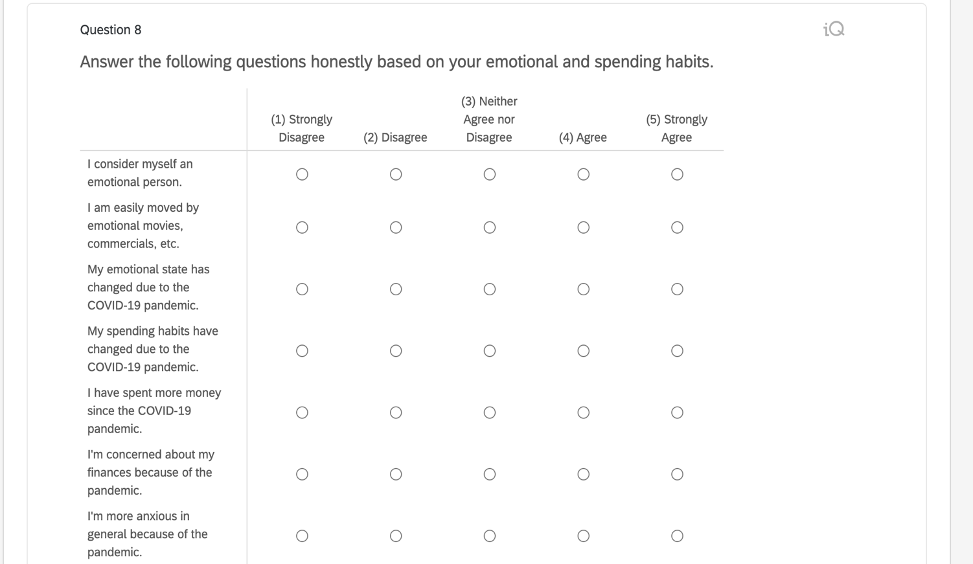
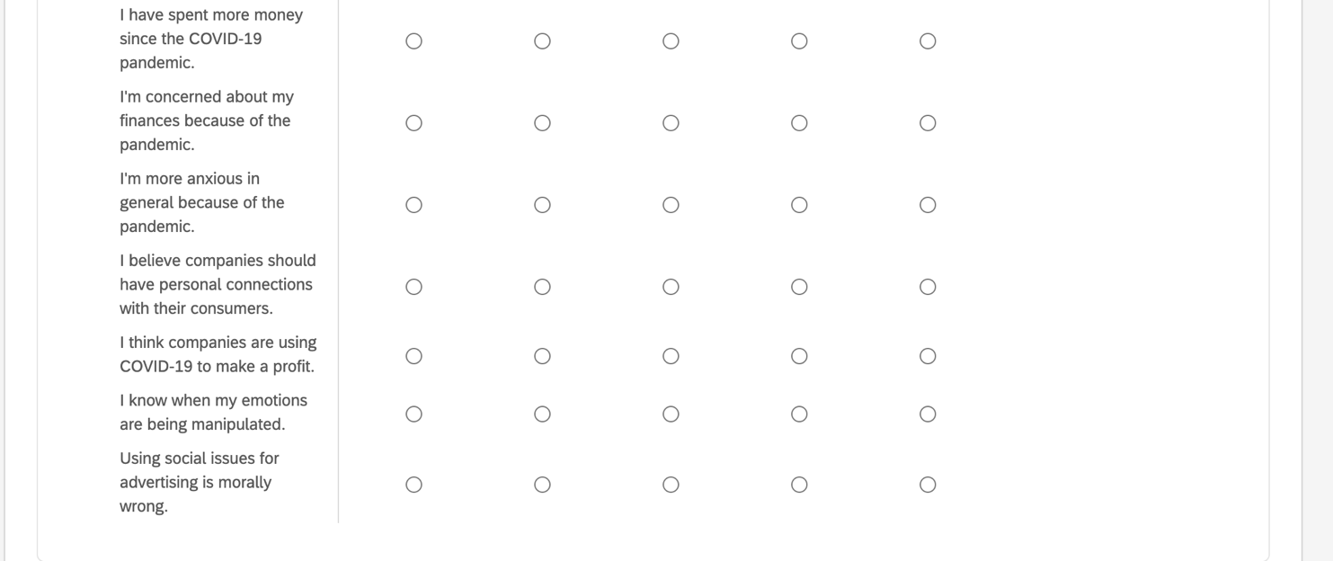
Data Methods
Qualtrics
Used to record responses and hold consent form(s)
Free to use via UDID account!
Created two surveys
Multiple choice, responses ranging Strongly Disagree (1) to Strongly Agree (5)
Links to ads from before and during the COVID-19 pandemic.
Excel
Used to store data from Qualtrics
Converted to CVS files for analysis
R Programming
Used to find trends in data
Means, histograms, linear analysis, etc.

Slide 5
Survey #1 Findings

Slide 6
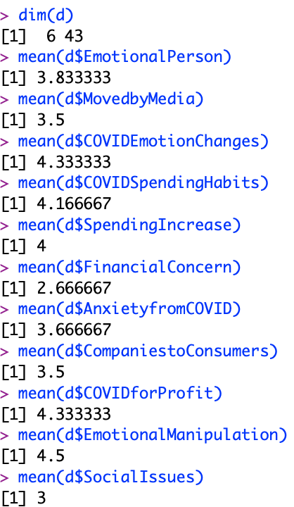
1 Strongly Disagree
2 Disagree
3 Neither Agree nor Disagree
4 Agree
5 Strongly Agree
YEAR 100% Juniors
GENDER 66.67% Female, 33.33% Male
ETHNICITY 83.33% Caucasian, 16.67% Asian
POLITICS 66.67% Conservative, 33.33% Liberal
INCOME 83.33% >$120,000, 33.33% =<$120,000
ECONOMICS 83.33% Capitalism, 16.67% Socialism
COVID-AFFECTED 100% Say ”Yes”
General Findings

Slide 7
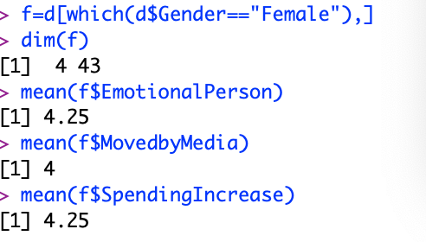
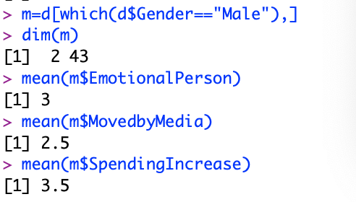
Response to Media: Male vs. Female

Slide 8
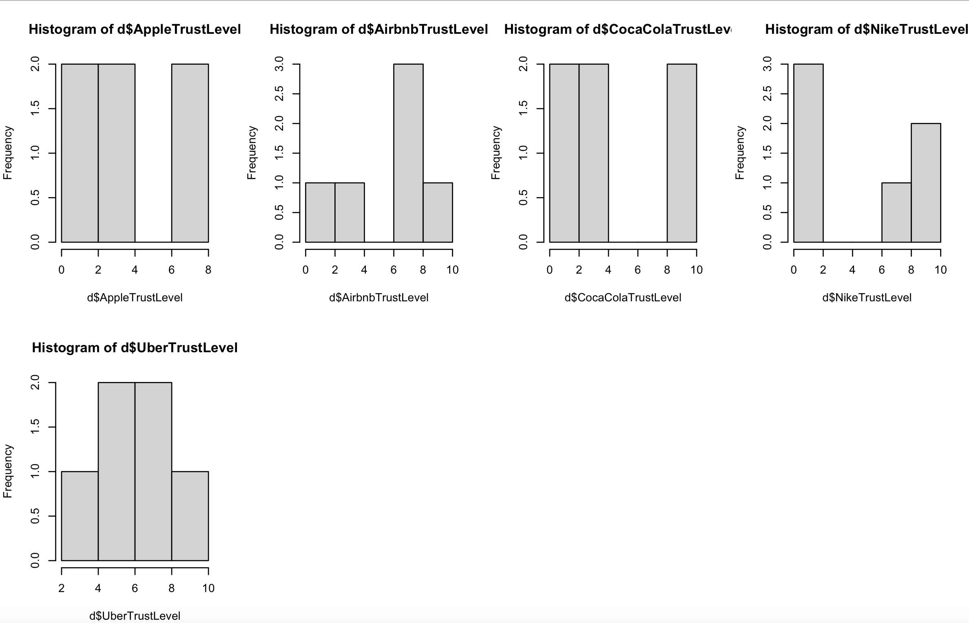
Trust Levels in the Five Companies

Slide 9
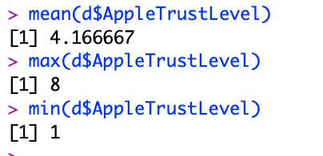
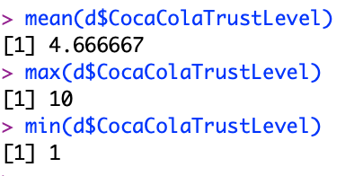
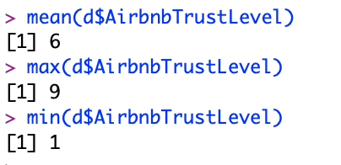
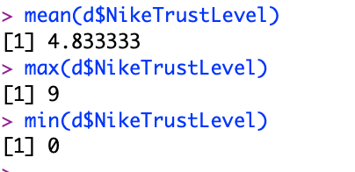
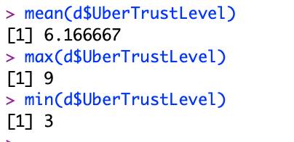
Apple, Inc.
Coca Cola Company
Airbnb, Inc.
Nike, Inc.
Uber Technologies, Inc.
Company Break-Down: Max, Min, and Mean

Slide 10
Survey #2 Findings
Note: There was only 1 response that was eligible for analysis, so R will not be used.

Slide 11
Apple
Pre-COVID 2
COVID 4
Airbnb
Pre-COVID 4
COVID 5
Coca-Cola
Pre-COVID 2
COVID 5
Nike
Pre-COVID 4
COVID 5
Uber
Pre-COVID 2
COVID 4
MOST CHANGE
Emotional Responses to Ads: Pre-COVID and COVID-Era

Slide 12
Survey #1
Survey #2
6
5
7
6
6
Company Trust Levels: Comparing Surveys

Slide 13
Conclusions
COVID-era advertisements contribute to a modest increase in trust among companies.
Because of the lack of eligible data from Survey #2, more will need to be collected for more conclusive results.
May suggest that social issues can be useful in advertising.

Slide 14
THANK YOU!

