Slide 1

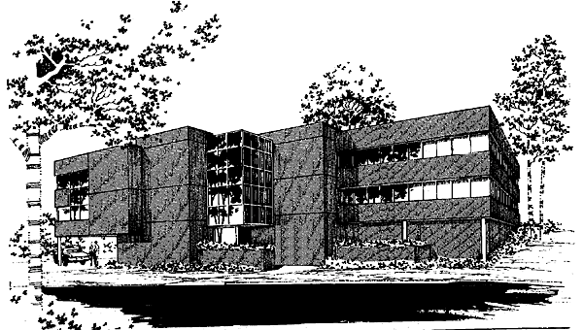

Corporate Office

Slide 9
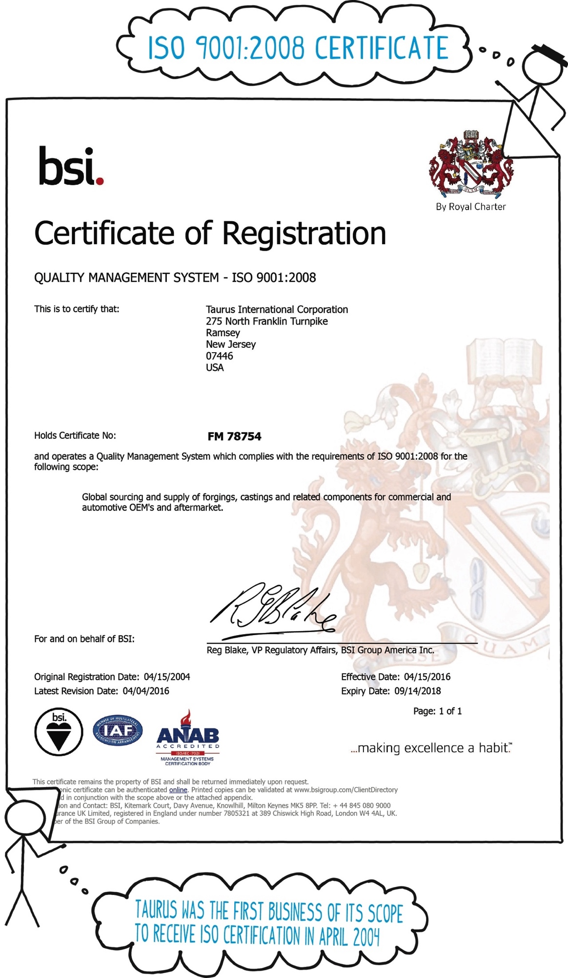

Slide 10
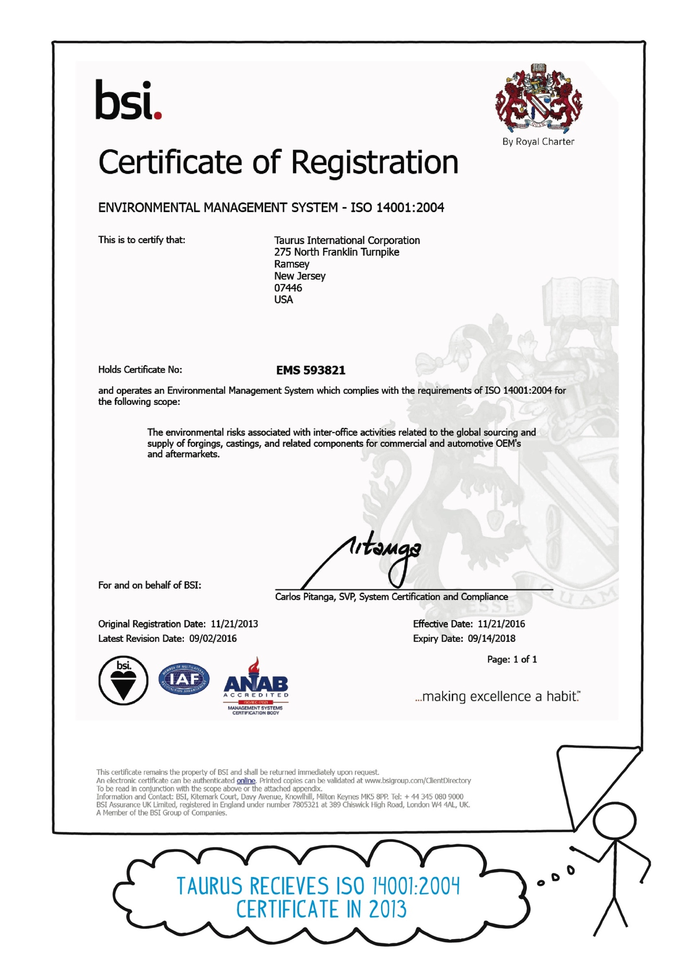

Slide 11



Slide 12
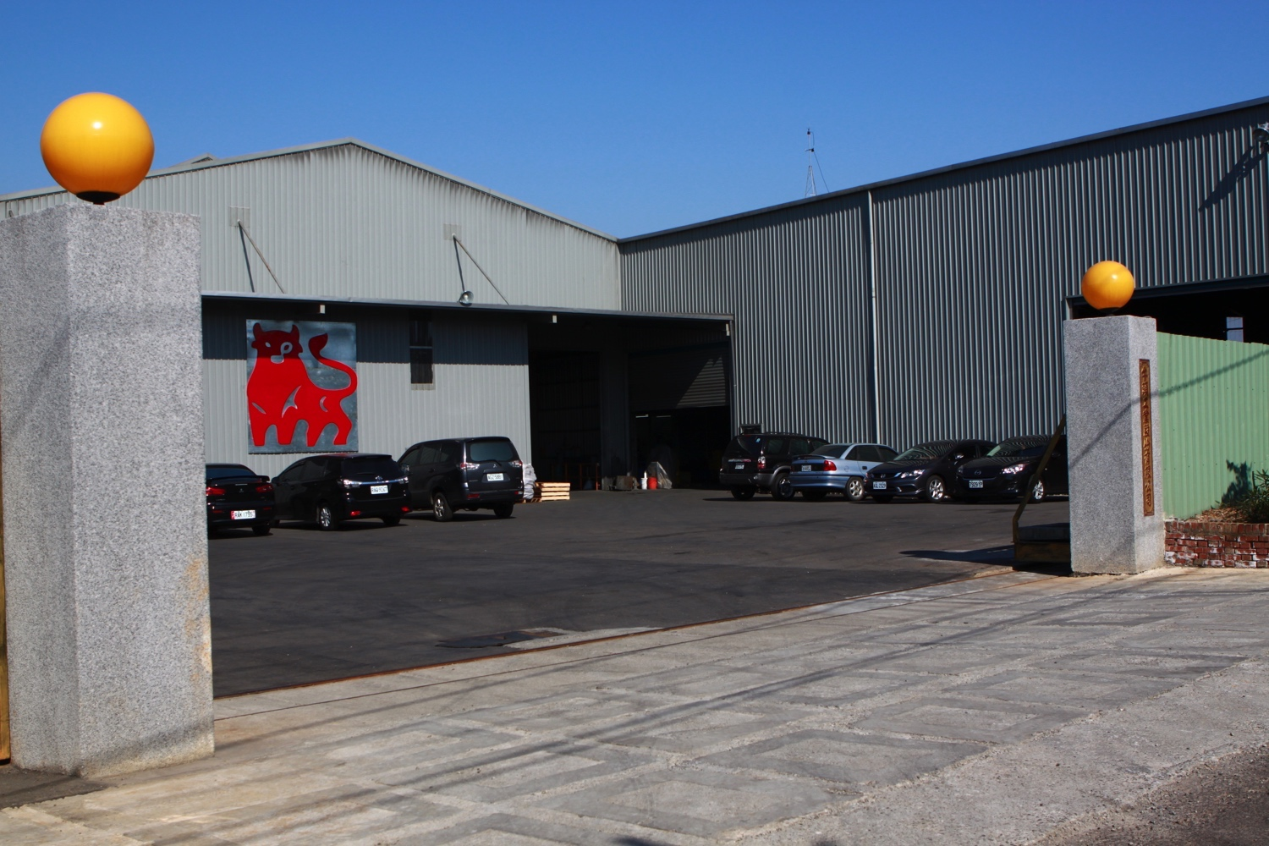

Slide 13
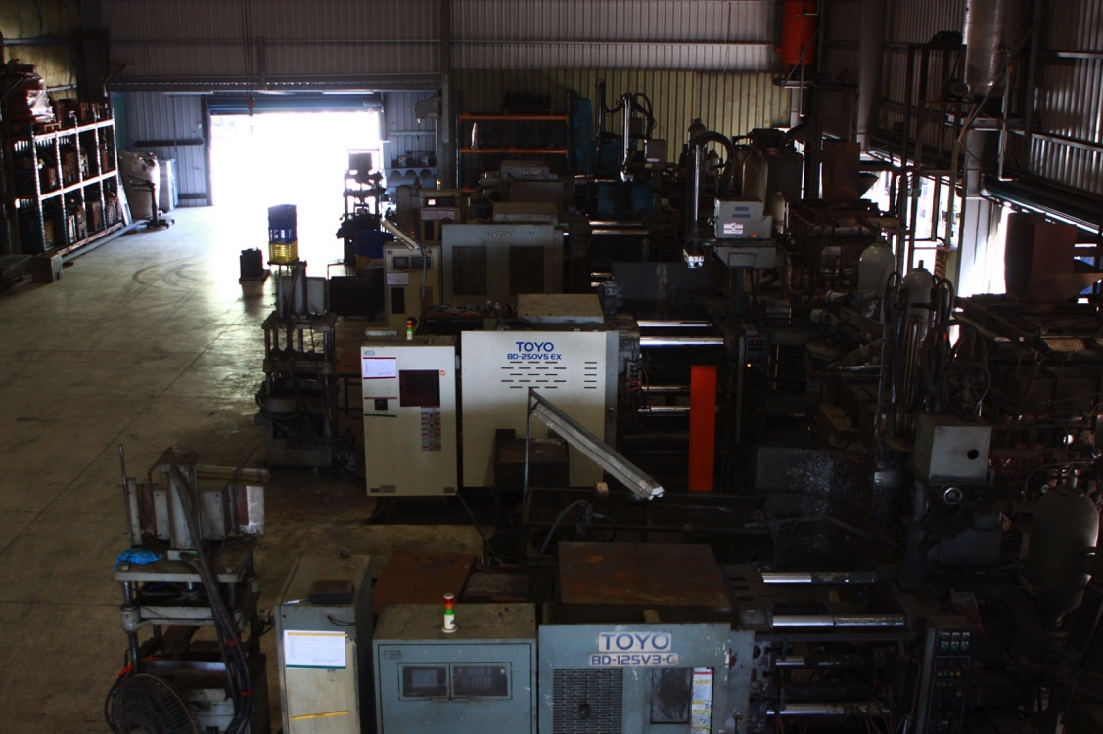
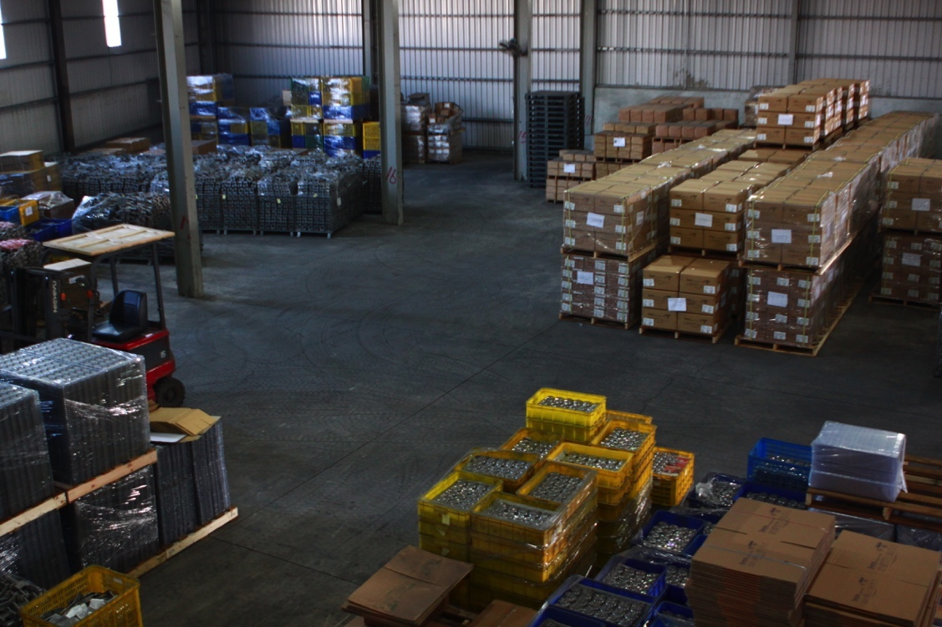

Slide 15
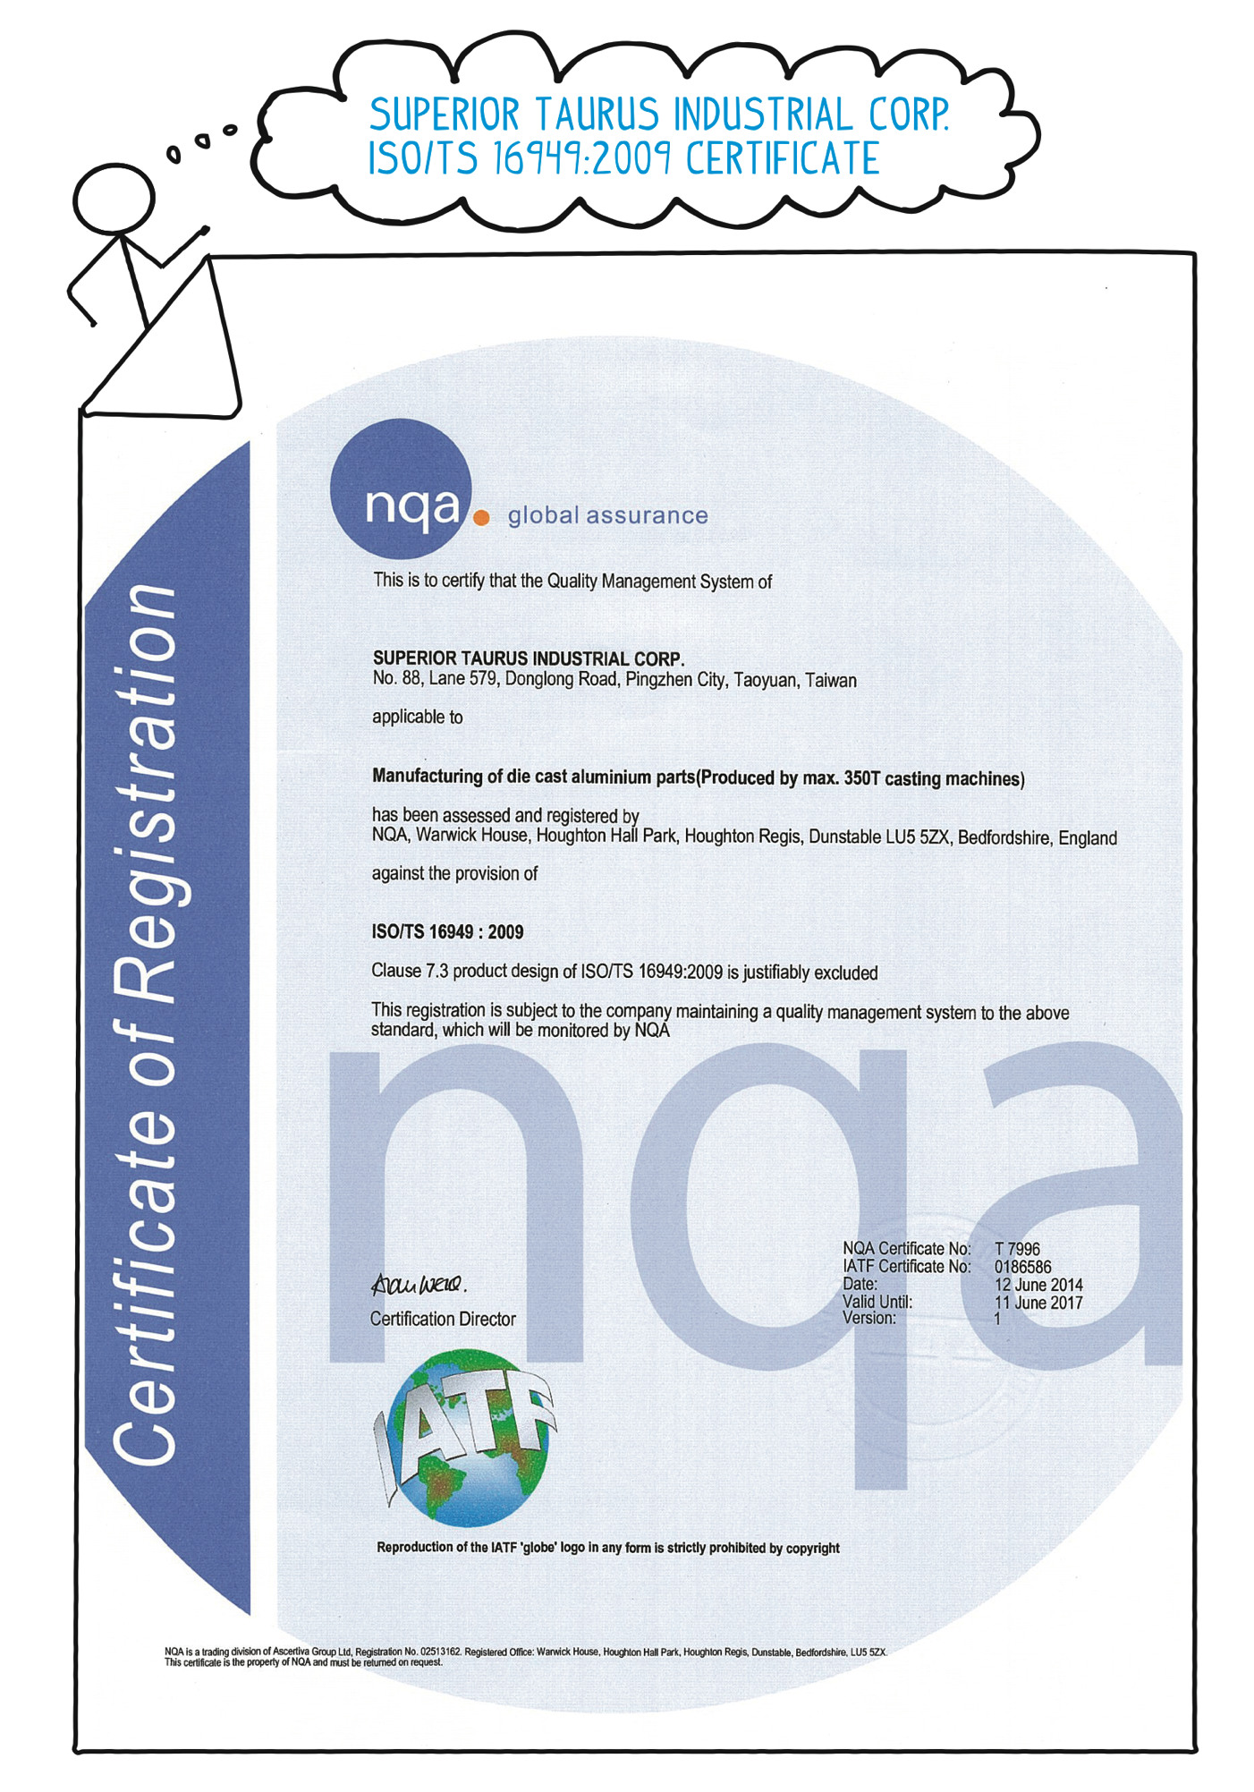

Slide 18
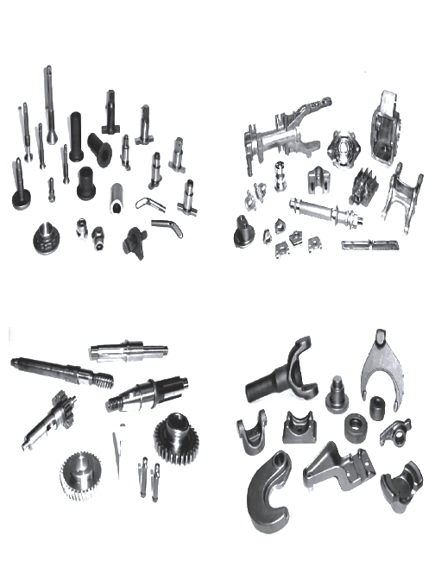

Slide 19
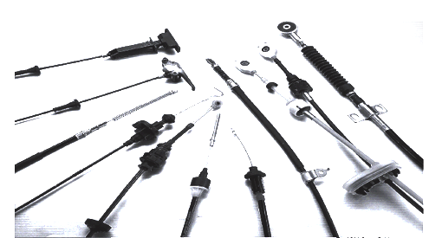
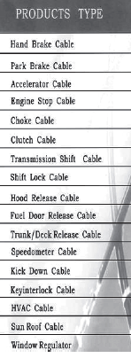
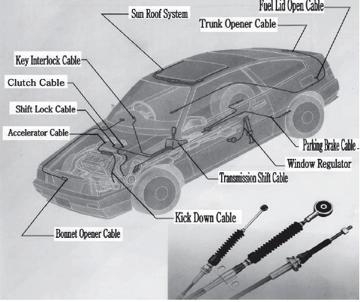

Slide 21
SALES VOLUME BY INDUSTRY

Slide 26



Taurus is a Registered Trade Name of TAURUS INTERNATIONAL CORPORATION
275 North Franklin Turnpike, Ramsey, NJ 07446
Tel. No. (201) 825-2420, Fax No. (201) 825-1437, Website: http://www.taurusinternational.com
© 2016 by Taurus International Corporation. All rights reserved.
No part of this presentation may be reproduced or transmitted in any form or by any means without the prior written permission of Taurus International Corporation.
01.15.17

