Slide 1
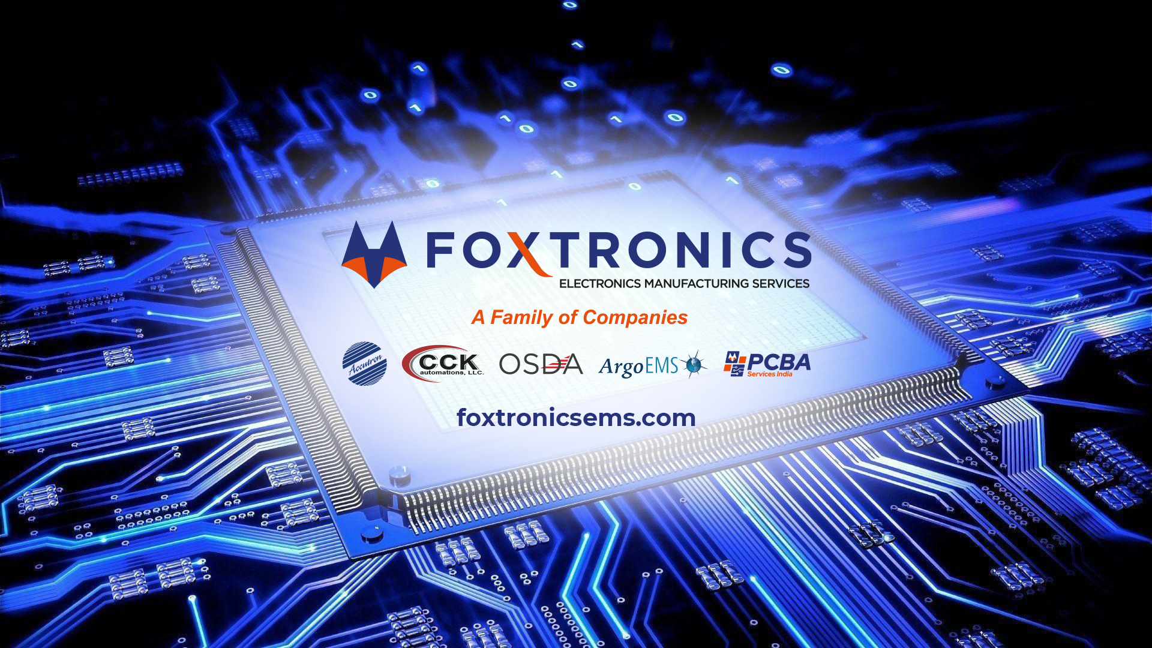

Slide 2

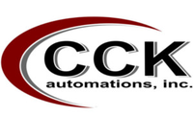

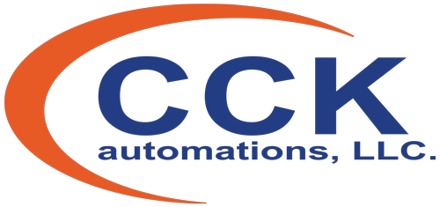


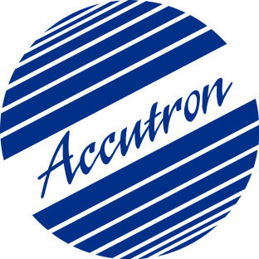










Facility Overview
Accelerating Time to Market with Full Turnkey Solutions
CCK Automations (Jacksonville, IL)
100,000 Sq. Ft. Facility
High Volume, Low Mix PCBA
4 Fully Automated SMT Production Lines
Box Build Work Cells
6 Injection Molding Lines
Team Size: 100+ Employees
Accutron (Windsor, CT)
55,000 Sq. Ft. Facility
Mid - High Volume Production
5 Fully Automated SMT Production Lines
Box Build Work Cells
In-Circuit, Flying Probe & Functional Testing
Conformal Coating & Encapsulation
Team Size: 100+ Employees
India
USA
OSDA / ARGO (Milford, CT)
17,000 Sq. Ft. Facility
Low - Mid Volume PCBA
Quick Turn Prototype
3 Fully Automated SMT Production Lines
Box Build Work Cells
Team Size: 40+ Employees
In-House Capabilities
PCBA Services (Ahmedabad, India)
High Volume PCB Assembly & Box Build
Injection Molding
In-Circuit & Flying Probe Testing
Commercial Market Centralized Internal Support Staff
Sales, Accounting, Quoting, Engineering & Purchasing
Team Size: 33
Mixed Technology
Quick Turn Prototype
Functional Testing
Lead & RoHS Soldering
Conformal Coating
ITAR Quoting

Slide 3
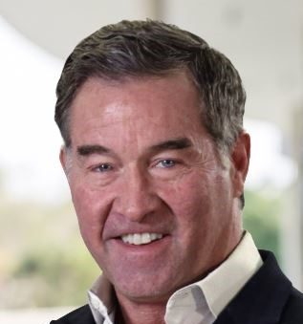

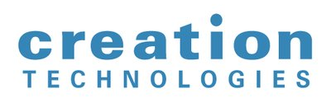
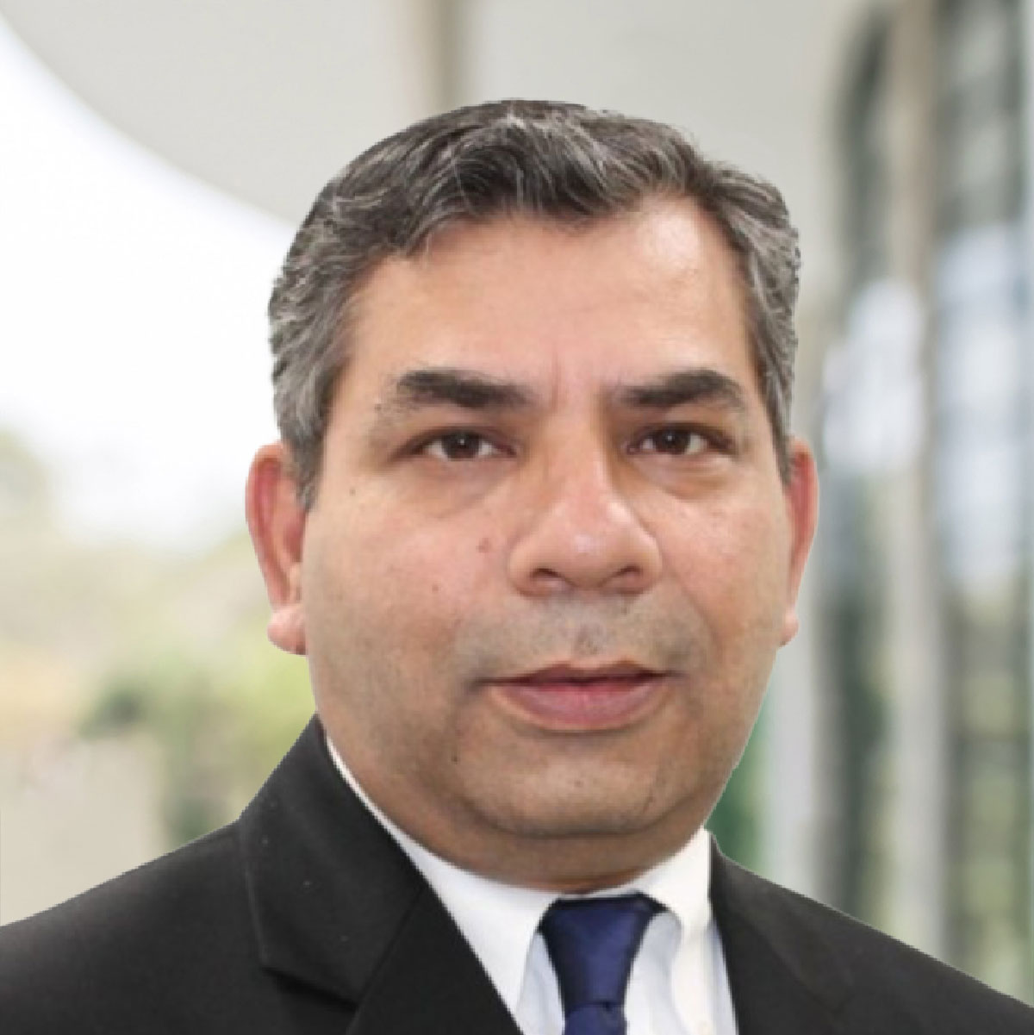

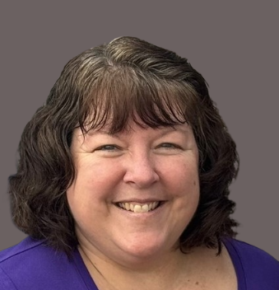
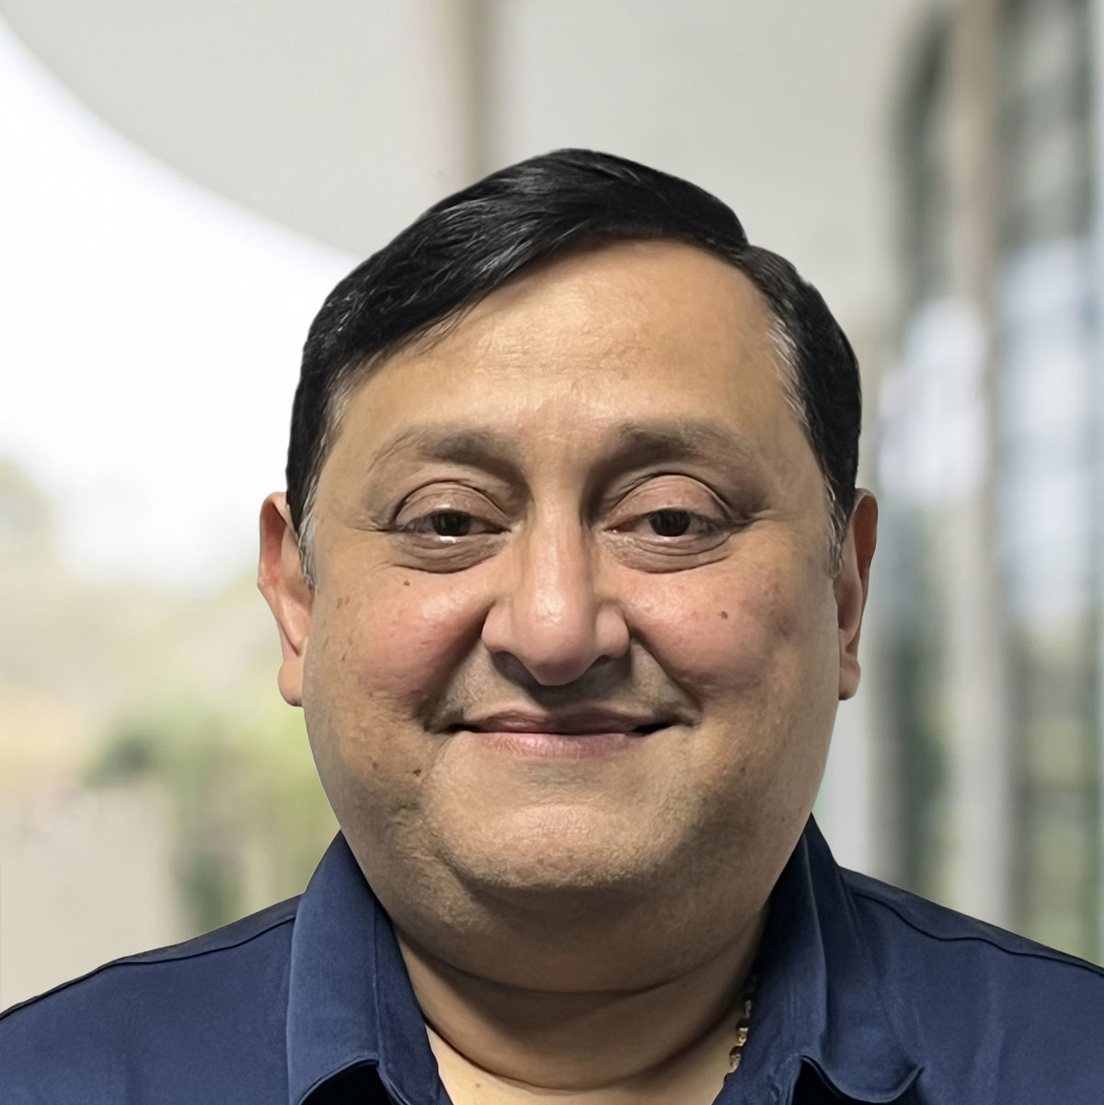
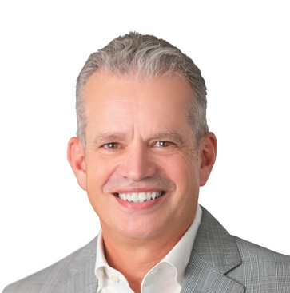
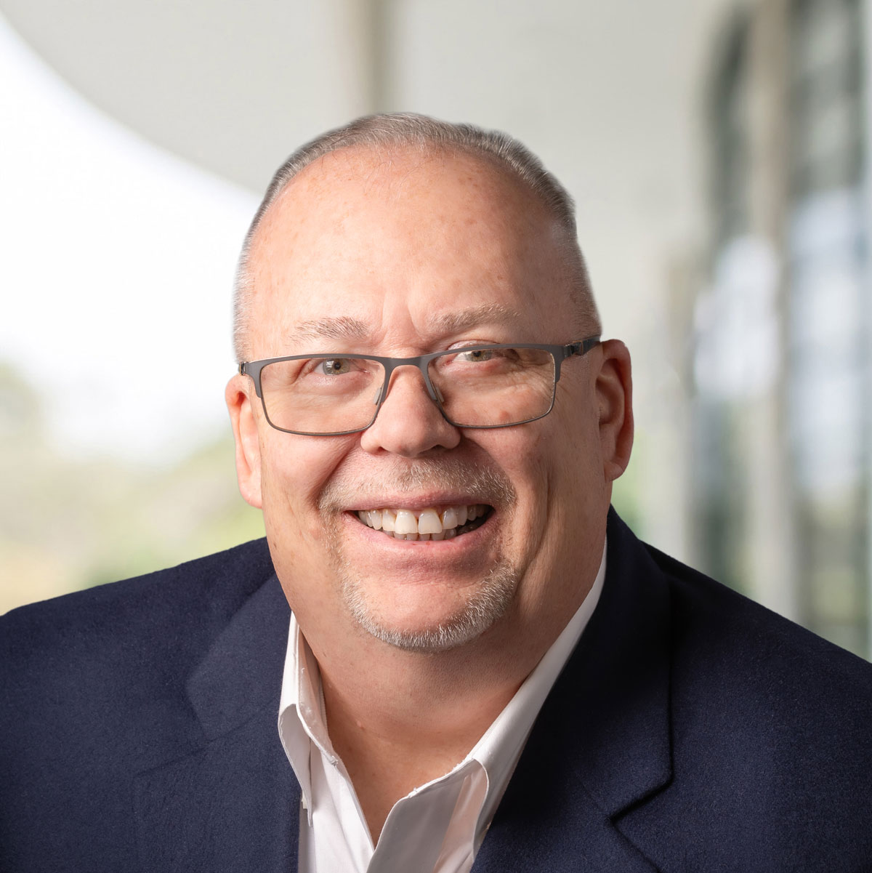
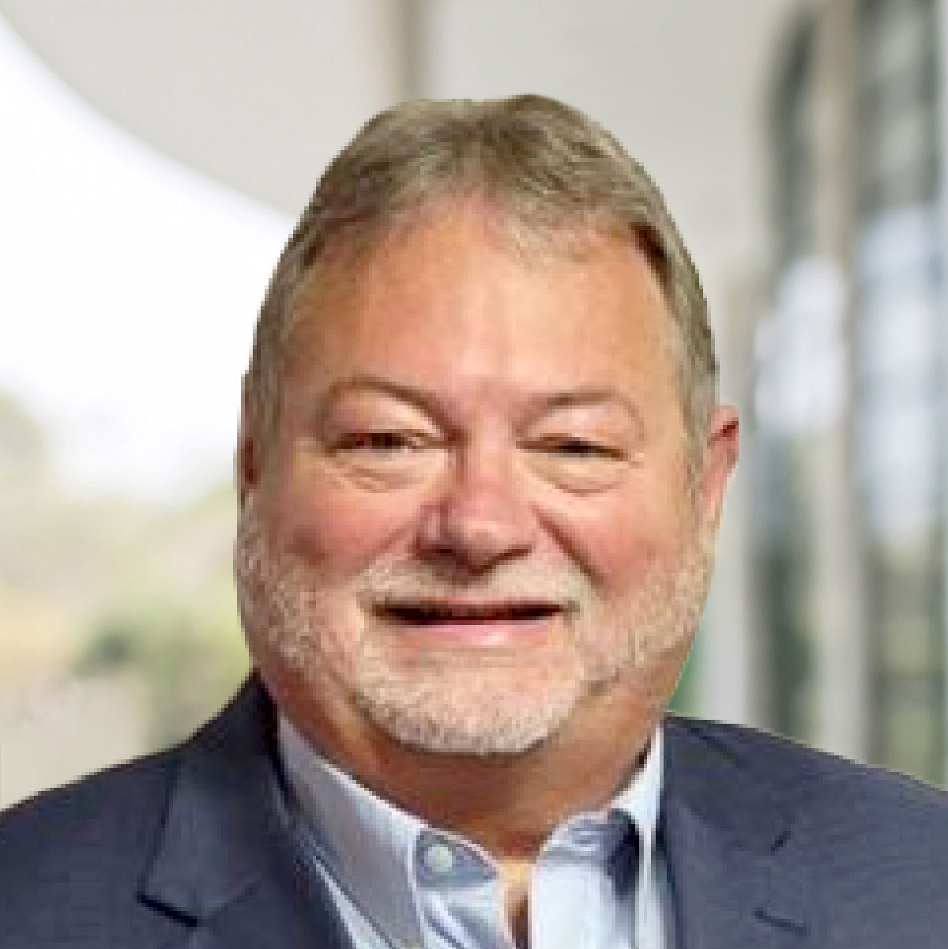



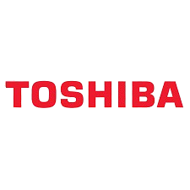


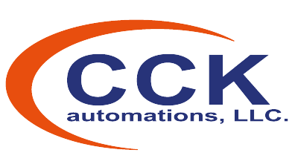



Executive Leadership Team
Seasoned Experts Driving Growth
Veteran EMS Sector Executive
20+ Years of Industry Experience
Proven Track Record - $800M Competitor
Technical Expertise of Full Manufacturing
& Design Processes
EXPERIENCES
Mark A. Stephenson
AVEX, Inc
CEO
Waseem Islam
Bill Deprofio
Michelle Scrogum
Samir Ghetia
^{Kevin Stone}
Jeffrey Mauck
JJ Richardson
CFO
Vice President, East Operations
General Manager,
CCK Automations
General Manager, Accutron
CRO
Vice President,
Sales
Vice President,
Technology
EXPERIENCES | Existing |  |  | Inactive | New
25 years – Finance & Leadership | 24 Years – EMS & Leadership | 25 Years - EMS & Leadership | 30+ Years – EMS & Leadership | 30+ Years EMS & Leadership | 30+ Years Sales & Marketing | 25 Years - EMS & Leadership

Slide 4


Enterprise Summary
Equipped to Serve a Broad Range of Production Mix & High-Tech Applications
Staffed with Decades of Experience in Electronic Manufacturing Services
High-Mid-Low Volume PCB Assembly & Box Build
12 Advanced Production Lines Across Three State-of-the-Art Facilities
Full Compliment of Secondary Process Automation
Selective Solder, Wave Solder, 3D AOI, Conformal Coating, Potting, Heat Staking & Testing
Complete Box Build Capabilities
DFM, DFT, Z2Data BOM Health Analysis
Quick Turn / Rapid Prototyping
High-Mix Focused Production Lines
Vast Range of Customer Sectors
Mil-Aero
Communication
Medical
Industrial
Mixed Technology
Ability to Service Entire Spectrum –
Surface Mount, Thru-Hole & Mixed Technologies
Technical Leadership –
25+ years of Electronics Manufacturing Experience

Slide 5
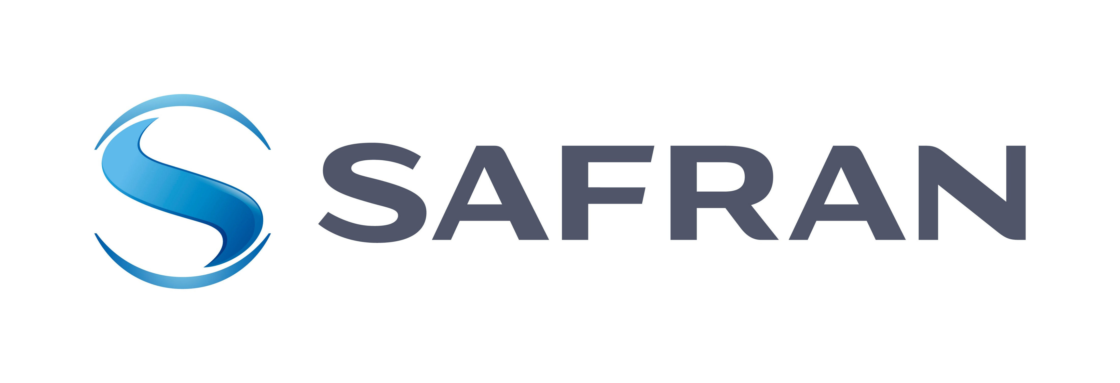




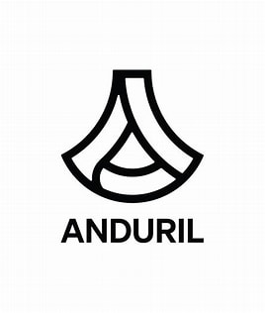
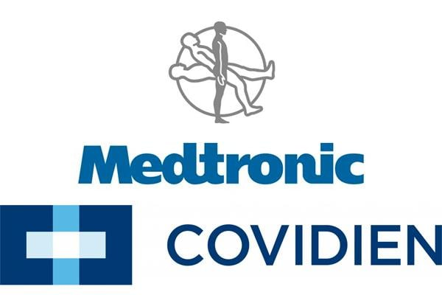


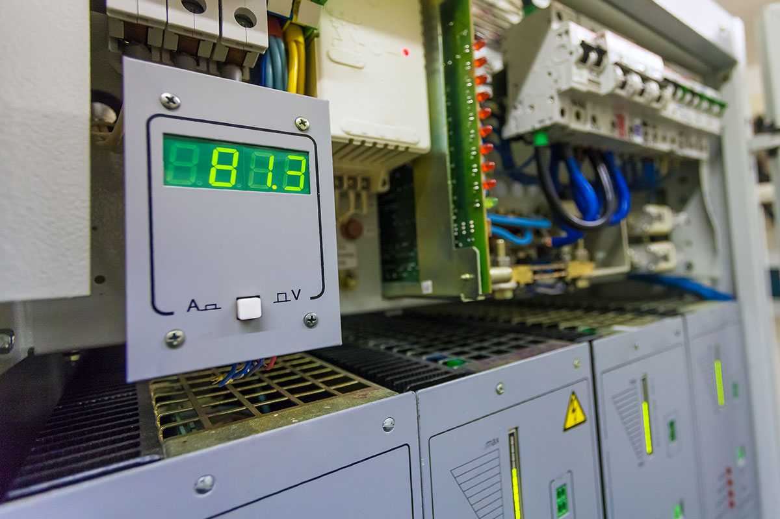
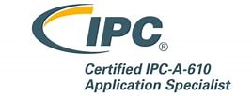


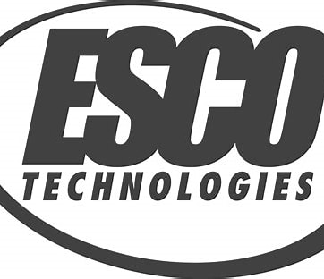



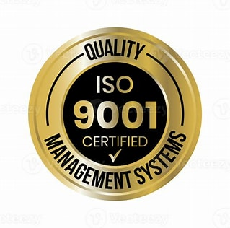
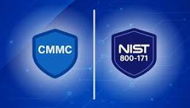
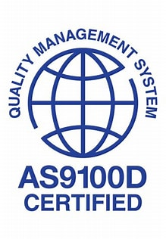
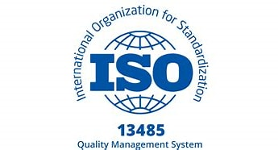

Focused Markets and Certifications
Aerospace and Defense | Medical
High Reliability Industrial | Governing Certifications

Slide 6
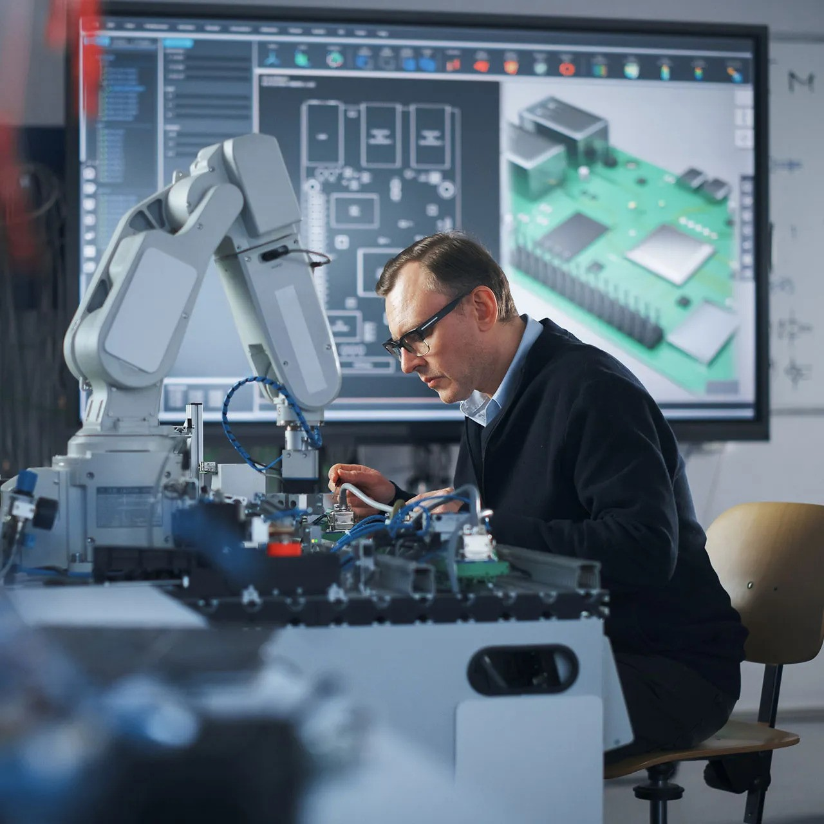

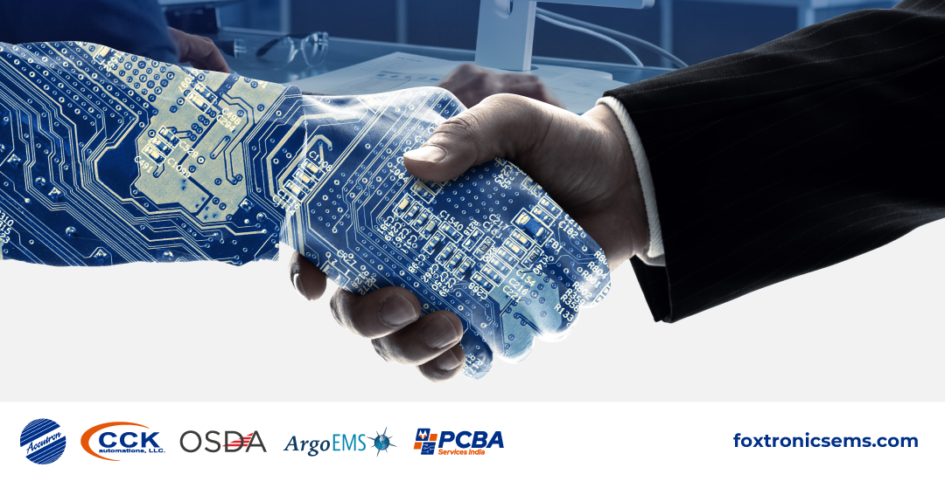
Strategic Vision, Forward Opportunities

Slide 7


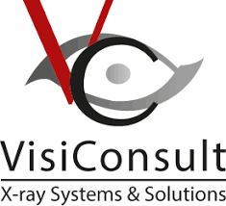
Key Planned Initiatives: (List 1/2)
Initiative | Description | Key Benefits | Implementation Schedule
Plex Implementation | Implementation of ERP and MES system Implemented in Jacksonville, IL plant | Increased plant performance and revenue growth Risk mitigation Maintain quality Human capital management | Complete
MODI Incoming Goods Scanner | Automatic label matching system Simplifies receiving process from incoming goods to existing POs Implemented in Jacksonville, IL plant. | Fully integrated with Plex Traceability of parts Inventory accuracy Reduce splicing errors Reduce rework by labeling Increased kitting productivity | Complete
VisiConsult X-Ray Counter | Accurate reel count tracking system Tracks returned parts per reel from SMT Recreates updates label Implemented in Jacksonville, IL plant | Fully integrated with PLEX Linked to MODI labeling station for real time reel count Inventory accuracy Productivity increase in kitting | Complete

Slide 8



Key Planned Initiatives: (List 2/2)
Initiative | Description | Key Benefits | Implementation Schedule
Consolidation | Consolidate facilities into one business unit | Remove duplication of fixed costs and other activities Sharpen focus on customers in the region | Completed
Operational LEAN (CIM) Activities | Implementation of a new SOP and work culture Focused on quality, delivery and personal ownership + accountability Implemented in Jacksonville, IL facility | Focus on reductions of Rework and RMA (process improvements based on root-cause analysis) Scheduling (predictable flow) and capacity increase | On-going, increase through Q2-2025
On-Boarding (NPI) & Partnerships | On-Board and ramp up new products | Establish long term relationships for future growth | On-going
/

Slide 9



The Vision: Customer-Centric Growth, Expanding Our National Reach
Current Locations
Future Locations
Industries Served
Medical & Life Sciences
Industrial & Commercial
Aerospace & Defense
Ag Tech
Comprehensive Range of Services
Complex PCB Assembly
Box Build
Quick Turn PCBA
Sophisticated Testing and Quality Inspection
Coating / Encapsulation
Injection Molding
WEST
Central
EAST
Mexico

