Slide 1

March 17, 2021

Slide 2
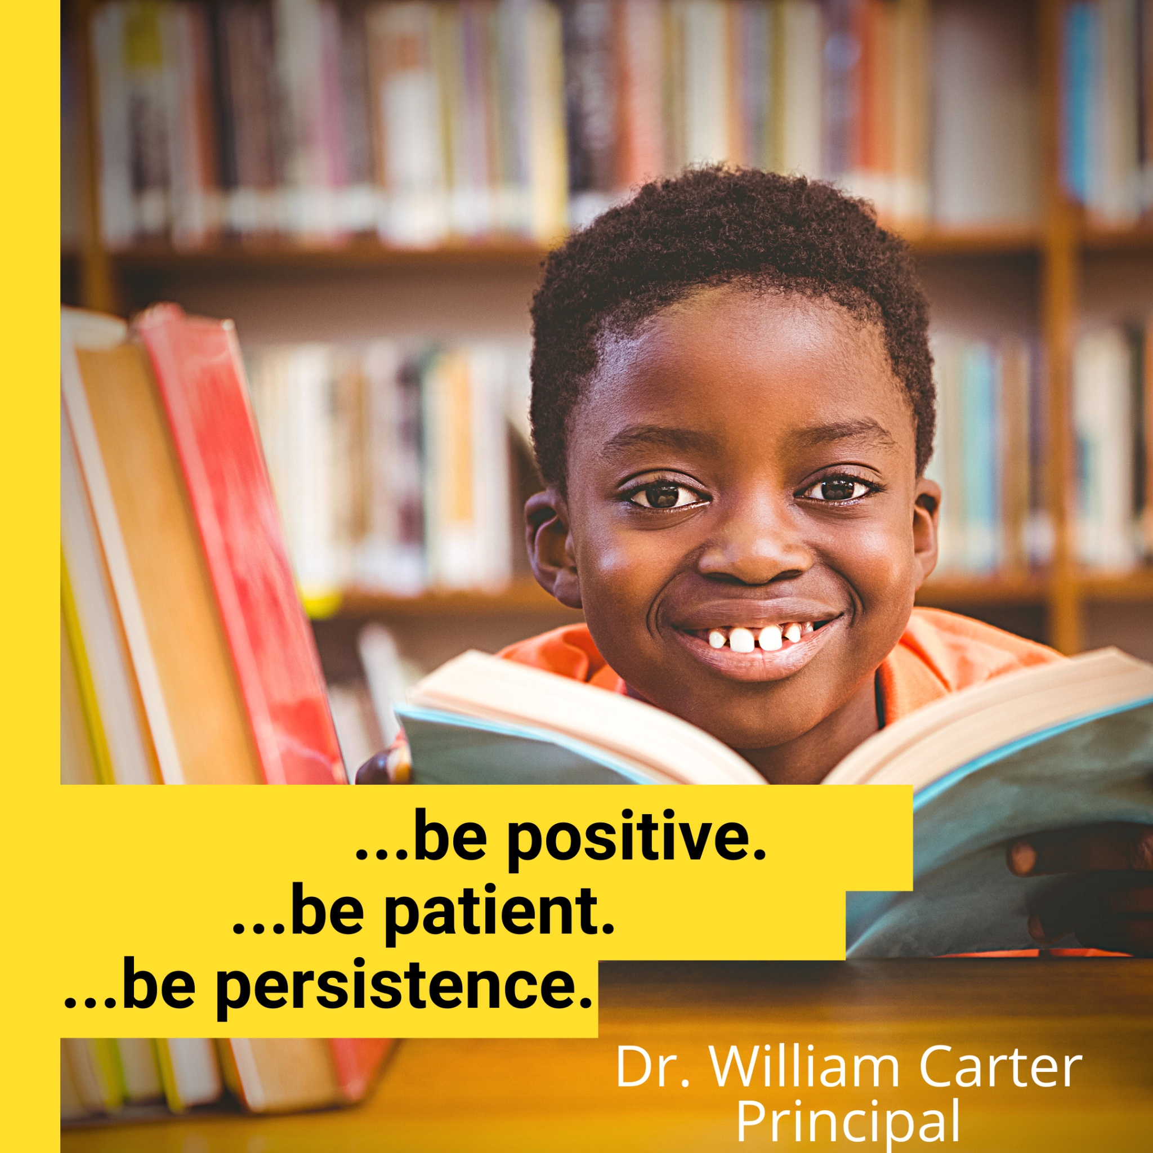

Slide 3

Positive:
"Attitude is a little thing, that makes a big difference."

Slide 4
Patient:
"The greatest power is often simple patience."

Slide 5
Persistent:
"The habit of persistence is the habit of victory."

Slide 6
AGENDA

Slide 7
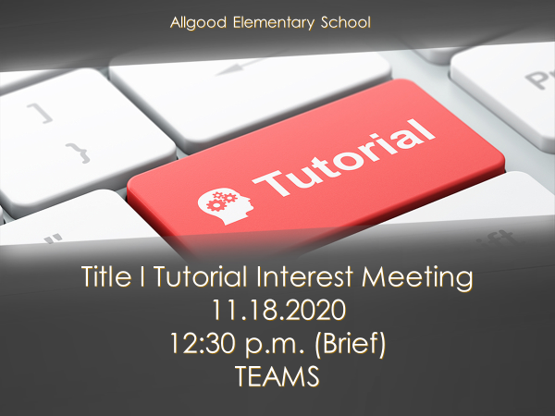

Slide 8


Slide 9


Slide 10
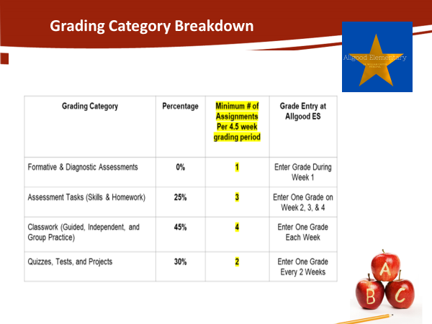

Slide 11
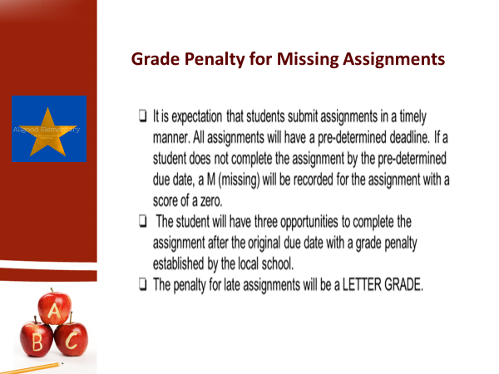

Slide 12


