Slide 1
CSIP Review
Priority Area #1
Collaborative Planning
Allgood Elementary School
Dr. William Carter, Principal
Dr. Lisa Steele Rhymer, Assistant Principal

Slide 2
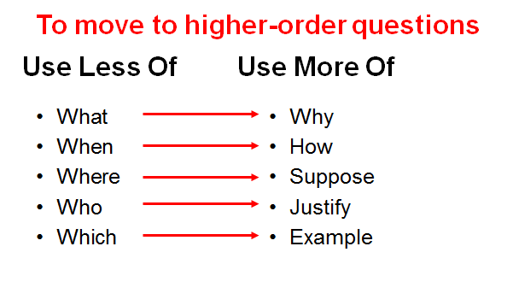
Use More Of…

Slide 3
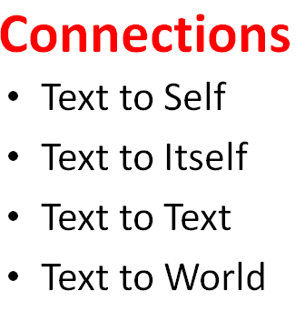
Make Connections…

Slide 4
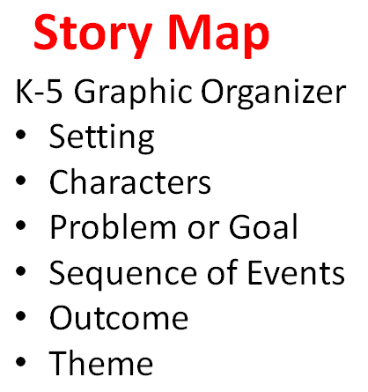
Create Story Maps…

Slide 5
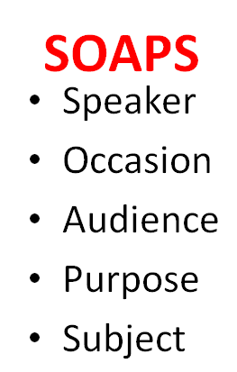
Use SOAPS…

Slide 6
Let’s take 2!

Slide 7
5 Steps to Implementation…

Slide 8
Step #1 Number the Paragraphs
Student should be able to cite and refer to the text. One simple way to do this is by numbering each paragraph, section or stanza in the left-hand margin. When students refer to the text, require them to state which paragraph they are referring to. The rest of the class will be able to quickly find the line being referred to.

Slide 9
Step #2: Chuck the Paragraphs
When faced with a full page of text, reading it can quickly become overwhelming for students. Breaking up the text into smaller sections (or chunks) makes the page much more manageable for students. Students do this by drawing a horizontal line between paragraphs to divide the page into smaller sections.

Slide 10
Step # 3: Underline what is IMPORTANT!
Telling students to simply underline “the important stuff” is too vague. “Stuff” is not a concrete thing that students can identify. Instead, direct students to underline and circle very specific things. Think about what information you want students to take from the text and ask them to look for those elements. What you have students circle and underline may change depending on the text type.

Slide 11
Step #4 Use the Margins.
It isn’t enough to ask students to “write in the margins”. We must be very specific and give students a game plan for what they will write. This is where the chunking comes into play. In the left margin, ask the students to summarize each chunk. Demonstrate how to write summaries in 10-words or less. The chunking allows the students to look at the text in smaller segments and summarize what the author is saying in just that small, specific chunk.

Slide 12
Step #5: Pictures and Questions…
Represent the information with a picture. This is a good way for students to be creative to visually represent the chunk with a drawing.
Ask questions. This has been found to be a struggle for many students, as they often say they don’t have any questions to ask. When modeled, students can begin to learn how to ask questions that dig deeper into the text.

Slide 13
Thank You Teachers!
Dr. Gretchen Jones Torbert
Academic Coach

