Slide 4
COMMUNICATION
Faculty and Staff have participated in meetings regarding the DSCD Re- Entry plan from September2020 to present.
Faculty and Staff also completed district and local school intent to return surveys in the month of October.
Parents and Guardians received information and updates about the DSCD Re-Entry plan in the months of September 2020 to present.
Parents and Guardians also completed the district intent to return survey in October 2020.
All Stakeholders will receive ongoing updates regarding district and local plans for Re-opening Schools.

Slide 7
CDC Guidelines
The Georgia Department of Public Health (DPH) in conjunction with the Georgia Department of Education have released guidance to help schools plan for a safe return to in-person instruction in fall 2020: https://www.georgiainsights.com/recovery.html. DPH recommends schools use this guidance which takes into account local COVID-19 transmission in the community, to make decisions regarding opening for in-person education.
CDC also provides guidance on preventing the spread of COVID-19 in school settings https://www.cdc.gov/coronavirus/2019-ncov/community/schools-childcare/schools.html.

Slide 9
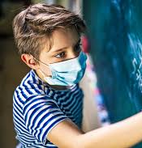
Building Practices:
Mask requirement for all staff/students
Clear partitioners have been placed in the main office and teacher classrooms.
Teachers have been given extra masks, wipes, and cleaning solution for their cleaning stations.
Touchless hand sanitizer stands have been placed on each hall.
Directional signs will be posted throughout the building and on the floors to promote social distancing.
Classroom Practices:
No more than 16 students in a classroom. Social distanced in the classroom.
Hand sanitizers have been placed on each hall, and inside cafeteria doors, and in the front of the building.
Students exhibiting COVID –19 symptoms(Fever, Cough, and Running Nose) will be escorted by designated staff to Nurse Station 2, Room 100.

Slide 10
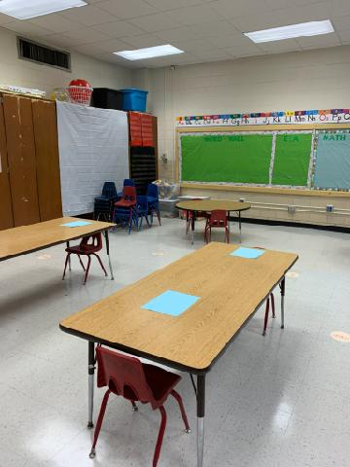
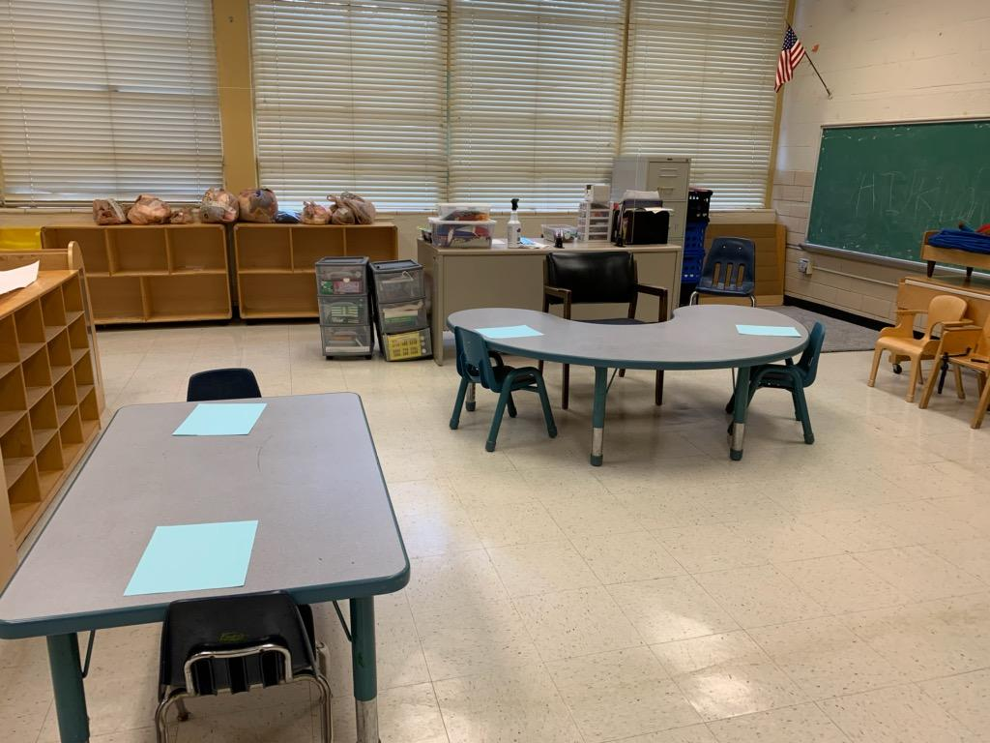
Students at Allgood Elementary School will be assigned to every other seat in the classroom setting to create a “buffer zone” to encourage distance.

Slide 11
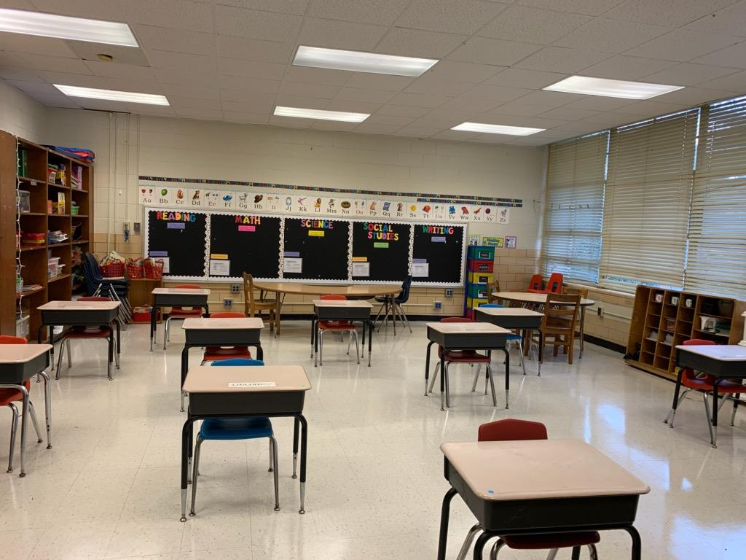
Students at Allgood Elementary School will be assigned to every other seat in the classroom setting to create a “buffer zone” to encourage distance.

Slide 12
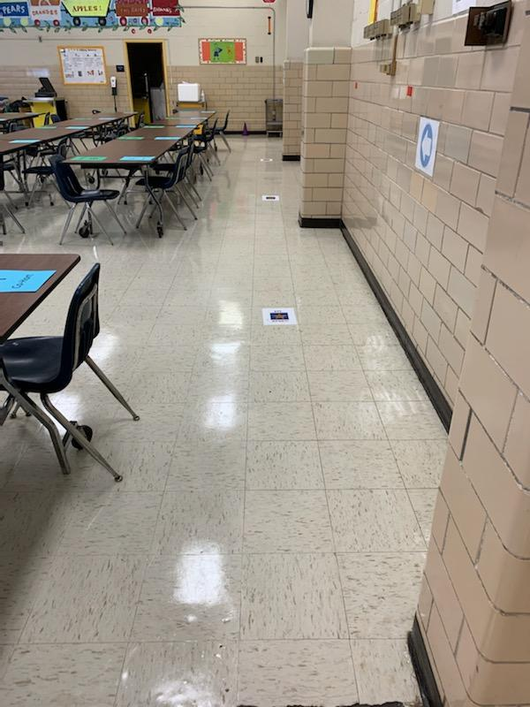
Students at Allgood Elementary School will be assigned to every other seat in the cafeteria to create a “buffer zone” to encourage distance.

Slide 14
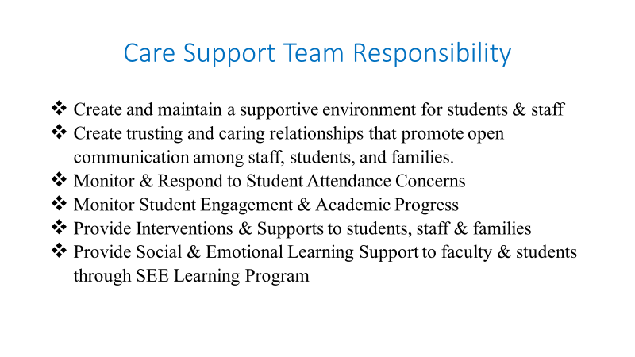
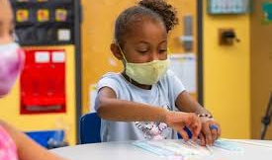

Slide 15
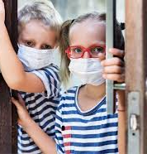
Response to Potential COVID-19
Students exhibiting symptoms of COVID-19 (fever, cough, runny nose) will be escorted to Nurse Station 2, Room 100 by designated staff from the Care Support Team.
Student will remain in Nurse Station 2, Room 100 until their parent pick them up.

Slide 16
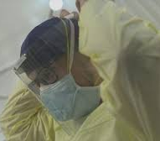
Team Responsibility Tasks
Nurse Station 2, Room 100 for the individual to wait until he/she can leave campus
Nurse Station 2, Room 100
Responsible for getting the individual to Nurse Station 2, Room 100
Care Team Zone Monitor/ Admin
Responsible for getting the individual to Nurse Station 1, Clinic
Care Team Zone Monitor/ Admin
Email Region IV Superintendent
Care Team Zone Monitor/ Admin
Receive guidance from Region IV Superintendent
Administration Team: Dr. Rhymer and Dr. Carter

Slide 19
Emergency Drill procedures will be determined by
the Hybrid or Traditional Instructional Models.

Slide 20
RECESS
Students may have a 15 min. recess period.
During recess:
Students must practice social distancing.
Students must wear a mask.
Students may not play on playground equipment, nor play with other recess equipment (balls, jump ropes, etc.)
Recess Schedule (TBD): To Be Determined

Slide 21
Student Discipline
Students who commit minor discipline infractions, should be addressed by the teacher using a discipline compilation form.
Students who commit major infractions should be immediately addressed by administration.

Slide 22
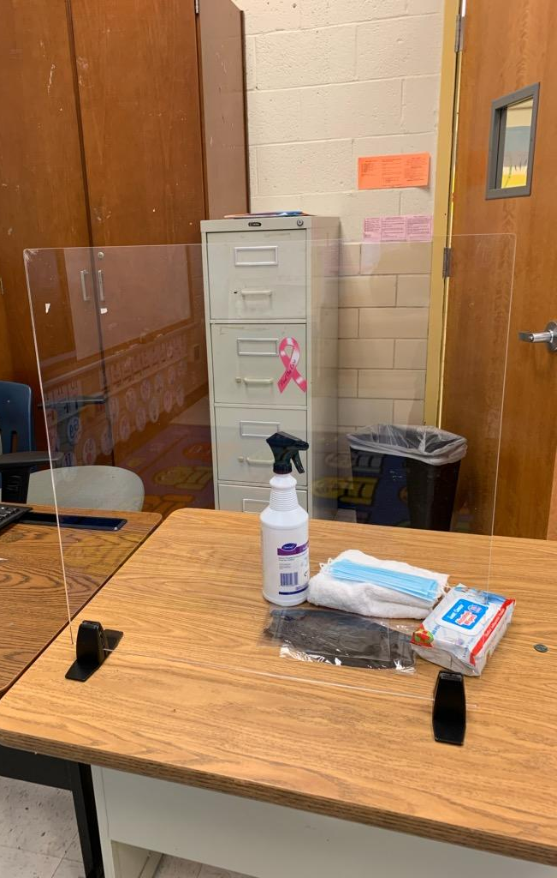
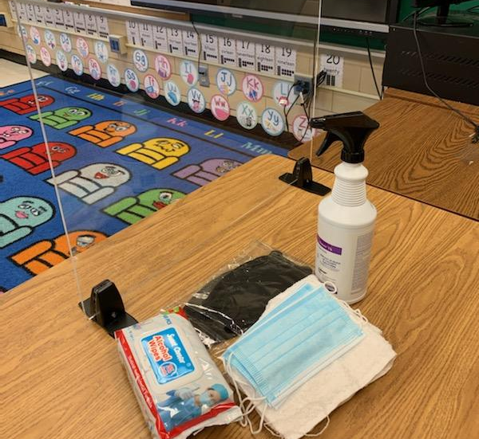
Cleaning
Cleaning from COVID 19 Exposure
CDC Guidance- wipe down all high touch areas with disinfectant
All classrooms disinfected daily.
District has provided cleaning and disinfection products, hand soap, and paper goods.
The custodial team will clean classrooms, office space and frequently touched areas daily.
It is suggested that faculty and staff clean personal workspace areas with disinfectant spray or wipes after use daily.
Faculty and staff should avoid sharing personal work related (chromebooks, desk top computers, etc.) items to reduce the spread of COVID-19.

Slide 23
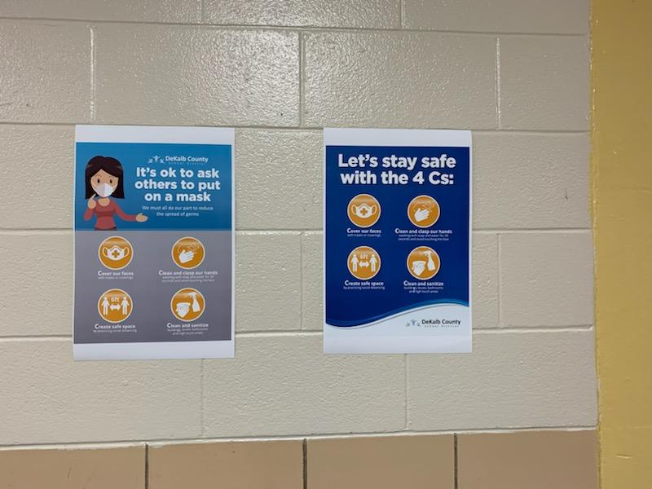
Faculty/ Staff Expectations
Wear a mask
No more than 2 staff members at a time, no congregation.
Practice social distancing-6 feet away from others
Use hand sanitation wipes
Wash hands and/ or sanitize hands often
Door handles and surfaces will be sanitized regularly by custodial staff.
Staff who choose to use the microwave must use sanitation wipes and clean the area after use.

Slide 24
Team Responsibility Tasks
Nurse Station 2, Room 100 for the individual to wait until he/she can leave campus
Nurse Station 2, Room 100
Responsible for getting the individual to Nurse Station 2, Room 100
Care Team Zone Monitor/ Admin
Responsible for getting the individual to Nurse Station 1, Clinic
Care Team Zone Monitor/ Admin
Email Region IV Superintendent
Care Team Zone Monitor/ Admin
Receive guidance from Region IV Superintendent
Administration Team: Dr. Rhymer and Dr. Carter

Slide 26
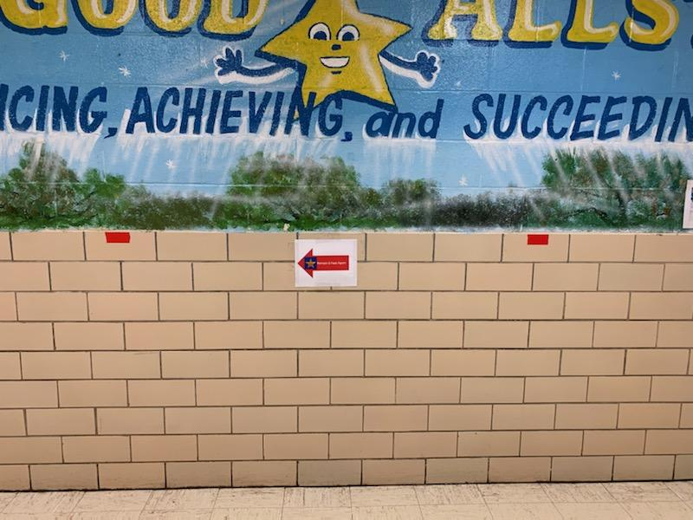
Directional Signage
Signage will be placed on the school entry doors and the office directing visitors to call the school to schedule an appointment.
Allgood will make use of our digital display board in the lobby to display scrolling messages about the importance of safety practices.
Ensure signage is posted in highly visible locations throughout the school to promote daily protective practices
Ensure floor markers for distancing is placed in the halls and other high traffic areas
Display arrows to guide traffic to avoid close contact
All movement will be in one direction, and classes will transition using a staggered schedule.

Slide 27
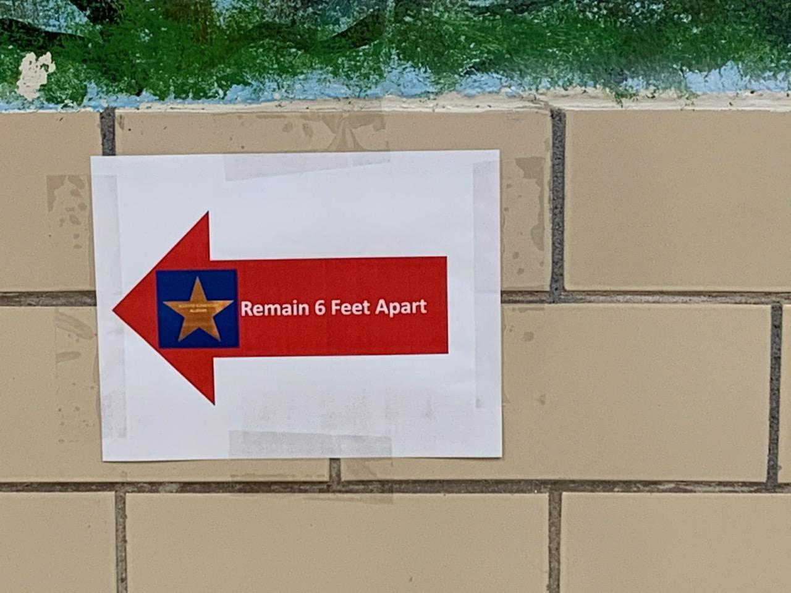

Slide 28
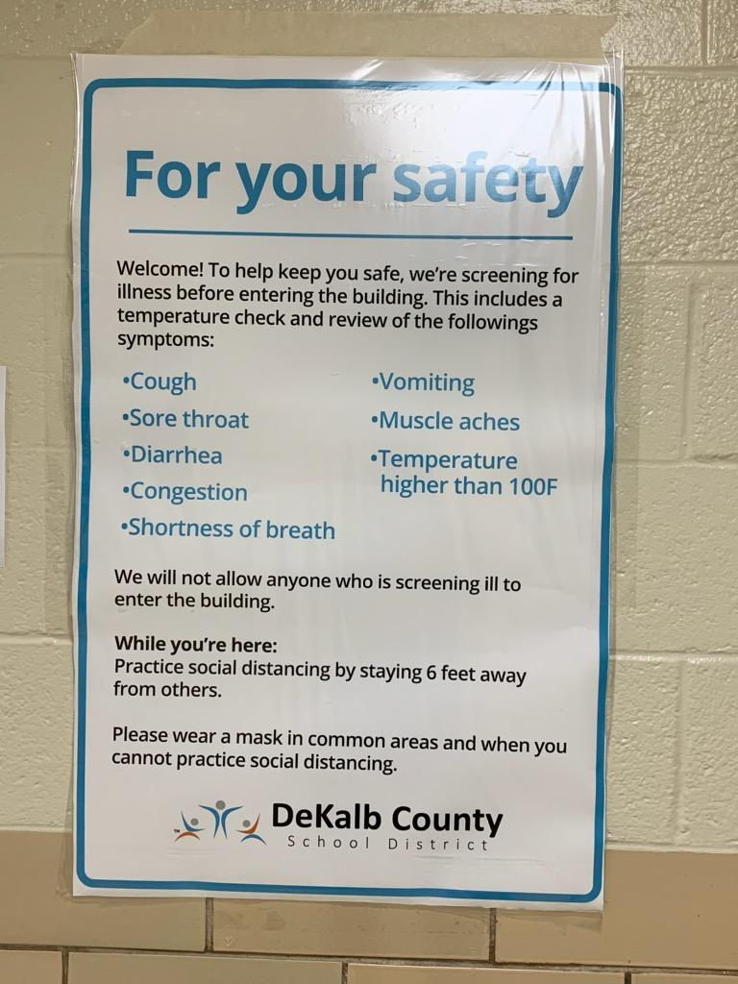
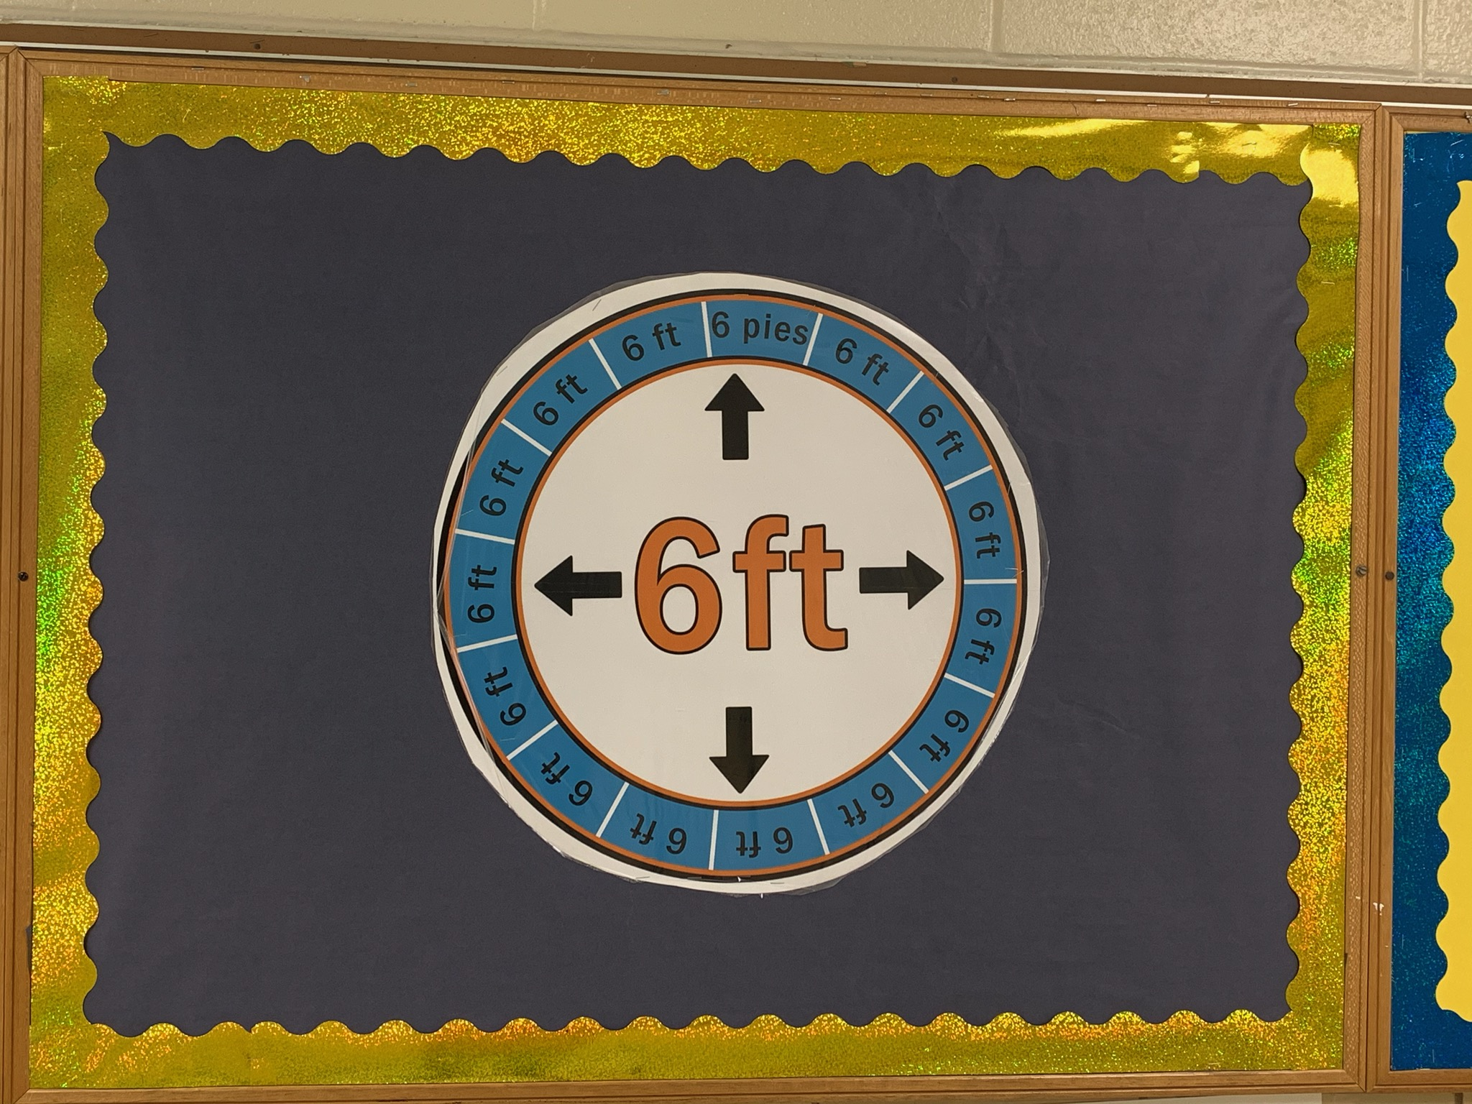

Slide 30
Head Custodian: 5:30 a.m.
Administration: 7:00 a.m.
Paraprofessionals: 7:00 a.m.-3:30 p.m.
Teachers: 7:00 a.m.- 3:00 p.m.

Slide 31
Morning Door Entry for Staff
Front Entrance: Administration , Custodians, Cafeteria Staff, Front Office Staff, Pre- K , Kindergarten Teachers, LTSE and School Psychologist
Side Entrance (Near Nurse’s Office): 1st and 2nd Grade Teachers
Bus Loading Lane: Counselors
Fifth Grade Breeze Way Doors: Specials Teacher, Media Specialist, Grades: 3, 4 and 5 Teachers, and ESOL Teachers

Slide 32
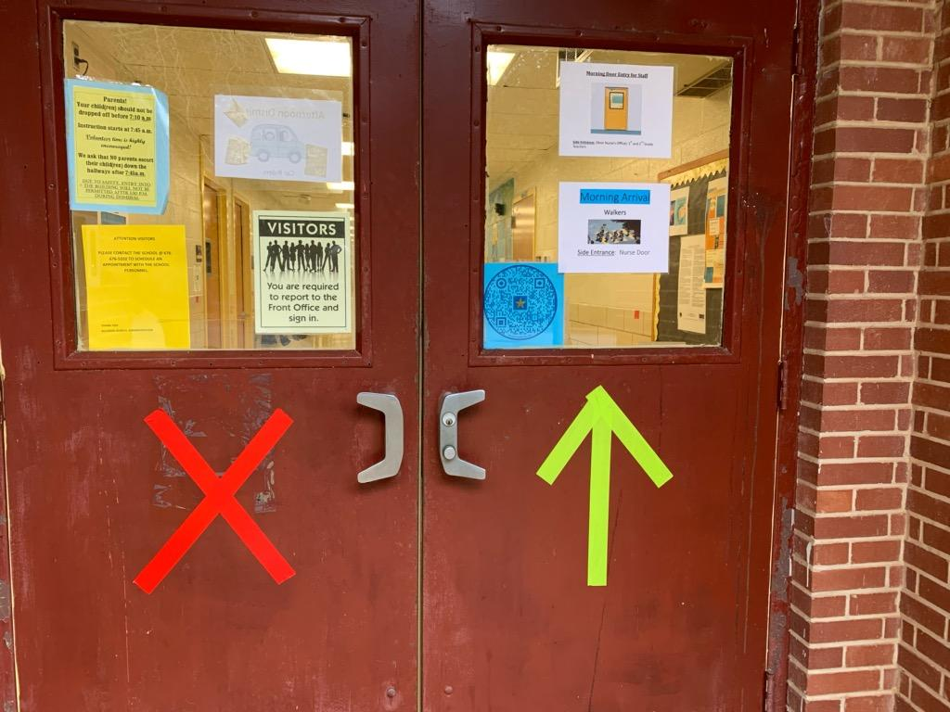
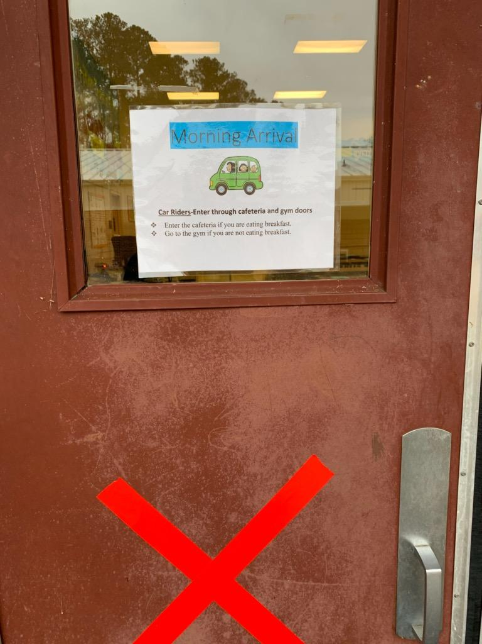
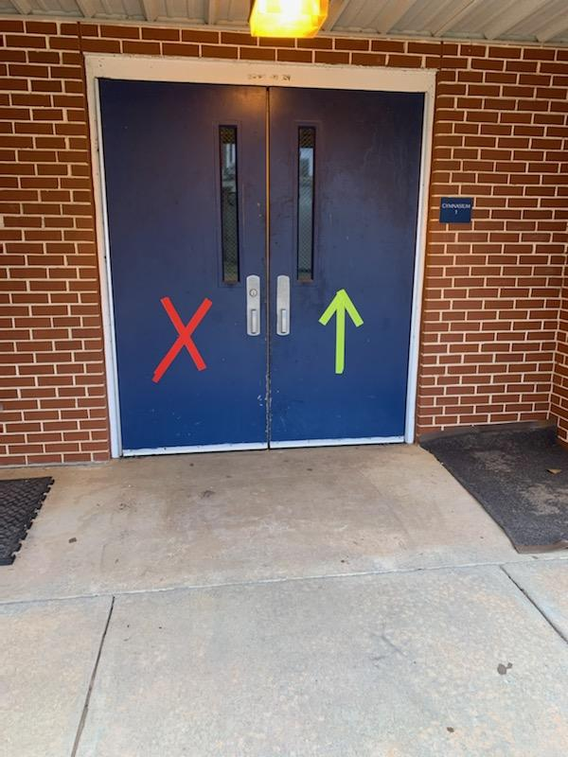
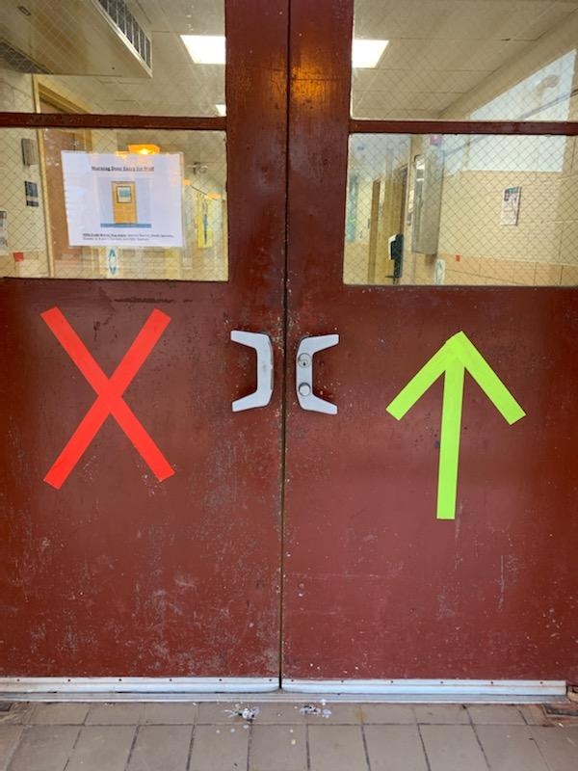
Green Arrow Means: Enter Red X Means: Do Not Enter

Slide 33
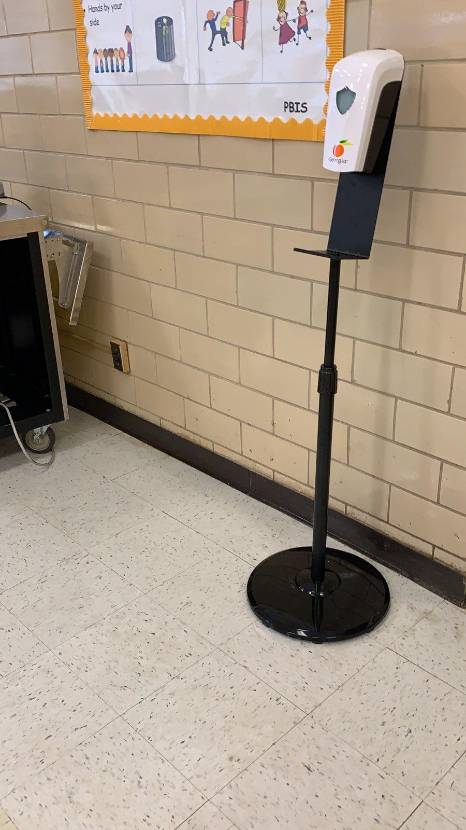
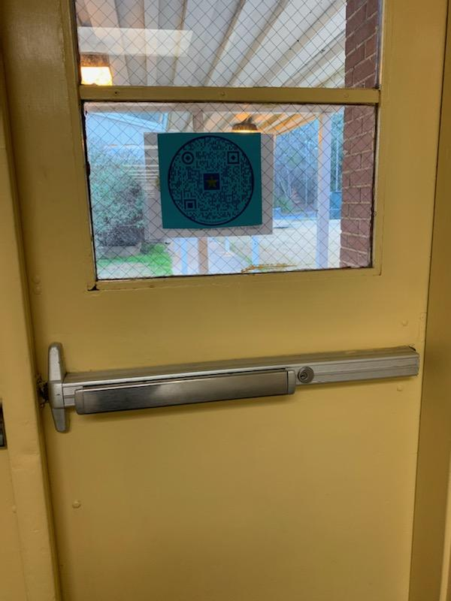
QR CODE:
Faculty/ Staff
Entering the Building
Hands Free Sanitizer Station

Slide 34
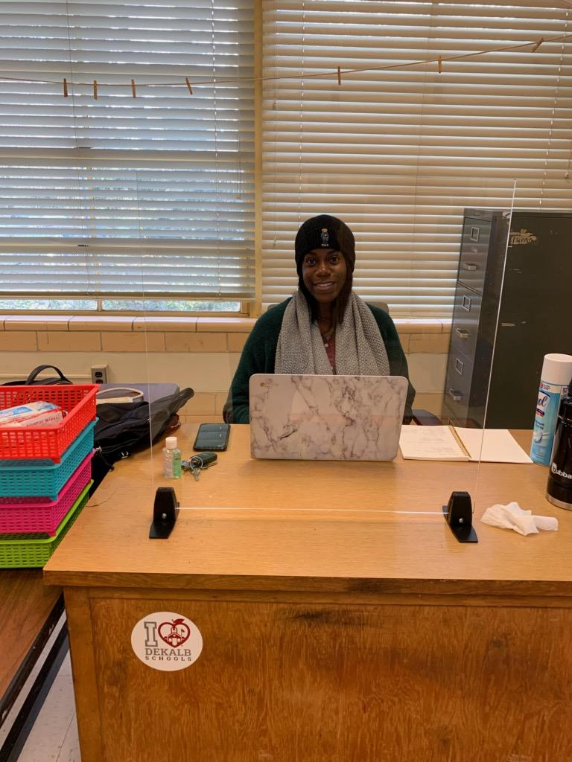
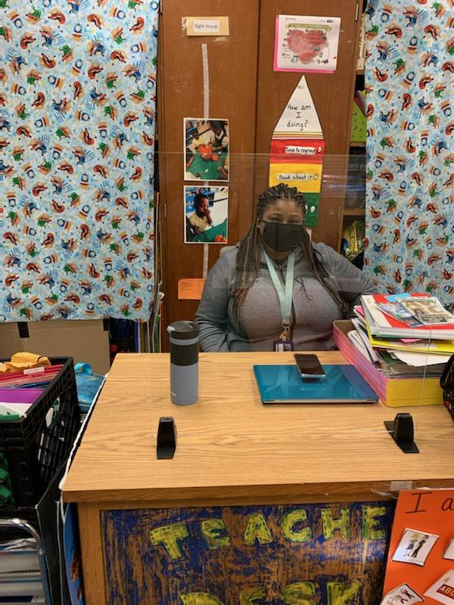

Slide 35
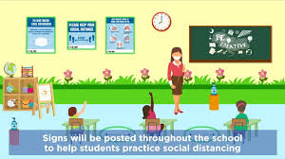
(Tentative)Hybrid Group Reporting Schedule
Cohort A reports on Monday and Tuesday.
Cohort B reports on Thursday and Friday.
Both Hybrid Groups are remote on Wednesday.

Slide 36
School starts at: 7:45 a.m. - Dismissal is at: 2:10 p.m.

Slide 37
Virtual LEARNING Schedule Elementary Grades Pre K – 5 (Allgood Elementary School)
Wednesday |  | Time | Monday/Thursday | Tuesday/Friday
Student Conferencing (Tutoring, Intervention Support, Small Groups, etc.) Parent Conferencing Parent Workshops Additional Meetings IEP MTSS 504 EL Professional Learning for Leaders and Teachers Instructional and Collaborative Planning (30 minute- Grade Level Session) (Academic Coach /Administration Lead) Wednesday’s Schedule will be provided. |  | 7:45 am – 8:30 AM | Staff Sign-on Attendance & Announcements/ Student Check-In
 |  | 8:30 am – 8:45 am | Technology Check, Gather Materials & Login (Planning)
 |  | 8:45 am – 9:00 am | School Pride, Announcements, Etc.
 |  | 9:00 am – 9:40 am | Morning Tutorial/ Extended Learning Time
 |  | 9:45 am – 10:30 am | Math | Math
 |  | 10:30 am – 10:40 am | Technology Check, Gather Materials & Login (Planning)
 |  | 10:40 am – 11:25 am | ELA – Reading/Writing | ELA – Reading/Writing
 |  | 11:25 am – 11:35 am | Technology Check, Gather Materials & Login (Planning)
 |  | 11:35 am – 12:20 pm | Science | Social Studies
 |  | 12:20 pm – 1:05 pm | Lunch Technology Check, Gather Materials & Login(Planning)
 |  | 1:05 pm – 1:50 pm | Specials | Specials
Considerations:
LIVE sessions will occur daily based upon the provided schedule.
LIVE sessions will occur the first 20 minutes of each class period.
The principal and/or designee will determine the specials breakout for each grade-level for the instructional block.
Allgood Elementary School Dr. William Carter- Principal Dr. Lisa Rhymer Steele- Assistant Principal
Notes:
This slide shows the LIVE Learning Sessions grades 3-5.
As in K-2, the same schedule is followed on Mondays and Thursdays with a slightly different schedule followed on Tuesdays and Fridays.
Breakfast, lunch, technology check times, and school pride time is also built in to the 3-5 schedule.
Extended learning time is from 9:00 – 9:40 and will be determined at the school level based on student need.
Monday and Thursday's instructional blocks include Math, ELA Reading and Writing, Science, and Specials. On Tuesdays and Fridays, the social studies block takes the place of science.
The principal or designee will determine the specials break—out schedule for each grade level.
Note that a designated 45 minutes lunch time is built in.
In grades 3-5, LIVE, synchronous sessions will occur during the first 20 minutes of each class period. The remainder of the period can be designed around synchronous and asynchronous work done independently, in pairs, or in small groups.
Wednesdays are again reserved for student and parent conferencing, meetings, Professional Learning, and collaborative planning.

Slide 38
Hybrid/ Transitional Schedule Allgood Elementary School 2020-2021 Master Schedule
Kindergarten | First Grade | Second Grade | Third Grade | Fourth Grade | Fifth Grade
7:50-8:10 (D.E.A.R.) | 7:50-8:10 (D.E.A.R.) | 7:50-8:10 (D.E.A.R.) | 7:50-8:35 (Specials) | 7:50-8:10 (D.E.A.R.) | 7:50-8:10 (D.E.A.R.)
8:10-9:20 (Reading) | 8:10-9:20 (Reading) | 8:10-8:40 (Science) | 8:40-10:50 (Math/Science-Richardson/Ziblim) 8:40-10:50 (Reading/ELA/Social Studies-Payne/Washington) **SWITCH CLASSES** | 8:10-9:25 (Math/Science-Casurra/Ellison) 8:10-9:25 (Reading/ELA/Social Studies-Clarke/McCray) | 8:10-8:35 (Math/Science-Moore/Reid) 8:10-8:35 (Reading/ELA Social Studies-Jackson/Kirk-Brown)
9:20-10:20 (Math) | 9:20-10:20 (Math) | 8:40-9:10 (Social Studies) | 10:55-11:15 (Math/Science-Richardson/Ziblim) 10:55-11:15 (Reading/ELA/Social Studies-Payne/Washington) | 9:30-10:15 (Specials) | 8:40-9:25 (Specials)
10:25-11:10 (Specials) | 10:25-11:04 (Lunch) | 9:10-10:20 (Reading) | 11:15-11:30 (Recess | 10:20-11:00 (Continue Math/Science-Casurra/Ellison) 10:20-11:00 (Continue Reading/ELA/Social Studies-Clarke/McCray) | 9:30-10:55 (Continue Math/Science-Moore/Reid) 9:30-10:55 (Continue Reading/ELA/Social Studies-Jackson/Kirk-Brown) **SWITCH CLASSES**

Slide 39
11:15-11:53 (Lunch) | 11:10-11:40 (Science) | 10:20-10:30 (ELA & Writing) | 11:35-12:12 (Lunch) | 11:05-11:41 (Lunch) **SWITCH CLASSES** | 11:00-11:50 (Math/Science-Moore/Reid) 11:00-11:50 (Reading/ELA/Social Studies-Jackson/Kirk-Brown)
11:55-12:35 ELA & Writing | 11:40-11:55 (Recess) | 10:30-10:45 (Recess) | 12:20-2:05 (Continue Math/Science-Richardson/Ziblim) 12:20-2:05 (Continue Reading/ELA/Social Studies Payne/Washington) | 11:45-1:45 (Math/Science-Casurra/Ellison) 11:45-1:45 (Reading/ELA/Social Studies Clarke/McCray) | 11:55-12:32 (Lunch)
12:35-1:05 (Social Studies) | 12:00-12:30 (Social Studies) | 10:50-11:27 (Lunch) |  | 1:45-2:00 (Recess) | 12:40-12:55 (Recess)
1:10-1:25 (Recess) | 12:30-1:05 (ELA & Writing) | 11:35-12:05 (ELA & Writing) |  |  | 1:00-2:00 (Continue Math/Science-Moore/Reid) 1:00-2:00 (Continue Math/Science-Moore/Reid)
1:30-2:00 (Science) | 1:10-1:55 (Specials) | 12:10-12:55 (Specials) 1:00-2:00 (Math)

Slide 40
Morning Arrival
Note: Students not eating breakfast should report directly to their classroom.
Breakfast will be grab and go.
Morning Tutorial: 7:20-7:40am
Mornings Announcements:
7:45-7:55am
D. E. A. R./ELT Time: 7:55am
Morning Arrival Entrances
Car Riders-Enter through cafeteria and gym doors
Bus & Van Riders-Students will exit off the bus in a staggered fashion and enter the building one bus at a time through the bus lane entrance.
Walkers- Enter through the side door( Nurse Office)
Parents: Will not be allowed to enter the building during Morning and Afternoon transitions.

Slide 41
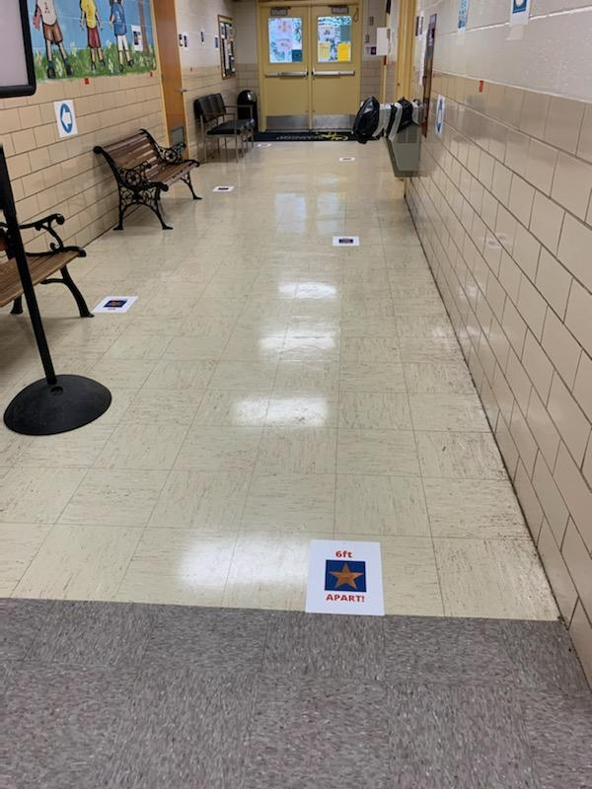
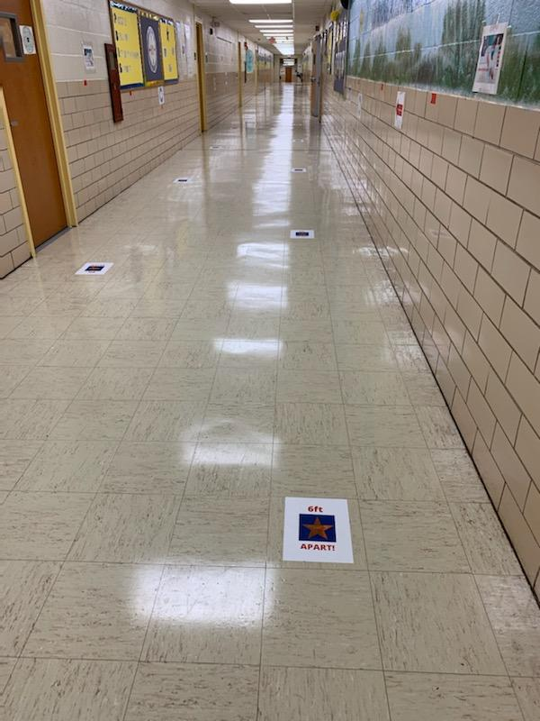

Slide 42
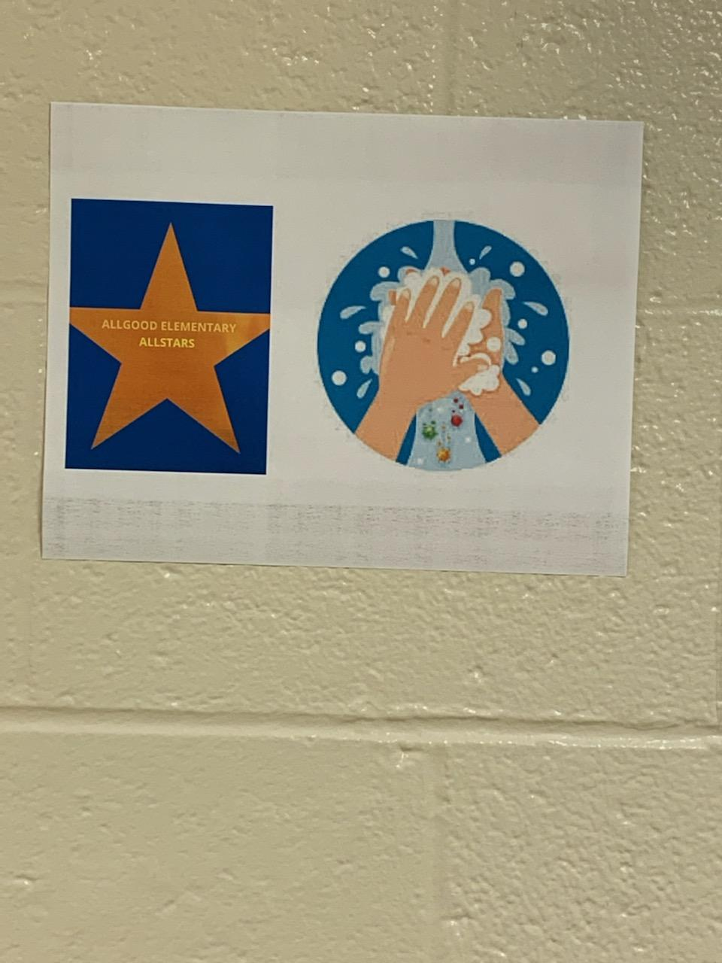
Students will follow directional signs posted in the halls.
1
Students will use floor markers for spacing.
2
Each homeroom class will use a staggered restroom schedule.
3
Only two students will be permitted to use the restroom at one time.
4
Students should only use grade level restrooms.
Water fountains will be covered.
5
Students will bring bottles of water from home.
6

Slide 43
Grades 3-5 Class Transition
Students in grades 3-5 will not change classrooms.
Teachers will report to each classroom according to the transition schedule.

Slide 44
Art and Music will not transition. Teachers will report to the classrooms.
Homeroom teachers will have designated transition routes.

Slide 45
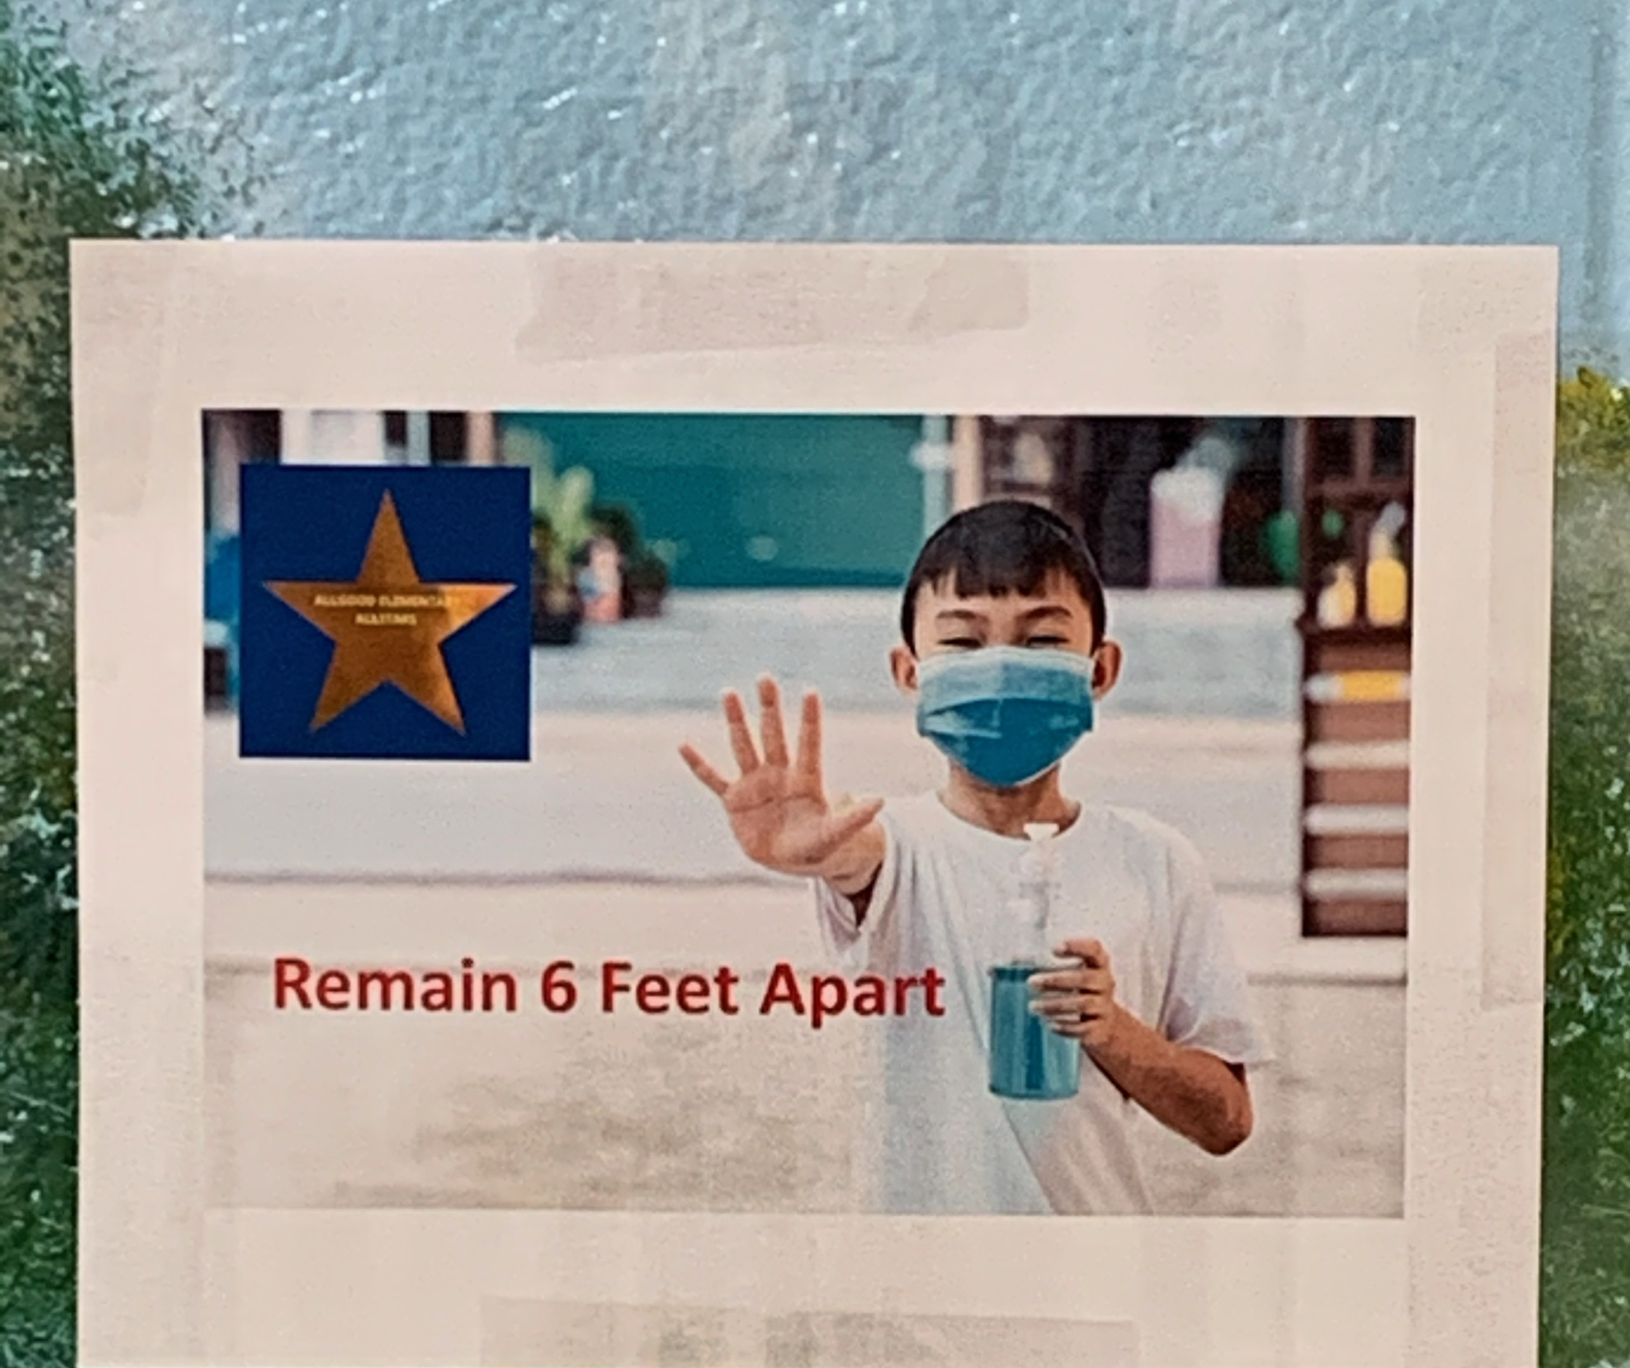
LUNCH TRANSITIONS
The Lunch rotation will be on a staggered schedule.
*Only one class per grade level will be allowed to eat in the cafeteria during their scheduled lunch period.
Lunch monitors will be on duty to provide teachers with a duty- free lunch.
Homerooms will rotate weekly taking turns to eat in the cafeteria.
All other homerooms will eat in their classrooms.
Lunch will be grab-and-go.
Students will transition to the cafeteria following the directional signs posted and by using the floor markers spacing them apart.
One door will be used for entry, and one door will be used for exiting the cafeteria.
*This will be on a trial basis. Adjustments will be made as administration deems appropriate

Slide 46
Afternoon Dismissal
Afternoon dismissal will be staggered.
Car Riders, Bus Riders, Nursery Van Riders, and Walkers will have a staggered schedule.
All hall transitions will be in one direction.
Signs and staff will guide this practice.
All duty personnel will have an assigned zone to monitor.

Slide 48
Late Check-In Procedures (After 7:45 a.m.) Parents should escort the student(s) to the front door entrance. Parents should ring the door-bell and wait for a response from the front office. Only the student(s) will be permitted to enter into the building. The front office will mark the student(s) present and provide a tardy pass to class.
Check-Out Procedures Prior to picking up the student(s) for early check out, the parent/guardian are required to notify the school. The front office will notify the teacher of the early dismissal. The student will remain in class until called to the front office for dismissal. The student will report to the front office to be checked out for early dismissal.

Slide 49
QR CODE:
Parent Assistance Form

Slide 50
