Slide 1
SWD General Ed. Special Ed.
Allgood Elementary School
Dr. William Carter, Principal
Dr. Lisa Steele Rhymer, Assistant Principal

Slide 2
AGENDA
Review of Target Scenarios
(3% goals for SWD)- Dr. Torbert
Review iReady, Education Galaxy, and Benchmark Data- IRR Teachers
Tutorial and Thanksgiving Packet update-
IRR Teachers
Winter Packet guidelines-
Dr. Rhymer & Dr. Carter
Study Guide Overview- Dr. Allen
Upcoming: "Co-Teaching in the Virtual Environment"- Dr. Allen
Tentative Meeting Schedule-
Dr. Allen
Next Steps- Dr. Carter & Dr. Rhymer

Slide 3
Targeted Goals

Slide 4
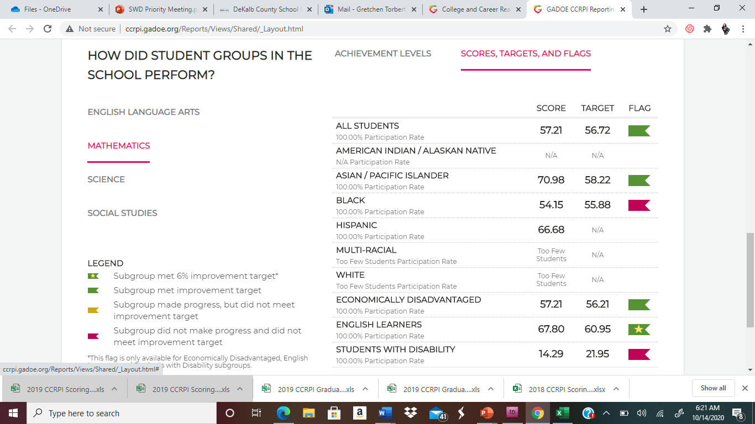
Mathematics: Content Mastery

Slide 5
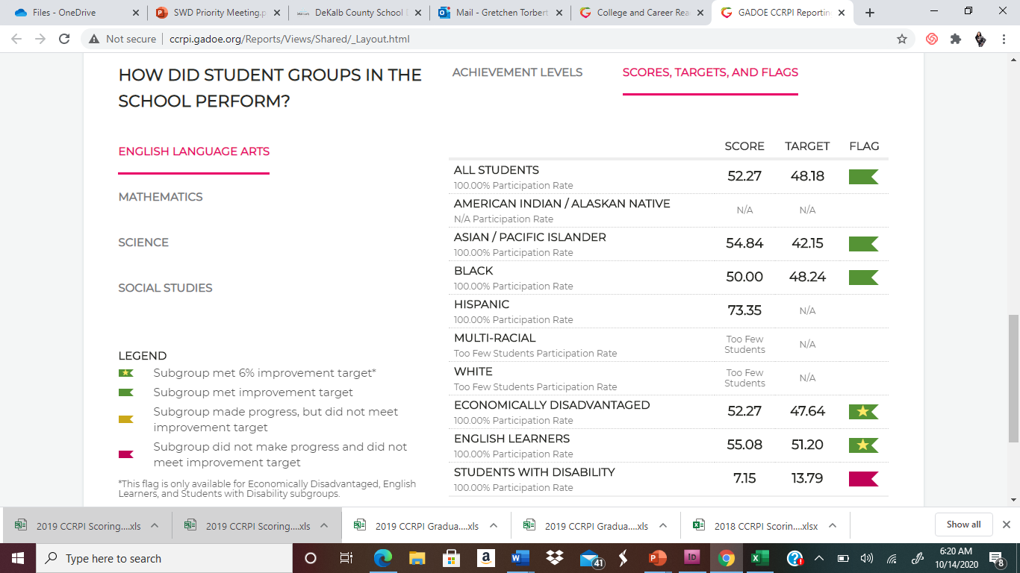
English Language Arts: Content Mastery

Slide 6
Content Mastery: Areas of Concern

Slide 7
3% Achievement Improvement Targets: Content Mastery

Slide 8
Content Mastery Calculation

Slide 9
Content Mastery is 30%

Slide 10
Stretch “Lexile Bands

Slide 11
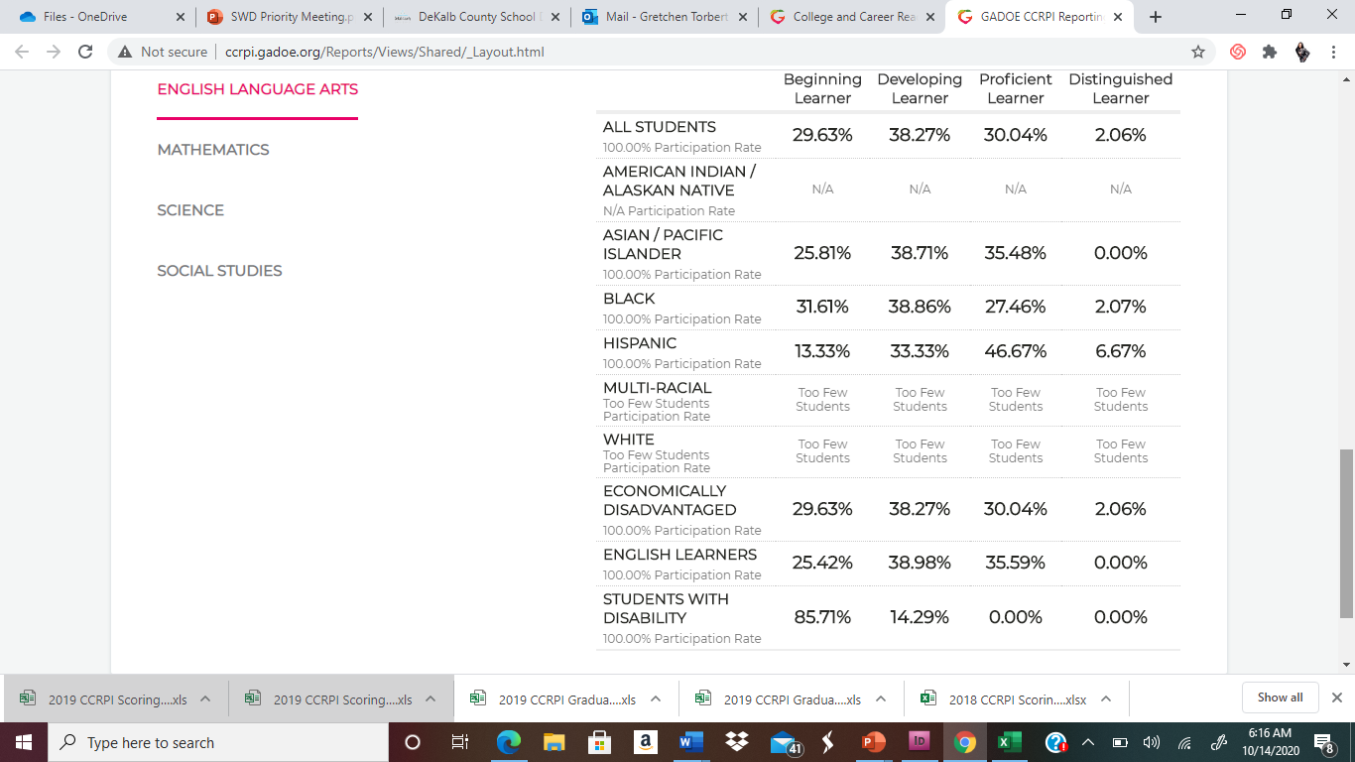
English Language Arts:
SWD Achievement Levels

Slide 12
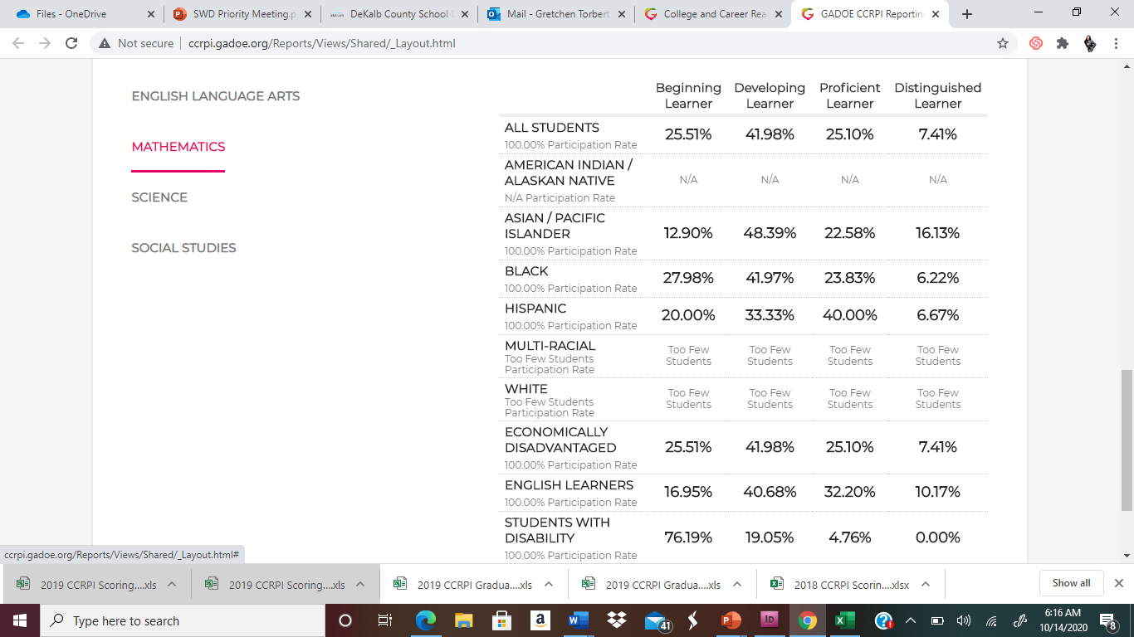
Mathematics: SWD Achievement Levels

Slide 13
GA Milestone Data 2018-2019
W. Crumbley- ELA-384; Math- 401; Lexile: 290 (1st Grade)
R. Fevrier- ELA- 506; Math-476; Lexile: 685 (3rd Grade)
S. Mathis- ELA- 408; Math- 445; Lexile: 330 ( 1st Grade)
S. Sheppard- ELA-451; Math-458; Lexile: 475 (2nd Grade)
A. Sims- No scores reported
J. Wauford- ELA-408; Math- 461; Lexile: 370 (1st Grade)
B. Wolde- ELA-434; Math-436; Lexile: 370 (1st Grade)
Anonymous Student-ELA-N/A; Math-Proficient, Lexile: N/A

Slide 16
LEADING MAP and 2020 NORM DATA
Name | Math | Reading | ELA
Willie Crumbley | 1981 RIT/ 29 Percentile Low Average | 179 RIT/ 7 Percentile Low | 178 RIT/ 4 Percentile Low
Roody Fevrier | 195 RIT/ 23 Percentile Low Average | 187 RIT/ 17 Percentile Low | 187 RIT/ 14 Percentile Low
Shane Mathis | 166 RIT/ 1 Percentile Low | 157 RIT/ 1 Percentile Low | 157 RIT/ 1 Percentile Low
Shun'tavius Sheppard | 189 RIT/ 13 Percentile Low | 189 RIT/ 20 Percentile Low | 185 RIT/ 11 Percentile Low
Adonis Sims | 166 RIT/ 1 Percentile Low | 172 RIT/ 3 Percentile Low | 172 RIT/ 2 Percentile Low
Javaris Wauford | 206 RIT/ 50 Percentile Average | 179 RIT/ 7 Percentile Low | 181 RIT/ 6 Percentile Low
Biniyam Wolde | 180 RIT/ 4 Percentile Low | 185 RIT/ 14 Percentile Low | 181 RIT/ 6 Percentile Low

Slide 17
Name | Math-Move 3-Possibilities for 3%. | ELA- Move 3 Possibilities for 3%.
Willie Crumbley | Developing | Sustain or Move
Roody Fevrier | Developing-Proficient | Developing-Proficient
Shane Mathis | Sustain or Move to Proficient | Sustain or Move
Shun'tavius Sheppard | Developing | Developing
Adonis Sims | No Scores | No Scores
Javaris Wauford | Sustain or Move to Proficient | Developing
Biniyam Wolde | Developing | Sustain or Move
Anonymous Student | No Scores Proficient | No Scores

Slide 19
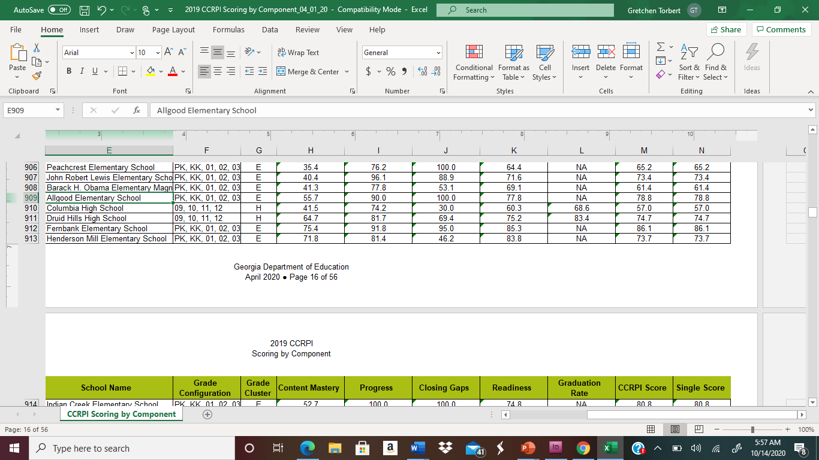

Slide 20
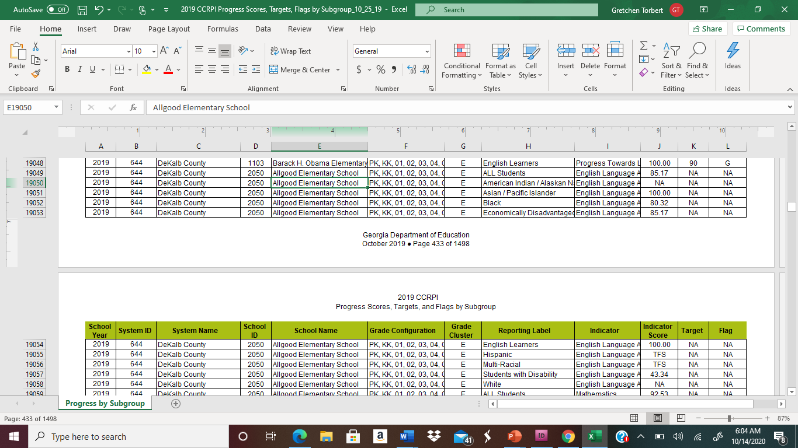

Slide 21
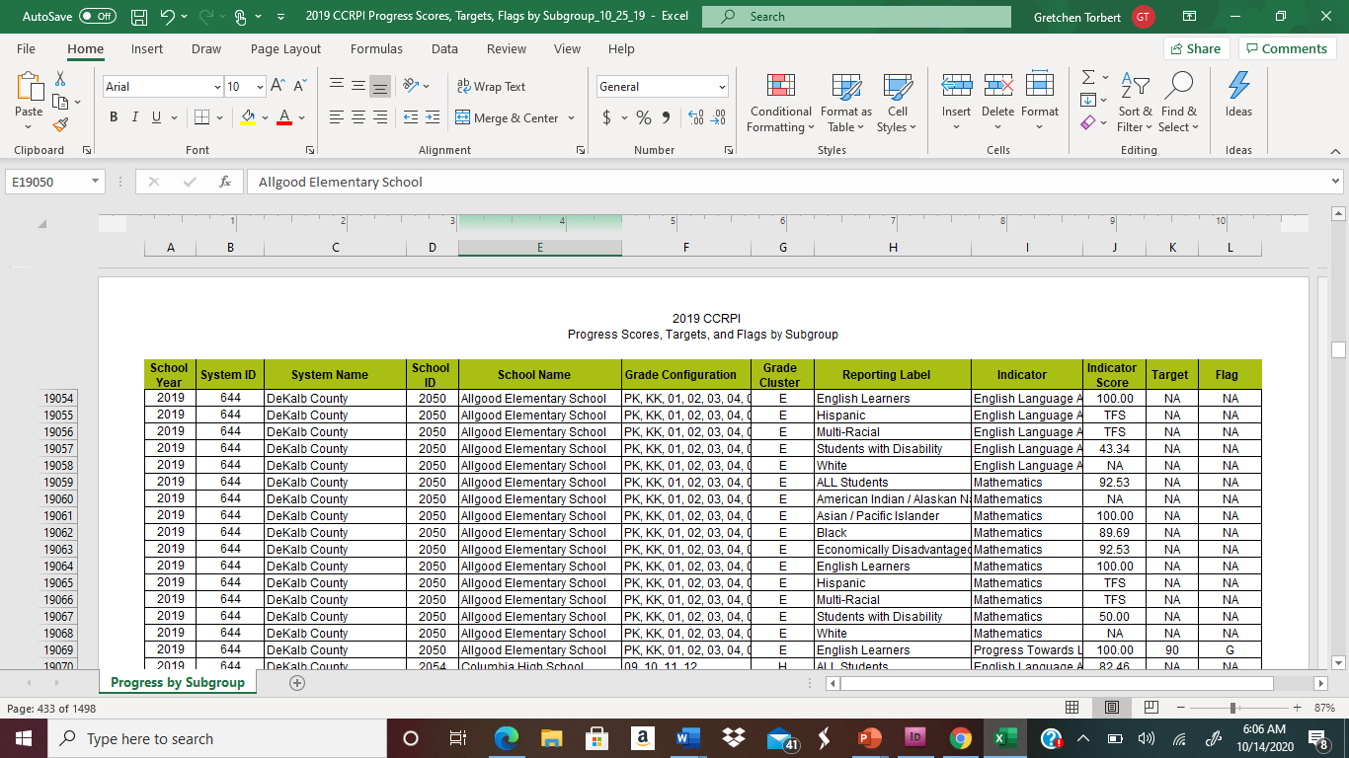

Slide 22
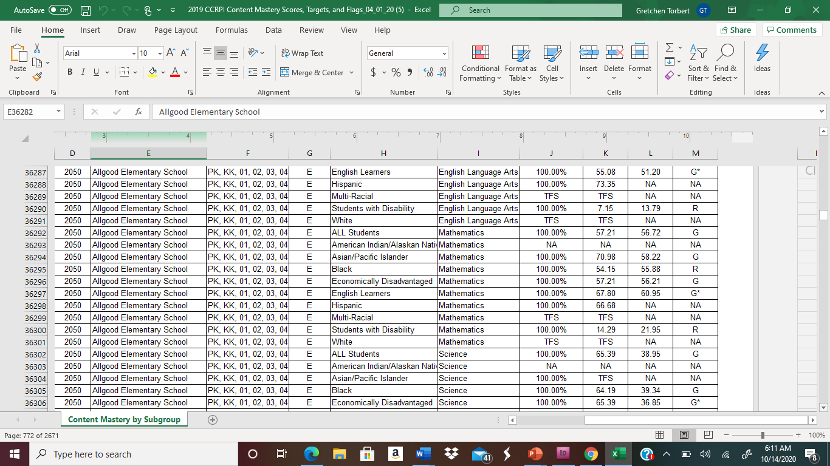

Slide 23
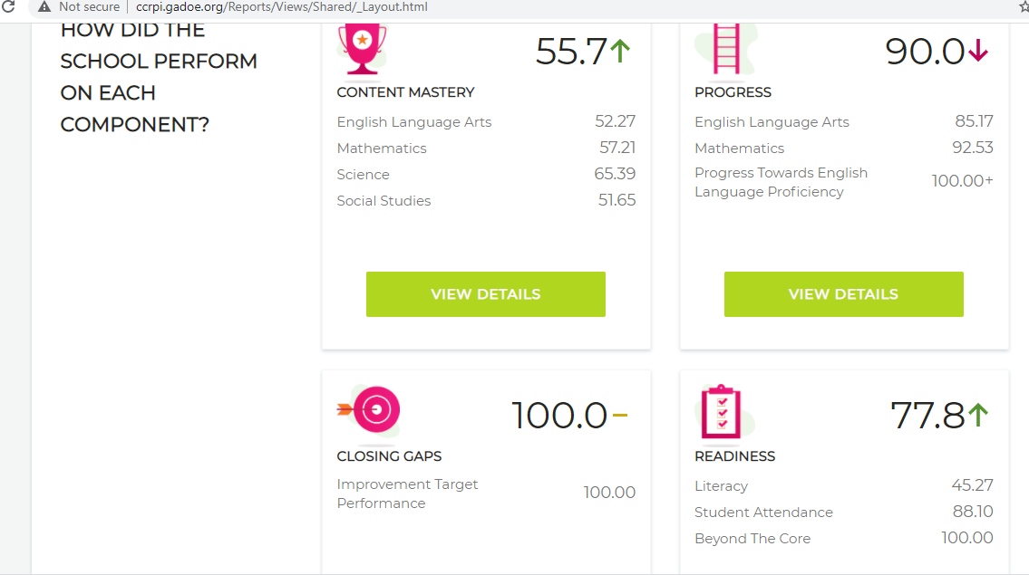

Slide 24
2019 Georgia Milestone Testing Lagging Data Scenario No#1 Move 2 students to Proficient Level divided by 7 (no# of students) times 100 is 28.57 Target for Mathematics. Move 2 students to Proficient Level divided by 7 (no# of students) times 100 is 28.57 Target for English Language Arts. Flag Weight: 1.0 Proficient Level for 3%.

Slide 25
2019 Georgia Milestone Testing Lagging Data Scenario No#2 Move 4 students to Developing Level divided by 7 (no# of students) times 100 is 28.57 Target for Mathematics. Move 4 students to Developing Level divided by 7 (no# of students) times 100 is 28.57 Target for English Language Arts. Flag Weight: 0.5 Developing Level for 3%.

Slide 26
2021 Georgia Milestone Testing Leading Data Scenario No#2 Move 8 students to Developing Level divided by 15 (no# of students) times 100 is 53.33 Target for Mathematics. Move 8 students to Developing Level divided by 15 (no# of students) times 100 is 53.33 Target for English Language Arts. Flag Weight: 0.5 Developing Level for 3%.

Slide 27
Our Fantastic 15!- Move 8 SWD 2021 3% Data
3rd-
Chloe Costa: M-181, R-169, LU-165
Samad Imani- No Scores
Andrew Pitt: M-176, R-176, LU-160
4th-
Troy Hunt: M-170, R-162, LU-147
Snow Klay: M-192, R-173, LU-174
Kevin Mayo: M-187, R-175, LU-165
Emmanuel Prieto: M-191, R-177, LU-177
Dya'moni Spears: M-179, R- 184, LU- 188
5th-
Willie Crumbley: M-209, R-176, LU- 179
Janiya Easley: M-172, R-173, LU-175
Roody Fevrier: M-194, R- 172,LU- 159
Shane Mathis: M-170, R-158, LU- 162
Shun'tavius Sheppard: M-187, R- 183, LU-189
Javaris Wauford: M-183, R-183, LU-170
Biniyam Wolde: M-183, R- 183, LU- 188

Slide 28
2019 Georgia Milestone Testing Lagging Data Scenario No#3 Move 3 students to Developing Level/ Move 1 to Proficient divided by 7 (no# of students) times 100 is 35.71 Target for Mathematics. Move 3 students to Developing Level/ Move 1 to Proficient divided by 7(no# of students) times 100 is 35.71 Target for English Language Arts. Flag Weight: 0.5 Developing Level / 1. 0 Proficient Level for 3%.

Slide 29
GADOE Resource
https://uat.gadoe.org/Curriculum-Instruction-and-Assessment/Accountability/Documents/Resdesigned%20CCRPI%20Support%20Documents/2018%20CCRPI%20Elementary%20Calculation%20Guide%207.18.18.pdf
https://www.gadoe.org/Curriculum-Instruction-and-Assessment/Assessment/Documents/Milestones/Content%20Weights/ContentWeights_EOGCharts_August_2019.pdf
http://www.ucschools.org/UserFiles/Servers/Server_5229565/File/Testing/EOG%20Score%20Interpretation%20Guide.pdf
http://www.ucschools.org/UserFiles/Servers/Server_5229565/File/Testing/EOG%20Score%20Interpretation%20Guide.pdf
https://uat.gadoe.org/Curriculum-Instruction-and-Assessment/Accountability/Documents/Resdesigned%20CCRPI%20Support%20Documents/2018%20CCRPI%20Elementary%20Calculation%20Guide%207.18.18.pdf

