Slide 1
SWD Collaborative Planning Meeting #4
Allgood elementary school
Every wednesday at 1:30 pm
Dr. William Carter, principal
Dr. Lisa steele Rhymer, Assistant principal

Slide 2
Committee Members
Dr. William Carter, Principal
Dr. Lisa Steele Rhymer, Assistant Principal
Dr. Nicole Allen, LTSE
Dr. Gretchen Jones Torbert, Academic Coach
Special Education Department
Ms. Francis Cook, Counselor
Mr. Charles Lightner, Part Time Counselor
Ms. Jonetta Myles, Student Support Specialist
Title 1 Part-Time Teachers
Mr. Hutcheson-Social Worker

Slide 3
Agenda
Norms for MAP DATA
Classroom Visits
One on one Meetings
Teacher Data Points
Attendance
Next Steps

Slide 4
3rd Graders
Chole Costa (Speech/Language Impairment)
Andrew Pitts (Autism & Speech/Language Impairment)

Slide 5
4th Graders
Troy Hunt Jr (Other Health Impairment & Speech/Language Impairment)
Snow Klay (Specific Learning Disability & Speech/Language Impairment)
Kevin Mayo (Significant Development Delay & Speech/Language Impairment)
Emmanuel Prieto (Specific Learning Disability)
Dya'Moni Spears (Other Health Impairment)

Slide 6
5th Graders
Willie Crumbley (Speech/Language Impairment)
Roody Fevrier (Emotional/Behavioral Disorder)
Shane Mathis (Mild Intellectual Disability & Speech/Language Impairment)
Shun'tavius Sheppard (Other Health Impairment)
Adonis Simms (Autism & Speech/Language Impairment)
Javaris Wauford (Specific Learning Disability & Speech/Language Impairment)
Biniyam Wolde (Autism & Speech/Language Impairment)

Slide 7
GA Milestone Data 2018-2019
W. Crumbley (Speech Only): ELA-384; Math- 401; Lexile: 290
R. Fevrier- ELA- 506; Math-476; Lexile: 685
S. Mathis- ELA- 408; Math- 445; Lexile: 330
S. Sheppard: ELA-451; Math-458; Lexile: 475
A. Sims: No scores reported
J. Wauford: ELA-408; Math- 461; Lexile: 370
B. Wolde: ELA-434; Math-436; Lexile: 370

Slide 8
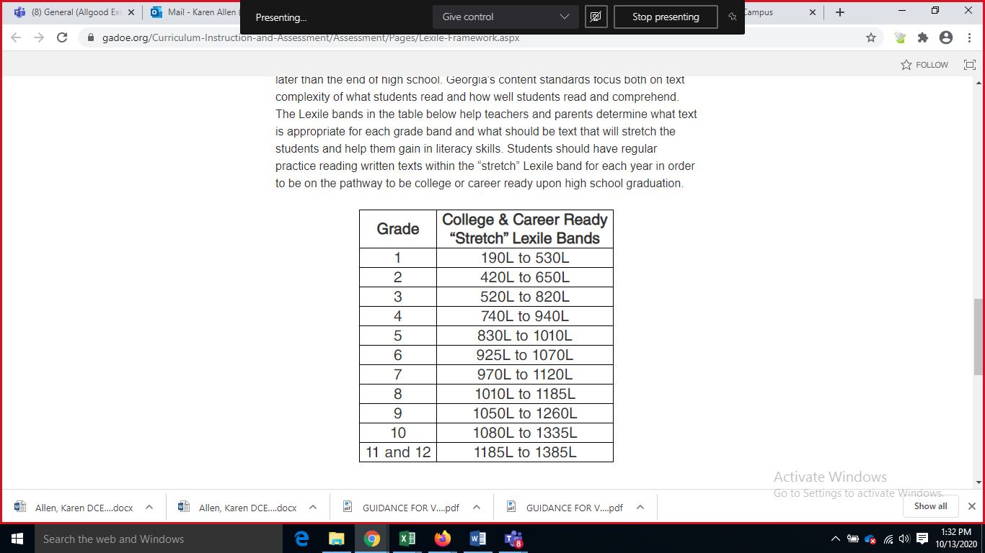
Lexile Level

Slide 9
Data Talk-Teacher(s)

Slide 10
3rd Grade MAP Data with 2020 Norms
Name | Math | Reading | ELA
Chloe Costa | F19-175 W20-195 F20-181 G: 194 | F19-163 W20-172 F20-169 G: 182 | F19-N/A W20-N/A F20-165 G: 179
Andrew Pitts | F19-166 W20-180 F20-176 G: 189 | F19-169 W20-172 F20-176 G: 188 | F19-N/A W20-n/A F20-160 G: 175

Slide 11
3rd Grade MAP Data
Name | Math | Reading | ELA
Chloe Costa | 195 RIT/ 80 Percentile High Average | 172 RIT/ 27 Percentile Low Average | N/A
Andrew Pitts | 180 RIT/ 38 Percentile Low Average | 181 RIT/ 13 Percentile Low | N/A

Slide 12
4th Grade MAP Data with 2020 Norms
(current Co-Taught coverage- Mrs. Grayer/Vacant; Math, ELA, and Reading Small Group- Ms. S. Taylor) Math Reading Language Usage
-Troy Hunt Jr.
-Snow Klay
-Kevin Mayo
-Emmanuel Prieto
-Dya'Moni Spears
F19-No data W20-156 F20- No data | F19-145 W20- 157 F20- No data | No Data
F19-181 W20-181 F- No Data | F19-163 W20- 187 F20- No data | F19-160 W20 186 F- No Data
F19-177 W20-185 F20-187 G:198 | F19-168 W20-170 F20-175 G:186 | F19-169 W20-173 F- No Data G: 183
F19-190 W20-196 F20-191 G; 202 | F19-163 W20-179 F20-177 G:188 | F19-163
F19-No data W20-No data F20-179 G: 190 | F19-No data W20-No Data F20-184 G:194 | No Data

Slide 13
4th Grade MAP Data
Name | Math | Reading | ELA
Troy Hunt Jr | N/A- New Student | N/A- New Student | N/A- New Student
Snow Klay | 181 RIT/ 13 Percentile Low | 187 RIT/33 Percentile Low Average | 186 RIT/ 27 Percentile Low Average
Kevin Mayo | 185 RIT/ 20 Percentile Low | 170 RIT/ 7 Percentile Low | 170 RIT/ 6 Percentile Low
Emmanuel Prieto | 196 RIT/ 49 Percentile Average | 179 RIT/18 Percentile Low | 183 RIT/ 20 Percentile Low
Dya'Moni Spears | N/A | N/A | N/A

Slide 14
5th Grade MAP Data with 2020 Norms
Math | Reading | ELA
F19-198 W20-198 F20-209 G: 219 | F19-177 W20-179 F20-176 G: 186 | F19-168 W20-178 F20-179 G: 189
R.F. F19-196 W20-195 F20-194 G: 203 | F19-189 W20-187 F20-172 G: 183 | F19-183 W20-187 F20-159 G: 171
S.S. F19-190 W20-189 F20-187 G: 196 | F19-187 W20-189 F20-183 G: 192 | F19-188 W20-185 F20-189 G: 197
A.S. F19-163 W20-166 F20-171 G: 180 | F19-164 W20-172 F20-185 G: 194 | F19-173 W20-172 F20-172 G: 182
J.W. F19-176 W20-206 F20-183 G: 192 | F19-166 W20-179 F20-183 G: 192 | F19-173 W20-181 F20-170 G: 181
B.W. F19-190 W20-180 F20-183 G: 192 | F19-177 W20-189 F20-183 G: 192 | F19-176 W20-181 F20-188 G: 196
S.M.F19-154 W20-165 F20-170 G: 179 | F19-145 W20-157 F20-158 G: 171 | F19-159 W20-157 F20-162 G: 174
Willie Crumbley (Speech/Language Impairment)
Roody Fevrier (Emotional/Behavioral Disorder)
Shane Mathis (Mild Intellectual Disability & Speech/Language Impairment)
Shun'tavius Sheppard (Other Health Impairment)
Adonis Simms (Autism & Speech/Language Impairment)
Javaris Wauford (Specific Learning Disability & Speech/Language Impairment)
Biniyam Wolde (Autism & Speech/Language Impairment)

Slide 15
Name | Math | Reading | ELA
Willie Crumbley | 1981 RIT/ 29 Percentile Low Average | 179 RIT/ 7 Percentile Low | 178 RIT/ 4 Percentile Low
Roody Fevrier | 195 RIT/ 23 Percentile Low Average | 187 RIT/ 17 Percentile Low | 187 RIT/ 14 Percentile Low
Shane Mathis | 166 RIT/ 1 Percentile Low | 157 RIT/ 1 Percentile Low | 157 RIT/ 1 Percentile Low
Shun'tavius Sheppard | 189 RIT/ 13 Percentile Low | 189 RIT/ 20 Percentile Low | 185 RIT/ 11 Percentile Low
Adonis Sims | 166 RIT/ 1 Percentile Low | 172 RIT/ 3 Percentile Low | 172 RIT/ 2 Percentile Low
Javaris Wauford | 206 RIT/ 50 Percentile Average | 179 RIT/ 7 Percentile Low | 181 RIT/ 6 Percentile Low
Biniyam Wolde | 180 RIT/ 4 Percentile Low | 185 RIT/ 14 Percentile Low | 181 RIT/ 6 Percentile Low

Slide 16
Data Talks-5th Grade- Jiwani 2020
Names | Reading | Language | Math | Science | comments
Roody Fevrier | 172/187 | 159/187 | 194/195 | 160/187 | Join class on first day of testing
Shane Mathis | 158/157 | 162/157 | 170/168 | 173/173
Shun'tavius Sheppard | 183/189 | 189/185 | 187/189 | 190/188
Adonis Sims | 185/172 | 172/172 | 171/166 | 174/181
Biniyam Wolde | 183/185 | 188/181 | 183/180 | 177/177

Slide 17
Interventions
Software (Education Galaxy & iReady)
Tutorial Opportunities (currently in the mornings)
Asynchronous 1:1 sessions
Technology Writing Lab with Ms. Fiona Johnson

Slide 18
Digital Platforms
Education galaxy
iReady
Diagnostic trends
Diagnostic trends

Slide 19
Data Talk-Teacher(s)

Slide 20
Tutorial (additional) Opportunities
Morning Tutorial
Ms. Taylor
Ms. Jiwani
Mrs. Grayer
Mr. Payne
After School Tutorial
Saturday School

Slide 21
Attendance & Engagement
Mr. Lightner & Mrs. Myles

Slide 22
Support
Mrs. Myles, Student Support Specialist
Mrs. Cook & Mr. Lightner, Counselors
Mr. Hutchenson, School Social Worker
Mrs. McGrady-Media Specialist
Notes:
Mrs. Myles, Student Support Specialist
Mrs. Cook & Mr. Lightner, Counselors (support services-study skills and attendance)
Mr. Hutchenson, School Social Worker (contacting hard to reach students)
Mrs. McGrady-Media Specialist (books on reading level)

Slide 23
Incentives
Drawing for Bikes
Tangible rewards (mechanical pencils, "air pods";
Virtual Star Bucks
Sweet Treats

Slide 24
Next Steps
Virtual Observations conducted by Leadership Team
Prioritize Webcams
Focus on priority standards for GA Milestones
Focus CCRPI- 3% & 6% targets
Accommodations & Supports PD- Ms. P. Williams (School Psychologist & Ms. Conley (SLP)
Asynchronous PD Co-Teaching
Parent Conferences every 4.5 weeks
Case managers Communication & Instructional Log
Student Accountability
Notes:
How many SWD to meet target ELA & Math for developing? Proficient? Distinguished?
Students accountability-data talk and understanding their data

Slide 25
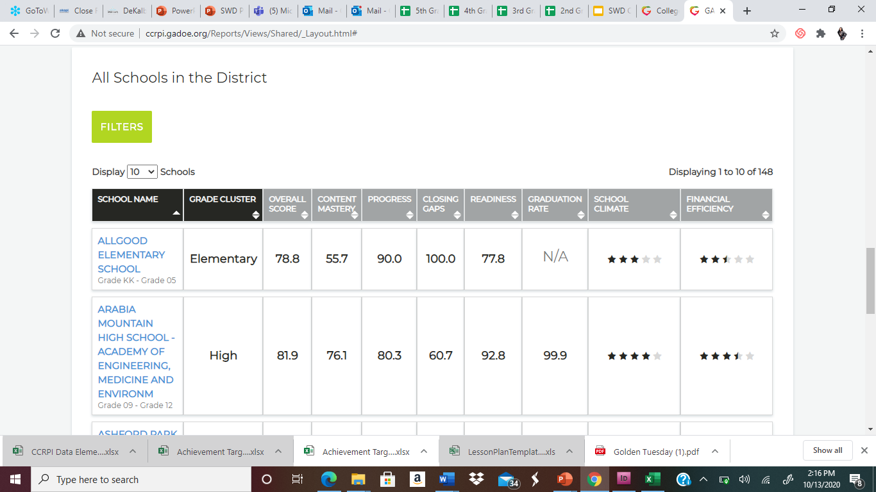

Slide 26
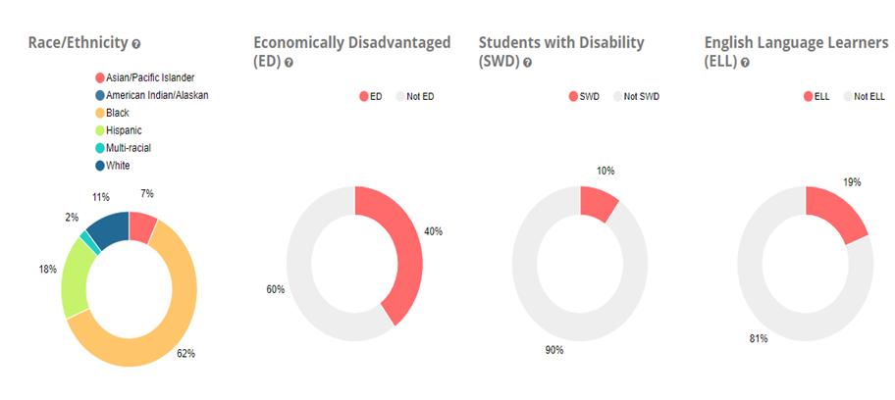

Slide 27
Content Area Goals
Mathematics•
During the 2020-2021 school year, our goal as a school will be to increase the percentage of all subgroups to meet or exceed projected growth on the NWEA MAP Mathematics Assessment by 3% to 6% in areas of the following domains: Operations and Algebraic Thinking, Number and Operations, Measurement and Data and Geometry.
Writing•
During the 2020-2021 school year, our goal as a school will be to increase the percentage of all subgroups to meet or exceed projected growth on the NWEA MAP Assessment for the Extended Writing Task and the Narrative Writing Response by and increase of 3% to 6%.
ELA•
During the 2020-2021 school year, our goal as a school will be to increase the percentage of all subgroups to meet or exceed projected growth on the NWEA MAP ELA Assessment by 3% to 6% in areas of the following domains: Reading and Vocabulary/ Writing and Language.

Slide 28
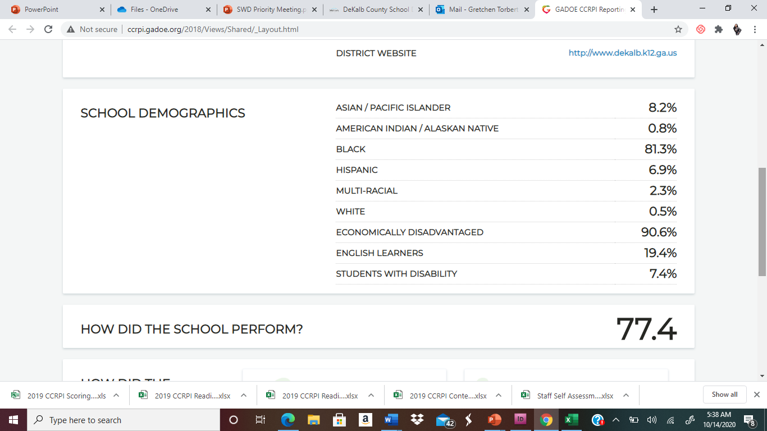

Slide 29
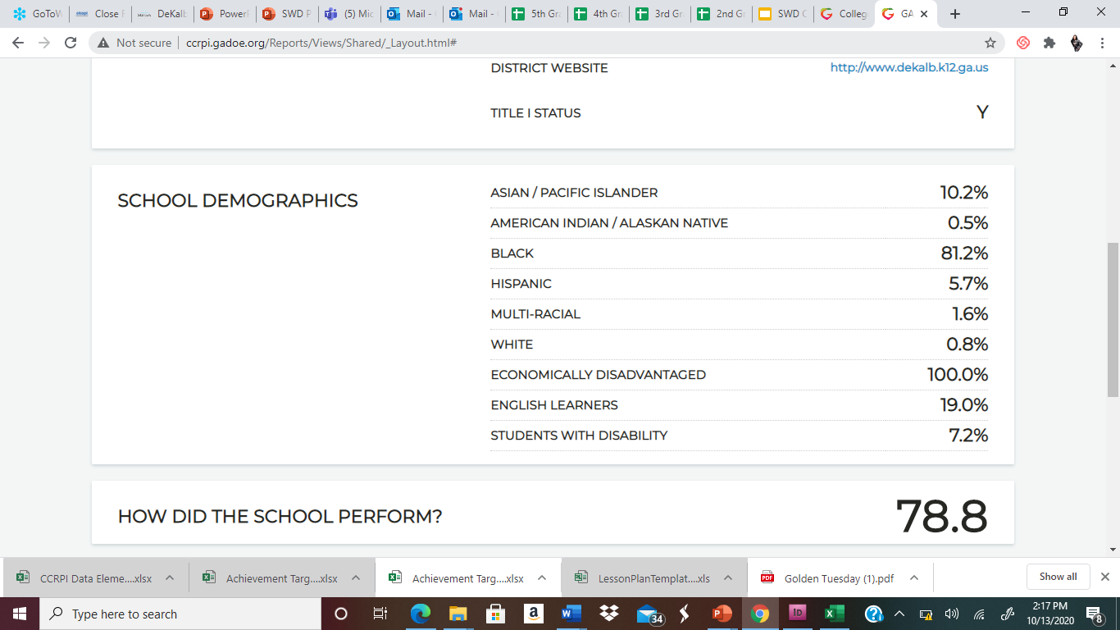

Slide 30
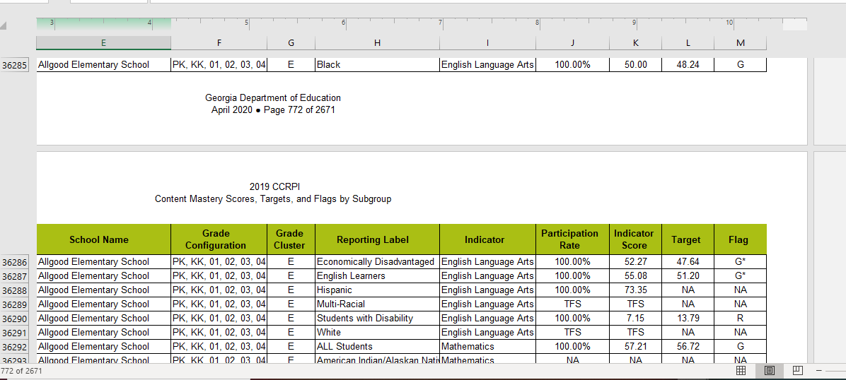

Slide 31
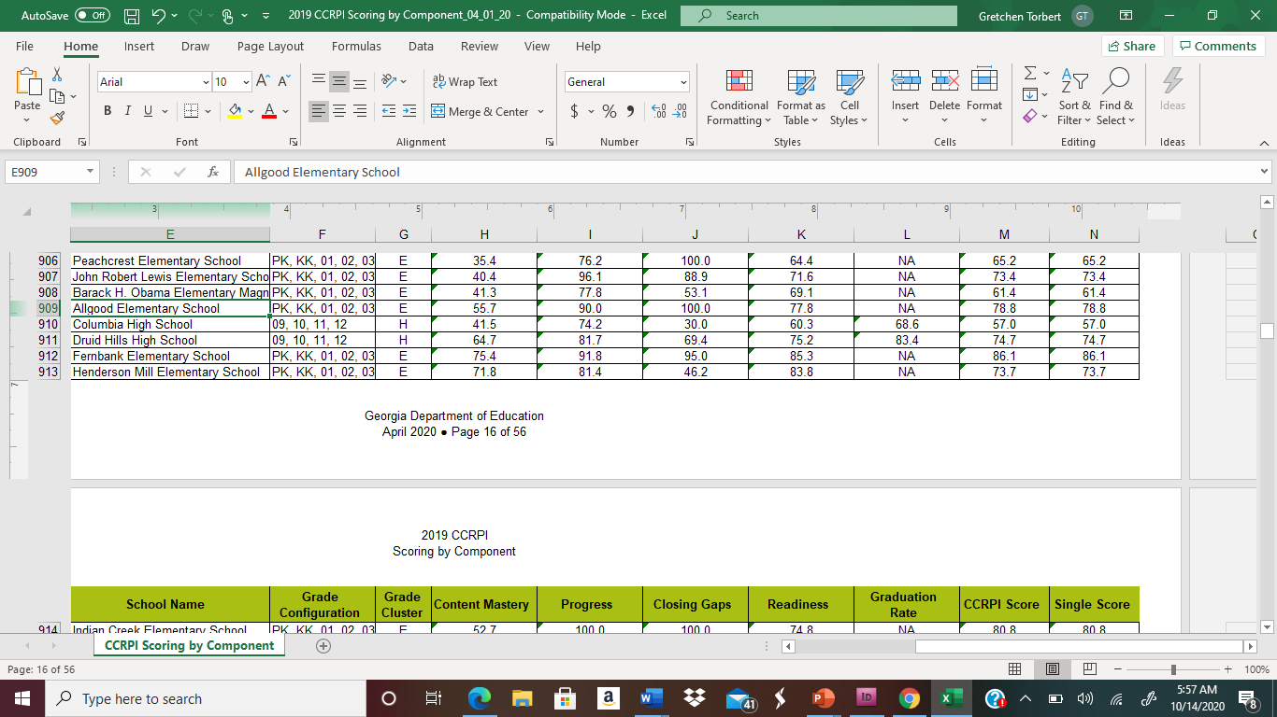

Slide 32
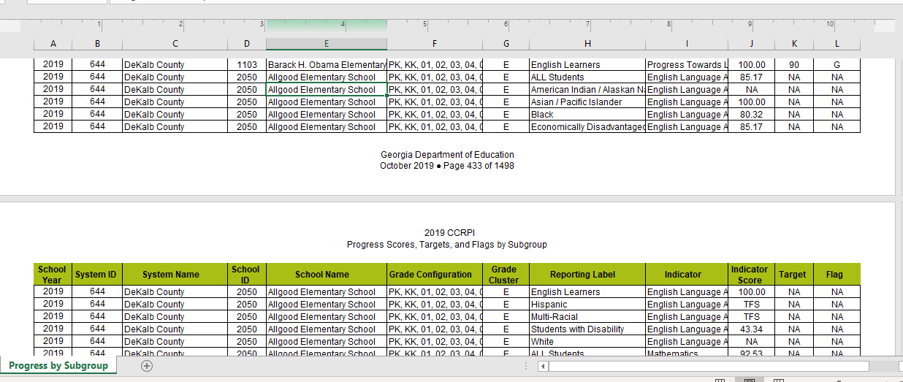

Slide 33
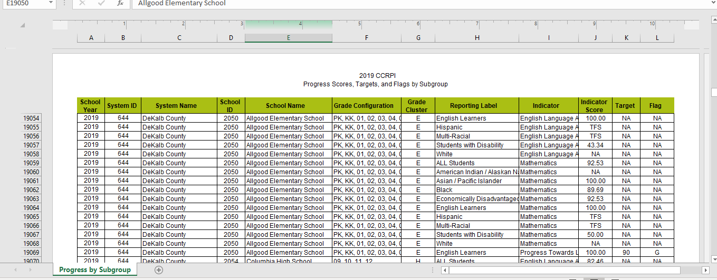

Slide 34
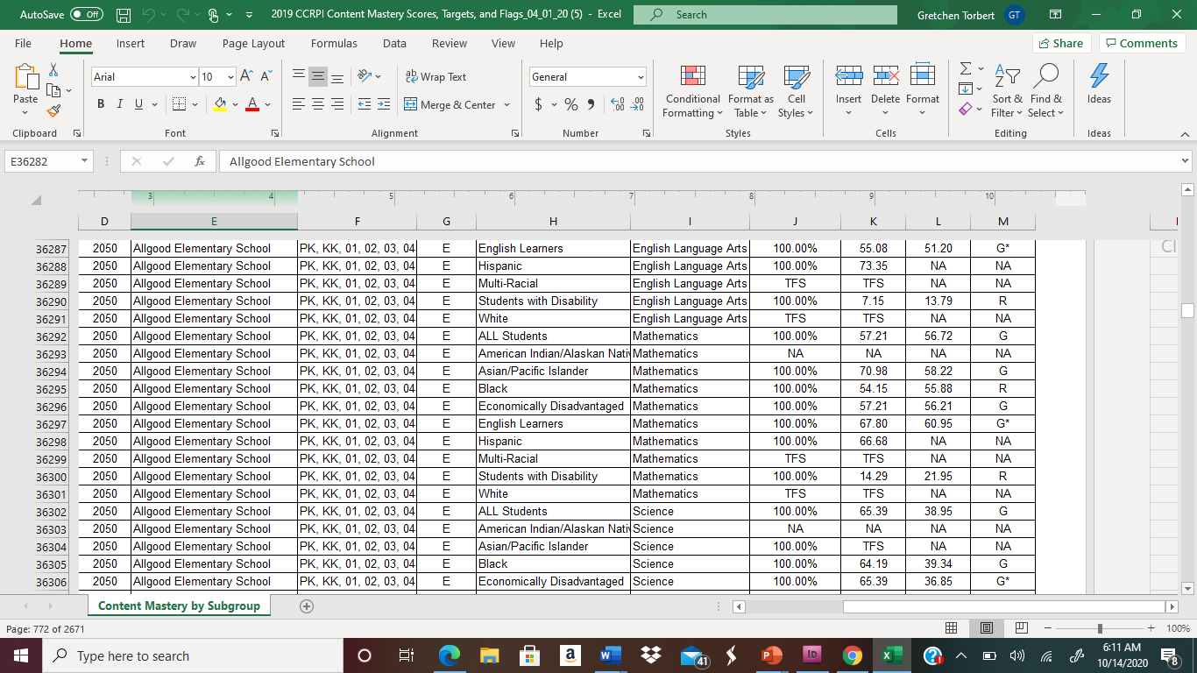

Slide 35
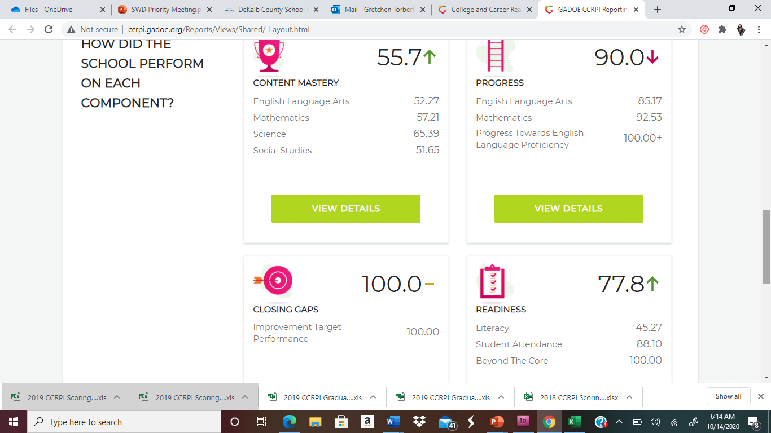

Slide 36
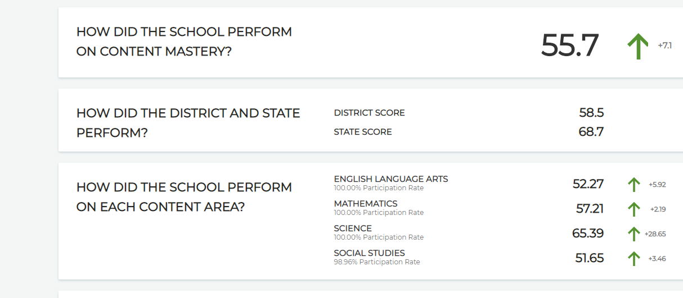

Slide 37
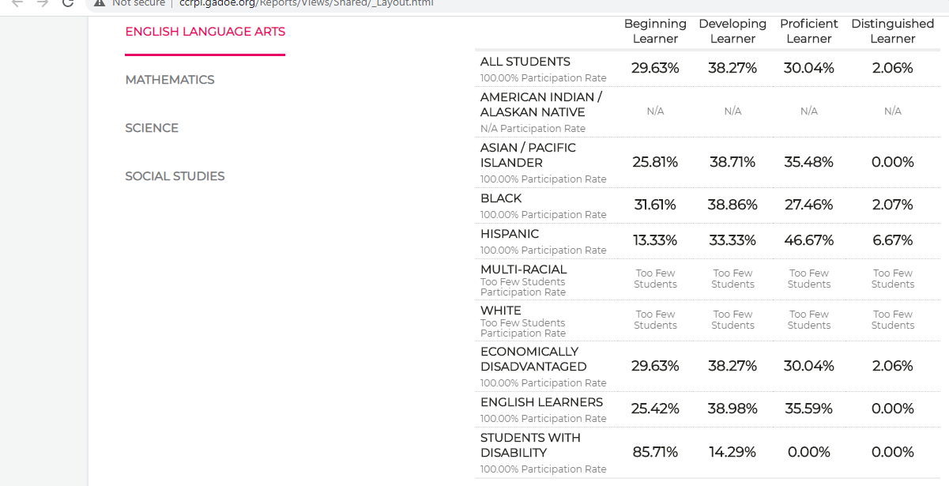

Slide 38
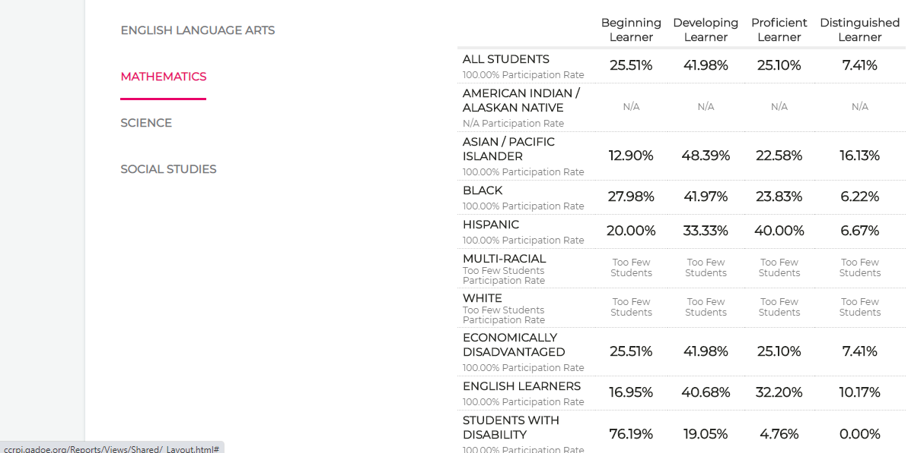

Slide 39
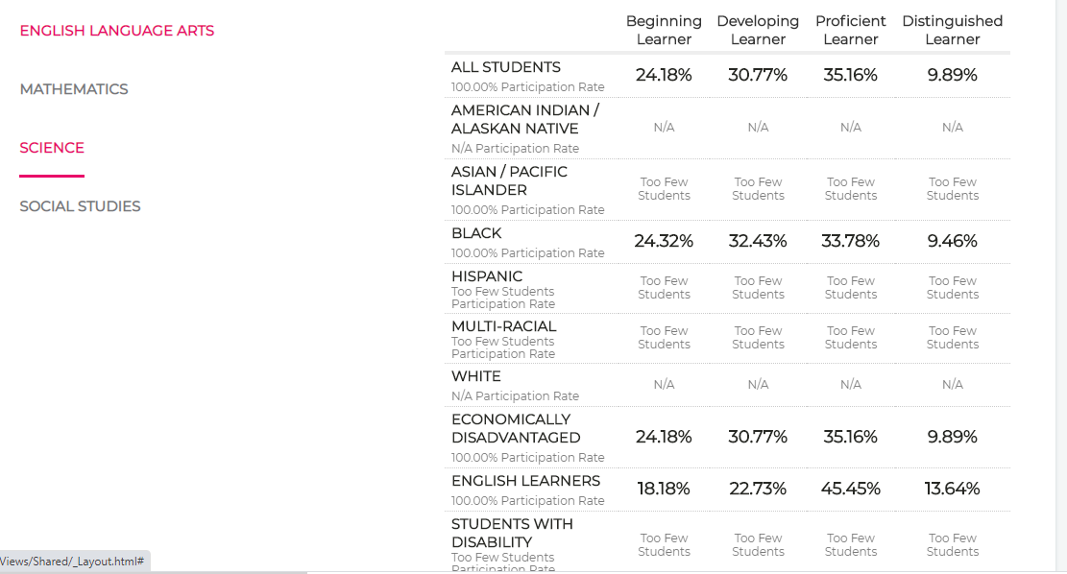

Slide 40
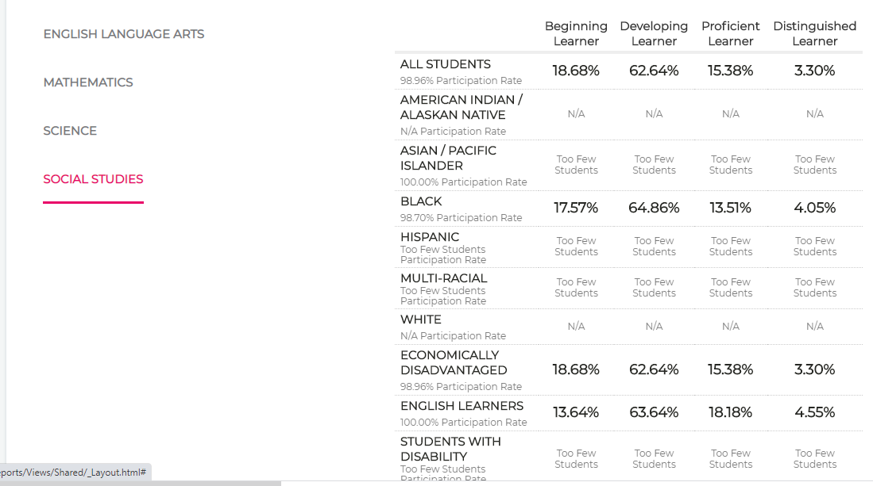

Slide 41
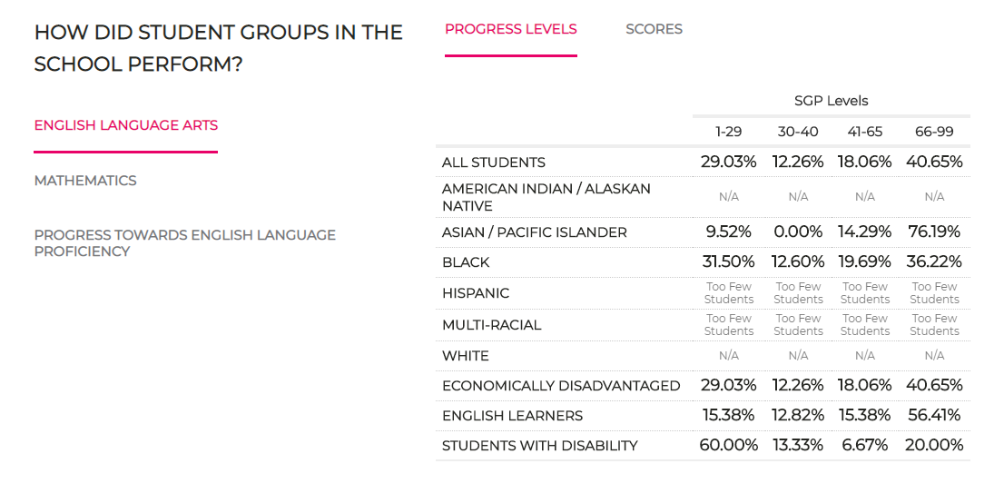

Slide 42
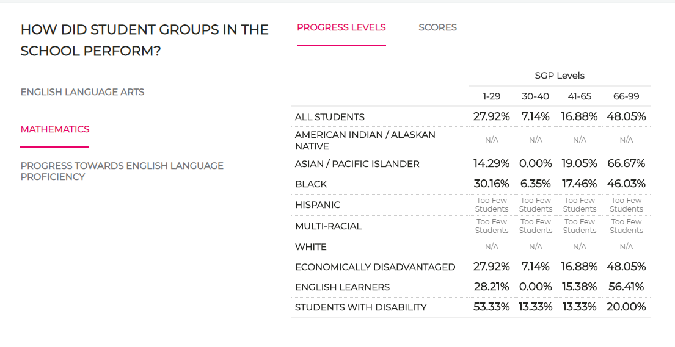

Slide 43
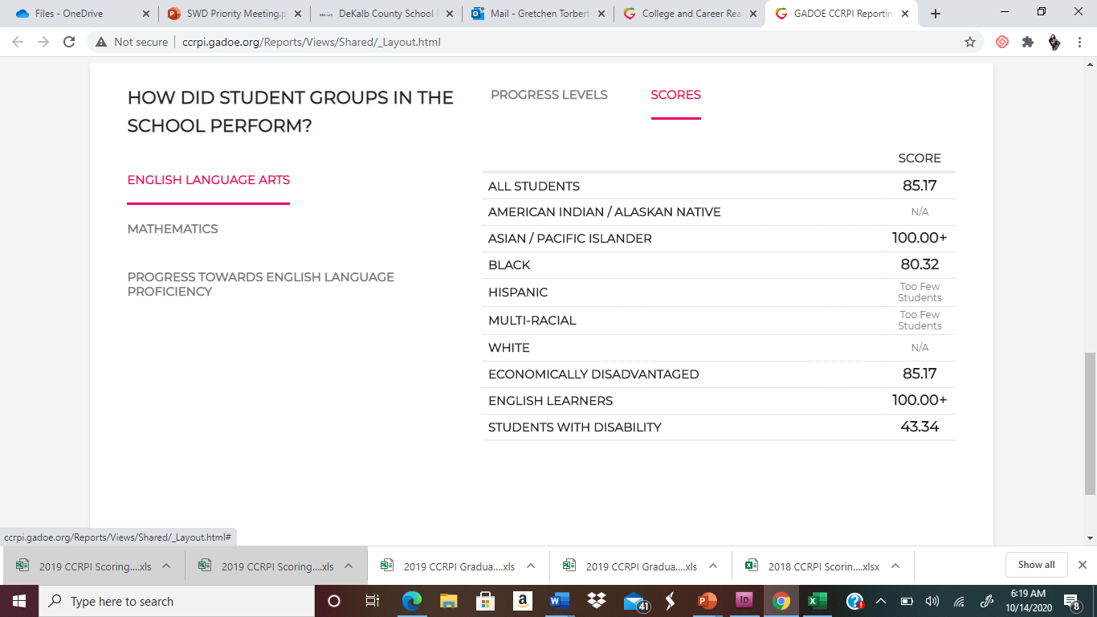

Slide 45
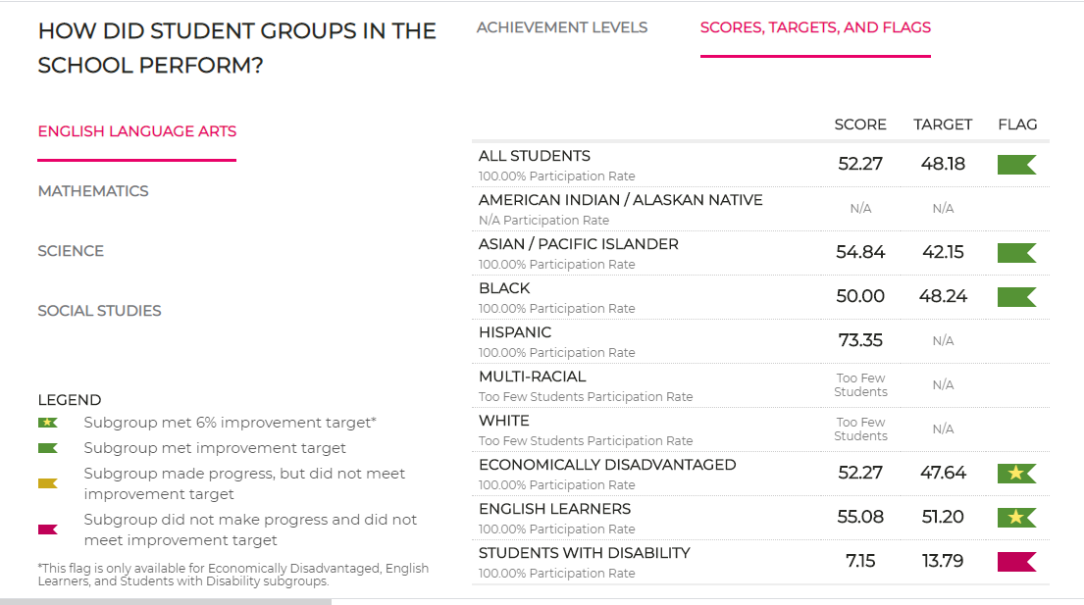

Slide 46
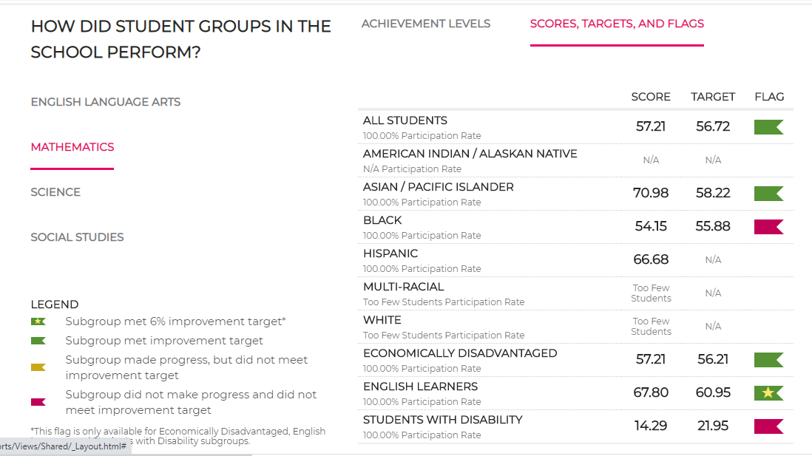

Slide 47
