Slide 1
Welcome to a great day of learning at Allgood!
7: 45 a.m.
Dr. William Carter- Principal
Dr. Lisa Steele Rhymer- Assistant Principal

Slide 9
Morning Tutorial/ Extended Learning Time 8:00 a.m.- 8:45 a.m.

Slide 12
Coming Soon in April 2021
3rd – 5th Grades Only!

Slide 16
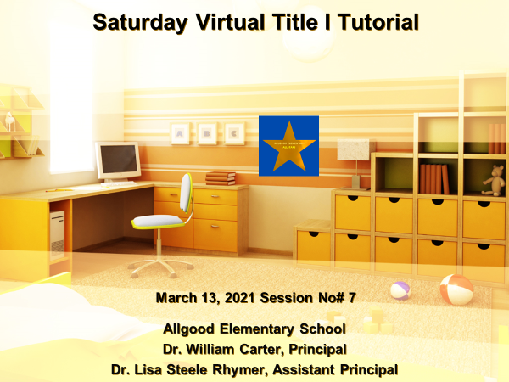
Our Final Session, March 27th

