Slide 1
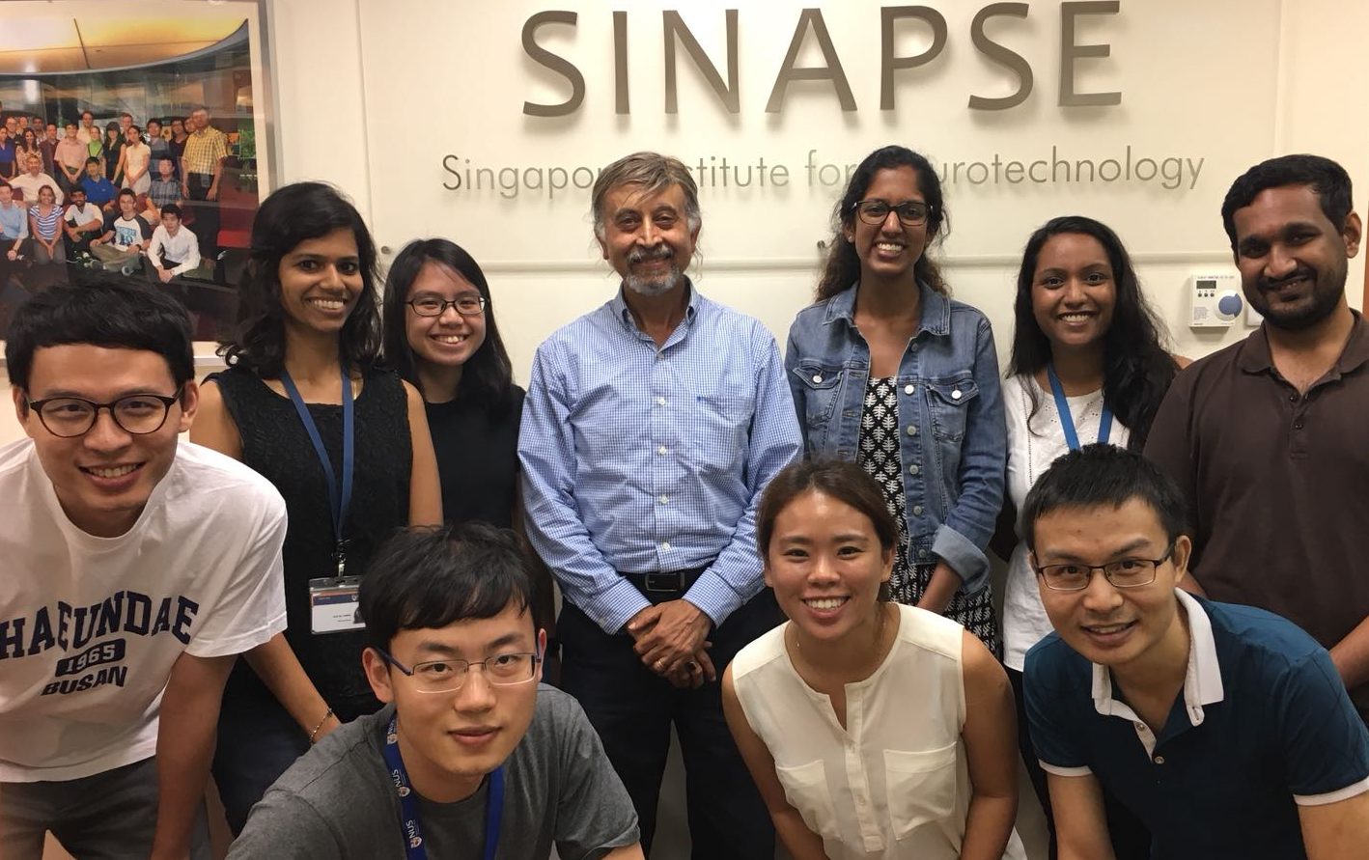
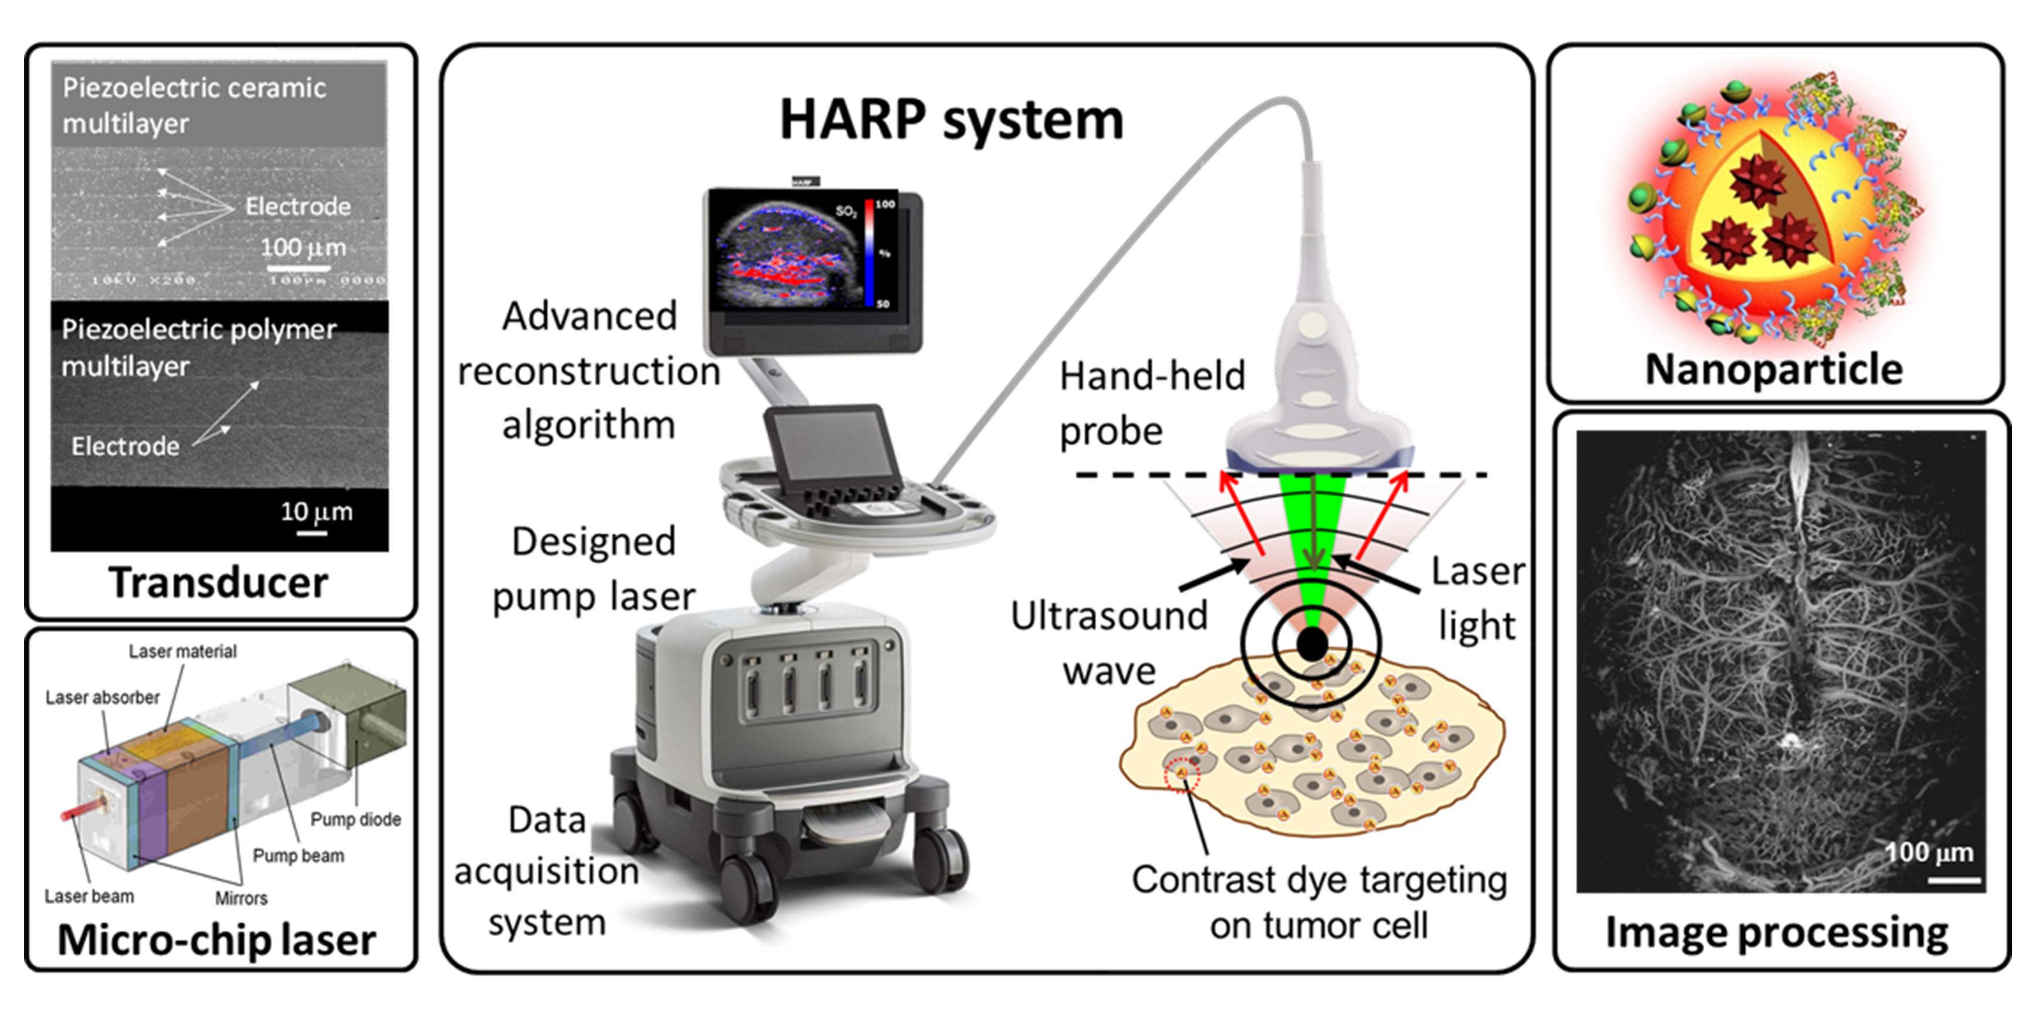
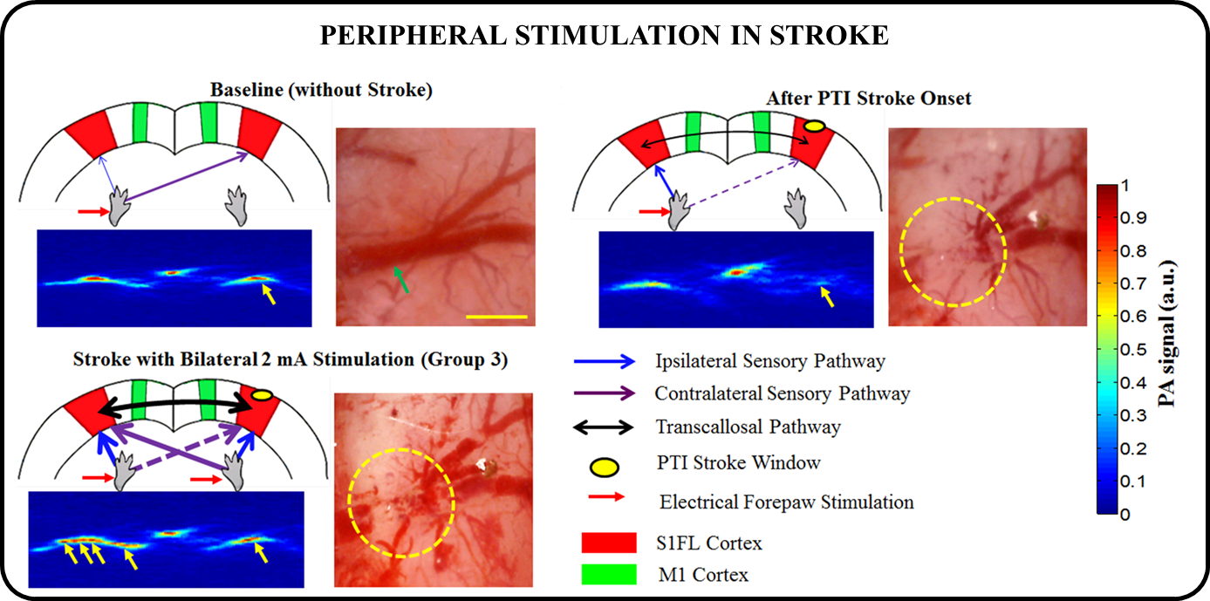
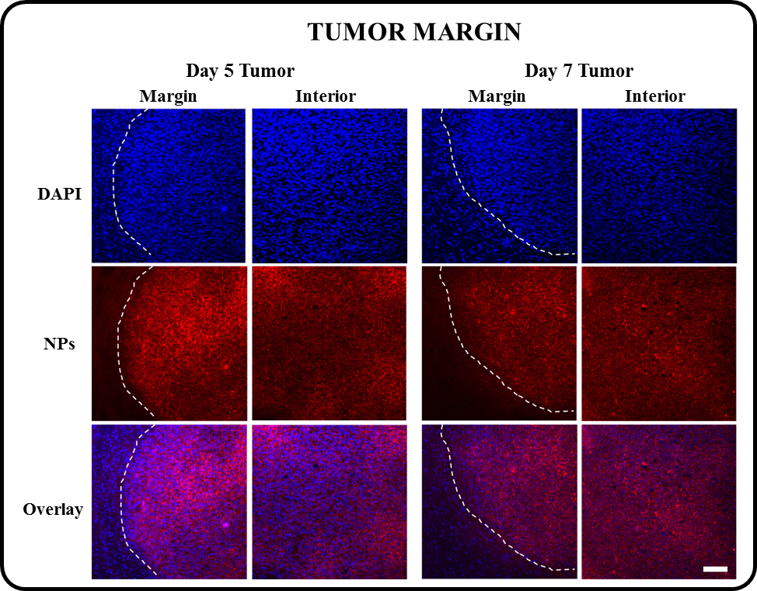
VISION
We focus on applying innovative in-vivo optical imaging technologies to study neurovascular functions in the nerve and the brain with an ultimate goal of translating pre-clinical development to early clinical testing of novel therapeutics.
TEAM
Professor Nitish V. Thakor (Principal Investigator)
Dr. Pramila Ghode (Research Fellow) | Dr. Aishwarya Bandla (Senior Fellow)
Professor Lun-De Liao (Senior Fellow) | Dr. Yu-Hang Liu (Post Doctoral Fellow)
Xu Yu (PhD Student) | Chan Kim Chuan (Research Assistant)
Sandhya Aiyer (PhD Student) | Gayathiri Magarajah (Research Assistant)
We are developing:
Laser speckle imaging technology, both for in situ imaging of brain function and a head mounted imager microscope for imaging brain health and disease in awake-behaving animal, and
Photoacoustic imaging system for monitoring brain vessels, blood flow and oxygenation at depth and a handheld imager for eventual translation to intraoperative imaging.
We use nanoparticles for contrast enhancement, penetrating the blood brain barrier, and for drug/oxygen delivery. Our focus is on two applications: stroke and glioblastoma brain tumor.
Prof. Nitish V. THAKOR
Department of Biomedical Engineering
National University of Singapore
Email: eletnv@nus.edu.sg
Website: https://neuroeng.org/

