Slide 1
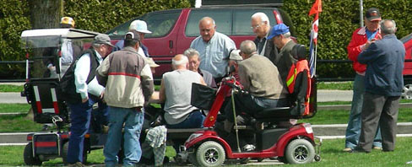
Delightful Public Spaces as Climate Action: The Next Five Years in Oaklands
Eric Doherty, MCIP
eric@ecoplanning.ca 250 818 8223
www.ecoplanning.ca

Slide 2
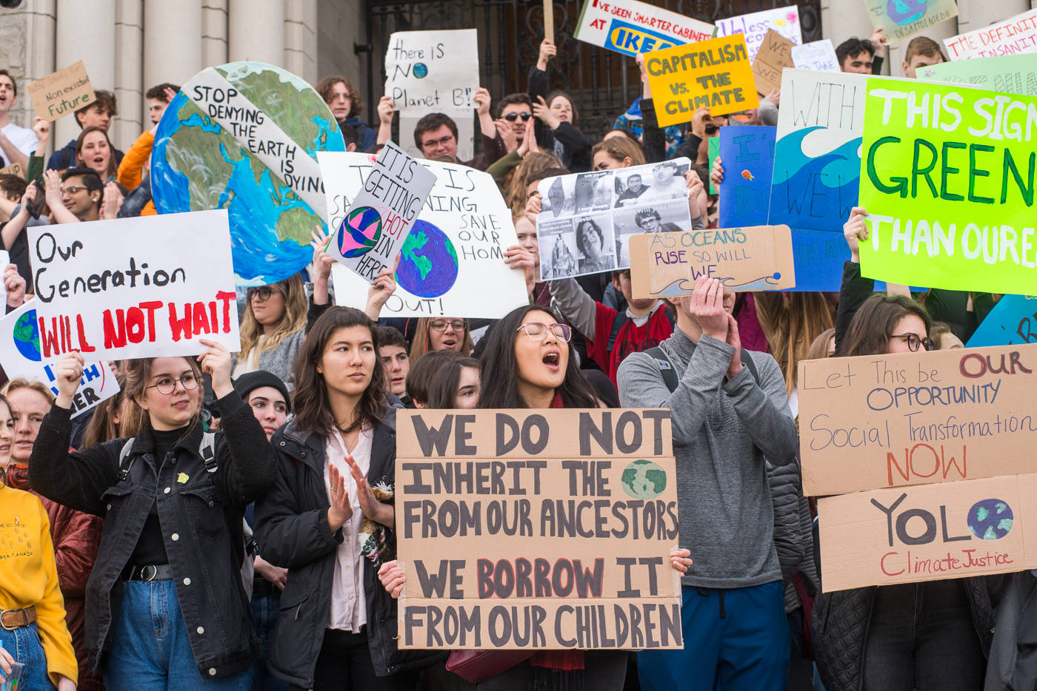
Climate Emergency

Slide 3
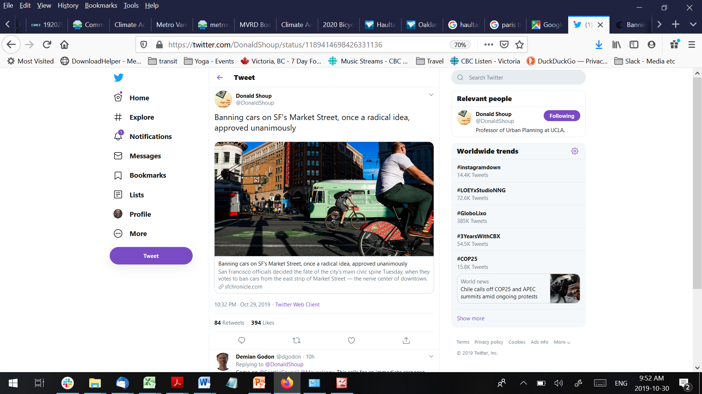

Slide 4
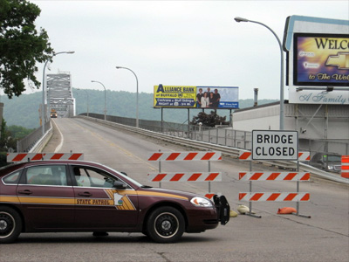
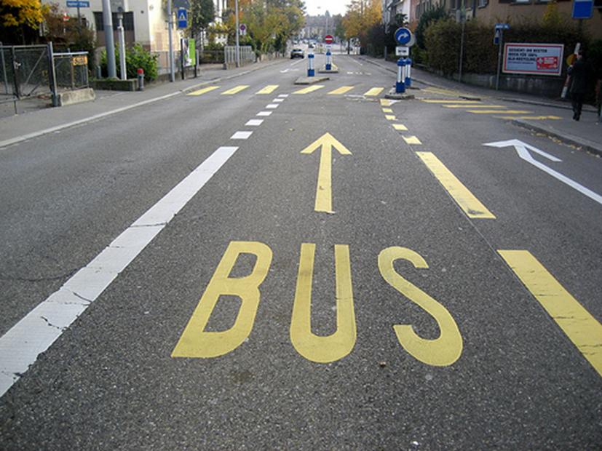
Less Road Space
= Less Traffic &
Less pollution

Slide 5
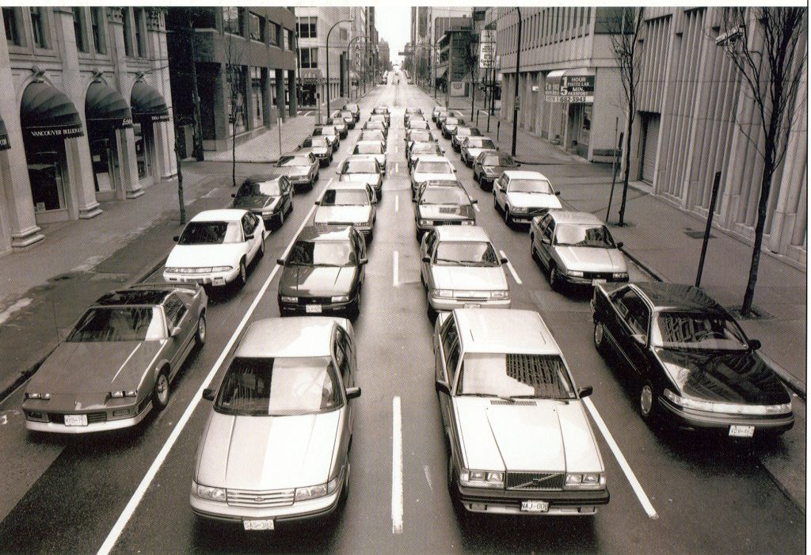

Slide 6
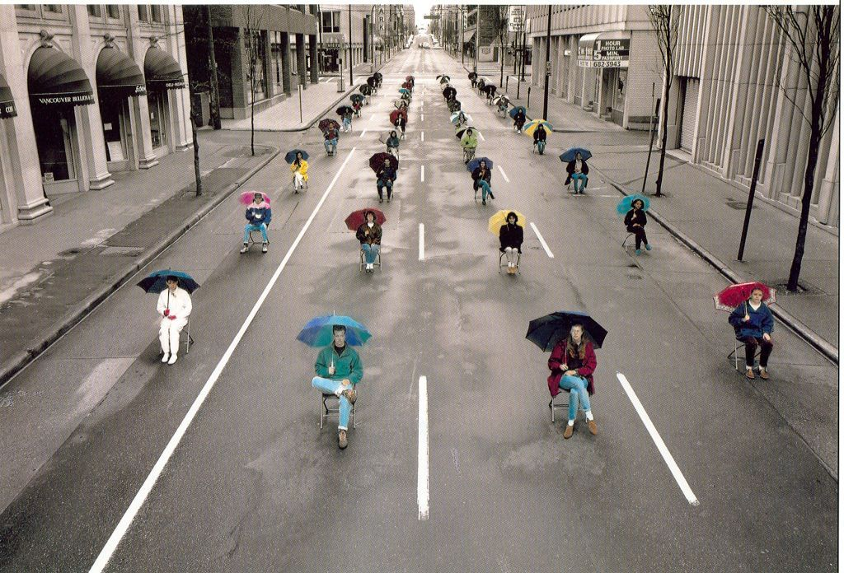

Slide 7
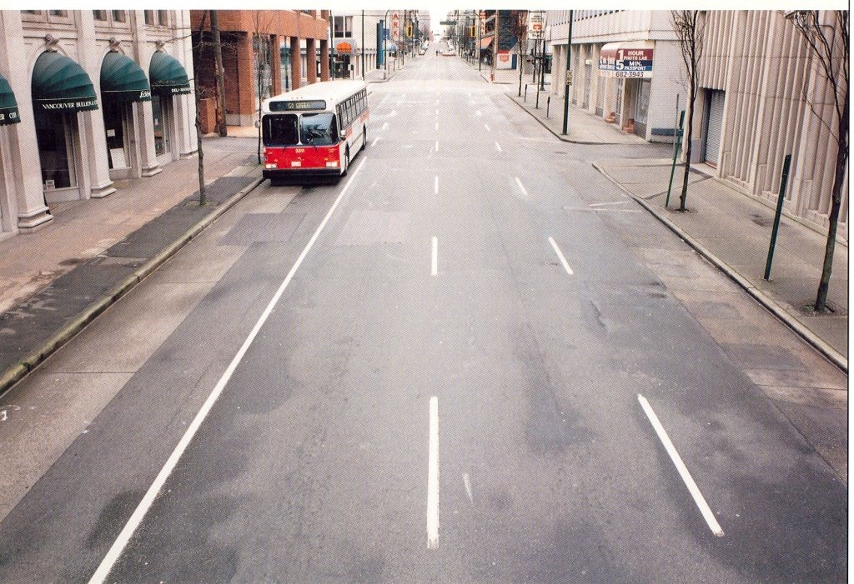

Slide 8
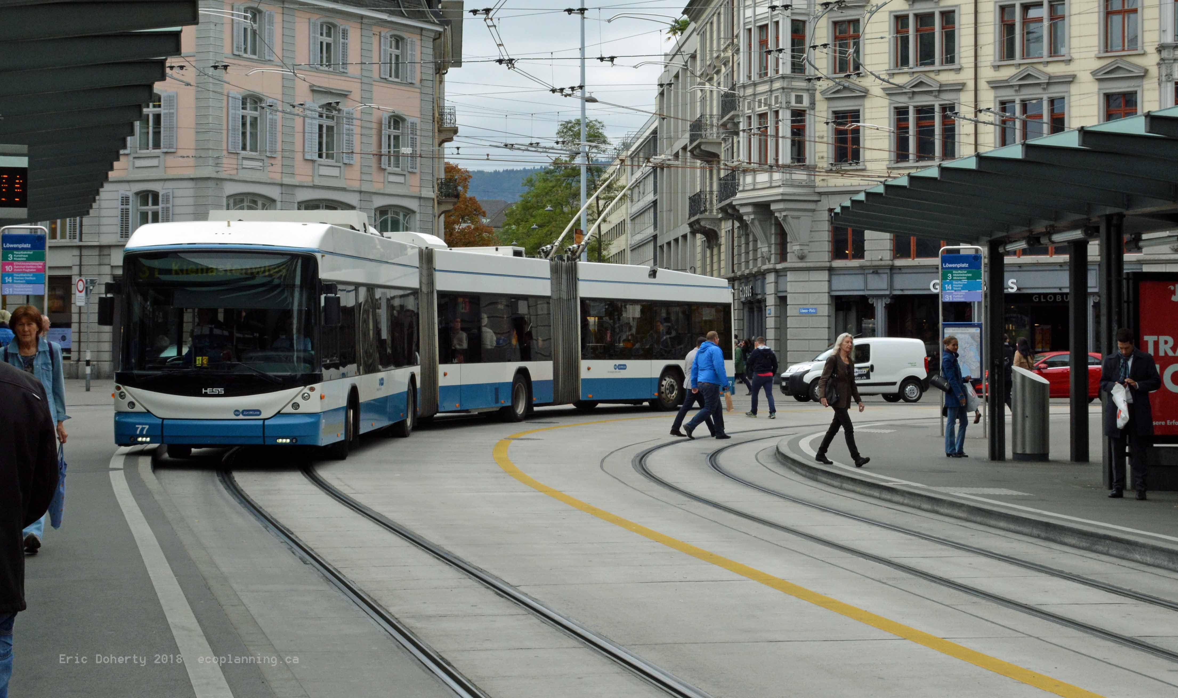

Slide 9
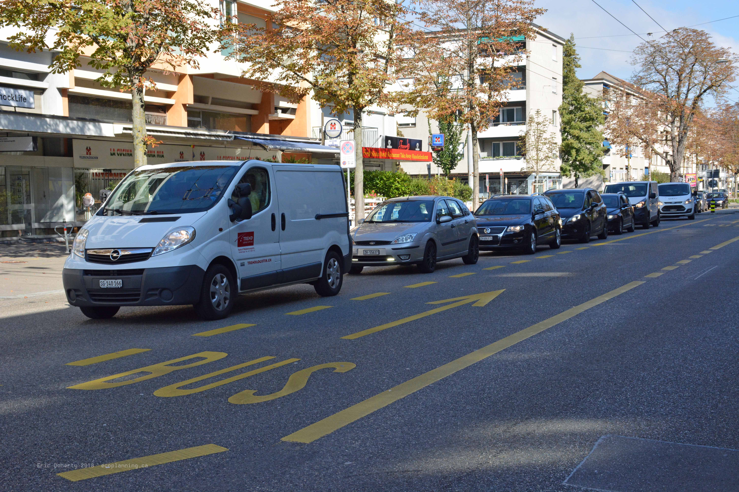

Slide 10
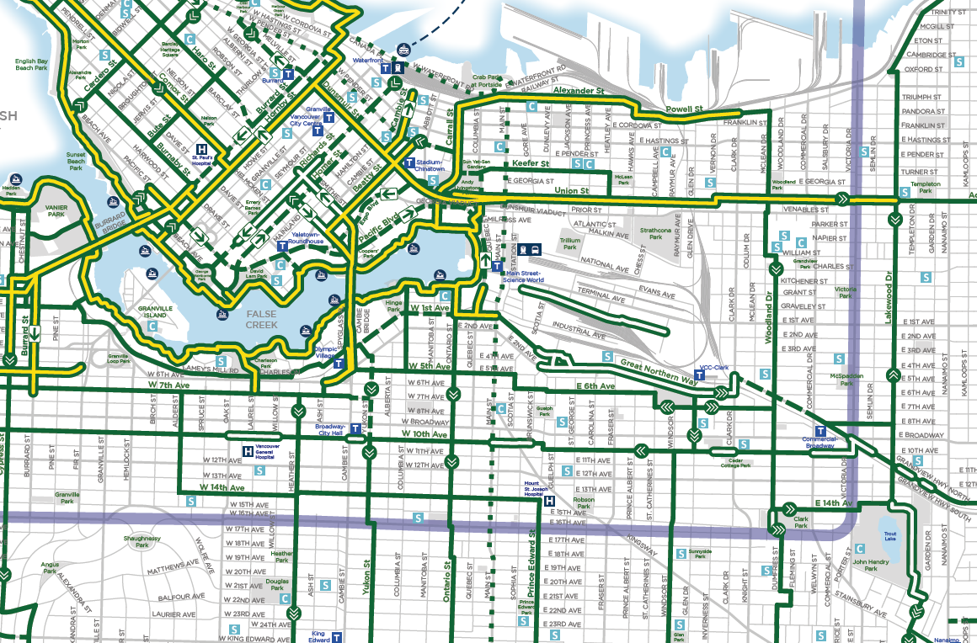
My Vancouver got better with Greenways & Traffic Calming
Downtown
Grandview
Woodlands
Union – Adanac Greenway
Lakewood Greenway
Home
B-Line Bus
& Skytrain
Park

Slide 11
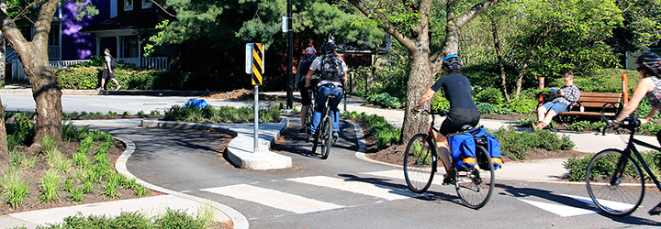
Union-Adanac Greenway - Pocket Park

Slide 12
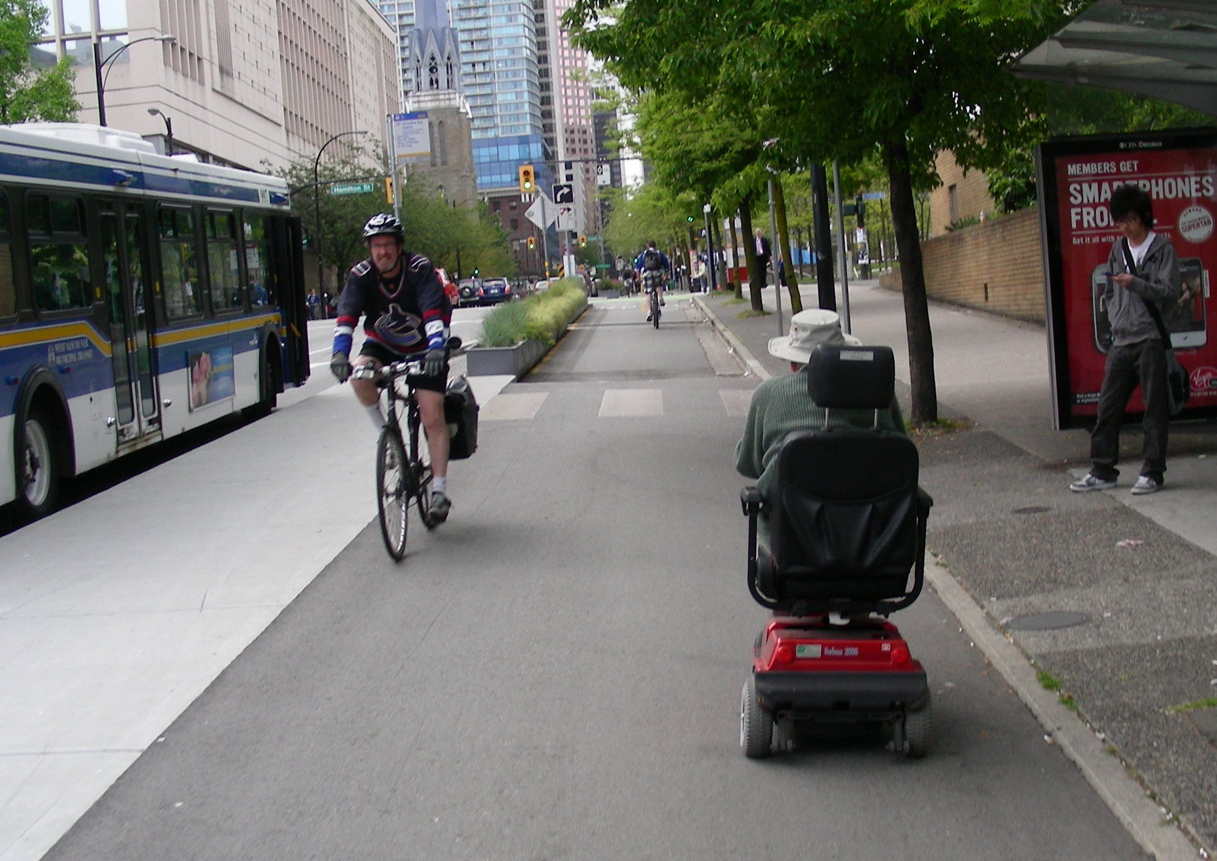
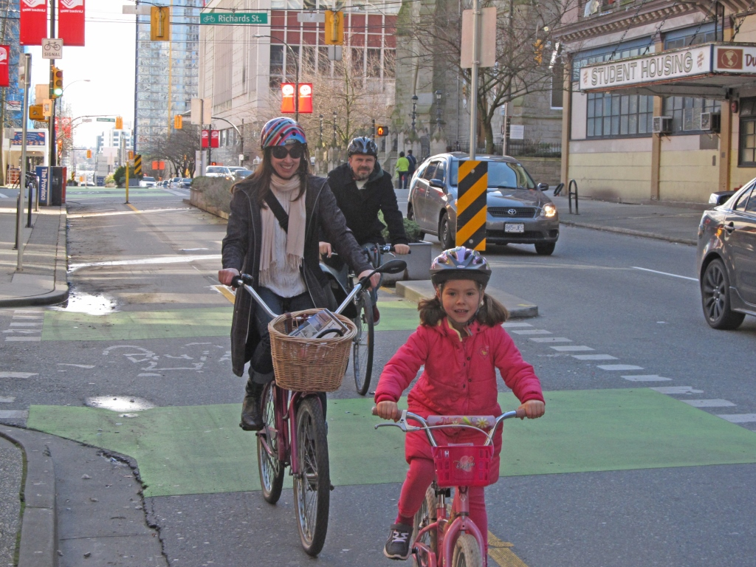
Dunsmuir Protected Bike+ Lane
Downtown Vancouver

Slide 13
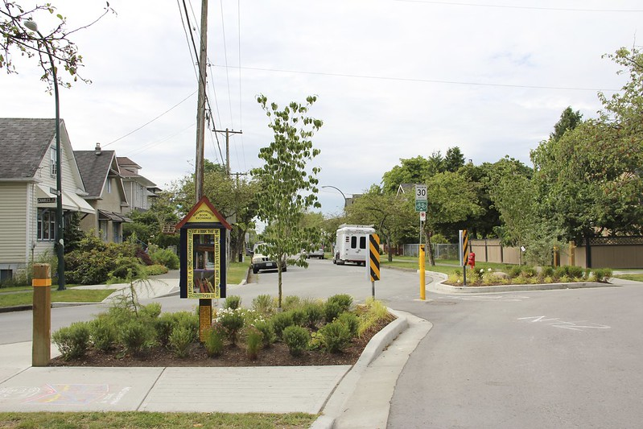
Lakewood Greenway – Diagonal Diverter

Slide 14

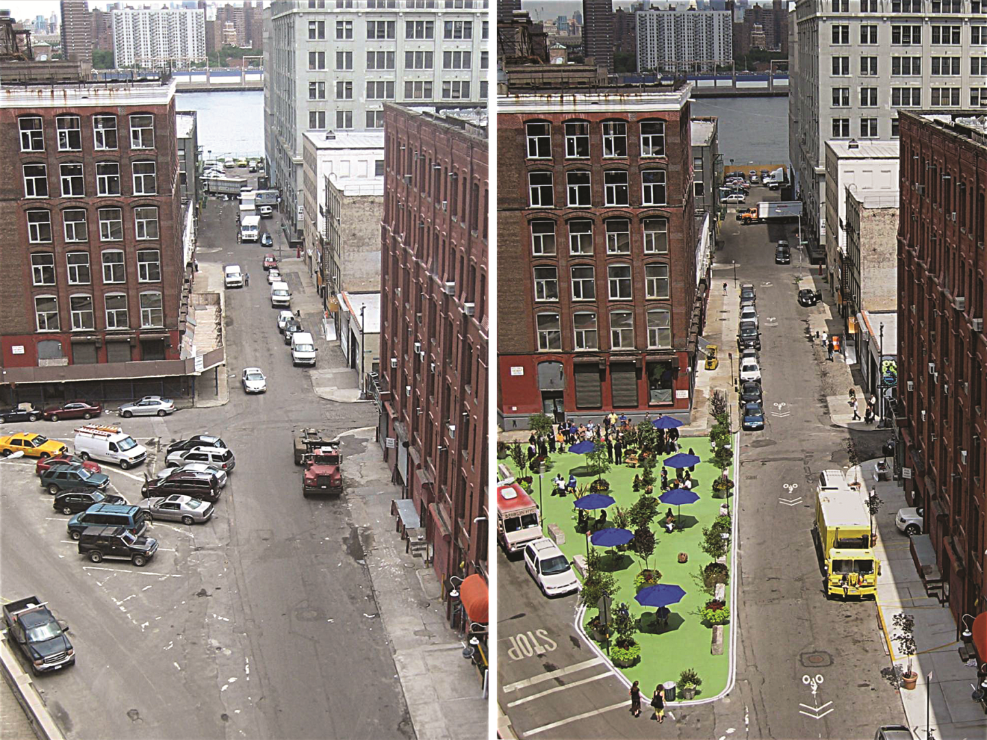
Tactical Urbanism

Slide 15
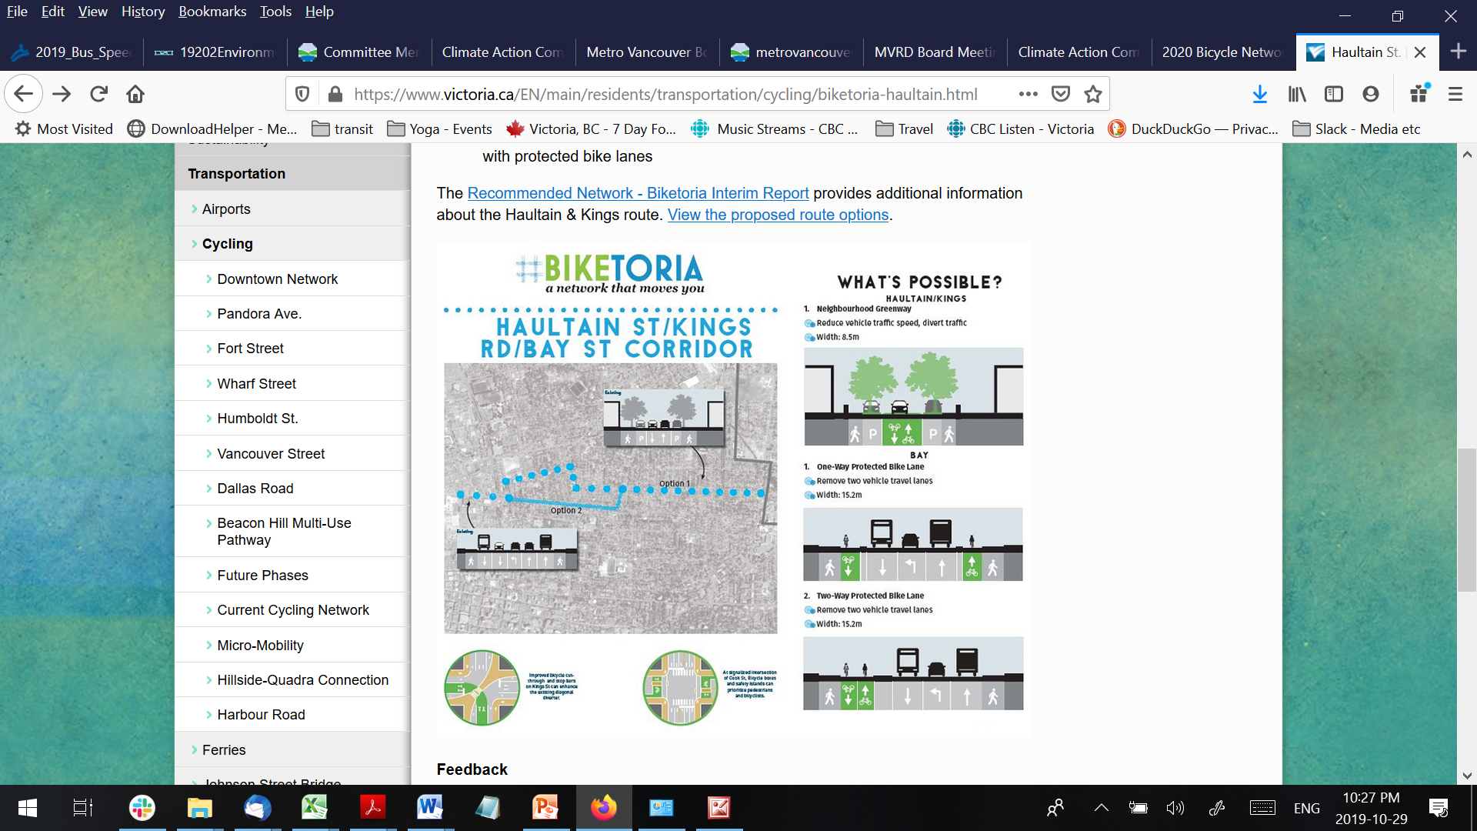

Slide 16
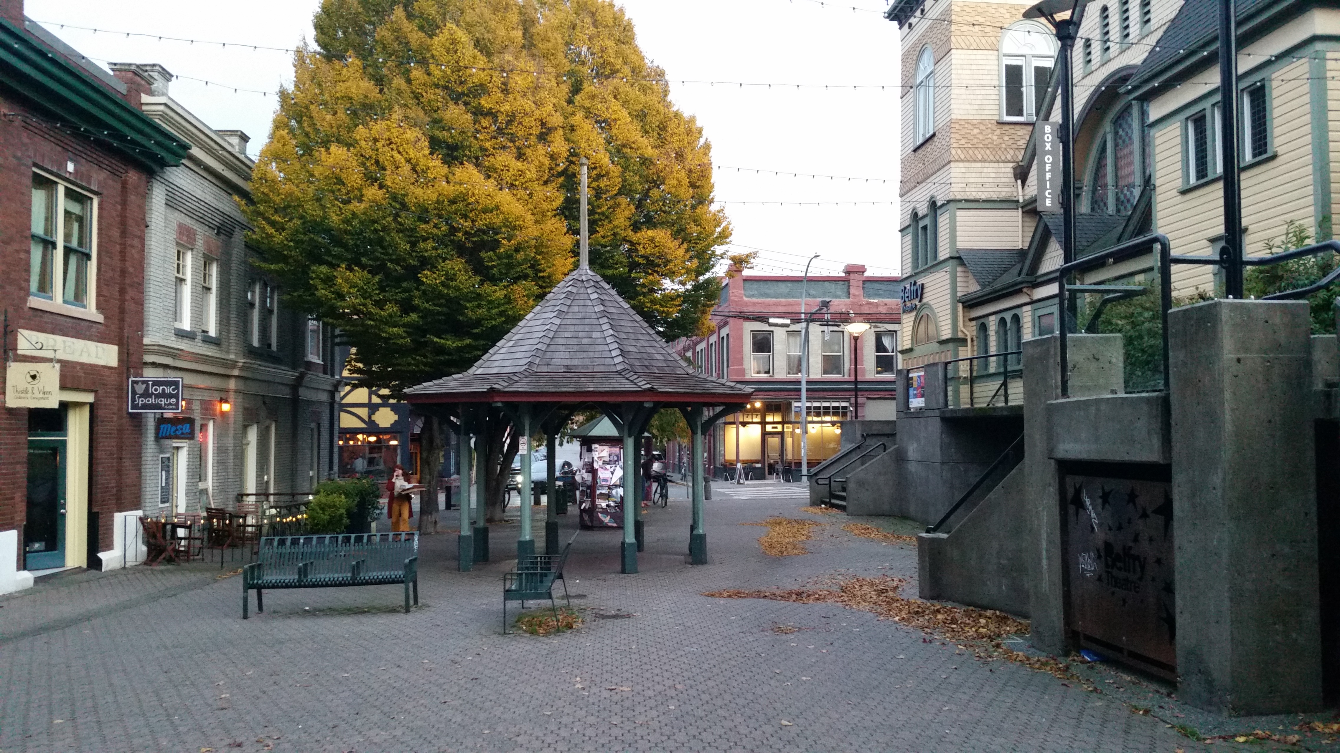

Slide 17
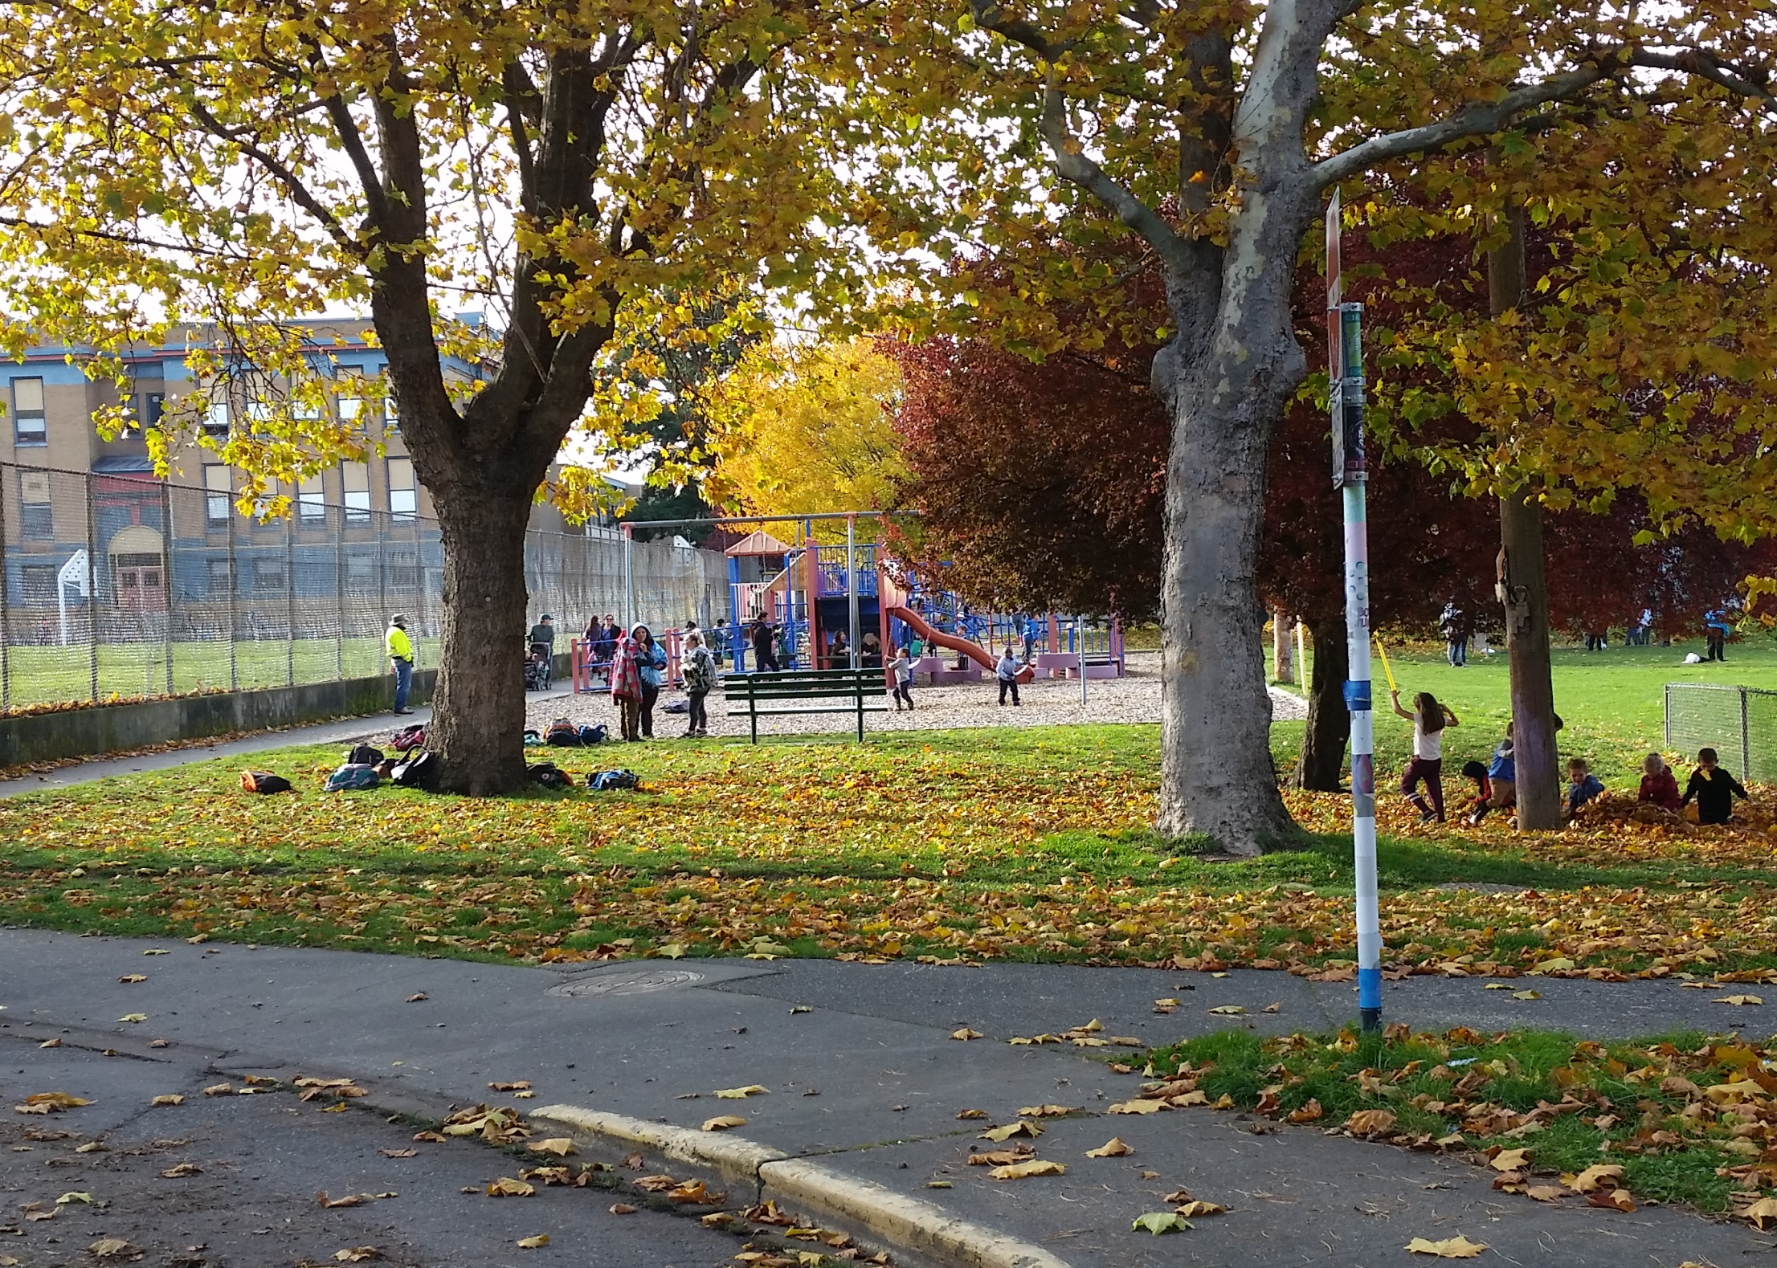

Slide 18
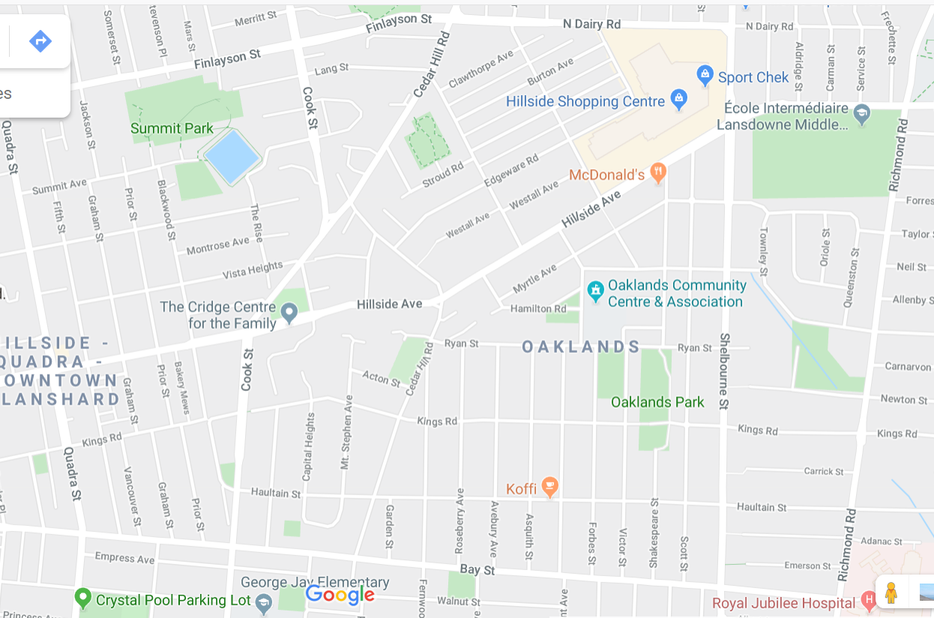

Slide 19
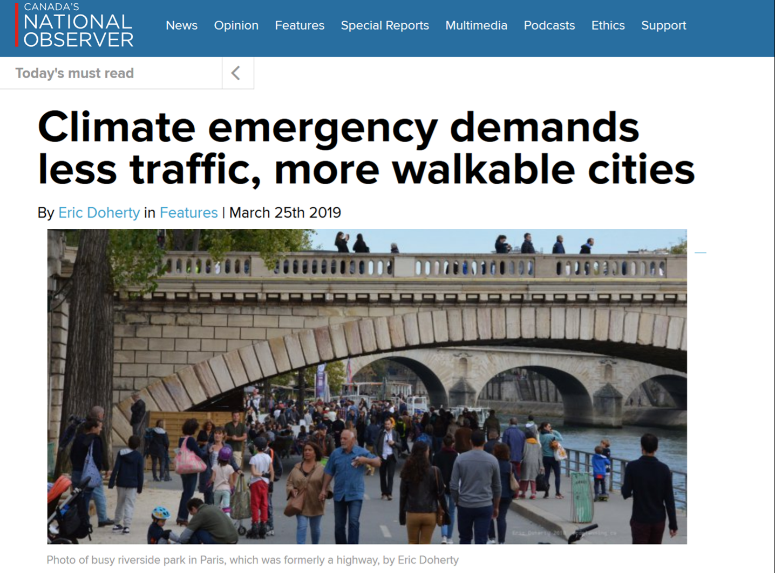
Eric Doherty, MCIP
eric@ecoplanning.ca 250 818 8223
www.ecoplanning.ca
www.BetterTransit YYJ.ca

