Slide 1


FOOD
FORWARD 50
Linda Geggie

Slide 2


THE FUTURE
  Food is a basic necessity. Over 80% of our food comes from the Global Food System and the Global Food System is going to look a lot different

Slide 3
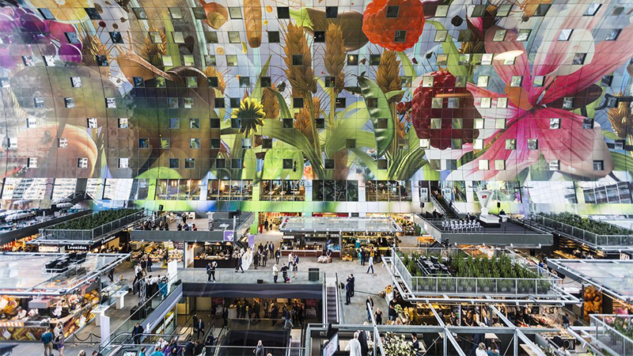
WHAT MIGHT THIS MEAN FOR OAKLANDS?

Slide 4
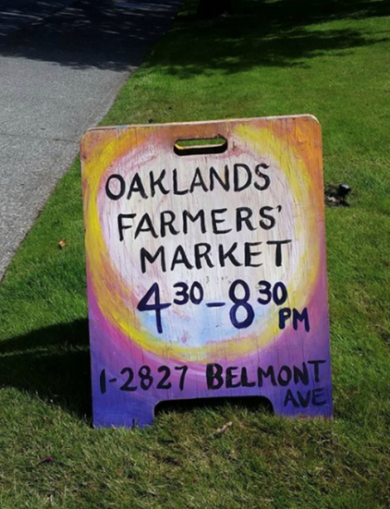
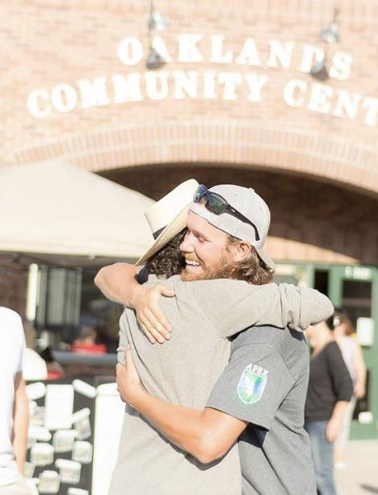


VALUES THAT GUIDE US

Slide 5
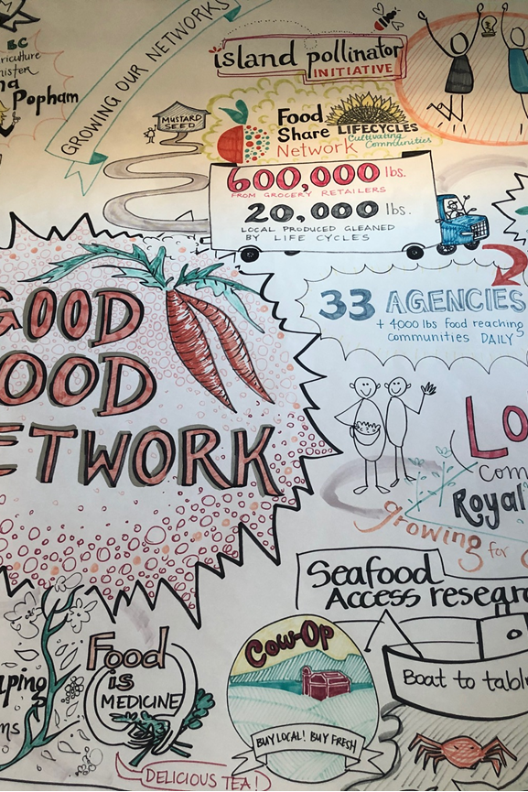



Slide 6

FOOD IS CELEBRATED AS VITAL TO VIBRANT CULTURE
GOOD FOOD FOR EVERYONE
FOOD SYSTEM IS PRIMARILY PLACE BASED AND REGENERATIVE
FOOD PROMOTES HEALTH AND WELLBEING

Slide 7
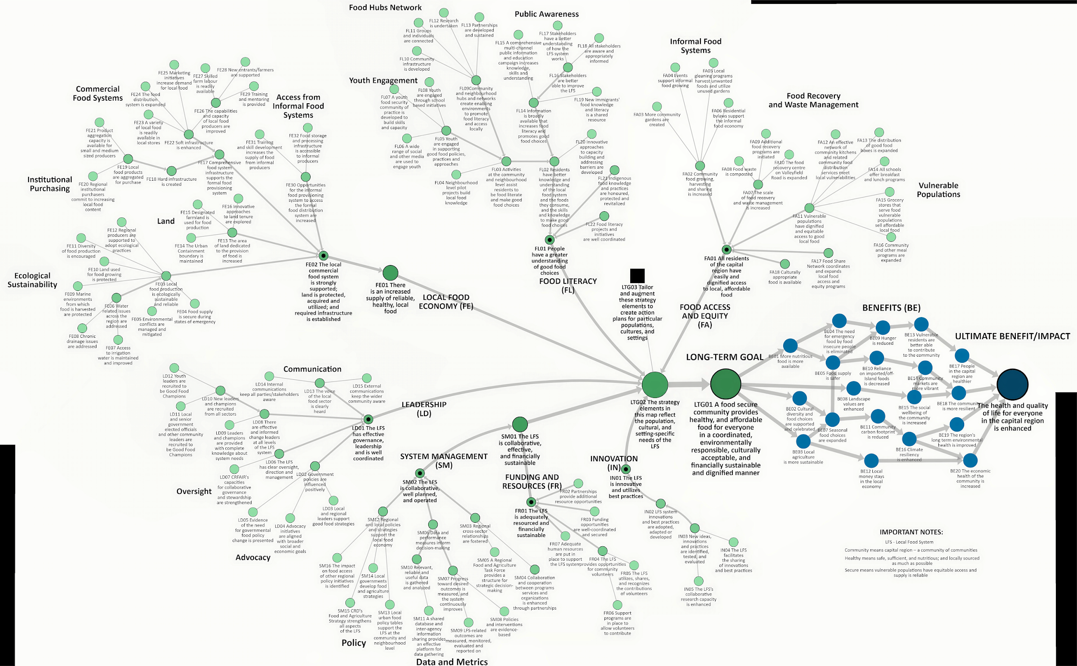
REGIONAL FOOD STRATEGY ROAD MAP

Slide 8
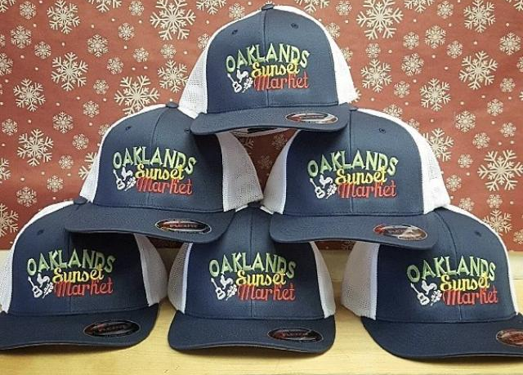
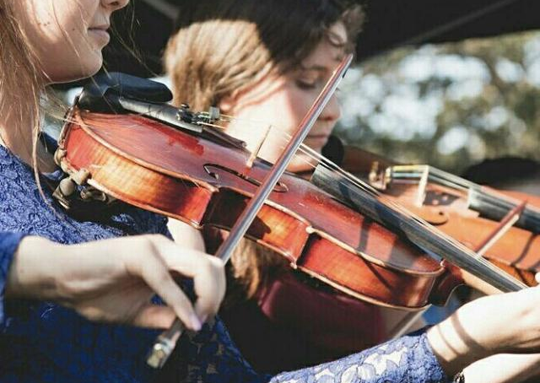
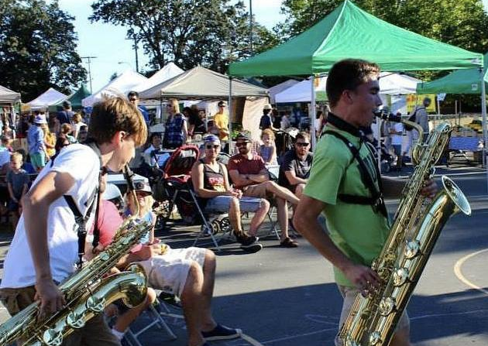
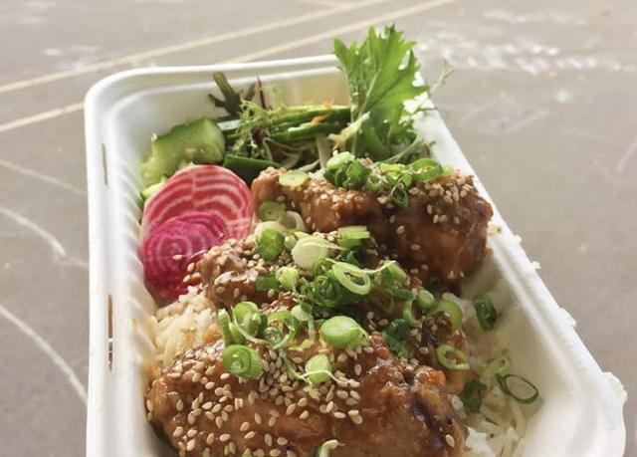

Slide 9
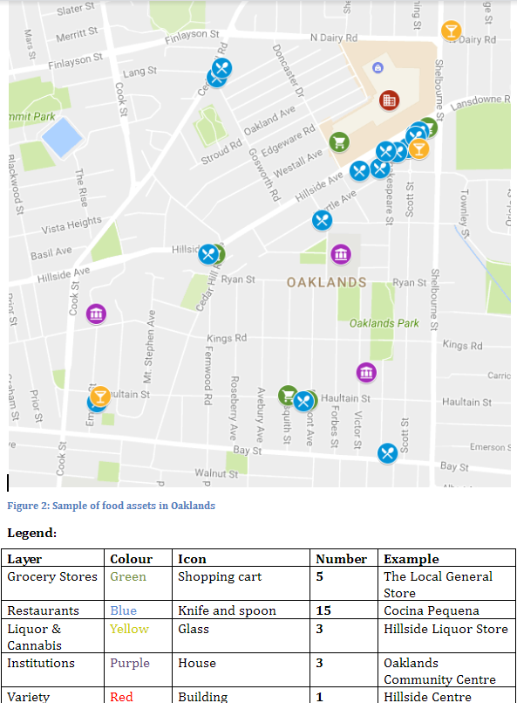

Slide 10
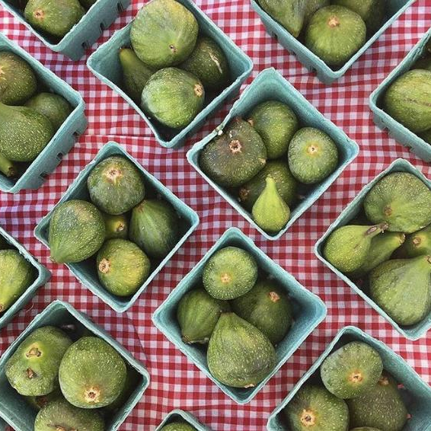
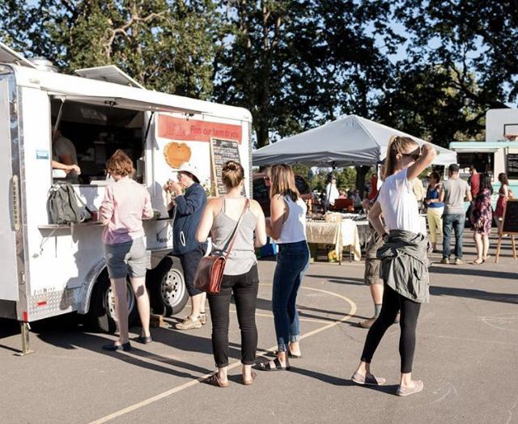
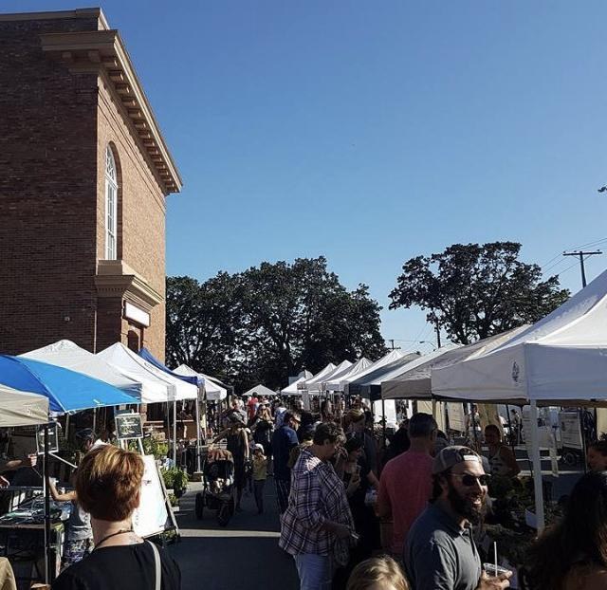

Slide 11
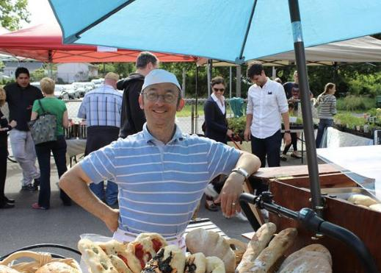
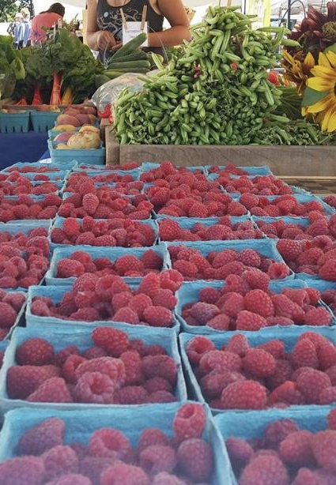
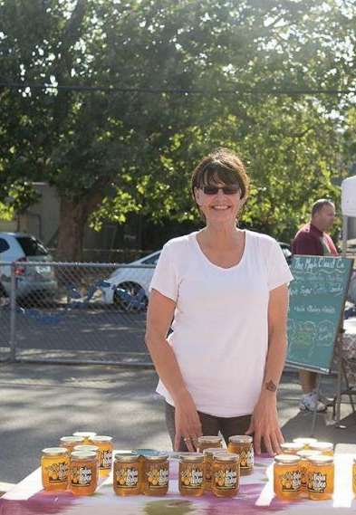

Slide 12
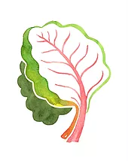
TAKE AWAYS FOR PLANNING AHEAD
The land and seas that we have, we have
Quality of life in the future depends on a cultural shift now
Good Food can be a driving value for planning
Oaklands and area is building foundations
New Foodways must be forged
Eggs in many baskets-diversity is resilient

Slide 13
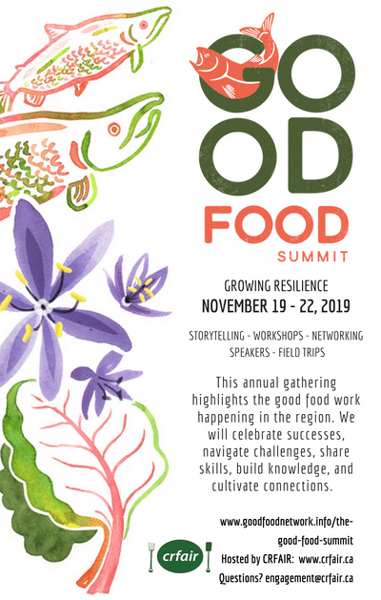

Slide 14

LINDA GEGGIE
LGEGGIE@CRFAIR.CA
WWW.CRFAIR.CA

