Slide 1
Shopping Centre? What’s a Shopping Centre?
The Future of Retail in a Digital World

Slide 2
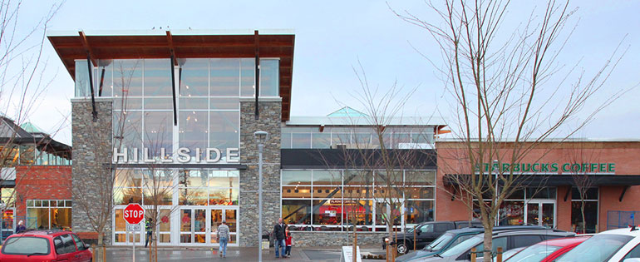
Sustainable?
When you hear the word “sustainable” what do you think of?
Energy and water conservation?
Waste management and recycling?
Green business practices?

Slide 3

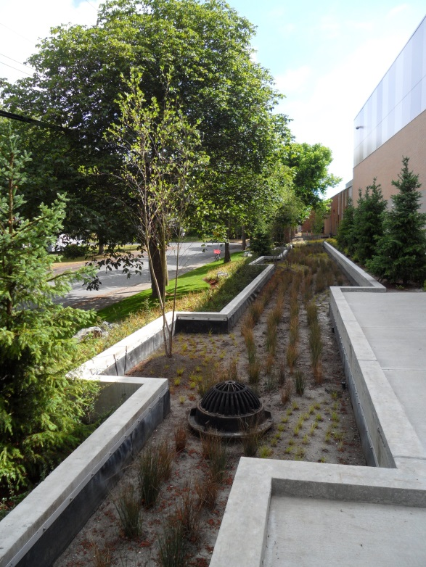
Green is good!
Hillside’s Green Commitment
Responsible Property Management – Hillside has achieved Platinum Certification by BOMA (an international green building certification program) and received a Greenhouse Gas Reduction Leadership Award.
Local Landscaping – Hillside’s landscaped area includes plants indigenous to the area, rain gardens, permeable pavers and bio-swales all of which help remove contaminants from surface run off water.

Slide 4



Green Clean – Hillside incorporates the use of green cleaning products, low VOC products and encourages the re-use of building materials wherever possible.
Powerful Thinking – We benchmark and measure all of our energy, water and gas consumption which allows us to make operational improvements to deliver better energy conservation. Low wattage lighting, LED technology and lighting controls are used throughout the centre and our heating/cooling units are equipped with high efficiency air filters and economizers. Hillside is equipped with EV chargers for customer use.
The Beginning of the End – When a product reaches the end of its useful life, Hillside has an extensive material and waste recycling and recovery program that includes paper, cardboard, cans, plastics, film, glass, cooking oil and organic waste. Hillside’s current diversion rate stands at 77% . In addition Hillside has helped to repurpose an annual average of 9,040 litres of cooking oil into bio-fuel resulting in the reduction of approximately 27.70 tonnes of CO2E per year.

Slide 5
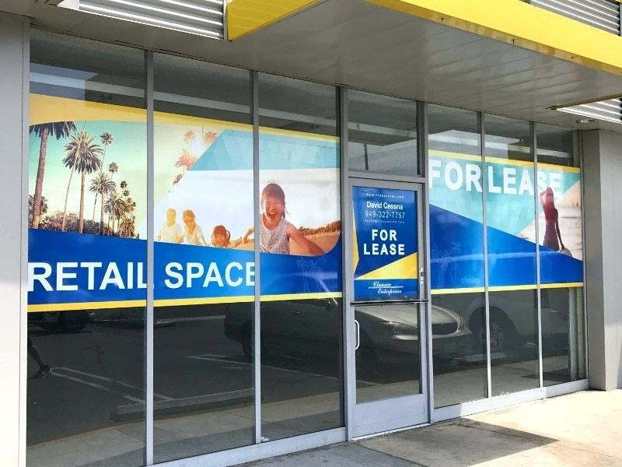
Sustainable – “an ability or capacity of something to be maintained or to sustain itself”
Shopping Centres and retail in general is undergoing the most profound transformation in its history.
Rapid advances in technology, the influence of Millennials and changes in shopping trends have created new challenges. In the last 3 years more than 7,000 North American stores closed their doors. Here in Canada the loss of retailers like Sears, Bombay, Payless Shoes, Crabtree & Evelyn, Jacob, Gymboree, Charming Charlie and now Forever 21 have left shopping centres scrambling to fill the empty spaces.

Slide 6
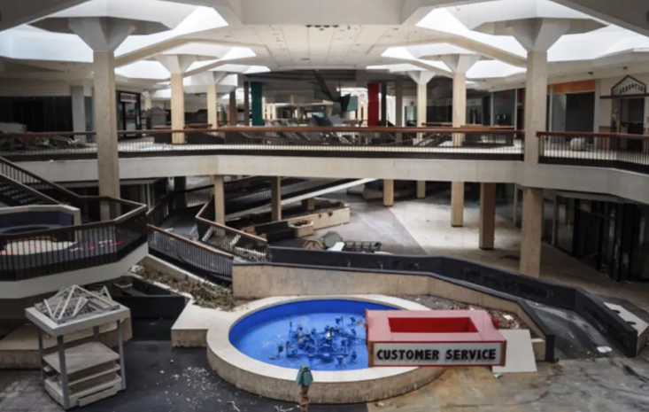
So … in five years, ten years or more will shopping centres be empty abandoned buildings? Will we buy everything from soup to shoes on-line?

Slide 7

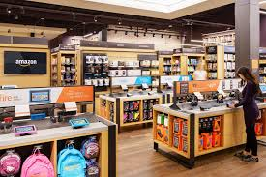
Bricks & Mortar and On-Line Retail – Partners in E-Commerce
We are pleased to announce that the retail apocalypse has been cancelled – because humans do occasionally like putting down their smartphones, leaving their sofas and going shopping .. even Millennials. According to consulting firm A.T. Kearney 90% of North American retail sales still occur in a physical store.
As we move forward a new hybrid form of shopping will emerge – one where consumers move seamlessly between physical and digital shopping.
Major e-tailers such as Amazon are rolling out bricks and mortar stores in an effort to solidify their brands and curate their product assortments.

Slide 8
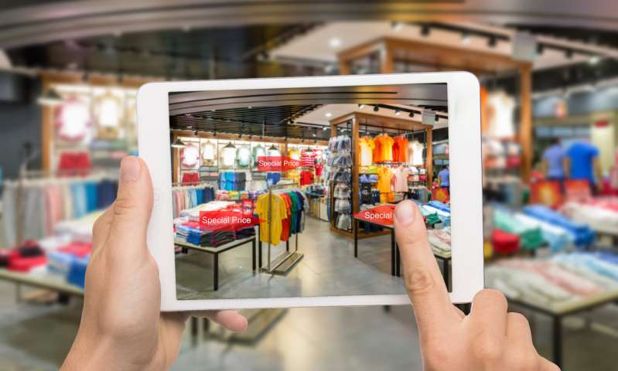
Hybrid retail outlets will be smaller in size and carry less inventory as consumers check out the product in store but then purchase on-line. They will be tech heavy with smart changing rooms, un-manned ordering kiosks, digital check outs and interactive activities and events.
The retailers of the future will rely less on inventory and more on creating personalized brand experiences.

Slide 9

Smart Centres
Shopping centres will share in the new technologies with the creation of their own shopping apps, e-lounges, mobile payment systems, smart parking lots, more sophisticated interactive websites and digital in centre directories.
Enhancing the shopping experience of consumers through accessible, easy-to-use technology will become a top priority in the shopping centre of the not so distant future.

Slide 10
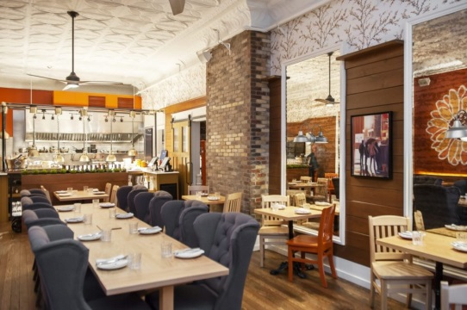



Dining, Leisure and Entertainment Centres .. Oh and Shopping Too.
As retail “downsizes” rising consumer demand for more things to do rather than more things to buy will spur an evolution of old retail space into entertainment venues that may include a multitude of restaurant offerings along with event spaces, libraries, gyms, cinemas, theatre space and even places of worship. Shopping centres will have to provide experiences and things to see and do that reward the consumers investment of time and entertain the whole family.
The shopping centre will play a greater role in the community’s cultural life and become a social hub for its residents.

Slide 11

Home Sweet Home?
Called Retaildential Centres, shopping centres of the future may become a community unto themselves with the addition of residential housing. These mixed use centres will appeal to maturing baby boomers looking to downsize and gain convenient access to various services as well as young professionals attracted by the restaurants, theaters and live-play offerings. Some mixed use projects will add office and medical space thereby creating the perfect twenty minute neighborhood for its residents .. Live, Work, Play .. Perhaps the new definition of sustainability.

Slide 12

Acknowledgements
International Council of Shopping Centres – Envision 2020, The Future of the Shopping Centre Industry
4 Models of the Shopping Mall of the Future – Pamela N. Danziger
Retail Predictions – Elizabeth Segran
HILLSIDE CENTRE

