Slide 1
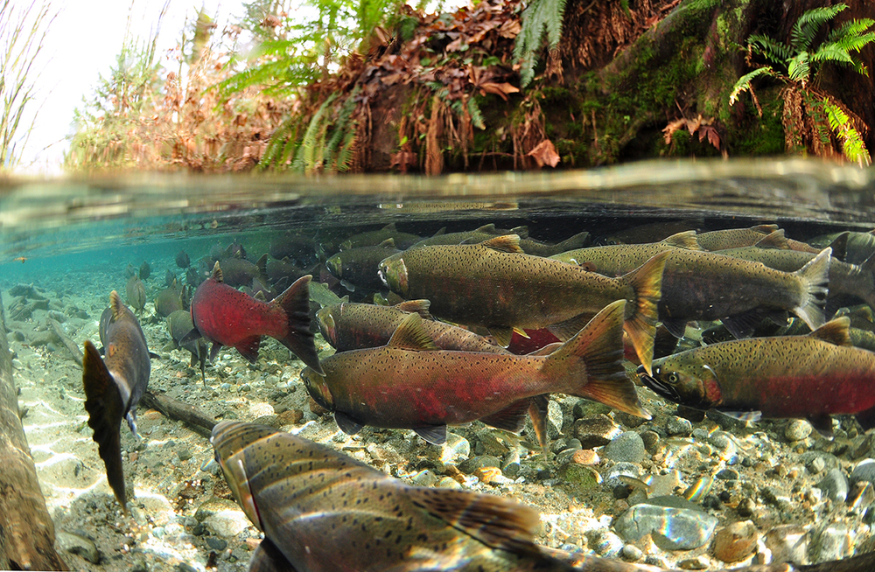
The Future Oaklands Green Space
Climate Change and The Value of Urban Green Space

Slide 2
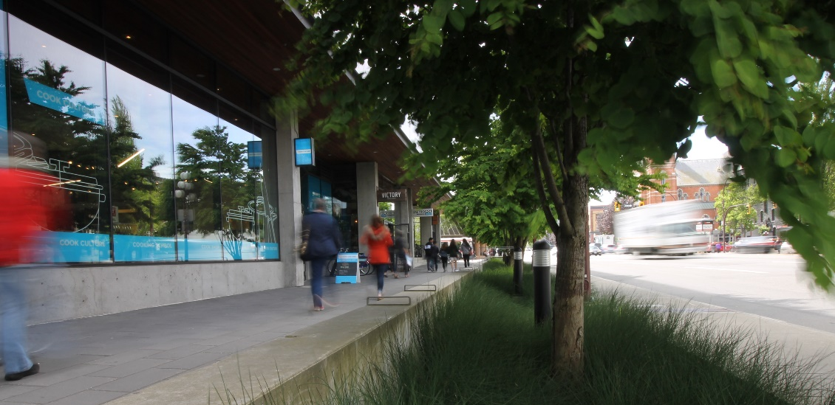
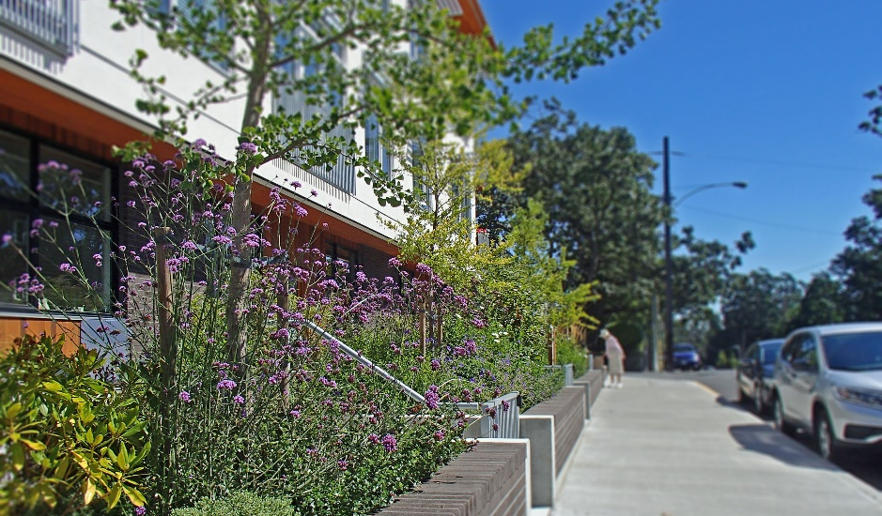
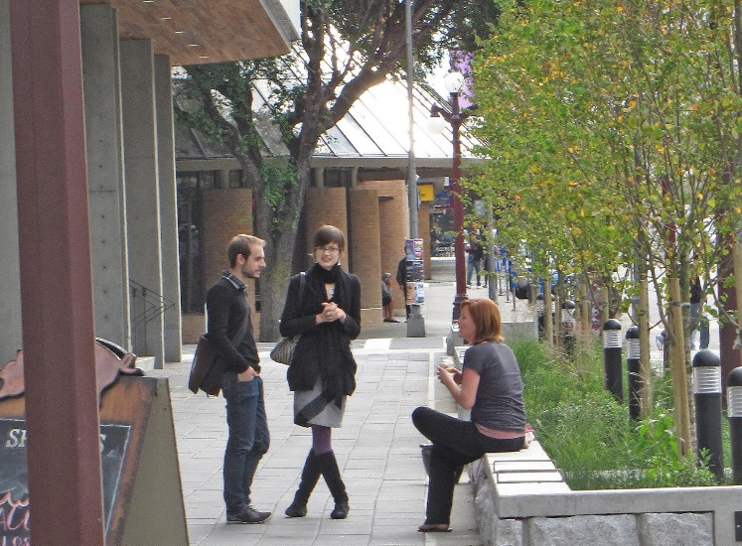
The Future of Oaklands Green Space:
Climate Change and
The Value of Urban Green Space
Historical and Current Landscape Condition and Landscape Systems
Climate Change Impacts
    Wetter Winters, Drier Summers
Climate Change Adaptation using Landscape
    Soil, Roots + Trees
Integrating Functional Landscape
    Past/Current/Future Design Strategies
What does ‘functional landscape’ look like?
Forward 50 Years – Incremental Change

Slide 3
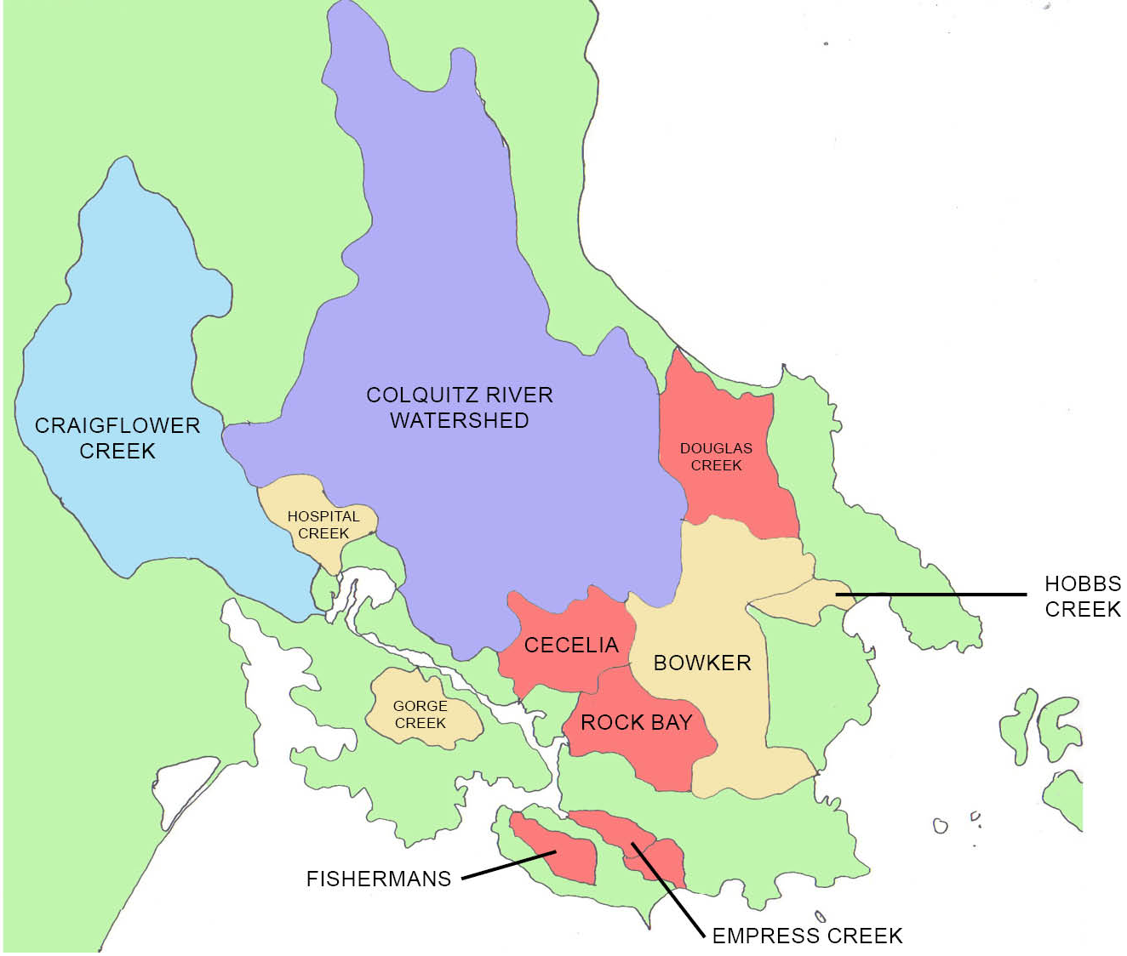
Lost &
Non-functional Streams
Oaklands

Slide 4
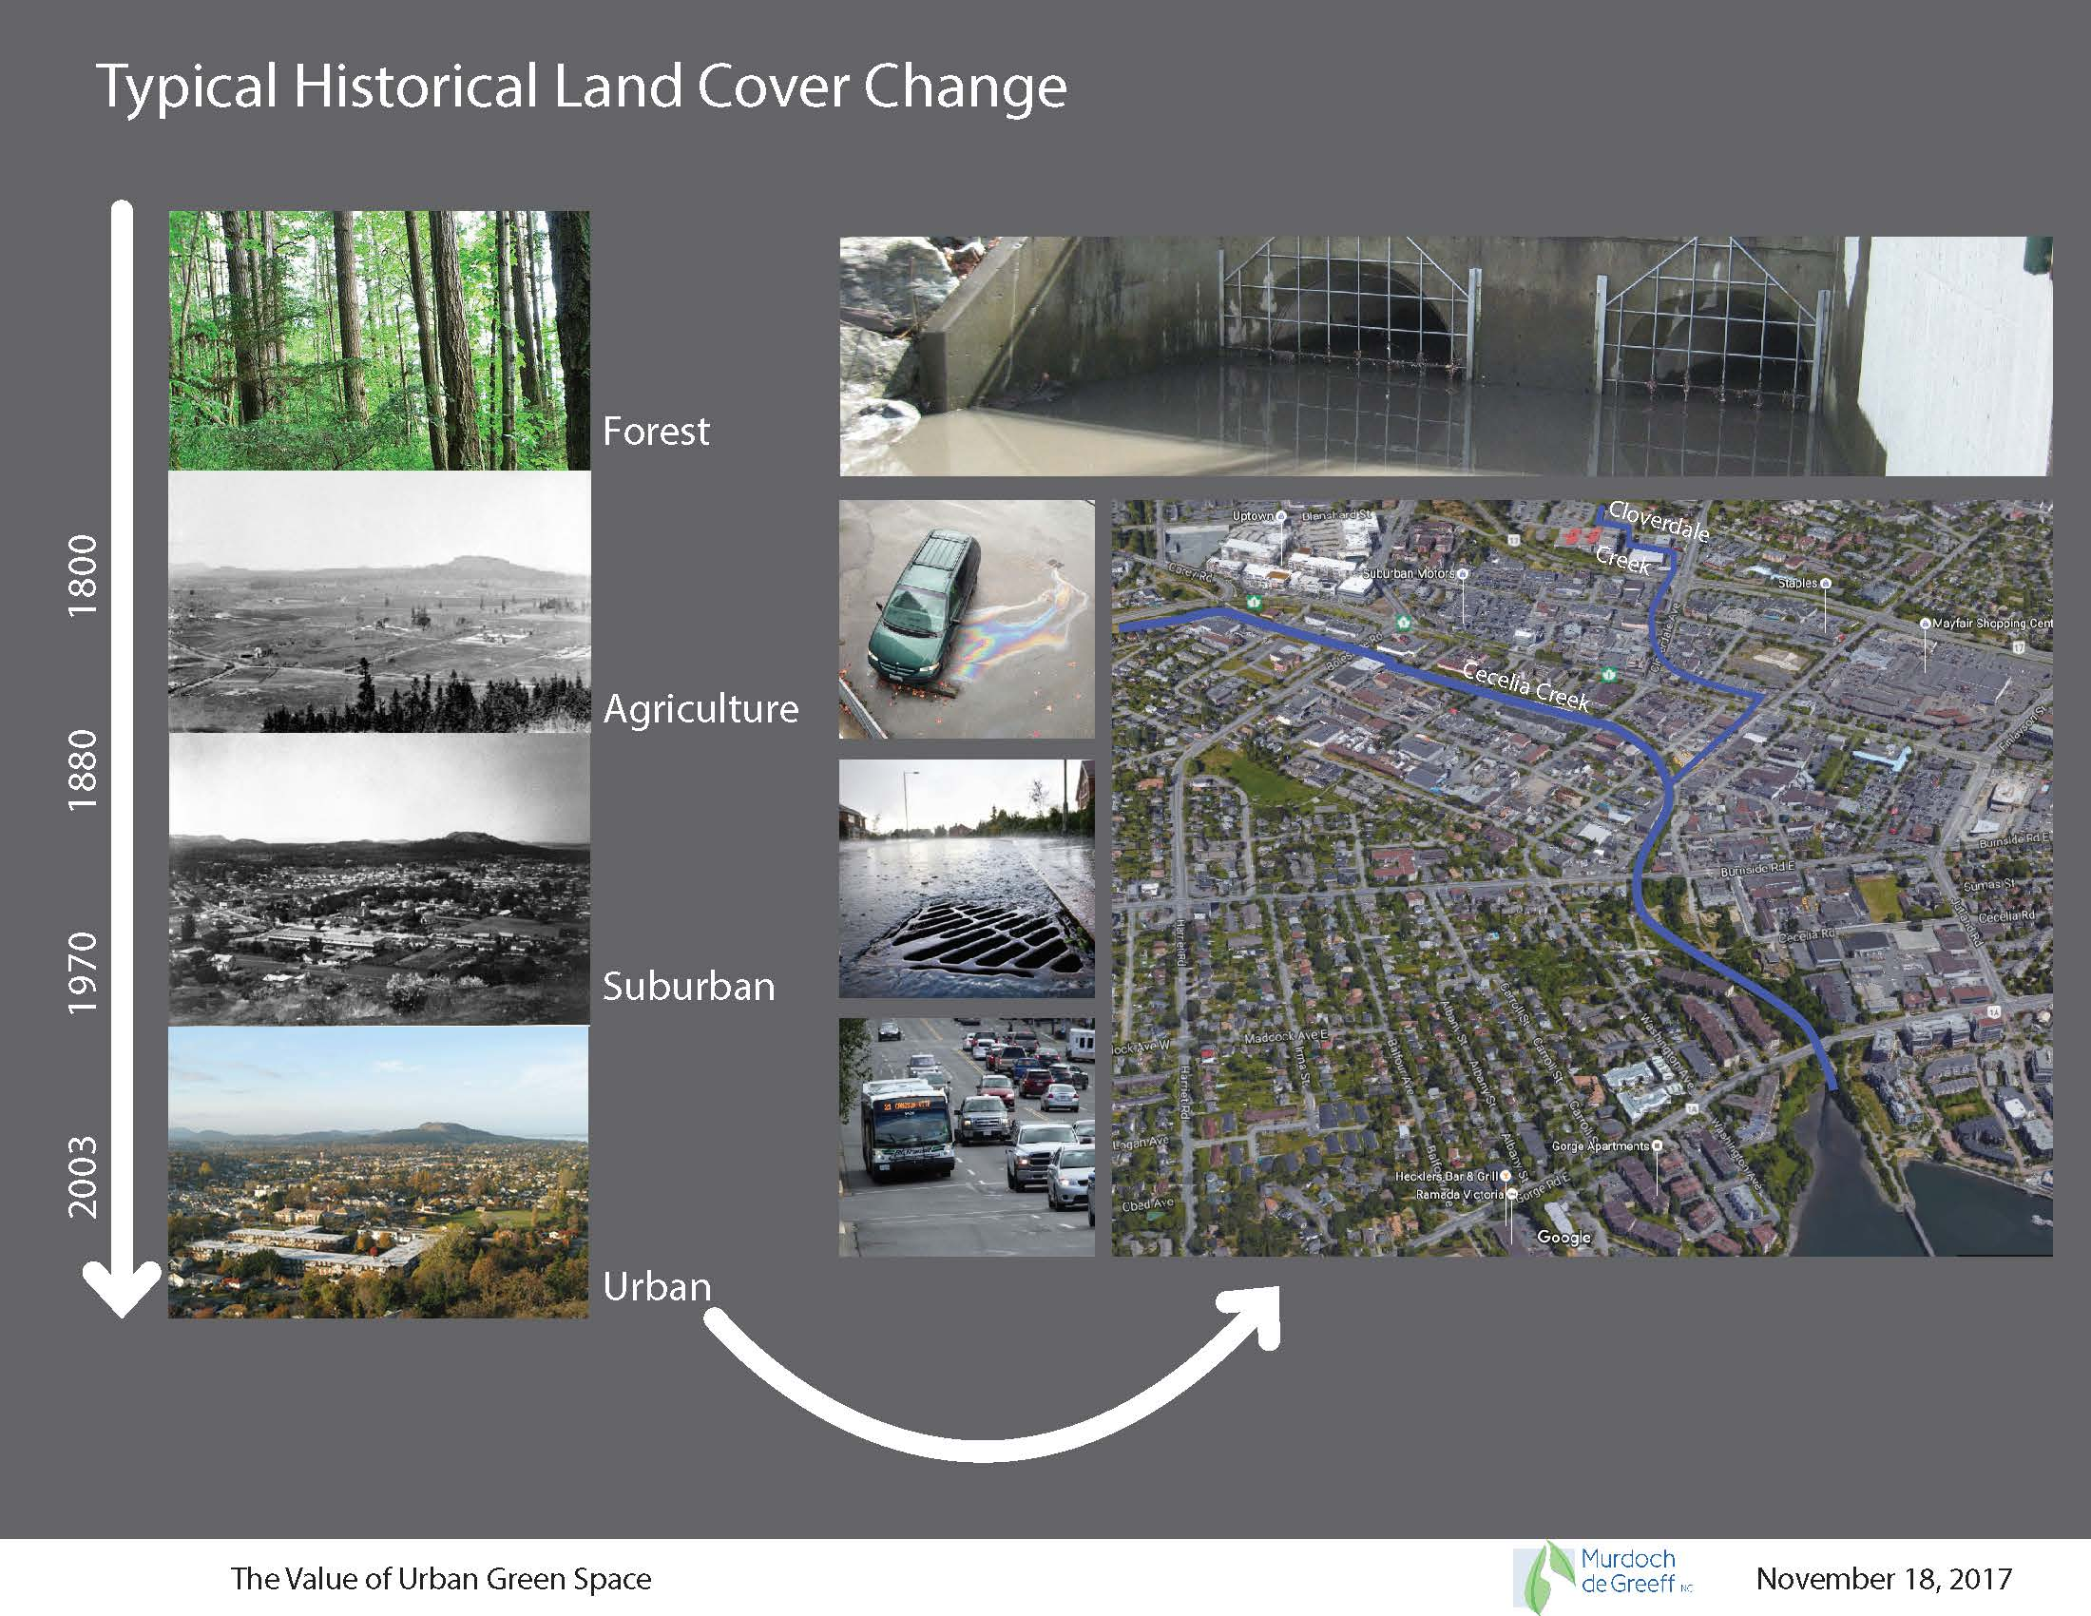
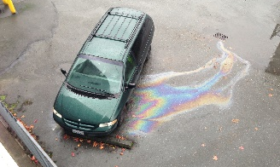
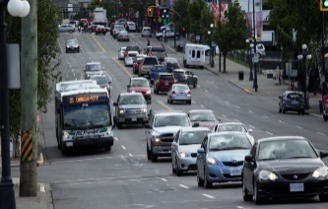
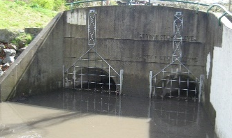
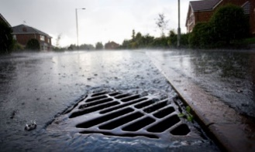
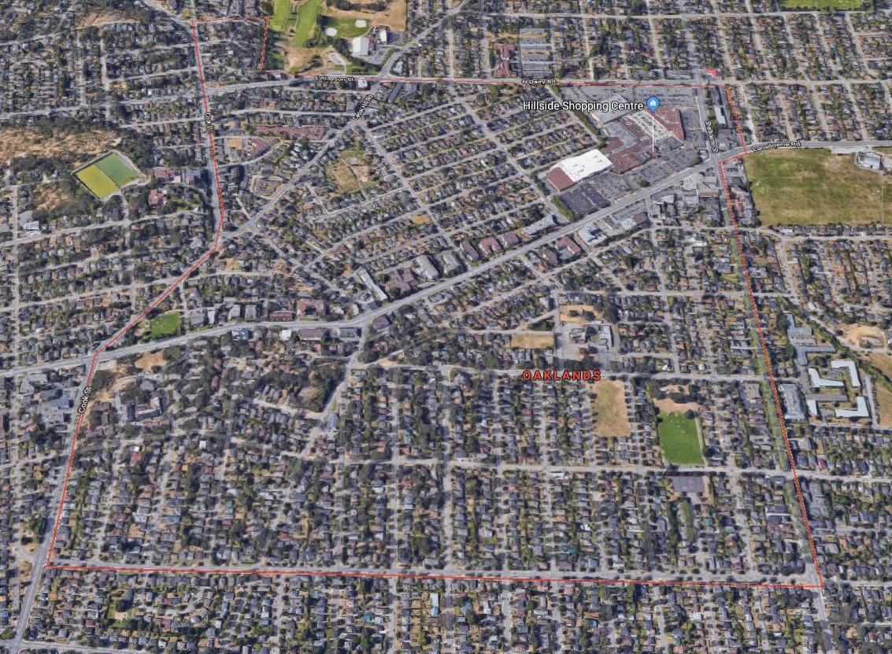
Historical Land Cover Change
1800
Forest
1880
Agriculture
1970
Suburban
Oaklands
2003
Urban

Slide 5
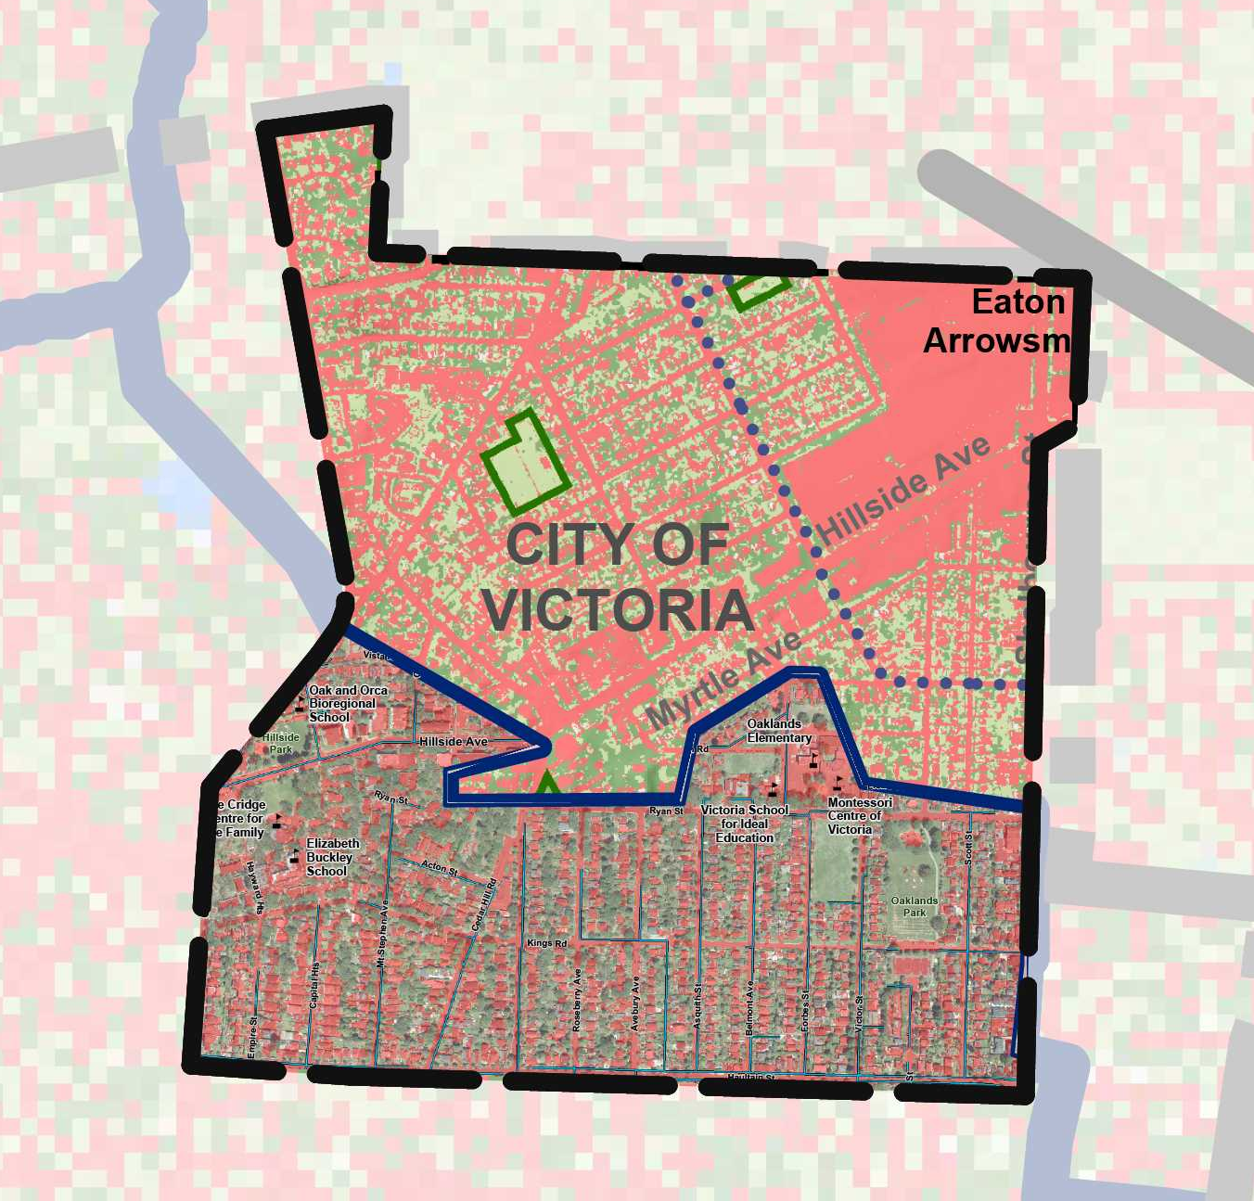
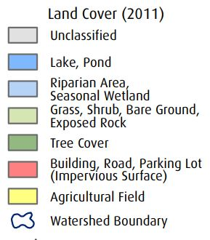
Land Cover
(2011)
Bowker Creek Watershed
Rock Bay Watershed

Slide 6
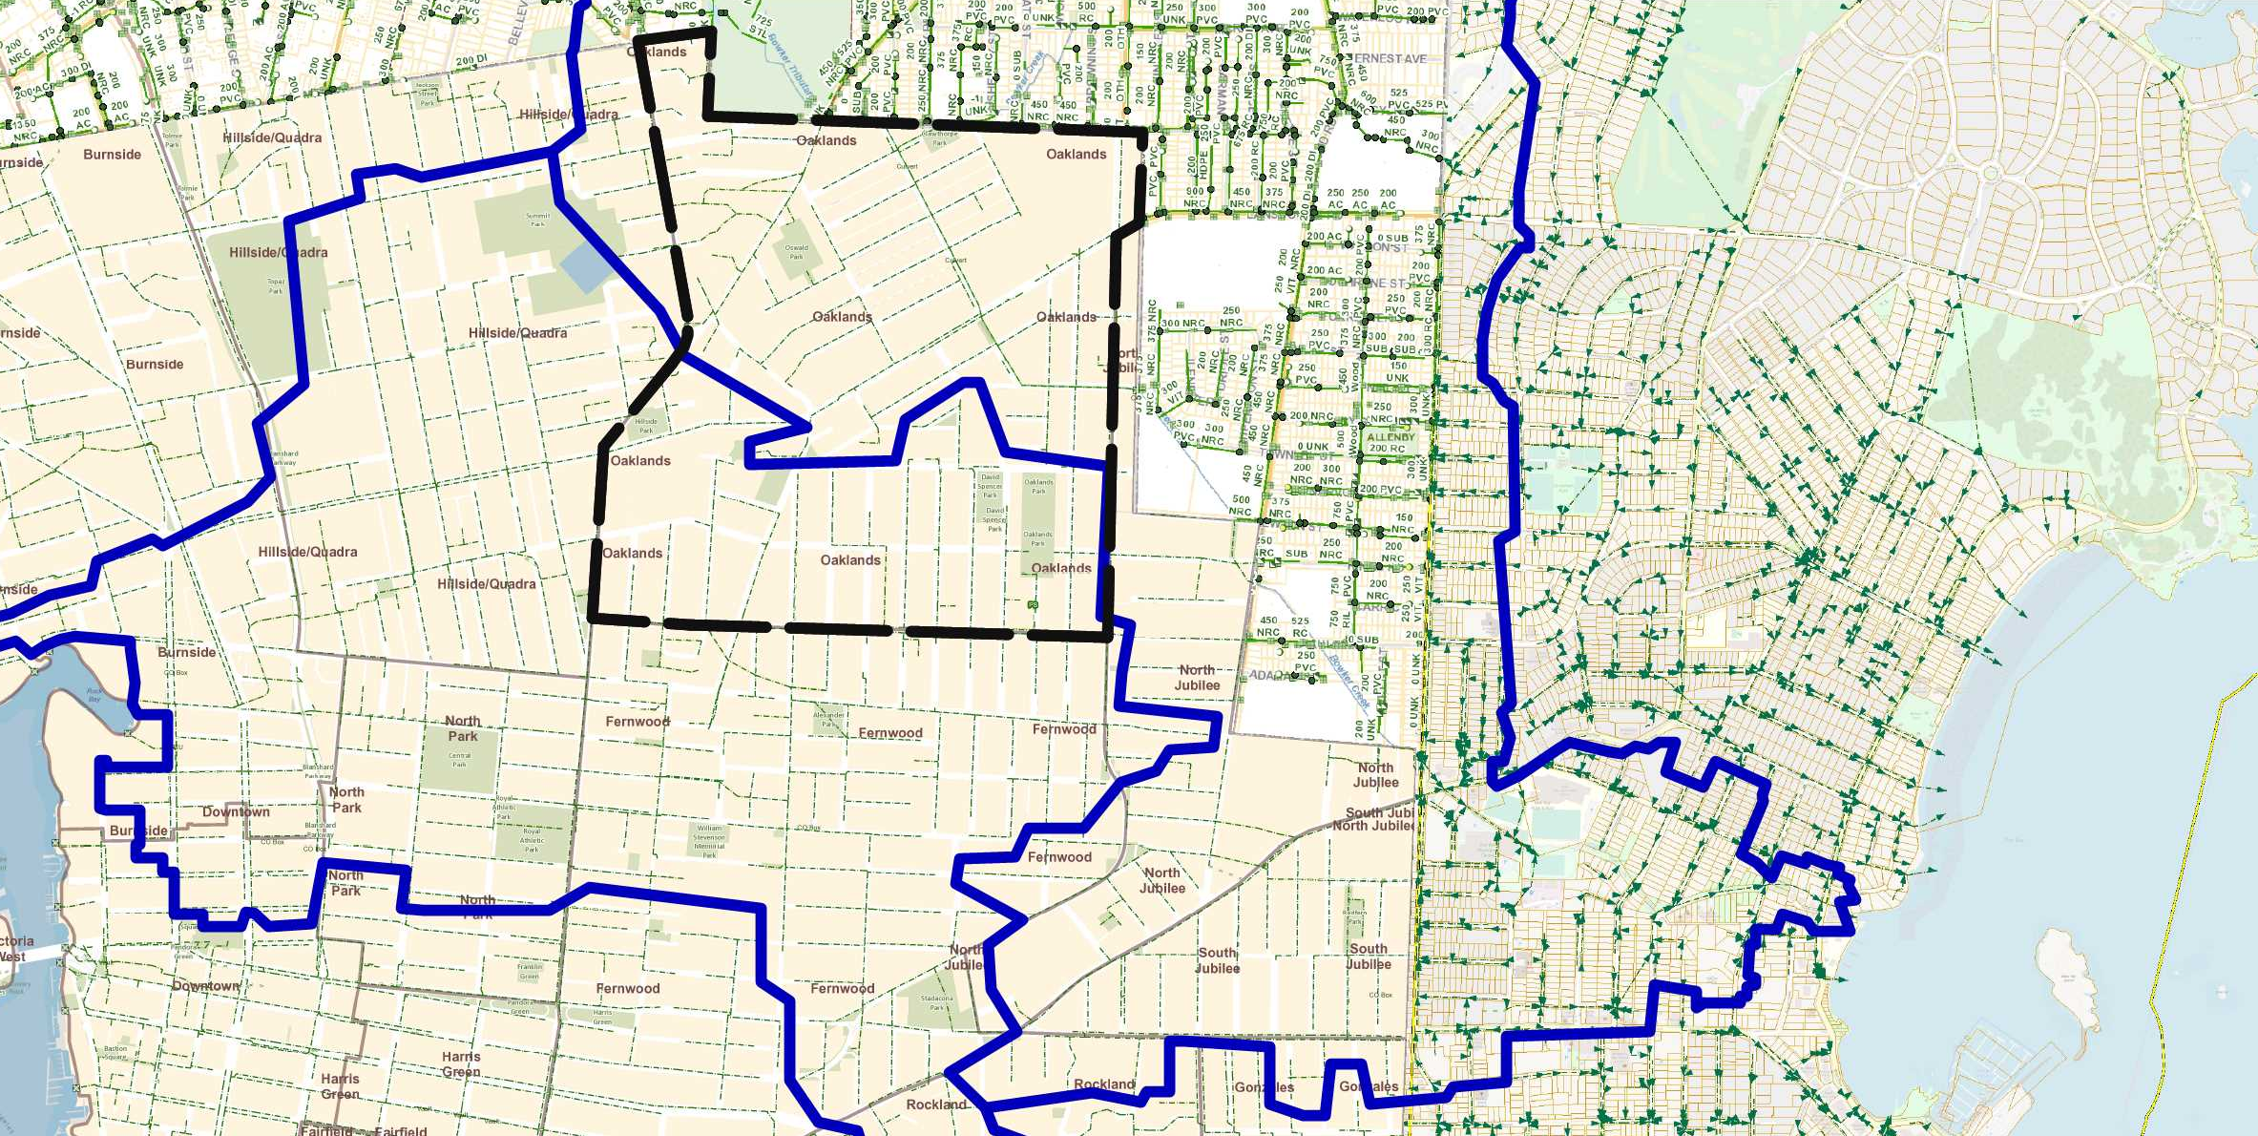
Drainage
to Rock Bay
to Oak Bay
Post-development : pipes
Pre-development: streams

Slide 7
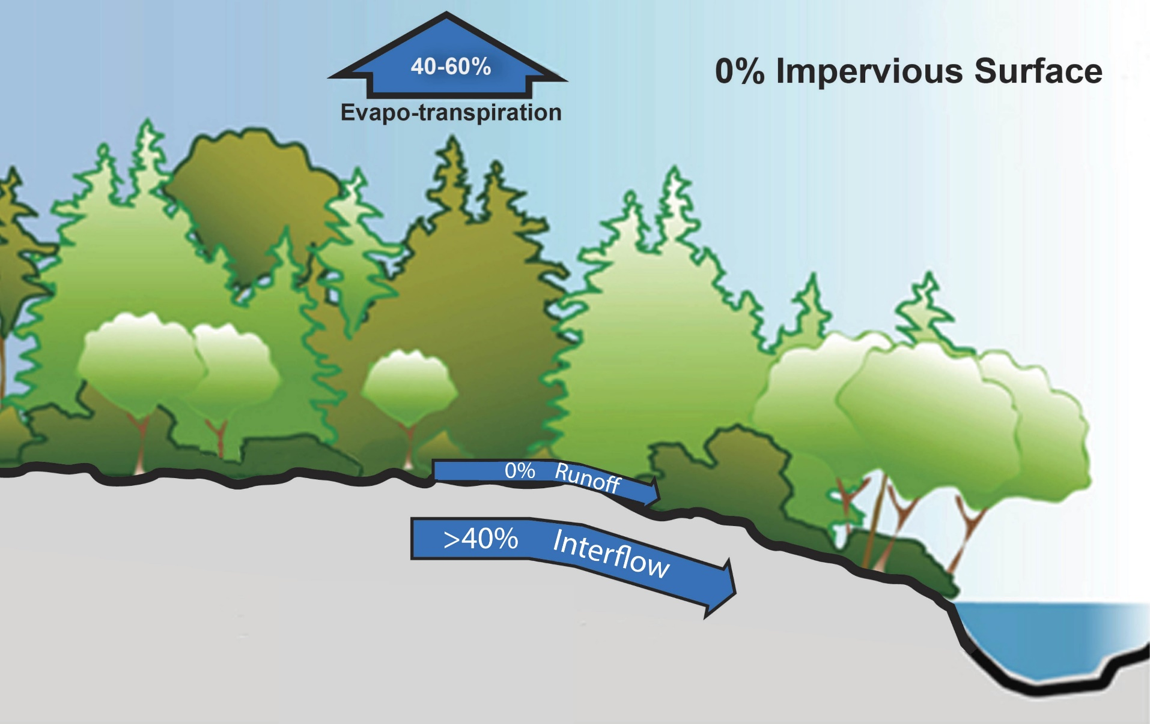
Pre-Development Landscape System
Extensive Tree Canopy
Rough Micro-Topography
Depression Storage + Infiltration
Absorptive Living Soils

Slide 8
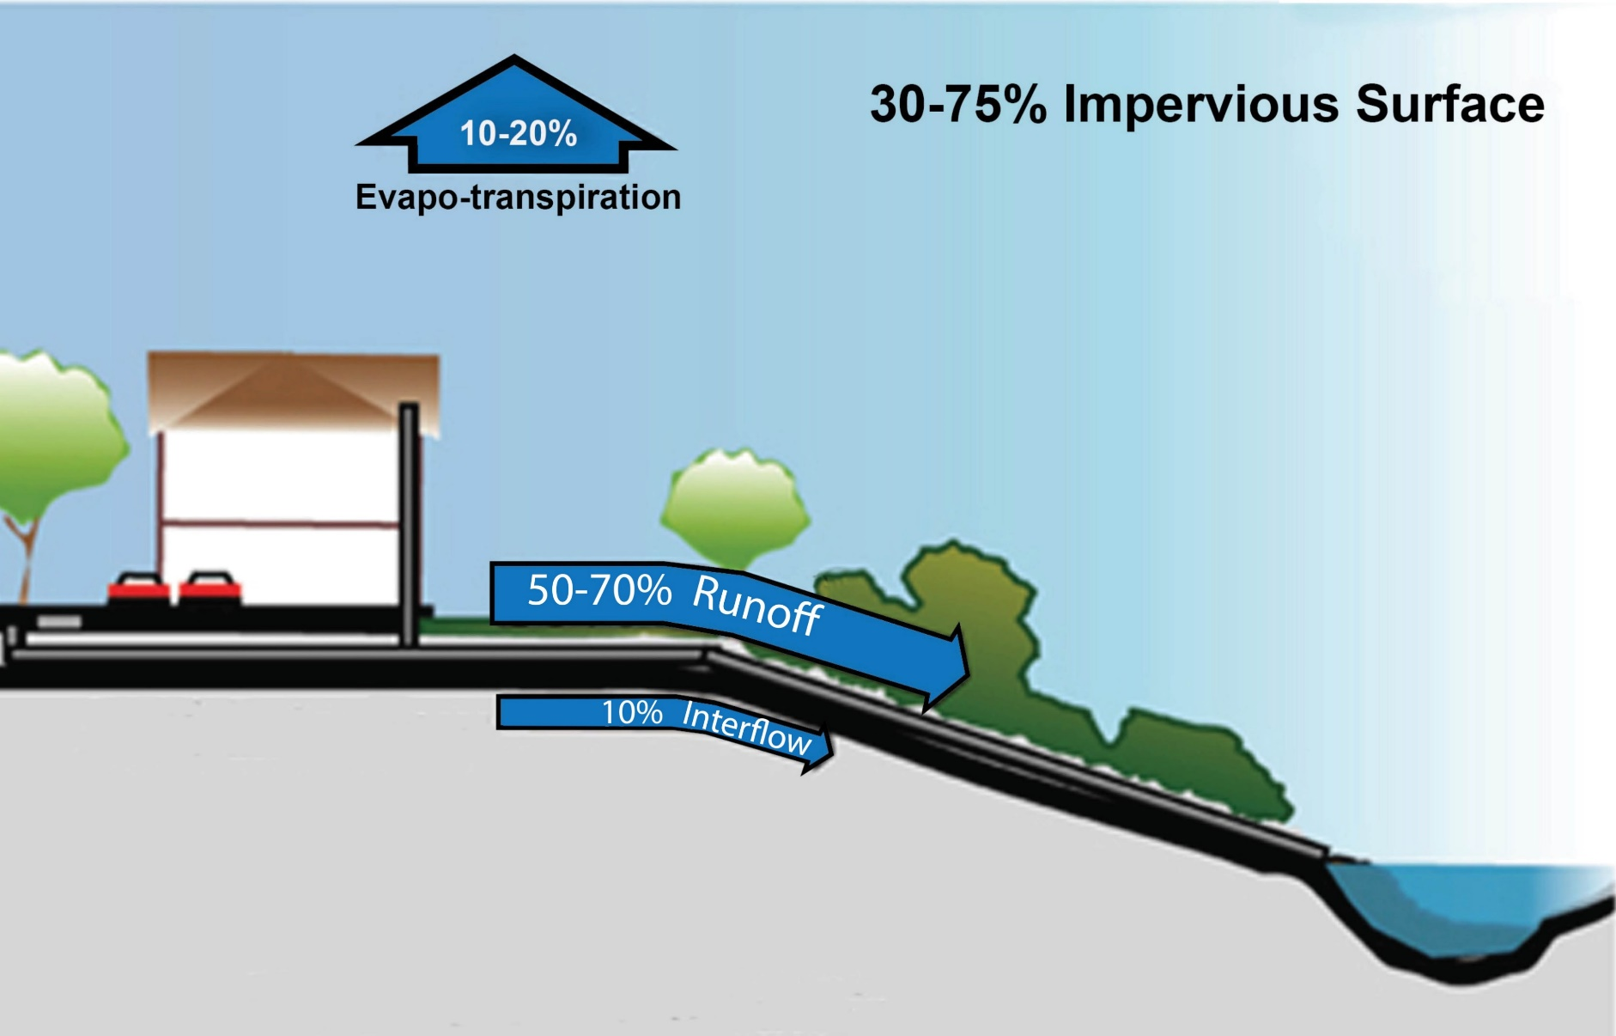
Current Landscape Function
Loss of Tree Canopy
Surface Smoothing
Piped Drainage System (Minimal Infiltration)
Living Soils replaced by Impervious Surfaces

Slide 9
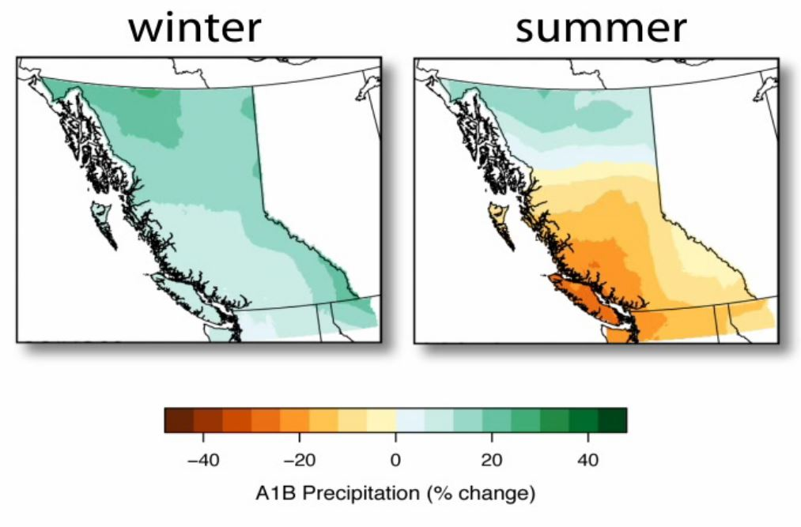
Climate Change in BC: Winter Precipitation
Increase storm intensity
Increased frequency of events
More precipitation in the fall and early winter

Slide 10
Climate Change in BC: Summer Precipitation
Reduced summer rainfall
Increased drought duration

Slide 11
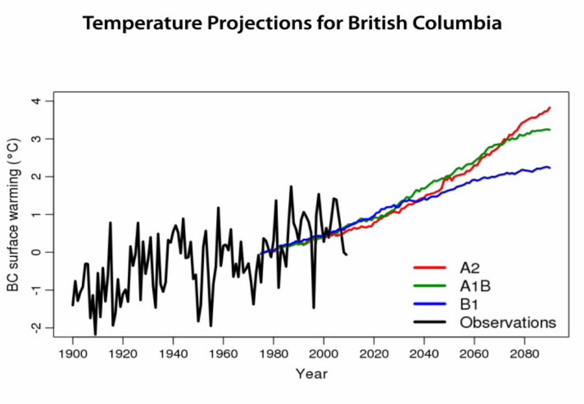
Climate Change in BC: Temperature Change
Warmer average temperature
Increased frequency of summer hot weather days
Urban heat island affect increase

Slide 12
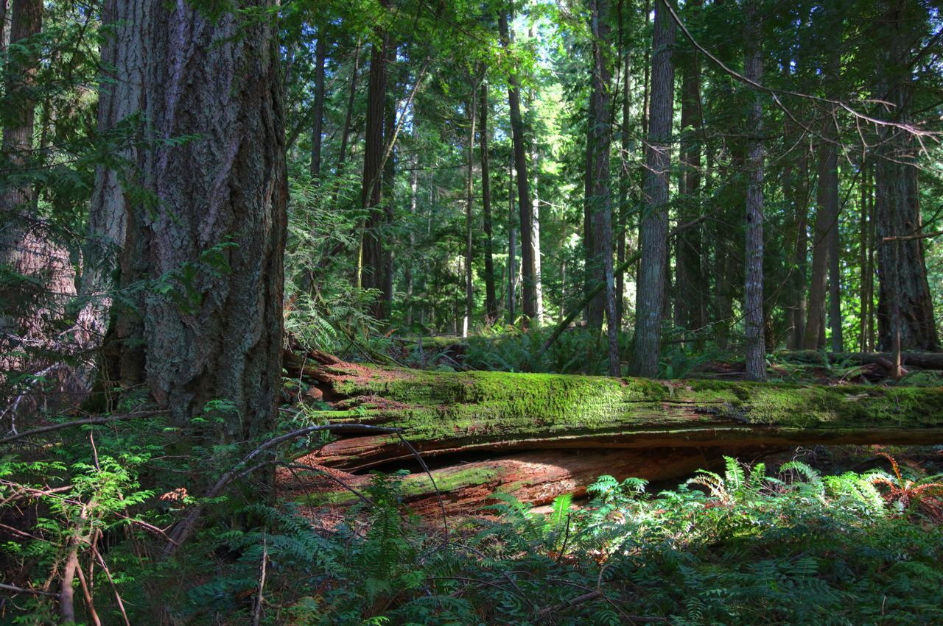
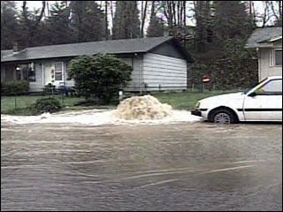


Which is more adaptable to climate change impacts?

Slide 13
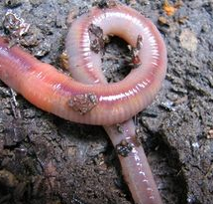
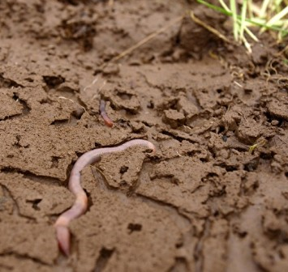
Urban Green Space Building Block:
Living Soils
One tablespoon of soil contains 50 billion microbes… conditions that favor soil life also promote plant growth and help breakdown and/or capture pollutants.
“A square metre of grassland or temperate woodland will have from 100-500 earthworms”
Clive A. Edwards, Ohio State University

Slide 14
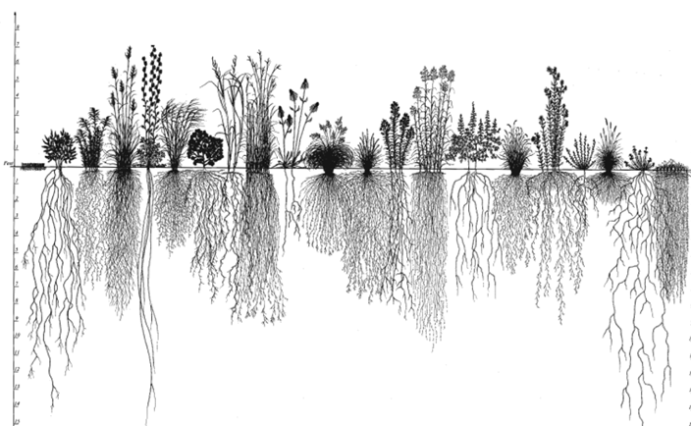
Urban Green Space Building Block:
Roots and Infiltration
“Black Oak and Red Maple Trees… penetrated compacted soil, increasing infiltration rates by an average of 153% compared to an unplanted control.”
Bartens et. Al. 2008
Deep Roots
Enhance Infiltration
Dense Roots
Create Soil Stability and Resistance
Dead Roots
Contribute to Soil Organic Matter, Carbon Fixation in the Soil, and Macropore Development

Slide 15
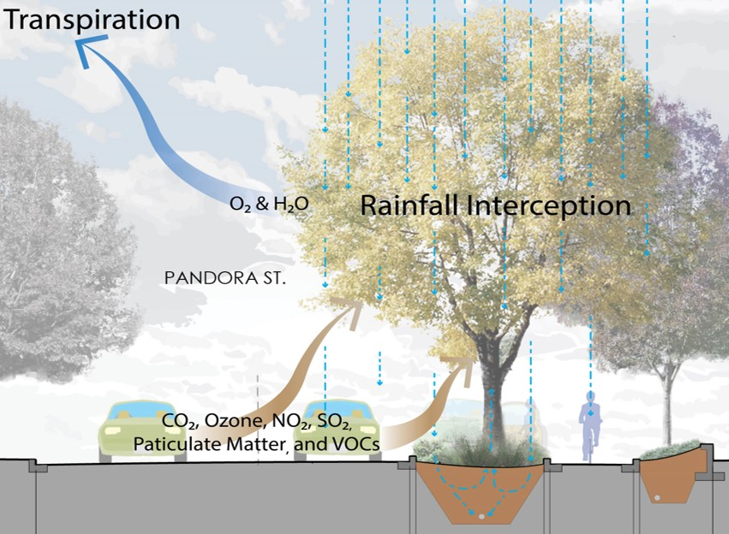
Urban Green Space Building Block:
Trees
Interception
10-45% of Annual Rainfall (Water use by trees, 2005)
Transpiration
30-39% of Annual Rainfall (Water use by trees, 2005)
Pollutants and CO2
A large tree averages up to 263 lb of CO2 savings directly and indirectly annually.
(Western Washington and Oregon Community Tree Guides, 2002)

Slide 16
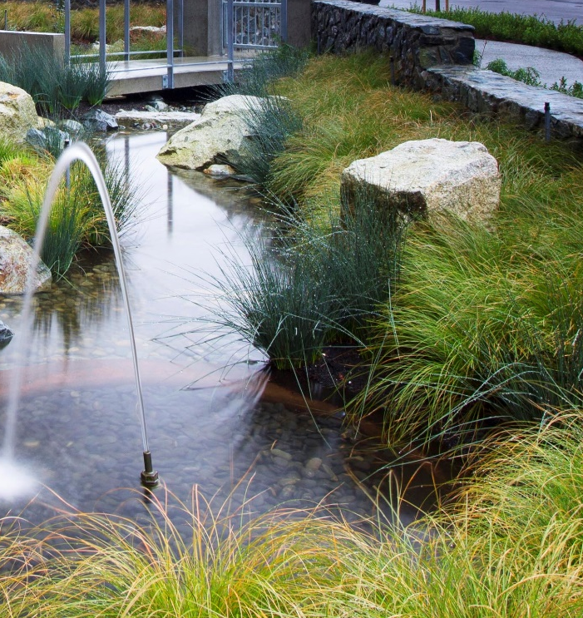
Designing Green Space for Climate Change Adaptation
Integrating natural functions in urban landscape
Notes:
How do we use trees, soils and roots to manage stormwater? While the image of the forest on the right is lovely, we’re not talking about restoring urban landscapes to their historical condition. We’re talking about installing landscapes that mimic the functions and services provided by the natural landscape, in a form that fits within the urban context and space.

Slide 17
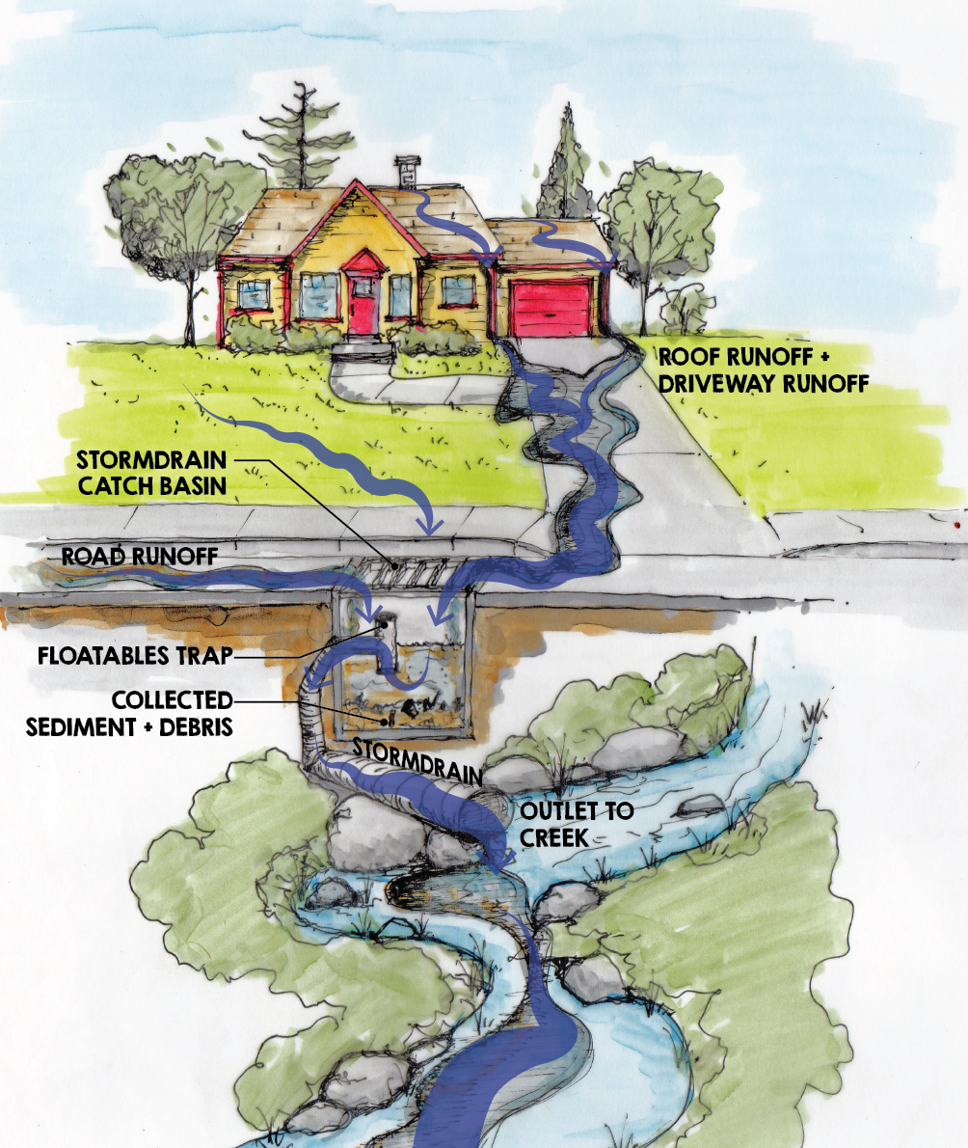
‘Old School’ Approach to Stormwater Management runoff directed quickly from impervious surfaces to infrastructure and then to marine environments
Current Best Practice
runoff directed first to landscape
BUT there is often not enough room!!
Impervious surfaces (buildings, parking, driveways, walkways, etc) are priorities.
Oaklands – Forward 50
Notes:
The Old School approach to stormwater management is to direct runoff as quickly as possible to storm pipe system. In this example, we have our nice little house. When it rains on that house, the runoff picks up sediments, pollutants, and debris from impervious surfaces, which then go directly into drains and pipes and into our streams and marine environment.
Click
Current best practice is directs runoff to landscape areas first. The blue area indicates runoff being is slowed, filtered, and cooled by the plants, soils and roots, before going to municipal storm system and downstream environment.
cLick
BUT! There is often not enough room to manage the volume of water generated by the impervious sufaces – building units, parking, sidewalks, and other infrastructure are the priority!

Slide 18
Future Best Practice
We need a shift in values!
Management of stormwater needs to be a ‘essential’ rather than ‘nice to have’
Oaklands – Forward 50
Notes:
To move forward, we need to see a shift in values! In the future, source control stormwater management needs to become essential or required, rather than “nice to have”. We need to make it a priority – and perhaps buildings and driveways and parking lots can get a bit smaller, while functional landscape areas get larger and more effective.

Slide 19
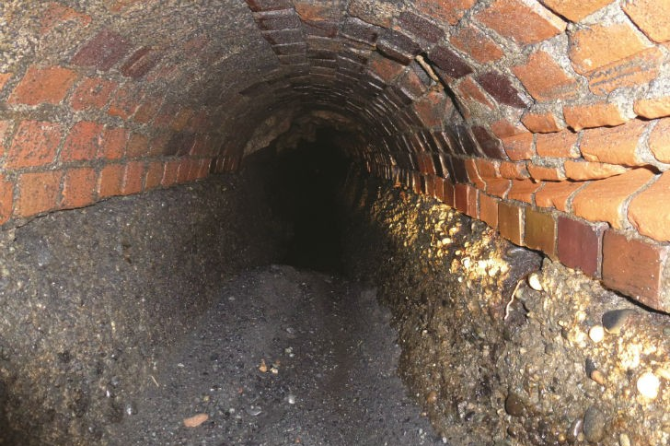
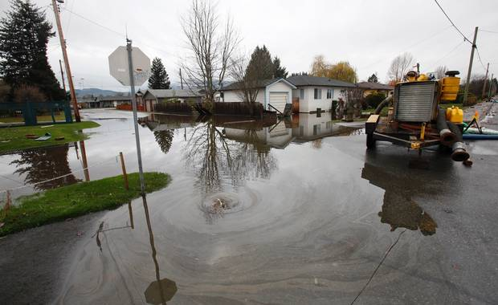
Functional Landscape: Impacts and Value in Urban Areas
Integrating green infrastructure into our urban landscape contributes to:
Increased capacity of existing infrastructure
Extended life of existing (aging) infrastructure
Incremental adaptation to climate change impacts
Oaklands – Forward 50
Notes:
And here’s why. As our land cover gets more and more impervious, more and more stormwater runoff is racing into our aging stormwater system. We are leaving ourselves at increased risk for flooding due to large rain events. If we begin to manage more stormwater in landscape, we begin to reduce the pressure on the existing infrastructure and buffer ourselves against the impacts of climate change.

Slide 20
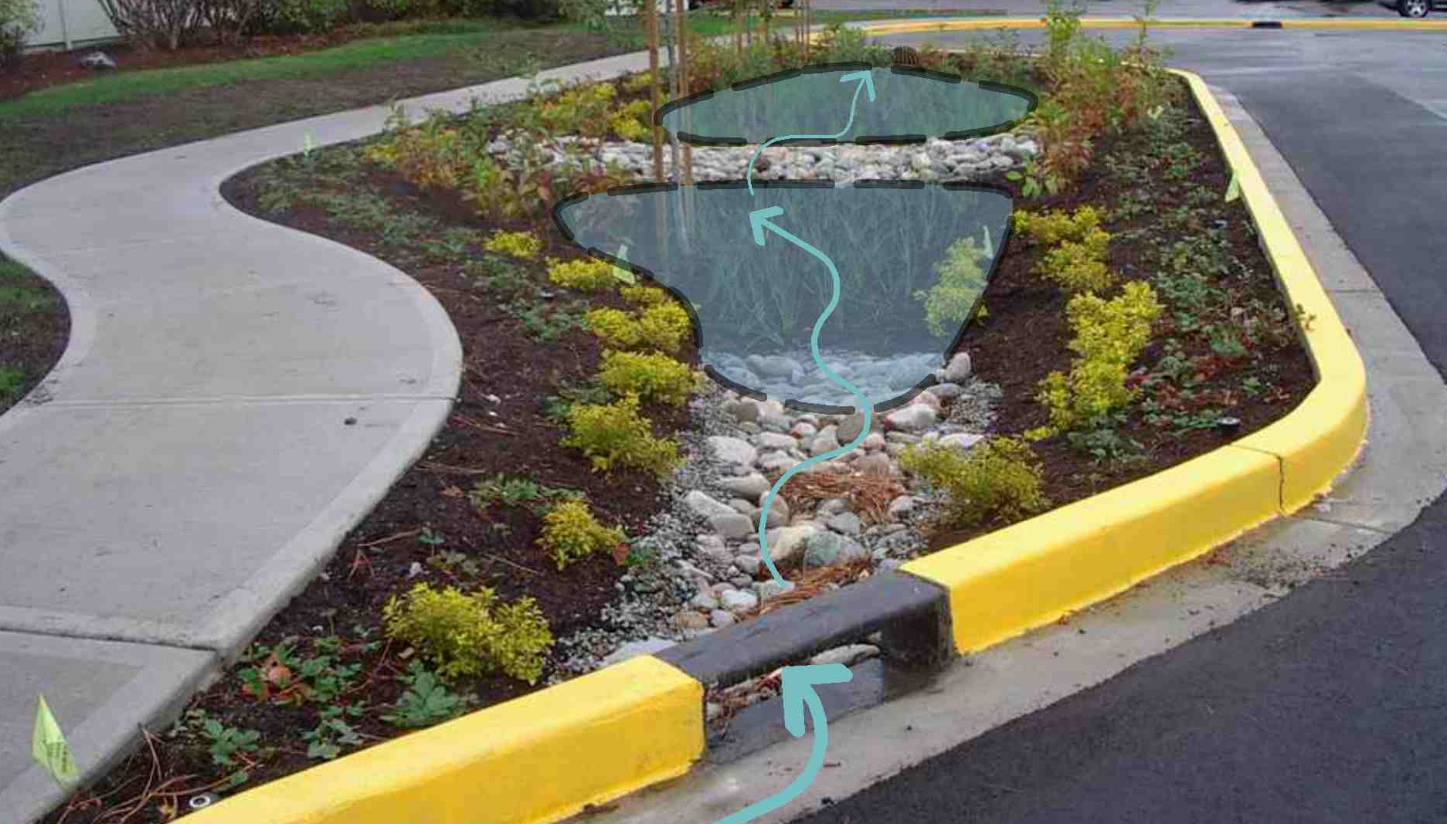
Functional Landscape in Urban Streets
Trent Street Rain Garden : City of Victoria
Notes:
Now, I’m going to show a bunch of pretty photos that will hopefully get you excited about stormwater management.
This is the first boulevard rain garden built by City of Victoria, on Trent Street. The curb cut allows water to enter a planting bulge. When it rains, runoff from the street enters the landscape area. The water pools in the rain garden, is filtered by the soils and the plants, and then flows through overflow drain into stormdrain system.

Slide 21

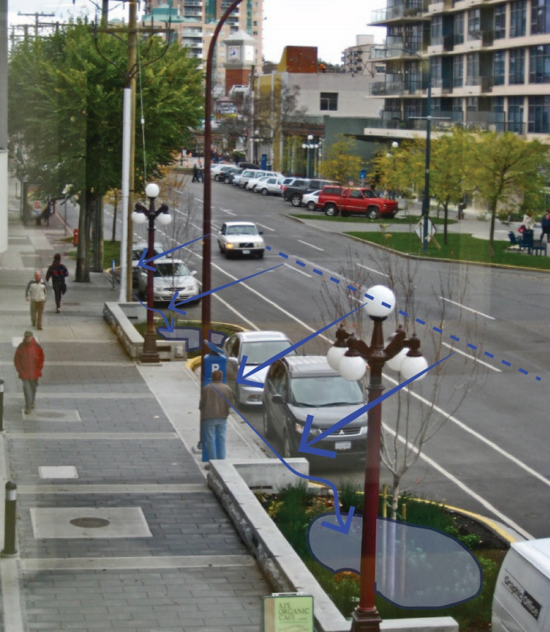
Functional Landscape in Urban Streets
Atrium Building (800 Yates St)
Victoria, BC
Notes:
The next example is also local. At the Atrium building, the developer built rain gardens in the boulevard area. Using a similar strategy to Trent St, the rainwater from the street flows into planting areas. The rain gardens manage the street’s runoff and at the same time create a more comfortable public realm, separating pedestrians from traffic.
These rain gardens clearly have had a big impact on the health of the boulevard trees. If you get a chance, go down take a look at the size of the trees in these planting bulges. It’s hard to believe that those trees were planting less than 10 years ago!

Slide 22
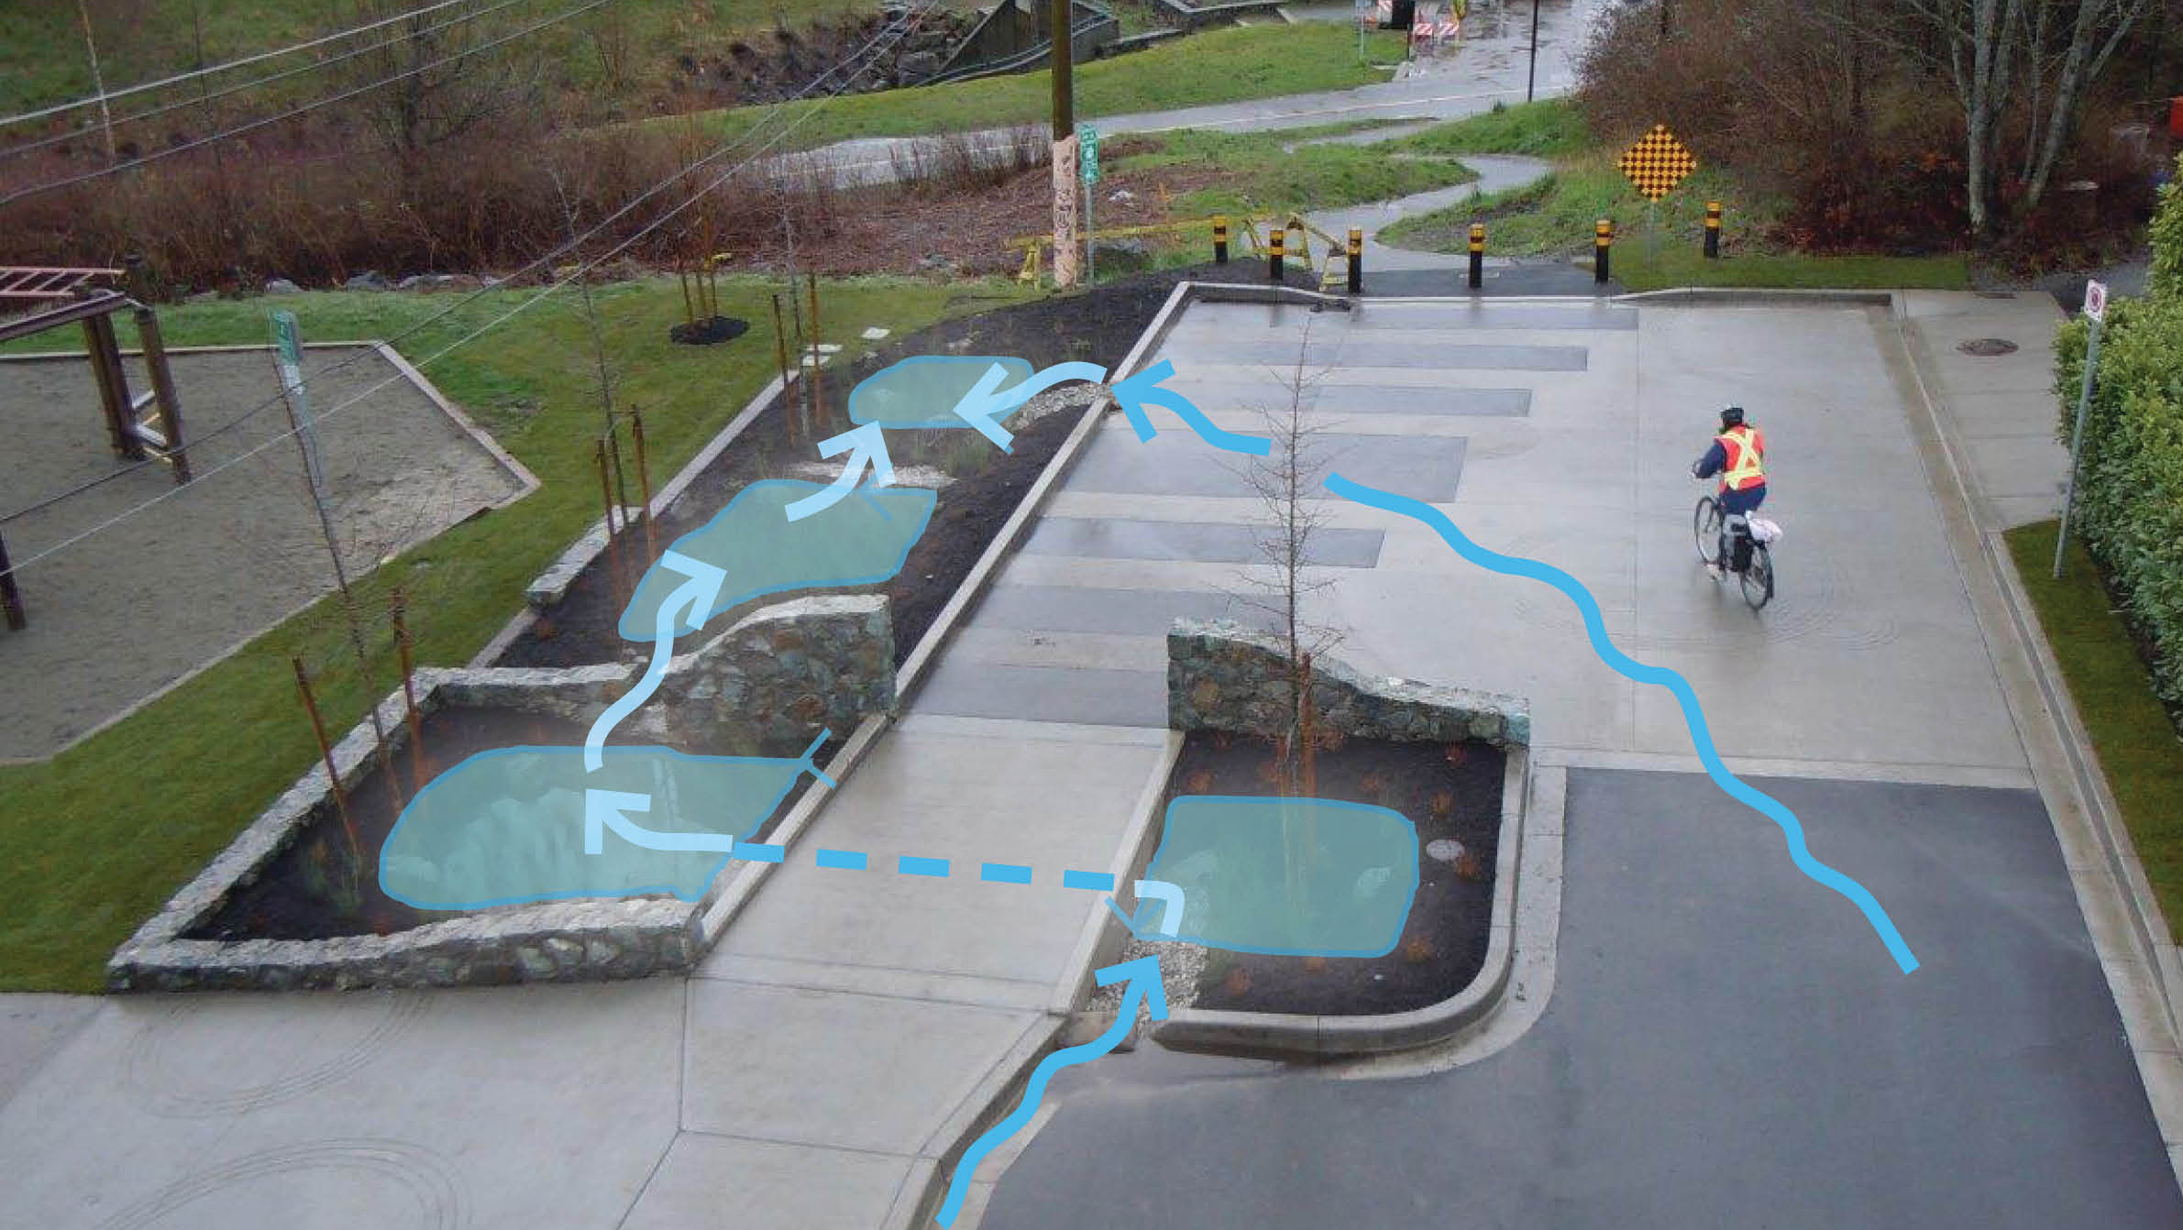
Functional Landscape in Greenways
Cecilia Greenway Rain Gardens-City of Victoria
Notes:
Another local example – this is a relatively small greenway connection near Cecelia Ravine. The runoff from the street travels through a terraced complex of rain gardens.

Slide 23
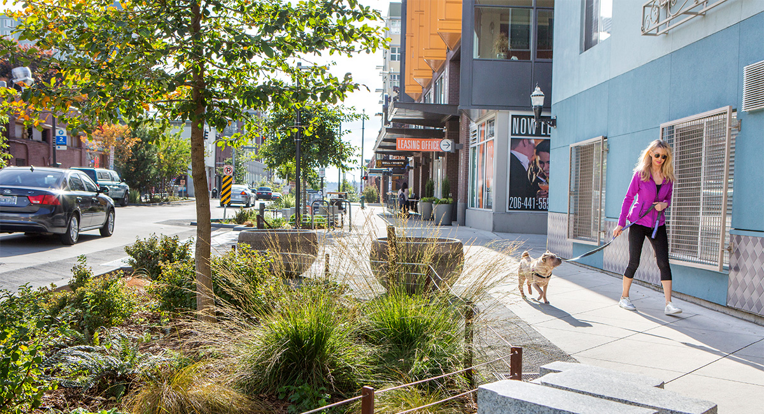
Bell Street Park, Seattle
Source: SVR
Atrium Building – Jawl Properties
Notes:
This is a great example from Seattle, in a neighbourhood scale commercial area. What I like about this example is that the plantings are not only designed to manage stormwater, but the design blurs the lines between streetscape and greenway or park space.

Slide 24
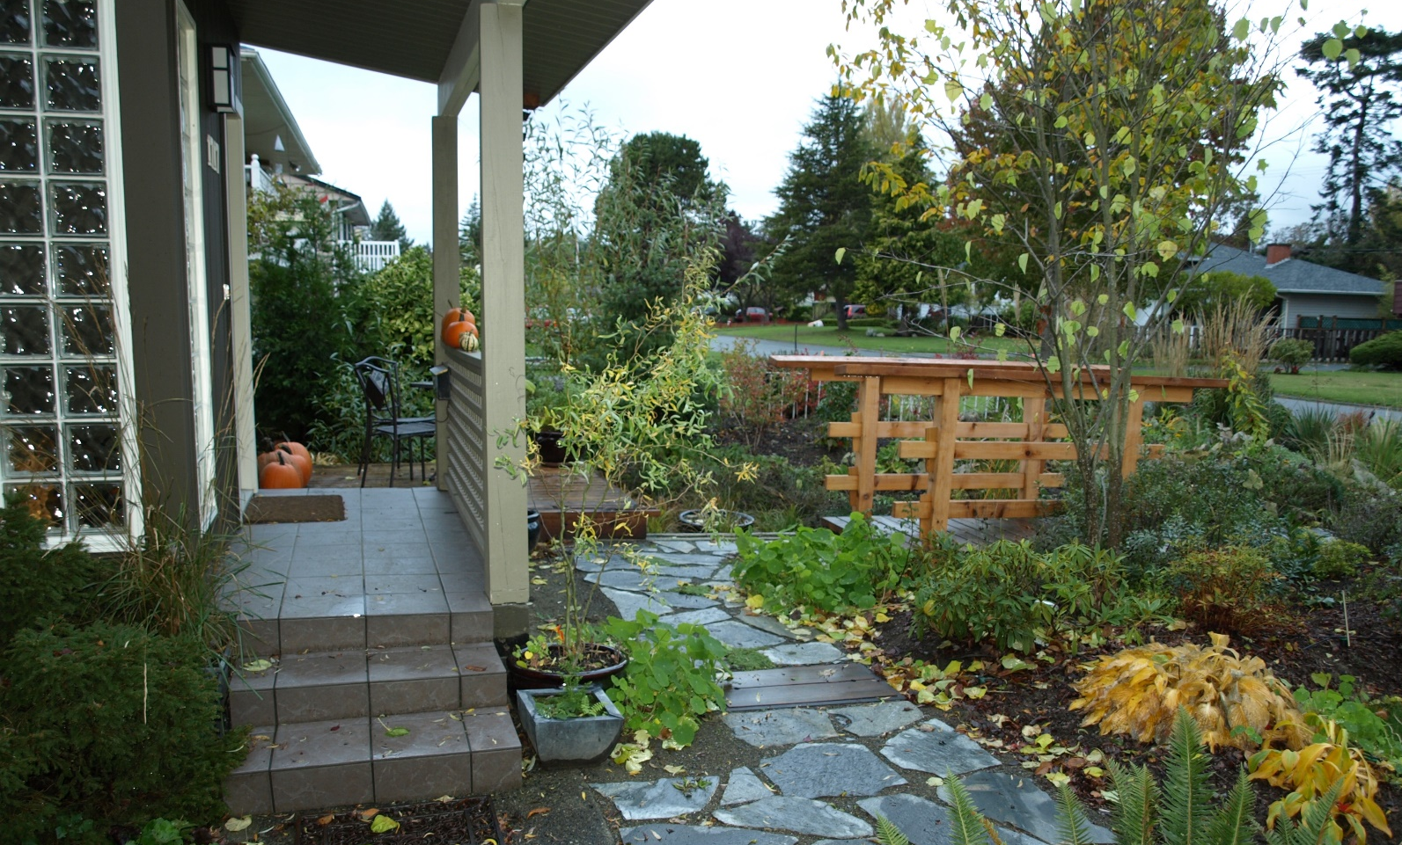
Functional Landscape in Residential Landscape
Residence
Saanich, BC
Notes:
This is a local example of a residence, where much of the front yard has been converted to a rain garden.

Slide 25
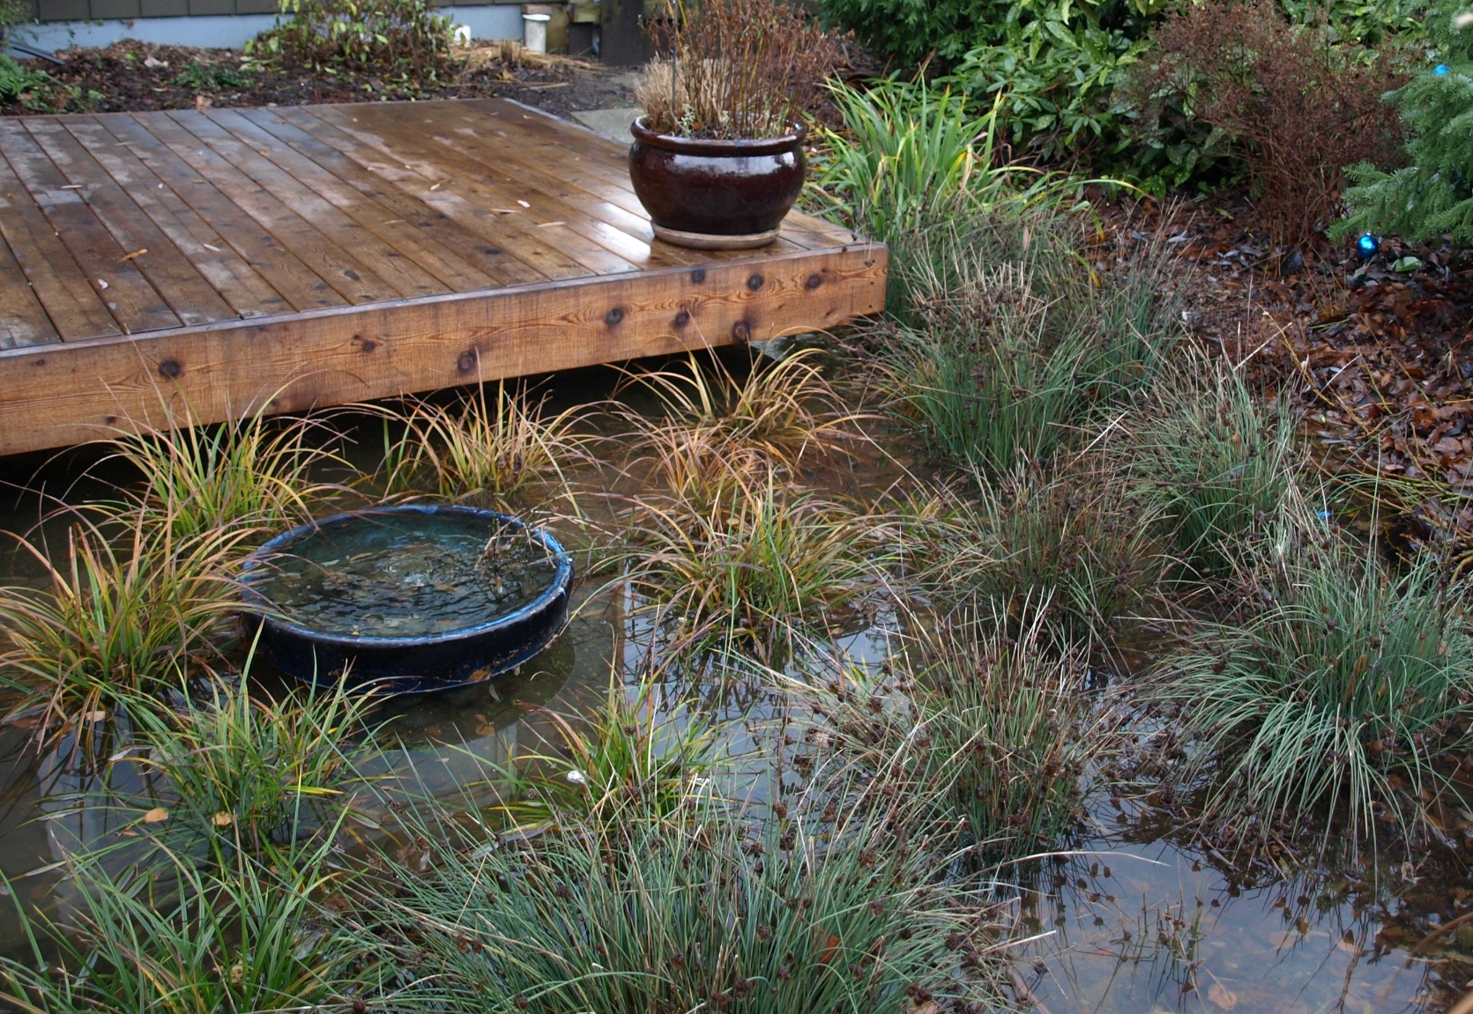
Residence
Saanich, BC
Notes:
The runoff from the roof is directed to a cistern and then piped to this small bowl (just left of centre in the image). The runoff bubbles up from the bowl and overflows into the rain garden.

Slide 26
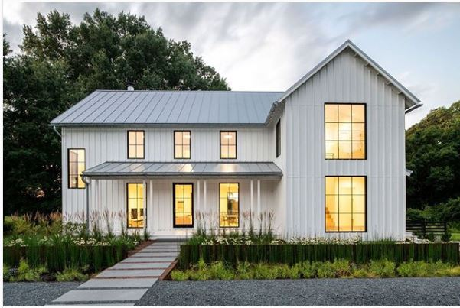
Functional Landscape in Residential Landscape
Miles House
Source: thinkmakebuild (via Instagram)
Notes:
This is a photo of quite a formal example of a stormwater landscape.

Slide 27
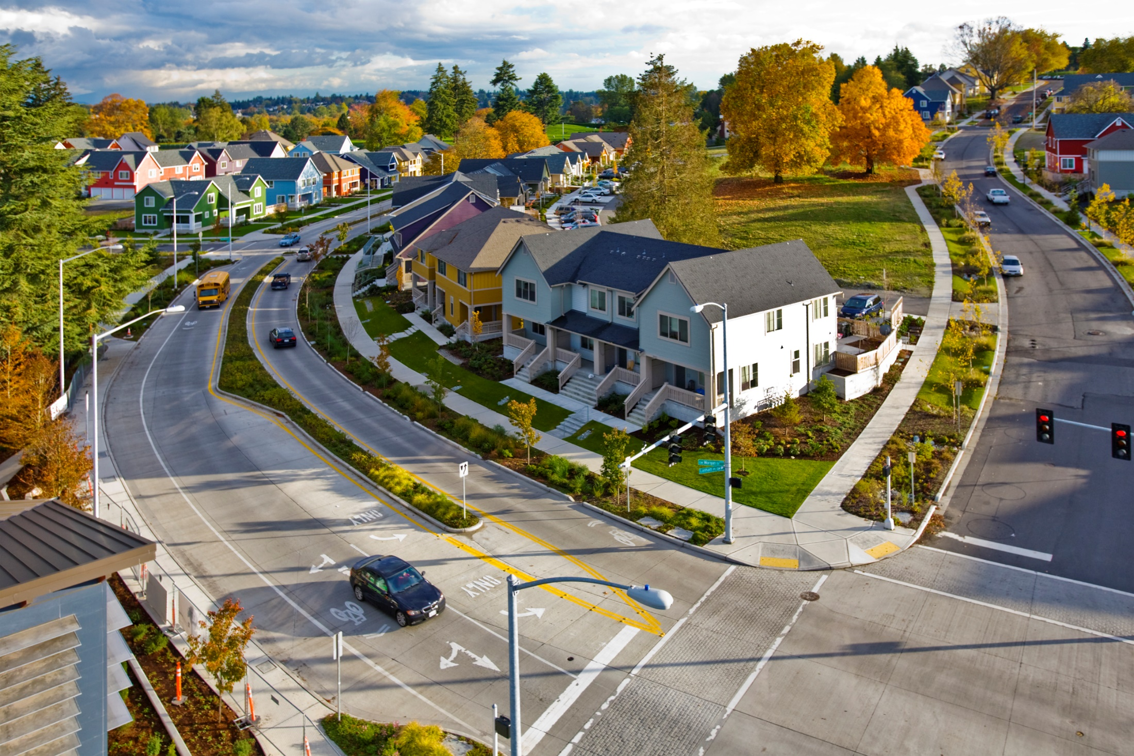
High Point Redevelopment, Seattle WA
Source: SVR
Notes:
This is High Point Redevelopment in Seattle, showing implementation of landscape based stormwater management, at a comprehensive housing development scale. You can see that the boulevard areas have rain gardens.

Slide 28
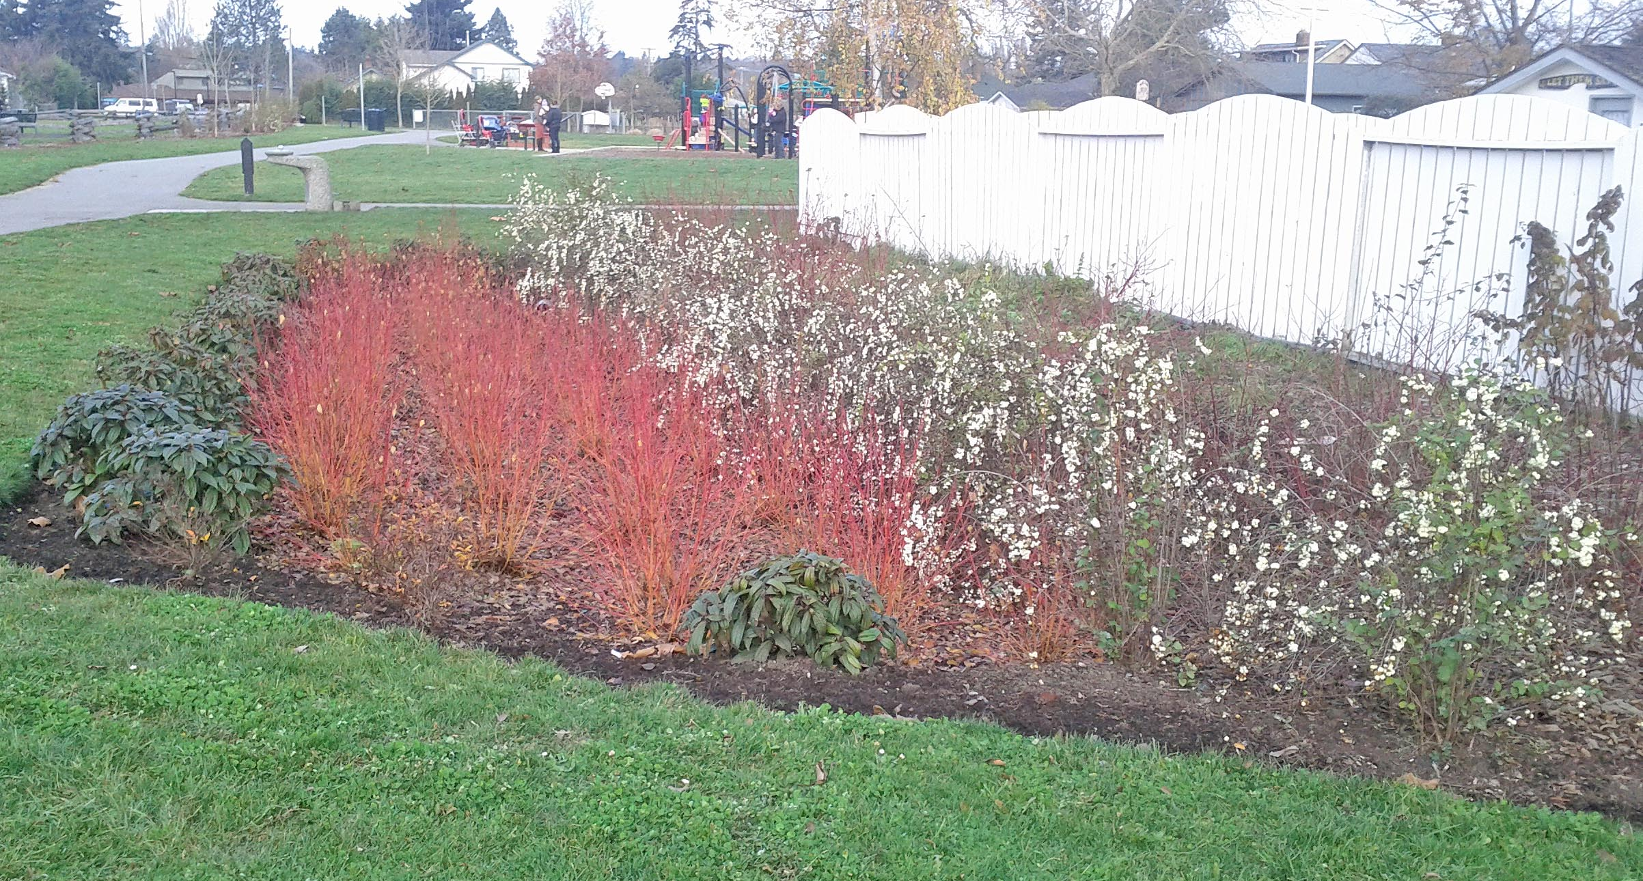
Functional Landscape in Public Parks
Oswald Park
Victoria, BC
Notes:
This is a shot of Oswald Park. Oswald Park has two rain gardens, which were implemented to help resolve drainage problems within the park.

Slide 29
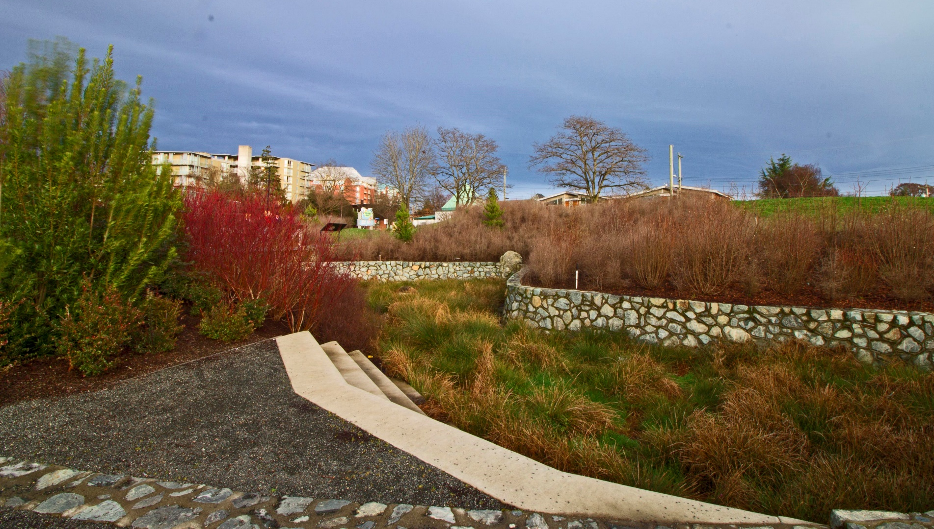
Functional Landscape in Public Parks
Fisherman’s Wharf Park
City of Victoria
Notes:
More local examples - this photo is of a large raingarden at Fisherman’s Wharf Park in Victoria.

Slide 30
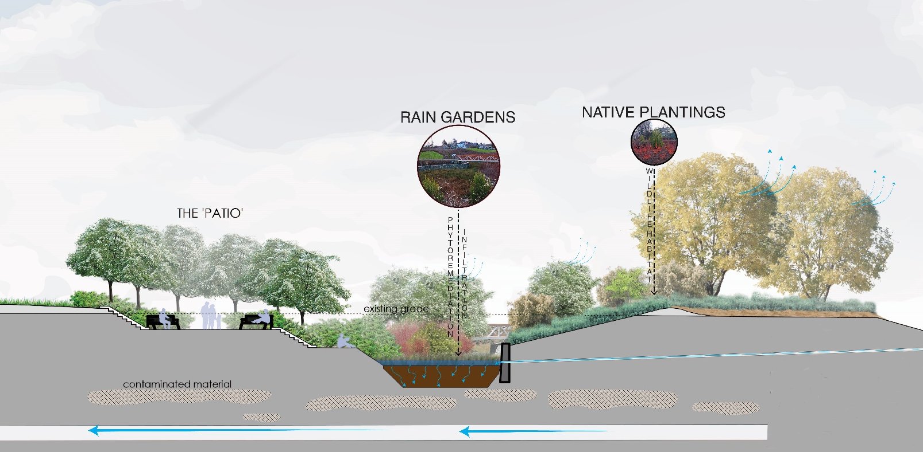
Functional Landscape in Public Parks
Fisherman's Wharf Park : City of Victoria
Stormwater Rehabilitation Unit
Notes:
This illustrative section shows how that rain garden at Fisherman’s Wharf Park works. As this rain garden is very near the bottom of the watershed, it intercepts a large amount of water from the stormdrain system, before it reaches the Inner Harbour.

Slide 31
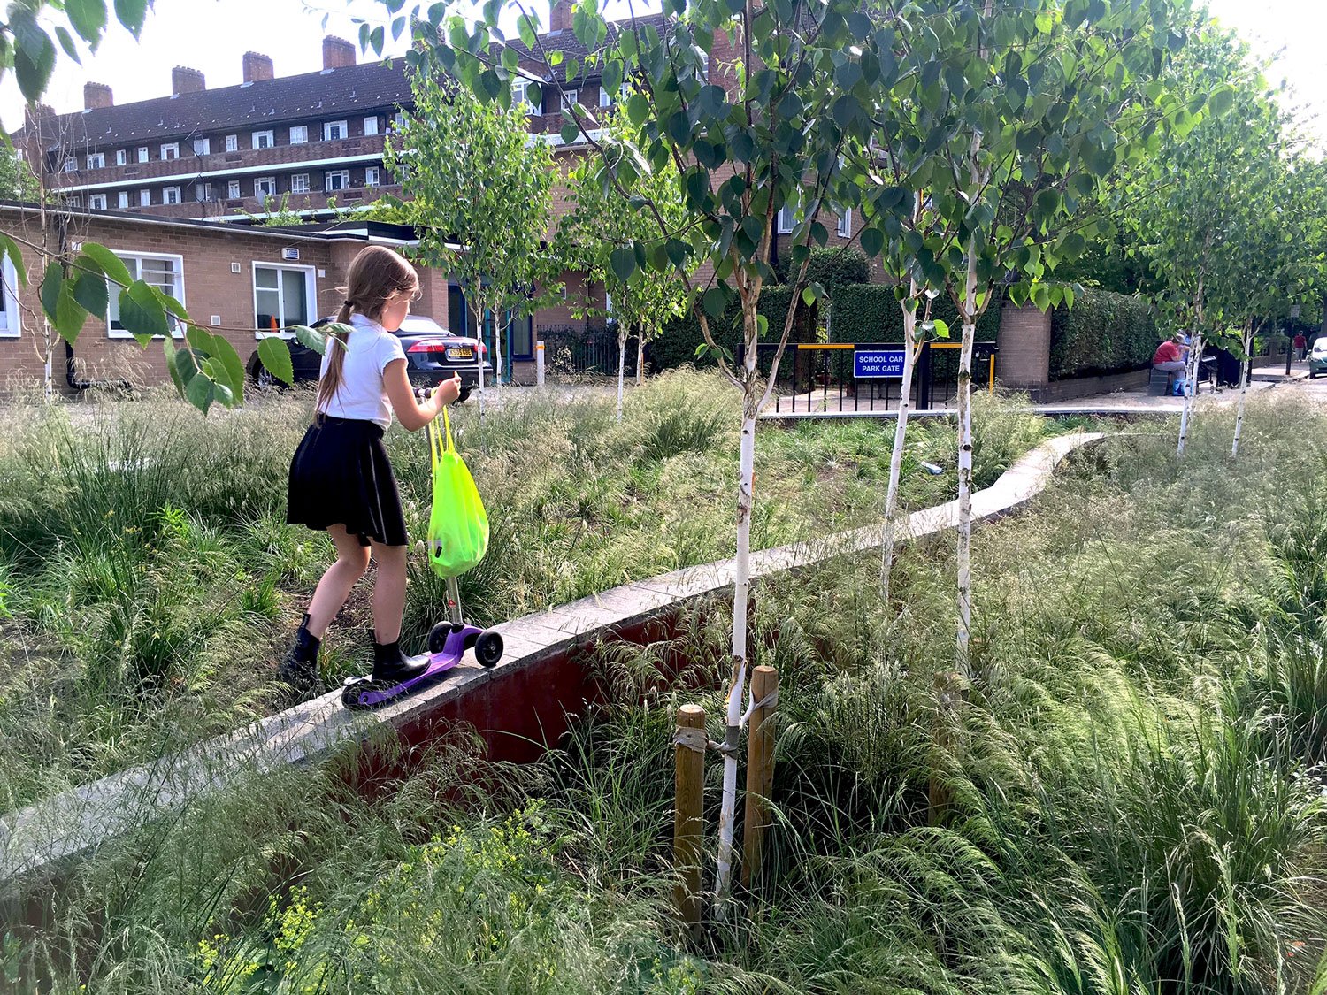
Bridget Joyce Square, London UK
Source: landezine-award.com
Notes:
This is quite a whimsical shot of Bridget Joyce Square in London.

Slide 32
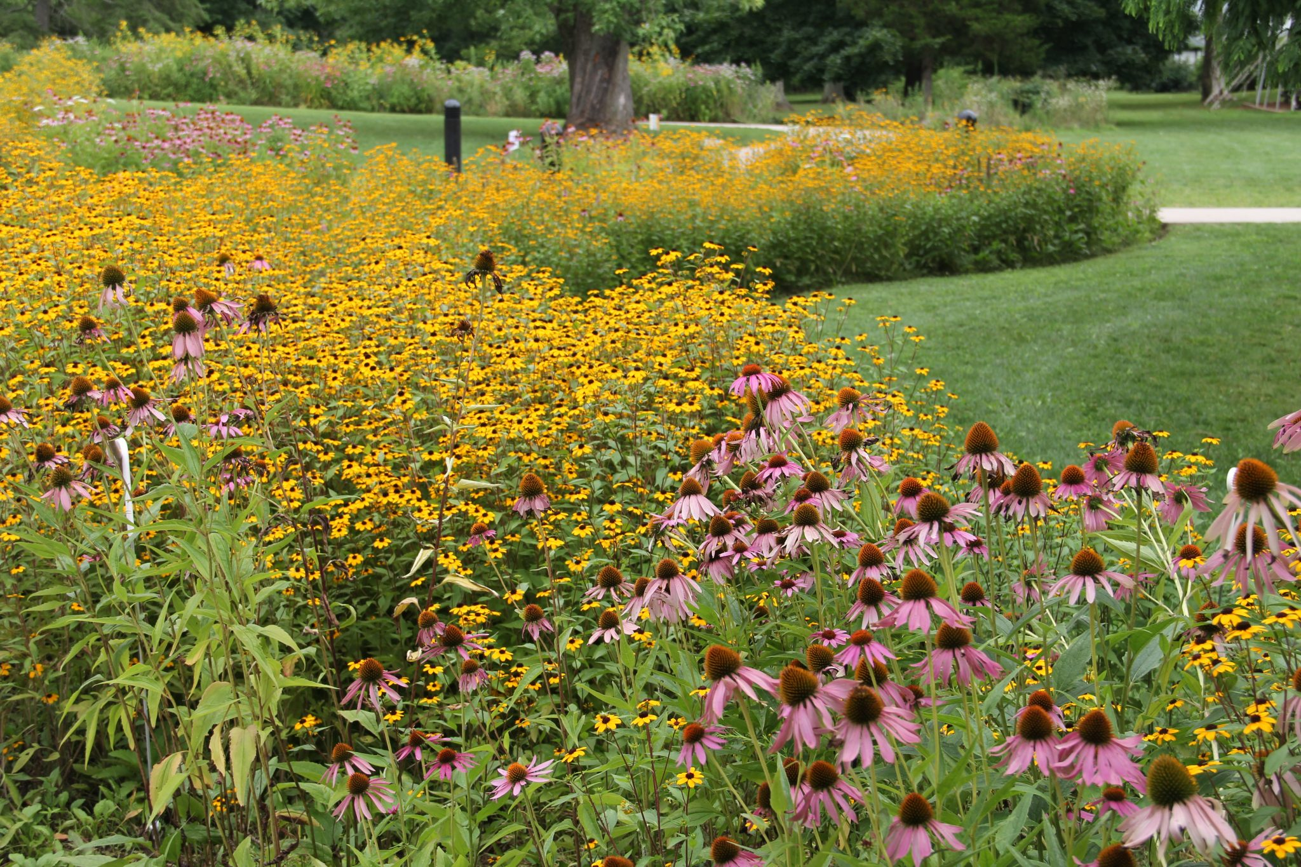
Source: watershed.org
Notes:
And don’t forget the pollinators! Pollinators are right at home in rain gardens.

Slide 33
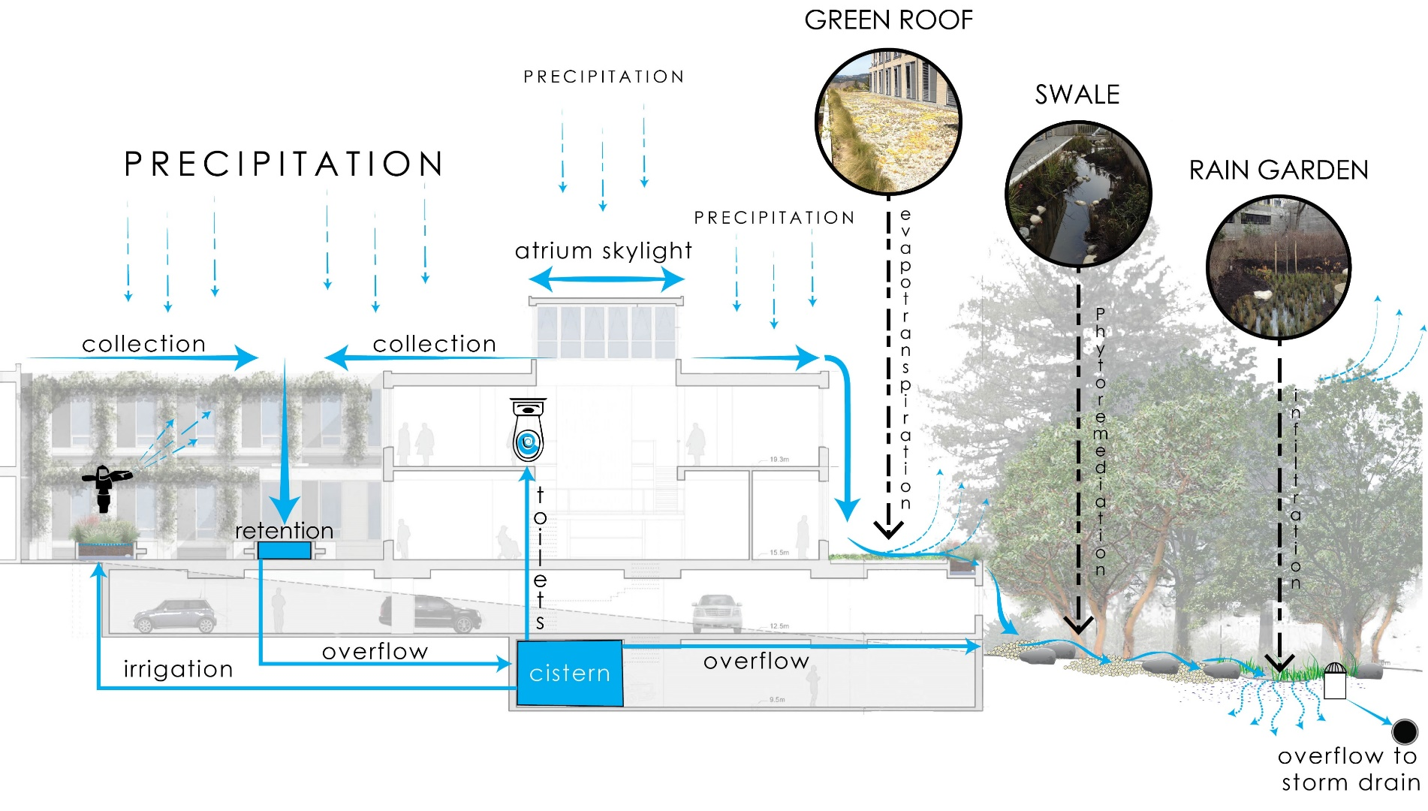
Functional Landscape in Residential or Mixed Use Developments
Reliable Controls, View Royal BC
Notes:
This is an illustration of an light industrial project in View Royal , which is an excellent example of an integrated approach to stormwater management. Runoff from the roof areas goes first to a cistern, which is then reused for toilet flushing and irrigation. Overflow is directed to landscape areas.

Slide 34

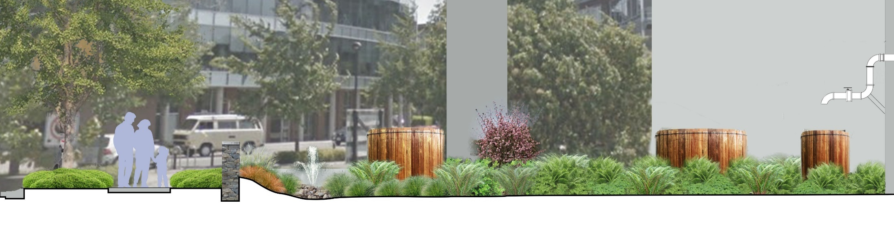
2950 Jutland Road, Victoria BC
Notes:
This is a commercial building at the Selkirk waterfront, which uses a similar approach. Roof runoff is collected in wood cisterns, and overflows through the water feature jet into the landscape.

Slide 35
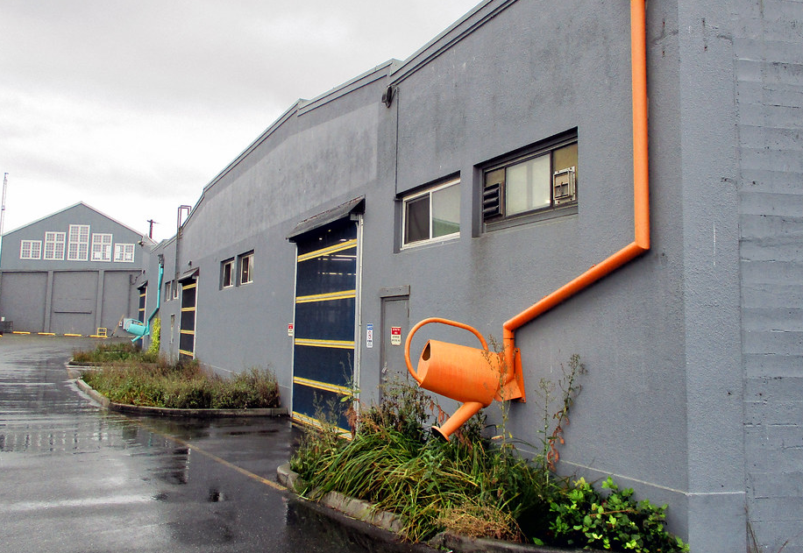
Anacortes, WA
Source: Flickr user -jon
Notes:
Another fun example at the Anacortes Port Building in Washington, with really cute downspouts that area directed to landscape areas.

Slide 36
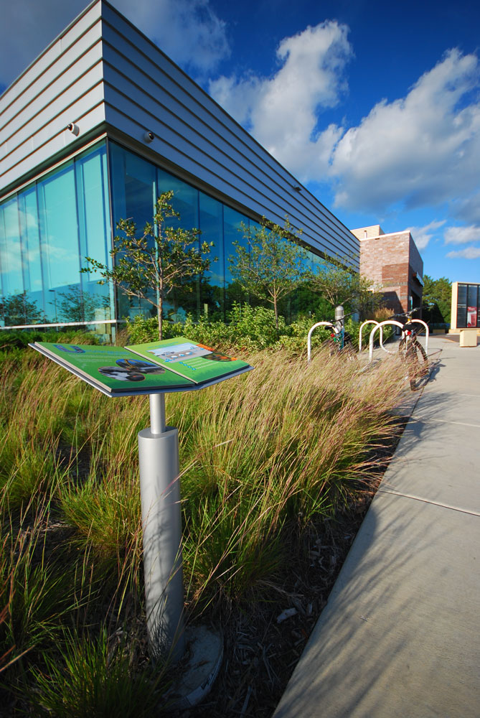
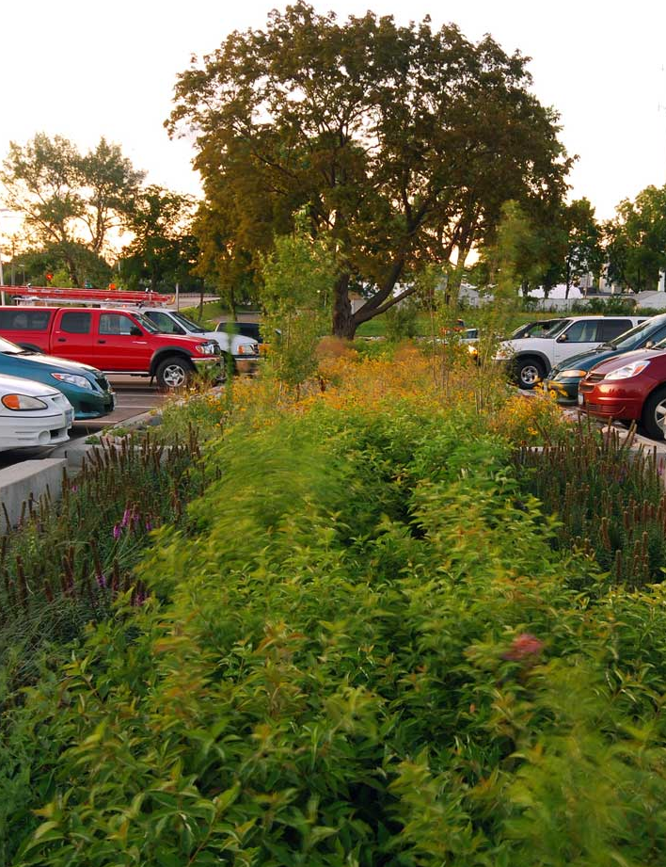
Roseville Library, Roseville, MN
Source: Damon Farber Landscape Architects
Notes:
And a lovely finally, a Library in Roseville MN. Great example of an education component and management of runoff from the parking area (on the right) in landscape areas.

Slide 37
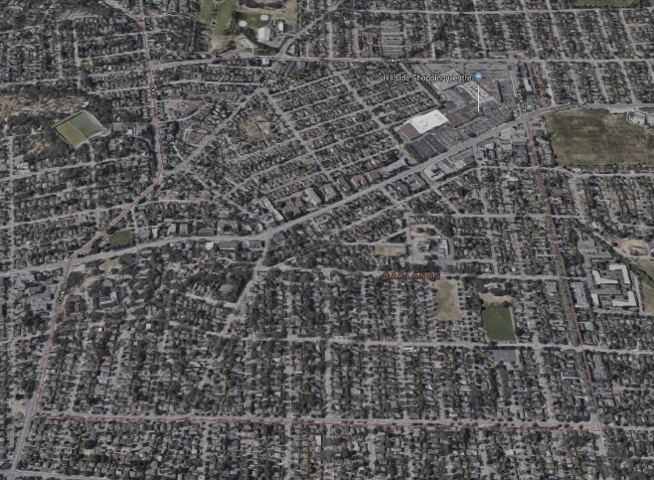

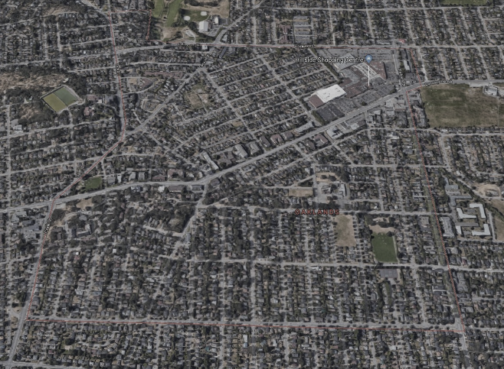
2019
Incremental climate change adaptation with urban green space.
2045
2070
Forward 50 –
Integrating ‘green’ in a meaningful way
Notes:
So, how does Oaklands begin to lead the way in landscape based stormwater management, in Victoria? This map shows Oaklands, and the green areas indicate landscape areas that are currently managing stormwater.
Click
The next image is a vision of how we might expand those green zones in the next 25 years. Knowing that most of the pollutants are in the runoff from roadways, perhaps there is a focus on major roadways and parking areas.
Click
And in 50 years, perhaps we start to connect that network of green by managing stormwater in more streets, in our commercial zones, and on more and more residential properties.
Incremental change in a meaningful way.

