Slide 1
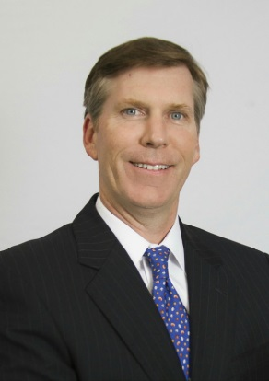
Jay Harris --- Managing Director
Steve Moiles
Regional Market Executive - PSRN
Steve Moiles is a Regional Market Executive and oversees the Private Sales Group (“PSRN”) for the Southeast and Southwest Regions. He has been with Bank of America Merrill Lynch for over 20-years helping entrepreneurs grow their businesses and create generational wealth.
Over his 30-year career, Steve has focused on a wide variety of early-stage and middle market corporate finance transactions including early-stage technology financing, middle market recapitalizations, and mergers/acquisitions for companies with enterprise values between $10MM and $200MM. Prior to entering his finance career, Steve held various leadership positions in private industry, which included the craft beer, ed-tech, building materials and aftermarket auto parts industries.
Steve earned a BS in Economics from Southern Methodist University and MBA from Texas A&M. He enjoys volunteering with various food banks and animal focused nonprofits.
Steve Moiles
steve.moiles@bofa.com
(214) 708-4832

