Slide 1
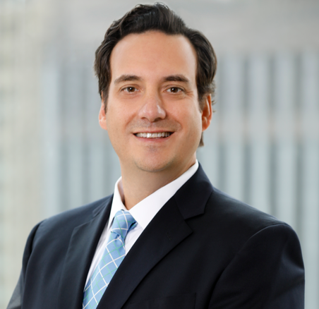
SCOTT B. MARTINEZ
DIRECTOR, PRIVATE BUSINESS GROUP REGIONAL MANAGER
Scott B. Martinez is a Director and Specialty Asset Regional Manager for the Private Business Group within the Specialty Asset Management Group in the Private Bank. Scott leads a team responsible for overseeing investments in private companies held in fiduciary accounts. The team leverages experience across multiple disciplines to provide oversight through performance monitoring, business valuation, corporate governance and financial analysis. Working with client teams and financial advisors the team can assist clients of the Private Bank and Merrill Lynch integrate these private business holdings into their overall wealth plan and ensure that they are consistent with overall investment objectives.
Previously, he served in a strategic and financial planning roles with the Belo Corporation, a publicly traded national media operations company.
Scott earned a Bachelor of Science from the University of Illinois at Urbana-Champaign College of Business and a Master of Business Administration from Baylor University. He holds the Chartered Financial Analyst (CFA) and Chartered Alternative Investment Analyst (CAIA) designations. He is currently President of the National Trust Closely Held Business Association.
FOR INTERNAL USE ONLY. NOT FOR DISTRIBUTION TO THE PUBLIC.
Bank of America Private Bank is a division of Bank of America, N.A., Member FDIC and a wholly owned subsidiary of BofA Corp. Trust and fiduciary services and other banking products are provided by wholly owned banking affiliates of BofA Corp., including Bank of America, N.A.
Investment products:
Are Not FDIC Insured | Are Not Bank Guaranteed | May Lose Value
© 2024 Bank of America Corporation. All rights reserved.
MAP6764556 | 7/2024

