Slide 1
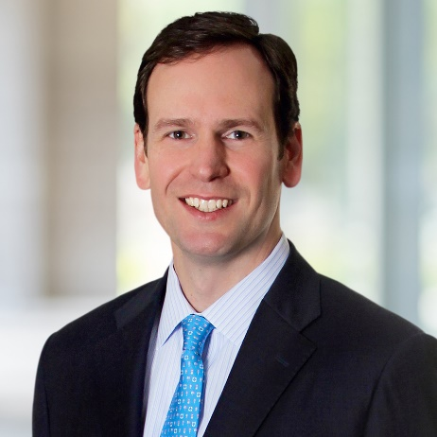
Robert L. Moore Jr.
Managing Director, Transaction Opinions & Valuation Advisory
Robert Moore is a Managing Director in the Transaction Opinions and Valuation Advisory groups. He has extensive experience in providing valuation advisory and transaction-related services to professional advisors, corporate boards and other fiduciaries, private equity firms and business owners.
Mr. Moore has over 20 years of financial advisory services experience and focuses on providing fairness opinion, solvency opinion and business valuation services. He has served as financial advisor or issued transaction opinions on a wide range of transactions, including mergers & acquisitions, financing transactions, going-privates and recapitalizations. Additionally, he serves on Stout’s Transaction Opinion Committee and Business Valuation Steering Committee.
Prior to joining Stout, Mr. Moore was a Senior Managing Director at Howard Frazier Barker Elliott, Inc. where he served in a similar capacity.
Professional Memberships
American Society of Appraisers, Association for Corporate Growth
Practice Areas
Transaction Opinions | Shareholder & Succession Planning | M&A Support Services
Industry Focus
Energy & Power | Real Estate, Lodging and Leisure | Consumer | Industrials | Healthcare
Education
M.B.A., Finance, University of Texas at Austin
B.B.A., Finance,
Southern Methodist University at Dallas
Designations
FINRA Series 7 and 63
Contact
Office +1 713.221.5131
rmoore@stout.com
Houston

