Slide 1
Segmentation from Traditional to Prospect-Based
John Story, Ph. D.
Fennell Story Insights LLC
These slides are designed to provide a quick overview of what segmentation is and how it has traditionally been done. They then introduce the work of Geraldine Fennell and provide insights to how segmentation can be improved using Fennell’s Perspective.

Slide 2
Segmentation – the goal
Segmentation simply reflects an understanding that people have different wants and needs, and the same person may have different wants and needs in different situations.
Effective segmentation creates groups of customers or prospects who have wants and needs that are similar enough for them to be served by the same market offering.
For instance, new parents are more likely to need diapers, baby wipes, and baby monitors than other consumers. People buying wine for a dinner party or a gift may want different wine than those buying for personal consumption.
Segmentation is simple to describe, but often really difficult to accomplish.
Fennell Story Insights LLC

Slide 3
Two ways to think about market segmentation
Disaggregation – you start with a single large group and divide them into numerous small groups. You are focusing on differences.
Aggregation – you start with a mass of diverse people or prospects and begin to group similar people/prospects together into groups. You are focusing on similarities.
These may ultimately create the same segments, but it’s two different conceptual approaches.

Slide 4
Traditional segmentation process
Traditionally, segments were created based on some combination of four types of characteristics
Demographic characteristics
Geographic location
Behavioral descriptors
Psychographic classification

Slide 5
Demographic Segmentation
relies on statistical data that is relatively objective, easy to measure, and can be used to classify customers or prospects.
Examples include:
Age
Gender
Race
Ethnicity
Marital status
Family size

Slide 6
Geographic Segmentation
groups prospects or customers based on their location. Location can be a geographically defined spot, such as Houston, or can refer to aspects that vary with geographic location, such as:
Mountains
Urban or rural
Climate (annual snowfall)
Population density
Language and culture

Slide 7
Behavioral Segmentation
uses behavior patterns that influence customers’ wants and needs to create segments. Examples include:
Usage rate (light, moderate, heavy, etc.)
User status (first-time, regular, etc.)
Consumer or business use
Benefits sought (what do they want? Convenience, enjoyment, etc.)
Purchase occasion (casual dinner, birthday/anniversary, gift, etc.)

Slide 8
Psychographic Segmentation
creates groups based on people’s values, personalities, attitudes, lifestyles, and interests.
Personality captures attributes such as introversion/extraversion, adventuresome/cautious, etc.
Values refer to what people find important and their attitudes toward various causes
Attitudes are their knowledge, feelings, and intention to act toward a variety of things in their environments
Lifestyles and interests are the activities they engage in and things that interest them.

Slide 9
Remember --
The purpose of segmentation is for the firm to develop offerings that better serve each individual segment defined and targeted. It’s all about creating value by better-serving customers.
Examples:
Light users may want a single item, while heavy users want a 12-pack
Someone buying an item as a gift may want it to come gift-wrapped
Customers in Wisconsin are much more likely to buy snow-blowers than those in Florida

Slide 10
Segmentation variables
The characteristics or attributes used to create segments are variables – variables can take on different values
Location can be rural or urban
Age could use segments such as Youth, Teenager, Young Adult, Older Adult
Family size could be 1(single), 2(couple), 3, 4, 5, . . .
Family life cycle segments could include singles, couples, parents of babies or toddlers, parents with older children at home, empty nesters
The idea is to select variables and levels that create segments that are meaningful for your particular market offerings

Slide 11
What makes a “good” segment?
There are many ways to assess the quality of the segments created by a segmentation schema. Most of them share several of these attributes:
Accessible: Can you effectively reach the different segments with promotions?
Differentiable: Are the segments really different, and in ways that affect wants and needs?
Substantial: Are there segments that are large enough to justify marketing to them?
Actionable: Can you differentiate your offering and deliver it to these segments?
Measurable: Can you assess and evaluate the segments?
You can apply these questions to the overall segmentation plan and then to each individual segment as you select your target market.

Slide 12
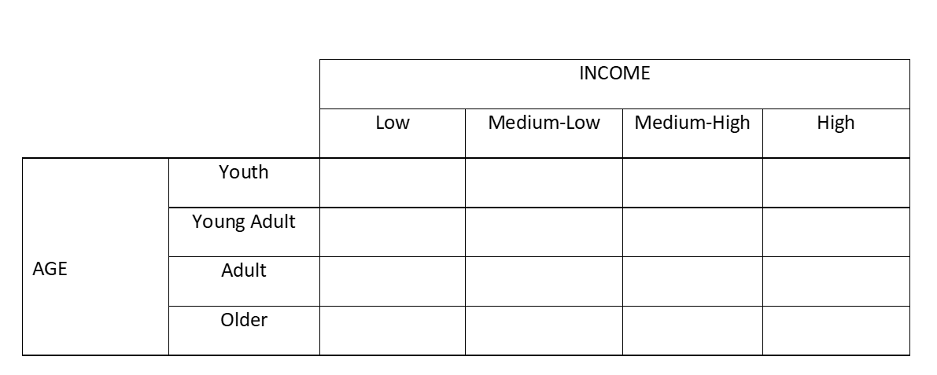
Segments that result from Segmentation
Companies typically use two or more of these segmentation variables
The outcome of applying these variables to segment a market is unique segments from which companies select their target markets
Each segment has a different probability of purchasing different products
For instance, adults and older adults with high incomes are more likely to buy custom golf clubs than youths with low to medium incomes
Companies can use this knowledge to better serve these different segments

Slide 13
Shortcomings of traditional segmentation
Segmenting based on individual attributes, such as demographics works, but provides little or no insights into motivations.
While demographics, geographics, and behavioral segments may predict the probability of purchase, they seldom inform markets as to why the purchases are made and motivations vary significantly within these segments.
For instance, women are more likely to buy purses than men, so marketers will target women with their promotions, but women buy purses for many different reasons. Different women are motivated differently and the same woman may have very different motives on two different purchase occasions.

Slide 14
Fennell’s Perspective
Fennell took a different approach to understanding markets and how to better serve customers
“Markets are made up not of people but of occasions”
“My primary unit of analysis is the usage situation as perceived”
Rather than focusing on objective characteristics to predict purchase, Fennell focused on the complex motivation developed from the interaction of the general environment, the person, and marketplace stimuli.

Slide 15
Developing a Perception of the Product-Use Situation
People have needs and wants that are influenced by their personal experiences, values, attitudes, or even physique.
These are filtered through and influenced by aspects in the general environment – everything from the economy, to the weather, to what needs to be accomplished.
The motivated potential buyer turns to the market and searches for the appropriate fit with their current situation. Market conditions and communications influence both their perceptions of the situation and the ability of market offering to meet their needs.
General Environment
Personal Characteristics
The Marketplace Stimuli
Physical Environment
Social Environment
Motivating Task
Knowledge and Experiences
Self Concept, Attitudes, Values
Physiology
Interests
Product Assortment
Promotional Communications
Brands and Channels
Social Communications
Different perceptions of the Product-Use Situation result in different Product Appetites

Slide 16
Perceived Product-Use Situation
General Environment
Personal Characteristics
Attributes in the general environment (outside the marketplace) interact with personal characteristics to develop a perception of the product-use situation and specific appetites for a product.
For instance, some dog owners perceive their pets as family members. When searching for dog food, they are interested in taste and health benefits.
Other owners simply view their dogs as animals and focus on low-price solutions.
An appetite for taste and health benefits creates different opportunities for brands than a simple price-focused appetite. These different appetites are served by differentiated offerings in the market.
Physical Environment
Social Environment
Motivating Task
Knowledge and Experiences
Self Concept, Attitudes, Values
Physiology
Interests
Different perceptions of the Product-Use Situation result in different Product Appetites

Slide 17
Perceptions of the Brand Array and “Fit”
Personal Characteristics
The Marketplace Stimuli
Stimuli in the marketplace (promotions, products, word-of-mouth, etc.) interact with personal characteristics to create perceptions of the array of available brands.
Different perceptions of the brand array and different product appetites result in consumers assessing the ability of a particular brand to satisfy their needs differently.
The same occasion may result in different consumers selecting different brands. Similarly, the same consumer may choose different brands on different occasions.
Knowledge and Experiences
Self Concept, Attitudes, Values
Physiology
Interests
Product Assortment
Promotional Communications
Brands and Channels
Social Communications
Perceptions of the brands in the Brand Array result in different levels of fit with the consumers’ Product Appetites

Slide 18
Appetites
Different perceptions of the product-use situation result in different appetites for the product class
An example:
Three young mothers, each with a 3-year-old and an infant, may be looking for very different things in their next vehicle because of personal differences:
One may prioritize safety
One may be focused on sustainable transportation
One may be looking for more seating, since they often travel with extended family
Understanding these different appetites enables brands to fine-tune their offerings, both the physical product and their promotions, to enhance consumers’ perceptions and their potential to add value.

Slide 19
Fennell’s Perspective illuminates consumers’ appetites and motives
Focusing on the “perceived product-use situation” provides a deeper insight
Includes specific motivations
Focuses only on prospects – people who are in a situation where they need a product class and are motivated to purchase
Reveals not just what people want, but why they want that
Enables firms to actually follow the Marketing Concept – make and sell what people want to buy.
It’s the difference between designing a “shoe for men” and a “shoe for middle-aged men who have decided to get in shape and run a marathon.”

Slide 20
Should we abandon traditional segmentation variables?
NO – even demographic variables often create useful segments
Parents with 2-year-olds buy tricycles, those with 12-year-olds buy bicycles
However, focusing on the different appetites and motivations created by consumers’ different perceptions of the product-use situation reveal opportunities to create additional value
Parents with 2-year-olds who live in high rise apartments have different tricycle needs from those who live in a single-family home in the suburbs or those who live on a farm in the country
Those different needs are reflected in their perception of the product-use situation – their different appetites for the product

Slide 21
The Model in Action
A brief example

Slide 22
Is this Person a Prospect or a Non-prospect?
Environment
Lives in Colorado
Lives in a mountain town
30-mile daily commute to differing locations
No children
Appetite
Wants a new car
Preferred 4-wheel or all-wheel drive
Sporty
Fuel efficient
Could be hybrid or electric
Wants carrying capacity for dogs/luggage/sporting equipment
Prefers American-made
Note: each of these attributes will have a different level of importance (weight)
Prospect for a new vehicle?
YES
Prospect for Public Transportation
NO
Person
Owns her second car
Never purchased a car on her own
Strongly independent
Moderate income
Active lifestyle
Etc.

Slide 23
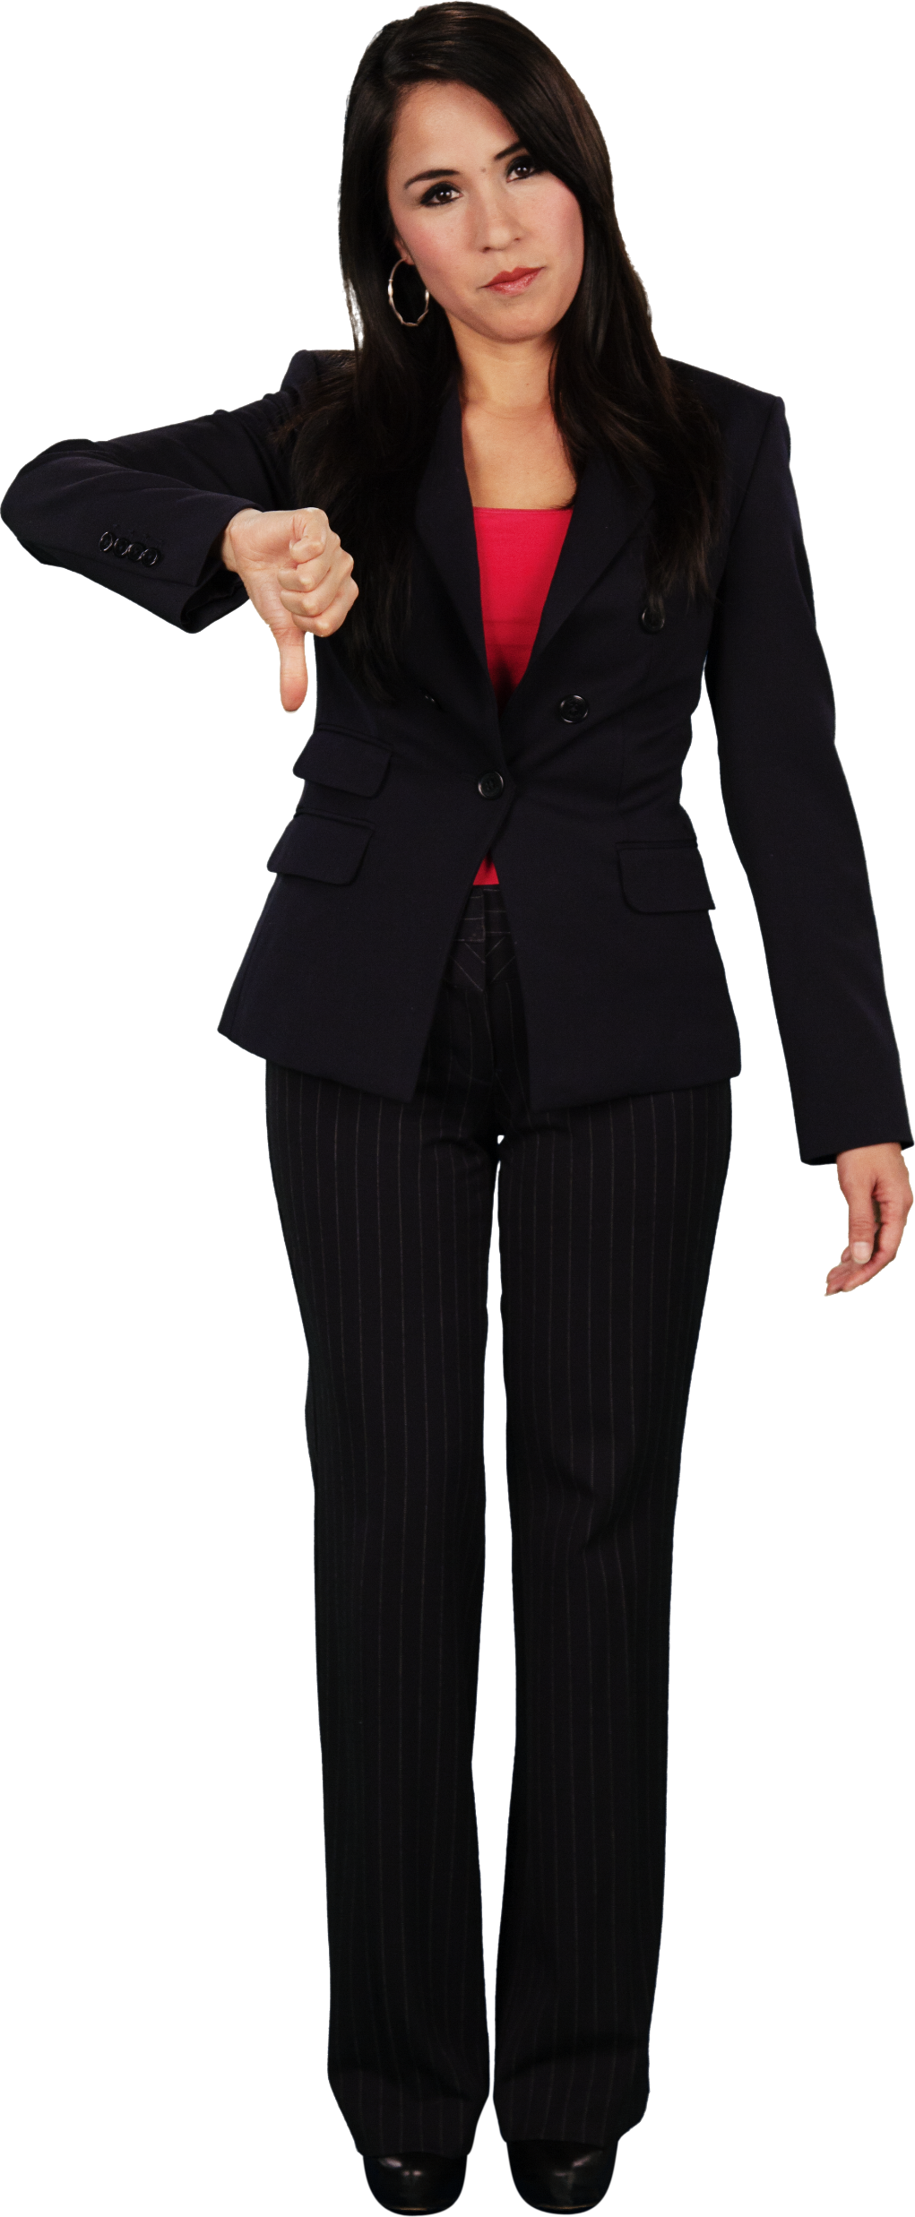
Environment
Lives in Colorado
Lives in a mountain town
30-mile daily commute to differing locations
No children
Person
Owns her second car
Never purchased a car on her own
Strongly independent
Moderate income
Active lifestyle
Etc.
Capacity for an offering to create value
Perceived Usage Situation
(Appetite)
Appetite
Wants a new car
Preferred 4-wheel or all-wheel drive
Sporty
Fuel efficient
Could be hybrid or electric
Wants carrying capacity for dogs/luggage/sporting equipment
Prefers American-made
Note: each of these attributes will have a different level of importance (weight)
Constraints
Budget maximum $35,000
Must have four doors
Must have convenient dealership
Must have driver-assist
Must have adaptive cruise
Good snow traction

Slide 24
Person
Owns her second car
Never purchased a car on her own
Strongly independent
Moderate income
Active lifestyle
Etc.
Brand Array
Brand A
Models 1, 2, 3, 4
Advertising
Incentives
Affective response
Brand A
Models 1, 2, 3, 4
Advertising
Incentives
Affective response
Perceived Brand Array
Consumer Decision
The consumer’s choice depends on the fit between available options, their appetite, and their constraints.
Their personal attributes interact with elements in the marketplace to develop a perception of the ability of each option to meet their appetite for the product category.
Not all occasions result in purchase/consumption. If none of the available options fall within their constraints and match their appetite, they may defer purchase/consumption.
The fit between the consumer’s appetite and the available options can be quantified using one of several attitude models.

Slide 25
Is this Person a Prospect or a Non-prospect?
Environment
Lives in Colorado
Lives in a mountain town
30-mile daily commute to differing locations
No children
Appetite
Prospect for a new vehicle?
YES
Prospect for Public Transportation
NO
Prospect for Elements in the Brand Array:
Ferrari, Porche,
NO
Chevrolet, Ford, Toyota, etc.
YES
Large SUV
NO
Etc.
Person
Owns her second car
Never purchased a car on her own
Strongly independent
Moderate income
Active lifestyle
Etc.

Slide 26
Prospects for dog food
Another example
This is based on a study of how often and which brands of dog food people actually purchased.
There are certain characteristics that serve as dichotomous differentiators between Prospects and Non-prospects for Dog Food
How many dogs do you own? (The answer to this question may tell us whether someone is a prospect for dog food but gives no insight into their motivations or what type of dog food they may purchase.)
0 dogs – very likely to be a non-prospect
1 dog – very likely to be a prospect (tendency towards certain dog food attributes)
2 – 3 dogs – very likely to be a prospect (need more information to determine appetites)
4 or more – likely to be a prospect (tendency towards certain dog food attributes)
People who don’t own dogs almost never buy dog food (Non-Prospects)
Most of those who own dogs buy dog food but have very different appetites (wants/needs) for dog food, depending on other attributes.

Slide 27
Determinants of brand choice for dog food
Dog owners’ responses to these questions had a significant impact on brand choice
My dog is a member of the family (strongly disagree to strongly agree)
How old is your dog? (puppy, 1-3 years, 4-7 years, 8 years or older)
It’s important to me that my dog(s) enjoy(s) the food they eat
I believe that all dog food brands are basically the same
The answers to these questions were significantly related to which brands of food dog owners purchased and how much they were willing to pay

Slide 28
Different perceptions of the product-use situation resulted in different appetites for dog food
For example:
Regardless of demographic attributes, owners who see their dog as part of the family were pickier about brands and were willing to pay more, particularly if they believe that certain brands of dog food really are different.
People with older dogs wanted different attributes in their dog food than those with younger dogs or puppies

Slide 29
At least for dog food,
Dog ownership, which could be considered a demographic variable, gives us a strong indication as to whether or not someone is a prospect for the product category.
However, designing an offering with characteristics that satisfy the wants and needs of different segments requires insights into the different ways that consumers view the purchase and the benefits they are seeking.
The real difference between which food dog owners purchase derives from their perception of the product-use situation, their resulting product appetite.

